Slide 1
User Behavior and
Order Trends Analysis
Exploring Cooking Sessions, Demographics, and Order Patterns for Strategic Insights…

Slide 2
Objective
The objective of this project is to analyze user behavior, cooking preferences, and order trends using structured datasets. The analysis aims to:
Understand User Behavior: Examine how demographic factors such as age, location, and meal preferences influence user behavior and order patterns.
Identify Popular Dishes: Determine the most frequently cooked and ordered dishes across different user demographics and times of the day.
Analyze Cooking and Order Relationship: Explore the connection between cooking sessions and subsequent orders, including dish preferences and session ratings.
Provide Business Insights: Derive actionable insights from the data to enhance customer engagement, optimize menu offerings, and improve user satisfaction.

Slide 3
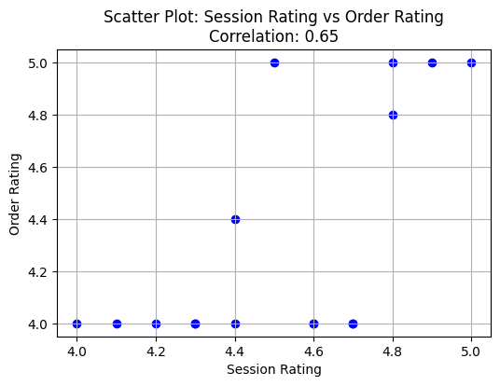
Correlation Between Session Rating and Order Rating
There is a positive correlation of 0.65
between session rating and order rating,
suggesting that higher-rated cooking
sessions tend to lead to higher-order
satisfaction.

Slide 4
Top 5 Popular Dishes by Frequency and Revenue
Dish name | Total orders | Total revenue
Grilled Chicken | 4 | 51.0
Spaghetti | 4 | 55.5
Caesar Salad | 3 | 28.0
Pancakes | 2 | 16.5
Veggie Burger | 2 | 22.0
Top Dishes by Orders: Grilled Chicken and Spaghetti are the most ordered dishes with 4 orders each.
Top Dishes by Revenue: Spaghetti leads in revenue with $55.5, followed closely by Grilled Chicken with $51.0.
These dishes are both customer favorites and contributors to overall revenue, making them key items to focus on for promotions or menu optimization.

Slide 5
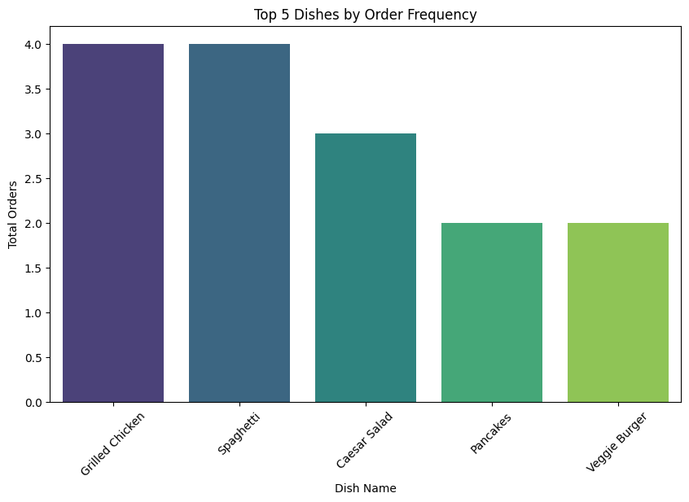
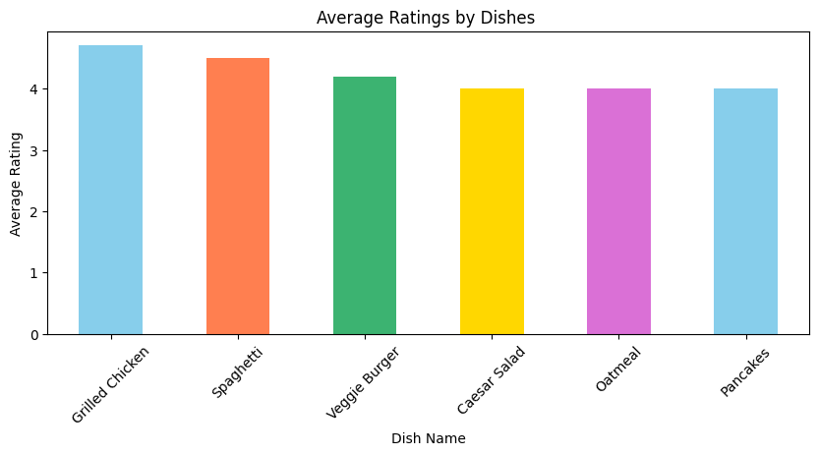
Top 5 Dishes by Order Frequency & Average Ratings
The Top 2 dishes by order frequency and average ratings are Grilled Chicken and Spaghetti, each with 4 orders, making them the most popular dishes among all options.

Slide 6
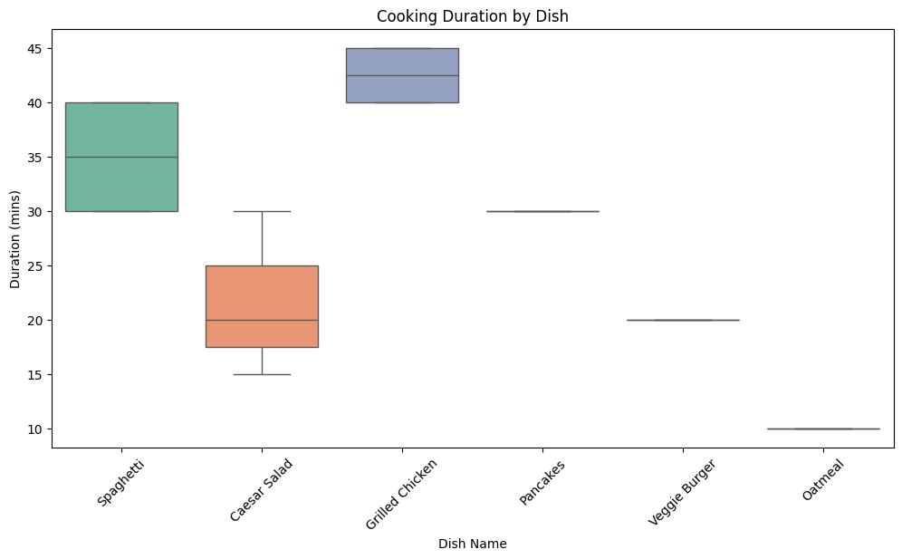
Cooking Duration by Dish
Grilled Chicken has the longest median cooking
time, around 40 minutes.
Oatmeal has the shortest median cooking time
at 10 minutes.
Dishes like Spaghetti and Pancakes have similar
cooking times around 25–35 minutes.

Slide 7
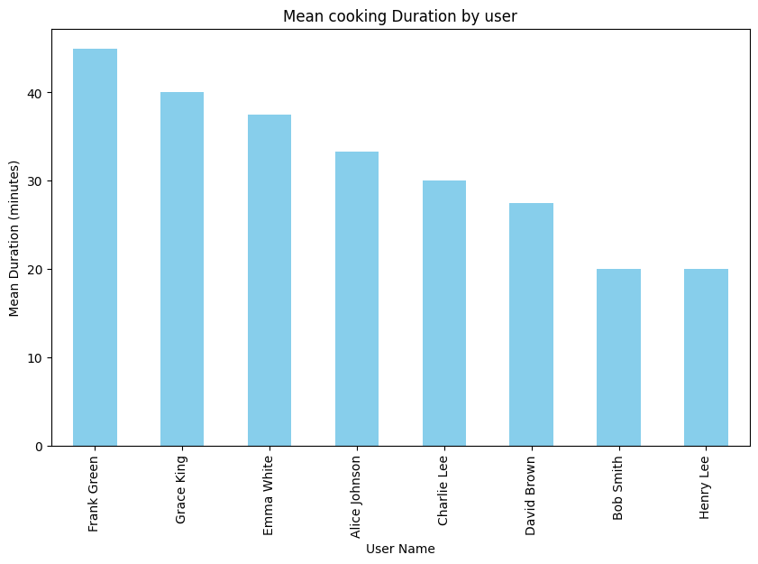
Mean Cooking Duration by User
Frank Green took the longest time to cook,
with an average cooking duration of 45 minutes.
Grace King is the second highest with an
average cooking time of 40 minutes.
Bob smith and Henry lee took the least
time to cook, with an average cooking duration
of 20 minutes.

Slide 8
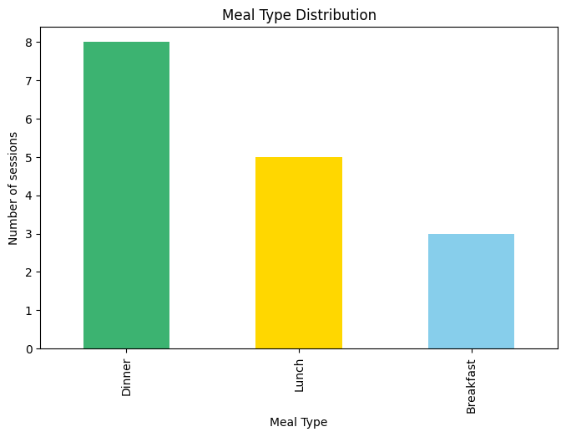
Meal Type Distribution
Dinner is the most popular meal type,
accounting for the highest number of
sessions (around 8).
Lunch follows as the second most popular
meal type, with around 5 sessions.
Breakfast is the least popular meal type, with
around 3 sessions.

Slide 9
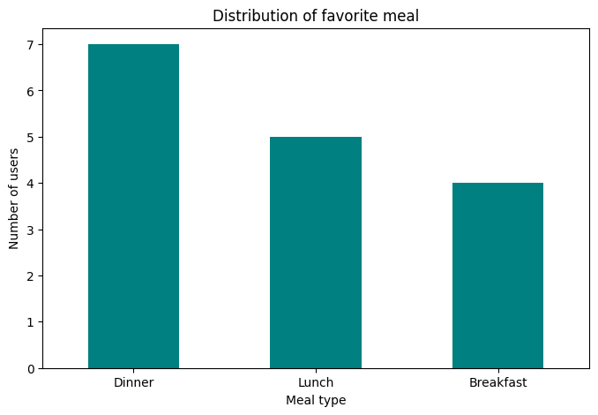
Distribution of Favorite Meal
Dinner is the most popular favorite
meal, chosen by around 7 users.
Lunch is the second most favorite
meal, with around 5 users.
Breakfast is the least favorite,
with around 4 users.

Slide 10
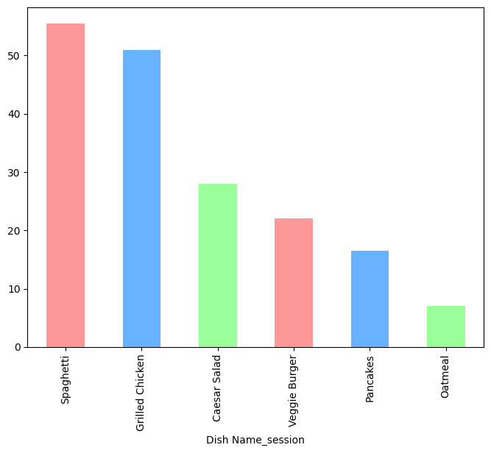
Total Revenue by Dish
Spaghetti generated the highest revenue,
around 55.
Grilled Chicken follows closely with a
total revenue of around 50.

Slide 11
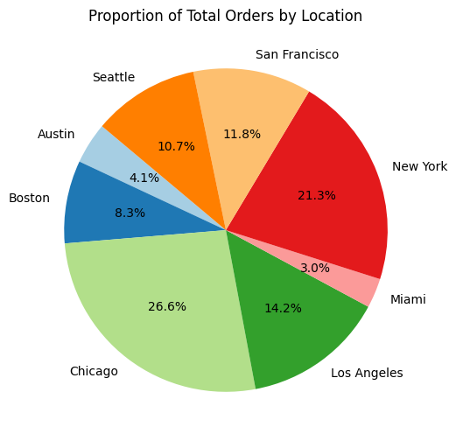
Proportion of Orders by Location
Chicago has the highest proportion, accounting for
around 27% of the total orders.
New York is the second highest, with around 21%
of the orders.
Los Angeles follows with around 14% of the orders.

Slide 12
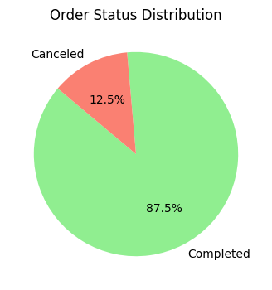
Order Status Distribution
87.5% of the orders are completed.
The remaining 12.5% of the orders
are cancelled.

Slide 13
Recommendations
Optimize Menu Offerings:
Promote popular dishes like Grilled Chicken and Spaghetti through targeted campaigns or discounts.
Introduce variations of Oatmeal and Pancakes to cater to users looking for quicker meal options.
Tailor Marketing Strategies by Location:
Focus marketing efforts in Chicago (27% of total orders), as it is the top location with the most active users.
Expand efforts in New York and Los Angeles, which contribute to significant order shares (21% and 14%, respectively).
Enhance User Experience Based on Ratings:
Encourage users to rate both cooking sessions and orders to gain insights into user satisfaction and improve future experiences.
Use positive ratings to drive customer loyalty through personalized offers or rewards programs.
Increase Focus on Lunch and Breakfast:
Consider offering promotions or discounts during lunch hours to increase engagement, as it is the second most popular meal type.
Expand the breakfast menu and market it more effectively, perhaps through convenience or "quick meal" options, to boost its popularity.
Monitor and Reduce Order Cancellations:
Investigate reasons behind the 12.5% cancellation rate and address key issues, such as delivery delays or order fulfillment problems, to minimize cancellations.

