Slide 1

Presented by Pratiksha M

Slide 2
Agenda
  Introduction
  Architecture of Mercurial
  Basic configuration
  Basic Commands
  Advantage
  Difference Between commands
  Branching in Mercurial
  Mercurial code hosting

Slide 3
JIRA
Main Functionality: Agile Project Management, Budgeting, Collaboration, Customization, Issue Tracking, Learning and Support, Notifications, Resource Management, Task Management, and Traditional Project Management
Intended User: Large Enterprise, Personal, and Small-Medium Business
Platform: Online

Slide 4
JIRA is the tracker for teams planning and building great products. Thousands of teams choose JIRA to capture and organize issues, assign work, and follow team activity. At your desk or on the go with the new mobile interface, JIRA helps your team get the job done.

Slide 5
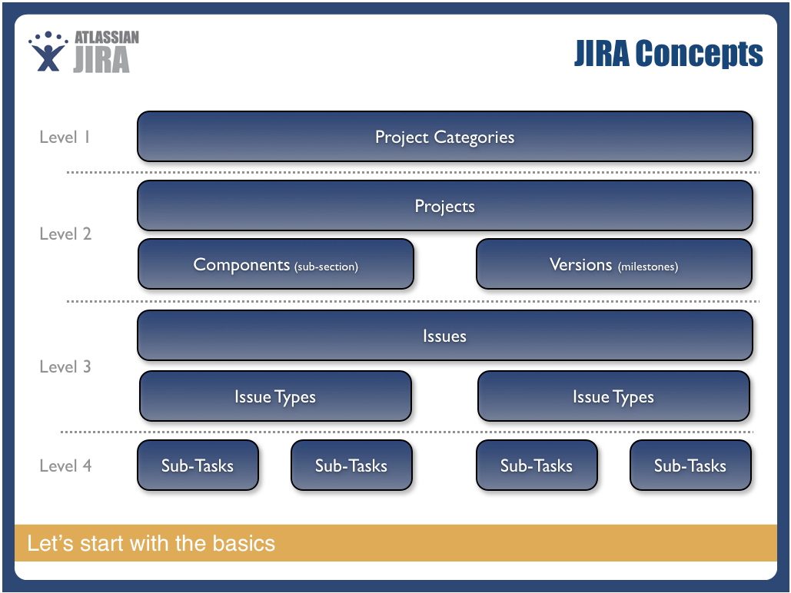
Project Phases
JIRA has a 4 level hierarchy: Project > Components (logical subsections) and Versions (phases/milestones) > Issues > Subtasks

Slide 6

Any Questions?

Slide 7
Thank You!

