Slide 1
Manipulating Strings

Slide 2
Objectives
Manipulate strings
Parse strings
Compare strings
Handle form submissions
Name of Book

Slide 3
Constructing Text Strings
A text string contains zero or more characters surrounded by double or single quotation marks
Text strings can be used as literal values or assigned to a variable
  echo "<p>Dr. Livingstone, I presume?</p>";
  $Explorer = "Henry M. Stanley";
  echo $Explorer;
Text strings can also be surrounded with single quotation marks
Name of Book

Slide 4
Constructing Text Strings (continued)
To include a quoted string within a literal string surrounded by double quotation marks, you surround the quoted string with single quotation marks
To include a quoted string within a literal string surrounded by single quotation marks, you surround the quoted string with double quotation marks
Name of Book

Slide 5
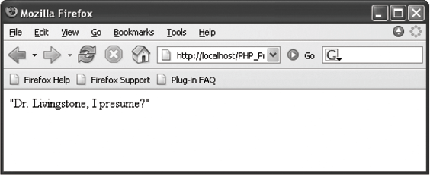
Constructing Text Strings (continued)
$ExplorerQuote = '<p>"Dr. Livingstone, I presume?"</p>';
echo $ExplorerQuote;
Figure 5-1 Output of a text string containing double quotation marks
Name of Book

Slide 6
Working with String Operators
In PHP, you use two operators to combine strings
Concatenation operator (.)
  $Destination = "Paris";
  $Location = "France";
  $Destination = "<p>“ . $Destination . “ is in “
  . $Location . ".</p>";
  echo $Destination;
Concatenation assignment operator (.=)
  $Destination = "<p>Paris";
  $Destination .= "is in France.</p>";
  echo $Destination;
Name of Book

Slide 7
Adding Escape Characters and Sequences
An escape character tells the compiler or interpreter that the character that follows it has a special purpose
In PHP, the escape character is the backslash \
echo '<p>Marilyn Monroe\'s real name was Norma Jean Baker.</p>';
Do not add a backslash before an apostrophe
if you surround the text string with double
quotation marks
echo "<p>Marilyn Monroe's real name was Norma Jean Baker.</p>";
Name of Book

Slide 8
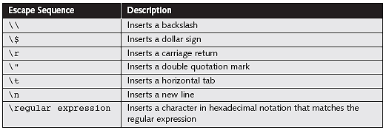
Adding Escape Characters and Sequences
The escape character combined with one or more other characters is called an escape sequence
Table 5-1 PHP escape sequences within double quotation marks
Name of Book

Slide 9
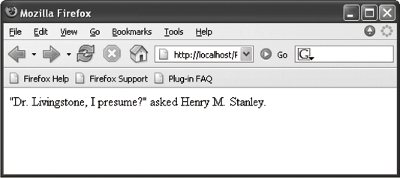
Adding Escape Characters and Sequences
$Explorer = "Henry M. Stanley";
echo "<p>\"Dr. Livingstone, I presume?\“ asked $Explorer.</p>";
Figure 5-3 Output of literal text containing double quotation escape sequences
Name of Book

Slide 10
Simple and Complex String Syntax
Simple string syntax uses the value of a variable within a string by including the variable name inside a text string with double quotation marks
  $Vegetable = "broccoli";
  echo "<p>Do you have any $Vegetable?</p>";
When variables are placed within curly braces inside of a string, it is called complex string syntax
  $Vegetable = "carrot";
  echo "<p>Do you have any {$Vegetable}s?</p>";
Name of Book

Slide 11
Parsing Strings
Parsing is the act of extracting characters or substrings from a larger string
When programming, parsing refers to the extraction of information from string literals
and variables
Name of Book

Slide 12
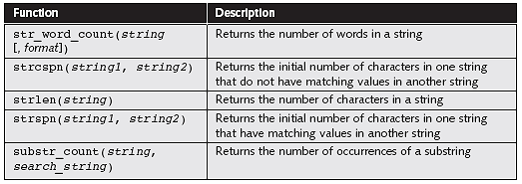
Counting Characters and Words in a String
The most commonly used string counting function is the strlen() function, which returns the total number of characters in a string
Table 5-2 PHP string counting functions
Name of Book

Slide 13
Counting Characters and Words in a String
The str_word_count() function returns the number of words in a string
Pass the str_word_count() function a literal string or the name of a string variable whose words you want to count
$BookTitle = "The Cask of Amontillado";
echo "<p>The book title contains “ . str_word_count($BookTitle). “ words.</p>";
Name of Book

Slide 14
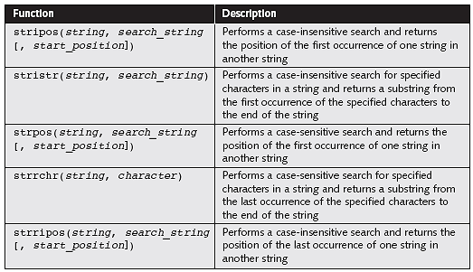
Finding and Extracting Characters and Substrings
Table 5-3 PHP string search and extraction functions
Name of Book

Slide 15
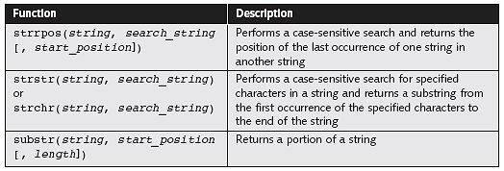
Finding and Extracting Characters and Substrings
Table 5-3 PHP string search and extraction functions (continued)
Name of Book

Slide 16
Finding and Extracting Characters and Substrings
There are two types of string search and extraction functions:
  Functions that return a numeric position in a text string
  Functions that return a character or substring
Name of Book

Slide 17
strpos() Function
Performs a case-sensitive search and returns the position of the first occurrence of one string in another string
Pass two arguments to the strpos() function:
  The first argument is the string you want to search
  The second argument contains the characters for which you want to search
If the search string is not found, the strpos() function returns a Boolean value of false
Name of Book

Slide 18
strchr() and strrchr() Functions
Pass to both functions the string and the character for which you want to search
Both functions return a substring from the specified characters to the end of the string
strchr() function starts searching at the beginning of a string
strrchr() function starts searching at the
end of a string
Name of Book

Slide 19
substr() Function
To extract characters from the beginning or middle of a string, combine the substr() function with other functions
You pass to the substr() function a text string along with the starting and ending positions of the substring you want to extract
  $Email = "president@whitehouse.gov";
  $NameEnd = strpos($Email, "@");
  echo "<p>The name portion of the e-mail address is '“ .
  substr($Email, 0, $NameEnd) . "'.</p>";
Name of Book

Slide 20
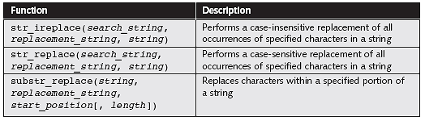
Replacing Characters and Substrings
Table 5-4 PHP string replacement functions
Name of Book

Slide 21
str_replace() and str_ireplace() Functions
The str_replace() and str_ireplace() functions both accept three arguments:
  The string you want to search for
  A replacement string
  The string in which you want to replace characters
$Email = "president@whitehouse.gov";
$NewEmail = str_replace("president", "vice.president", $Email);
echo $NewEmail; // prints 'vice.president@whitehouse.gov'
Name of Book

Slide 22
Dividing Strings into Smaller Pieces
Use the strtok() function to break a string into smaller strings, called tokens
The syntax for the strtok() function is:
$variable = strtok(string, separators);
The strtok() function returns the entire string if:
  An empty string is specified as the second argument of the strtok() function
  The string does not contain any of the separators specified
Name of Book

Slide 23
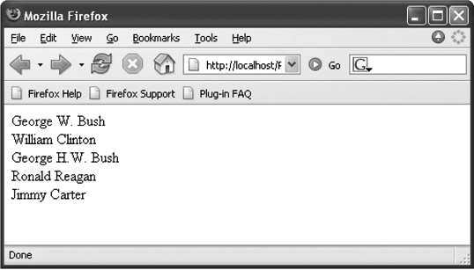
strtok() Function
$Presidents = "George W. Bush;William Clinton;George H.W.
Bush;Ronald Reagan;Jimmy Carter";
$President = strtok($Presidents, ";");
While ($President != NULL) {
echo "$President<br />";
$President = strtok(";");
}
Figure 5-4 Output of a script that uses the strtok() function
Name of Book

Slide 24
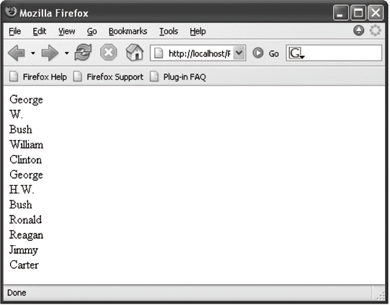
strtok() Function
$Presidents = "George W. Bush;William Clinton;George H.W.
Bush;Ronald Reagan;Jimmy Carter";
$President = strtok($Presidents, "; ");
while ($President != NULL) {
echo "$President<br />";
$President = strtok("; ");
}
Figure 5-5 Output of a script with a strtok() function that uses two separators
Name of Book

Slide 25
Converting Between Strings and Arrays
The str_split() and explode() functions split a string into an indexed array
The str_split() function splits each character in a string into an array element using the syntax:
$array = str_split(string[, length]);
The length argument represents the number
of characters you want assigned to each array element
Name of Book

Slide 26
Converting Between Strings and Arrays
The explode() function splits a string into an indexed array at a specified separator
The syntax for the explode() function is:
$array = explode(separators, string);
The order of the arguments for the explode() function is the reverse of the arguments for the strtok() function
Name of Book

Slide 27
Converting Between Strings and Arrays
$Presidents = "George W. Bush;William Clinton;George H.W. Bush;Ronald Reagan;Jimmy Carter";
$PresidentArray = explode(";", $Presidents);
foreach ($PresidentArray as $President) {
echo "$President<br />";
}
If the string does not contain the specified separators, the entire string is assigned to the
first element of the array
Name of Book

Slide 28
explode() Function
Does not separate a string at each character that is included in the separator argument
Evaluates the characters in the separator argument as a substring
If you pass to the explode() function an empty string as the separator argument, the function returns a value of false
Name of Book

Slide 29
implode() Function
Combines an array’s elements into a single string, separated by specified characters
The syntax is:
$variable = implode(separators, array);
Name of Book

Slide 30
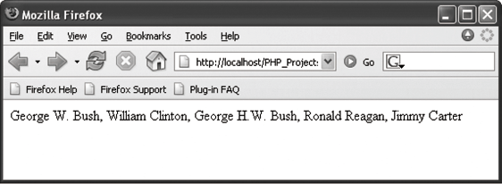
implode() Function
$PresidentsArray = array("George W. Bush", "William Clinton",
"George H.W. Bush", "Ronald Reagan", "Jimmy Carter");
$Presidents = implode(", ", $PresidentsArray);
echo $Presidents;
Figure 5-6 Output of a string created with the implode() function
Name of Book

Slide 31
Comparing Strings
  $Florida = "Miami is in Florida.";
  $Cuba = "Havana is in Cuba.";
  if ($Florida == $Cuba)
  echo "<p>Same location.</p>";
  else
  echo "<p>Different location.</p>";
Name of Book

Slide 32
Comparing Strings (continued)
$FirstLetter = "A";
$SecondLetter = "B";
If ($SecondLetter > $FirstLetter)
echo "<p>The second letter is higher in the alphabet than
the first letter.</p>";
else
echo "<p>The second letter is lower in the alphabet than
The first letter.</p>";
Name of Book

Slide 33
American Standard Code for Information Interchange (ASCII)
Numeric representations of English characters
ASCII values range from 0 to 256
Lowercase letters are represented by the values 97 (“a”) to 122 (“z”)
Uppercase letters are represented by the values 65 (“A”) to 90 (“Z”)
Since lowercase letters have higher values than uppercase letters, they are evaluated as being “greater” than the uppercase letters
Name of Book

Slide 34
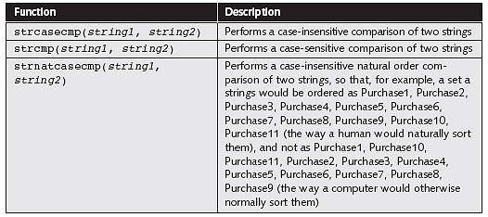
String Comparison Functions
Table 5-5 PHP string comparison functions
Name of Book

Slide 35
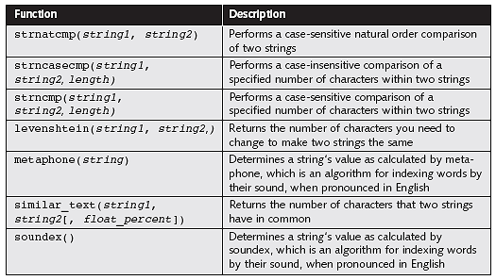
String Comparison Functions (continued)
Table 5-5 PHP string comparison functions (continued)
Name of Book

Slide 36
String Comparison Functions
The strcasecmp() function performs a case-insensitive comparison of strings
The strcmp() function performs a case-sensitive comparison of strings
Both functions accept two arguments representing the strings you want to compare
Most string comparison functions compare strings based on their ASCII values
Name of Book

Slide 37
Determining the Similarity of
Two Strings
The similar_text() and levenshtein() functions are used to determine the similarity between two strings
The similar_text() function returns the number of characters that two strings have in common
The levenshtein() function returns the number of characters you need to change for two strings to be the same
Name of Book

Slide 38
Determining the Similarity of
Two Strings
Both functions accept two string arguments representing the values you want to compare
$FirstName = "Don";
$SecondName = "Dan";
echo "<p>The names \"$FirstName\“ and \"$SecondName\“ have “ .
similar_text($FirstName, $SecondName) . “ characters in
common.</p>";
echo "<p>You must change “ . levenshtein($FirstName, $SecondName)
. “ character(s) to make the names \"$FirstName\“ and
\"$SecondName\“ the same.</p>";
Name of Book

Slide 39
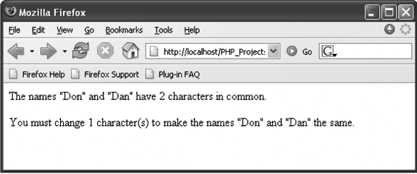
Determining the Similarity of
Two Strings
Figure 5-7 Output of a script with the similar_text()
and levenshtein() functions
Name of Book

Slide 40
Determining if Words Are Pronounced Similarly
The soundex() and metaphone() functions determine whether two strings are pronounced similarly
Both functions return a value representing how words sound
The soundex() function returns a value representing a name’s phonetic equivalent
The metaphone() function returns a code representing an English word’s approximate sound
Name of Book

Slide 41
Determining if Words Are Pronounced Similarly (continued)
$FirstName = "Gosselin";
$SecondName = "Gauselin";
$FirstNameSoundsLike = metaphone($FirstName);
$SecondNameSoundsLike = metaphone($SecondName);
if ($FirstNameSoundsLike == $SecondNameSoundsLike)
echo "<p>The names are pronounced the same.</p>";
else
echo "<p>The names are not pronounced the same.</p>";
Name of Book

Slide 42
Handling Form Submissions
A query string is a set of name=value pairs appended to a target URL
Form data is submitted in name=value pairs, based on the name and value attributes of each element
A question mark (?) and a query string are automatically appended to the URL of a server-side script for any forms that are submitted with the GET method
Name of Book

Slide 43
Handling Form Submissions
Each name=value pair within the query string is separated with ampersands (&)
<form method="get“ action="ProcessOrder.php">
<input type="text“ name="favorite_books“ value="technical“ />
<input type="text“ name="favorite_author“ value="Gosselin“ />
</form>
ProcessOrder.php?favorite_books=technical&favorite_author=Gosselin
Name of Book

Slide 44
Validating Submitted Data
Use the isset() or empty() functions to ensure that a variable contains a value
Use the is_numeric() function to test whether a variable contains a numeric string
Name of Book

Slide 45
Determining if Form Variables Contain Values
The isset() function determines whether a variable has been declared and initialized (or “set”)
The empty() function determines whether a variable is empty
Pass to both functions the name of the variable you want to check
Name of Book

Slide 46
Testing if Form Variables Contain Numeric Values
if (isset($_GET['height']) && isset($_GET['weight'])) {
if (is_numeric($_GET['weight']) && is_numeric($_GET['height'])) {
$BodyMass = $_GET['weight'] / ($_GET['height']
* $_GET['height']) * 703;
printf("<p>Your body mass index is %d.</p>",
$BodyMass);
}
else
echo "<p>You must enter numeric values!</p>";
}
Name of Book

Slide 47
Summary
The concatenation operator (.) and the concatenation assignment operator (.=) can be used to combine two strings
An escape character tells the compiler or interpreter that the character following the escape character has a special purpose
The most commonly used string counting function is the strlen() function, which returns the total number of characters in a string
Name of Book

Slide 48
Summary (continued)
Use the str_replace(), str_ireplace(), and substr_replace() functions to replace text in strings
The strtok() function breaks a string into smaller strings, called tokens
The str_split() and explode() functions split a string into an indexed array
The implode() function combines an array’s elements into a single string, separated by specified characters
Name of Book

Slide 49
Summary (continued)
The strcasecmp() function performs a case-insensitive comparison of strings, whereas the strcmp() function performs a case-sensitive comparison of strings
The similar_text() and levenshtein() functions are used to determine the similarity of two strings
The soundex() and metaphone() functions determine whether two strings are pronounced similarly
Name of Book

