Slide 1
Nightwatch
Presented by Pratiksha MIsal.

Slide 2
Agenda
Introduction
Why nightwatch?
Advantages of mongodb
Where to use mongodb?
Structure of mongodb
Database
Collection

Slide 3
Nightwatch
Nightwatch.js is an easy to use Node.js based End-to-End (E2E) testing solution for browser based apps and websites.
It uses the powerful Selenium WebDriver API to perform commands and assertions on DOM elements.

Slide 4
Main Features
Clean syntax
Built-in test runner
Cloud services support
CSS & Xpath support
Continous integration support
Easy to extend

Slide 5
Selenium
Selenium is a very popular and comprehensive set of tools for browser automation, initially written for Java but now with support for most programming languages.
Nightwatch uses the Selenium WebDriver, specifically the WebDriver Wire Protocol to perform the browser automation related tasks.

Slide 6
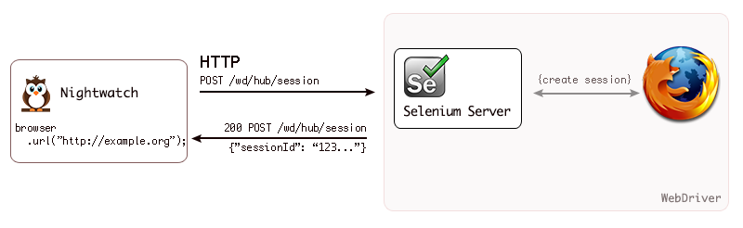
Flow Of Operation

Slide 7
Installation
Install Node.js
Install Nightwatch
To install the latest version using the npm command line tool, run the following:
$ npm install nightwatch
Running the Selenium Server
Download jar file
selenium-server-standalone-{VERSION}.jar
Run selenium server manually:
$ java -jar selenium-server-standalone-{VERSION}.jar

Slide 8
Configuration
The test runner expects a configuration file to be passed, using by default a nightwatch.json file from the current directory.
Basic settings
Selenium settings
Test settings

Slide 9
Writing Tests
module.exports = {
'Demo test Google' : function (browser) {
browser
.url('http://www.google.com')
.waitForElementVisible('body', 1000)
.setValue('input[type=text]', 'nightwatch')
.waitForElementVisible('button[name=btnG]', 1000)
.click('button[name=btnG]')
.pause(1000)
.assert.containsText('#main', 'Night Watch')
.end();
}
};

Slide 10
Running Tests
For Linux and MacOSX:
#!/usr/bin/env node require('nightwatch/bin/runner.js');
Then set the permissions:
$ chmod a+x nightwatch
For Windows:
Name the file nightwatch.js and add the following line:
require('nightwatch/bin/runner.js');
Then run as follows:
C:\workspace\project> node nightwatch.js

Slide 11
Command-line Options
db.COLLECTION_NAME.insert(document)
The test runner supports a number of run-time options to be passed at.
$ ./nightwatch --help
--output
--group
--skipgroup
--config
--env
--test

Slide 12
Find() and Pretty()
find() :
To query data from MongoDB collection, you need to use MongoDB's find() method.
Syntax:
db.COLLECTION_NAME.find()
find() method will display all the documents in a non structured way.
pretty() :
To display the results in a formatted way, you can use pretty() method.
Syntax:
db.COLLECTION_NAME.find().pretty()

Slide 13
Update()
The update() method updates values in the existing document.
Syntax:
db.COLLECTION_NAME.update(SELECTIOIN_CRITERIA,UPDATED_DATA)
Eg:
db.mycol.update({'title':'MongoDB Overview'},{$set:{'title':'New MongoDB Tutorial'}},{multi:true})
The save() method replaces the existing document with the new document passed in save() method
Syntax:
db.COLLECTION_NAME.save({_id:ObjectId(),NEW_DATA})

Slide 14
Remove()
deletion criteria : (Optional) deletion criteria according to documents will be removed.
justOne : (Optional) if set to true or 1, then remove only one document
db.COLLECTION_NAME.remove(DELLETION_CRITTERIA)
Eg:
db.mycol.remove({'title':'MongoDB Overview'})
Remove only one:
If there are multiple records and you want to delete only first record, then set justOne parameter in remove() method
db.COLLECTION_NAME.remove(DELETION_CRITERIA,1)
Remove All documents:
This is equivalent of SQL's truncate command.
db.mycol.remove()

Slide 15
Aggregate()
The aggregation in mongodb you should use aggregate() method.
Syntax:
db.COLLECTION_NAME.aggregate(AGGREGATE_OPERATION)
Example:
db.mycol.aggregate([{$group : {_id : "$by_user", num_tutorial : {$sum : 1}}}])
Expression :
Min
Max
Last
First
avg

