Slide 1
Mocha and Chai
Presented by Pratiksha MIsal.

Slide 2
Agenda

Slide 3
Mocha
Mocha is a JavaScript test framework that runs on both node.js and the browser.
Mocha is the test runner, so it doesn't really care too much about the actual tests, what it cares about is the tests structure, because that is how it knows what is failing and how to layout the results.

Slide 4
Feature
Write tests with Behavior Driven Development (BDD)
It all depends on the kind of testing you want; TDD or BDD.
Makes Asynchronous testing extremely easy
Mocha gives you a "Done" callback. Place this "Done" parameter in your callback function, that'll let Mocha know that you've written an asynchronous function. It's that dead simple.

Slide 5
Integrates really well with NodeJS
The Mocha test framework itself runs on NodeJS, hence it makes everything related to it extremely simple. With Mocha's simple syntax and speed, testing your node.js app just got a whole lot easier.
Supports different assertion libraries
Mocha runs independently from the assertion library, so you can choose which assertion format works best for you.
Mocha most often is run in combination with assertion library Chai.

Slide 6
Custom full color test reporters
Mocha has multiple test reporters built in and you can create your own as well. The test reporters have full color and makes it easy to see if your tests fail or not.
Runs in Node.js and the browser
Mocha has a browser build as well as a node command line program so you can test in client and server side environments.

Slide 7
Why we chose it:
Mocha is a javascript testing framework that makes asynchronous testing easy.
Why we chose it: Mocha can run on either node.js or in the browser. When compared to other javascript testing frameworks like Jasmine, we found that Mocha’s handling of asynchronous testing was a key factor in our decision to use it.

Slide 8
Setup
To get started, let's install Mocha globally by running:
Npm install –g mocha
Installation of chai
Npm install chai
This will install a local copy of Chai for our project.

Slide 9
Chai
Chai is an assertion library that lets you choose the assertion interface that you like best, including “assert”, “expect”, and “should”
Why we chose it:
Although Mocha can be used with any assertion library and Chai can be used with any javascript testing framework, many javascript developers choose to use them together.

Slide 10
Mocha & chai
Example:
expect(4+5).equal(9);
Chai added the following chain getters which don't do anything but you can add them to make it more verbose and readable. The chain getters are as follows: to,Be,been,is,that,a,an,same,of,with
By using chai:
expect(4+5).to.equal(9);
expect(4+5).to.not.equal(10);

Slide 11
Structure of Mocha
db.COLLECTION_NAME.insert(document)
describe('Suite one', function()
{
it(function(done)
{
...
});
it(function(done)
{
...
});
});
we need to add done() call to notify Mocha that asynchronous test has finished its work.

Slide 12
Hook
If we want to get fancy, we can add before and beforeEach hooks which will, according to their names, execute once before the test (or suite) or each time before the test (or suite)
before(function()
{ ------});
describe('suite one ',function() {----
beforeEach(function(){
{ ------});
it('test one', function(done) { ... });
});
Note that before and beforeEach can be placed inside or outside of describe construction.

Slide 13
Run Mocha()
To run our test simply execute:
$ mocha test.js
To use different report type:
$ mocha test.js -R list

Slide 14
Reporter
Spec
The "spec" reporter outputs a hierarchical view nested just as the test cases are.
$ mocha test.js -R spec
List
The "List" reporter outputs a simple specifications list as test cases pass or fail, outputting the failure details at the bottom of the output.
$ mocha test.js –R List

Slide 15
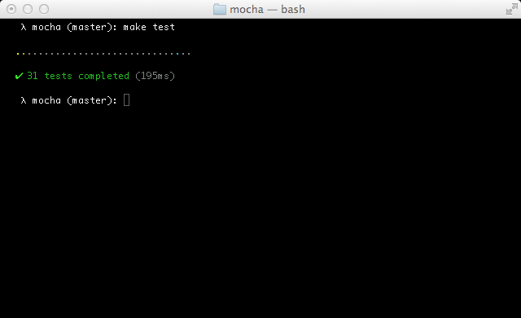
Dot Matrix\
The "dot" matrix reporter is simply a series of dots that represent test cases, failures highlight in red, pending in blue, slow as yellow.

Slide 16
https://www.youtube.com/watch?v=4mKiGkokyx8
https://www.youtube.com/watch?v=BwNMUVzo3vs

