Slide 1
Nightwatch
Presented by Pratiksha MIsal.

Slide 2
Agenda
Introduction
Features
Selenium
Flow of Operation
Installatioion
Running Test

Slide 3
Nightwatch
Nightwatch.js is an easy to use Node.js based End-to-End (E2E) testing solution for browser based apps and websites.
It uses the powerful Selenium WebDriver API to perform commands and assertions on DOM elements.

Slide 4
Main Features
Clean syntax
Built-in test runner
Cloud services support
CSS & Xpath support
Continous integration support
Easy to extend

Slide 5
Selenium
Selenium is a very popular and comprehensive set of tools for browser automation, initially written for Java but now with support for most programming languages.
Nightwatch uses the Selenium WebDriver, specifically the WebDriver Wire Protocol to perform the browser automation related tasks.

Slide 6
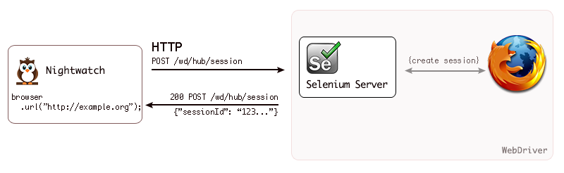
Flow Of Operation

Slide 7
Installation
Install Node.js
Install Nightwatch
To install the latest version using the npm command line tool, run the following:
$ npm install nightwatch
Running the Selenium Server
Download jar file
selenium-server-standalone-{VERSION}.jar
Run selenium server manually:
$ java -jar selenium-server-standalone-{VERSION}.jar

Slide 8
Writing Tests
module.exports = {
'Demo test Google' : function (browser) {
browser
.url('http://www.google.com')
.waitForElementVisible('body', 1000)
.setValue('input[type=text]', 'nightwatch')
.waitForElementVisible('button[name=btnG]', 1000)
.click('button[name=btnG]')
.pause(1000)
.assert.containsText('#main', 'Night Watch')
.end();
}
};

Slide 9
Running Tests
For Linux and MacOSX:
#!/usr/bin/env node require('nightwatch/bin/runner.js');
Then set the permissions:
$ chmod a+x nightwatch
For Windows:
Name the file nightwatch.js and add the following line:
require('nightwatch/bin/runner.js');
Then run as follows:
C:\workspace\project> node nightwatch.js

Slide 10
Command-line Options
db.COLLECTION_NAME.insert(document)
The test runner supports a number of run-time options to be passed at.
$ ./nightwatch --help
--output
--group
--skipgroup
--config
--env
--test

Slide 11
Using Grunt
Grunt is a popular JavaScript task runner.
Task Configuration and Targets:
The Nightwatch task will have one more more targets which can be used in various ways :
cwd - current working directory
argv - command-line arguments that would normally be passed to the Nightwatch runner (e.g.: env);
settings - the test settings specified to a single Nightwatch environment.
Download grunt-nightwatch plugin.

Slide 12


