Slide 1

WELCOME
TO
DATA TECH
PROJECT TEAM

Slide 2

EDA Capston Project-1 on
Play Store App Review Analysis
Presented By: 1. Akshay Shinde
2. Pratiksha More
3. Somya Gupta
4. Prashant Gour

Slide 3
Introduction
Google Play Store is an online store where you can get apps, games and digital content for your device. There are more than 3.04 million apps found on Google Play Store. With this project we will analysing various apps found on the play store with the help of different python libraries.
Dataset: The dataset is been taken from Almabetter .
It consists of 13 columns:- App, Category, Rating, Reviews, Size, Installs, Type, Price, Content Rating, Genres, Last Updated, Current Ver, and Android Ver with 10841 Rows and 13 columns.

Slide 4
Problem Statement:
The Provided Data is of two types, one is the information of the application and other is the review and feedback of the app.
We need to find out how many users are downloading the applications. How the rating and feedback impact the application. What are category involved. How it is distributed on the basis of size, age, free, paid, updated, etc.
In the initial phase, we focused more on the problem statements and data cleaning, in order to ensure that we give them the best results out of our analysis. Our major challenge was data cleaning, In Data Cleaning, we have performed a few steps to ensure the data quality such as removing NAN values. During the Data Cleaning step we found that 13.60% of reviews were NaN values, and even after merging both the data frames, we could not infer much in order to fill them. Thus, we had to drop them.
Type of Data Provided:
Play Store Data.csv: This Data set contains the basic information in detail of the applications on Google Play Store.
User Review.csv: This Data set contains the reviews of an particular application.

Slide 5
Loading the data into data frame.
Finding out the basic information about the data.
AGENDA
Cleaning the data(Check for null or missing values in the dataset).
Extracting statistics from the dataset.
Exploratory analysis and visualizations.

Slide 6
Content
1.Total number of app install in each category.
1.1.Category wise percentage of no of applications
2. Overall Comparison of Category & install(Category and count wise)
2.1Comparison top 32 Category present in the google play store as per their installation ?
3.What are the top 32 apps present in the google play store as per their Genres?
4.What is the count of Rating in each category differentiated by Customer Ratings?
5.Find the number of free and paid applications
6. Comparison of positive , negative and neutral sentiments.
9. Comparison of age wise number of downloading the apps
8. Android versions different types
9.Conclusion.

Slide 7
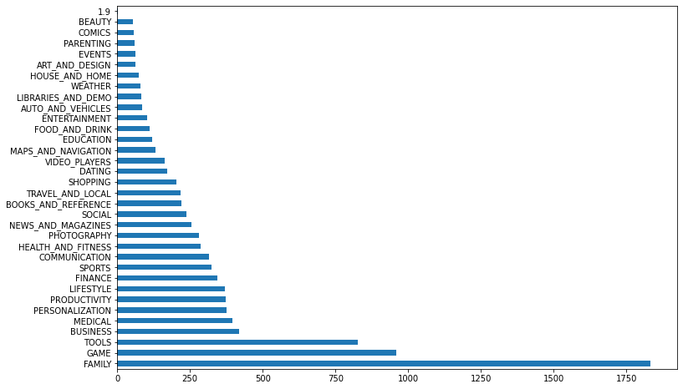
1.Total no of Application in each Category

Slide 8
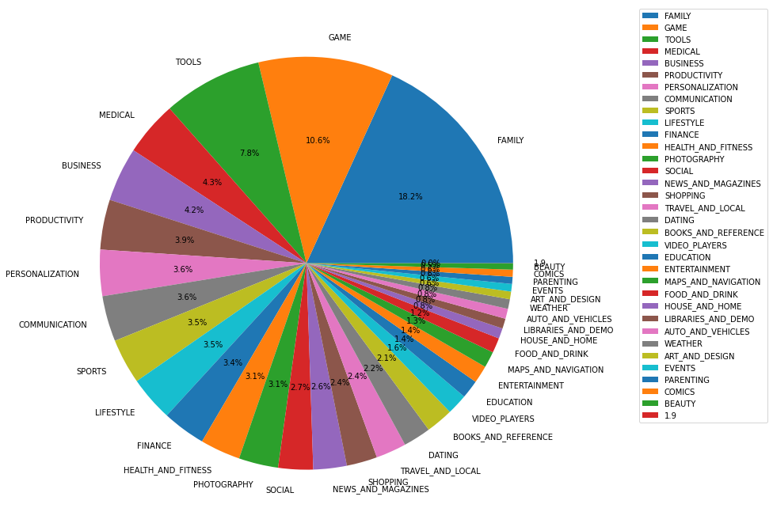
1.1.Category wise percentage of no of applications
In the given Pie chart it is shown that the percentage of different categories containing the number of application.
Were family category is on top to have number of application.

Slide 9
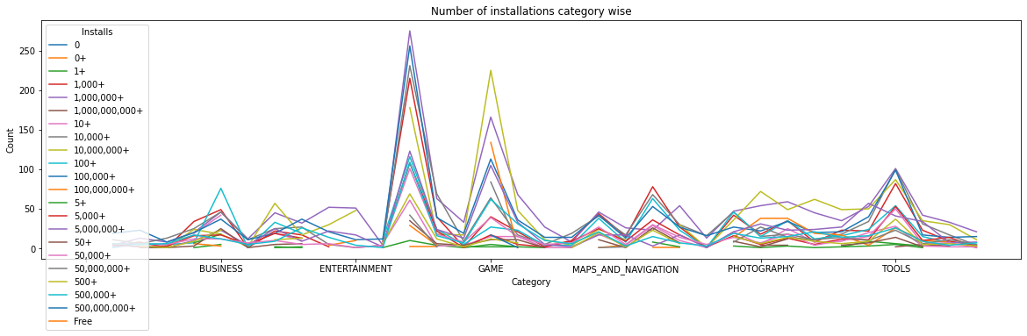
2.Overall Comparison of Category & install
The data is too vast and more difficult to read and understand.
So to make it understable we made addition of all counts of installation and present in the form of comparisons

Slide 10
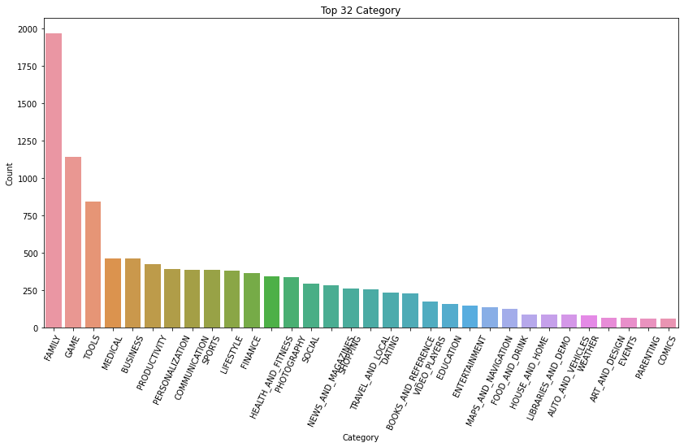
2.1Number of Peoples installed application in each category
This graph shows the distribution of top 32 categories vs the count of installation of the categories.
Here family has the most number of installation as compare to others.

Slide 11
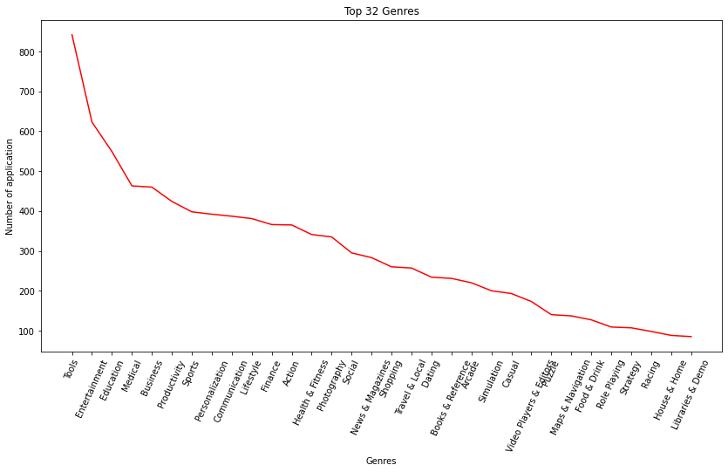
3.Comparison applications as per Genres
This line graph represent the Top application from the play store as per the Genres.
In the previous slide we have seen that the rating of family category is high but in this the Genres type Tools is high.

Slide 12
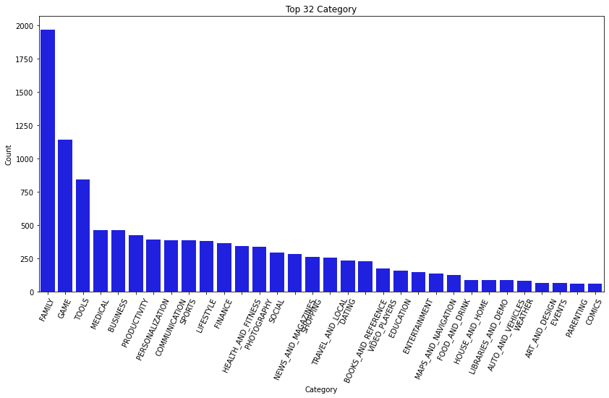
4.Distribution of Rating for different category
In thus graph it is shown the distribution of percentage for different categories of rating.
This data contains the information of top 32 apps from play store. It is a category vs count graph.
Were the family category consist of hight number of rating from all of them.

Slide 13
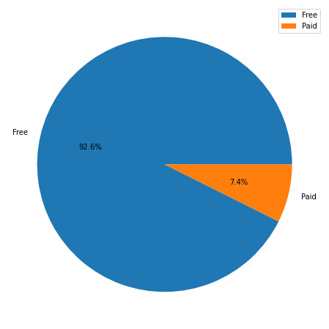
5.Distribution of Free and Paid Application
As the pie chart shows the distribution of Free application and Paid Application.
We can clearly see the percentage difference between both of them as Free contains more percentage than Paid.

Slide 14
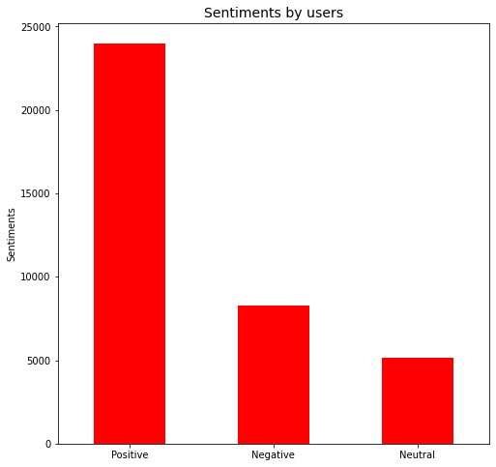
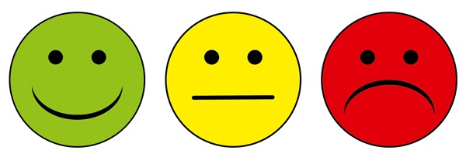
6.Percentage Comparison of Good and Bad Sentiments
Here we can see the comparative of percentage between positive, negative and neutral.
No. Of Good sentiment are 23998 and followed by Bad sentiment are 8271 and the netural arw 5163.

Slide 15
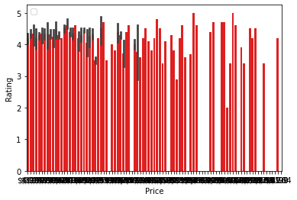
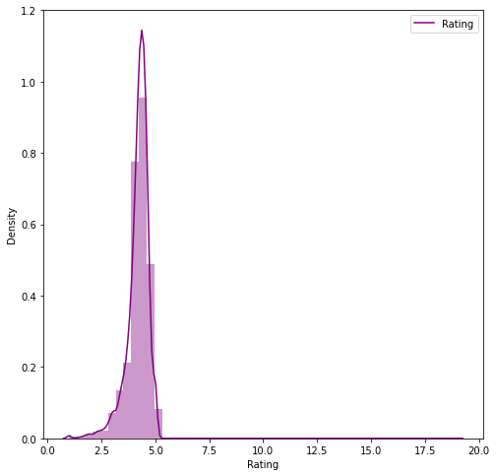
8.Price V/S Rating comparison
Here we can see a huge no of apps are compare for price with respect to its rating.
We can see that highly expensive apps are not necessarily well rated
This graph is based on density wise rating. According to our analysis avg .rating is 4.1

Slide 16
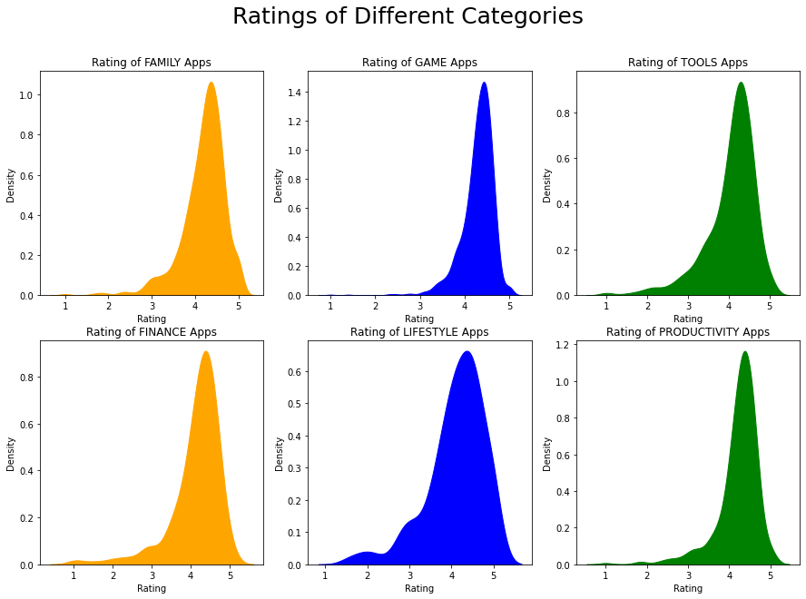
Visualization of all the ratings seprately
In this graph we can see the Rating of different categories.
Here it is also seen that most of the apps have high rating between 4 to 4.5.

Slide 17
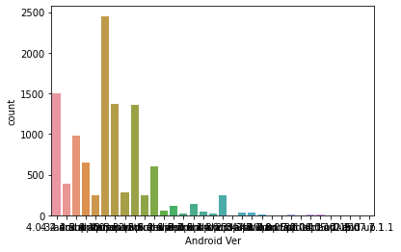
8.Different types of Android Version
From the graphs it shows the lots of versions used by the application with respect to x axis.
On Y axis it is shown the count of this version.

Slide 18
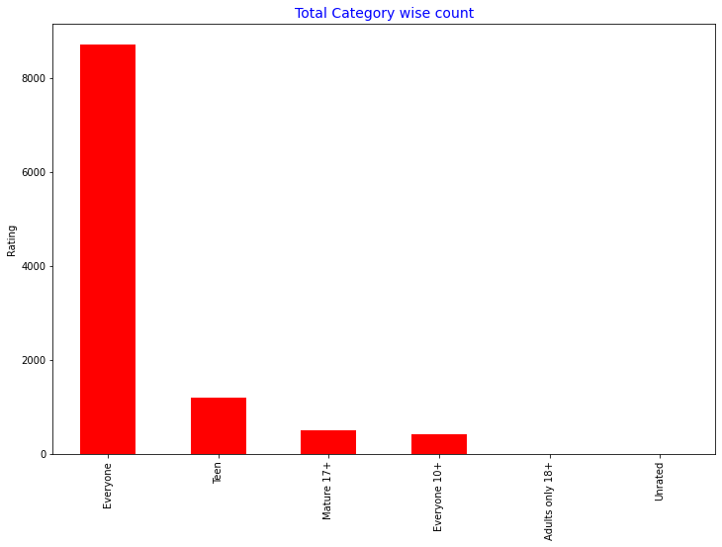
Comparison of age wise number of downloading the apps
Above graph shows that the most of the
applications installed by Teen agers

Slide 19
Conclusion
From the given data we have concluded lots of outputs which make us easy to understand and get the actual calculations of data comparing with category.
We have also understand the actual data analysis and how to take insides from the data and prepare understandable work for present.
The dataset contains possibilities to deliver insights to understand customer demands better and thus help developers to popularize the product. Dataset can also be used to look whether the original ratings of the app matches the predicted rating to know whether the app is performing better or worse compared to other apps on the Play Store.

Slide 20
Thank You… For your valuable time

