Slide 1
Cybersecurity Incident Response AI Agent
An intelligent system for analyzing cybersecurity incidents and delivering actionable response recommendations.
AI-POWERED SECURITY
WRITE TO U2U SYSTEM

Slide 2


Project Details
Project
Objective
Cybersecurity Incident Response AI Agent
To analyze cybersecurity incidents and provide response recommendations.
Technologies Used
Outcome
React.js, FastAPI, Python, JavaScript
Detects incidents and suggests appropriate security actions.

Slide 3
Team Details
Project: Cybersecurity Incident Response AI Agent
Team: Write to U2U System
Team Member
Roll No.
Ashvani Pal
45
Pratiksha Patel
48
Rinki Tiwari
69
Kajal Vishwakarma
70

Slide 4
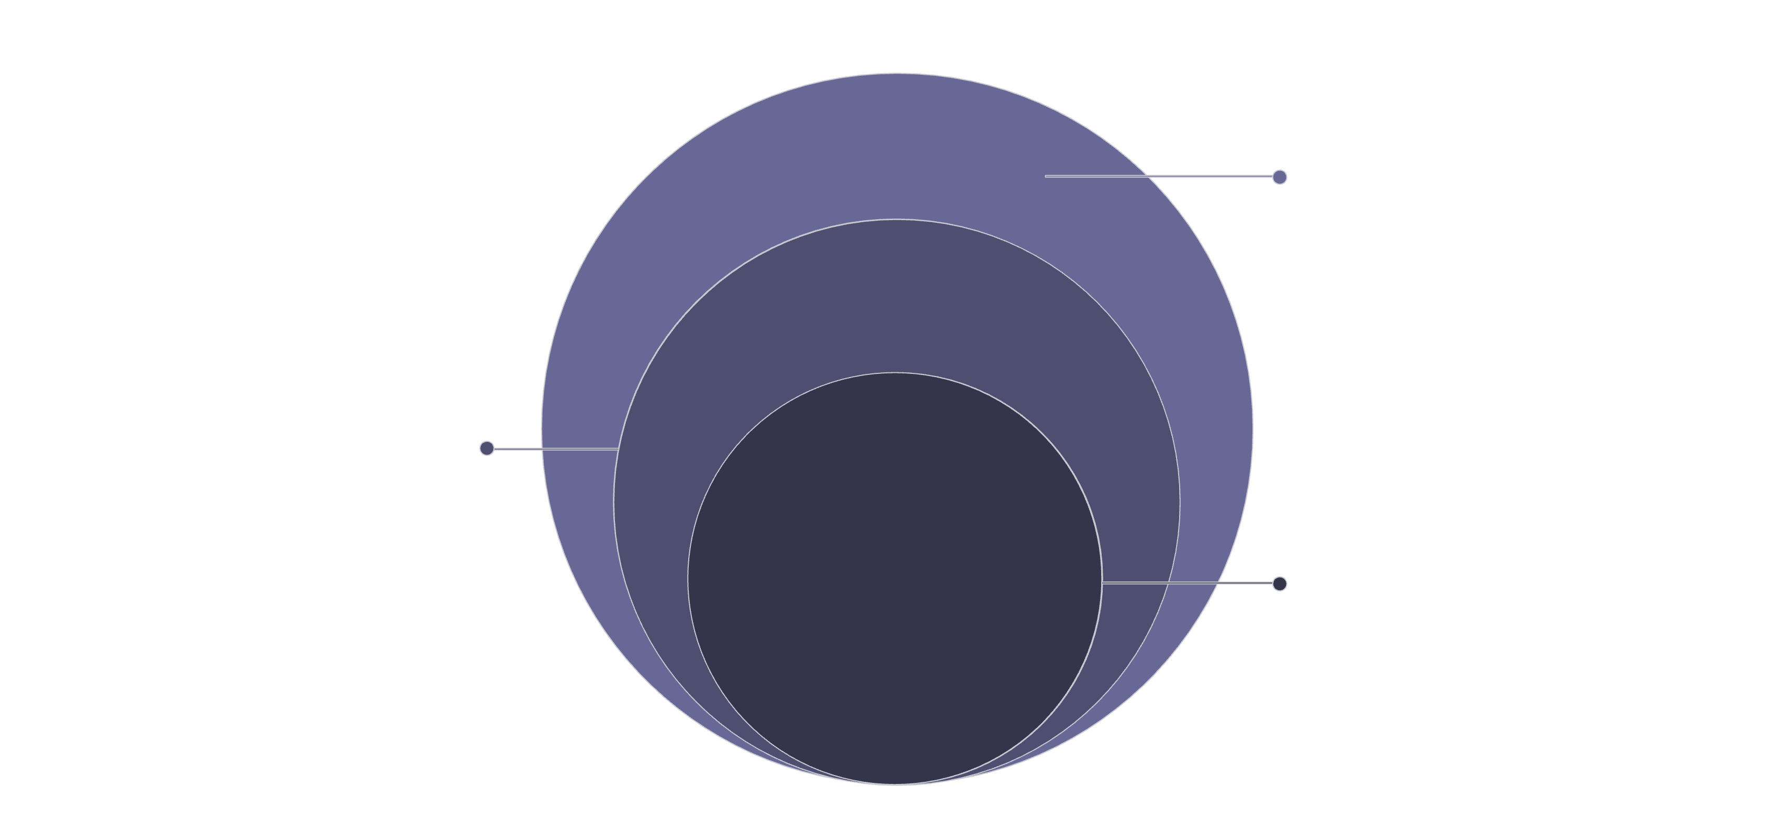
Project Architecture
Components: React Frontend · FastAPI Backend · AI Analysis Module · User Interface
User Interaction
React frontend captures input and shows results
Application Backend
FastAPI handles requests and orchestrates AI
Core Analysis
AI Analysis Service producing insights
The system is structured as a layered pipeline — user input flows from the React frontend through the FastAPI backend into the AI Analysis Service, which returns structured results and security recommendations back to the user interface.

Slide 5
Project Workflow
Working Process
01
02
Incident Entry
Frontend Request
User enters the cybersecurity incident.
Frontend sends the request to the FastAPI backend.
03
04
Backend Forwarding
AI Analysis
Backend forwards the incident to the AI analysis module.
AI identifies the attack type and severity.
05
06
Response Delivery
Result Display
The backend sends the response back to the frontend.
The result is displayed with security recommendations.

Slide 6
GitHub Directory Structure
cybersecurity-ai-agent/
📁 backend/
📁 frontend/
FastAPI server, AI analysis module, and API route definitions.
React.js application, UI components, and client-side logic.
📁 docs/
📁 screenshots/
Project documentation and technical specifications.
Visual captures of the application interface and outputs.
📁 architecture/
📄 README.md
System architecture diagrams and design artifacts.
Project overview, setup instructions, and usage guide.

Slide 7


Summary
1
2
AI-Driven Detection
Full-Stack Architecture
Automatically identifies attack type and severity from incident descriptions.
React.js frontend paired with a FastAPI backend for seamless end-to-end processing.
3
4
Actionable Recommendations
Team: Write to U2U System
Delivers structured security response guidance directly to the user interface.
Developed by Ashvani Pal, Pratiksha Patel, Rinki Tiwari, and Kajal Vishwakarma.
This project demonstrates an end-to-end AI-powered cybersecurity pipeline — from incident input to intelligent, actionable response recommendations.

