Slide 1
Fundamentals of HDFS

Slide 2
Agenda
What is HDFS?
HDFS basic commands
MapReduce Basics
MapReduce Fundamentals
WordCount Program
Chicago Crime Data Analysis.

Slide 3
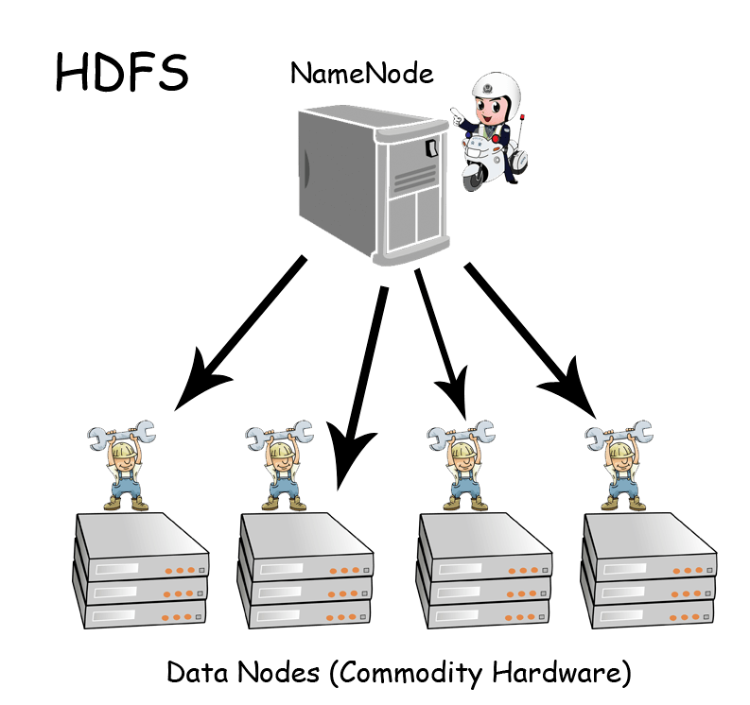

Slide 4
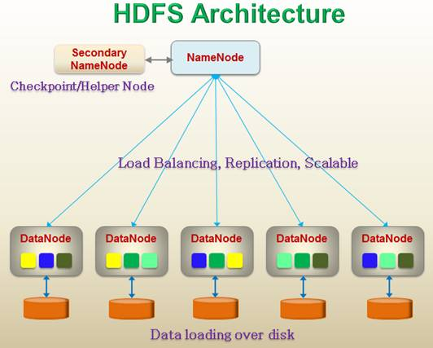
Notes:
Master/slave architecture
HDFS cluster consists of a single Namenode, a master server that manages the file system namespace and regulates access to files by clients.
There are a number of DataNodes usually one per node in a cluster.
The DataNodes manage storage attached to the nodes that they run on.
HDFS exposes a file system namespace and allows user data to be stored in files.
A file is split into one or more blocks and set of blocks are stored in DataNodes.
DataNodes: serves read, write requests, performs block creation, deletion, and replication upon instruction from Namenode

Slide 5
HDFS Features
Highly fault-tolerant
High throughput
Suitable for applications with large data sets
Streaming access to file system data
Can be built out of commodity hardware

Slide 6
HDFS – User Commands (dfs)
List directory contents
Display the disk space used by files
hdfs dfs –ls
hdfs dfs -ls /
hdfs dfs -ls -R /var
hdfs dfs -du -h /
hdfs dfs -du /hbase/data/hbase/namespace/
hdfs dfs -du -h /hbase/data/hbase/namespace/
hdfs dfs -du -s /hbase/data/hbase/namespace/
Notes:
NameNode and DataNode each run an internal web server in order to display basic information about the current status of the cluster

Slide 7
HDFS – User Commands (dfs)
Copy data to HDFS
Copy the file back to local filesystem
hdfs dfs -mkdir tdata
hdfs dfs -ls
hdfs dfs -copyFromLocal tutorials/data/geneva.csv tdata
hdfs dfs -ls –R
cd tutorials/data/
hdfs dfs –copyToLocal tdata/geneva.csv geneva.csv.hdfs
md5sum geneva.csv geneva.csv.hdfs

Slide 8
Fundamentals of Map-Reduce

Slide 9
MapReduce Fundamentals
What is MapReduce?
Where it can be used?
Real life Scenario where Mapreduce is used.
How Mapreduce is implemented

Slide 10
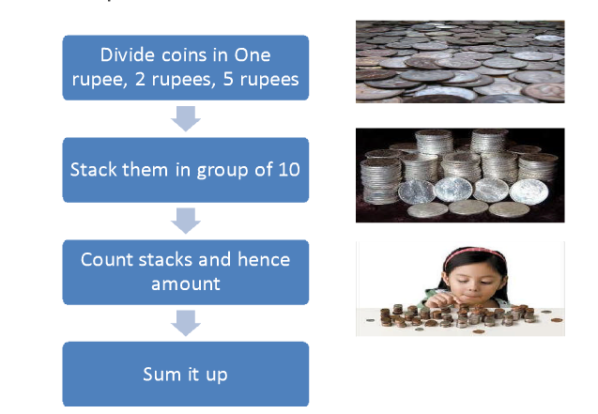
Real Life problem

Slide 11
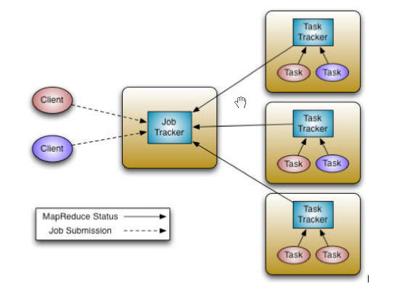
JobTracker and TaskTracker

Slide 12
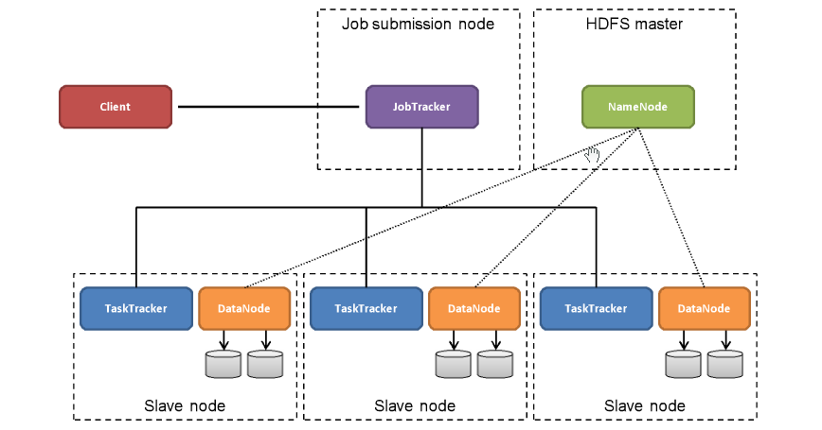
MapReduce at cluster level

Slide 13
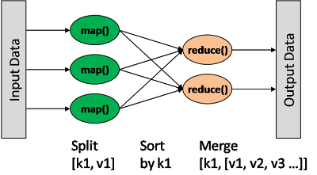
MapReduce Framework

Slide 14
Understanding MapReduce – P1/3
Map>>
(K1, V1) →
Info in
Input Split
list (K2, V2)
Key / Value out (intermediate values)
One list per local node
Can implement local Reducer (or Combiner)
Notes:
The Hadoop MapReduce framework spawns one map task for each InputSplit generated by the InputFormat for the job.

Slide 15
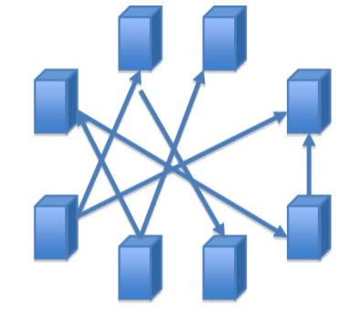
Understanding MapReduce – P2/3
Map>>
(K1, V1) →
Info in
Input Split
list (K2, V2)
Key / Value out (intermediate values)
One list per local node
Can implement local Reducer (or Combiner)
Shuffle/Sort>>
Notes:
The Hadoop MapReduce framework spawns one map task for each InputSplit generated by the InputFormat for the job.

Slide 16
Understanding MapReduce – P3/3
Map>>
(K1, V1) →
Info in
Input Split
list (K2, V2)
Key / Value out (intermediate values)
One list per local node
Can implement local Reducer (or Combiner)
Shuffle/Sort>>
Reduce
(K2, list(V2) →
Shuffle / Sort phase precedes Reduce phase
Combines Map output into a list
list (K3, V3)
Usually aggregates intermediate values
(input) <k1, v1> → map → <k2, v2> → combine → <k2, v2> → reduce → <k3, v3> (output)
Notes:
The Hadoop MapReduce framework spawns one map task for each InputSplit generated by the InputFormat for the job.

Slide 17
Hands-On Exercise
Problem Statement :
We have a large file of words and we need to count the number of times each word appeared in the file
Eg. Input : file<to be or not to be, that is the question>
Output : file <to:2, be:2, or:1, not:1.....>

Slide 18
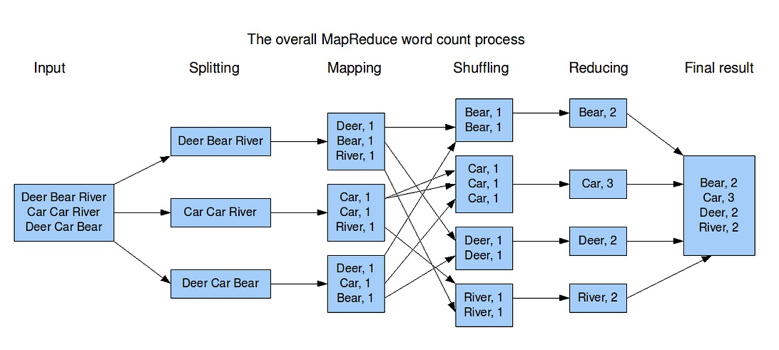
MapReduce Example - WordCount
Image from: http://blog.jteam.nl/wp-content/uploads/2009/08/MapReduceWordCountOverview1.png

Slide 19
Execution Steps:
Load data to HDFS
Create Map-Reduce Java program file
Compile java code:
javac -cp .:../lib/* <javaSrcFile>
Create jar file:
jar cvfe <jarName.jar> <driverClassName> *.class
Execute Map-Reduce code
hadoop jar <jarName.jar> <inputDataPath> <outputDataPath>

Slide 20
Chicago Crime DataSet
What’s in the DataSet:
Schema: (ID, Case_Number, Date, Block, IUCR, Primary_Type, Description, Location_Description, Arrest, Domestic, Beat, District, Ward, Community_Area, FBI_Code, X_Coordinate, Y_Coordinate, Year, Updated_On, Latitude, Longitude, Location)
Rows | Columns | Each row is a
6.41 Million | 22 | Reported Crime

Slide 21
Chicago Crime Data Analysis: 1/3
Number of Reported Crimes by - District
Sol:
Map Phase:
Input (K, V): (offset, line)
Output list(K, V) : (District, 1)

Slide 22
Chicago Crime Data Analysis: 1/3
Number of Reported Crimes by - District
Sol:
Shuffle Phase :
Input list(K, V) : (District, 1)
Output K, list<V> : (District, <1, 1, 1, ...>)

Slide 23
Chicago Crime Data Analysis: 1/3
Number of Reported Crimes by - District
Sol:
ReducePhase:
Input (K, list<V> ): (District, <1, 1, 1, ...>)
Output (K, V) : (District, NoOfCrimes)

Slide 24
Chicago Crime Data Analysis: 2/3
2. Number of Reported Crimes per Year, per Month :
Sol:
Map Phase:
Input (K, V): (offset, line)
Output list(K, V) : (Year+Month, 1)

Slide 25
Chicago Crime Data Analysis: 2/3
2. Number of Reported Crimes per Year, per Month :
Sol:
Shuffle Phase :
Input list(K, V) : (Year+Month, 1)
Output K, list<V> : (Year+Month, <1, 1, 1, ...>)

Slide 26
Chicago Crime Data Analysis: 2/3
2. Number of Reported Crimes per Year, per Month:
Sol:
ReducePhase:
Input (K, list<V> ): (Year+Month, <1, 1, 1, ...>)
Output (K, V) : (District, NoOfCrimes)

Slide 27
Chicago Crime Data Analysis: 3/3
3. Number of Reported Crimes per Year, per Month, where arrests has been made :
Sol:
Map Phase:
Input (K, V): (offset, line)
Output list(K, V) : (Year+Month+arrestFlag, 1)

Slide 28
Chicago Crime Data Analysis: 3/3
3. Number of Reported Crimes per Year, per Month, where arrests has been made :
Sol:
Shuffle Phase :
Input list(K, V) : (Year+Month+arrestFlag, 1)
Output K, list<V> : (Year+Month+arrestFlag, <1, 1, 1, ...>)

Slide 29
Chicago Crime Data Analysis: 3/3
3. Number of Reported Crimes per Year, per Month, where arrests has been made :
Sol:
ReducePhase:
Input (K, list<V> ): (Year+Month+arrestFlag, <1, 1, 1, ...>)
Output (K, V) : (Year+Month+arrestFlag, NoOfArrests)

Slide 30

Questions ?

Slide 31

Thank You!!!

