Slide 1


Case Study:
Food Quality Prediction
Student names:
Pratiksha.Mallikarjun.Ullagaddi

Slide 2
Problem Statement
The task is to predict the Food Quality Rating of a dish based on multiple factors, including taste, texture, color, nutritional value, and preparation time.The goal is to develop a predictive model using linear regression to determine how these features influence the food quality rating. A dataset with 100 samples has been generated, where the target variable (food quality rating) is influenced by the aforementioned features, with some added noise for realism. The model will be evaluated using Mean Absolute Error (MAE) and R-squared (R²). The objective is to build an accurate model that can predict the food quality rating based on these factors, providing insights into how different attributes impact overall food quality.
Source :
https://www.kaggle.com/

Slide 3
Key Objectives:
Generate Synthetic Dataset
Create a dataset with 100 samples, including features such as taste, texture, color, nutritional value, and preparation time generated randomly.
2. Simulate the Target Variable
Compute the food quality rating using a weighted formula that incorporates the features and adds noise to reflect real- world variations.
3. Split Data into Training and Testing Sets
Divide the data into 80% training and 20% testing sets for model evaluation.
4. Train a Linear Regression Model
Train a linear regression model using the training data to predict food quality ratings based on the features.
5. Evaluate Model Performance
Assess the model's performance using Mean Absolute Error (MAE) and R-squared (R²) metrics.
6. Visualize Predictions
Plot actual vs. predicted food quality ratings to visually evaluate the accuracy of the model's predictions.
Source :
https://www.kaggle.com/

Slide 4
Dataset Overview :
Features :
Taste Score, Texture Score, Color Score, Nutritional Value: These are subjective ratings of food quality (on a scale from 6 to 10).
Preparation Time: The time required to prepare the food, ranging from 20 to 50 minutes.
Target Variable:
Food Quality Rating: A calculated rating (1-10) influenced by the features, with some noise added for realism.
Purpose:
Objective: Predict the Food Quality Rating based on the five features using a Linear Regression model.
Evaluation: The model performance is measured using Mean Absolute Error (MAE) and R-squared (R²) to assess how accurately it predicts food quality.
Sources :https://www.kaggle.com/
Source :
https://www.kaggle.com/

Slide 5
Methodology
Data Collection:
Gather data on ingredients, processing methods, and environmental factors.
2. Feature Extraction:
Identify critical features such as texture, taste, and chemical composition.
3. Preprocessing:
Clean and normalize the data to ensure quality.
4. Model Selection:
Choose appropriate machine learning algorithms for prediction.
5. Evaluation:
Test and validate the model using accuracy metrics.
Source :
https://www.kaggle.com/

Slide 6
. *Prediction and Analysis* -
Algorithms Used:
Generate Data: Simulate food features (taste, texture, color, nutrition, prep time) and target (food quality rating) with noise.
2. Prepare Data: Store the data in a Data Frame, separating features (X) and target (y).
3. Split Data: Divide data into training (80%) and testing (20%) sets.
4. Train Model: Initialize and train a linear regression model using training data.
5. Evaluate: Predict food quality ratings on test data, calculate Mean Absolute Error (MAE) and R² score.
6. Visualize: Plot actual vs predicted food quality ratings to evaluate model performance.
Source :
https://www.kaggle.com/

Slide 7
Flow Chart:
FOOD PRODUCTION
FOOD PROCESSING
HEALTHY PEOPLE
FOOD PACKAGING
Fig : Food Quality Prediction
Source :
https://www.kaggle.com/

Slide 8
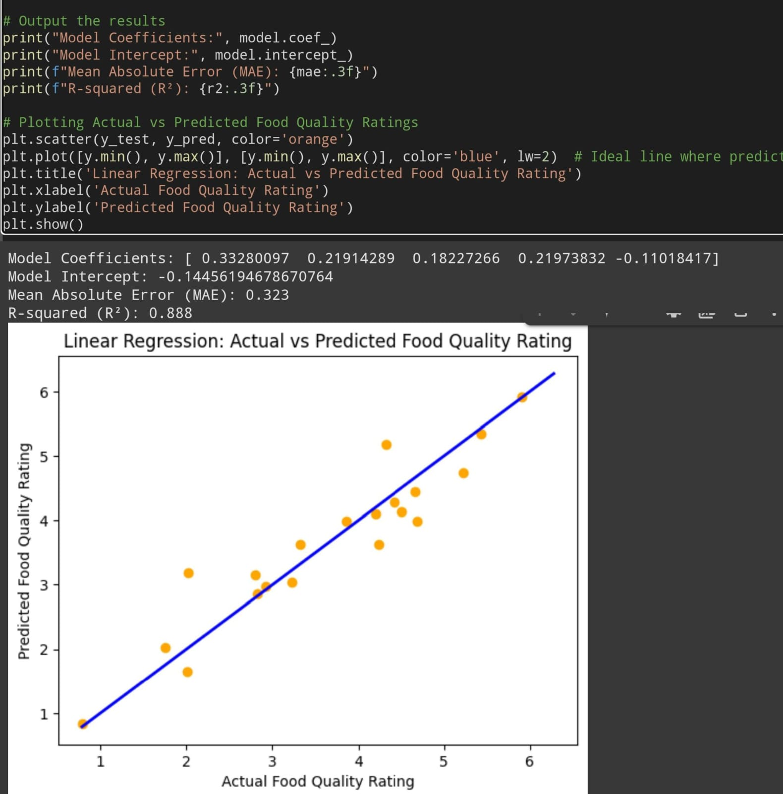
Output

Slide 9

Conclusion
1. Linear regression is used to predict food quality ratings based on multiple features like taste, texture, and preparation time.
2. Synthetic data with 100 samples was generated to simulate real-world food quality data.
3. The model was trained using an 80-20 train-test split and evaluated using Mean Absolute Error (MAE) and R-squared (R²) metrics.
4. A scatter plot visualizes the relationship between actual and predicted food quality ratings.
5. The model performs well but can be enhanced by refining features or using more complex algorithms.
Source :
https://www.kaggle.com/

Slide 10
References
Books
FOOD QUALITY AND PREDICTION
PREM KUMAR JAISEWAL
FOOD ANALYSIS AND QUALITY CONTROL
H.W. DESHPANDE
POSHADRI
Online set:
www.kaggal.com
www.chatgpt.com
www.googlecolab.com

Slide 11
Thank You
Notes:
Thank You !!

