Slide 1

IPL Data Analysis:
Building a Winning Strategy for RCB
Pratikshya Priyadarshani Patra

Slide 2
Agenda
Problem Statement
Data Description
Setting the Context (The Unanswered Question: Why No Trophy? & RCB Performance Overview (Season-wise))
On-Field Patterns & Tactical Insights (Home vs Away Performance & Toss Decisions & Venue Impact)
Team Dependency & Squad Structure(Player Presence & Morale Impact, Squad Balance: Batting vs Bowling, Role of All-Rounders & Stars vs Team Performance)
The Verdict & The Way Forward (Key Reasons for the Trophy Drought & Forging a New Path: Strategies for Success)

Slide 3
Problem Statement
RCB aims to build a strong and competitive squad for the 2017 Mega Auction while operating within a limited budget. The challenge is to identify players who not only deliver consistent on-field performance but also provide the best value for their auction price. A data-driven approach is required to evaluate player performance, reliability, and cost-effectiveness in order to optimize auction investments and maximize the team's chances of winning future tournaments.

Slide 4
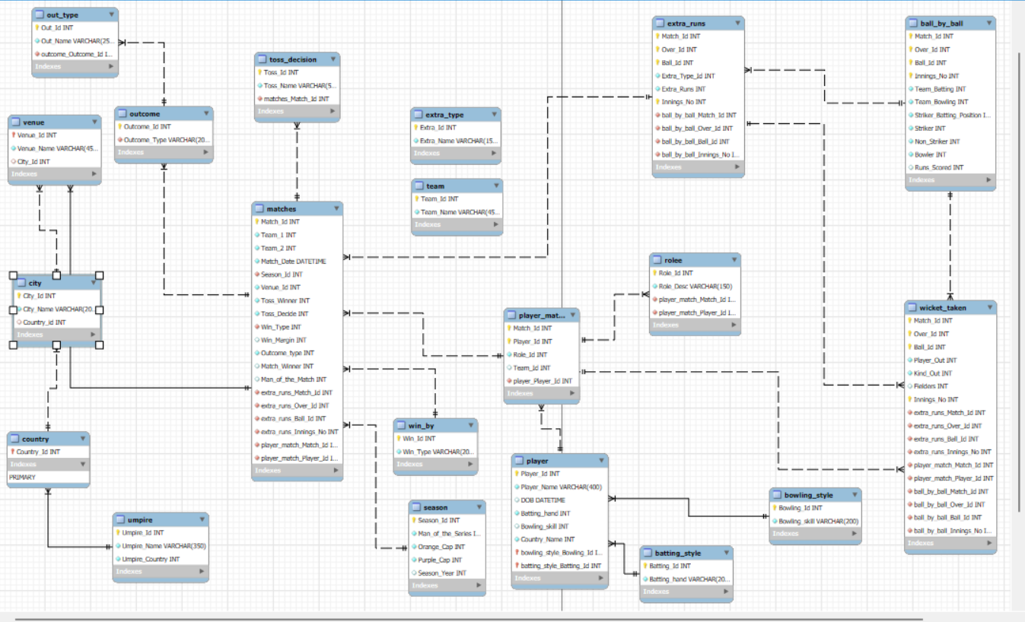
Database schema

Slide 5
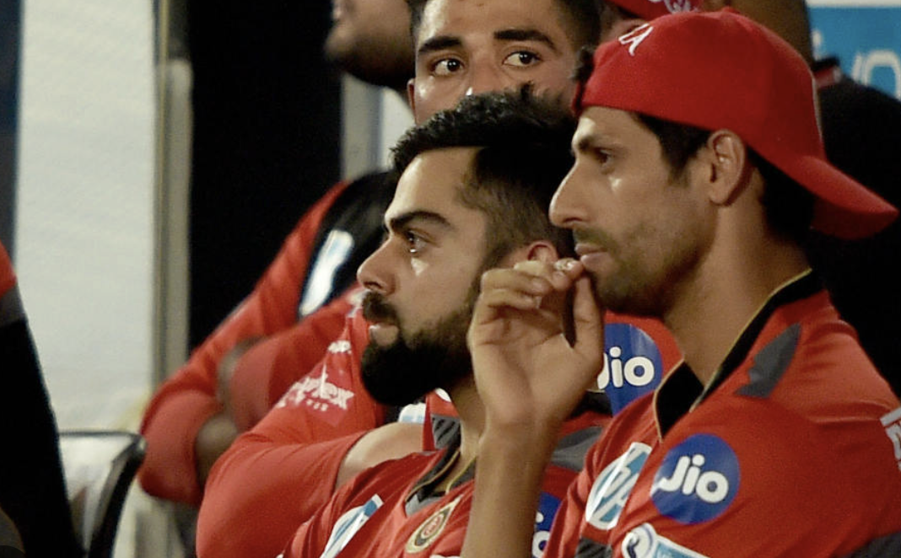
The Unanswered Question:
Why Has Success Not Translated into a Trophy?
Despite boasting world-class talent across multiple seasons, the Royal Challengers Bangalore have yet to lift the IPL trophy. This analysis dives deep into performance patterns, identifies critical gaps, and proposes data-driven strategies for future success.

Slide 6
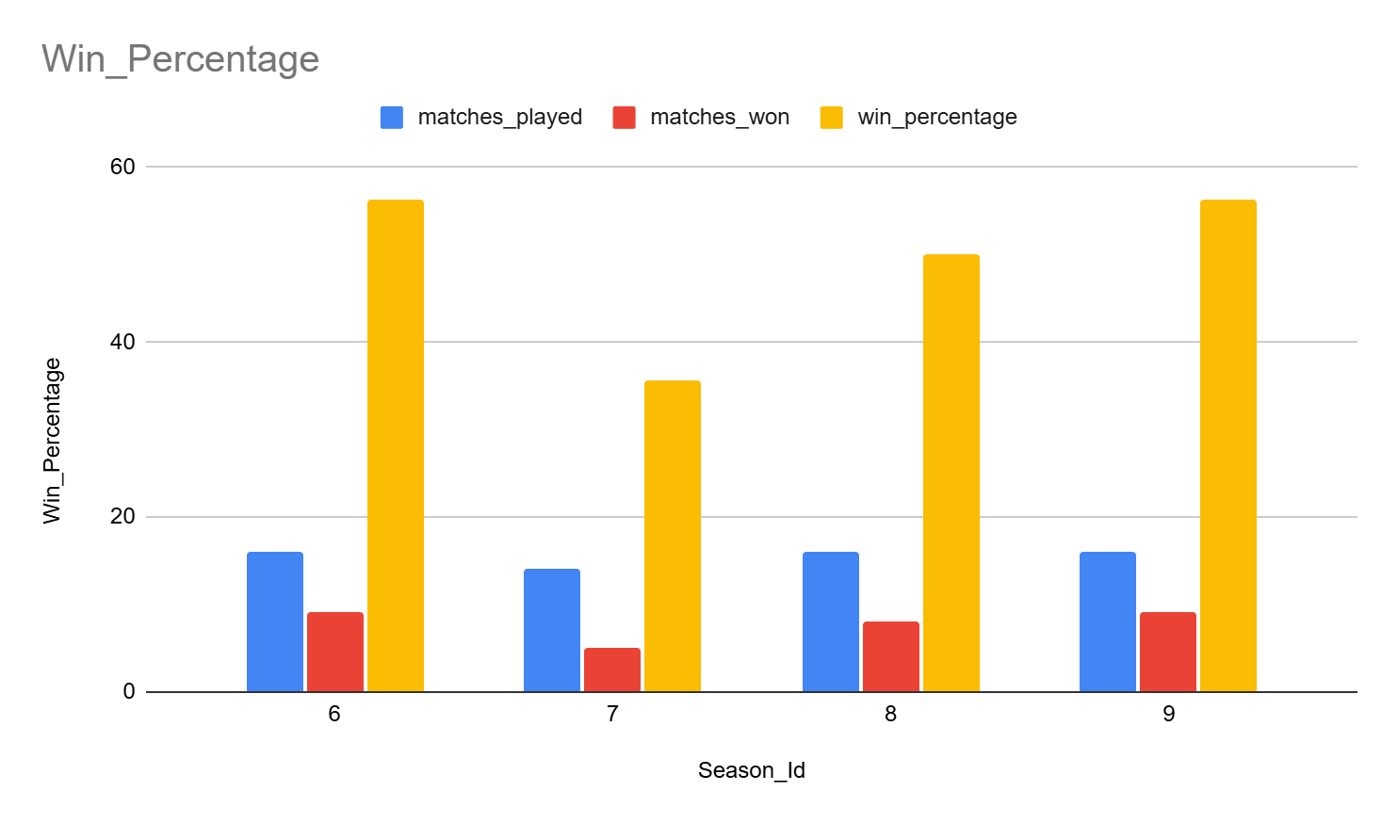
RCB Performance Overview (Season-wise)
RCB has displayed significant volatility in performance across different IPL seasons, with periods of strong individual performances failing to translate into consistent team success. Despite having a talented squad capable of match-winning contributions, the team has struggled to maintain stability over time. This pattern highlights that the primary challenge is not a lack of talent, but rather inconsistency in performance and execution across matches and seasons.

Slide 7
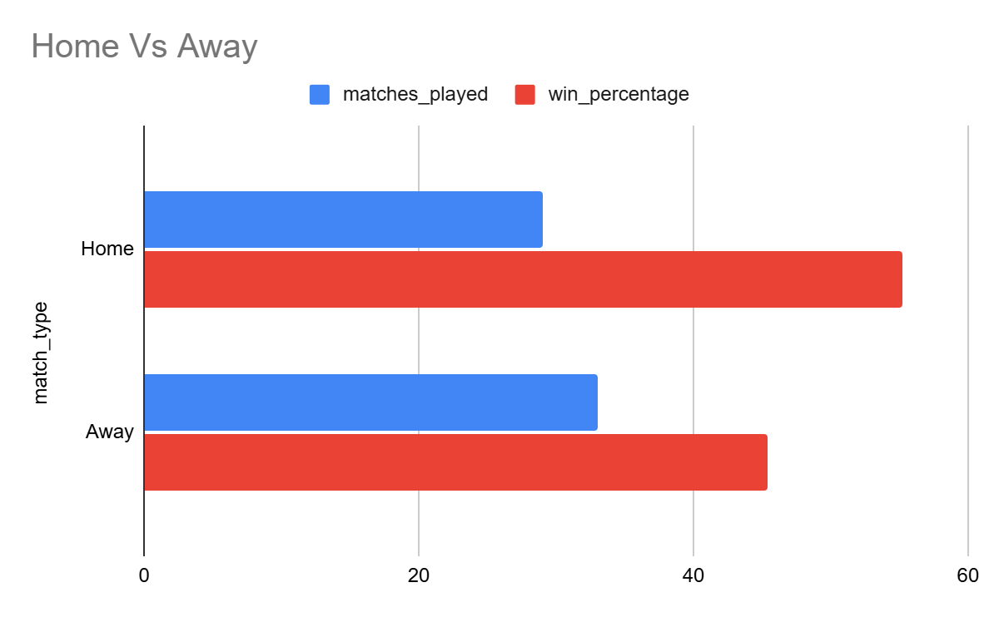
Home vs Away performance
RCB has consistently performed better in home conditions compared to away matches, indicating a strong dependence on familiar pitches and environments. In contrast, their performance drops significantly in away games, highlighting difficulties in adapting to varying pitch conditions and venue dynamics. This reliance on home advantage has limited the team’s ability to maintain consistent results throughout the tournament, ultimately affecting their overall success.

Slide 8
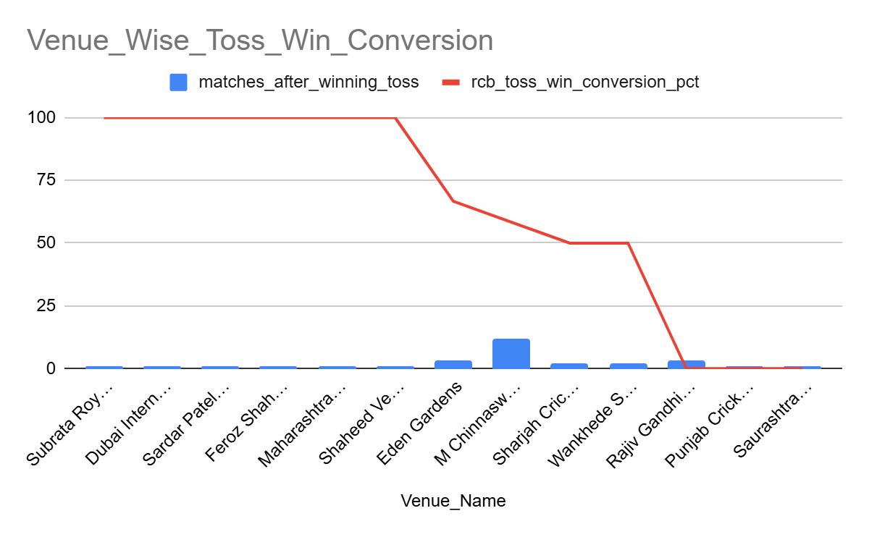
Toss Decisions & Venue Impact
Toss decisions were effective only at certain venues and failed to deliver consistent outcomes across different conditions. Identical choices often produced varying and sometimes opposite results depending on the venue, indicating a lack of flexibility in strategy. This inconsistency highlights a weak alignment between toss decisions and pitch behavior, suggesting the need for a more adaptive, venue-specific approach to improve decision-making effectiveness.

Slide 9
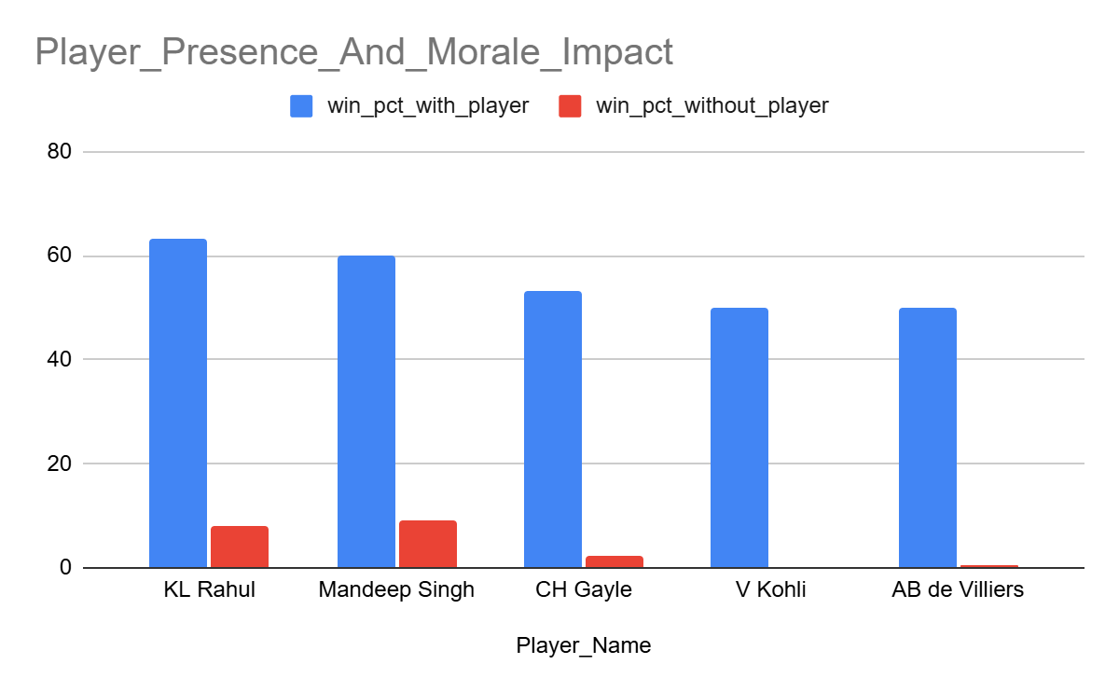
Player Presence & Morale Impact
The team’s win percentage shows a noticeable improvement when certain key players are part of the playing XI, while their absence leads to a significant decline in overall performance. This pattern indicates a strong dependency on a few impactful individuals rather than a well-balanced and consistently performing unit.

Slide 10
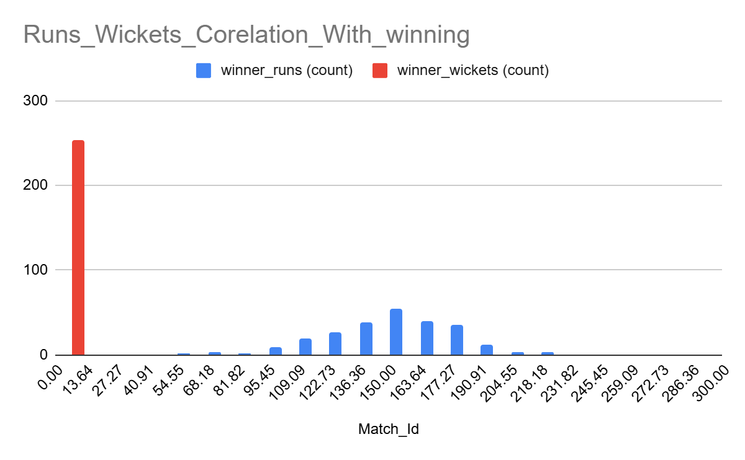
Squad Balance – Batting vs Bowling
Batting performances have generally outperformed bowling contributions, indicating an imbalance in the team’s overall structure. The bowling unit has struggled with consistent wicket-taking across seasons, leading to reduced control over match situations. This lack of bowling stability has often resulted in the team’s inability to defend totals effectively or restrict opposition during run chases.

Slide 11
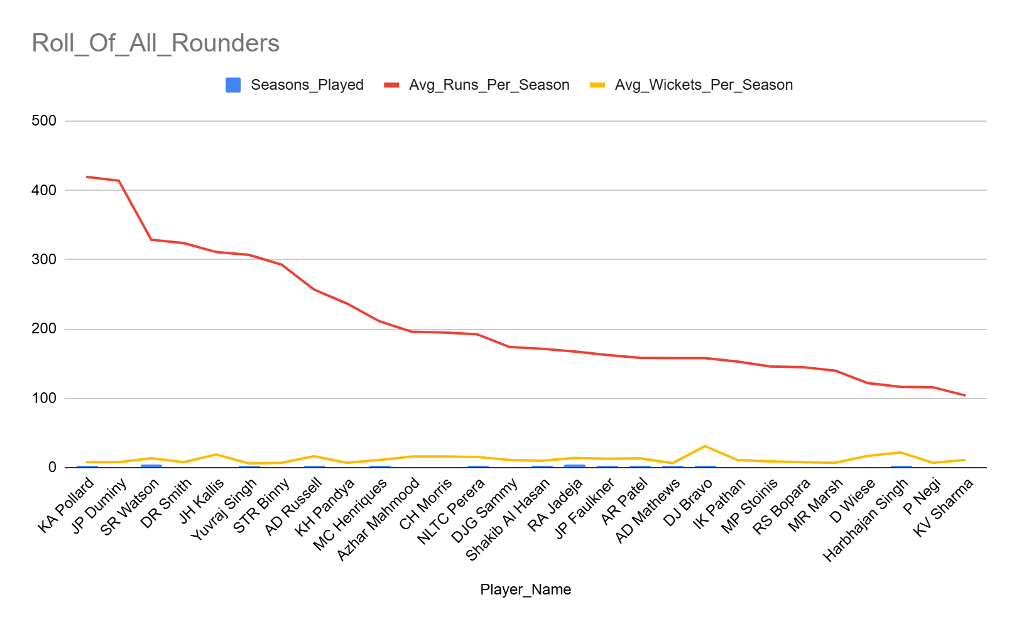
Role of All-Rounders
Successful teams typically benefit from strong contributions from multi-skilled players who add balance to both batting and bowling departments. However, RCB’s all-rounder impact has been limited and inconsistent across seasons. This lack of reliable all-round depth increases pressure on specialist top-order batters and strike bowlers, reducing overall team balance and flexibility in match situations.

Slide 12
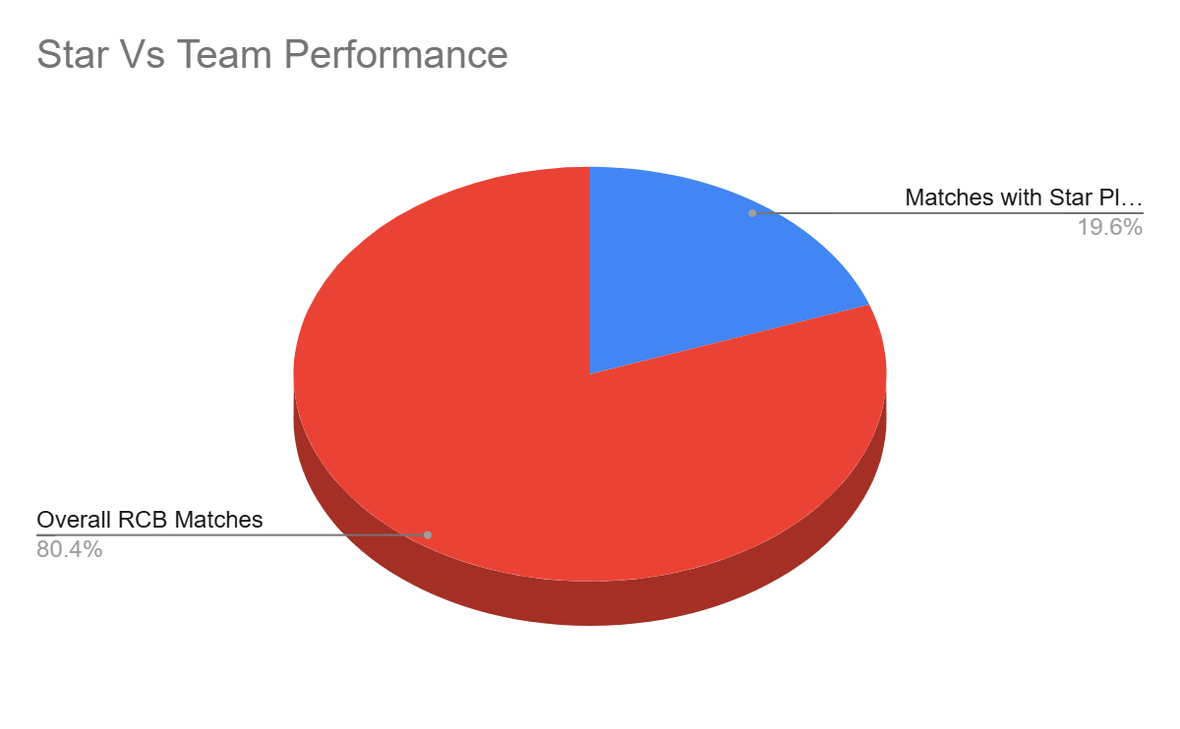
Stars vs Team Performance
The presence of star players often leads to strong individual match performances and can influence short-term outcomes. However, relying solely on star power has not translated into consistent playoff qualification or dominance in finals. This highlights that winning trophies requires cohesive team performance and collective execution rather than isolated individual brilliance.

Slide 13
Why NO Trophy:
Inconsistent performance: Strong seasons followed by sharp drops, lacking long-term momentum
Rigid tactics: Limited adaptability in strategies across venues and conditions
Over-reliance on stars: Dependence on a few players instead of team-wide contributions
Weak bowling unit: Inconsistent wicket-taking and poor death-over control
Poor adaptability: Underperformance in away conditions
Unbalanced squad: Focus on star players over building a complete, balanced team

Slide 14

Crafting a Path to Glory
What Went Wrong
Inconsistent performance across seasons
Rigid and predictable strategies
Over-reliance on star players
Weak bowling in key moments
Imbalanced squad structure
What Must Be Implemented
Role-based team structure
Flexible, situation-based tactics
Balanced squad beyond star players
Stronger death-over bowling
More impactful all-rounders

Slide 15
Improvement Plan
All-rounders: Bat + ball balance for flexibility and reduced pressure on specialists
Wicket-taking bowlers: Prioritize breakthroughs in powerplay and death overs
Role backups: Ensure reliable replacements for every key player
Venue-based planning: Adapt strategies based on pitch and ground conditions
Flexible batting order: Adjust lineup based on match situation and opposition
Death-over specialization: Invest in bowlers skilled in closing out matches
Data-driven selection: Use performance metrics and consistency for auction picks
Core team stability: Maintain a consistent core group across seasons
Reduce star dependency: Distribute responsibility across multiple players
Balance squad composition: Maintain equal strength across batting, bowling, and all-round roles

Slide 16

Closing Remarks
To ultimately win the trophy, RCB must evolve from a star-dependent side into a well-balanced, strategy-oriented team. This shift requires data-driven auction decisions, venue-specific planning, and smarter squad rotation. In the end, championships are earned not through occasional brilliance, but through consistency, depth, and adaptability across the entire season.

Slide 17

Thank You

