Slide 1
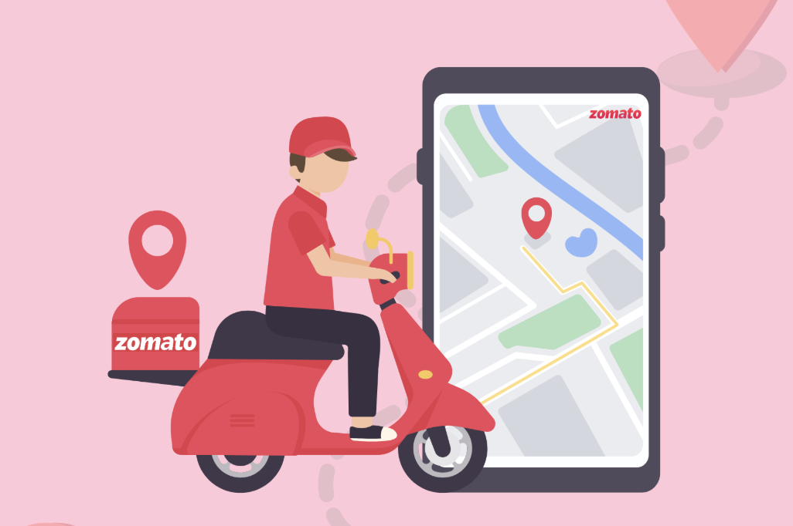

Spreadsheet Project
Zomato Restaurant
Analysis
A Data-driven Analysis & Recommendation
Submitted By – Pratikshya Priyadarshani Patra
Date :- 09-06-2026

Slide 2
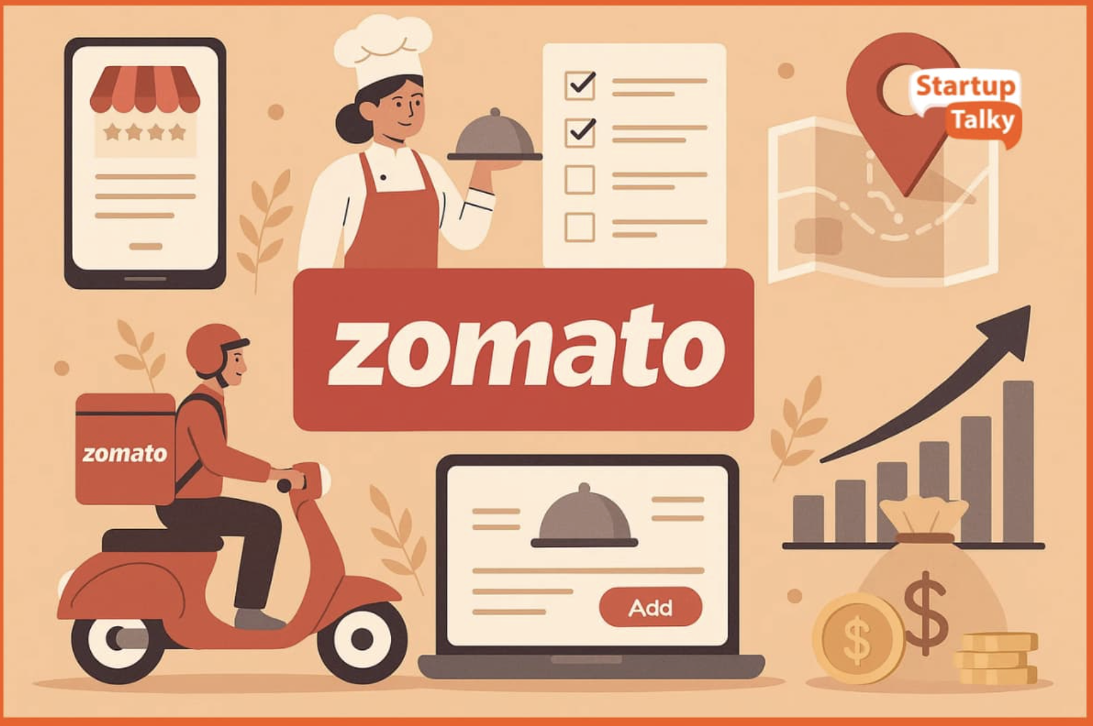
What is Zomato & how does it work?
Zomato is a highly popular and user-friendly platform that helps people discover nearby restaurants and cafés for dining out or ordering food online.
The company was founded in 2008 by Deepinder Goyal.
Zomato follows a simple and efficient working model. To enjoy a tasty meal, customers just need to follow five easy steps.
Its main purpose is to recommend local eateries and enable customers to conveniently place food orders.

Slide 3
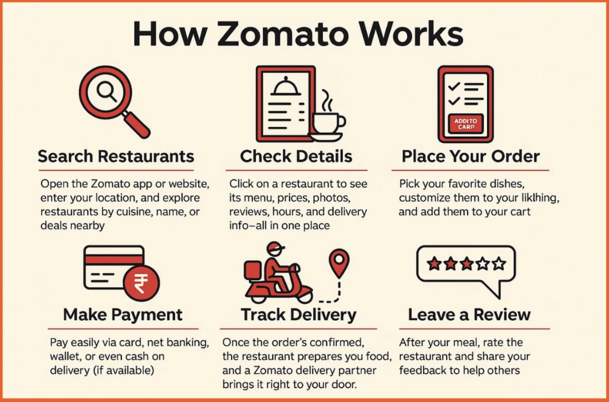
Step 1: Restaurant Discovery
:- Users browse and select restaurants through the Zomato app or website. They can explore menus, ratings, and food options before choosing a restaurant.
Step 2: Placing the Order
:- After selecting the restaurant, customers add food items to their cart, confirm the order, and make payment (online or cash on delivery).
Step 3: Restaurant Preparation
:- The restaurant receives the order and starts preparing the selected dishes.
Step 4: Delivery to Customer
:- Once the food is ready, a delivery partner picks it up and delivers it to the customer’s location.
Step 5: Payment & Feedback
:- After receiving the order, customers can complete payment (if not prepaid) and provide ratings and feedback based on their experience.

Slide 4
Zomato Project
Zomato Dataset
Contains approximately 9,000 restaurants across multiple cities
Covers 15 major cities
Includes over 100 types of cuisines
Average cost for two ranges between ₹300 and ₹2,500
Online delivery option available (Yes/No)
Table booking facility available in selected restaurants
Ratings range from 1.0 to 5.0 (based on customer feedback)
Data Cleaning & Preprocessing Performed
Removed duplicate restaurant records
Handled missing values in rating and cost columns
Standardized city and cuisine names
Converted the cost column into numeric format
Eliminated invalid or zero ratings

Slide 5
Agenda.
Problem Statement
Objects Of Project
Data Description & Methodology
Key Metrics & Visualisation

Slide 6

Problem Statement
Zomato aims to broaden its market reach by identifying potential strategic locations for launching new restaurants. This project applies data-driven analysis to recommend the most suitable areas for expansion, considering key factors such as customer ratings, pricing levels, number of votes, and popular cuisines.

Slide 7
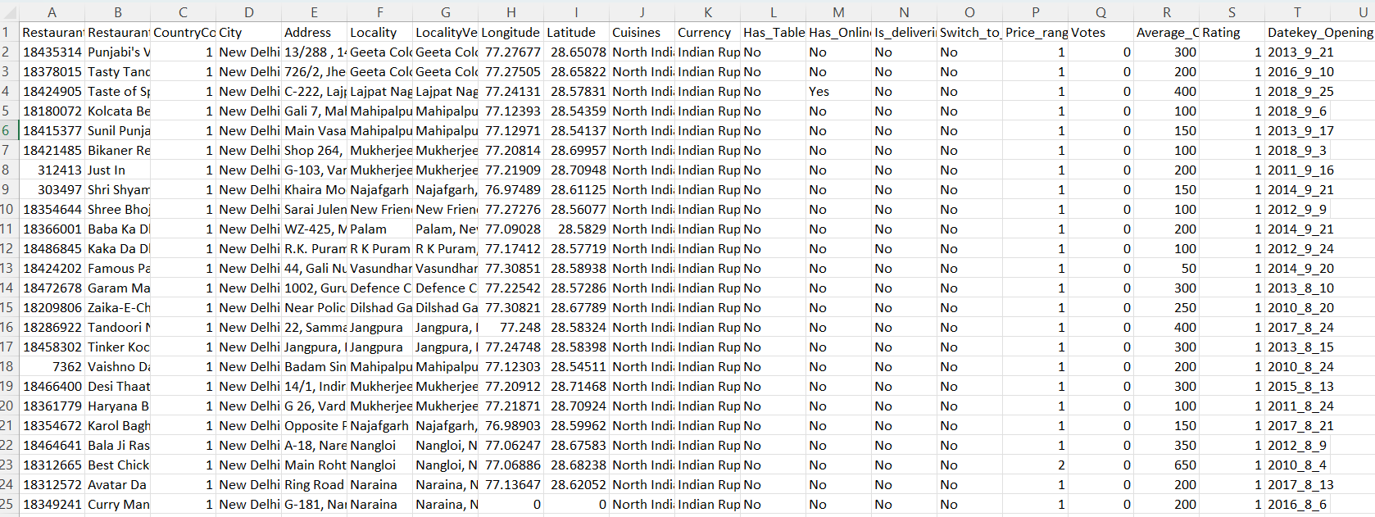

You are hired as a consultant data analyst by Zomato where the team is looking for expansion and opening more restaurants. Your task is to develop strategies/suggestions for opening newer restaurants.

Slide 8

Objective Of Project
Identify Potential Countries for Expansion.
Analyze Market Patterns and Trends.
Examine Restaurant Distribution.
Evaluate Customer Feedback and Satisfaction Levels.
Assess Pricing Strategies.
Enhance Service Delivery Through Data Insights.
Notes:
Enhance Service Delivery Through Data Insights

Slide 9
Data Overview
Restaurant ID: Unique identifier for each restaurant.
Restaurant Name: The name of the restaurant.
CountryCode: Country code of the location where the restaurant is situated.
City: The city where the restaurant is located.
Address: The specific address of the restaurant.
Locality: The locality or neighborhood where the restaurant is situated.
Locality Verbose: Detailed information about the locality.
Longitude: The geographical longitude coordinate of the restaurant.
Latitude: The geographical latitude coordinate of the restaurant.
Cuisines: The type of cuisine offered by the restaurant.
Currency: The currency used for transactions in the restaurant.
Datekey_opening: The date when the restaurant was opened.
Has_Table_booking: Indicates whether the restaurant has a table booking option (Yes/No).
Has_Online_delivery: Indicates whether the restaurant offers online delivery (Yes/No).
Is_delivering_now: Indicates whether the restaurant is currently delivering (Yes/No).
Switch_to_order_menu: Indicates whether users can switch to the order menu (Yes/No).
Price_range: A numeric value indicating the price range category of the restaurant.
Votes: The number of votes or ratings/(feedback) received by the restaurant.
Average_Cost_for_two: The average cost for two people dining at the restaurant.
Rating: The overall rating of the restaurant is based on user reviews.

Slide 10
Data Snapshot
Total Restaurants | 9552
Total Countries | 16
Total Cities | 140
Total cuisines | 1819
Service offered | Online Booking, Table Booking
Average Rating | 2.89
Average price in INR | ₹903

Slide 11
Methodology
Data Cleaning
Resolved missing values in the Cuisines column to ensure data accuracy and consistency.
Removed irrelevant and redundant columns to streamline the dataset for analysis.
Data Enrichment
Augmented the dataset by adding country names using the VLOOKUP function based on the country code.
Extracted the year from the Date Key Opening field using text functions to enable time-based trend analysis.
Descriptive Analysis
Utilized Pivot Tables and Pivot Charts to perform dynamic data summarization and visualization, generating clear, structured, and actionable insights.

Slide 12
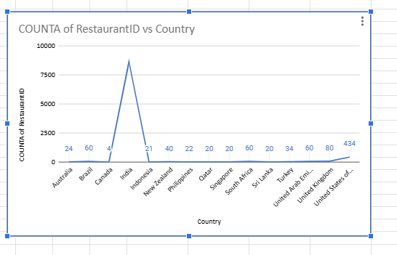
Key Metrics and Visualization
Count of Restaurants:
Computed the total number of restaurants in each country to understand market presence and distribution.
Presented the findings using charts and visualizations to make the insights more clear and easy to interpret.
Based on the analysis, identified Brazil, Sri Lanka, Canada, and Australia as potential markets with strong opportunities for opening new restaurants.

Slide 13
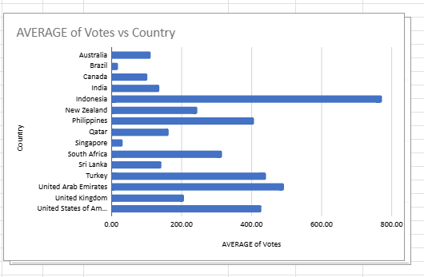
Average number of Voters in each country:
Calculated the average number of voters per restaurant for each country to enable a meaningful comparative analysis of customer engagement levels.
Analyzed voter proportions across countries, as a higher average number of voters indicates stronger customer interaction and platform engagement.
From the chart analysis, countries such as Indonesia, UAE, and Turkey demonstrated a significant proportion of voter activity, suggesting higher customer participation in these markets.

Slide 14
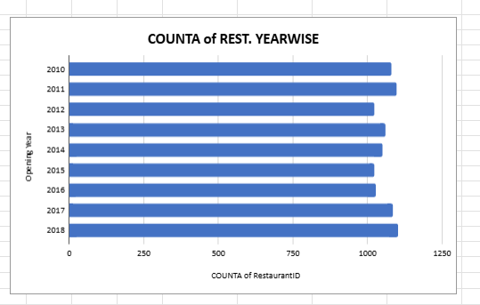
Restaurants opened each year:
An increase in the number of restaurants indicates stronger consumer participation and market activity.
Based on the chart analysis, the years 2011, 2017, and 2018 recorded a notably higher number of restaurant openings, reflecting heightened customer engagement during these periods.

Slide 15
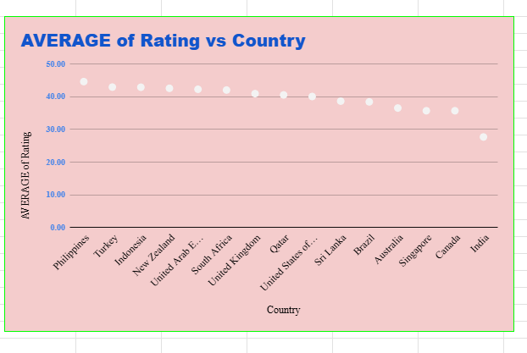
Average Rating of Restaurants in each Country:
Analyzing restaurant ratings is essential for designing effective marketing strategies and evaluating overall business performance.
Countries such as the Philippines and Turkey have higher average ratings, indicating strong market demand and positive customer satisfaction levels.
In contrast, Canada and Singapore show comparatively lower ratings, highlighting the need for service improvements and strategic adjustments.

Slide 16
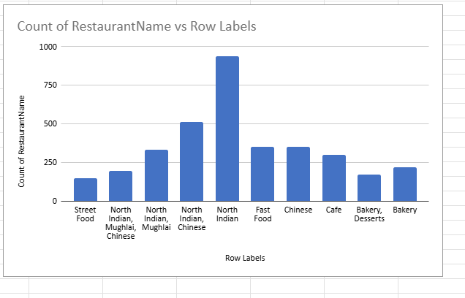
Top 10 Cuisines:
North Indian and Chinese cuisines are the most
preferred among customers.
The analysis indicates that North Indian and
Chinese cuisines dominate in popularity.
North Indian and Chinese cuisinese
merge as the leading choices based on customer
preference data.

Slide 17
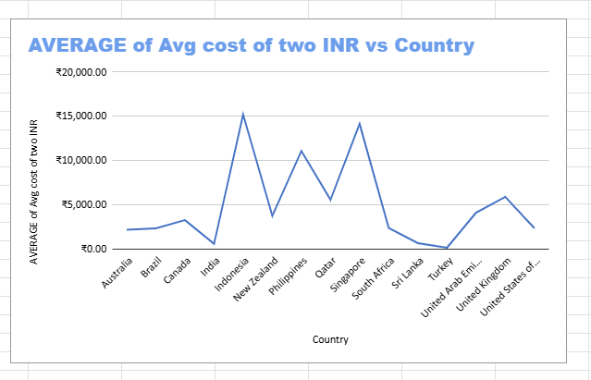
Average cost of two INR:
Singapore has the highest average dining cost, making it the most expensive market among the countries analyzed.
India and the UAE rank among the most affordable markets, offering comparatively lower average dining expenses.
Only Singapore and the Philippines surpass the specified pricing threshold, indicating relatively premium cost levels in these countries.
The United Kingdom’s average dining cost is more than twice that of the United States, reflecting substantial pricing differences even between major developed markets.

Slide 18
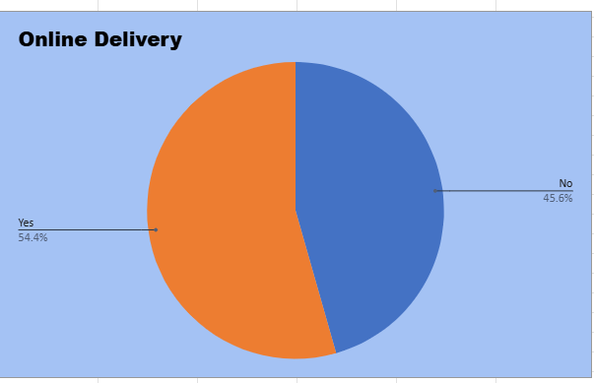
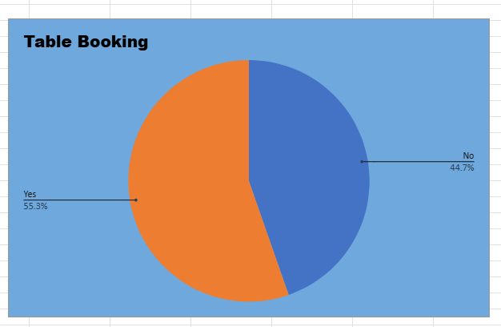
Delivery and Table Booking Analysis:
Restaurants that provide online delivery and table booking tend to have marginally higher average ratings.
Maintaining an online presence helps attract a wider customer base, which can positively influence overall ratings.
To enhance customer satisfaction and improve ratings, new restaurants should consider offering at least one of these services—preferably both table booking and online delivery.

Slide 19
Recommendations:
Concentrate on launching new restaurants in countries that show strong growth potential along with a balanced competitive landscape.
Give preference to markets with a lower number of existing restaurants, as this allows for smoother market entry and reduced competitive pressure.
Leverage restaurant density analysis to identify high-growth areas and strategically important customer locations.
Assess key competitors to develop clear differentiation strategies for new outlets.
Analyze customer feedback and sentiment to uncover improvement opportunities.
Focus on delivering high-quality food at competitive pricing to attract and retain customers.
Adopt online delivery and table booking systems to enhance customer satisfaction and improve overall ratings.

Slide 20
Conclusion:
Market Prioritization
Identify and shortlist countries with high average ratings and lower restaurant density to ensure better entry opportunities.
City-Level Analysis
Focus on high-performing cities within target countries (such as Sri Lanka and Indonesia) based on ratings, demand, and growth indicators.
Cuisine Strategy Development
Offer top-performing cuisines—North Indian, Chinese, Fast Food, Café, Bakery, Desserts, and Street Food—to align with customer preferences.
Competitive Positioning
Analyze existing competitors to create a differentiated value proposition in terms of quality, pricing, and service.
Customer-Centric Operations
Ensure high food quality, competitive pricing, and strong digital presence (online delivery and table booking) to maximize satisfaction and ratings.

Slide 21
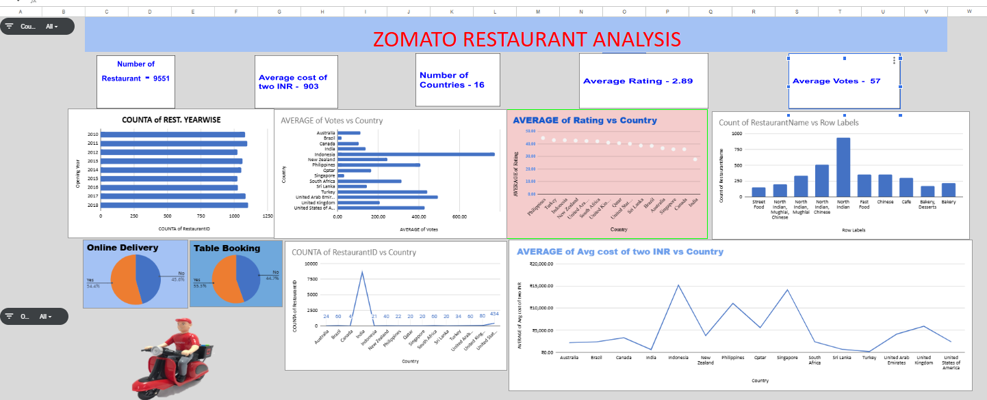

Slide 22
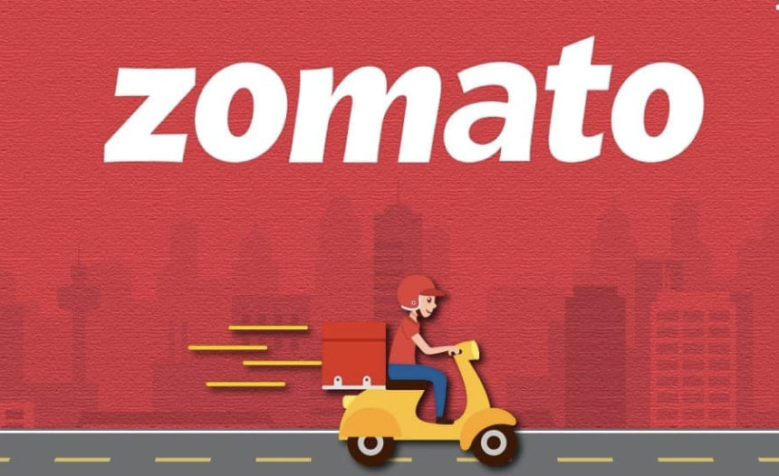
Thank You

