Slide 1
JMeter and LoadRunner
Software Engineering – CSI5324
Pratik Siwakoti
November 28, 2022

Slide 2
Objectives
Introduction – Performance Testing
What is JMeter?
Elements of JMeter
What is LoadRunner?
LoadRunner Architecture - Components
LoadRunner Process
JMeter and LoadRunner – Differences
Demo
Questions

Slide 3
Introduction
Performance Testing
  a non-functional software testing technique that determines how the stability, speed, scalability, and responsiveness of an application holds up under a given workload
Load Testing
  process of subjecting a computer, peripheral, server, network or application to a work level approaching the limits of its specifications
Abundance of tools in the market
JMeter and LoadRunner are two of the most popular tools for performance and load testing
Performance is very important for software applications: users have many choices

Slide 4

What is JMeter?
Pure Java open-source application
It is platform independent and highly extensible
Supports protocols like HTTP, FTP, SOAP, JDBC, JMS, and more
Can create lots of virtual concurrent users to simulate a heavy load on the application for load testing
Comprehensive documentation and wide user community for support

Slide 5
Elements of JMeter
Thread Group
  basic element of the JMeter Test plan
  as said in the name Thread group is a group of threads that are executing the same scenario
Sampler
  the actual requests which are sent to the server
Listener (View Results Tree, Summary Report, Graph Results, View Results in Table)
  component that shows the results of the samples
Configuration
  Configuration Elements allow you to create defaults and variables to be used by Samplers
Assertion
  used to validate response of the request that you have sent to the server

Slide 6
Load Time, Latency, and Data Size
Load Time
  the time from just before sending the request to just after receiving the last part of the response
Latency
  the time from just before sending the request to just after receiving the first part of the response
Data Size
  Size of the data in the response in bytes

Slide 7

What is LoadRunner?
LoadRunner is a performance testing tool pioneered by Mercury in 1999
Later acquired by HP Enterprises in 2006 and then by Micro Focus in 2016
Supports multiple protocols like HTTP, FTP, Web Services and more
Leads the market with 85% market share in current assessments

Slide 8
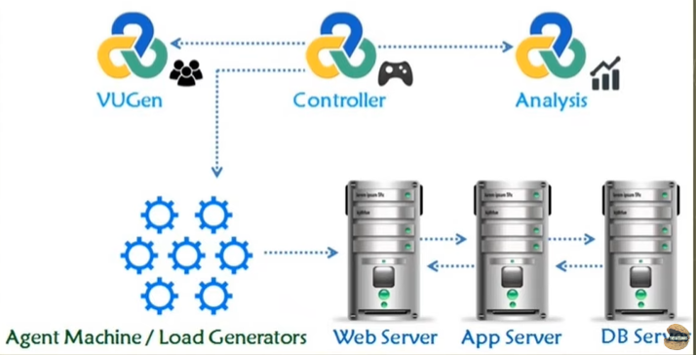
LoadRunner Architecture - Component
Virtual User Generator
  used to replicate System Under Load (SUL) behavior
  provides a recording feature which records communication to and from client and Server in form of a coded script
  Transaction defines the end-to-end measurement of time when one or more steps are completed
Controller
  component which controls the Load simulation
  manages the VUsers to simulate against each business process
  also manages the Group Behavior of VUsers (ramp up, ramp down, simultaneous or concurrent nature) and nature of Load scenario e.g. Real Life or Goal Oriented or verifying SLA
Analysis
  Component that lets us analyze the results using graphs and metrics
Agent Machine/ Load Generator
  Load generators are the machines that run the Vuser scripts in your scenarios

Slide 9
LoadRunner Process
VuGen (Scripts)
Controller (Scenario)
Analysis (session)

Slide 10

JMeter and LoadRunner- Differences
JMeter | LoadRunner
Open source software - easy to install and use | Not open source - users have to buy Some free versions like the community edition are available
User interface is less proficient and has fewer features compared to LoadRunner software | LoadRunner is technically more proficient and comes with more features with high development compared to JMeter
JMeter can generate more load. Max = 300 | Load generated by Load Runner is limited. Max = 50
We can customize function since it is open source | We cannot customize the function since it is not open source

Slide 11
Demo

Slide 12
Questions?
Thank You

