Slide 1
Wine Quality Prediction
ChatGPT for Data Science and Machine Learning

Slide 2
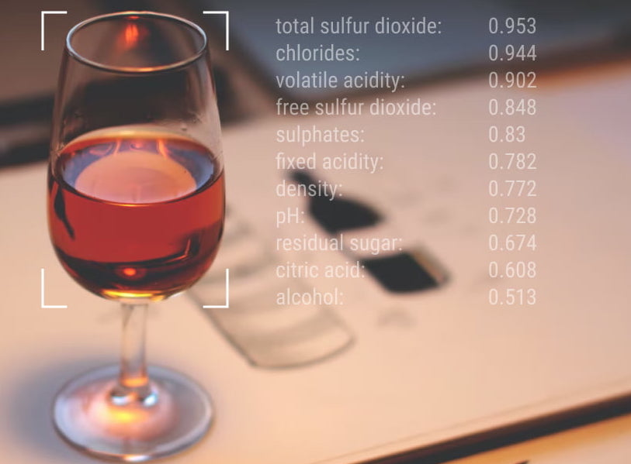

Slide 3
Dataset features
Citric Acid
Residual Sugar
Density
pH
Alcohol
Fixed Acidity
Volatile Acidity
Chlorides
Sulphur Dioxide
Quality

Slide 4
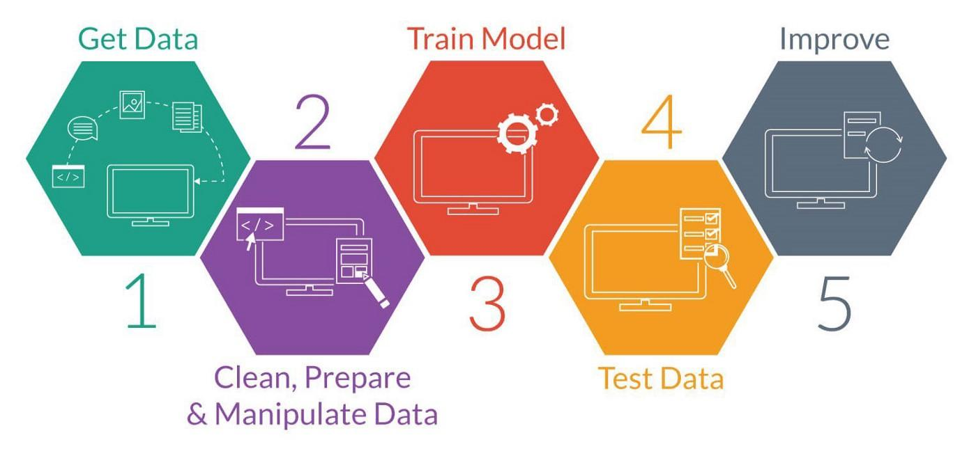
Project Workflow

Slide 5
Lets start the coding part

