Slide 1




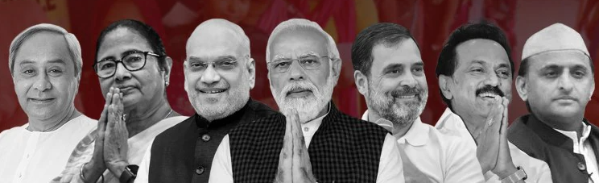

DATA ANALYSIS
SQL PROJECT
SQL Server
Management Studio(SSMS)
INDIA GENERAL ELECTIONS RESULT ANALYSIS 2024
PRESENTED BY: PRATIK TAMGADGE

Slide 2
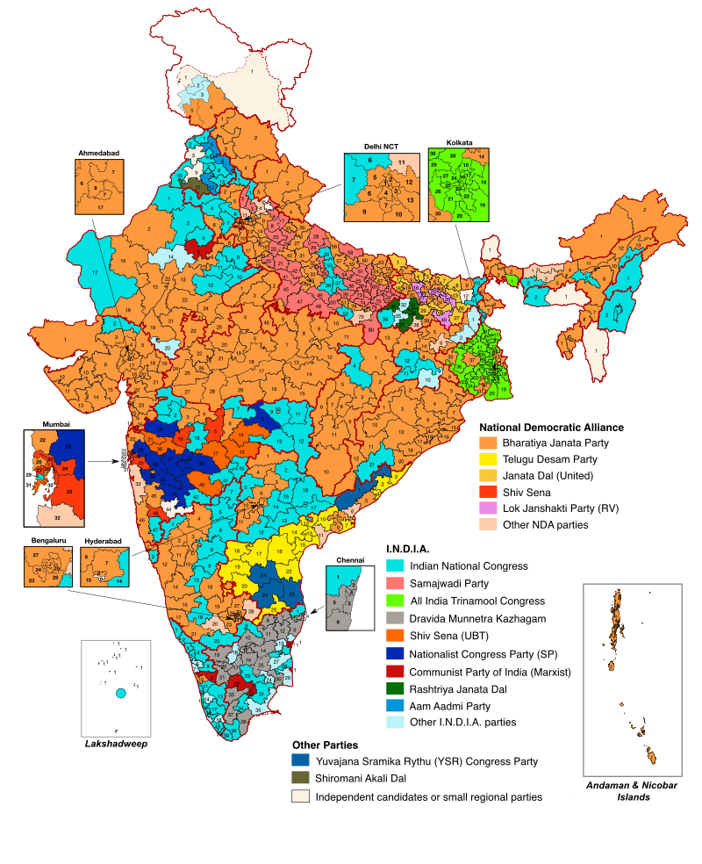
INDIA GENERAL ELECTIONS RESULT ANALYSIS 2024
The 2024 Indian general elections were held from 19 April to 1 June to elect 543 members of the Lok Sabha. Over 968 million people were eligible to vote, and 642 million participated, making it the largest election in history. The Bharatiya Janata Party (BJP), led by Prime Minister Narendra Modi, won 240 seats, losing its singular majority but securing a third consecutive term through the National Democratic Alliance (NDA) coalition. The opposition, the Indian National Developmental Inclusive Alliance (INDIA), secured 234 seats, exceeding expectations. This marked the highest-ever participation by women voters, with 312 million women casting votes.

Slide 3
PROBLEM STATEMENT:
1.Total Seats
2.What are the total number of seats available for elections in each state
3.Total Seats Won by NDA Alliance
4.Seats Won by NDA Alliance Parties
5.Total Seats Won by I.N.D.I.A, Alliance
6.Seats Won by I.N.D.I.A. Alliance Parties
7.Add new column field in table partywise_results to get the Party Allianz as NDA, I.N.D.I.A and OTHER
8.Which party alliance (NDA, I.N.D.I.A, or OTHER) won the most seats across all states?
9.Winning candidate's name, their party name, total votes, and the margin of victory for a specific state and constituency?
10.What is the distribution of EVM votes versus postal votes for candidates in a specific constituency?

Slide 4
PROBLEM STATEMENT:
11.Which parties won the most seats in a State, and how many seats did each party win?
12.What is the total number won by each party alliance (NDA, I.N D.i.A, and OTHER) in each state for the India Elections 2024?
13.Which candidate received the highest number of EVM votes in each constituency (Top 10)?
14.Which candidate won and which candidate was the runner-up in each constituency of State for the 2024 elections?
15.For the state of Odisha, what are the total number of seats, total number of candidates, total number of parties, total votes (including EVM and postal), and the breakdown of EVM and postal votes?

Slide 5
KEY SQL FUNCTIONALITIES YOU WILL LEARN:
DISTINCT
ON
SELECT
ALTER TABLE
COUNT()
ORDER BY
PARTITION BY
ADD
SUM()
GROUP BY
OVER()
SET
MAX()
WITH
WHERE
CASE
ROW_NUMBER
UPDATE
THEN
JOIN

Slide 6
KEY SQL FUNCTIONALITIES YOU WILL LEARN:
ELSE
RANK
SCHEMAS
MULTITABLE JOINS
HAVING
DATE FUNCTIONS
IFF()
AVG()
WINDOW()
INNER JOIN
CAST()
LEFT JOIN
WITH
CTE

Slide 7
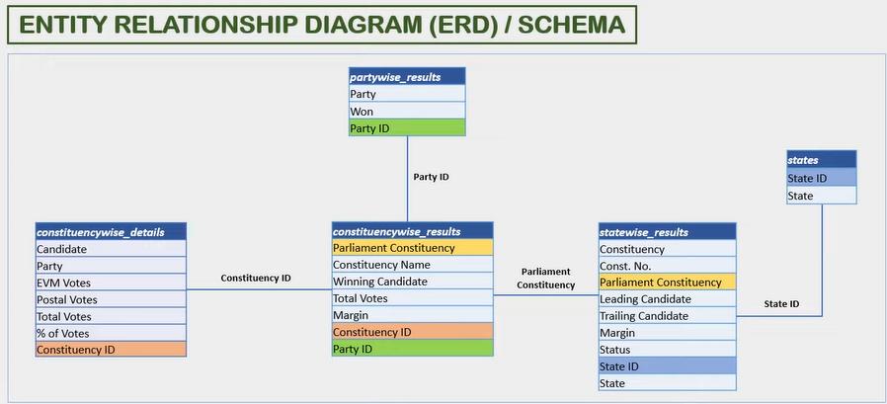
INDIA GENERAL ELECTIONS RESULT ANALYSIS 2024

Slide 8

1.Total Seats
1.Total Seats
SELECT
DISTINCT COUNT (Parliament_Constituency) AS Total_Seats
FROM constituencywise_results

Slide 9
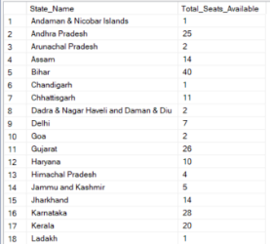
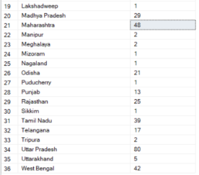
2.What is the total number of seats available for elections in each state
1.Total Seats
SELECT
s.State AS State_Name,
COUNT(cr.Constituency_ID) AS Total_Seats_Available
FROM
constituencywise_results cr
JOIN
statewise_results sr ON cr.Parliament_Constituency = sr.Parliament_Constituency
JOIN
states s ON sr.State_ID = s.State_ID
GROUP BY
s.State
ORDER BY
s.State;

Slide 10

3.Total Seats Won by NDA Allianz
1.Total Seats
SELECT
SUM(CASE
WHEN party IN (
'Bharatiya Janata Party - BJP',
'Telugu Desam - TDP',
'Janata Dal (United) - JD(U)',
'Shiv Sena - SHS',
'AJSU Party - AJSUP',
'Apna Dal (Soneylal) - ADAL',
'Asom Gana Parishad - AGP',
'Hindustani Awam Morcha (Secular) - HAMS',
'Janasena Party - JnP',
'Janata Dal (Secular) - JD(S)',
'Lok Janshakti Party(Ram Vilas) - LJPRV',
'Nationalist Congress Party - NCP',
'Rashtriya Lok Dal - RLD',
'Sikkim Krantikari Morcha - SKM'
) THEN [Won]
ELSE 0
END) AS NDA_Total_Seats_Won
FROM
partywise_results

Slide 11
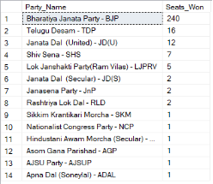
4.Seats Won by NDA Allianz Parties
1.Total Seats
SELECT
party as Party_Name,
won as Seats_Won
FROM
partywise_results
WHERE
party IN (
'Bharatiya Janata Party - BJP',
'Telugu Desam - TDP',
'Janata Dal (United) - JD(U)',
'Shiv Sena - SHS',
'AJSU Party - AJSUP',
'Apna Dal (Soneylal) - ADAL',
'Asom Gana Parishad - AGP',
'Hindustani Awam Morcha (Secular) - HAMS',
'Janasena Party - JnP',
'Janata Dal (Secular) - JD(S)',
'Lok Janshakti Party(Ram Vilas) - LJPRV',
'Nationalist Congress Party - NCP',
'Rashtriya Lok Dal - RLD',
'Sikkim Krantikari Morcha - SKM'
)
ORDER BY Seats_Won DESC

Slide 12

5.Total Seats Won by I.N.D.I.A. Allianz
SELECT
SUM(CASE
WHEN party IN (
'Indian National Congress - INC',
'Aam Aadmi Party - AAAP',
'All India Trinamool Congress - AITC',
'Bharat Adivasi Party - BHRTADVSIP',
'Communist Party of India (Marxist) - CPI(M)',
'Communist Party of India (Marxist-Leninist) (Liberation) - CPI(ML)(L)',
'Communist Party of India - CPI',
'Dravida Munnetra Kazhagam - DMK',
'Indian Union Muslim League - IUML',
'Nat`Jammu & Kashmir National Conference - JKN',
'Jharkhand Mukti Morcha - JMM',
'Jammu & Kashmir National Conference - JKN',
'Kerala Congress - KEC',
'Marumalarchi Dravida Munnetra Kazhagam - MDMK',
'Nationalist Congress Party Sharadchandra Pawar - NCPSP',
'Rashtriya Janata Dal - RJD',
'Rashtriya Loktantrik Party - RLTP',
'Revolutionary Socialist Party - RSP',
'Samajwadi Party - SP',
'Shiv Sena (Uddhav Balasaheb Thackrey) - SHSUBT',
'Viduthalai Chiruthaigal Katchi - VCK'
) THEN [Won]
ELSE 0
END) AS INDIA_Total_Seats_Won
FROM
partywise_results
'
1.Total Seats

Slide 13
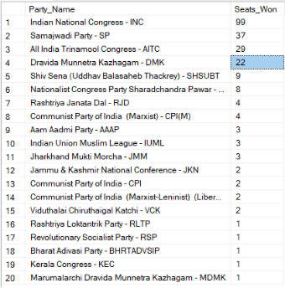
6.Seats Won by I.N.D.I.A. Allianz Parties
1.Total Seats
SELECT
party as Party_Name,
won as Seats_Won
FROM
partywise_results
WHERE
party IN (
'Indian National Congress - INC',
'Aam Aadmi Party - AAAP',
'All India Trinamool Congress - AITC',
'Bharat Adivasi Party - BHRTADVSIP',
'Communist Party of India (Marxist) - CPI(M)',
'Communist Party of India (Marxist-Leninist) (Liberation) - CPI(ML)(L)',
'Communist Party of India - CPI',
'Dravida Munnetra Kazhagam - DMK',
'Indian Union Muslim League - IUML',
'Nat`Jammu & Kashmir National Conference - JKN',
'Jharkhand Mukti Morcha - JMM',
'Jammu & Kashmir National Conference - JKN',
'Kerala Congress - KEC',
'Marumalarchi Dravida Munnetra Kazhagam - MDMK',
'Nationalist Congress Party Sharadchandra Pawar - NCPSP',
'Rashtriya Janata Dal - RJD',
'Rashtriya Loktantrik Party - RLTP',
'Revolutionary Socialist Party - RSP',
'Samajwadi Party - SP',
'Shiv Sena (Uddhav Balasaheb Thackrey) - SHSUBT',
'Viduthalai Chiruthaigal Katchi - VCK'
)
ORDER BY Seats_Won DESC
'

Slide 14
7.Add new column field in table partywise_results to get the Party Allianz as NDA, I.N.D.I.A and OTHER
1.Total Seats
ALTER TABLE partywise_results
ADD party_alliance VARCHAR(50);
I.N.D.I.A Allianz
UPDATE partywise_results
SET party_alliance = 'I.N.D.I.A'
WHERE party IN (
'Indian National Congress - INC',
'Aam Aadmi Party - AAAP',
'All India Trinamool Congress - AITC',
'Bharat Adivasi Party - BHRTADVSIP',
'Communist Party of India (Marxist) - CPI(M)',
'Communist Party of India (Marxist-Leninist) (Liberation) - CPI(ML)(L)',
'Communist Party of India - CPI',
'Dravida Munnetra Kazhagam - DMK',
'Indian Union Muslim League - IUML',
'Jammu & Kashmir National Conference - JKN',
'Jharkhand Mukti Morcha - JMM',
'Kerala Congress - KEC',
'Marumalarchi Dravida Munnetra Kazhagam - MDMK',
'Nationalist Congress Party Sharadchandra Pawar - NCPSP',
'Rashtriya Janata Dal - RJD',
'Rashtriya Loktantrik Party - RLTP',
'Revolutionary Socialist Party - RSP',
'Samajwadi Party - SP',
'Shiv Sena (Uddhav Balasaheb Thackrey) - SHSUBT',
'Viduthalai Chiruthaigal Katchi - VCK'
);
'
NDA Allianz
UPDATE partywise_results
SET party_alliance = 'NDA'
WHERE party IN (
'Bharatiya Janata Party - BJP',
'Telugu Desam - TDP',
'Janata Dal (United) - JD(U)',
'Shiv Sena - SHS',
'AJSU Party - AJSUP',
'Apna Dal (Soneylal) - ADAL',
'Asom Gana Parishad - AGP',
'Hindustani Awam Morcha (Secular) - HAMS',
'Janasena Party - JnP',
'Janata Dal (Secular) - JD(S)',
'Lok Janshakti Party(Ram Vilas) - LJPRV',
'Nationalist Congress Party - NCP',
'Rashtriya Lok Dal - RLD',
'Sikkim Krantikari Morcha - SKM'
);
OTHER
UPDATE partywise_results
SET party_alliance = 'OTHER'
WHERE party_alliance IS NULL;

Slide 15

8.Which party alliance (NDA, I.N.D.I.A, or OTHER) won the most seats across all states?
SELECT
p.party_alliance,
COUNT(cr.Constituency_ID) AS Seats_Won
FROM
constituencywise_results cr
JOIN
partywise_results p ON cr.Party_ID = p.Party_ID
WHERE
p.party_alliance IN ('NDA', 'I.N.D.I.A', 'OTHER')
GROUP BY
p.party_alliance
ORDER BY
Seats_Won DESC;

Slide 16
9.Winning candidate's name, their party name, total votes, and the margin of victory for a specific state and constituency?
SELECT cr.Winning_Candidate, p.Party, p.party_alliance, cr.Total_Votes, cr.Margin, cr.Constituency_Name, s.State
FROM constituencywise_results cr
JOIN partywise_results p ON cr.Party_ID = p.Party_ID
JOIN statewise_results sr ON cr.Parliament_Constituency = sr.Parliament_Constituency
JOIN states s ON sr.State_ID = s.State_ID
WHERE s.State = 'Uttar Pradesh' AND cr.Constituency_Name = 'AMETHI';

Slide 17
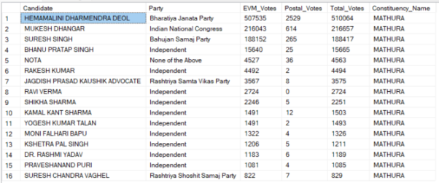
10.What is the distribution of EVM votes versus postal votes for candidates in a specific constituency?
SELECT
cd.Candidate,
cd.Party,
cd.EVM_Votes,
cd.Postal_Votes,
cd.Total_Votes,
cr.Constituency_Name
FROM
constituencywise_details cd
JOIN
constituencywise_results cr ON cd.Constituency_ID = cr.Constituency_ID
WHERE
cr.Constituency_Name = 'MATHURA'
ORDER BY cd.Total_Votes DESC;

Slide 18
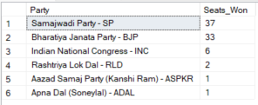
11.Which parties won the most seats in s State, and how many seats did each party win?
SELECT
p.Party,
COUNT(cr.Constituency_ID) AS Seats_Won
FROM
constituencywise_results cr
JOIN
partywise_results p ON cr.Party_ID = p.Party_ID
JOIN
statewise_results sr ON cr.Parliament_Constituency = sr.Parliament_Constituency
JOIN states s ON sr.State_ID = s.State_ID
WHERE
s.state = 'Andhra Pradesh'
GROUP BY
p.Party
ORDER BY
Seats_Won DESC;

Slide 19
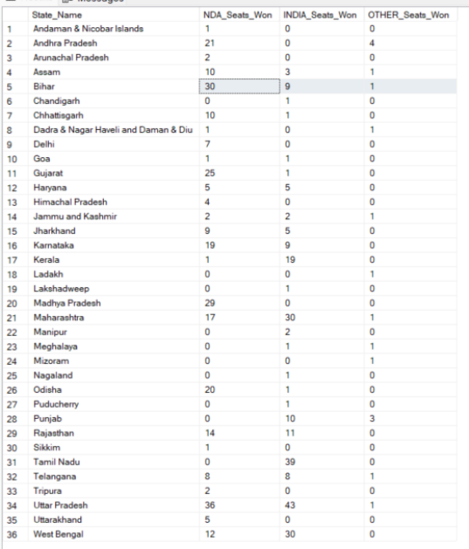
12.What is the total number of seats won by each party alliance (NDA, I.N.D.I.A, and OTHER) in each state for the India Elections 2024
SELECT
s.State AS State_Name,
SUM(CASE WHEN p.party_alliance = 'NDA' THEN 1 ELSE 0 END) AS NDA_Seats_Won,
SUM(CASE WHEN p.party_alliance = 'I.N.D.I.A' THEN 1 ELSE 0 END) AS INDIA_Seats_Won,
SUM(CASE WHEN p.party_alliance = 'OTHER' THEN 1 ELSE 0 END) AS OTHER_Seats_Won
FROM
constituencywise_results cr
JOIN
partywise_results p ON cr.Party_ID = p.Party_ID
JOIN
statewise_results sr ON cr.Parliament_Constituency = sr.Parliament_Constituency
JOIN
states s ON sr.State_ID = s.State_ID
WHERE
p.party_alliance IN ('NDA', 'I.N.D.I.A', 'OTHER') -- Filter for NDA and INDIA alliances
GROUP BY
s.State
ORDER BY
s.State;

Slide 20
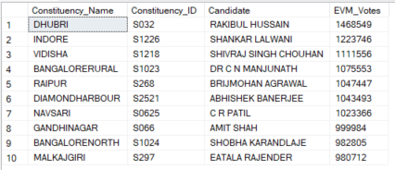
13.Which candidate received the highest number of EVM votes in each constituency (Top 10)?
SELECT TOP 10
cr.Constituency_Name,
cd.Constituency_ID,
cd.Candidate,
cd.EVM_Votes
FROM
constituencywise_details cd
JOIN
constituencywise_results cr ON cd.Constituency_ID = cr.Constituency_ID
WHERE
cd.EVM_Votes = (
SELECT MAX(cd1.EVM_Votes)
FROM constituencywise_details cd1
WHERE cd1.Constituency_ID = cd.Constituency_ID
)
ORDER BY
cd.EVM_Votes DESC;

Slide 21
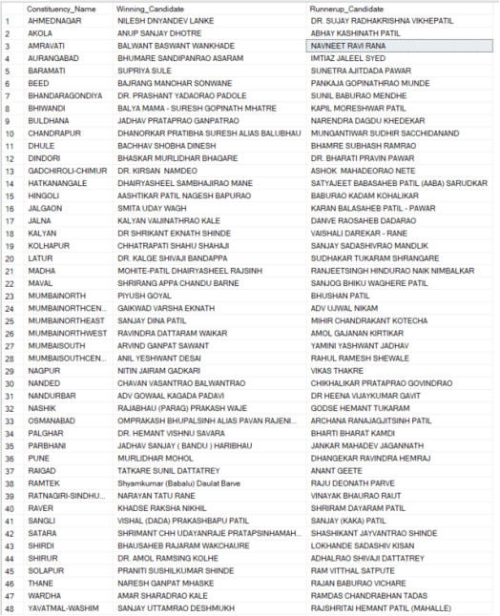
14.Which candidate won and which candidate was the runner-up in each constituency of State for the 2024 elections?
WITH RankedCandidates AS (
SELECT
cd.Constituency_ID,
cd.Candidate,
cd.Party,
cd.EVM_Votes,
cd.Postal_Votes,
cd.EVM_Votes + cd.Postal_Votes AS Total_Votes,
ROW_NUMBER() OVER (PARTITION BY cd.Constituency_ID ORDER BY cd.EVM_Votes + cd.Postal_Votes DESC) AS VoteRank
FROM
constituencywise_details cd
JOIN
constituencywise_results cr ON cd.Constituency_ID = cr.Constituency_ID
JOIN
statewise_results sr ON cr.Parliament_Constituency = sr.Parliament_Constituency
JOIN
states s ON sr.State_ID = s.State_ID
WHERE
s.State = 'Maharashtra'
)
SELECT
cr.Constituency_Name,
MAX(CASE WHEN rc.VoteRank = 1 THEN rc.Candidate END) AS Winning_Candidate,
MAX(CASE WHEN rc.VoteRank = 2 THEN rc.Candidate END) AS Runnerup_Candidate
FROM
RankedCandidates rc
JOIN
constituencywise_results cr ON rc.Constituency_ID = cr.Constituency_ID
GROUP BY
cr.Constituency_Name
ORDER BY
cr.Constituency_Name;

Slide 22
15.For the state of Maharashtra, what are the total number of seats, total number of candidates, total number of parties, total votes (including EVM and postal), and the breakdown of EVM and postal votes?
SELECT
COUNT(DISTINCT cr.Constituency_ID) AS Total_Seats,
COUNT(DISTINCT cd.Candidate) AS Total_Candidates,
COUNT(DISTINCT p.Party) AS Total_Parties,
SUM(cd.EVM_Votes + cd.Postal_Votes) AS Total_Votes,
SUM(cd.EVM_Votes) AS Total_EVM_Votes,
SUM(cd.Postal_Votes) AS Total_Postal_Votes
FROM
constituencywise_results cr
JOIN
constituencywise_details cd ON cr.Constituency_ID = cd.Constituency_ID
JOIN
statewise_results sr ON cr.Parliament_Constituency = sr.Parliament_Constituency
JOIN
states s ON sr.State_ID = s.State_ID
JOIN
partywise_results p ON cr.Party_ID = p.Party_ID
WHERE
s.State = 'Maharashtra';

Slide 23
Presented by: Pratik Tamgadge
Thank you!

