Slide 1
Gatling.io
Pratik Thorve| Pune

Slide 2
Agenda
What is Gatling ?
Gatling vs JMeter
Why Gatling
Demo

Slide 3
What is Gatling ?
Gatling is a highly capable load testing tool. It is designed for ease of use, maintainability and high performance.
Free & Paid version
Based on Scala
Scenario based (with DSL)
Excellent support for HTTP

Slide 4
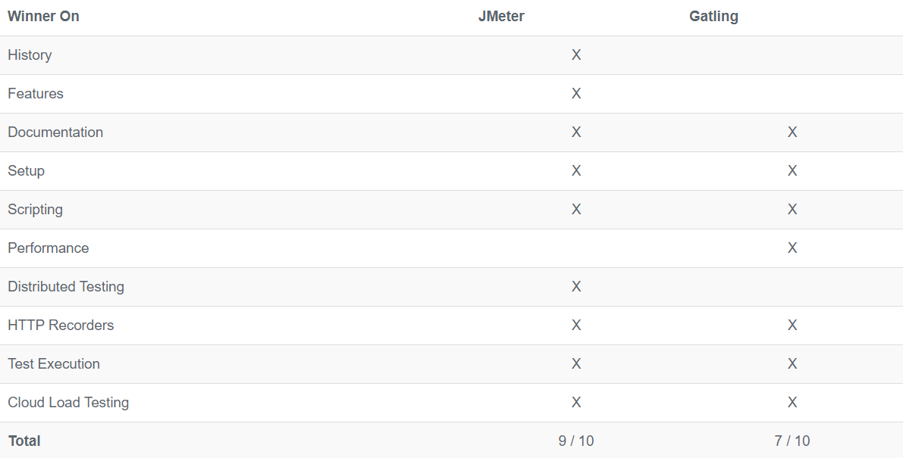
JMeter v/s Gatling

Slide 5
Why Gatling ?
Shift Left
Developer Tool
Test small test early
Performance !!! (Hardware)

Slide 6
Demo

