Slide 1
Concept manuscript meeting
Working title:
Individual space-use in the context of the social environment, the resource landscape, and a fluctuating physical environment

Slide 2
Outline
Why this presentation
What I have
  Outline of the patch method
  Outline of the cluster method
What may be interesting
  Concept of this study
How you could help

Slide 3
Why this presentation
I have a method to extract interesting data
I have some ideas
I don’t know whether the ideas are interesting

Slide 4
What I have
The residence patch method
  Identifies ‘residence patches’ (foraging/resting) from ATLAS data using 4 parameters
  Handles edge cases unique to WATLAS
The network cluster method
  Identifies clusters of spatially proximate residence patches

Slide 5
What may be interesting
Study individual behaviour with most major drivers accounted for:
  Physical environment (tidal cycle, weather)
  Resource landscape (SIBES)
  Social environment (flock size, composition)
  Intrinsic drivers (physiology, personality)
  Missing: Predation risk

Slide 6
Concepts in this study
None so far

Slide 7
The residence patch method
Why this method
What are the pre-conditions
How it works
What it makes

Slide 8
Residence patch method: Why?
We want to infer behaviour from movement
  Binary: resident (foraging/roosting) vs moving
WATLAS data:
  Are very large (~20 million positions)
  Have lots of error
This poses a problem for conventional methods
  MoveHMM (too slow)
  Segclust2d [Lavielle segmentation] (affected by error)
  K-means clustering (too rigid)

Slide 9
Residence patch method: What?
Preconditions:
  Coordinates (x, y, time)
  Supplementary data (water level, time since high tide)
Water level & time since high tide
  Uses water level data from West Terschelling
  Calculates sequence of high tides (Troy and Hill, 2014)
  Assigns water level and time since high tide to position data

Slide 10
Residence patch method: What?
Preconditions:
  Coordinates (x, y, time)
  Discriminating column (residence time)
Residence time:
  Following Bracis et al. (2018)
  Duration within D distance of a position, not counting repeated visits (eg. during high tide)

Slide 11
Residence patch method: How?
Infer residence points from missing data
Identify residence patches per tidal cycle
Repair high tide residence patches

Slide 12
Inferring residence patches
Gaps in the data may represent birds on the mudflats
  Localisation is better in flight
Gather the gaps and identify where the distance is not proportional to time
Assign these ‘inferred residence patches’

Slide 13
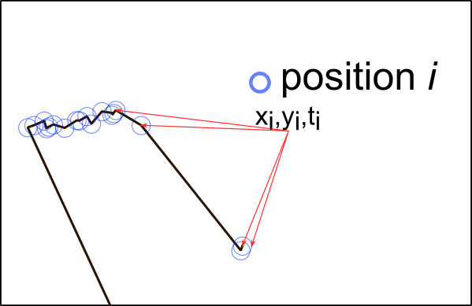
Identifying residence patches
Start with a sequence of positions
  X, Y, time

Slide 14
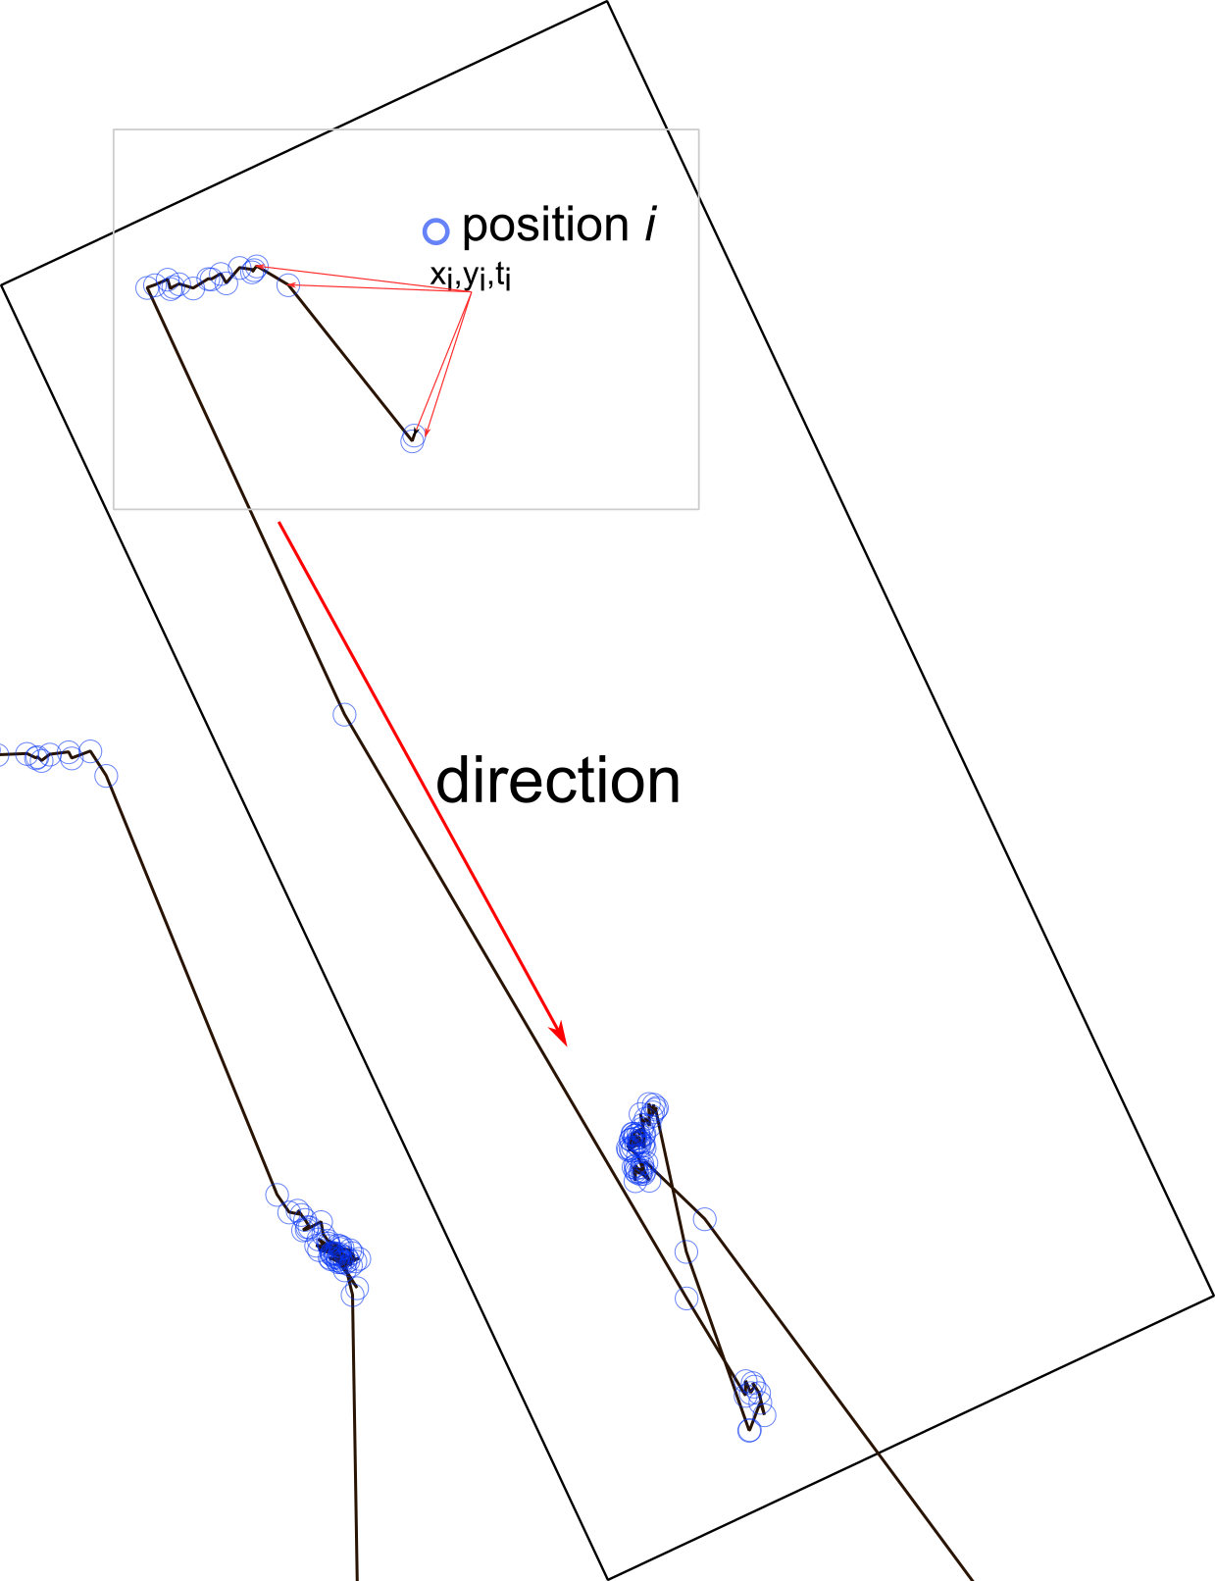
Start with a sequence of positions
  X, Y, time
Individual trajectory apparent to human eye

Slide 15
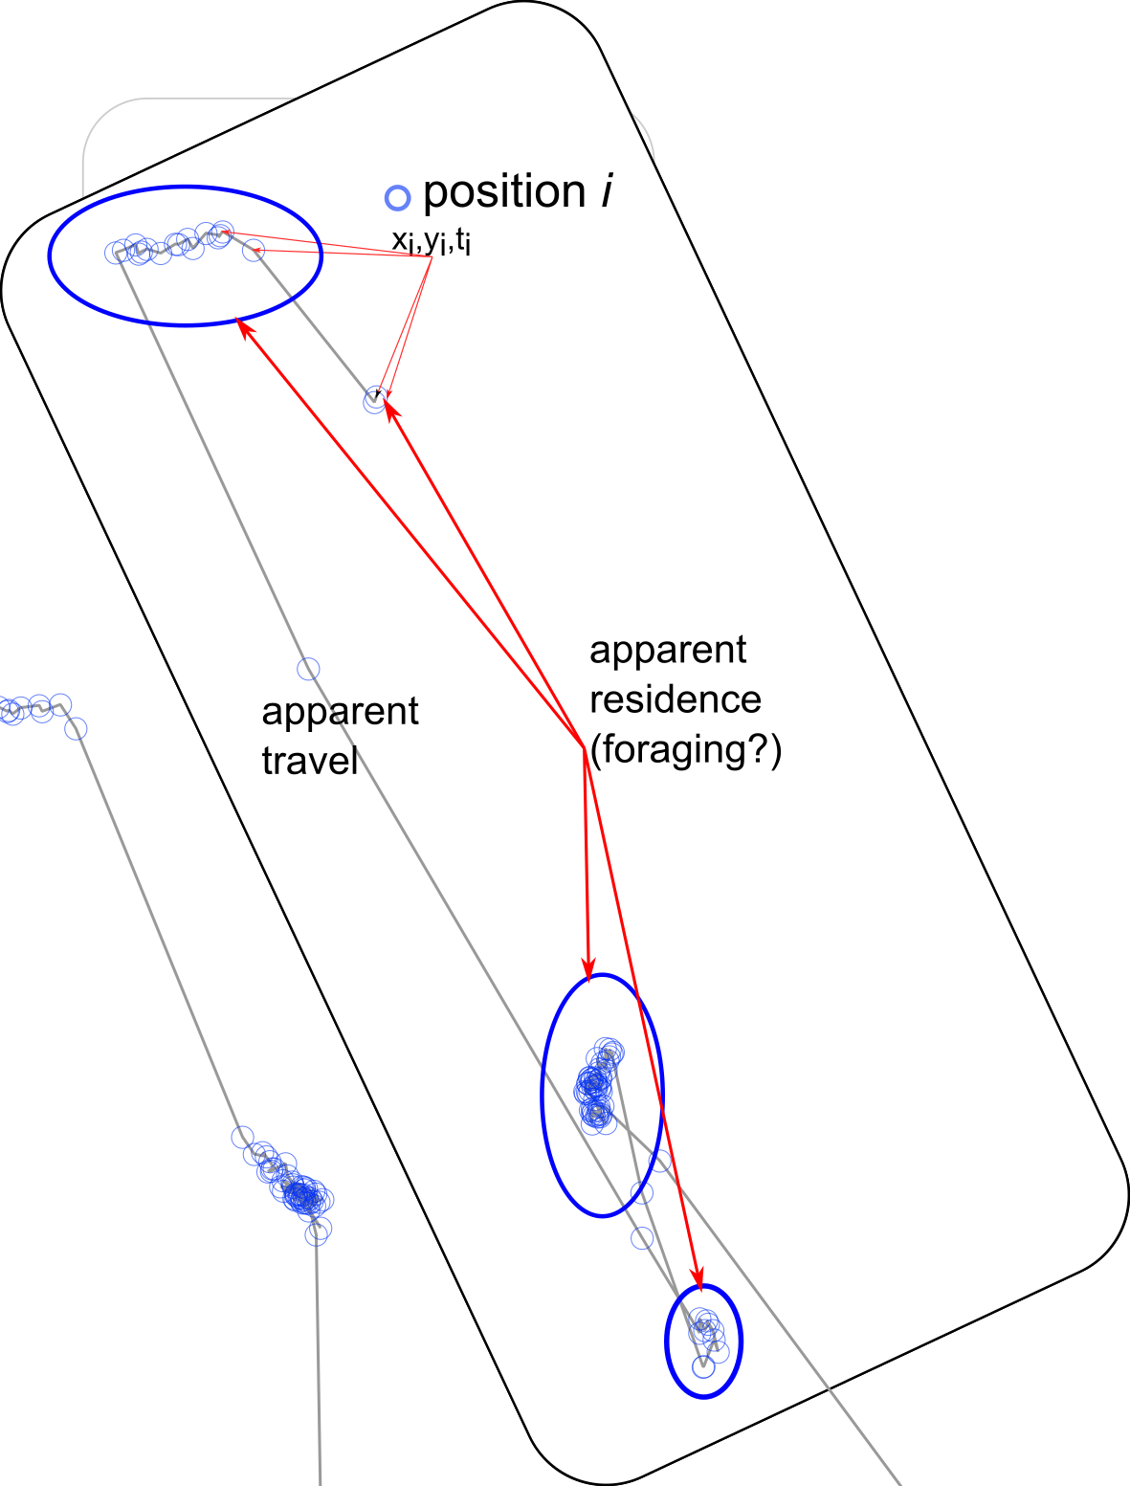
Positions clustered together may represent residence
Positions far apart may represent travel

Slide 16
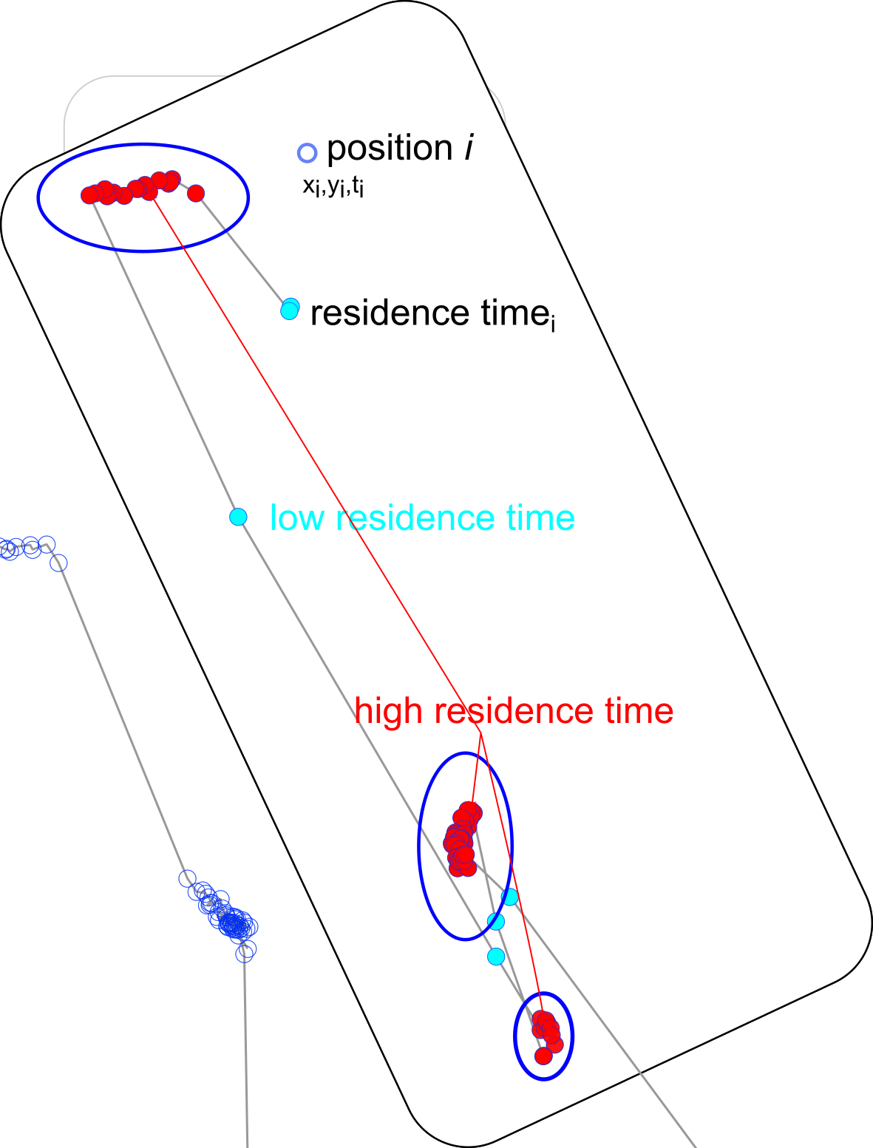
Residence vs travel
Identify positions with residence time > cutoff
Helps delineate patches
Patch = cluster of residence positions

Slide 17
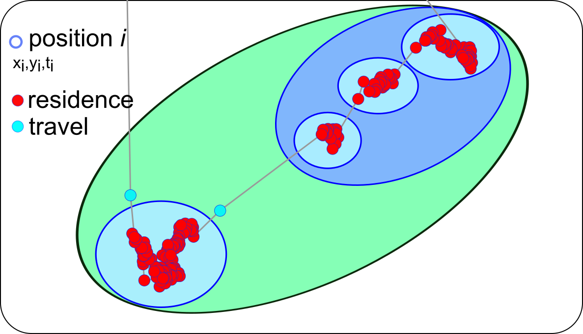
Splitting and lumping patches
Some clusters may appear obvious to humans
Computers need rules to choose between options

Slide 18
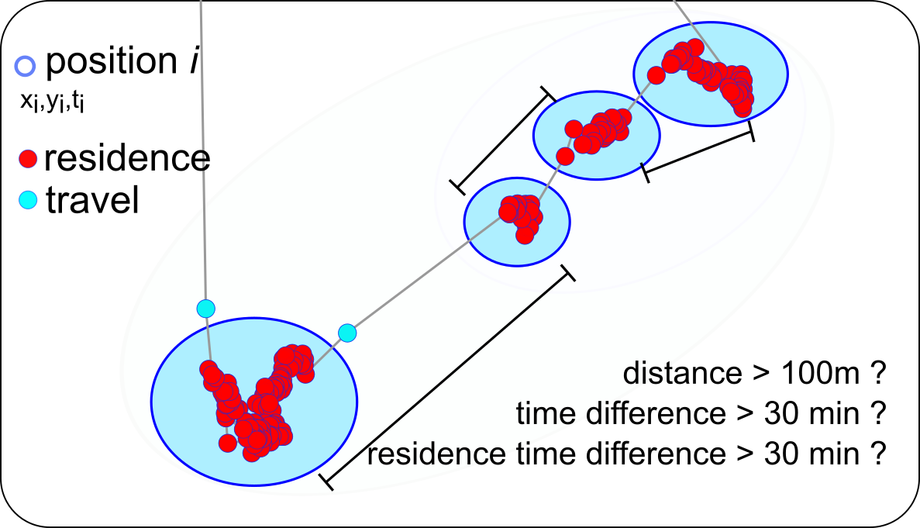
For each ‘proto-patch’, determine independence from previous proto-patch
Independence:
  Proto-patches > 100 m apart
  Time difference > 30 mins
  Difference in mean residence time > 30 mins

Slide 19
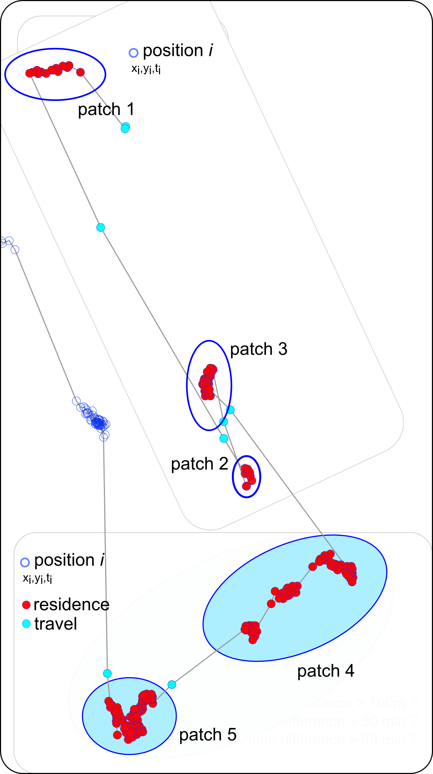
There is no correct answer
Parameters are based on expert opinion

Slide 20
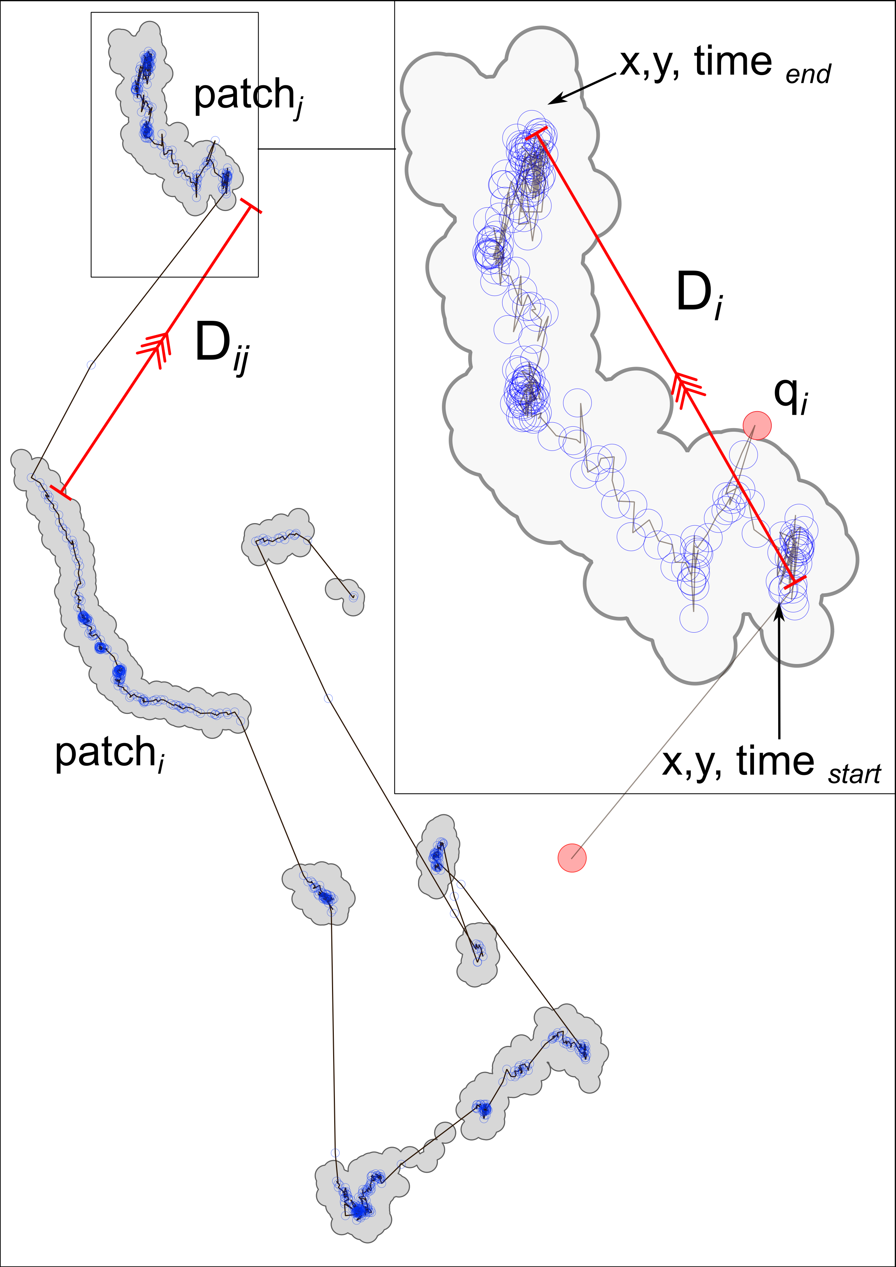
Draw 10 m buffer around each patch
Merge overlaps within a patch
Calculate patch metrics

