Slide 1

Mutual Fund Analytics Platform
Bluestock Fintech Capstone Project
End-to-End Data Engineering · ETL Pipeline · Interactive Dashboard
87K+
40+
10
6
Data Rows
MF Schemes
Datasets
Dashboard Pages
Pratik Kumar Yadav · Data Analyst Intern · June 2026

Slide 2








PROBLEM & OBJECTIVE
What Problem Are We Solving?
Fragmented Data
Project Objectives
MF data scattered across AMFI, AMC portals and SEBI filings with no unified view.
Ingest & clean 10 CSV datasets (87K+ rows) via Python ETL
No Analytics Layer
Build a normalised SQLite star-schema database
Raw NAV history gives no actionable risk-adjusted metrics like Sharpe or drawdown.
Compute CAGR, Sharpe, Sortino, Alpha, Beta, VaR & CVaR
Investor Blind Spots
Deliver a 7-page interactive Streamlit + HTML dashboard
Investor demographics, tier distribution and SIP continuity are largely unanalysed.
Enable fund comparisons with composite scoring & recommender

Slide 3
DATA SOURCES
10 Datasets · 87,000+ Rows · Jan 2022 – May 2026
01
Fund Master
06
Industry Folio Count
40 rows
21 rows
40 real MF schemes from top AMCs
Folio growth milestones data
02
NAV History
07
Scheme Performance
~46K rows
40 rows
Daily NAV Jan 2022 – May 2026
Returns, Sharpe, Alpha, Beta
03
AUM by Fund House
08
Investor Transactions
~90 rows
~32K rows
Quarterly AUM for 10 fund houses
5,000 investor transaction records
04
Monthly SIP Inflows
09
Portfolio Holdings
48 rows
~320 rows
AMFI monthly SIP data 2022-2026
Top equity holdings by fund
05
Category Inflows
10
Benchmark Indices
~144 rows
~8K rows
Net inflows by MF category
Daily Nifty 50 / 100 / BSE values

Slide 4

ARCHITECTURE
End-to-End Data Pipeline
Raw Data
ETL Pipeline
SQLite DB
Analytics
Dashboard
▶
▶
▶
▶
10 CSVs
AMFI · mfapi.in
Ingest · Clean
Validate
Star Schema
11 Tables
Metrics · EDA
Advanced
Streamlit
HTML/JS
Tech Stack:
Python 3.10+ · Pandas · NumPy · SQLite3 · SQLAlchemy · Matplotlib · Seaborn · Chart.js · Streamlit · SciPy (OLS)
Deliverables: D1: ETL Script · D2: SQLite DB · D3: EDA Notebooks · D4: Performance Metrics · D5: Dashboard · D6: Advanced Analytics · D7: Final Report

Slide 5
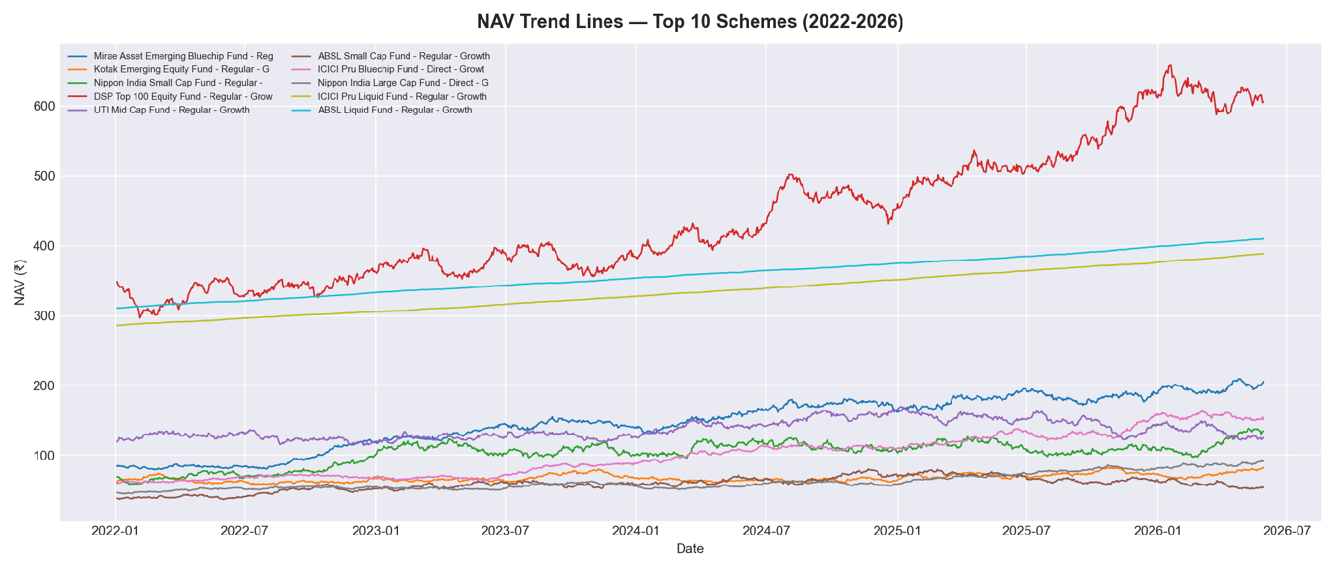
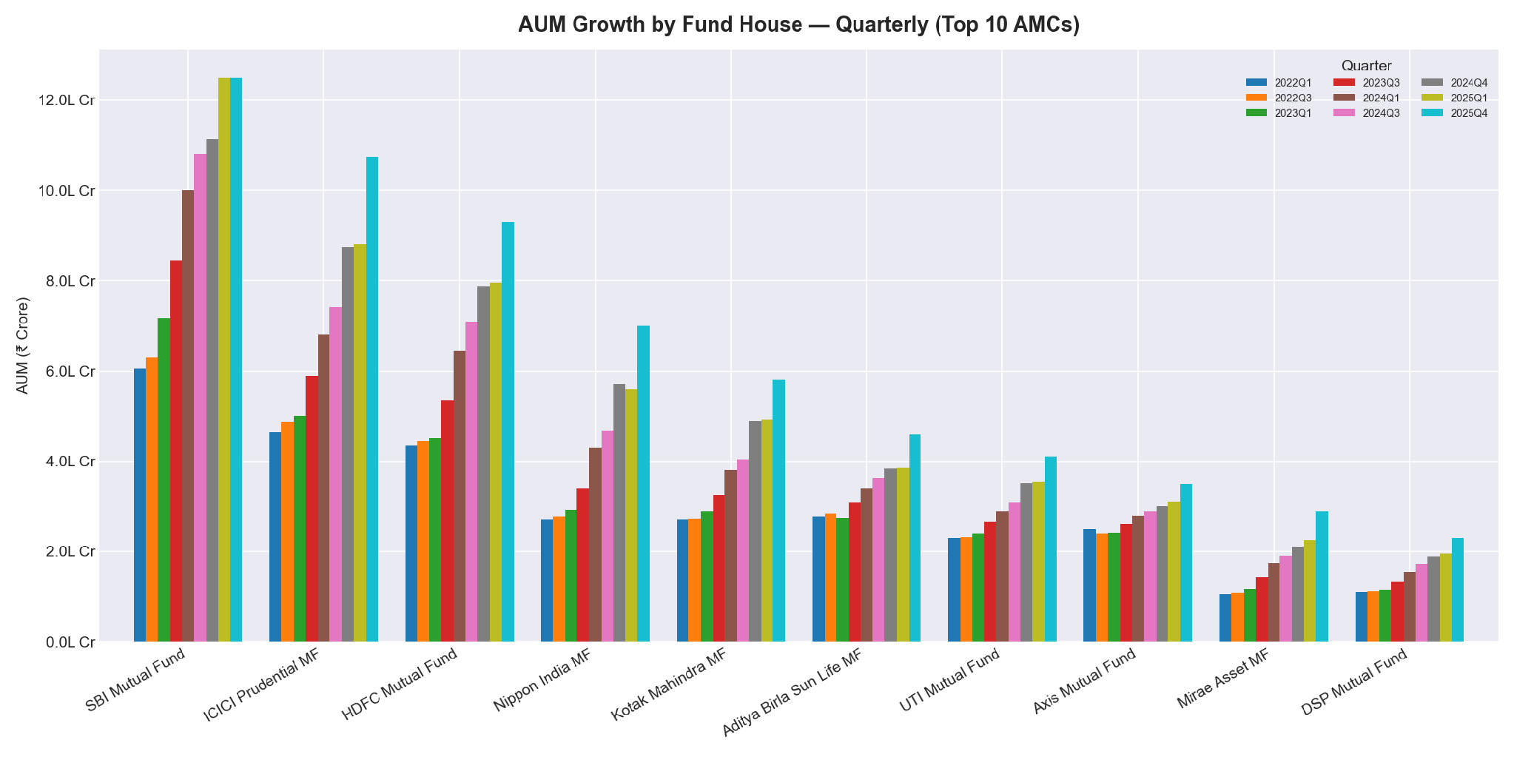
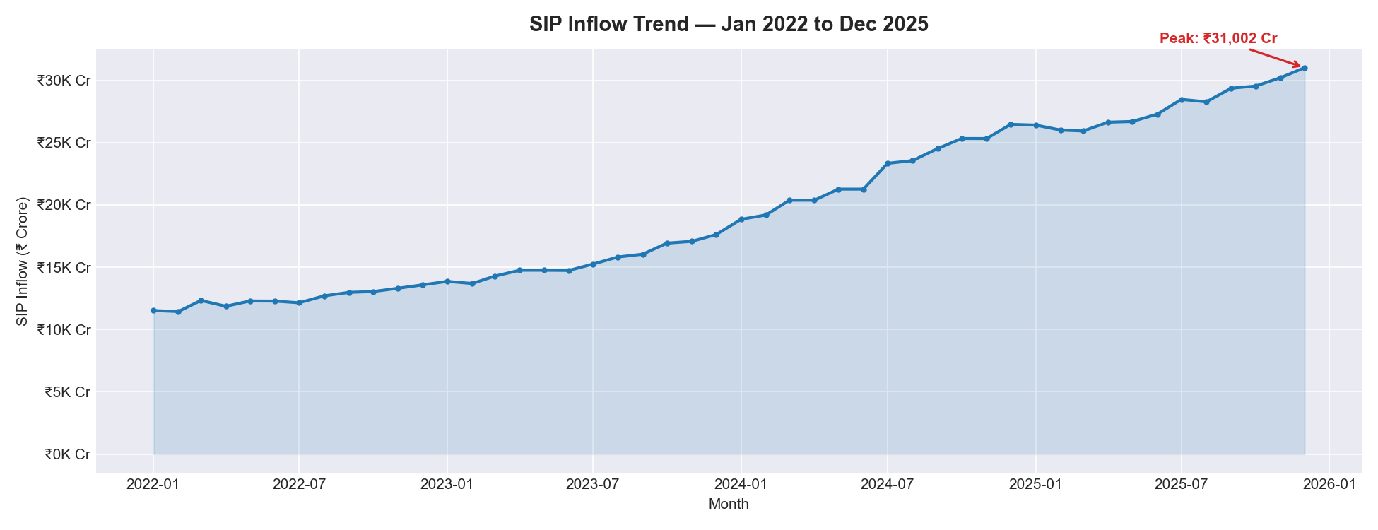
EDA HIGHLIGHTS · 1 / 2
NAV Trends, AUM Growth & SIP Inflows
22%+ CAGR
₹31,002 Cr
₹12.5L Cr
Small Cap 3-yr outperformance
SIP ATH – Dec 2025 (+34% YoY)
SBI MF – top AUM (Dec 2025)

Slide 6
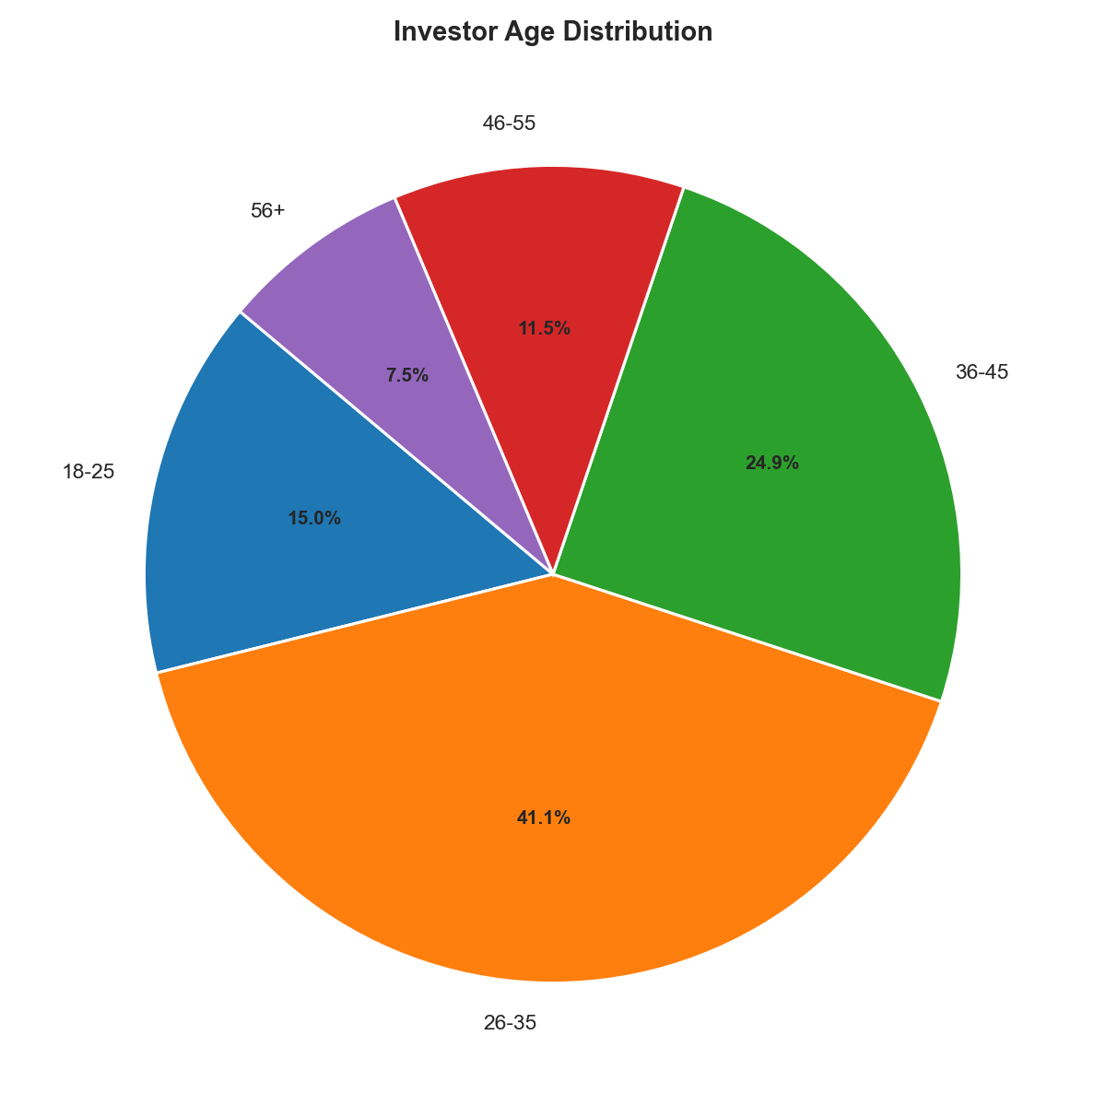
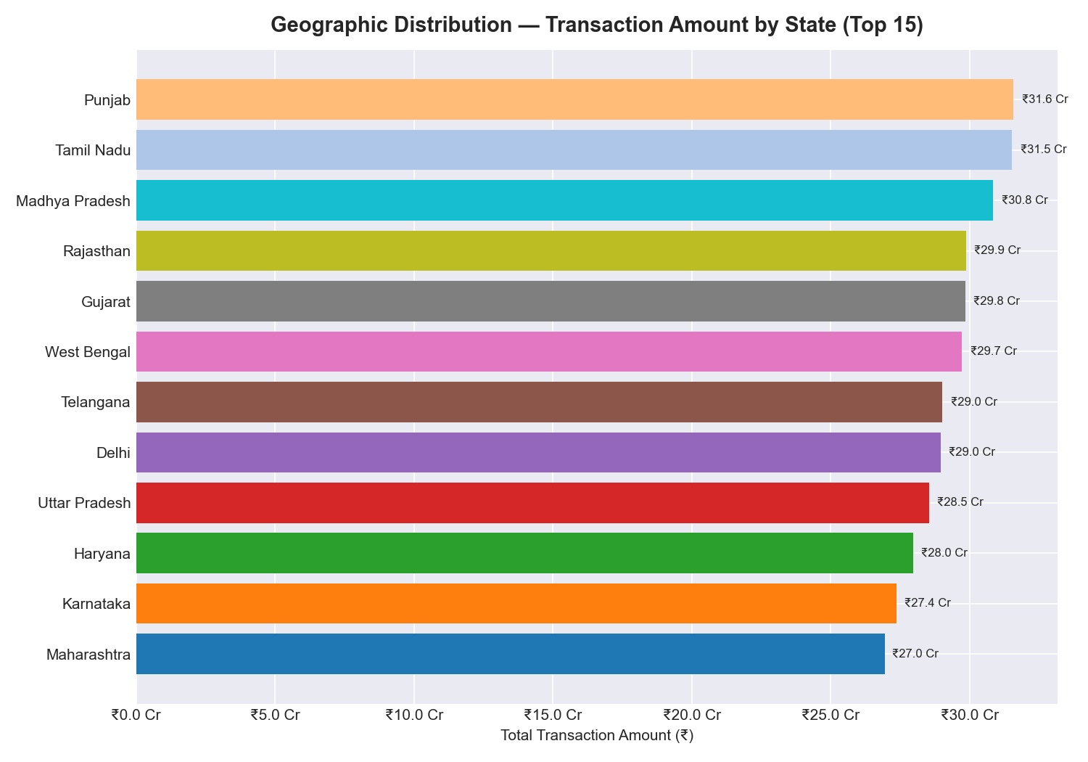
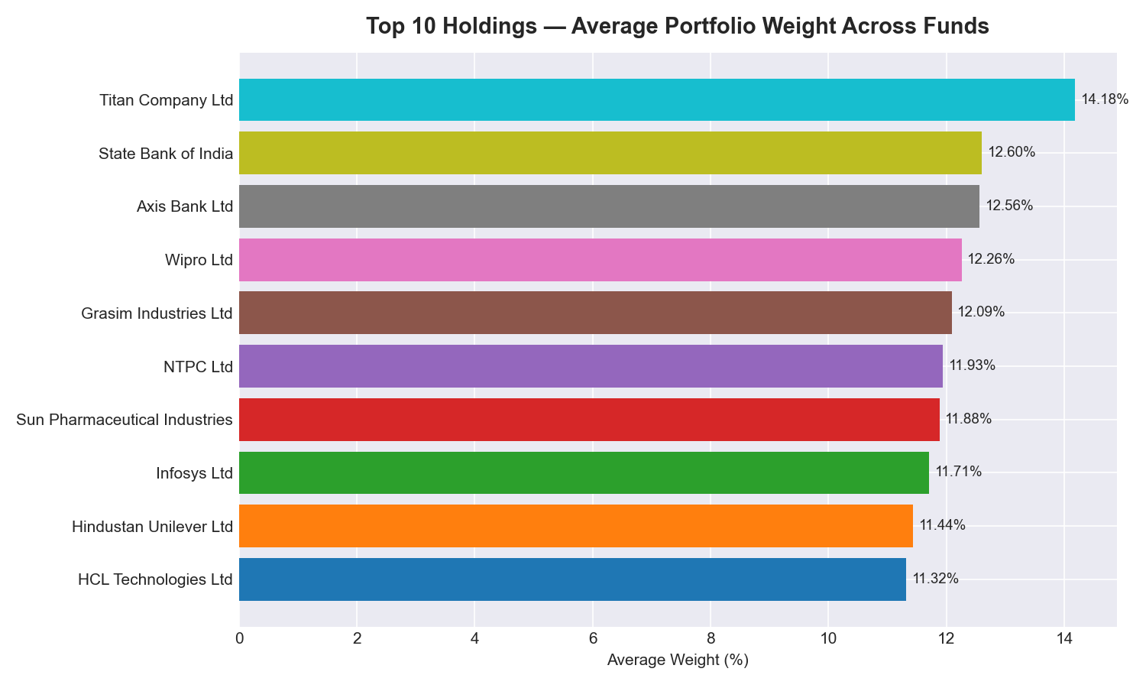
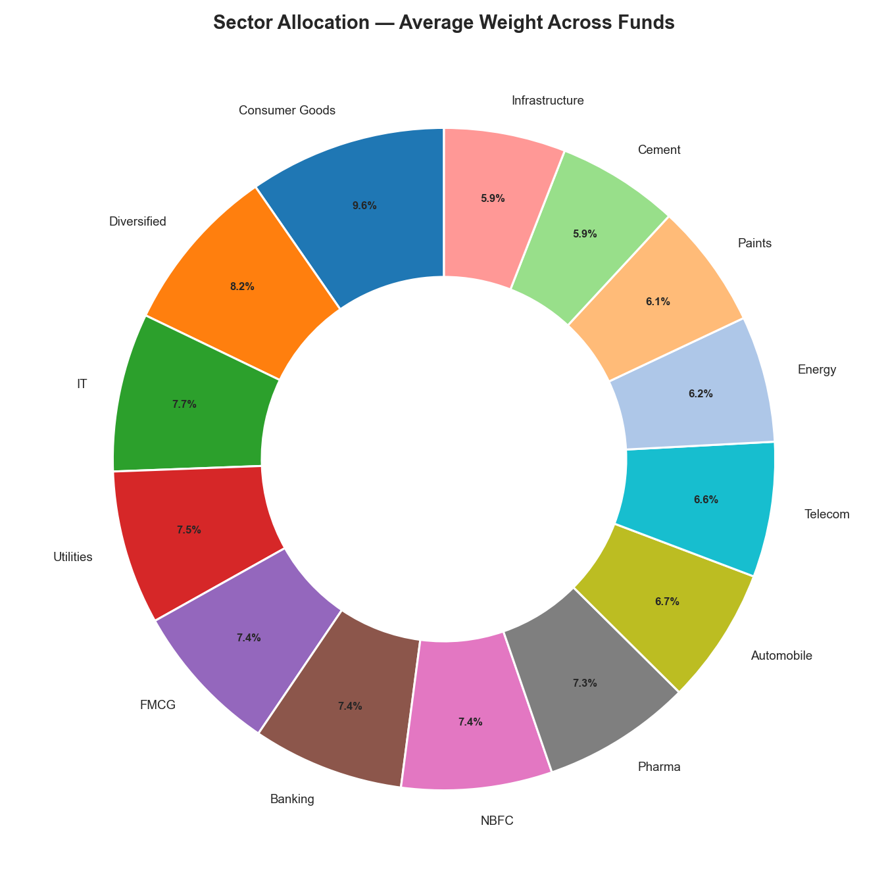
EDA HIGHLIGHTS · 2 / 2
Investor Behaviour, Geography & Portfolio Holdings
35% 26-35 age group – largest investor segment
50%+ Maharashtra + Karnataka + Delhi transactions
26.1 Cr Total MF folios (Dec 2025) – doubled in 4 yrs
BFSI Most-weighted sector across equity portfolios

Slide 7
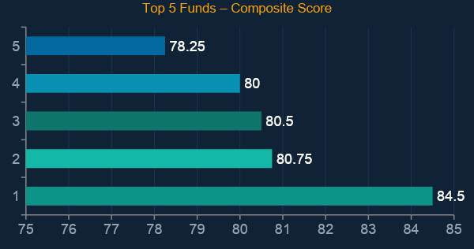
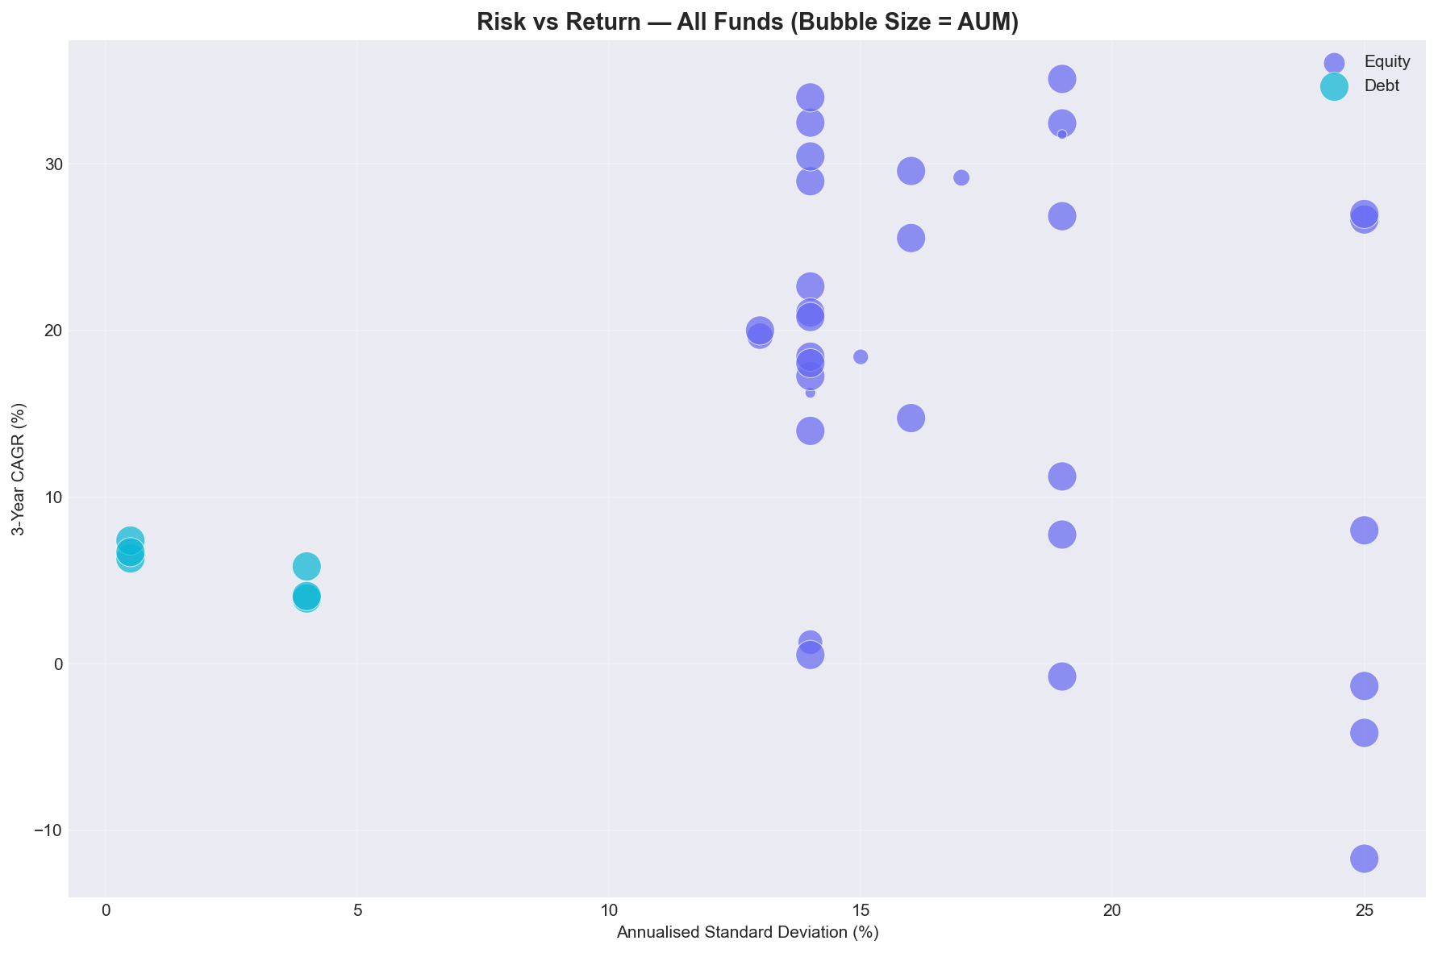


PERFORMANCE METRICS · 1 / 2
Risk-Adjusted Returns & Fund Scorecard
1.46
–0.10%
35.1%
84.5
Best Sharpe Ratio
(Mirae Large Cap)
Lowest Drawdown
(ICICI Liq Fund)
Best 3-yr CAGR
(Axis Midcap)
Top Composite Score
(ICICI Midcap)

Slide 8
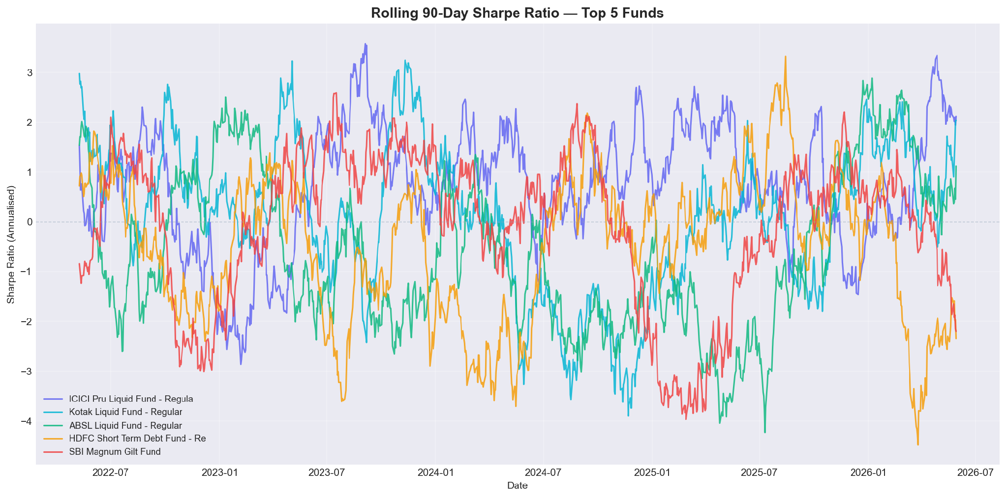
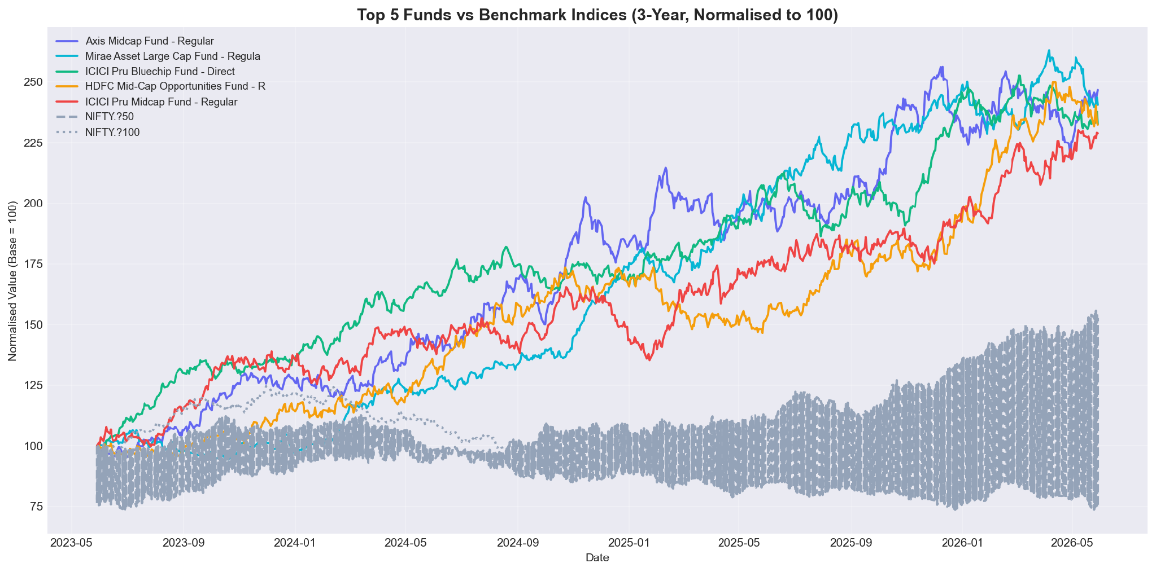
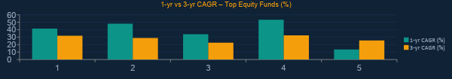
PERFORMANCE METRICS · 2 / 2
Rolling Sharpe, Benchmark Comparison & Advanced Analytics

Slide 9
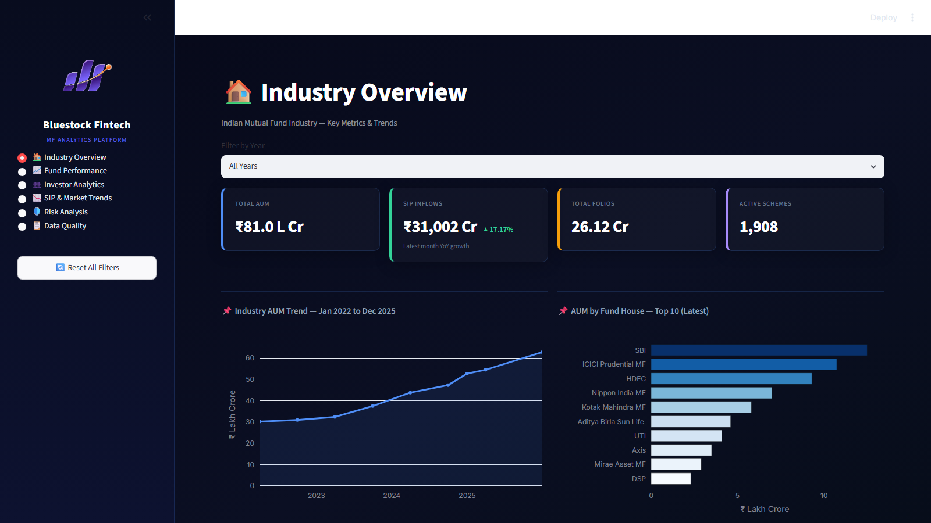
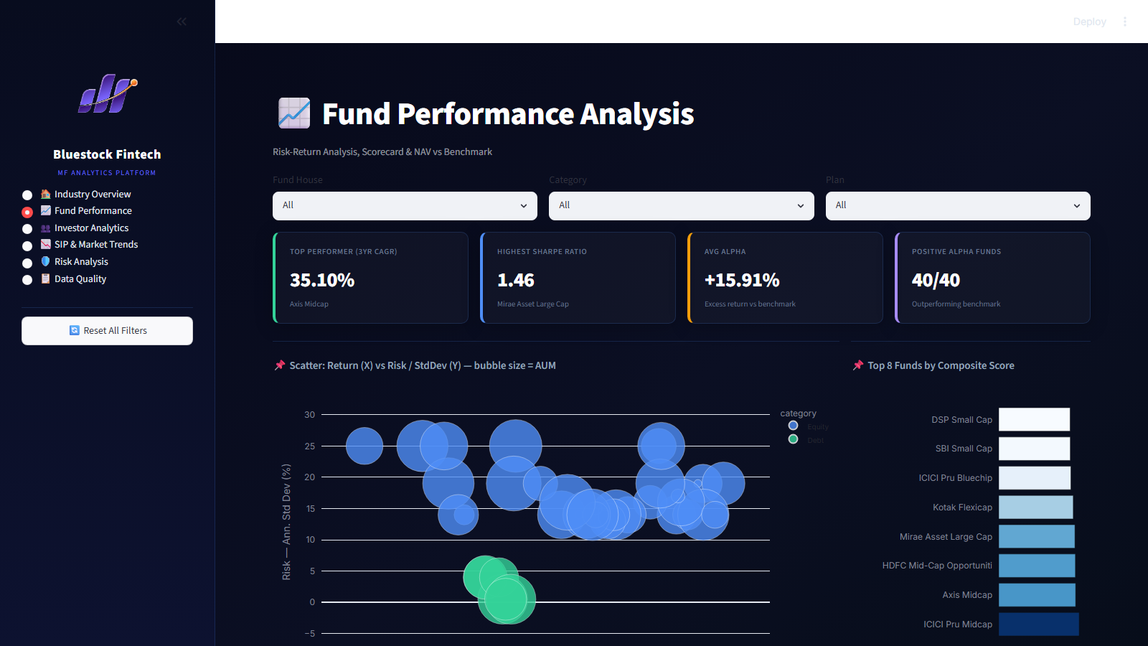
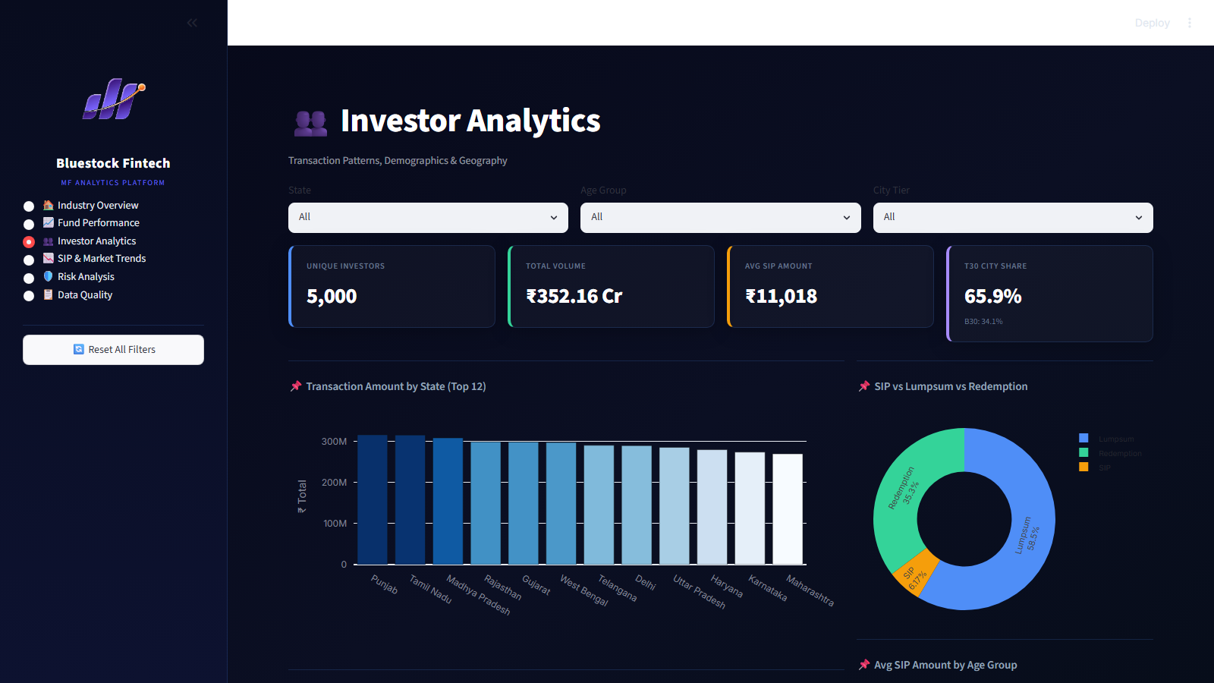

DASHBOARD · 1 / 2
Interactive Analytics Platform – Overview & Performance
⚡ Fund Performance
🏆 Executive Dashboard
👥 Investor Analytics
7 Interactive Pages
Real-time Filters
Exportable Scorecard
Automated Insights

Slide 10
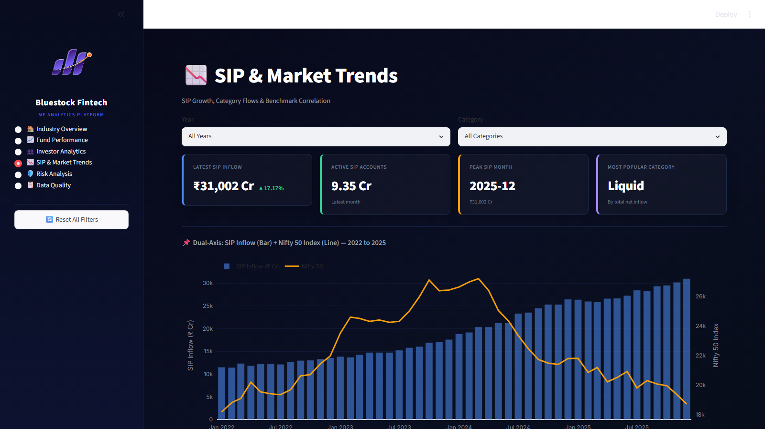
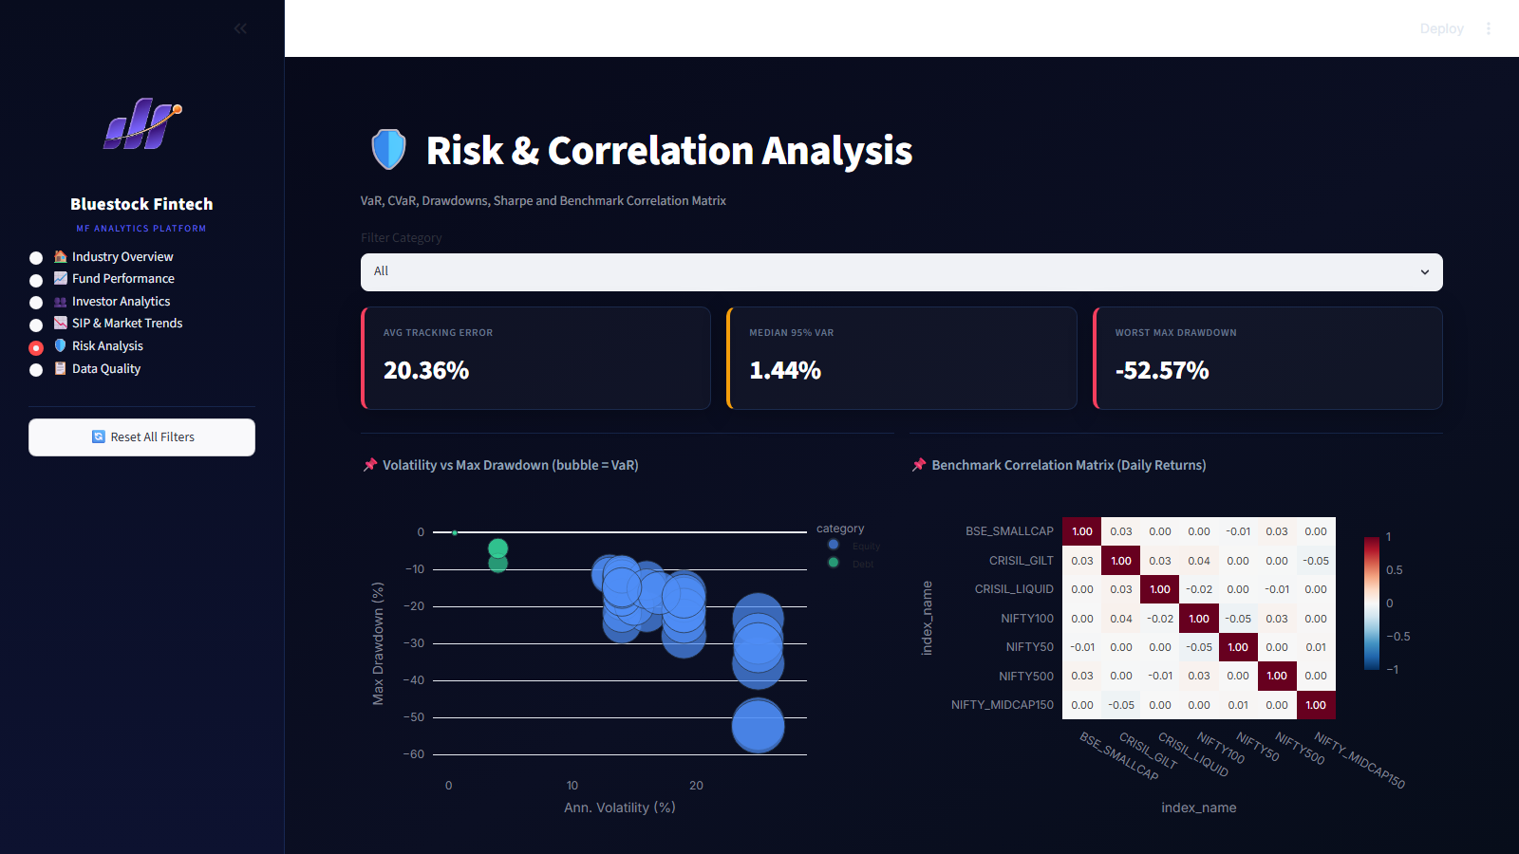
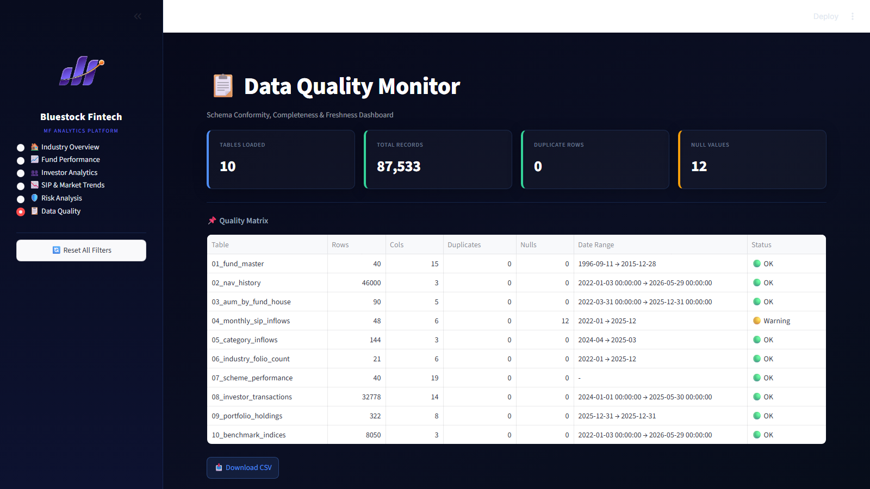
DASHBOARD · 2 / 2
SIP & Market Trends · Risk Analytics · Data Quality
📈 SIP & Market Trends
🛡️ Risk & Correlation
📋 Data Quality Monitor
SIP vs Nifty Correlation
VaR & CVaR Analytics
Data Quality Audit
Dual y-axis chart showing SIP inflow growth alongside Nifty 50 index — tracks retail participation vs market movements.
95% & 99% confidence Value at Risk and Conditional VaR computed per fund. Correlation heatmap across benchmark indices.
In-app engineering panel: row counts, duplicate flags, null checks, date coverage and automated system health warnings.

Slide 11


KEY FINDINGS
10 Insights from the Analysis
Small Cap Outperformance
AUM Concentration
SBI & Nippon Small Cap delivered 22%+ 3-yr CAGR, far ahead of Large Cap average of ~15%.
Top 3 AMCs (SBI, ICICI, HDFC) control 39%+ of India's total mutual fund AUM.
SIP Milestone
Millennial-Led Investing
Monthly SIP hit ₹31,002 Cr ATH in Dec 2025 — 34% YoY growth, up from ₹13K Cr in 2022.
The 26-35 age cohort drives 35% of all transactions; older investors invest larger SIP amounts.
Geographic Skew
Folio Doubling
Maharashtra + Karnataka + Delhi NCR generate 50%+ of transactions; B30 cities growing faster.
MF folios nearly doubled from 13.26 Cr (2022) to 26.12 Cr (Dec 2025), driven by equity SIPs.
Diversification Signal
Sector Concentration Risk
Small/Mid Cap funds show 0.65-0.80 correlation to Large Caps — meaningful portfolio benefit.
BFSI tops all equity fund portfolios; some sectoral funds show HHI > 2500, signalling risk.
SIP Dominates by Count
Best Risk-Adjusted Fund
SIPs account for ~60% of transaction count but only ~25% of total value (smaller ticket sizes).
Mirae Asset Large Cap leads with Sharpe 1.46 & Sortino 2.41; ICICI Pru Midcap scores 84.5 composite.

Slide 12
Thank You
Mutual Fund Analytics Platform · Bluestock Fintech Capstone
Pratik Kumar Yadav
Data Analyst Intern · Bluestock Fintech Pvt. Ltd. · June 2026
87K+
40+
15+
6
Rows Analysed
MF Schemes
Visualisations
Dashboard Pages
⚠️ For educational purposes only. Mutual Fund investments are subject to market risks.

