Slide 1
Password Enabled Security System and Automated Lights based on Motion Detection
Presented BY-
Swapnil Roy(510714008)
Sarthak shekhar roy paul(510714010)
Pratim Dasmahapatra(510714012)

Slide 2
Why this project?
To increase the security network of mainly residential areas where occurrences of theft and other intruder incidents are common.
Manual security service is not upto the mark.
Technologies like biometric detection and face recognition are not viable due to economic difficulties and functional complexities.
To establish a secure and simple security system.
To integrate both password authentication mechanism and sensor detection together.

Slide 3
Outline and highlights
This is a password protected system which is used to detect the person entering the confined area in question.
This is followed by ultrasonic and PIR motion sensing for automated lights.
The ultrasonic sensor is used to detect the initial presence of the intruder.
It is instrumental in the lighting at the entrance.
The PIR motion sensors help to detect the movement of the person inside the room.
The opening of the door is signaled by the green LED.
The red LED indicates wrong password being entered signifying presence of intruder and alarm has been raised.

Slide 4
Equipments Used
Arduino uno R3 board based on microcontroller AT mega328 chip.
Hc-SR04 ultrasonic sensors using SONAR to determine distance of objects.
PIR Motion Sensor using infrared radiation sensing.
LEDS and Breadboards.

Slide 5
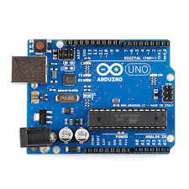
Arduino Uno R3 Board
Most widely used variant of the Arduino.
Features:
i) Atmega 328P microcontroller manufactured by AtMel corporation.
ii) Input voltage - 7-12V
iii) 14 Digital I/O Pins (6 PWM outputs)
iv) 6 Analog Inputs
v) 32k Flash Memory
vi) 16Mhz Clock Speed
Additional Components:
i) USB connection
ii) Power Jack
iii) ICSP Header
iv) Reset Button

Slide 6
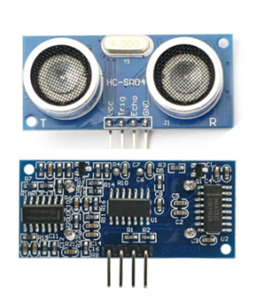
HC-SR04 Module
Uses sonar to determine distance to an object.
Operation is not affected by sunlight or black material.
Consists of ultrasonic transmitter and receiver module.
Features:-
i) Power Supply : +5V DC
ii) Effectual Angle : <15°
iii) Ranging Distance : 2cm – 400 cm
iv) Measuring Angle : 30 degree
Pins:-
VCC : +5V DC
Trig : Trigger (INPUT)
Echo : Echo (OUTPUT)
GND : Ground

Slide 7
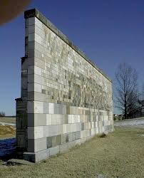
HC-SR04 Module
Working Principle:-
Emitted Wave
Reflected Wave
Ultrasonic Sensor
Obstacle

Slide 8
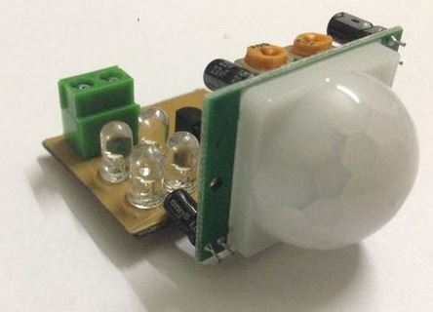
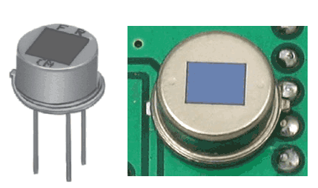
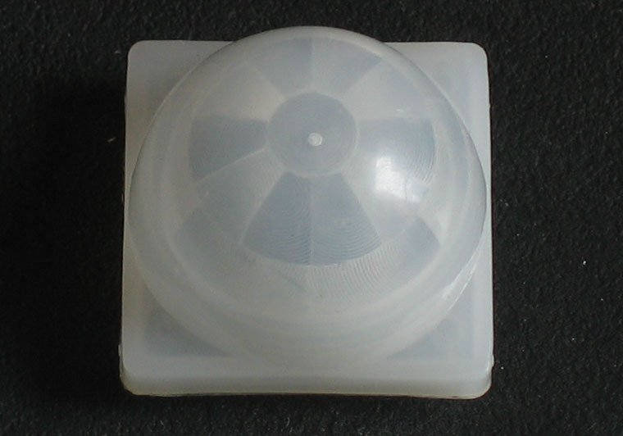
PIR Motion Sensor
PIR stands for Pyroelectric(“Passive”) Infrared Sensors.
PIR sensors allow to sense motion and are used to detect whether any person has moved in or out of the sensors’ range.
Small, inexpensive, low-power, easy to use.
Features:
Sensitivity range: Up to 20 feet (6 meters) 110° x 70° detection
range.
Power supply: 3V-9V input voltage, but 5V is ideal.
A PIR Motion Sensor
PIR Sensor
PIR Fresnel Lens

Slide 9
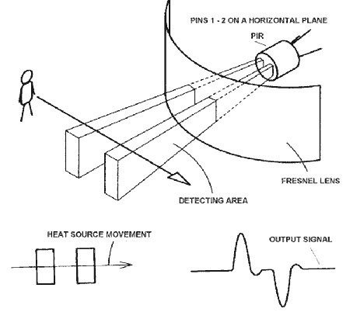
PIR Motion Sensor
Working Principle:
The PIR sensor itself has two slots in it, each slot is made of a special material that is sensitive to IR.
When the sensor is idle, both slots detect the same amount of IR, the ambient amount radiated from the room or walls or outdoors.
When a warm body like a human or animal passes by, it first intercepts one half of the PIR sensor, which causes a positive differential change between the two halves.
When the warm body leaves the sensing area, the reverse happens, whereby the sensor generates a negative differential change. These change pulses are what is detected.

Slide 10
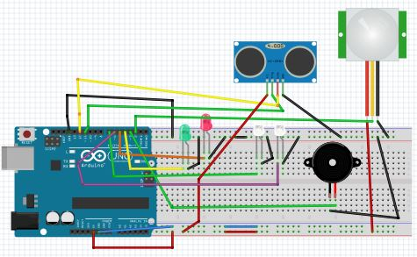
Circuit Diagram

Slide 11
Algorithm for Whole Process
The sequence-
Correct
Wrong
Enter password
Green Light ON, door opens
Red light ON Intruder alarm raised
Entrance light ON
Other lights ON
Exit, all lights switched off

Slide 12
Algorithm for Matlab Code
The sequence
Creating Serial Communication object on the Port connected to Arduino
Initiation of Arduino Communication
Sending Password content to Arduino
Asking User to Enter Password
Ending Communication With Arduino

Slide 13
MATLAB Code
answer=123; % this is where we'll store the user's Password
arduino =serial('COM5','BaudRate',9600); % create serial communication object
on port COM5 (Where Arduino is connected)
fopen (arduino); % initiate arduino communication
while answer
fprintf (arduino, '%s', answer); % send answer variable content to arduino
answer=input('ENTER PASSWORD : '); % ask user to enter Password
end
fclose (arduino); % end communication with Arduino

Slide 14
Algorithm for Arduino Code
The Sequence
Matching the user entered Password with the correct one
If matches
Mismatch
Green LED ON
Red LED & Buzzer ON
Entrance
Detection by Ultrasonic Sensor
Light at the entrance ON
Proceeding inside
Detection by PIR Motion Sensor
Exit
Other lights ON
All lights OFF

Slide 15
Arduino Code
int matlabData;
#define trigPin 11
#define echoPin 12
#define buzzer 3
int ultrasono(int duration, int distance);
long distance,duration;
int led = 4;
int led1 = 5;
int led2 = 6;
int led3 = 7;
int sound = 250;
int pir=2;

Slide 16
void setup() {
pinMode(trigPin, OUTPUT);
pinMode(echoPin, INPUT);
pinMode(led, OUTPUT);
pinMode(led1, OUTPUT);
pinMode(led2, OUTPUT);
pinMode(led3, OUTPUT);
pinMode(buzzer, OUTPUT);
pinMode(pir, INPUT);
Serial.begin (9600);
}
void loop()
{
digitalWrite(led3,LOW);
int value=digitalRead(pir);

Slide 17
if(value==HIGH)
{
digitalWrite(led3,HIGH);
delay(30000);
digitalWrite(led3,LOW);
}
else
digitalWrite(led3,LOW);
distance=ultrasono(duration,distance);
if(distance <= 10)
digitalWrite(led2, HIGH);
else
digitalWrite(led2, LOW);

Slide 18
while(Serial.available()> 0)
{
matlabData=Serial.read(); // read data
if(matlabData==123)
{
digitalWrite(led,HIGH); // turn green light on
digitalWrite(led1, LOW); // turn red light off
digitalWrite(buzzer,LOW);
}
else if(matlabData!=123 && matlabData!=9)
{
digitalWrite(led1, HIGH); // turn red light on
digitalWrite(led,LOW); // turn green led off
digitalWrite(buzzer,HIGH);
else if(matlabData==9)
digitalWrite(led,LOW); } }

Slide 19
int ultrasono(long duration, long distance)
{
digitalWrite(trigPin, LOW);
delayMicroseconds(2);
digitalWrite(trigPin, HIGH);
delayMicroseconds(10);
digitalWrite(trigPin, LOW);
duration = pulseIn(echoPin, HIGH);
distance = (duration/2) / 29.1;
return distance;
}

Slide 20
Limitations and Scope
The PIR sensors are not that effective in detection .
Sometimes the distance at which an object is detected around an ultrasonic sensor varies practically from it’s theoretical value. As a result, errors in calculation takes place.
There is a delay in serial communication between MATLAB and Arduino coding.
Easing on the economic factor, more expensive sensors would yield better results.
An allowance regarding distance and sensor detection should be made.
Instead of using MATLAB; OpenCV, Java or Python based password authentication techniques can be used.

Slide 21
BIBLIOGRAPHY
http://www.instructables.com/id/Make-An-Simple-Motion-Sensor-Light-PIR/?ALLSTEPS
http://allaboutee.com/2011/07/04/how-to-send-data-from-matlab-to-your-arduino
http://in.mathworks.com
http://www.arduino.cc

Slide 22
Acknowledgement
This work was inspired and supported in part by Prof. Santanu Das, Professor and Head of the Department, Department of Electronics and Telecommunication Engineering, Indian Institute of Engineering Science and Technology, Shibpur.
THANK YOU

