Slide 1
शिमशोनको कथा
न्यायकर्ता १३ अध्याय

Slide 2
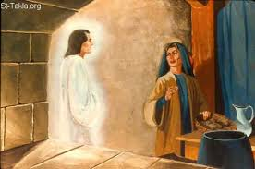
sorga dudh Manoah ko Srimati kaha dekha parcha
13:3-5 garna hune ra garna nahune kuro batuancha
Sriman lai vanche
Sriman le parmeshor ssanga pray garchan ani parmeshor le sunnu huncha ra feri sorga dudh barima basiraheski stri kaha aauchan

Slide 3
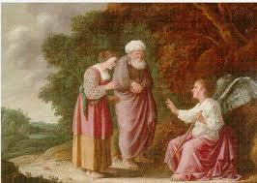
feri sorga dukh le k garna ra k garna hune kuro dubai lai batauchan
13-15 padh
Patho tayar garchu vanyo tara bhojan khanan vancha dut tara hombali chadau parmeshor lai vanchan

Slide 4
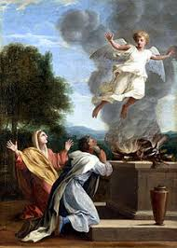
Parmeshor lai chattan mathi bai chadaye
Bedi bata jwala uthyo
Jwala sangai dut mathi tira gaye
Yo dekhera Manoah ra tinki stri ghopto paryo

Slide 5
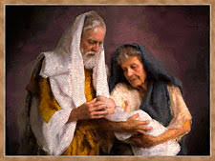
Stri le euta choro janmain
Tesko naun chao simson rakhe or in English name its “Samson”
Timna ki stri
Timna vanne thau ma simson janchan teha chai palisti stri dekhchan ani bihe garne vanera baa ama lai vanchan
Teha baa ama sanga janchan
Jaba tya dakhbari ma pugchan

Slide 6
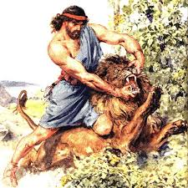
Teha lion le jhamtyo
Parmeshor ko atma aaunu huncha ani hatei le chyatchut parcha
Feri biha garna tala jharda lion ko sino herna dakhbari ma gaye
Teha mauri sametko chaka vetaucha
This becomes question to the palestines
Question=14:14 ma cha
Yo sataun din ma adko fukauna sakyo vane 30 than kapada ra 20 jor lagaune luga dine parcha This is the bet.

Slide 7
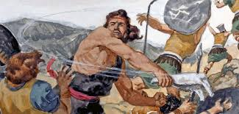
Stri snaga sodhcha ani dhamki dincha sodhideu vanera natra aago lai dinchu ghar ma vnera
Tespaxi simson sanga roi roi kana sodhcha adko k ho vanera
Satau din ma simson le vanyo jiddi gaeko vayera
Saharko manish haru le simson lai vanyo ----18 padh
Simson askolon ma gaye ani teha 30 jana manche mare

Slide 8
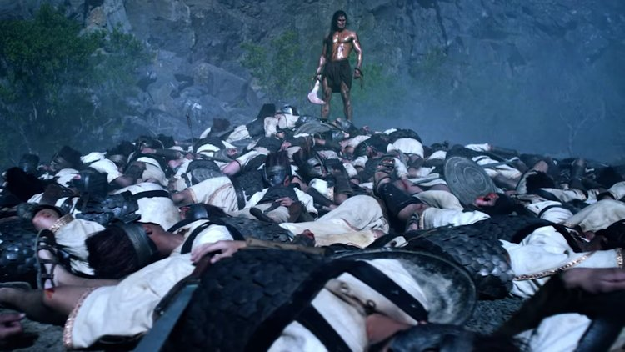
Ti tis jana mancheko luga haru ra chizbiz sapai lagera manisharu lai diye
Ani simson ko swasni lai lokanta haru kaha diye
16 adhyaya
Sorek ma dalilah lai dkehcha nai prem ma parcha

Slide 9
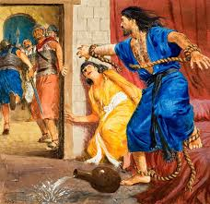
1100 ko sikka dine kuro
Padh 7-nasukeko taja taandanle badhne

Slide 10
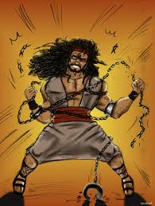
Nachalayeko naya sori le kasera badhne

Slide 11
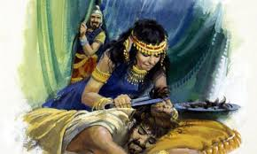
Rahsya kapal ko bataucha stri lai
Stri le kapal katidinchin
Simson lai badhe ani aakha nikali diye
गाजामा lyaucha
Kapal badhna thalcha jhyalkhana ma huda
Khamba chamcha
Parmeshor lai pukar garchan

Slide 12
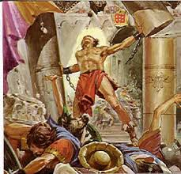
Parmeshor le shakti dinu huncha
Padh29
Sampurna shakti lagayera khamba thelcha ani samai palisti thichera marchan, simson pani marcha
Simson 3o year samman isarael ka aguwa vaye

Slide 13
कण्ठ पद्
व्यवस्था ३१:६
“बलिया र साहसी होओ! यिनिहरीसित नडराओ र त्रसित नहोओ! किनभने परमप्रभु तिमीहरुका परमेशोर नै तिमीहरुसंग जानुहुन्छ| उहाँले तिमीहरुलाई कहिल्य छोडनुहुनेछैन न त त्यागनुहुनेछ|”

Slide 14
Question And Answers
शिमाशोन जन्मिन अघि मानहकि स्त्रीले के के गर्न हुन्न?
कुन कुरा मा बाजी थापे रके बाजी थापे?
शिमाशोनको मृत्यु निम्त्याउने स्त्री को हुन्?

Slide 15
Question And Answers
शिमाशोनले दलिलाहलाई आफ्नो शक्ति के कुरा बाट आउछ वनेर धाते?
शिमाशोनको शक्ति केबाट आउछ?
शिमाशोनले आखा नहुँदा पनि कसरि मारे?

