Slide 1
Thirsty
SEIS 744 – Capstone project
Pratish Karmacharya

Slide 2
Agenda
Problem
Solution
Design
Demo
Future enhancement
Questions

Slide 3
Problem
Importance of water
Flush out waste and bacteria
Lose weight
Lubricate and cushion joints
64 Oz water a day
40 hours a week at work.
Hard to keep track of drinking while you are focused at work
Notes:
Hydrate Spark costs $54.
Cheaper solution.

Slide 4
Solution - Thirsty
A system…
… that can remind you to drink water on a timely basis.
… that can track how much water you have consumed over a period of time.
… that will help you live a better life.

Slide 5


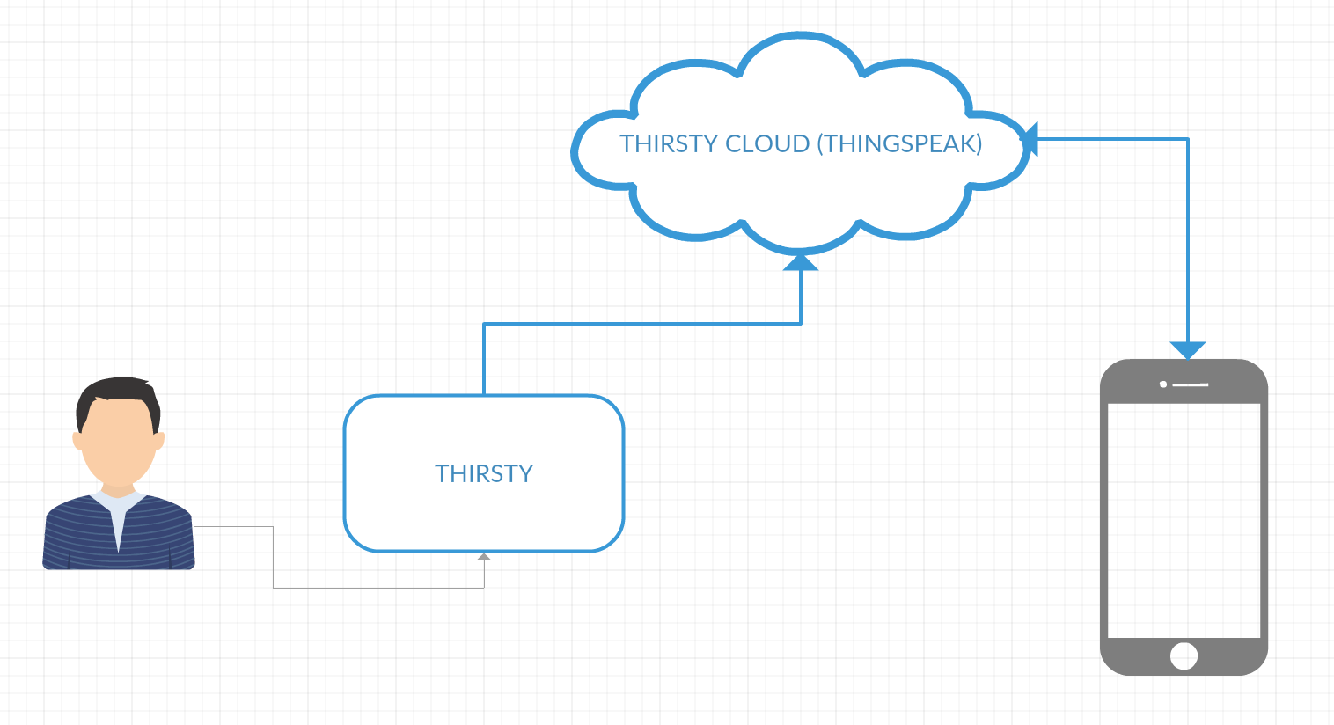
Design

Slide 6
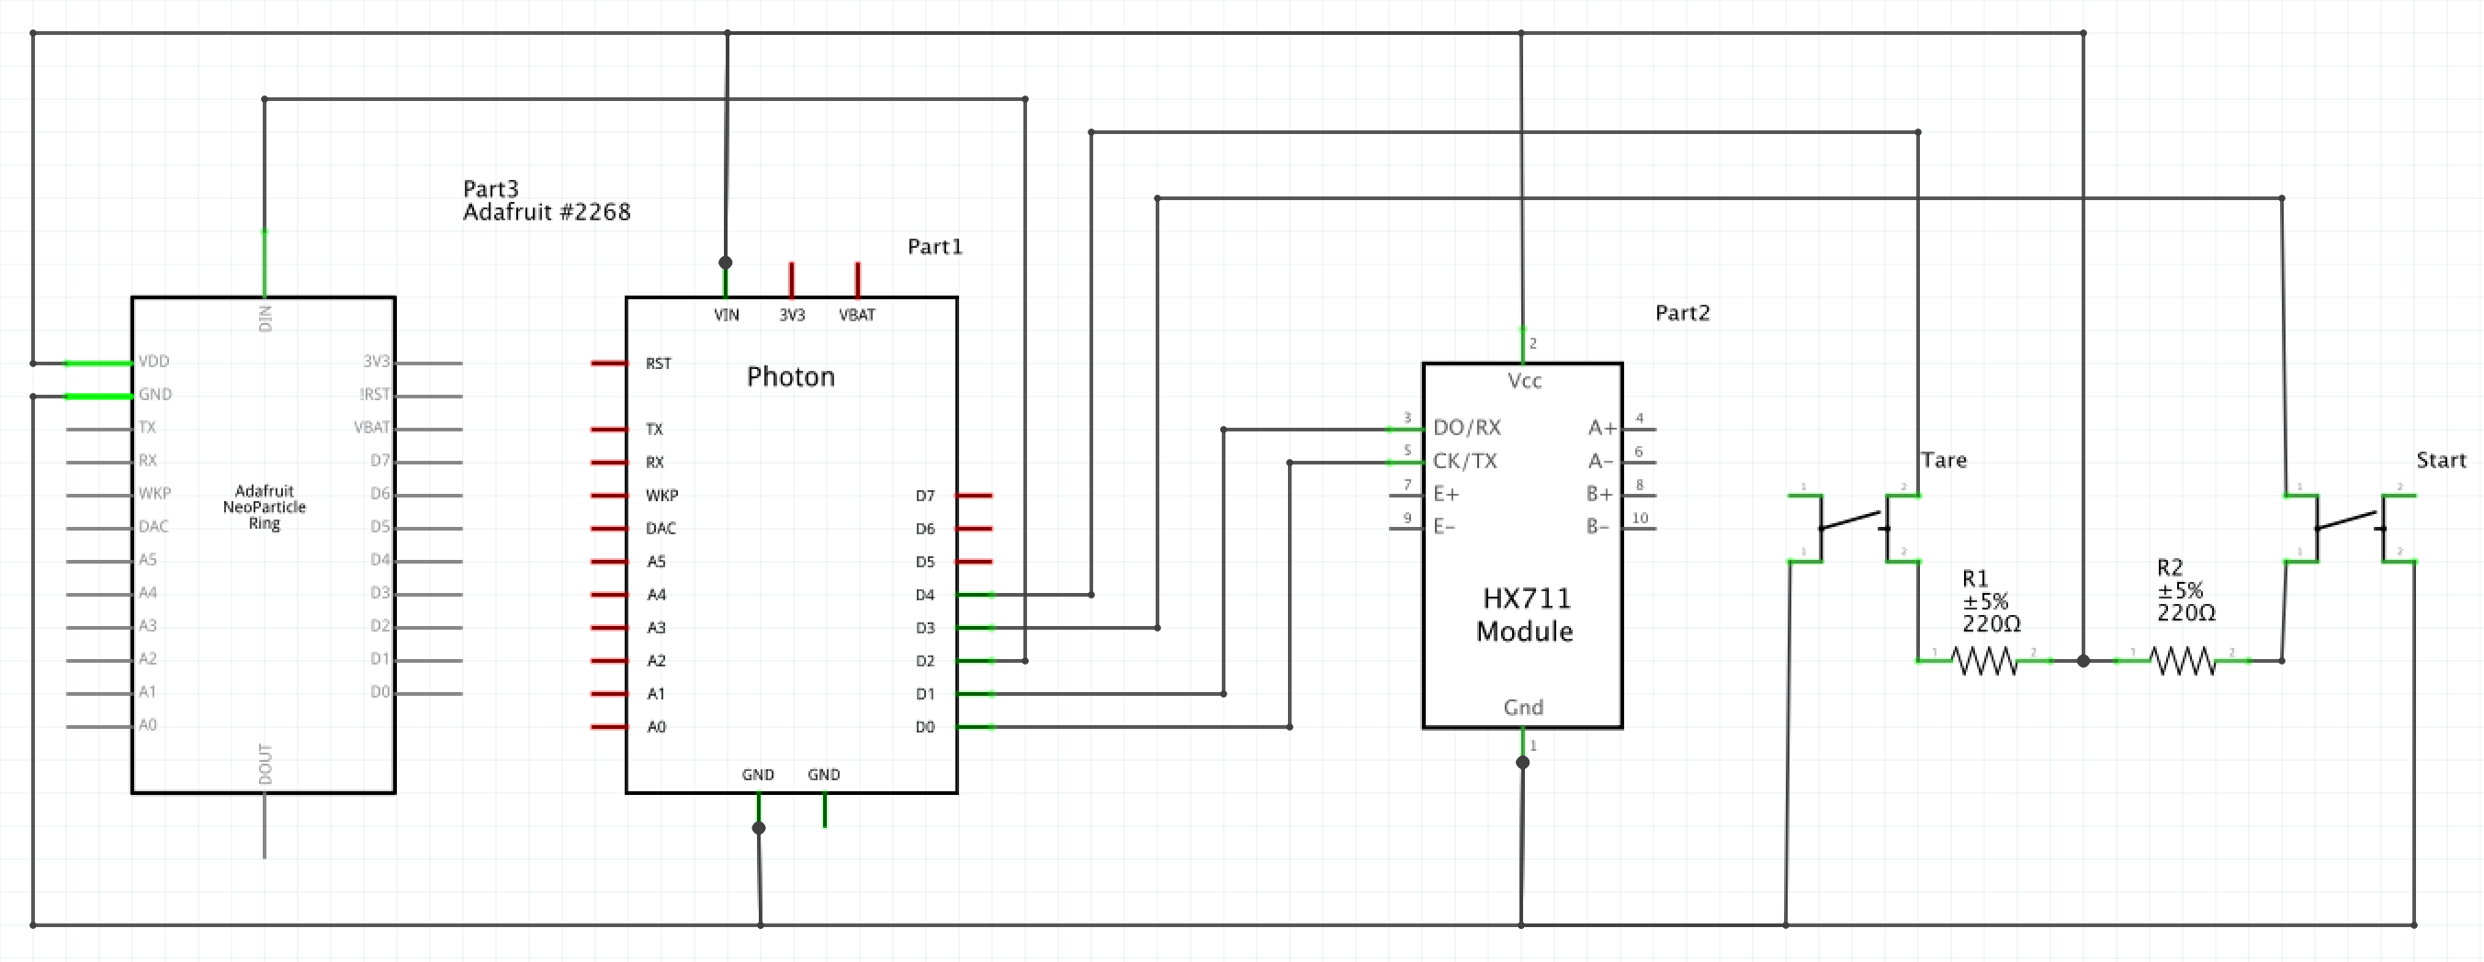
Schematic

Slide 7
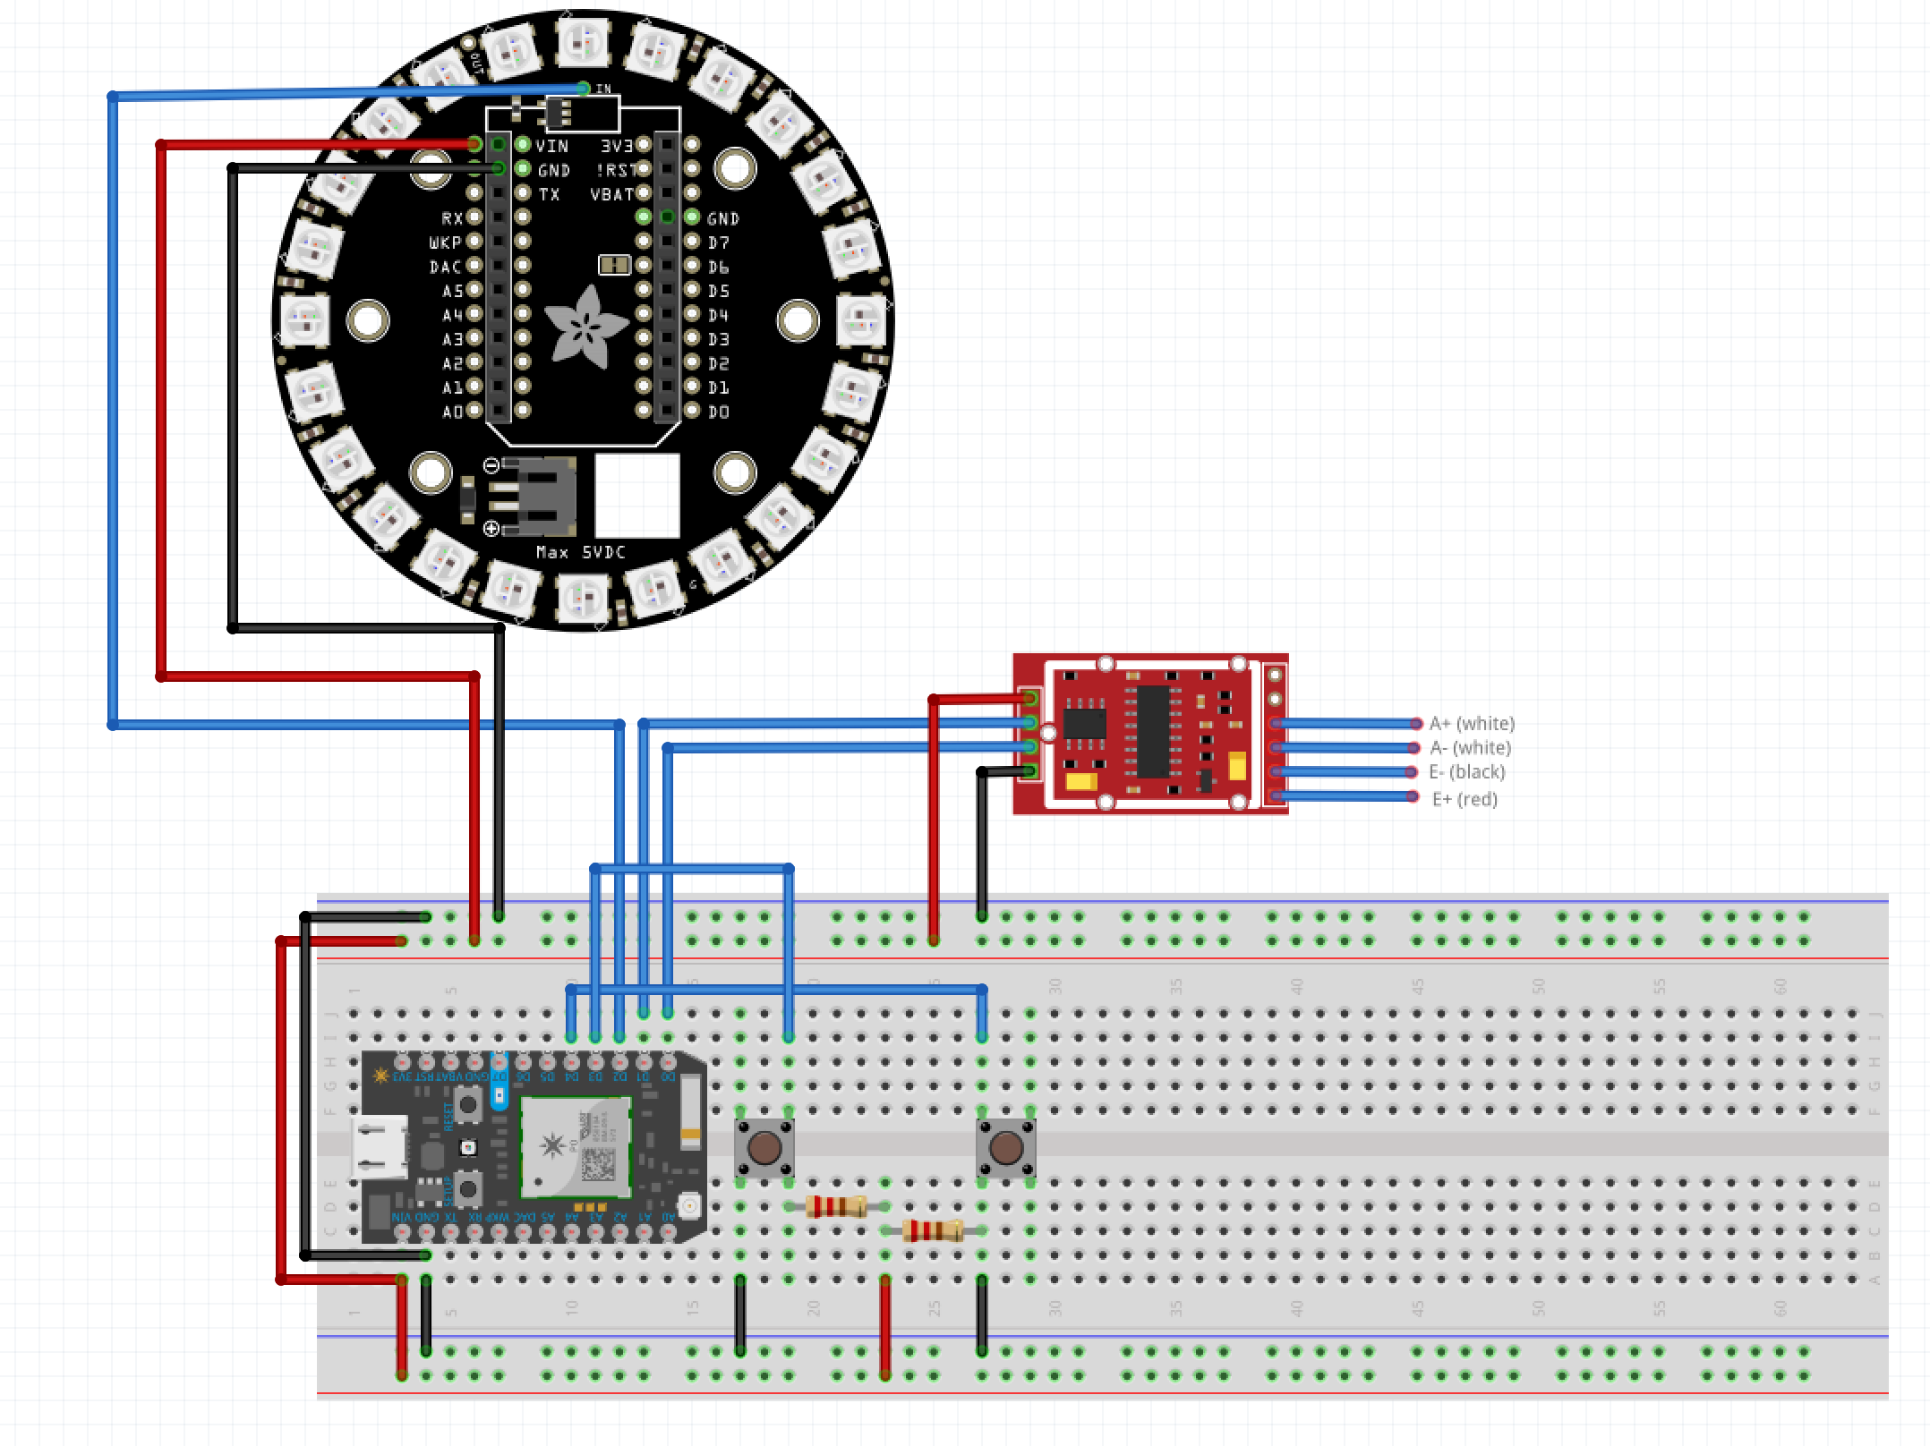
Wiring
HX711
Loadcell
Tare
Start

Slide 8
Demo
Constraints
Changed drink reminder time to 30 seconds.
System shutdown time changed to 2 minutes.

Slide 9
Future enhancements
Display
Companion app
Suggest drinking limit
Groups
Games
Company can make sure their employee is properly hydrated.

Slide 10
Questions?

