Slide 1
AI-Powered Cloud Resource Demand Prediction and Auto-Scaling System
Pratistha Singh | Btech/25047/24
Arushi Goel | Btech/25111/24
B.Tech V Semester | CSE Section A
Dept. of Computer Science and Engineering
BIT, Mesra - Jaipur Campus
Under the Supervision of
Dr. Kuntal Mukherji
Assistant Professor, BIT Mesra - Jaipur Campus

Slide 2
Table of Contents
Introduction
Problem Statement and Objectives
Dataset Description
Design and Methodology (Part 1)
Design and Methodology (Part 2)
Literature Review
Conclusions and Future Scope
References

Slide 3
Introduction
Dynamic Cloud Workload
Modern microservice web applications face highly dynamic, non-linear traffic bursts.
User demand swings unpredictably due to flash sales, breaking events, and viral user activity.
High static resource allocation leads to severe financial and energy inefficiency during low-traffic periods.
Legacy Reactive Scaling
Threshold-based triggers (e.g., Kubernetes HPA at CPU > 80%) react ONLY AFTER congestion occurs.
Container Cold-Start Lag: Pod spinning, image pulling, and readiness checks take 30s to 180s.
Result: Unavoidable transient performance degradation, dropped packets, and SLA violations.
Proposed AI Solution
Proactive Demand Prediction: Deep time-series models (GRU/LSTM)
forecast workload surges 3 to 5 minutes ahead.
Closed-Loop Orchestration: Programmatically triggers Kubernetes pod
scaling before traffic spikes hit the cluster.
Eliminates cold-start delays while optimizing cluster cost.

Slide 4
Problem Statement and Objectives
Problem Statement
Cloud applications experience continuously changing and unpredictable workloads.
During high-demand periods, insufficient resources cause slow response times,
service degradation, and failures that directly impact end users.
On the other hand, allocating too many resources during low-demand periods
leads to unnecessary cloud costs and significant resource wastage.
Traditional auto-scaling methods usually react after resource usage increases.
This reactive approach causes delays because the system needs time to detect
the increased demand and provision additional resources (30-180 seconds),
leaving a critical vulnerability window where users experience service failures.
Research Objectives
1. Forecast CPU, memory and request-rate demand 3-5 min ahead using AI models.
2. Build a proactive Kubernetes controller that scales pods before load arrives.
3. Eliminate SLA violations and reduce resource wastage by 20-30 percent.
4. Validate the system with live Prometheus metrics and Grafana dashboards.

Slide 5
Dataset Description
Dataset 1 - Google Cluster Workload Traces v2 (2020)
Published by Google. Contains CPU and memory usage metrics sampled every 5 seconds
from thousands of container jobs running on a real Google data-centre cluster.
Covers both stable periodic patterns AND sudden burst events, making it ideal for
training and validating deep learning forecasting models under realistic conditions.
Source: github.com/google/cluster-data
Dataset 2 - NASA HTTP Web Server Access Logs
Real-world HTTP access logs from NASA Kennedy Space Centre web servers.
Contains over 1.8 million requests with timestamps, showing strong diurnal (day/night)
traffic cycles and sharp burst spikes triggered by news events.
Used to model request-rate time series and test how well the system handles
sudden public-traffic surges typical of real web applications.

Slide 6
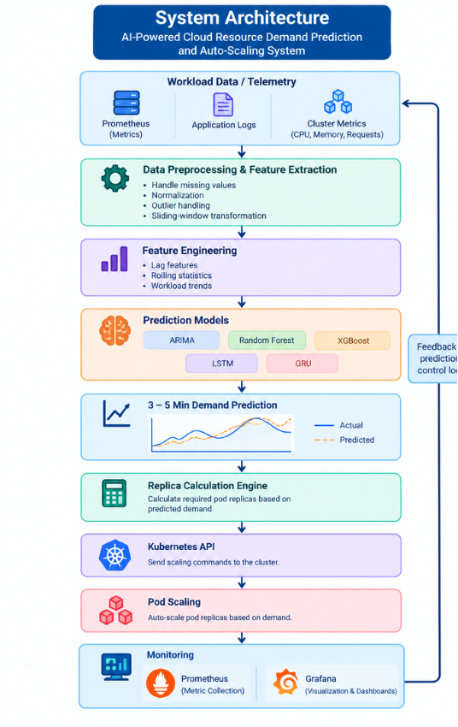
Design and Methodology - Part 1
End-to-End System Pipeline (Planned)
Raw Data -> Preprocessing -> Feature Engineering -> Model Training->
Forecasting Engine -> Scaling Controller -> Kubernetes REST API
Module 1 - Data Preprocessing
Ingests raw telemetry, handles missing values via forward-fill and imputation,
applies MinMaxScaler normalisation, and creates sliding-window sequences
ready for model training.
Module 2 - Feature Engineering
Derives lag features from historical CPU and memory readings,
computes rolling statistics (mean and standard deviation), and
encodes time-of-day calendar indices to capture diurnal demand patterns.
Both modules together ensure the model receives clean, enriched,
temporally-structured data as input sequences.

Slide 7
Design and Methodology - Part 2
Module 3 - Model Training and Selection
Trains ARIMA, Random Forest, XGBoost, LSTM, and GRU on the prepared sequences.
Evaluates each on the validation set using MAE and RMSE metrics.
The model with the lowest error is saved as the active forecasting checkpoint.
Module 4 - Forecasting Engine
The selected model takes recent metric history and outputs a predicted
resource utilisation value 3 to 5 minutes into the future.
This lead time allows the controller to act before the load actually arrives.
Module 5 - Scaling Controller (Planned)
Every 30 seconds: reads the forecast, calculates the required pod replica
count, and sends a PATCH command to the Kubernetes REST API server.
Pods are warm and ready before the traffic spike arrives.
Module 6 - Observability Layer
Prometheus scrapes live cluster metrics every 5 seconds.
Grafana renders real-time dashboards: predicted load, actual usage, replicas.

Slide 8
Literature Review
Survey of Existing Approaches
1. ARIMA / Holt-Winters (Statistical)
Classical time-series models that work well for
stable, stationary, periodic workloads. Cannot
capture sudden non-linear traffic bursts.
2. Random Forest (Ensemble ML)
Incorporates lag-based features and handles
non-linearity better than ARIMA. But makes
independent predictions with no memory of sequence.
3. XGBoost (Gradient Boosting)
Fast and accurate for tabular data with engineered
features. Lacks the temporal context needed for
multi-step time-series forecasting.
4. LSTM (Deep Learning)
Learns long-range temporal dependencies via gated
memory cells. Highly accurate but computationally
heavy — may be too slow for 30-second control loops.
5. GRU (State of the Art)
Matches LSTM accuracy with fewer parameters and
faster training/inference — ideal for real-time
cloud resource prediction in production systems.
Key Gaps in Existing Literature
Gap 1: Offline Evaluation Only
Most studies benchmark models offline. None
connect the predictor to a live Kubernetes cluster.
Gap 2: Cold-Start Delay Ignored
No existing framework accounts for the 30-180 sec
pod startup delay in the scaling decision logic.
Gap 3: No Real-Time Control Loop
Forecasting models are not integrated into a
cyclic, automated Kubernetes scaling controller.
Gap 4: No Unified Observability
No dashboard correlates predicted load, actual
usage, and active replica count in real time.
How Our Work Addresses These Gaps
We connect a lightweight GRU model directly to
the Kubernetes REST API in a closed 30-sec loop,
with a 3-5 min look-ahead to pre-empt the cold-start
delay — and visualise everything live in Grafana.

Slide 9
Conclusions and Future Scope
Current Project Status
The project is in the planning phase with SRS and SDS documents completed,and with that we are working on preprocessing i.e collecting data to train our AI model.
Conclusion and future scope
The proposed AI-powered cloud resource management system provides a proactive approach to auto-scaling by predicting future workload demand 3–5 minutes in advance. By integrating LSTM/GRU-based forecasting with Kubernetes, the system can scale resources before traffic spikes occur, helping reduce provisioning delays, SLA violations, and unnecessary resource consumption.
The integration of Prometheus and Grafana enables real-time monitoring of actual workload, predicted demand, and scaling decisions. Overall, the project aims to transform traditional reactive auto-scaling into an intelligent, predictive, and cost-efficient cloud resource management framework.

Slide 10
References
Rossi, A., Visentin, A., Carraro, D., Prestwich, S., & Brown, K. N. (2025). Forecasting workload in cloud computing: towards uncertainty-aware predictions and transfer learning. Cluster Computing, 28, Article 258. https://doi.org/10.1007/s10586-024-04933-2
Zanussi, L., Tessera, D., Massari, L., Bermejo, B., Juiz, C., & Calzarossa, M. (2026). Load-aware predictive auto-scaling framework for cloud environments. Cluster Computing, 29, Article 197. https://doi.org/10.1007/s10586-026-05944-x
Pintye, I., Kovács, J., & Lovas, R. (2024). Enhancing Machine Learning-Based Autoscaling for Cloud Resource Orchestration. Journal of Grid Computing, 22, Article 68. https://doi.org/10.1007/s10723-024-09783-1
Nawrocki, P., & Osypanka, P. (2021). Cloud Resource Demand Prediction using Machine Learning in the Context of QoS Parameters. Journal of Grid Computing, 19, Article 20. https://doi.org/10.1007/s10723-021-09561-3
Moreno-Vozmediano, R., Montero, R. S., Huedo, E., & Llorente, I. M. (2019). Efficient resource provisioning for elastic Cloud services based on machine learning techniques^{[6]}. Journal of Cloud Computing, 8, Article 5. https://doi.org/10.1186/s13677-019-0128-9
R. Buyya, R. Ranjan, and R. N. Calheiros, “Modeling and Simulation of Scalable Cloud Computing Environments and the CloudSim Toolkit: Challenges and Opportunities,” 2009 International Conference on High Performance Computing & Simulation (HPCS), IEEE, 2009.
M. Mao and M. Humphrey, “Auto-Scaling to Minimize Cost and Meet Application Deadlines in Cloud Workflows,” 2011 International Conference for High Performance Computing, Networking, Storage and Analysis (SC), IEEE/ACM, 2011.
Google Inc., Google Cluster Workload Traces v2, Google Cloud Platform Datasets, 2020.
NASA Ames Research Center, NASA HTTP Web Server Traffic Logs, NASA Data Repository, 2000.
S. Hochreiter and J. Schmidhuber, “Long Short-Term Memory,” Neural Computation, vol. 9, no. 8, 1997.

Slide 11
Thank You!
Pratistha Singh (Roll: Btech/25047/24 | CSE Sec A)
Arushi Goel (Roll: Btech/25111/24 | CSE Sec A)
Under the Supervision of
Dr. Kuntal Mukherji
Assistant Professor, BIT Mesra - Jaipur Campus

