Slide 1

HTTP PROXY SERVER
WITH INTELLIGENT CACHING
Mini-project presentation
Computer Networks Laboratory (CSE20110)
Department of Computer Engineering and Technology
Swapna Khire – 1262242618 Dishita Rao – 1262242968
Navya Tiwari – 1262243688 Pratiti Patlia – 1262240974
Panel J | Batch J1
Faculty: Dr. Uma Pujeri
Computer Networks Laboratory CSE20110
15 seconds
Notes:
Suggested time: 15 seconds. Replace all bracketed placeholders and prompts with your own project details. Keep explanations brief. Total time across slides 1–7 is 5 minutes, including the demonstration. Slide 8 is for reference during questions. Logo source: https://mitwpu.edu.in/uploads/images/MIT-WPU-logo-1.webp. Introduce only the title and team; do not read every PRN.

Slide 2
Problem and Objectives
Problem
Repeated HTTP requests can create avoidable origin-server traffic and latency. A basic forwarding proxy also offers limited visibility into request activity and cache effectiveness.
This project is an educational HTTP proxy prototype for supported HTTP GET requests, with caching, domain blocking, request statistics and a live dashboard.
Objectives
ID | Objective | Verified by
O1 | Forward supported HTTP GET requests to the origin | cURL through proxy to local origin
O2 | Cache eligible responses; serve repeats from memory | Repeat request; check logs and stats
O3 | Expire entries (TTL) and evict old ones (LRU) | Short-TTL test; cache-manager logic
O4 | Block configured domains with an HTTP error | Request a blocked domain
O5 | Expose request and cache metrics in a dashboard | Dashboard page and /api/data
Computer Networks Laboratory CSE20110
40 seconds
Notes:
Suggested time: 40 seconds. Replace all bracketed placeholders and prompts with your own project details. Keep explanations brief. Total time across slides 1–7 is 5 minutes, including the demonstration. Slide 8 is for reference during questions.

Slide 3
Proposed Design and Tools
Client
cURL
Sends absolute-form HTTP URL
HTTP Proxy
127.0.0.1:8080
Blocklist · Cache · Forward
Origin Server
127.0.0.1:9000
Python http.server
Flask Dashboard
127.0.0.1:5000
Shares in-process state with proxy
Tools: Python 3.x, socket, threading, Flask, cURL, Python http.server.
Protocols: HTTP over TCP; TCP provides reliable, ordered byte delivery.
Addressing: Proxy 127.0.0.1:8080 | Origin 127.0.0.1:9000 | Dashboard 127.0.0.1:5000.
Scope: HTTP GET with absolute-form URLs; HTTPS CONNECT tunnelling is not implemented.
Computer Networks Laboratory CSE20110
45 seconds
Notes:
Suggested time: 45 seconds. Replace all bracketed placeholders and prompts with your own project details. Keep explanations brief. Total time across slides 1–7 is 5 minutes, including the demonstration. Slide 8 is for reference during questions. Explain the diagram and only the most relevant design decisions. Use an actual project diagram with readable labels.

Slide 4
Implementation and Working
1
Accept
Client TCP connection handled in a worker thread
2
Parse and filter
Validate the request and check the domain blocklist
3
Cache lookup
Hit: serve from memory. Miss: forward to origin
4
Store and respond
Cache eligible response, return it, record metrics
Module | Responsibility
main.py, config.py | Start proxy and dashboard in one process; hold host, port, TTL and blocklist settings
member1_proxy/ | Listener and worker threads, request parsing, blocklist check, forwarding
member2_cache/ | In-memory cache: lookup, storage, TTL expiry, LRU eviction, statistics
dashboard_state.py, dashboard.py | Bounded recent-events list; Flask page and /api/data endpoint
Cache: in-memory storage, TTL expiry, LRU eviction and cacheability checks.
Troubleshooting: external requests may time out; use the local Python HTTP server for repeatable tests. Keep the proxy and dashboard in the same process to share in-memory metrics.
Computer Networks Laboratory CSE20110
55 seconds
Notes:
Suggested time: 55 seconds. Replace all bracketed placeholders and prompts with your own project details. Keep explanations brief. Total time across slides 1–7 is 5 minutes, including the demonstration. Slide 8 is for reference during questions.

Slide 5
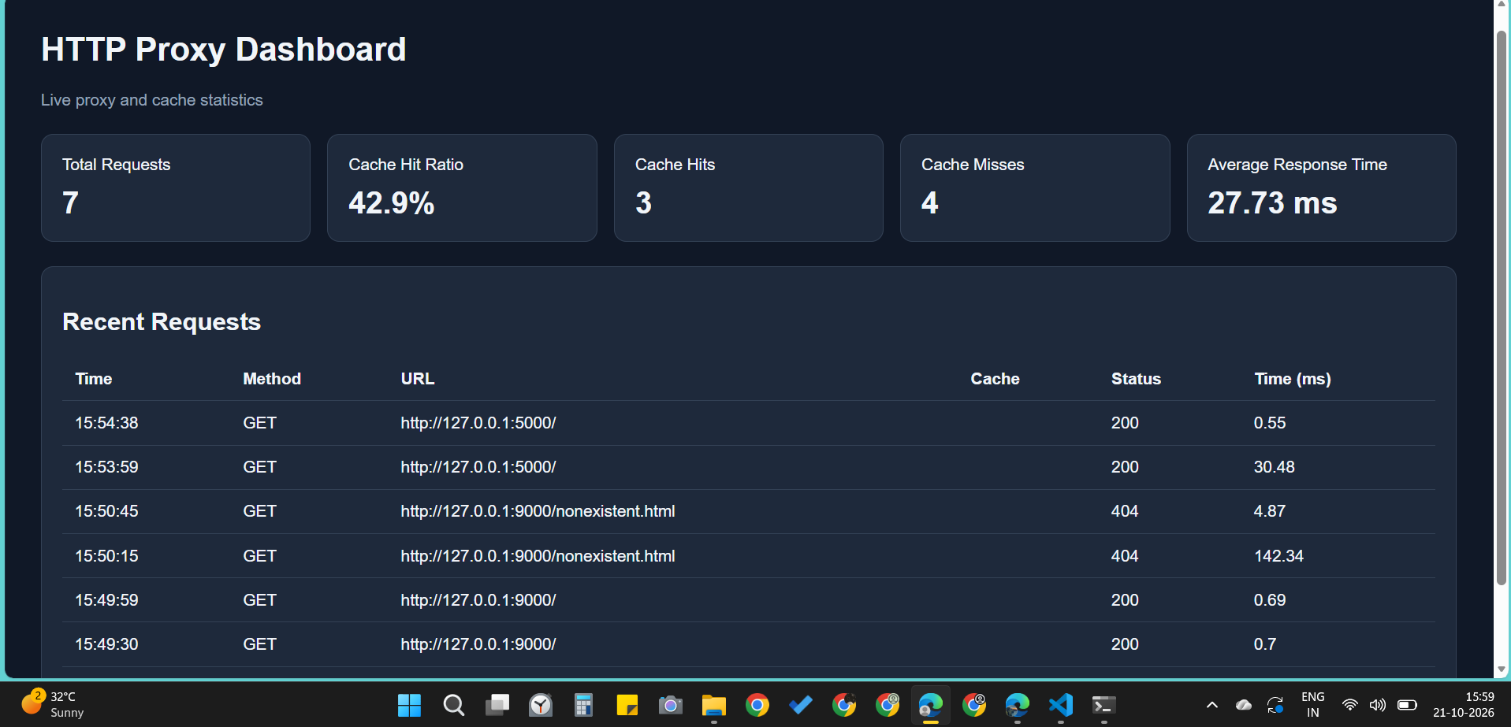
Testing and Results
Test: cURL request through proxy to local origin, then repeat the same URL.
Expected: first request is fetched and cached; the repeat is served from cache.
Observed during development: local forwarding returned HTTP 200; logs showed cache miss/store, then cache hit.
Dashboard snapshot: 7 requests, 3 hits, 4 misses
ID | Test | Expected | Status
T1 | GET / through proxy to local origin | Origin response relayed | Observed pass
T2 | Repeat the same eligible GET | Miss and store, then hit | Observed pass
T3 | Request blocked domain (example.com) | HTTP 403, not forwarded | Re-run to capture
T4 | Repeat request after short TTL | Expired entry not served | Re-run to capture
T5 | Open dashboard and /api/data | Metrics endpoint responds | Re-run to capture
T6 | Request a nonexistent local path | Origin error relayed | Re-run to capture
T7 | Two concurrent requests | Listener not blocked | Re-run to capture
No formal performance benchmark is claimed; latency and traffic reduction are not quantified.
Computer Networks Laboratory CSE20110
50 seconds
Notes:
Suggested time: 50 seconds. Replace all bracketed placeholders and prompts with your own project details. Keep explanations brief. Total time across slides 1–7 is 5 minutes, including the demonstration. Slide 8 is for reference during questions. Show actual evidence. Explain the output and mention any failed or partial tests. Do not invent performance figures.

Slide 6
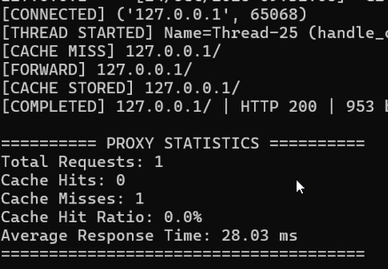
Working Demonstration
Function to demonstrate
Core feature: demonstrate HTTP forwarding, caching and domain blocking.
1. Start origin: python -m http.server 9000 --bind 127.0.0.1
2. Start the project: python main.py
3. Run: curl.exe -i -x http://127.0.0.1:8080 http://127.0.0.1:9000/
4. Repeat the exact command and show CACHE HIT in the logs/dashboard.
5. Request http://example.com/ when it is configured as blocked.
Computer Networks Laboratory CSE20110
65 seconds
Notes:
Suggested time: 65 seconds. Replace all bracketed placeholders and prompts with your own project details. Keep explanations brief. Total time across slides 1–7 is 5 minutes, including the demonstration. Slide 8 is for reference during questions. Prepare the project before the timer starts. Keep the demo to about one minute. Keep a screenshot or short recording ready as a backup, and identify it as recorded evidence if used.

Slide 7
Conclusion and Contributions
Outcome: working educational HTTP proxy with forwarding, blocklist, in-memory cache and dashboard.
Application: learning, request filtering, and observing repeated-resource caching.
Limitation: no HTTPS CONNECT tunnelling; cache is lost on process restart; only a subset of HTTP behaviour is supported.
Future scope: HTTPS tunnelling, persistent cache, stronger HTTP compliance and controlled performance tests.
Swapna Khire – Analytics and dashboard
Dishita Rao – Configuration, test plan and integration setup
Navya Tiwari – Cache implementation
Pratiti Patlia – Proxy server and HTTP handling
AI use: assistance used to organize report sections and clarify networking concepts; the team is responsible for verifying implementation and results.
Computer Networks Laboratory CSE20110
30 seconds
Notes:
Suggested time: 30 seconds. Replace all bracketed placeholders and prompts with your own project details. Keep explanations brief. Total time across slides 1–7 is 5 minutes, including the demonstration. Slide 8 is for reference during questions.

Slide 8
References
[1] R. Fielding, M. Nottingham and J. Reschke, “HTTP Semantics,” RFC 9110, IETF, June 2022.
https://www.rfc-editor.org/rfc/rfc9110
[2] R. Fielding, M. Nottingham and J. Reschke, “HTTP Caching,” RFC 9111, IETF, June 2022.
https://www.rfc-editor.org/rfc/rfc9111
[3] Python Software Foundation, “socket — Low-level networking interface.”
https://docs.python.org/3/library/socket.html
Project repository: https://github.com/pratitipatlia/http-proxy-server
Computer Networks Laboratory CSE20110
Backup slide
Notes:
Suggested time: Backup slide. Replace all bracketed placeholders and prompts with your own project details. Keep explanations brief. Total time across slides 1–7 is 5 minutes, including the demonstration. Slide 8 is for reference during questions.

