Slide 1
Cyclistic Bike Share
Last updated: August 6, 2024

Slide 2
Executive Summary
Rides increase in Summer season.
Members prefer weekdays, casual riders weekend.
Members do not use docked bikes.
Members peak 8 AM and 17 PM, casual riders evening.

Slide 3
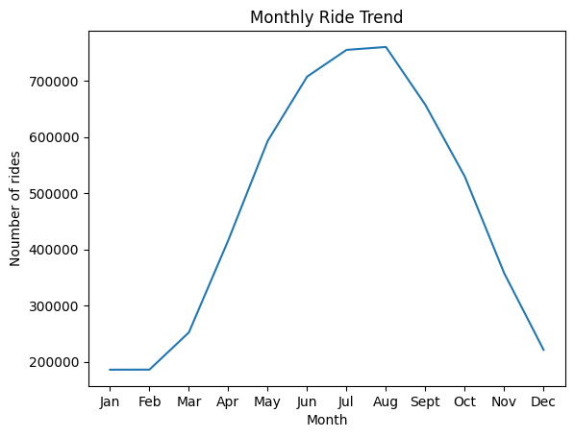
Monthly Ride Trend
Rides peak in month of jun, july, aug
i.e. Summer

Slide 4
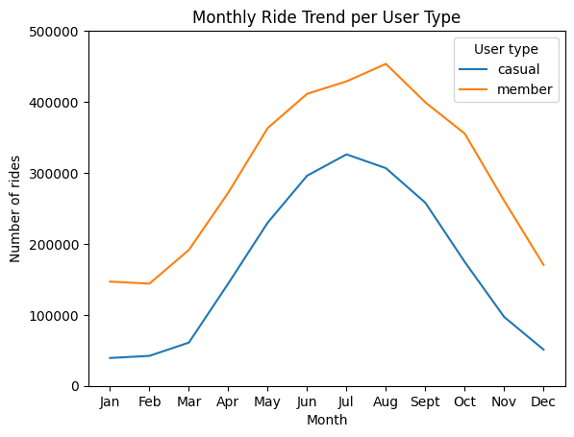
Monthly Ride Trend by User Type
Members take more rides than casual
Riders throughout the year.

Slide 5
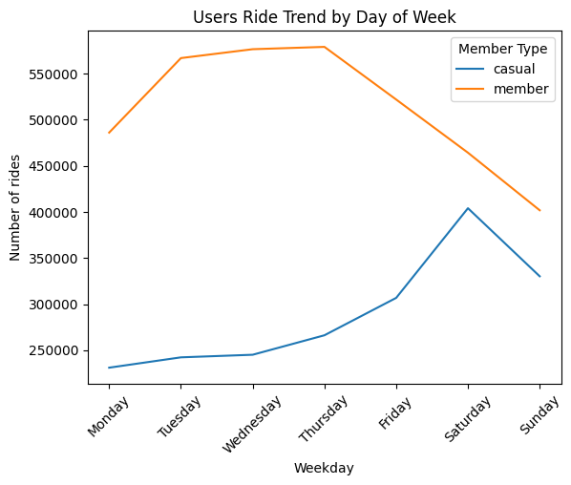
Weekly Ride Trend by User Type
Members prefer weekdays.
Casual riders prefer weekends.

Slide 6
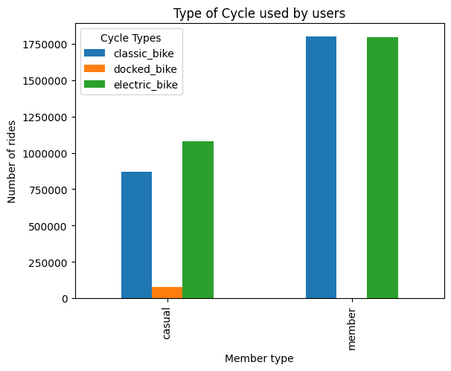
Type of cycle used by user type
Electric and classic bikes both are used.

Slide 7
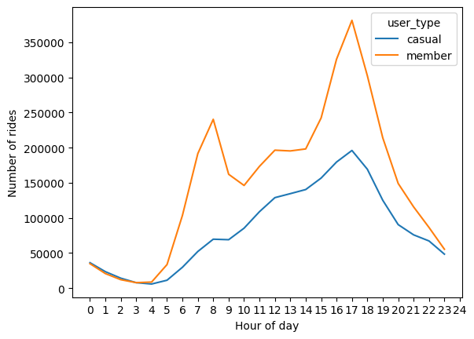
Hourly Ride Trend by User Type
Members prefer Weekdays.
Casual riders prefer Weekends.

Slide 8
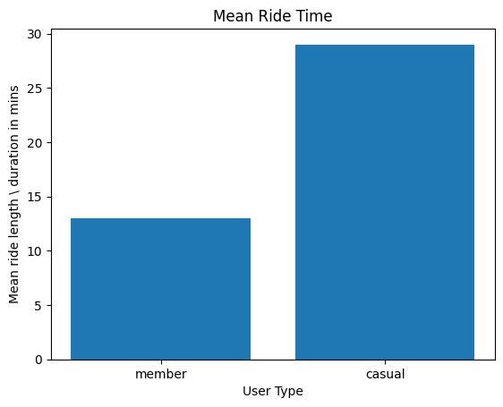
Mean Ride Duration by User Type
On Average, Casual riders drive more than
members.

Slide 9
Data

Slide 10
Data Frame
<class 'pandas.core.frame.DataFrame'>
Index: 5621879 entries, 0 to 224072
Data columns (total 15 columns):
# Column Dtype
--- ------ -----
0 ride_id object
1 rideable_type object
2 started_at datetime64[ns]
3 ended_at datetime64[ns]
4 start_lat float64
5 start_lng float64
6 end_lat float64
7 end_lng float64
8 user_type object
9 ride_len timedelta64[ns]
10 ride_len_min int64
11 started_at_day int32
12 started_at_month int32
13 started_at_hour int32
14 started_at_dayname category
dtypes: category(1), datetime64[ns](2), float64(4), int32(3), int64(1), object(3), timedelta64[ns](1)
memory usage: 584.4+ MB
<class 'pandas.core.frame.DataFrame'>
Index: 5719877 entries, 0 to 224072
Data columns (total 13 columns):
# Column Dtype
--- ------ -----
0 ride_id object
1 rideable_type object
2 started_at object
3 ended_at object
4 start_station_name object
5 start_station_id object
6 end_station_name object
7 end_station_id object
8 start_lat float64
9 start_lng float64
10 end_lat float64
11 end_lng float64
12 member_casual object
dtypes: float64(4), object(9)
memory usage: 610.9+ MB

