Slide 1
Google Cluster: Machine & Job Level Analysis
April 9, 2021
School of Information Studies
Research Symposium
Presenter: Prathamesh Pradip Datar
Faculty Supervisor: MD Tariqul Islam “Pavel”

Slide 2
Introduction
Industries and workloads are shifting towards cloud
Modern cluster management systems are evolving to cope with managing diverse cloud applications on heterogeneous clusters
Vast amounts of data available for analysis

Slide 3
Objectives
Conducting exploratory analysis to reveal underlying trends required to build an efficient cloud scheduler
Taking a top-down approach to decode complex decisions taken by cloud schedulers
Focusing on machine and collection level aspects to uncover valuable insights that will ensure high service reliability and availability

Slide 4
Cloud Components
Clusters – A set of machines, packed into physical enclosures, and connected by a high bandwidth cluster network
Cell – A set of machines, typically all in a single cluster, that share a common cluster-management system that allocates work to machines
Jobs – A collection of one or more tasks
Tasks – Linux program, consisting of multiple processes, to be run on a single cluster

Slide 5
Data Components
Machine Events – Records ADD, REMOVE, UPDATE Events
Machine Attribute Events – Records Machine Property changes
Collection Events – Records Job lifecycle Events
Instance Events – Records Task events
Instance Usage – Resource Usage stats

Slide 6
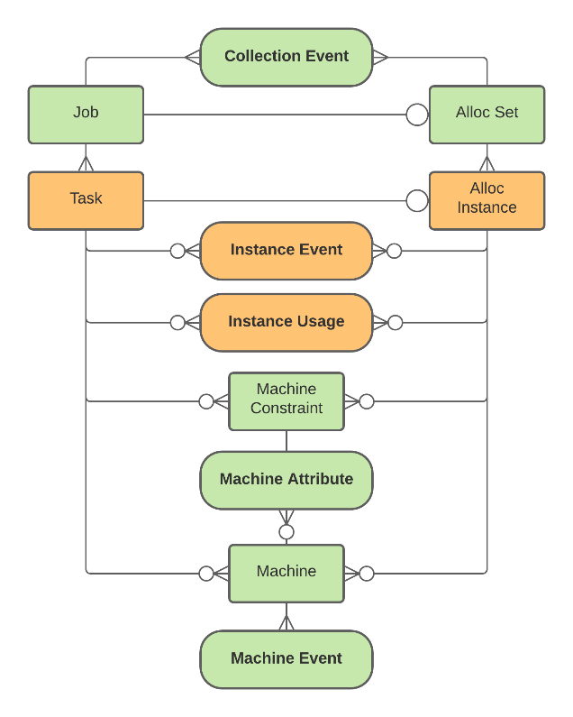
Entity-Relationship Model

Slide 7
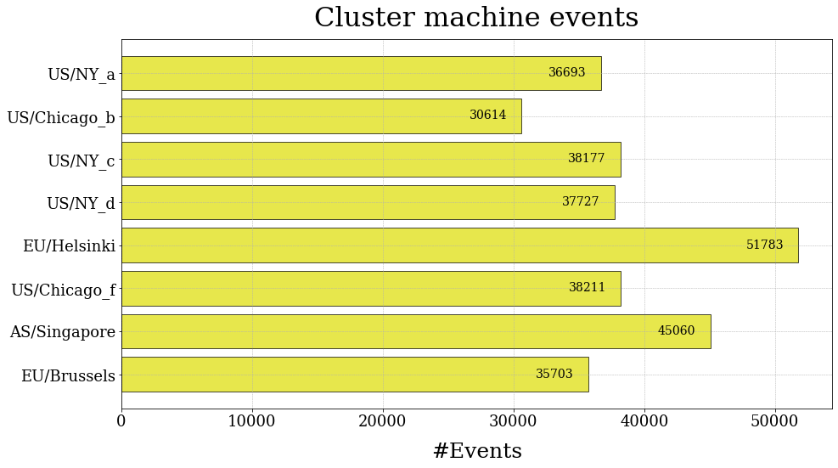
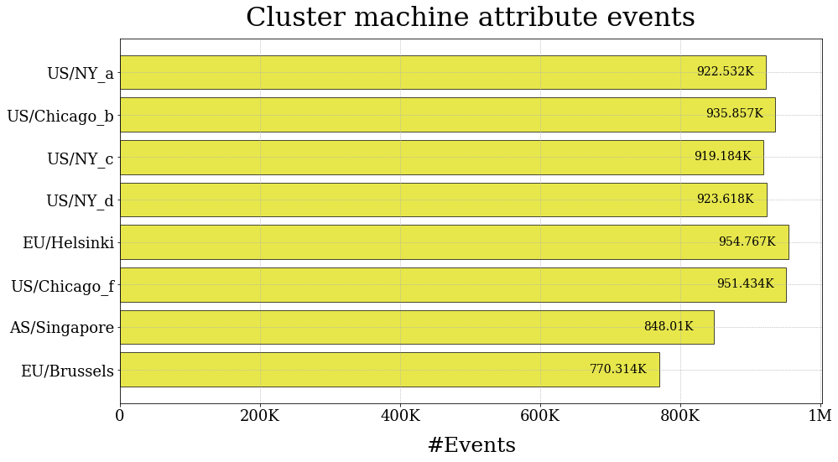
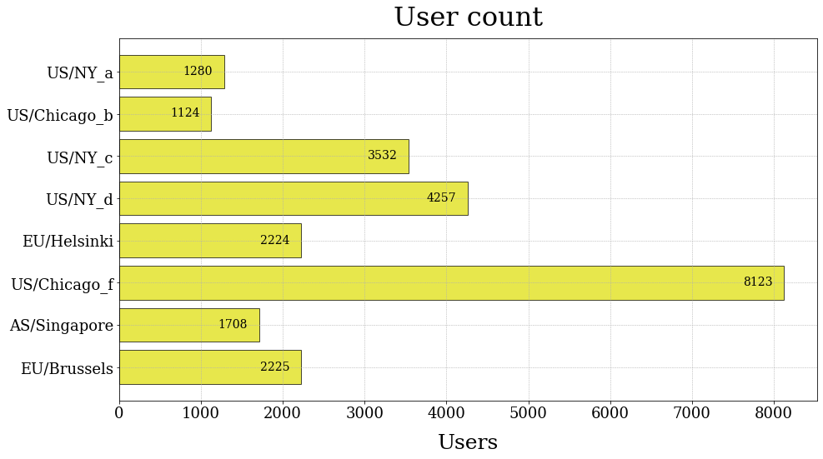
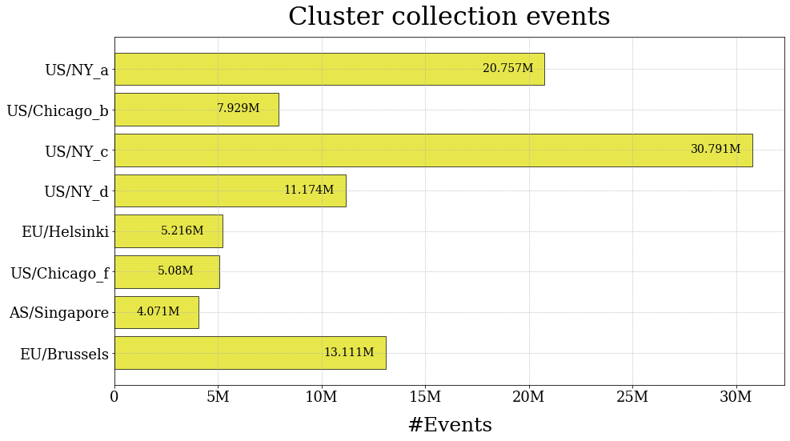
Data at Scale

Slide 8
Machine Events
There are three types of machine events:
ADD: Machine becoming available to the cluster.
REMOVE: Machine removed from the cluster. Machine removal could indicate system failure or scheduled maintenance.
UPDATE: The machine has its resources changed when it was available to the cluster.
A typical machine lifecycle is as follows:
Machines become available to the scheduler to host tasks and alloc instances. While being operational, they may experience changes in resource availability. They might get removed and become unavailable due to a system failure or scheduled maintenance. They become available to the programmed after resolving the problem.

Slide 9
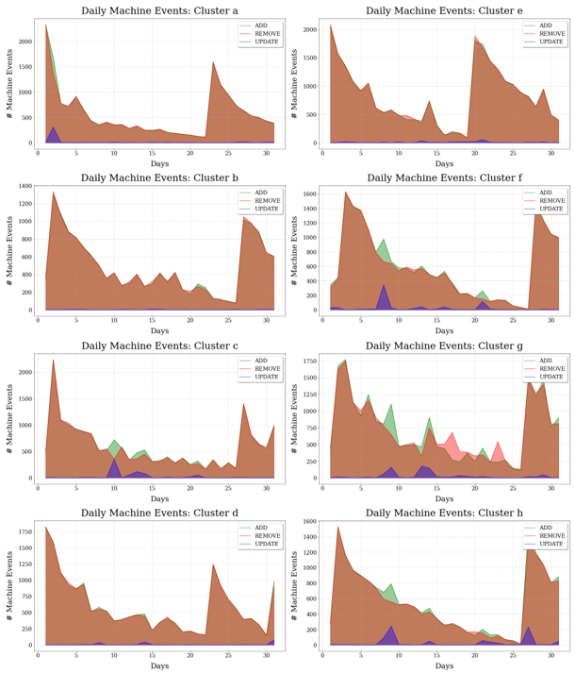
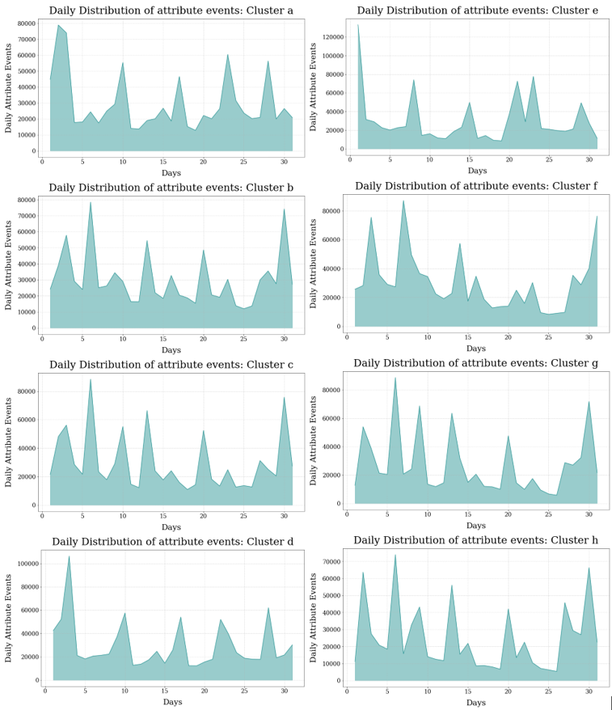

Slide 10
Machine Downtime Analysis
Machine downtime is the time a machine was unavailable for task scheduling.
Machine downtime is the time difference between REMOVE and subsequent ADD events.
For the cases where we do not have a subsequent ADD event, we have considered the end of the trace time.

Slide 11
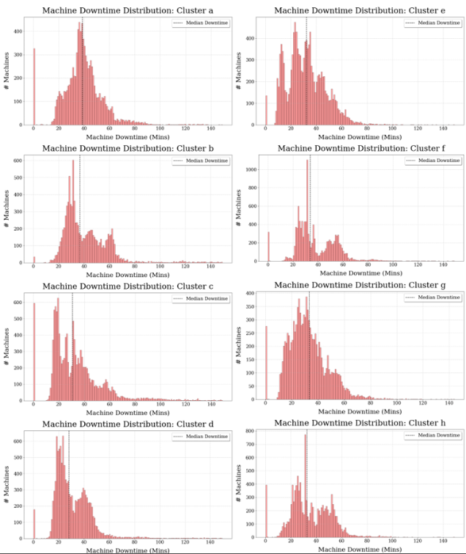
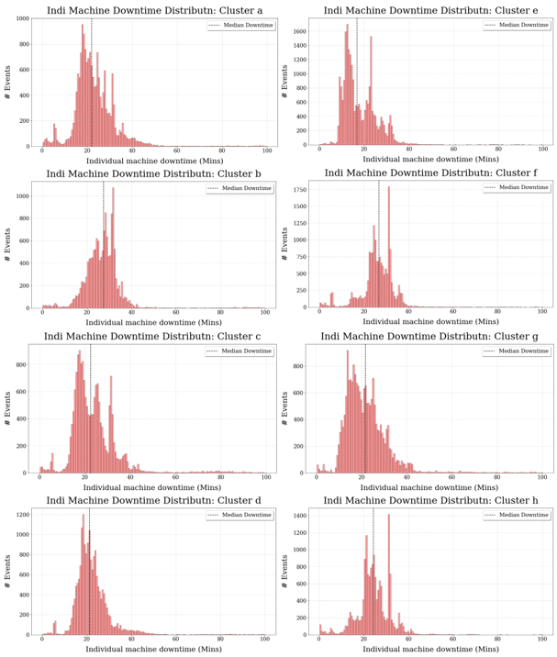

Slide 12
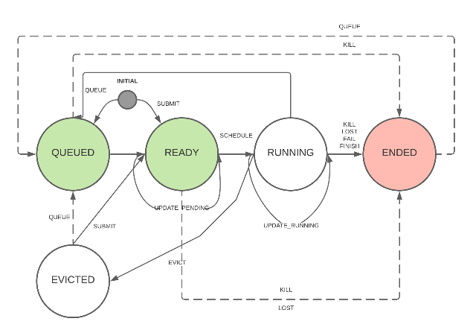
Collection Events

Slide 13
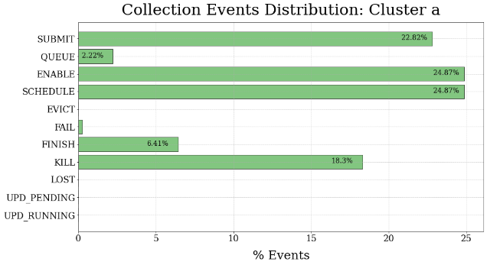
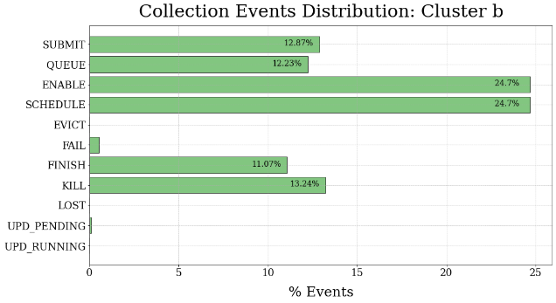
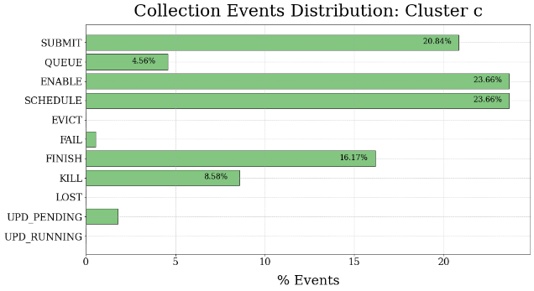
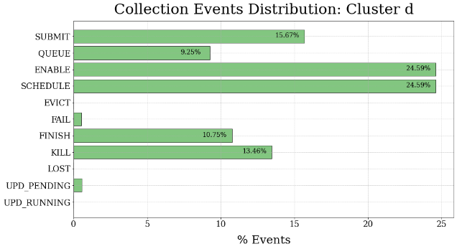
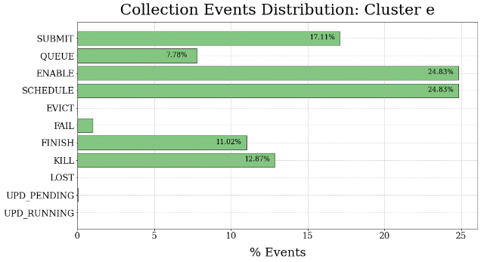
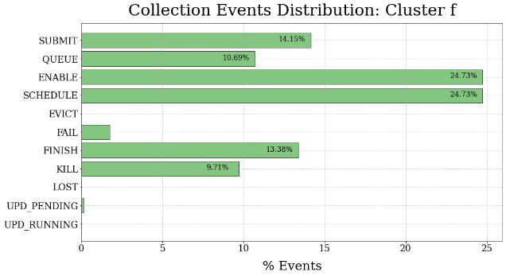
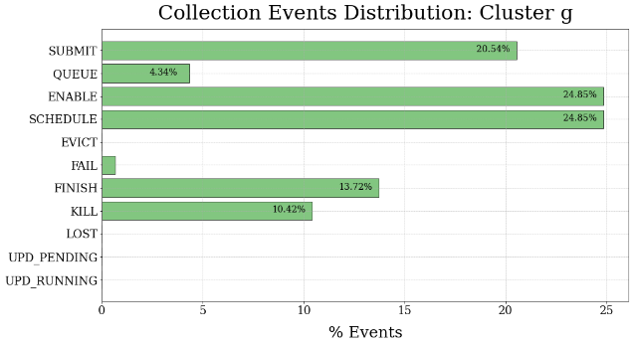
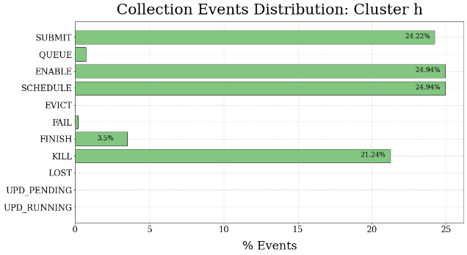
Collection Events Distribution

Slide 14
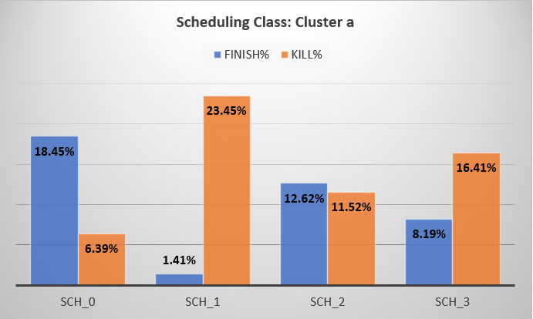
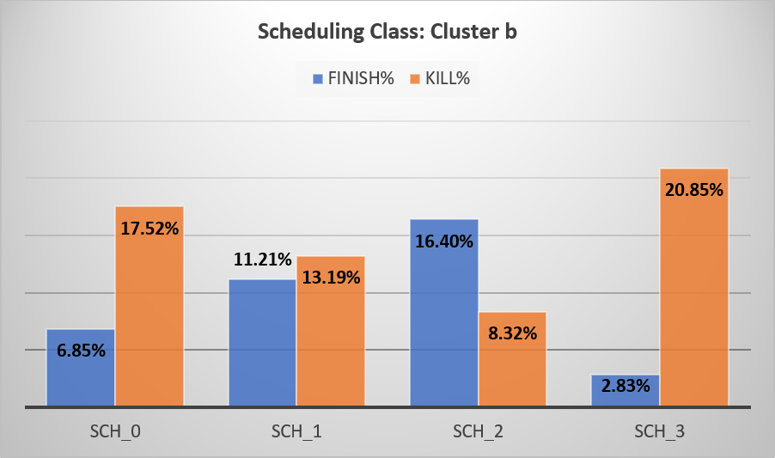
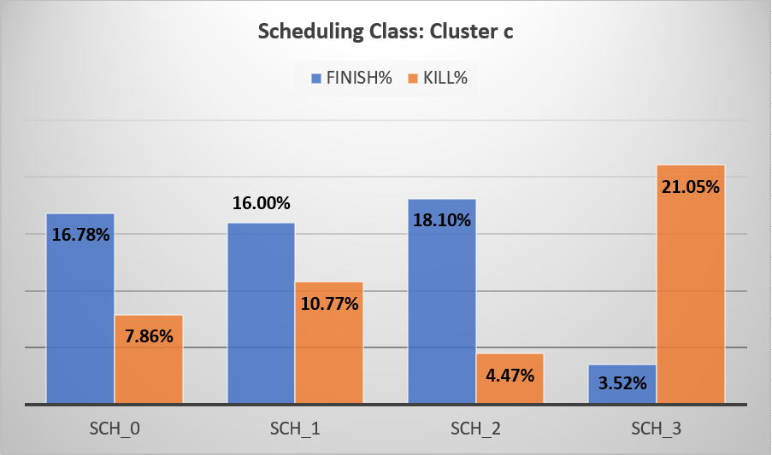
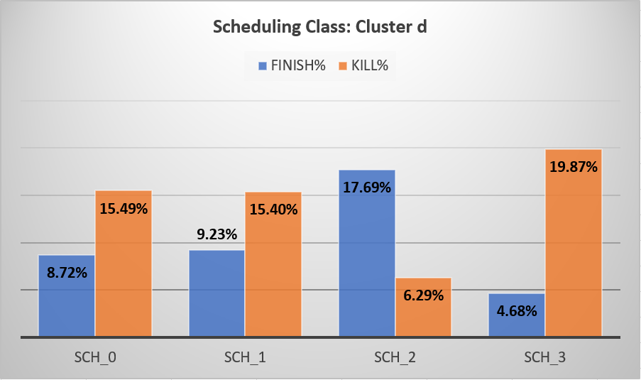
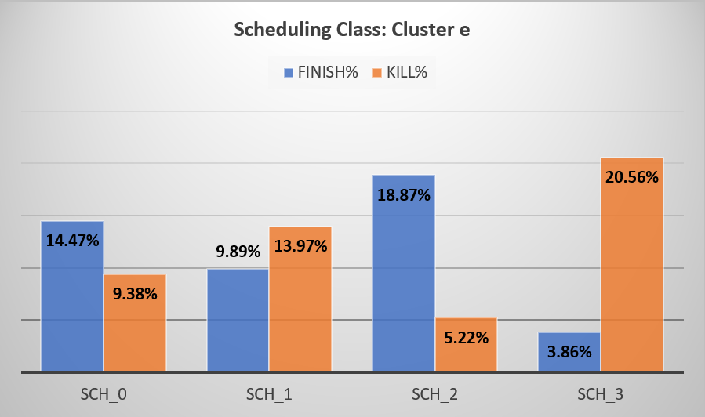
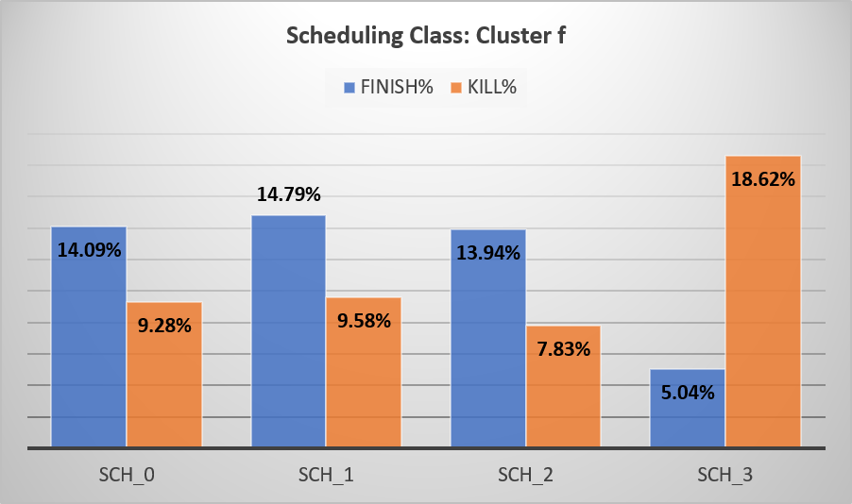
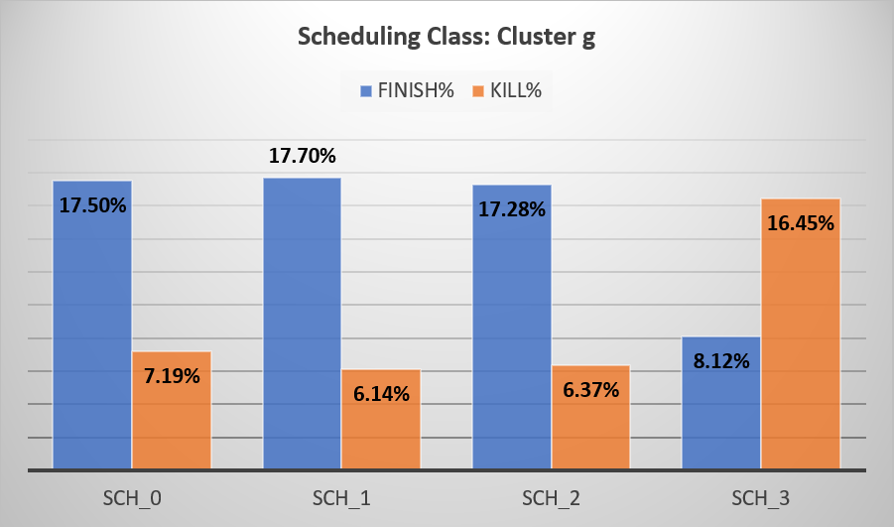
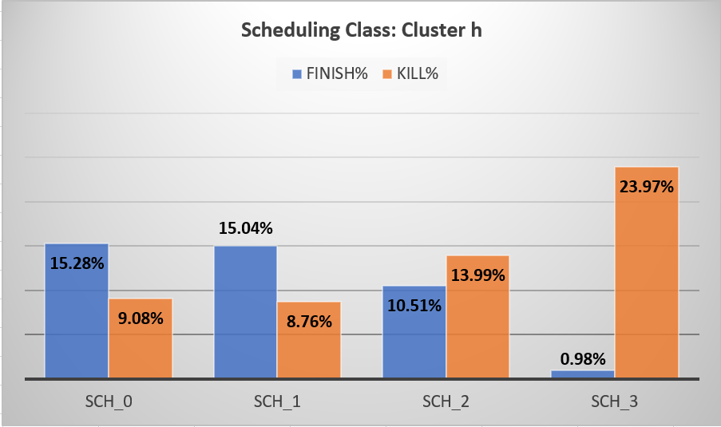
Scheduling Class FINISH and KILL Rates

Slide 15
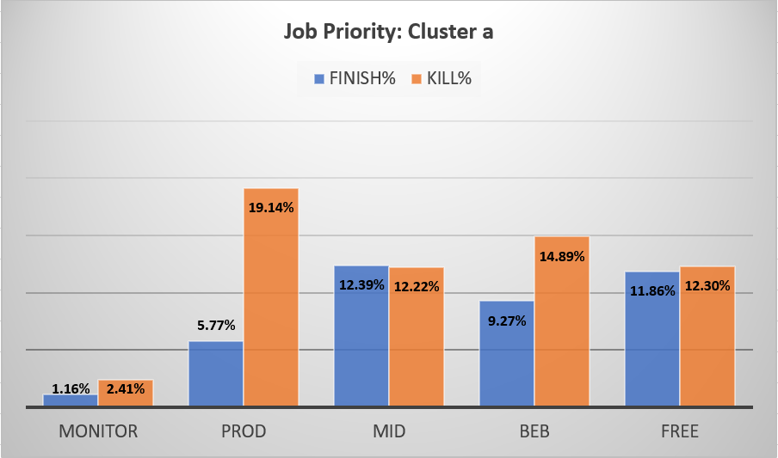
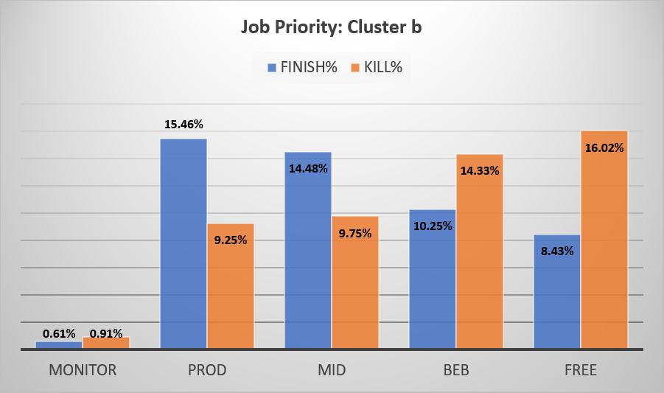
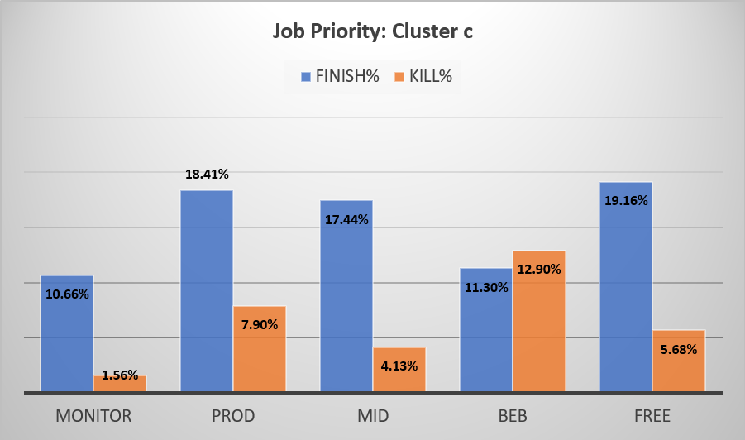
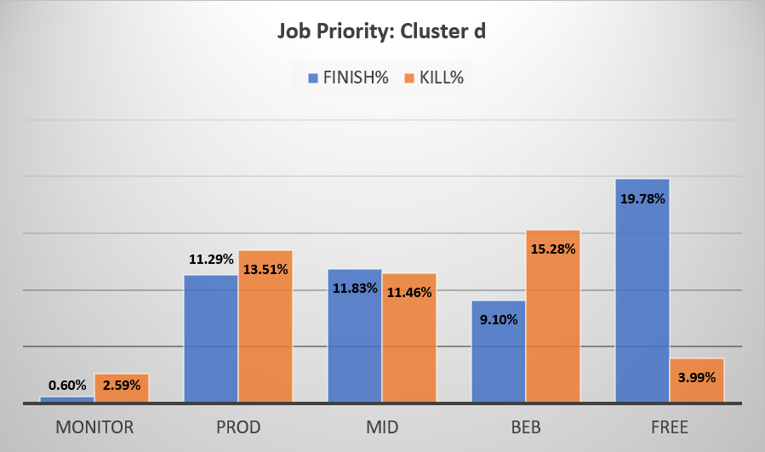
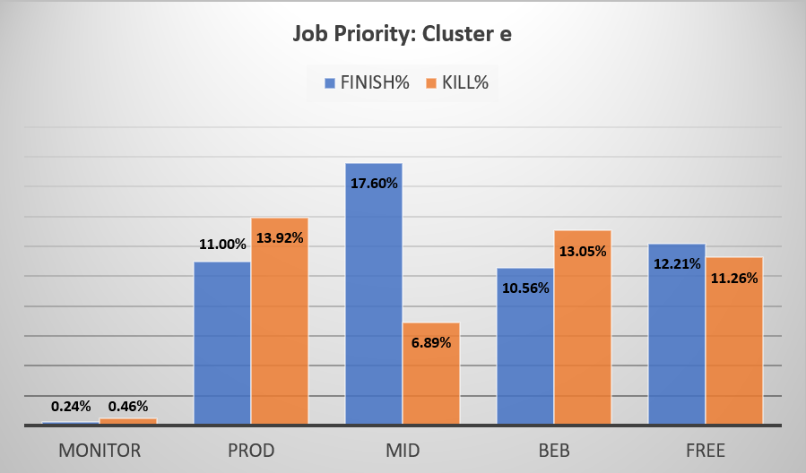
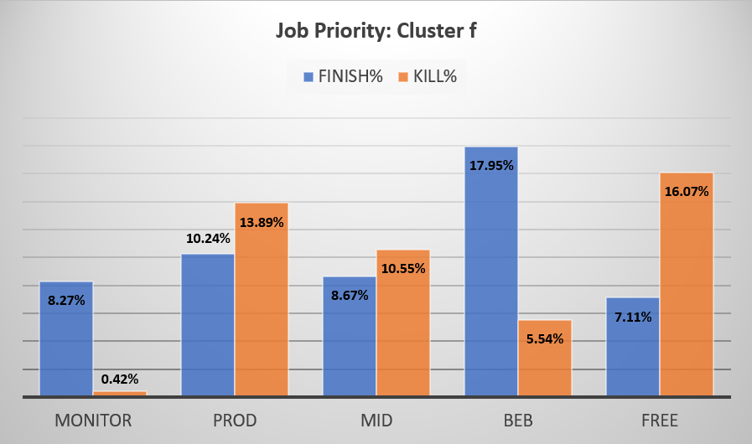
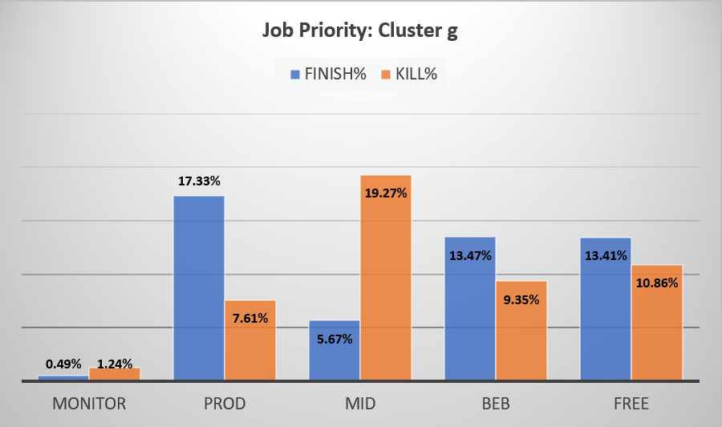
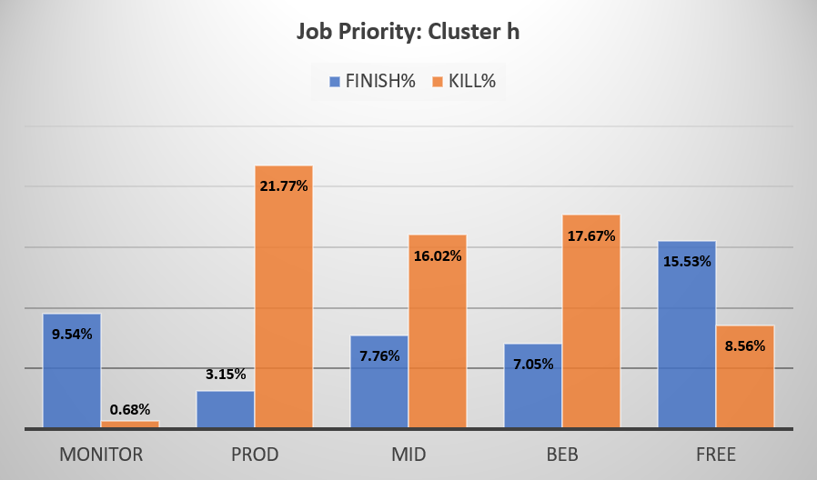
Job Priority FINISH and KILL Rates

Slide 16
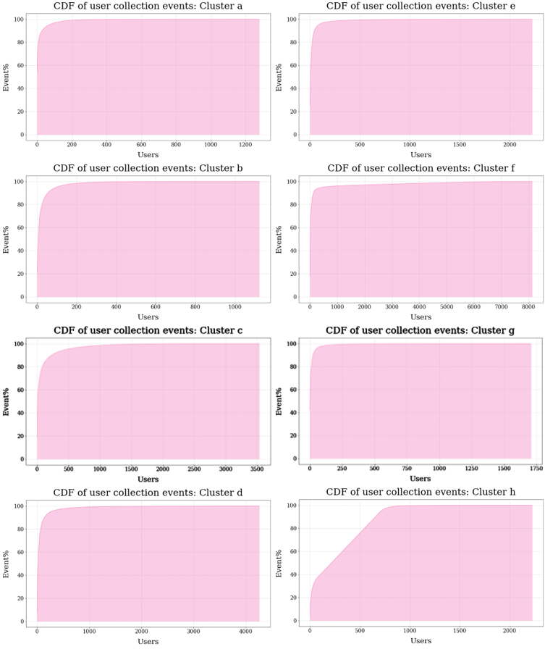
User Event Rates

Slide 17
Journey Ahead
We wish to dig deeper in understanding the remarkable shift of free tier jobs to best effort batch jobs that will help cater to the users’ requirement needs
We plan to employ a parallel research to combine queuing delay for collections and scheduling delays for tasks to better visualize task life cycle inside best effort batch tier jobs
We plan to investigate quantitative contributions of vertical scaling to reduce slack resources.
We would like to draw strong conclusions in how heterogeneity of machines is affecting machine downtimes

Slide 18

Questions

