Slide 1

IST 615: Cloud Project Presentation ‘CoronaEXT’
Prathamesh Datar
Sheetal Chowdhary
Shradha Kulkarni
Shripad Laddha
Vasundhara Patil

Slide 2

Refined Business Idea
Battling COVID-19 is an unprecedented challenge
Huge disparity between public awareness and availability of testing facilities
Our CoronaEXT web-app is a unique solution that will help communities get back up and running
Innovative one stop cloud approach to track COVID-19 cases to increase general awareness
CoronaEXT will help users travel without worrying about misuse of location data
CoronaEXT will help update users about nearest testing centers
Users can now assess their symptoms on the fly
Notes:
General overview about covid-19, stats about COVID, say that there are competetors but no one app provides one stop solution.
Innovative
Unique
Problem solving
Profitable
How ? we came up with this idea
One stop solution for tracking covid cases
Website and app
Find nearest testing centre
Login, take personal demographics from users
Get access to location data
1.. Testing centre tags address of positive cases
User filling out form to assess symptoms and get suggestion to consult a doctor

Slide 3
Assumptions
Stakeholders share COVID-19 data willingly
Testing centers only share zip code and number of cases with no personal identifiable information of users
Users would take initiative to share their location data
Location data would get erased every 14 days
Data managers will update data to central database

Slide 4
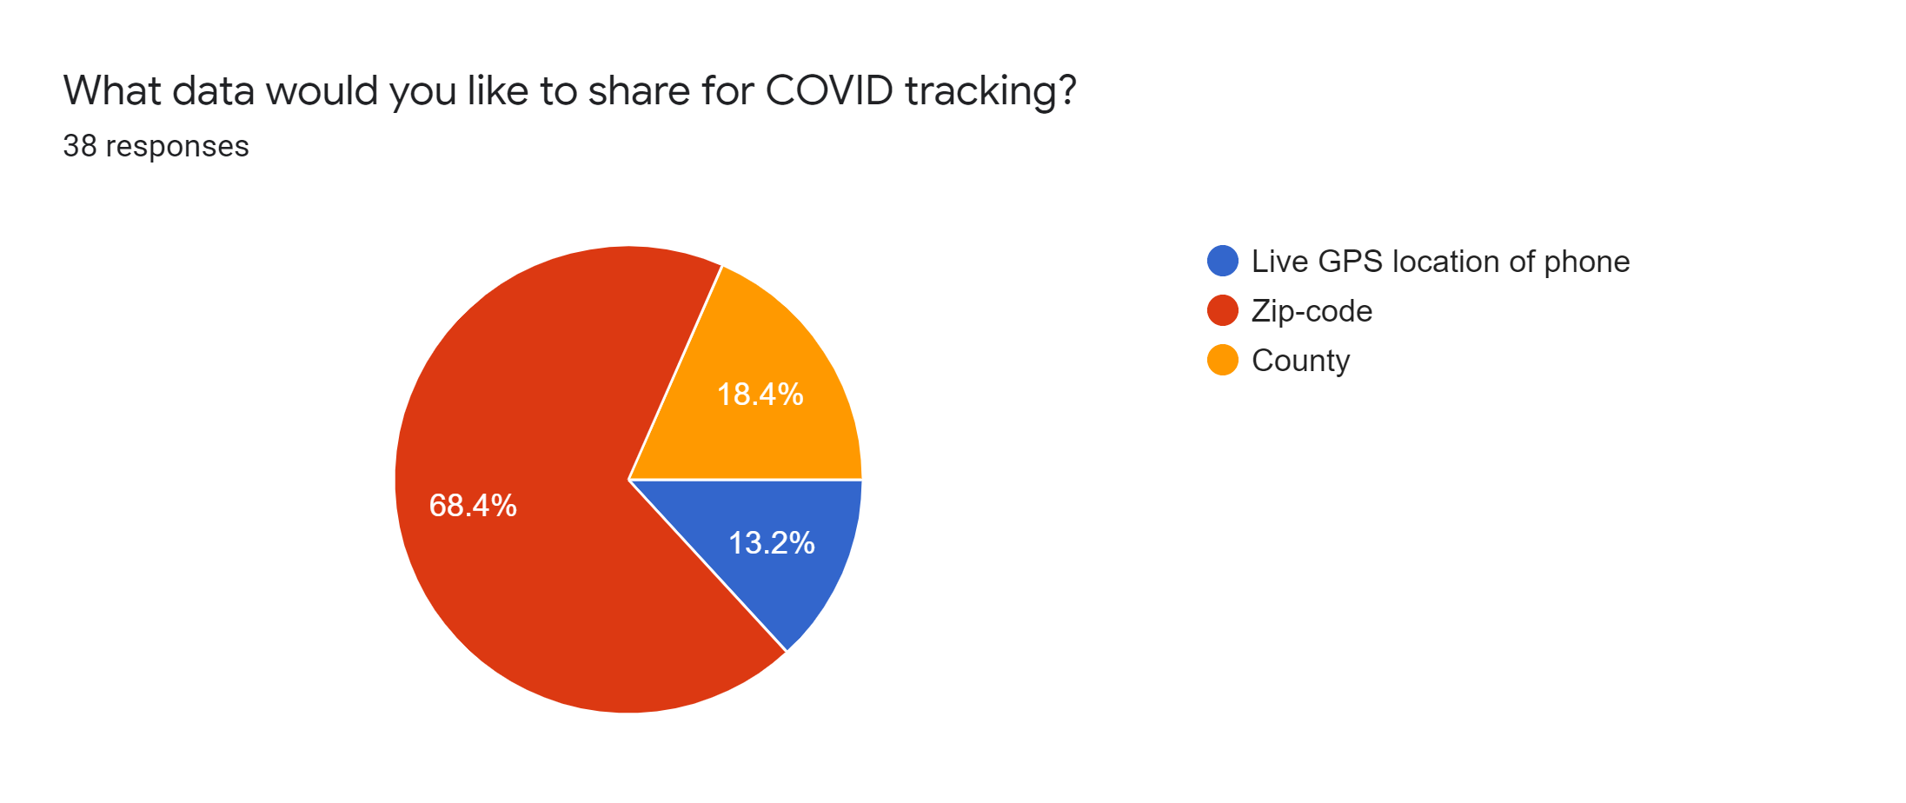
Scope: Functionalities Of The Website
Based on market research we selected zip code as the primary parameter for COVID-19 tracking
Check COVID-19 cases based on your zip code
Details will be visible on the website of the user to notify the number of cases nearby their entered location
Local testing centers information in your area
Self-assessment survey
Diagnose your symptoms by filling out a survey

Slide 5
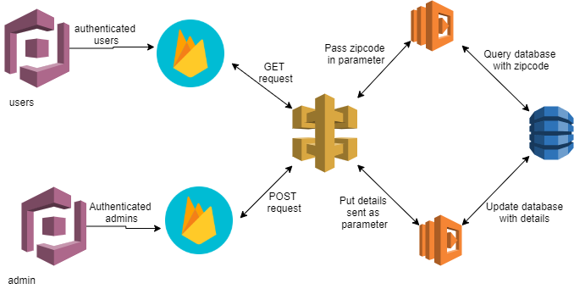
Refined Architecture and Tech Stack
Notes:
AWS Cloud Services – cognito, api gateway, lambda, dynamodb
Hosting on firebase
Labda code in python 3.7
Front end Languages
Javascript, HTML, CSS, ajax
AWS cognito: let users sign-up, sign-in and it provides access control to your web-apps easily and quickly. It supports multi-factor authentication and encryption of data;. It is also HIPPA eligible
Firebase: mobile application development platform that helps build, improve your app. It integrates with real time database sdks, so we have hosted our webpages on Firebase
API gateway: mgmt tool that sits between a client and collection of backend services. It accepts all API calls, aggregates from various services required to fulfill them and return the appropriate result.
AWS Lambda: helps run your code when triggered on event using only the compute resources needed. It runs code to retrieve information from dynamodb returns data back to API to app. You can use AWS lambda to extend other AWS services with custom logic, or create your own back end services that operate at AWS scale, performance and security.
getCases and postCases methods in Lambda
Dynamodb: supports key value and document data structure. Here we are using zipcode as key and cases, hospital names as values. Data is first distributed into different partitions by hashing on the partition key.

Slide 6

Privacy and Security
Disclaimer on user login
No unauthorized access to user data
Data manager – IAM role
API security
Exception handling
Notes:
1. disclaimer
2. through user and admin registeration and login
3. IAM roles and policies will be assigned to specific people....thus un-authorised access to central database and services will be prevented
4. API's are not publicly accessible
5. Code level exception handeling to prevent missing values, numeric/text type data entry, buffer overflow prevention and alerting is handeled in Python code as well as html and javascript

Slide 7

HIPAA Privacy Considerations
HIPAA Law Violations | Our Product considerations
Impermissible disclosures of protected health information (PHI) | We are not extracting any patient records; the cases data are sent to our DBA by the hospitals
Unauthorized access of PHI | All user emails for verified before accessing the website
Failure to implement access controls to limit who can view PHI | Only DBA will have access to the cases data provided by the hospitals. IAM roles and security policies will handle security aspects.
Failure to terminate access rights to PHI when no longer required | The database will be refreshed every 14 days

Slide 8

Future Goals and Expectations
Implementation of a functionality where users can share their live location input and in-return, get the number of cases in their nearby area.
Push real-time alerts to users when new cases are detected in their location
After COVID-19 the web-app can be used for any CDC applications which will give them centralized view.
Improved User Interface

Slide 9

Cost and Revenue Model
We are anticipating 1 M users in 3 months, 10 M in 6 months and 30 M in 12 months
42000 Zipcode and 2 healthcentres per zipcode i.e. 84,000 admins
Application development, upgradation and maintenance and licensing will cost around 100k$ per year
We will just keep 15 releases of around 200 MB size at a time on Firebase which will help us to use Firebase without any charges
Service | 3 months | 6 months | 1 year
AWS Cognito (for Users) | $ 13,245.00 | $ 100,995.00 | $ 400,995.00
AWS Cognito (for Admins) | $ 561.00 | $ 1,122.00 | $ 2,244.00
API Gateway (User Requests) | $ 113.51 | $ 1,248.56 | $ 8,058.32
API Gateway (Admin Requests) | $ 28.58 | $ 57.16 | $ 114.33
Lambda (for Users) | $ 485.40 | $ 5,524.81 | $ 35,843.67
Lambda (for Admins) | $ 106.91 | $ 213.82 | $ 427.65
DynamoDB | $ 50.64 | $ 468.78 | $ 2,925.06
Total | $ 14,591.04 | $ 109,630.13 | $ 450,608.02
Notes:
Major cost is the cloud services and application development/maintenance cost.
The figures you see are estimates based on AWS Price Calculator and are cumulative
Gradual growth in the number of users 1 M to 30 M in 12 months
450k+100k = 550k cost

Slide 10
Cost and Revenue Model
Service | Charges
AWS Cognito | Cognito User Pool 50,000 MAUs free Unit Cost Range - $0.0055 to $0.0025
API Gateway | Amazon API Gateway API call charges + Data Transfer Charges (Request + Response) For REST APIs, the API Gateway free tier includes one million API calls per month for up to 12 months, the first 333 million - $3.50
Lambda | Monthly Request Charges + Monthly Compute Charges Free usage tier includes 1M free requests per month and 400,000 GB-seconds of compute time per month. Requests $0.20 per 1M requests Duration $0.0000166667 for every GB-second
DynamoDB | Read & Write + Data Storage + Backup & Restore 1 backup every month and 1 restore every quarter
Firebase | Free Storage 10 GB , then $0.026/GB Free Transfer - 360 MB/day, then $0.15/GB
Notes:
Cognito – 1M, 10M, 30M, 84000
API Gateway – Each user 10 requests on an avg in a month
Admin user makes 1 request every day
(3 KB + 0.3 KB)
Caching
For better performance and faster API execution, you can optionally provision a dedicated cache for each stage of your APIs.
Lambda – each user making 10 requests every month
Each Request Runs for 1 second and we allocated 1 GB memory to our function
DynamoDB – 25GB, 50GB, 100 GB
Firebase – 200MB – 5 releases each month – 3 months – 15 releases – 3000MB – 3 GB
We plan to delete previous releases- At a time 15

Slide 11
Cost and Revenue Model
Revenue is generated through advertising and user donations
We expect advertisement revenue of around ~$292k annually
User donations of ~300$k
Government Sponsorship
We are expecting government and health-care providers sponsorship of ~$100K
Revenue Source | 3 months | 6 months | 1 year
Advertisement | $ 45,000 | $ 112,500 | $ 292,500
User Donations | $ 50,000.00 | $ 100,000.00 | $ 300,000.00
Govt. Grant | $ 25,000.00 | $ 50,000.00 | $ 50,000.00
Total | $120,000 | $262,500 | $642,500
At the end of 1 year we are seeing profit as ~$142,000k
Notes:
Sheetal
Advertisements from health centres and urgent cares:
Advertising masks, thermometers, sanitizers other medical essentials in the nearby locations take up major advertisement space
If banner ads are 50,000 ads per day and CPC is 750, then revenue will be $75 per day

Slide 12

Demo
User Website: https://coronaext.auth.us-east-1.amazoncognito.com/login?response_type=token&client_id=4vg9qkjp5vcatisdtvd6pvac13&redirect_uri=https://covidextusers.web.app
Admin Website: https://coronaextadmin.auth.us-east-1.amazoncognito.com/login?response_type=token&client_id=6dmg88qjl1iqi1a7kt8l35f1uf&redirect_uri=https://covidextadmin.web.app/

Slide 13
Thank you "Join us to stop the spread ”
Notes:
Please Invest in our company to help societies tackle COVID-19

