Slide 1
Air Conditioner Controller using Fuzzy logic
41166 – Prathamesh sonawne
41169 – Yuvraj Tambe
Notes:
<number>

Slide 2
Objective
To develop an Air Conditioner Controller using Fuzzy Logic.
Scope
Fuzzy logic is used in Natural language processing and various intensive applications in Artiﬁcial Intelligence.
Fuzzy logic is extensively used in modern control systems such as expert systems.
Fuzzy Logic is used with Neural Networks as it mimics how a person would make decisions, only much faster.
It is done by Aggregation of data and changing into more meaningful data by forming partial truths as Fuzzy sets.

Slide 3

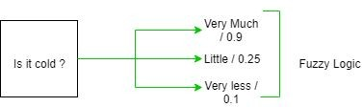
Introduction
The term fuzzy refers to things which are not clear or are vague. In the real world many times we encounter a situation when we can’t determine whether the state is true or false, their fuzzy logic provides a very valuable ﬂexibility for reasoning.
In this way, we can consider the inaccuracies and uncertainties of any situation.
In the boolean system, truth value, 1.0 represents absolute truth value and 0.0 represents absolute false value.
But in the fuzzy system, there is no logic for absolute truth and absolute false value. But in fuzzy logic, there is intermediate value to present which is partially true and partially false

Slide 4
ArchiteCture
Its Architecture contains four parts :
RULE BASE: It contains the set of rules and the IF-THEN conditions provided by the experts to govern the decision making system, on the basis of linguistic information. Recent developments in fuzzy theory over several effective methods for the design and tuning of fuzzy controllers. Most of these developments reduce the number of fuzzy rules.
FUZZIFICATION: It is used to convert inputs i.e. crisp numbers into fuzzy sets. Crisp inputs are basically the exact inputs measured by sensors and passed into the control system for processing, such as temperature, pressure, rpm’s, etc.

Slide 5
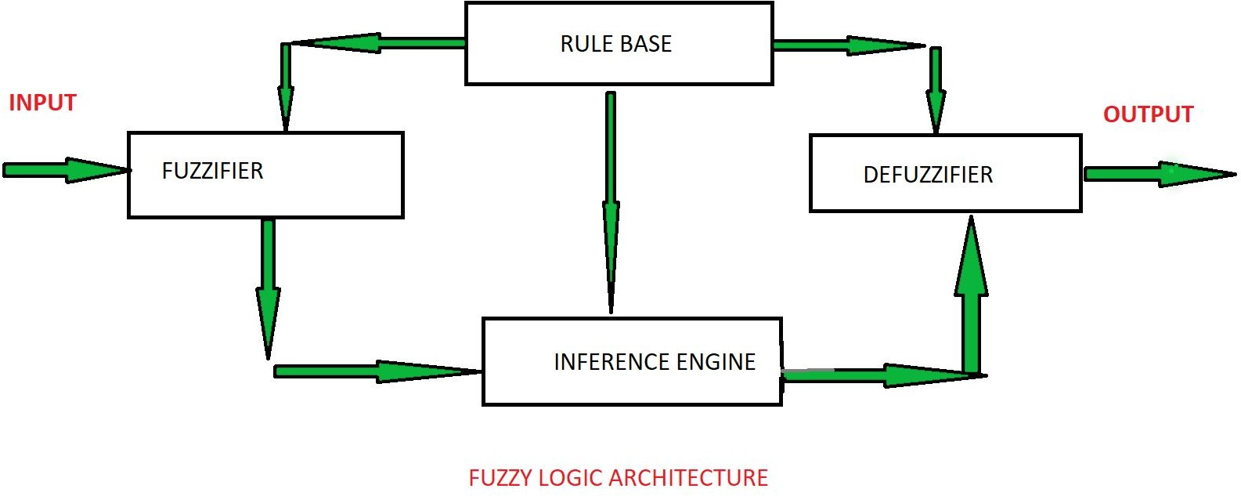
INFERENCE ENGINE: It determines the matching degree of the current fuzzy input with respect to each rule and decides which rules are to be ﬁred according to the input ﬁeld. Next, the ﬁred rules are combined to form the control actions.
DEFUZZIFICATION: It is used to convert the fuzzy sets obtained by inference engine into a crisp value. There are several defuzziﬁcation methods available and the best suited one is used with a speciﬁc expert system to reduce the error.

Slide 6
Membership Function
A graph that deﬁnes how each point in the input space is mapped to membership value between 0 and 1.
Input space is often referred to as the universe of discourse or universal set (u), which contain all the possible elements of concern in each particular application.
There are largely three types of fuzziﬁers:
Singleton fuzziﬁer
Gaussian fuzziﬁer
Trapezoidal or triangular fuzziﬁer

Slide 7
Fuzzy Control
It is a technique to embody human-like thinking into a control system.
It may not be designed to give accurate reasoning but it is designed to give acceptable reasoning.
It can emulate human deductive thinking, that is, the process people use to infer conclusions from what they know.
Any uncertainties can be easily dealt with the help of fuzzy logic.

Slide 8
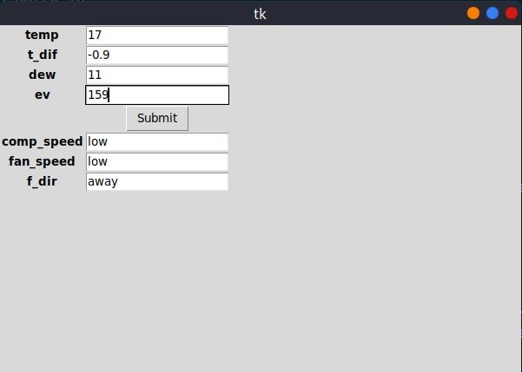
Results

Slide 9
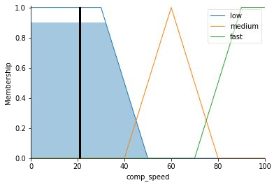

Results

Slide 10
Conclusion
We have successfully built an Air Conditioner Controller using Fuzzy Logic.

Slide 11
References
Sameh Mohamed, Sobhy Wael Mohamed Khedr, “Developing of Fuzzy Logic Controller for Air Condition System” , International Journal of Computer Applications Volume 126 – No.15, September 2015, [Online] Available https://www.ijcaonline.org/research/volume126/ number15/sobhy-2015-ijca-906083.pdf
Fuzzy Control System - “https://en.wikipedia.org/wiki/Fuzzy_control_system”

Slide 12
Thank you!

