Slide 1
Self-Supervised learning in Images
Domain : Machine Learning (Computer vision)
Prathamesh Sonawane
Roll No. 31164
Class TE 1
Internal guide : Prof. Rutuja Kulkarni

Slide 2
ACKNOWLEDGEMENT
I sincerely thank our Seminar Coordinator Prof. B.D.Zope and Head of De-partment Prof. M.S.Takalikar for their support. I also sincerely convey my gratitude to my guide Prof. Rujuta Kulkarni, Department of Computer Engineering for her constant support, providing all the help, motivation and encouragement from beginning till end to make this seminar a grand success.

Slide 3
Index
Introduction
Motivation
Literature Survey
Implementation
Results
Conclusion
Refereances

Slide 4
Introduction
Self supervised learning these days has become essential, considering the amount of data that is needed to train models it is highly effective to create labels empirically rather than by manual effort.
Learning good image representations is a key challenge in computer vision as it allows for efficient training on downstream tasks. Many different training approaches have been proposed to learn such representations, usually relying on visual pretext tasks.

Slide 5
Introduction (Continued)
You can predict any part of the input from any other part. Between images and videos you could predict the future from the past you could predict the future from the recent past you could try predicting the past from the present.
The top from the bottom in case of an image. In a more broader sense you could predict the occluded from the visible in general, you pretend there is a part of the input that you don’t know and try to predict that, those are the different tasks or pretext tasks that you can use in self-supervised learning.

Slide 6
Motivation
The primary motivation for me to pursue research in this; as we can observe throughout the years model sizes have been increasing exponentially.
Larger models will need a larger size of labeled data set to converge and this is where the problem occurs. It is not feasible to employ more and more people to do the menial job of labeling datasets. Self supervised learning tackles this problem by creating labels empirically.

Slide 7
Literature Survey - BYOL
BYOL (Bootstrap your own latent) consists of 2 networks, online and target. An unlabeled image is chosen (STL-10) and two unique sets of augmentations are applied to the image, this way we get 2 versions of the same image.
The main idea of the paper is these 2 representations are passes through their individual networks and 2 vectors are received. The aim is train the online network so that we get same vector representations.

Slide 8
Literature Survey – BYOL (Contd.)
An interesting fact is, although a collapsed solution exists for the task curated for BYOL, the model avoids it safely.
The authors of the original paper, conjecture that it might be due to the complex network(Deep Resnet with skip connections) used in the backbone, the model never gets to the straightforward collapsed solution.
Another explanation is that the “stop-gradient” operation that makes the model to avoid the collapsed representations. Stop-gradient means that the network never gets to update the weights of the target network directly through gradients and hence never gets to the collapsed solution.

Slide 9
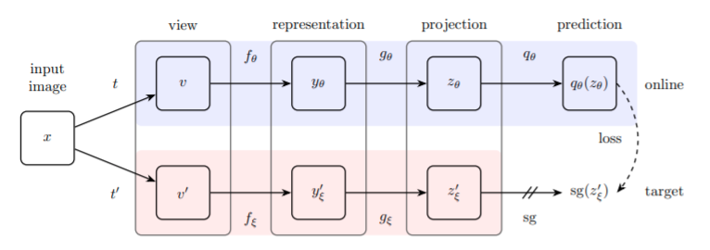
Literature Survey – BYOL (Contd.)
Below we can see the architecture of BYOL, it follows a somewhat Siamese style architecture.

Slide 10
Literature Survey – Mutual Information maximization
The paper revolves around discussing if maximizing Mutual Information(MI) between vectors yields good results.
Take an image split it into half, pass the half images through independent encoders(CNN, MLP layers), get 2 vectors and now calculate the MI between these 2 vectors using an estimator (In-foNCE/ InfoMAX, etc).
The task is to maximize this MI. In the paper we discuss if maximizing MI is sufficient.

Slide 11
Literature Survey – Mutual Information maximization
The authors go on to prove that that alone is not sufficient and that encoder architecture, estimator function, critics etc play an equally important role.
They do this by keeping the MI formula constant and vary the other parameters mentioned above.
It is suggested to use triplet technique in which we use representation of images and we reduce difference between similar images and increasing difference between different images where difference can be called as mutual information.

Slide 12
Literature Survey - Clustering
In this we try to assign labels to random images by clustering. But we use a better method that traditional K-means.
Sinkhorn-Knopp optimization for obtaining pseudo-labels is always better than K-means on all metrics.
After this we train the network on a simple downstream task for classification of images
The method is obtained by maximizing the information between labels and input data indices.

Slide 13
Literature Survey - Jigsaw++
Suppose you get two patches A and B from the same image can you tell where B should go relative to A?
We argue that doing this often requires recognizing object semantics hence given unlabeled images we create a supervised task by randomly sampling one patch then a second patch and then training a deep network to predict the relative positions

Slide 14
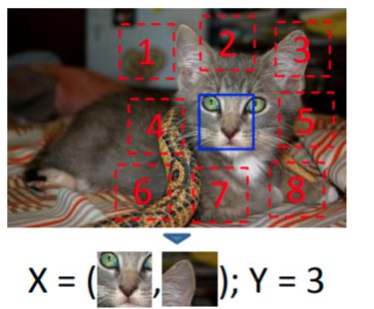
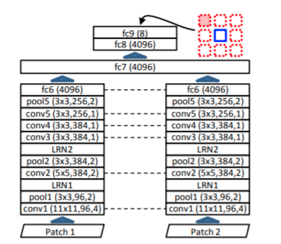
Literature Survey – Jigsaw++ (Continued)

Slide 15
Literature Survey – A critical analysis of self-supervision
It is mentioned that initial layer features can be trained by just training on one image and its augmentations.
We do not need a huge data set. They noted that even if we train on a single image(and its augmentations) we can get 2/3rd the accuracy meaning big data sets only provide small increments in self-supervised learning and goes on to prove that augmentations are very important.
In the end they discovered that one image is enough to train the first 3 layers and produces similar results.

Slide 16
Literature Survey – A critical analysis of self-supervision
Our main conclusion is that these method succeed perfectly in capturing the simplest image statistics, but that for deeper layers a gap exist with strong supervision which is compensated only in limited manner by using large data sets.
This novel finding motivates a renewed focus on the role of augmentations in self-supervised learning and critical rethinking ofhow to better leverage the available data

Slide 17
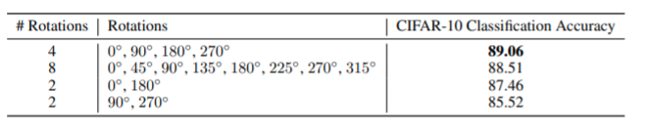
Literature Survey - Rotnet
In this they propose to produce 4 copies of a single image by rotating it by 0°,90°, 180°, 270°and let a single network predict the rotation which was applied—a4-class classification task

Slide 18
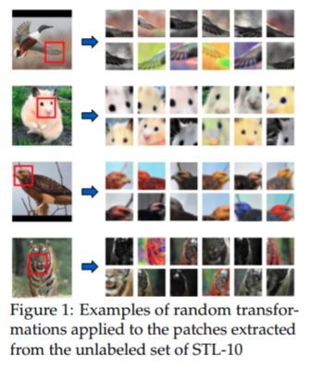
Literature Survey - Exemplar
In this technique, every individual image corresponds to its own class, and multiple examples of it are generated by heavy random data augmentation such as translation, scaling, rotation, and contrast and color shifts.
The triplet loss avoids explicit class labels and, instead, encourages examples of the same image to have representations that are close in the Euclidean space while also being far from the representations of different images.

Slide 19
Implementation (Jigsaw++)
While implementing this many new insights came to light. If image patches are adjacent to each other then the model intrinsically learns to match just the edges theu to tackle this problem, I had to remove a 2px border from the patch so that the model learns better image representations.
Another would be size of data set and training time, in the original paper the authors trained for 2 weeks on a TitanX GPU, to overcome this I reduced the data set size, while maintaining diversity to achieve almost the same results

Slide 20
Results
No. | Techniques | Data set (initial) | Architecture | Parameters | Cl. Accuracy (Downstream)
1. | BYOL[1] | Imagenet cifar100 | online & target networks (Resnets) | 250 million | 74.3/ 79.6(Imagenet)
2. | MI [4] | MNIST CIFAR10 | Custom MLP architecture | 250 million | 85 (MNIST)
3. | Clustering[3] | SVHN CIFAR-10/100 ImageNet | Custom MLP architecture | 230 million | 77.2 (Imagenet)
4. | Jigsaw++[5] | ImageNet | Custom architecture | 200 million | 54.2 (Imagenet)
5. | What we can learn from a image [2] | ImageNet | BIGGAN Deep Cluster Alexnet monoGAN | 150 million | 72.3 (Imagenet)

Slide 21
Conclusion
In conclusion we can see that many techniques have been employed in order to make networks learn features of an image. Self-supervised learning isn’t restricted to only images, similarly people are conducting research for videos, audio, 3Dimages, text and reinforcement learning too.
The ultimate aim to find a perfect task that includes all the characteristics in the surrounding, and get appropriateoutputs as we, as humans do in out daily life, and progress is being made in that direction everyday.

Slide 22
References
[1] Jean-Bastien Grill ,1 Florian Strub,1 Florent Altch ́e, Corentin Tallec, PierreH. Richemond, Elena Buchatskaya1, Carl Doersch1, Bernardo Avila Pires1,Zhaohan Daniel Guo1, Mohammad Gheshlaghi Azar1, Bilal Piot1, KorayKavukcuoglu1, R ́emi Munos1, Michal Valko1. Bootstrap Your Own Latent ANew Approach to Self-Supervised Learning. In NeurIPS, 2020.
[2] Yuki M. Asano, Christian Rupprecht, Andrea Vedaldi. A critical analysisof self-supervision, or what we can learn from a single image. InternationalConference on Learning Representations (ICLR) 2020.
[3] Yuki Markus Asano, Christian Rupprecht, Andrea Vedaldi. Self-labelling viasimultaneous clustering and representation learning. International Conferenceon Learning Representations (ICLR) 2020.
[4] Michael Tschannen, Josip Djolonga, Paul K. Rubenstein, Sylvain Gelly, MarioLucic. On Mutual Information Maximization for Representation Learning.ICLR 2020.
[5] C. Doersch, A. Gupta, and A. A. Efros. Unsupervised visual representationlearning by context prediction. In International Conference on Computer Vi-sion (ICCV), 2015.

Slide 23
References (Continued)
[6] S. Gidaris, P. Singh, and N. Komodakis. Unsupervised representation learn-ing by predicting image rotations. In International Conference on LearningRepresentations (ICLR), 2018.
[7] M. Noroozi and P. Favaro. Unsupervised learning of visual representations bysolving jigsaw puzzles. In European Conference on Computer Vision (ECCV),2016.
[8] A. Dosovitskiy, J. T. Springenberg, M. Riedmiller, and T. Brox. Discrimi-native unsupervised feature learning with convolutional neural networks. InAdvances in Neural Information Processing Systems (NIPS), 2014.
[9] Richard Zhang, Phillip Isola, Alexei A. Efros. Colorful Image Colorization.arxiv.com
[10] Eric Arazo, Noel E. O’Connor, Kevin McGuinness. Improving UnsupervisedLearning With Exemplar CNNS. IMVIP, 2019

