Slide 1
OBJECT TRACKING
Using OpenCV and Arduino

Slide 2
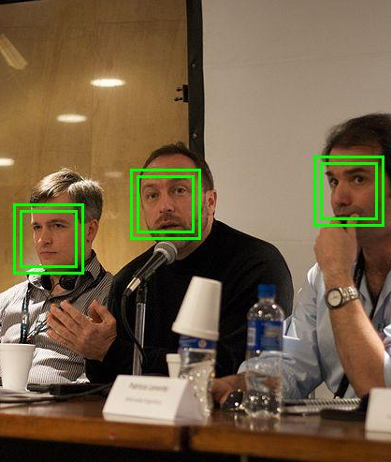
Face Detection
Face detection is a process, which is to analysis the input image and to determine the number, location, size, position and the orientation of a face.
Face detection is the base for face tracking and face recognition, whose results directly affect the process and accuracy of face recognition. This method has real-time detection speed and high detection accuracy.

Slide 3
What is OpenCV?
The digital image of the face generated is a representation of a two-dimensional image as a finite set of digital values, which typically represent gray levels, colours, heights, opacities etc.
The conversion of this huge amount of low level information into usable high level information is the subject of computer vision(CV).
It deals with the development of the theoretical and algorithmic basis by which useful information about the 3D world can be automatically extracted.

Slide 4
What is Arduino?
Arduino can sense the environment by receiving input from a variety of sensors and can affect its surroundings by controlling lights, motors, and other actuators.
The microcontroller on the board is programmed using the Arduino programming language (based on Wiring) and the Arduino development environment (based on Processing).
Arduino projects can be stand-alone or they can communicate with software running on a computer.

Slide 5
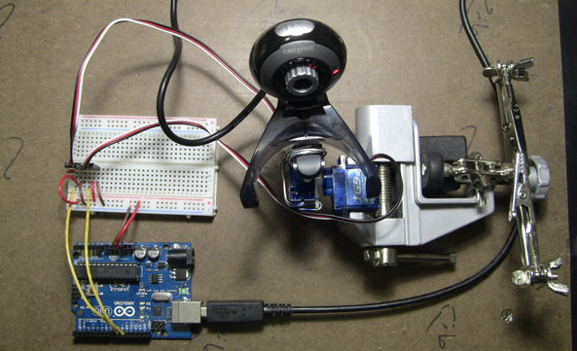
Implementation
The hardware connections

Slide 6
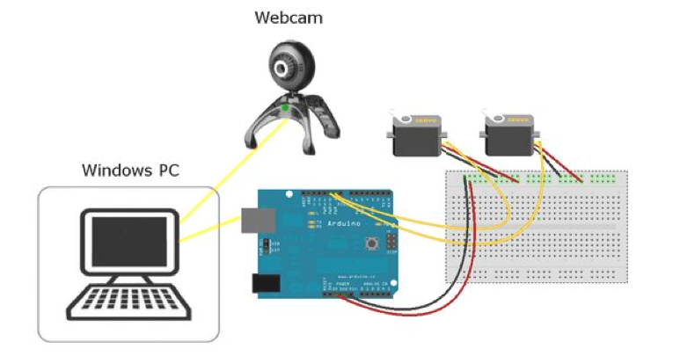
Connecting the hardware
WEBCAM: The webcam's USB goes to the PC. The C++ code will identify it via a number representing the USB port its connected to.

Slide 7
SERVOS
The yellow/signal wire for the pan (X axis) servo goes to digital pin 9.
The yellow/signal wire for the tilt (y axis) servo goes to digital pin 10.
The red/Vcc wires of both servos go to the Arduino's 5V pin.
The black/GND wires of both servos go to Arduino's GND pin.
ARDUINO
The Arduino Uno is connected to the PC via USB. Take note of the COM port the USB is connected to. This is the com port used in the C++ code to communicate with the Arduino.

Slide 8
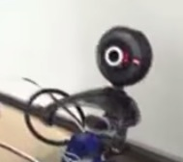
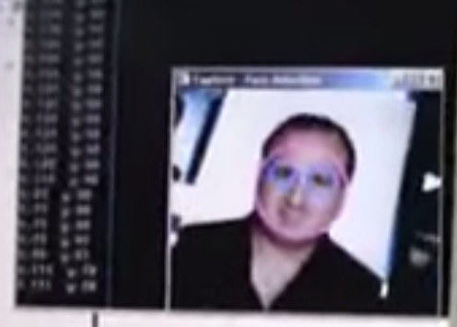
WORKING
The webcam sends video frames to OpenCV running on a PC.
If OpenCV detects a face it will track it and calculate its center's X,Y coordinates.

Slide 9
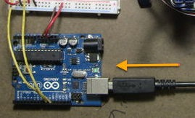
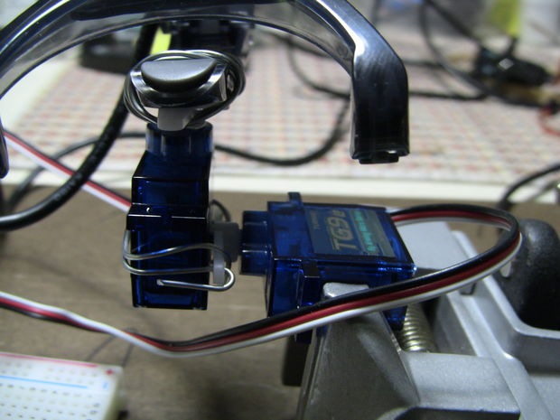
The coordinates are then passed on to the Arduino via a serial USB connection.
The Arduino controls the movement of the webcam with the help of two pan/tilt servos, one servo for each X and Y co-ordinate to follow the detected face.

Slide 10
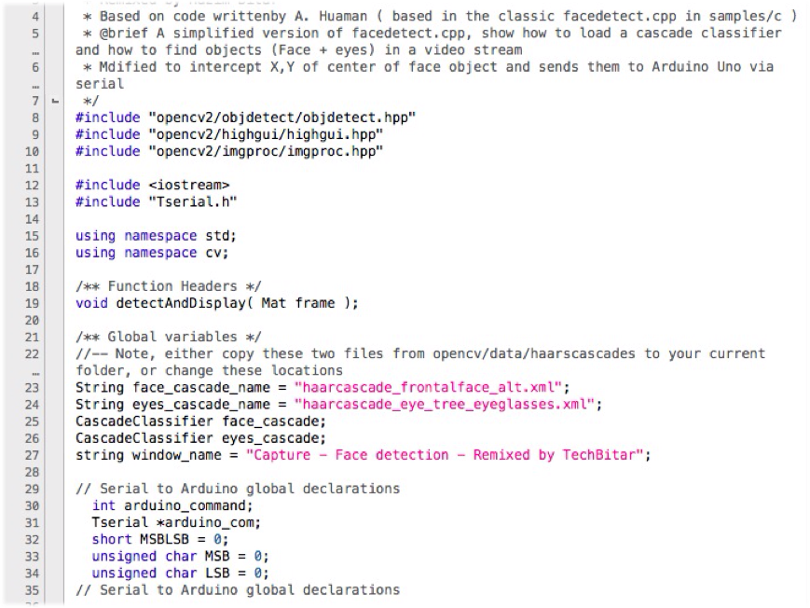
The OpenCV Code

Slide 11
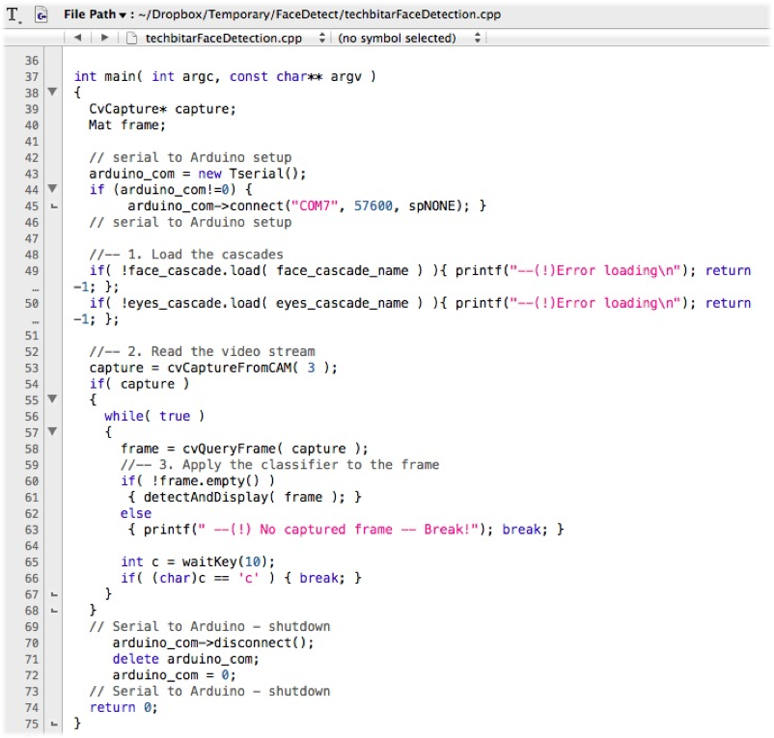

Slide 12
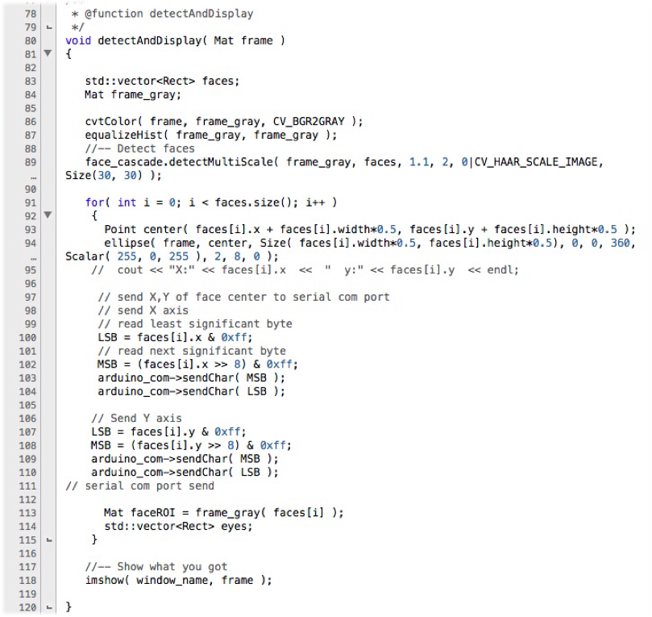

Slide 13
APPLICATIONS
Face detection is used in biometrics, often as a part of a facial recognition system.
It is also used in video surveillance, human computer interface and image database management.
Some recent digital cameras use face detection for autofocus.
Face detection is gaining the interest of marketers. A webcam can be integrated into a television and detect any face that walks by.

