Slide 1

PRODUCT MATTERS 6.0 | CAPSTONE
INDIE
Protect
A bank-native protection cockpit for the complete insurance lifecycle
Discover clearly. Manage every policy. Act with confidence when something goes wrong.
IndusInd General Insurance x E-Cell IIT Guwahati
Capstone submission | July 2026

Slide 2
INDIE PROTECT
PROBLEM
Insurance fails when customers need clarity most
Low penetration is not only a distribution problem; fragmented discovery, policy language, claims, and renewals erode trust across the lifecycle.
The customer’s real journey
1.0%
Non-life insurance penetration
DISCOVER
Too many options, too little context
India, FY 2023-24
Comparison optimises price, not protection fit.
MANAGE
Policies live across providers and inboxes
USD 25
Non-life insurance density
Coverage, exclusions, and renewals stay invisible.
Per person, FY 2023-24
CLAIM
The stressful moment becomes a document hunt
Customers cannot see ownership or the next step.
93%+
IndusInd digital transaction mix
RENEW
Reminders arrive without advice
A ready digital distribution base
Renewal is treated as a payment, not a protection review.
Sources: DFS Annual Report 2024-25; IndusInd Bank Annual Report 2024-25.
02

Slide 3
INDIE PROTECT
PERSONA
Ananya needs one protection view, not another policy store
Primary persona: digitally confident urban banking customers who own multiple policies but lack a unified way to understand and use them.
PRIMARY PERSONA
Ananya Rao, 31
Product manager | Bengaluru | INDIE salary customer
OWNS
Car policy + family health cover
BEHAVIOUR
Mobile-first, compares before buying
TRIGGER
Motor renewal due; parents ageing
FRUSTRATION
Does not know what is covered until a claim
JOB TO BE DONE
“Help me understand my protection and take the right action before, during, and after an incident.”
03

Slide 4
INDIE PROTECT
OPPORTUNITY
Start with 15M INDIE retail accounts and earn the right to expand
A focused motor + health wedge uses existing customer trust and digital reach, then expands into a unified protection ecosystem.
Reach funnel
WHY MOTOR + HEALTH
TAM
41M+
IndusInd customers
1
High-frequency trigger
Motor renewal creates a predictable annual moment.
SAM
15M
Retail accounts targeted for INDIE migration
2
High-stakes gap
Health underinsurance threatens household savings.
3
Shared lifecycle
SOM
1.5M
Three-year insured-customer ambition
Both need discovery, documents, claims, and renewals.
Illustrative premium throughput at SOM
Rs. 1,200 crore / year
Assumption: SOM = 10% of SAM in three years.
1.5M customers x assumed Rs. 8,000 annual premium. This is premium throughput, not revenue.
Sources: IndusInd Bank Annual Report 2024-25; INDIE press release, 5 Jun 2025. SOM and premium are assumptions.
04

Slide 5
INDIE PROTECT
COMPETITION
Competitors solve transactions; INDIE Protect connects the lifecycle
The whitespace is a consent-led, bank-native experience that unifies external policies, proactive insights, claims, and value-added services.
PLAYER
COMPARE /
BUY
UNIFIED
VAULT
PROACTIVE
BANK INSIGHT
CLAIMS /
RENEWAL
SERVICES
Policybazaar
Strong
Partial
-
Partial
-
ACKO
Own / partners
Partial
-
Strong
Strong
Digit
Own products
-
-
Strong
Partial
IndusInd today
Own products
Own only
-
Strong
Partial
INDIE Protect
Strong
Cross-insurer
Strong
Strong
Strong
Strategic edge
Use bank trust and consented context to recommend the next protection action, then complete it in the same experience.
Sources: ACKO, Policybazaar, Digit, and IndusInd General Insurance official app/claims pages. Assessment based on public feature descriptions.
05

Slide 6
INDIE PROTECT
VISION
Know. Cover. Act.
INDIE Protect transforms insurance from a policy transaction into an ongoing protection service.
KNOW
COVER
ACT
See every policy and gap
Choose with transparent trade-offs
Get help with clear ownership
A protection score, plain-language summaries, and a cross-insurer policy vault.
Profile-matched recommendations, side-by-side comparison, and secure bank-linked purchase.
Guided claims, visible status, renewals, roadside assistance, and telemedicine.
CUSTOMER VALUE
BANK VALUE
INSURER VALUE
Confidence before purchase and control during a claim
Higher adoption, retention, and relevant cross-sell
Cleaner intake, stronger engagement, fewer avoidable lapses
06

Slide 7
INDIE PROTECT
JOURNEY
The experience creates a repeatable protection loop
Each stage produces a useful action and better context for the next stage, without turning sensitive bank data into a claim decision.
1
2
3
4
5
6
DISCOVER
COMPARE
BUY
MANAGE
CLAIM
RENEW
Gap signal
>
Trade-off clarity
>
Low-friction issue
>
One vault
>
Visible ownership
>
Protection review
Profile and life-stage recommendations
Premium, cover, exclusions, fit
Consent and bank-linked payment
Documents, plain language, reminders
Evidence, next step, status
Continuity, NCB, proactive advice
THE LOOP
Every protected action improves the next recommendation, but underwriting and claim decisions remain purpose-limited and explainable.
07

Slide 8
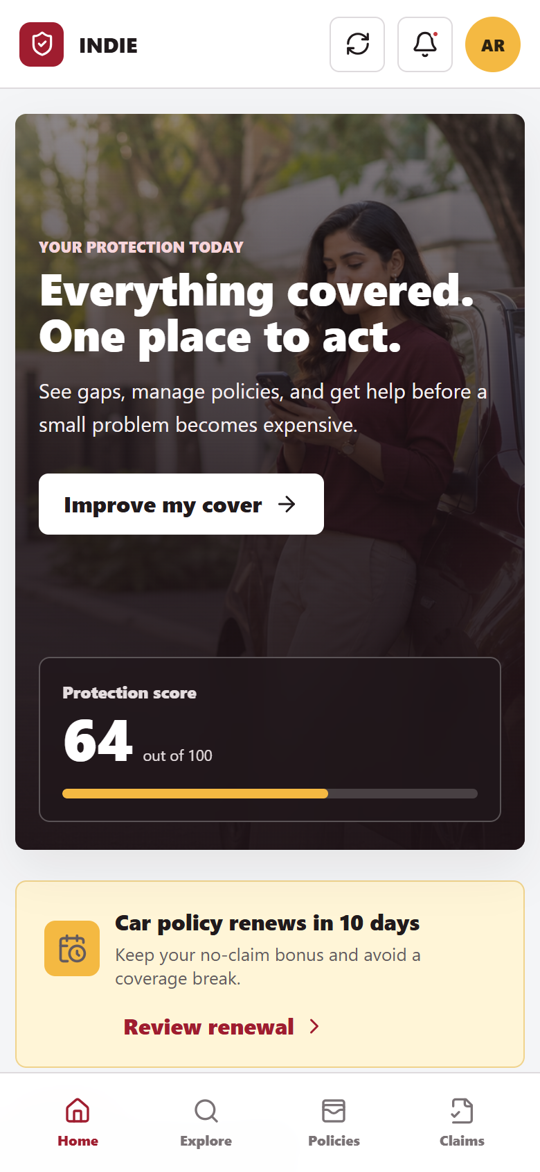
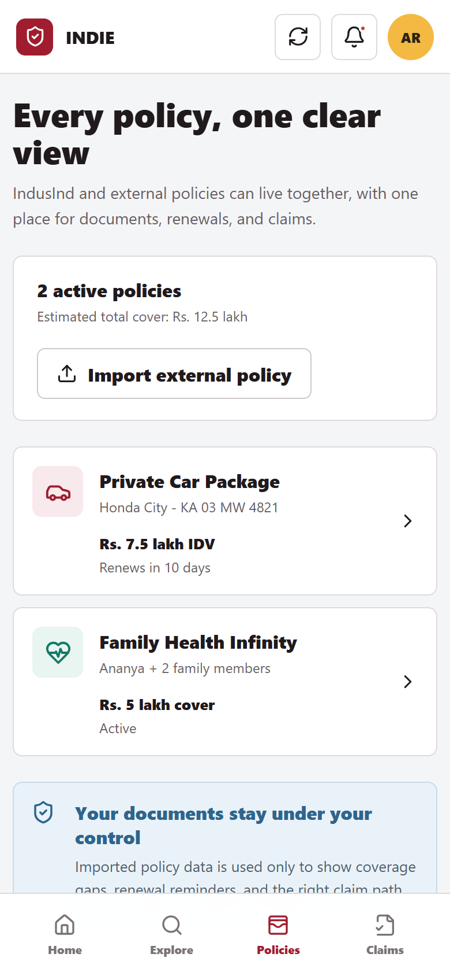
INDIE PROTECT
PROTOTYPE
The dashboard turns fragmented cover into clear next actions
The home experience is not a product catalogue. It prioritises protection gaps, imminent renewals, policies, and immediate help.
1
Protection score
One number converts passive ownership into an improvement path.
2
Renewal urgency
The due date, no-claim bonus, and action appear together.
3
Cross-insurer vault
Customers can manage IndusInd and external policies in one view.
4
Consent control
Connected data helps find gaps; the customer can remove access.
08

Slide 9
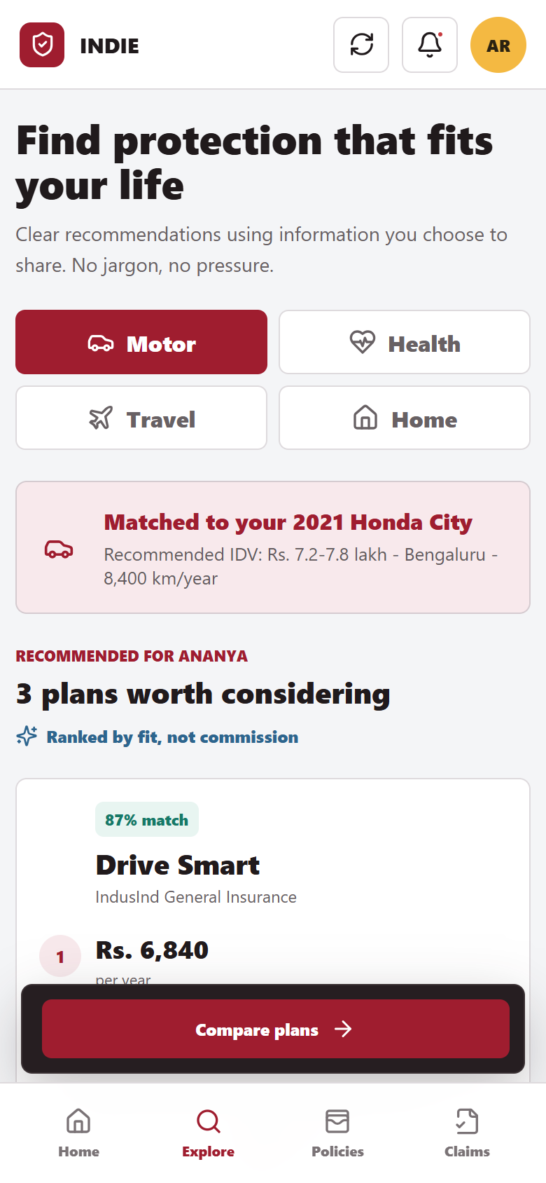
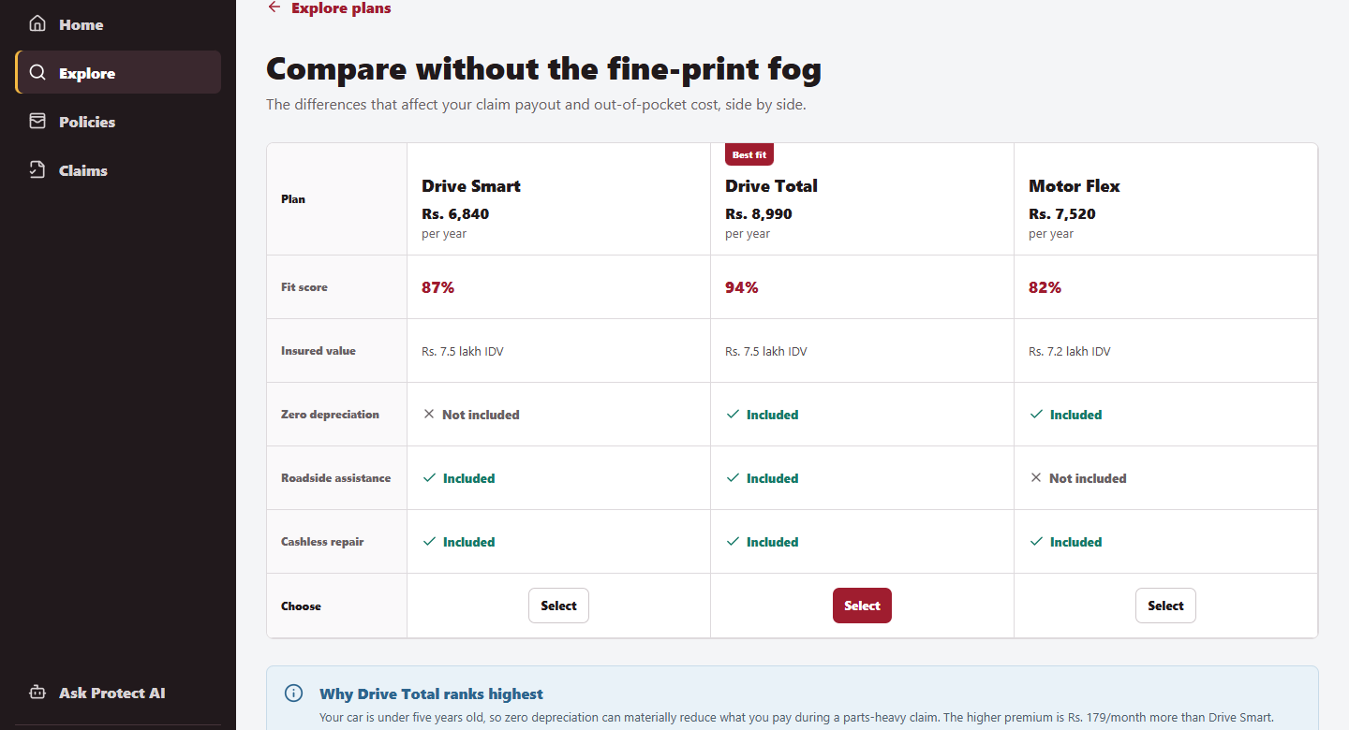
INDIE PROTECT
PROTOTYPE
Comparison makes trade-offs visible before purchase
Customers see fit, insured value, add-ons, and exclusions in the same decision surface, then complete a simulated bank-linked checkout.
Why this matters
Rs. 179/month makes the upgrade cost tangible.
Trust pattern
Coverage and exclusions stay visible before confirmation.
09

Slide 10
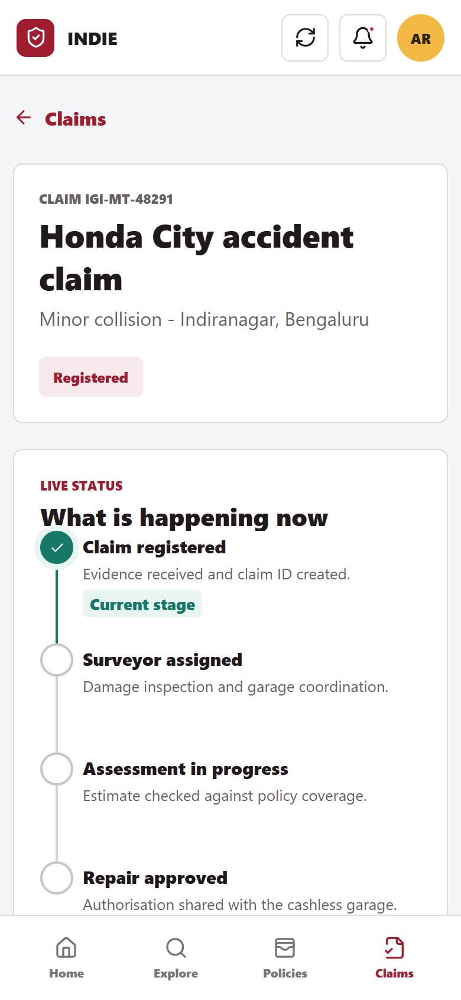
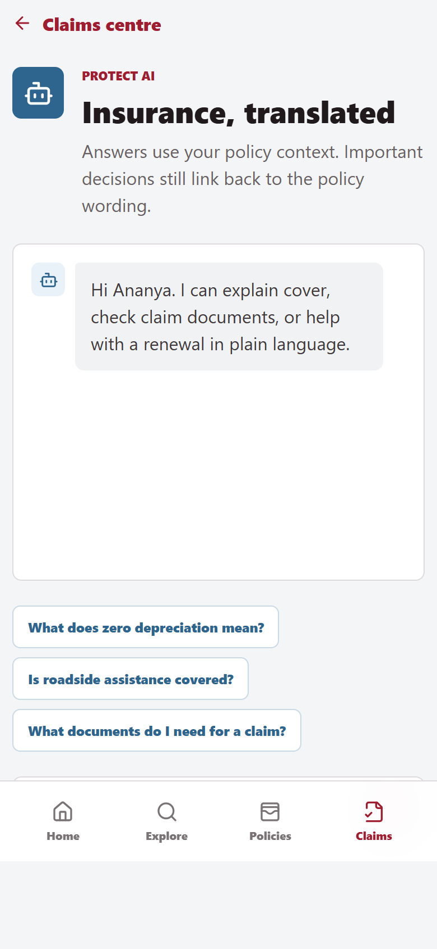
INDIE PROTECT
PROTOTYPE
Claims show ownership, evidence, and the next step
A guided intake reduces document anxiety; tracking states who owns the claim; Protect AI explains policy language using the customer’s context.
1
Three-step intake
Incident, evidence, and confirmation. Ask only for what is needed.
2
Visible ownership
The customer sees the current team, action, and expected update.
3
Plain-language support
AI explains terms and documents but links decisions back to policy wording.
Prototype behaviour
Claim updates are simulated so evaluators can walk through the full lifecycle without backend integrations.
10

Slide 11
INDIE PROTECT
EXECUTION
The MVP prioritises trust-building actions over feature breadth
Illustrative RICE scoring favours features that improve lifecycle completion with manageable integration effort.
FEATURE
REACH
IMPACT
CONF.
EFFORT
RICE
Unified policy vault
9
3.0
85%
2
11.5
MUST
Guided motor claims
8
3.0
90%
2
10.8
MUST
Renewal nudges + autopay
9
2.0
90%
2
8.1
MUST
Transparent comparison
8
2.0
85%
2
6.8
MUST
Protection score
7
2.0
70%
2
4.9
SHOULD
Protect AI explanations
6
2.0
65%
3
2.6
SHOULD
OUT OF MVP
Real-time telematics, automated fraud decisions, pet/rental cover, and fully autonomous claim adjudication.
RICE inputs are product assumptions: Reach (1-10), Impact (0.5-3), Confidence, Effort (person-month index).
11

Slide 12
INDIE PROTECT
METRICS
Protected actions are the leading indicator of long-term value
The north star rewards useful lifecycle behaviour, while trust and loss-related guardrails prevent growth at the customer’s expense.
NORTH STAR METRIC
Examples: gap review, policy import, purchase, renewal, claim step, or assistance request.
Monthly Protected Actions per Active Insured Customer
ADOPTION
LIFECYCLE
TRUST
GUARDRAILS
Quote-to-purchase conversion
Renewal completion rate
Coverage comprehension
Complaint rate
Policies imported per user
Claim step completion
Claim CSAT / NPS
Consent opt-out rate
New insured customers
Monthly protected actions
Support repeat-contact rate
Claim TAT and leakage
Pilot target
+10% renewal completion and -20% claim-status support contacts versus matched control.
12

Slide 13
INDIE PROTECT
GTM
Bank signals create high-intent distribution moments
Launch inside INDIE with consented, contextual prompts. Measure incremental protection actions against a holdout group.
MOTOR
HEALTH
TRAVEL
Renewal or vehicle signal
Family protection gap
Upcoming trip
Policy premium detected, FASTag activity, or car-loan milestone.
Salary customer with dependants and low declared base cover.
Forex, travel card, or ticket-related intent with explicit consent.
Review cover
Check health gap
Offer trip cover
90-day pilot design
AUDIENCE
CHANNELS
TEST
100K eligible retail customers
INDIE home, inbox, RM assist
Personalised vs generic vs holdout
Bengaluru + Mumbai; motor renewal window
No unsolicited cold-call dependency
Measure incremental quote, renewal, and trust
Pilot audience and thresholds are proposed assumptions. All targeting requires explicit purpose and consent controls.
13

Slide 14
INDIE PROTECT
ROADMAP
Prove motor and health value before scaling the ecosystem
Sequence integrations by customer value and operational confidence, not by category count.
0-3 MONTHS
3-6 MONTHS
6-12 MONTHS
12-18 MONTHS
Foundation
MVP launch
Value ecosystem
Scale
Policy vault + import
Motor + health discovery
Roadside + telemedicine
Travel and home
Consent and profile layer
Compare and purchase
Protect AI explanations
Open policy connectors
Motor renewal pilot
Guided claim tracking
Partner service SLAs
Claims automation pilots
ARCHITECTURE PRINCIPLE
Consent + policy data
>
Protection orchestration
>
Insurers + service partners
Auditable events across every layer
14

Slide 15
INDIE PROTECT
DECISION
Build trust with explainability, consent, and accountable claims
Approve a 12-week motor + health pilot inside INDIE, with success judged on protected actions, renewal lift, and claim confidence.
Mis-selling or biased recommendations
Rank by customer fit; disclose trade-offs and commercial relationships.
RECOMMENDATION
Sensitive-data overreach
Purpose-specific consent, minimisation, revocation, and audit logs.
Launch the focused pilot
AI hallucination in policy advice
Retrieval from approved wording, citations, guardrails, and human escalation.
Motor renewal + health-gap discovery
Unified policy vault
Guided claims + visible ownership
Claim-status mismatch
Insurer-system source of truth, timestamps, ownership, and SLA alerts.
Partner service failure
Coverage map, service-level contracts, fallback providers, and incident review.
WORKING PROTOTYPE
Local demo: http://localhost:5173
Public URL to be added after deployment approval.
Prototype, product assumptions, and roadmap prepared for Product Matters 6.0 capstone evaluation.
15

