Slide 1

PRODUCT MATTERS 6.0 | CAPSTONE
INDIE
Protect
Insurance that stays useful after purchase
See what you have. Compare what matters. Know who owns the next step when you claim.
IndusInd General Insurance x E Cell IIT Guwahati
Capstone submission | July 2026

Slide 2
INDIE PROTECT
PROBLEM
Buying insurance is easy. Understanding it is not.
Customers can buy in minutes, yet still struggle to find their cover, exclusions, renewal date, or claim owner when it matters.
Where the journey breaks
1.0%
Non life insurance penetration
DISCOVER
Price is clear, suitability is not
India, FY 2023 to 2024
People see premiums before they understand what is missing.
MANAGE
Policies are scattered
USD 25
Non life insurance density
Documents, exclusions, and renewal dates sit in different places.
Per person, FY 2023 to 2024
CLAIM
A stressful moment becomes a document search
The customer cannot see who owns the claim or what happens next.
93%+
IndusInd digital transaction mix
RENEW
The reminder asks for payment
A ready digital distribution base
It rarely helps the customer decide whether the cover is still right.
Sources: DFS Annual Report 2024 to 2025; IndusInd Bank Annual Report 2024 to 2025.
02

Slide 3

INDIE PROTECT
PERSONA
Ananya has insurance. She still does not feel protected.
She owns a car policy and family health cover, but has no simple way to see what is covered or what needs attention.
PRIMARY PERSONA
Ananya Rao, 31
Product manager | Bengaluru | INDIE salary customer
OWNS
Car policy + family health cover
BEHAVIOUR
Mobile first, compares before buying
TRIGGER
Motor renewal due; parents ageing
FRUSTRATION
Does not know what is covered until a claim
JOB TO BE DONE
"Show me what I have, what I am missing, and what to do when something goes wrong."
03

Slide 4
INDIE PROTECT
OPPORTUNITY
Begin with 15M INDIE retail accounts
Motor and health provide clear renewal and claim moments. They are a practical place to prove value before adding more categories.
Reach funnel
WHY MOTOR AND HEALTH
TAM
41M+
IndusInd customers
1
A regular trigger
Motor renewal creates a predictable annual moment.
SAM
15M
Retail accounts targeted for INDIE migration
2
A costly gap
Low health cover can put household savings at risk.
3
The same core jobs
SOM
1.5M
Three year protected customer ambition
Both require comparison, documents, claims, and renewal.
Illustrative premium throughput at SOM
Rs. 1,200 crore each year
Assumption: SOM = 10% of SAM in three years.
1.5M customers x assumed Rs. 8,000 annual premium. This is premium throughput, not revenue.
Sources: IndusInd Bank Annual Report 2024 to 2025; INDIE press release, 5 Jun 2025. SOM and premium are assumptions.
04

Slide 5
INDIE PROTECT
COMPETITION
Others help customers buy. INDIE Protect stays for the full journey.
The opportunity is to connect policies, useful reminders, claims, and support inside a banking app customers already use.
PLAYER
COMPARE AND
BUY
UNIFIED
VAULT
USEFUL BANK
CONTEXT
CLAIMS AND
RENEWAL
SERVICES
Policybazaar
Strong
Partial
Not offered
Partial
Not offered
ACKO
Own and partners
Partial
Not offered
Strong
Strong
Digit
Own products
Not offered
Not offered
Strong
Partial
IndusInd today
Own products
Own only
Not offered
Strong
Partial
INDIE Protect
Strong
Cross insurer
Strong
Strong
Strong
Bank advantage
Use consented bank context to spot a real need, explain the choice, and let the customer act in the same place.
Sources: ACKO, Policybazaar, Digit, and IndusInd General Insurance official app and claims pages.
05

Slide 6
INDIE PROTECT
VISION
Know what you have. Choose what fits. Get help when it matters.
INDIE Protect gives customers one place to understand cover, take action, and follow a claim.
KNOW
COVER
ACT
See every policy and gap
Compare the details that matter
Get help with clear ownership
A protection score, plain language summaries, and one vault for every policy.
Matched choices, clear exclusions, and secure purchase through INDIE.
Guided claims, visible status, renewals, roadside assistance, and telemedicine.
CUSTOMER VALUE
BANK VALUE
INSURER VALUE
Confidence before purchase and control during a claim
More useful visits, stronger retention, and relevant offers
Cleaner intake, stronger engagement, fewer avoidable lapses
06

Slide 7
INDIE PROTECT
JOURNEY
Each useful action makes the next one easier
The journey keeps policy context together while keeping bank data out of underwriting and claim decisions.
1
2
3
4
5
6
DISCOVER
COMPARE
BUY
MANAGE
CLAIM
RENEW
Spot a need
>
See the choice
>
Confirm clearly
>
One vault
>
Visible ownership
>
Protection review
Profile and life stage prompts
Premium, cover, exclusions, fit
Consent and payment through INDIE
Documents, plain language, reminders
Evidence, next step, status
Continuity, NCB, proactive advice
THE LOOP
What the customer does next can improve future prompts. It must never influence underwriting or the outcome of a claim.
07

Slide 8
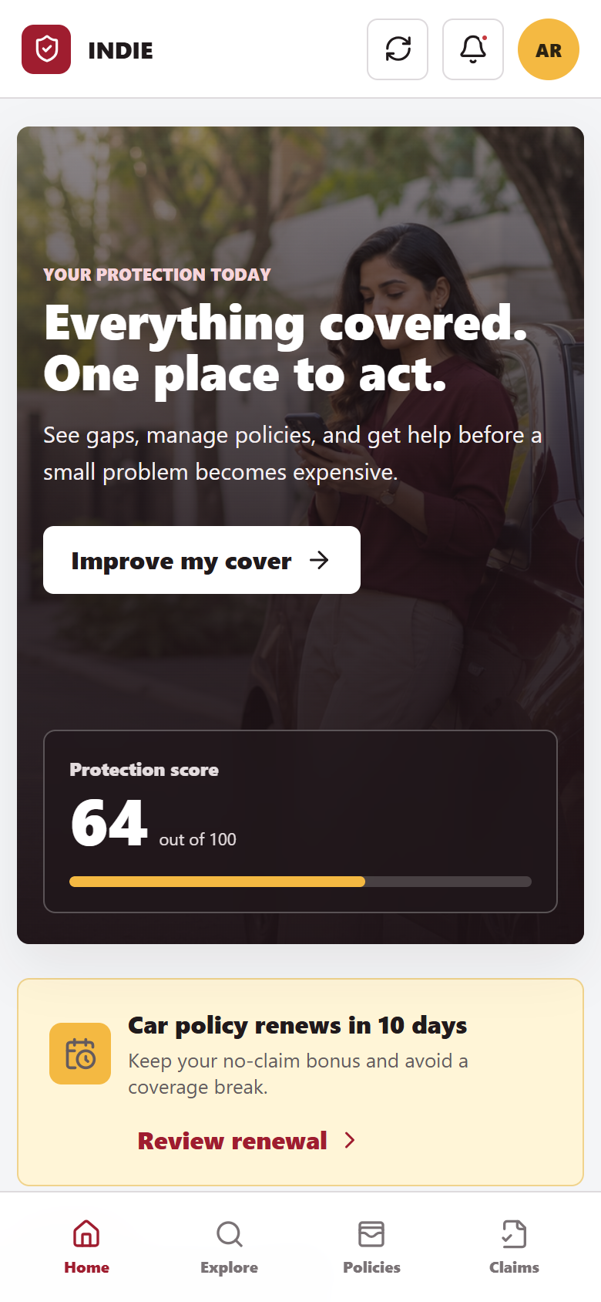
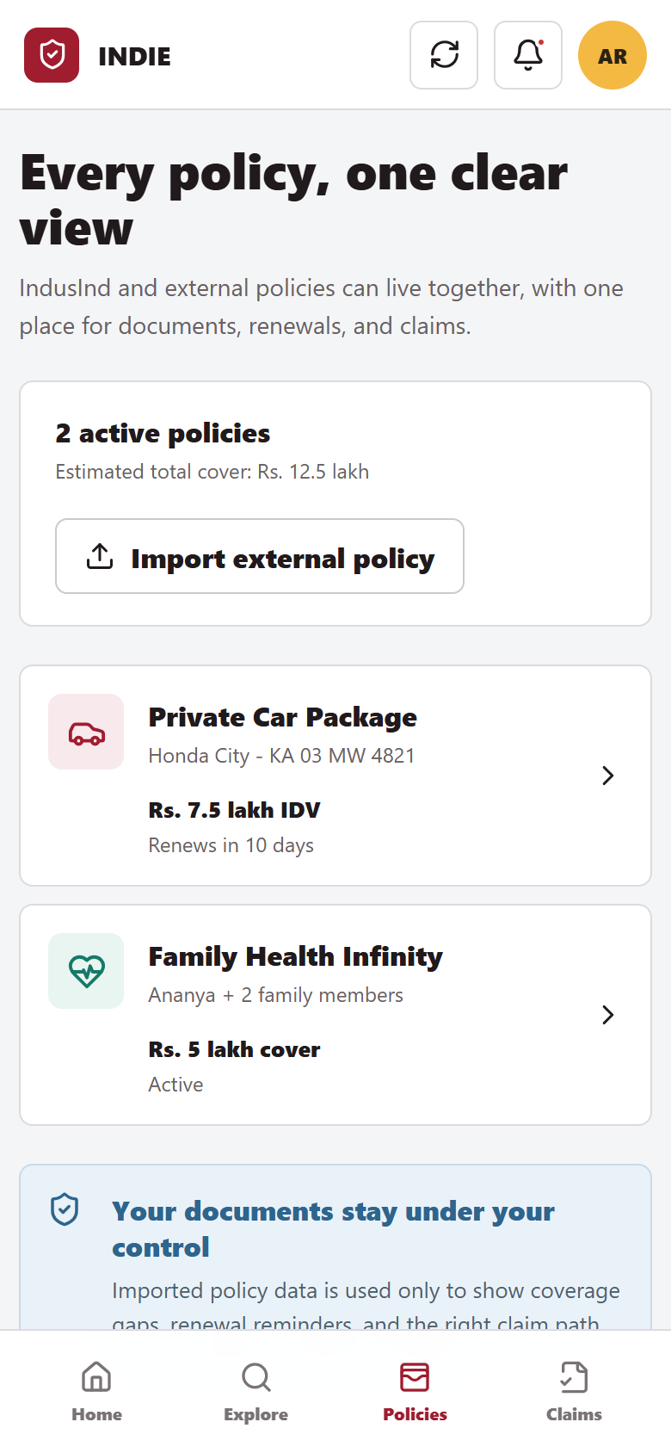
INDIE PROTECT
PROTOTYPE
Home tells Ananya what needs attention now
The first screen shows her protection score, upcoming renewal, active policies, and the fastest route to help.
1
Protection score
A quick view of what is covered and what needs attention.
2
Renewal due
The date, no claim bonus, and next action appear together.
3
One policy vault
IndusInd and external policies sit in the same view.
4
Consent control
Connected data helps find gaps; the customer can remove access.
08

Slide 9
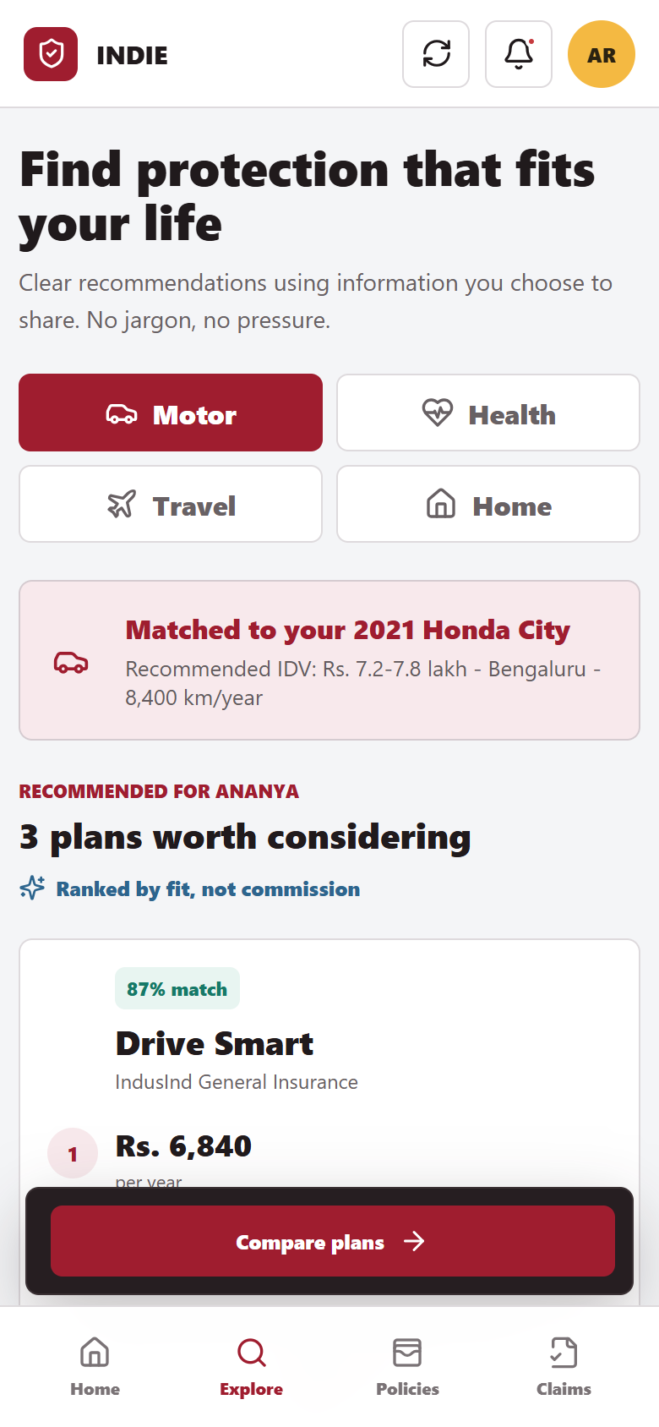
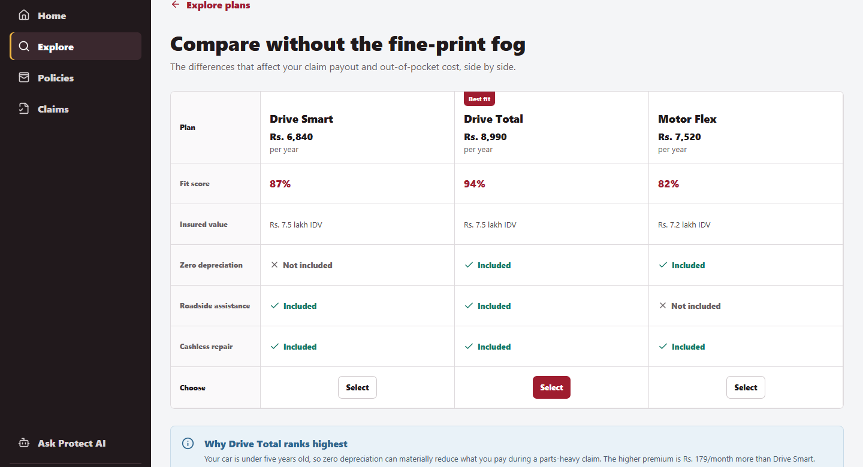
INDIE PROTECT
PROTOTYPE
Show the real choice, not just the cheapest premium
Customers compare fit, insured value, useful add ons, exclusions, and price before they confirm a simulated purchase.
Why this matters
Rs. 179 each month makes the upgrade cost clear.
Trust pattern
Coverage and exclusions stay visible before confirmation.
09

Slide 10
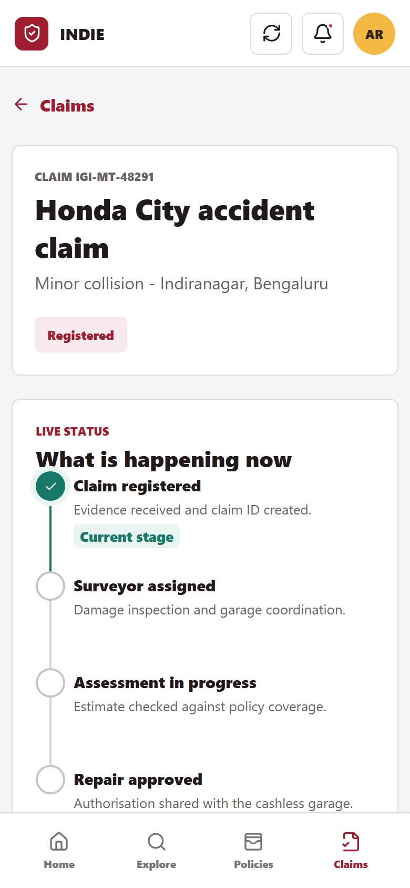
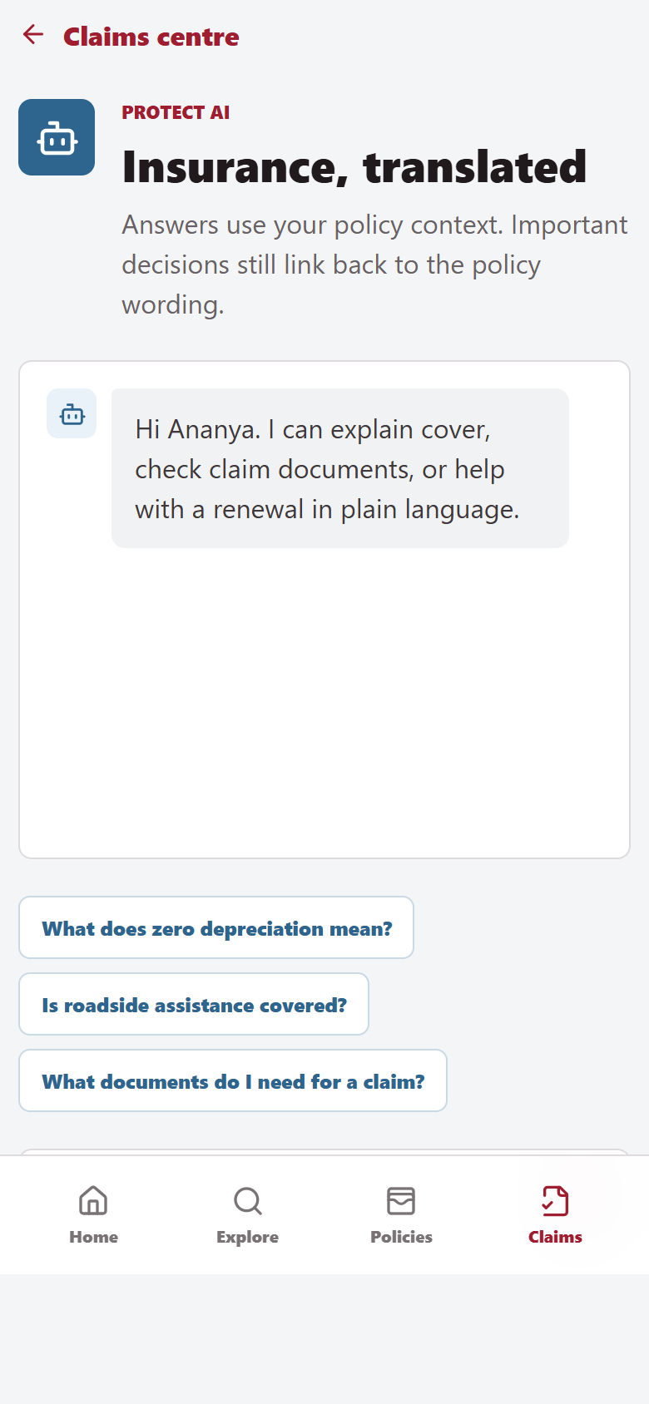
INDIE PROTECT
PROTOTYPE
A claim should always show what happens next and who owns it
The flow asks for only the evidence needed, shows the current owner, and explains policy wording in plain language.
1
Three step intake
Incident, evidence, and confirmation. Ask only for what is needed.
2
Visible ownership
The customer sees the current team, action, and expected update.
3
Plain language support
The assistant explains terms and always links back to the policy wording.
Prototype behaviour
Claim updates are simulated so the full journey can be tested without live insurer systems.
10

Slide 11
INDIE PROTECT
EXECUTION
Build the trust basics before adding more categories
The first release favours the features customers need to understand cover, renew on time, and finish a claim.
FEATURE
REACH
IMPACT
CONF.
EFFORT
RICE
Unified policy vault
9
3.0
85%
2
11.5
MUST
Guided motor claims
8
3.0
90%
2
10.8
MUST
Renewal nudges and autopay
9
2.0
90%
2
8.1
MUST
Transparent comparison
8
2.0
85%
2
6.8
MUST
Protection score
7
2.0
70%
2
4.9
SHOULD
Policy explanations
6
2.0
65%
3
2.6
SHOULD
OUT OF MVP
Real time telematics, automated fraud decisions, pet and rental cover, and autonomous claim decisions.
RICE inputs are product assumptions: Reach (1 to 10), Impact (0.5 to 3), Confidence, and person month effort.
11

Slide 12
INDIE PROTECT
METRICS
Measure useful protection actions, not app opens
The main measure counts actions that improve protection. Trust and claim quality remain firm guardrails.
NORTH STAR METRIC
Examples: gap review, policy import, purchase, renewal, claim step, or assistance request.
Monthly Protected Actions per Active Insured Customer
ADOPTION
LIFECYCLE
TRUST
GUARDRAILS
Quote conversion
Renewal completion rate
Coverage comprehension
Complaint rate
Policies imported per user
Claim step completion
Claim CSAT / NPS
Consent opt out rate
New insured customers
Monthly protected actions
Repeat support contacts
Claim TAT and leakage
Pilot target
10% more completed renewals and 20% fewer claim status support contacts versus a matched control.
12

Slide 13
INDIE PROTECT
GTM
Offer cover when the need is real and visible
Start inside INDIE with clear consent. Compare the result with a holdout group so the team can see what actually changed.
MOTOR
HEALTH
TRAVEL
Renewal or vehicle signal
Family protection gap
Upcoming trip
Policy premium detected, FASTag activity, or a car loan milestone.
Salary customer with dependants and low declared base cover.
Forex, travel card, or ticket activity with explicit consent.
Review cover
Check health gap
Offer trip cover
90 day pilot design
AUDIENCE
CHANNELS
TEST
100K eligible retail customers
INDIE home, inbox, RM assist
Personalised vs generic vs holdout
Bengaluru + Mumbai; motor renewal window
No unsolicited cold call dependency
Measure incremental quote, renewal, and trust
Pilot audience and thresholds are proposed assumptions. All targeting requires explicit purpose and consent controls.
13

Slide 14
INDIE PROTECT
ROADMAP
Prove motor and health first. Then widen the offer.
Add each new capability only after the customer journey and service operation work reliably.
MONTHS 0 TO 3
MONTHS 3 TO 6
MONTHS 6 TO 12
MONTHS 12 TO 18
Foundation
MVP launch
Service layer
Scale
Policy vault and import
Motor and health discovery
Roadside and telemedicine
Travel and home
Consent and profile layer
Compare and purchase
Policy assistant
Open policy connectors
Motor renewal pilot
Guided claim tracking
Partner service targets
Claim automation pilots
ARCHITECTURE PRINCIPLE
Consent and policy data
>
Protection orchestration
>
Insurers and service partners
Auditable events across every layer
14

Slide 15
INDIE PROTECT
DECISION
Launch a focused pilot and make trust measurable
Run a 12 week motor and health pilot inside INDIE. Judge it by useful actions, completed renewals, and confidence during claims.
Biased recommendations
Rank by customer fit and disclose commercial relationships.
RECOMMENDATION
Sensitive data overreach
Use specific consent, collect less data, and make access easy to revoke.
Launch the focused pilot
Wrong policy answer
Use approved policy wording, show the source, and offer human help.
Motor renewal and health gap discovery
One policy vault
Guided claims with visible ownership
Claim status mismatch
Use the insurer record as truth, with timestamps and clear ownership.
Partner service failure
Set coverage areas, service targets, backup providers, and incident reviews.
WORKING PROTOTYPE
indie-protect-capstone.vercel.app
Open the live prototype in any modern browser.
Prototype, product assumptions, and roadmap prepared for Product Matters 6.0 capstone evaluation.
15

