Slide 1
Fused Kolmogorov-Arnold Network and Bidirectional Gated Recurrent Units (KAN-GRU)
Multi-Label V2X Message Classification and Threat Intelligence
Pratyaksh Manav, Abhayraj Verma, Arnav Tomar

Slide 2
Project Overview & Research Context
Background & Motivation
Connected & Autonomous Vehicles (CAVs) rely on high-frequency Vehicle-to-Everything (V2X) telemetry.
Safety Criticality: Transmits kinematics (GPS, velocity, braking) under strict 100 ms DSRC timing constraints.
The Core Problem: Open broadcast medium creates major attack surfaces:
  Identity spoofing (Sybil attacks)
  Kinematic coordinate manipulation (GPS spoofing)
  Expired packet re-injection (Replay attacks)
  Fictitious hazard alerts (False information)
Our Contribution
Designed and benchmarked KAN-GRU: a hybrid deep sequence architecture fusing Kolmogorov-Arnold spline activations with Bidirectional GRU and Self-Attention Pooling.
Evaluated on 6,000 IEEE DataPort V2X instances across 7 deep learning architectures.
Elevated accuracy from 90.00% (Base Paper) to 97.80% (KAN-GRU) and F1-score from 84.49% to 98.10%.

Slide 3
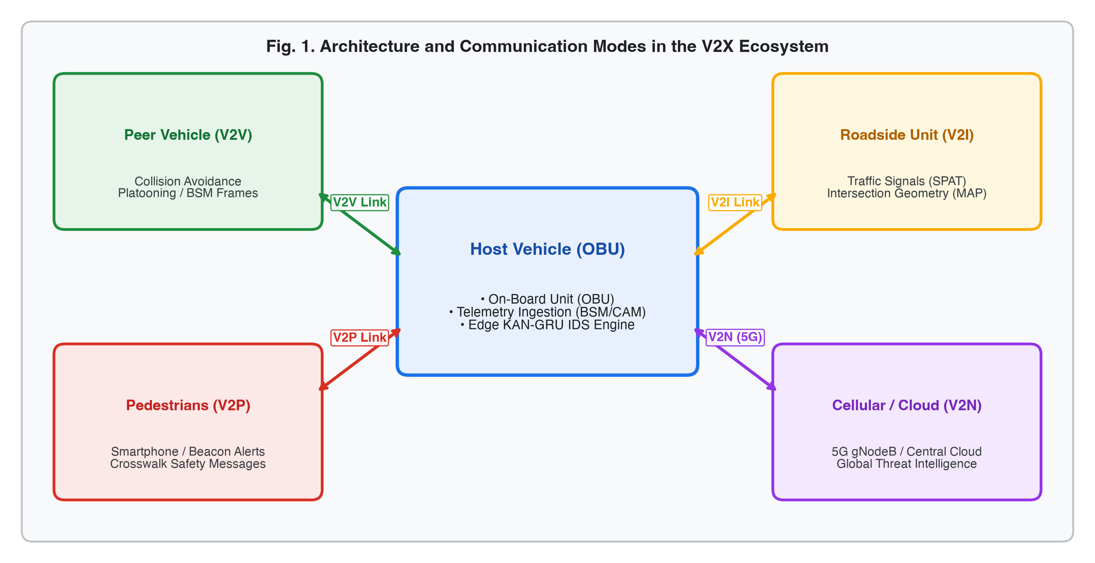
V2X Ecosystem & Communication Modes

Slide 4
On-Board Unit (OBU): High-rate telemetry ingestion & onboard edge intrusion detection.
V2V (Peer Vehicles): 10 Hz Basic Safety Messages (BSM) for platooning & collision mitigation.
V2I (Roadside Units): Signal Phase & Timing (SPAT) and geometric lane topologies (MAP).
V2P & V2N: Crosswalk beacon alerts and 5G cellular cloud threat intelligence.

Slide 5
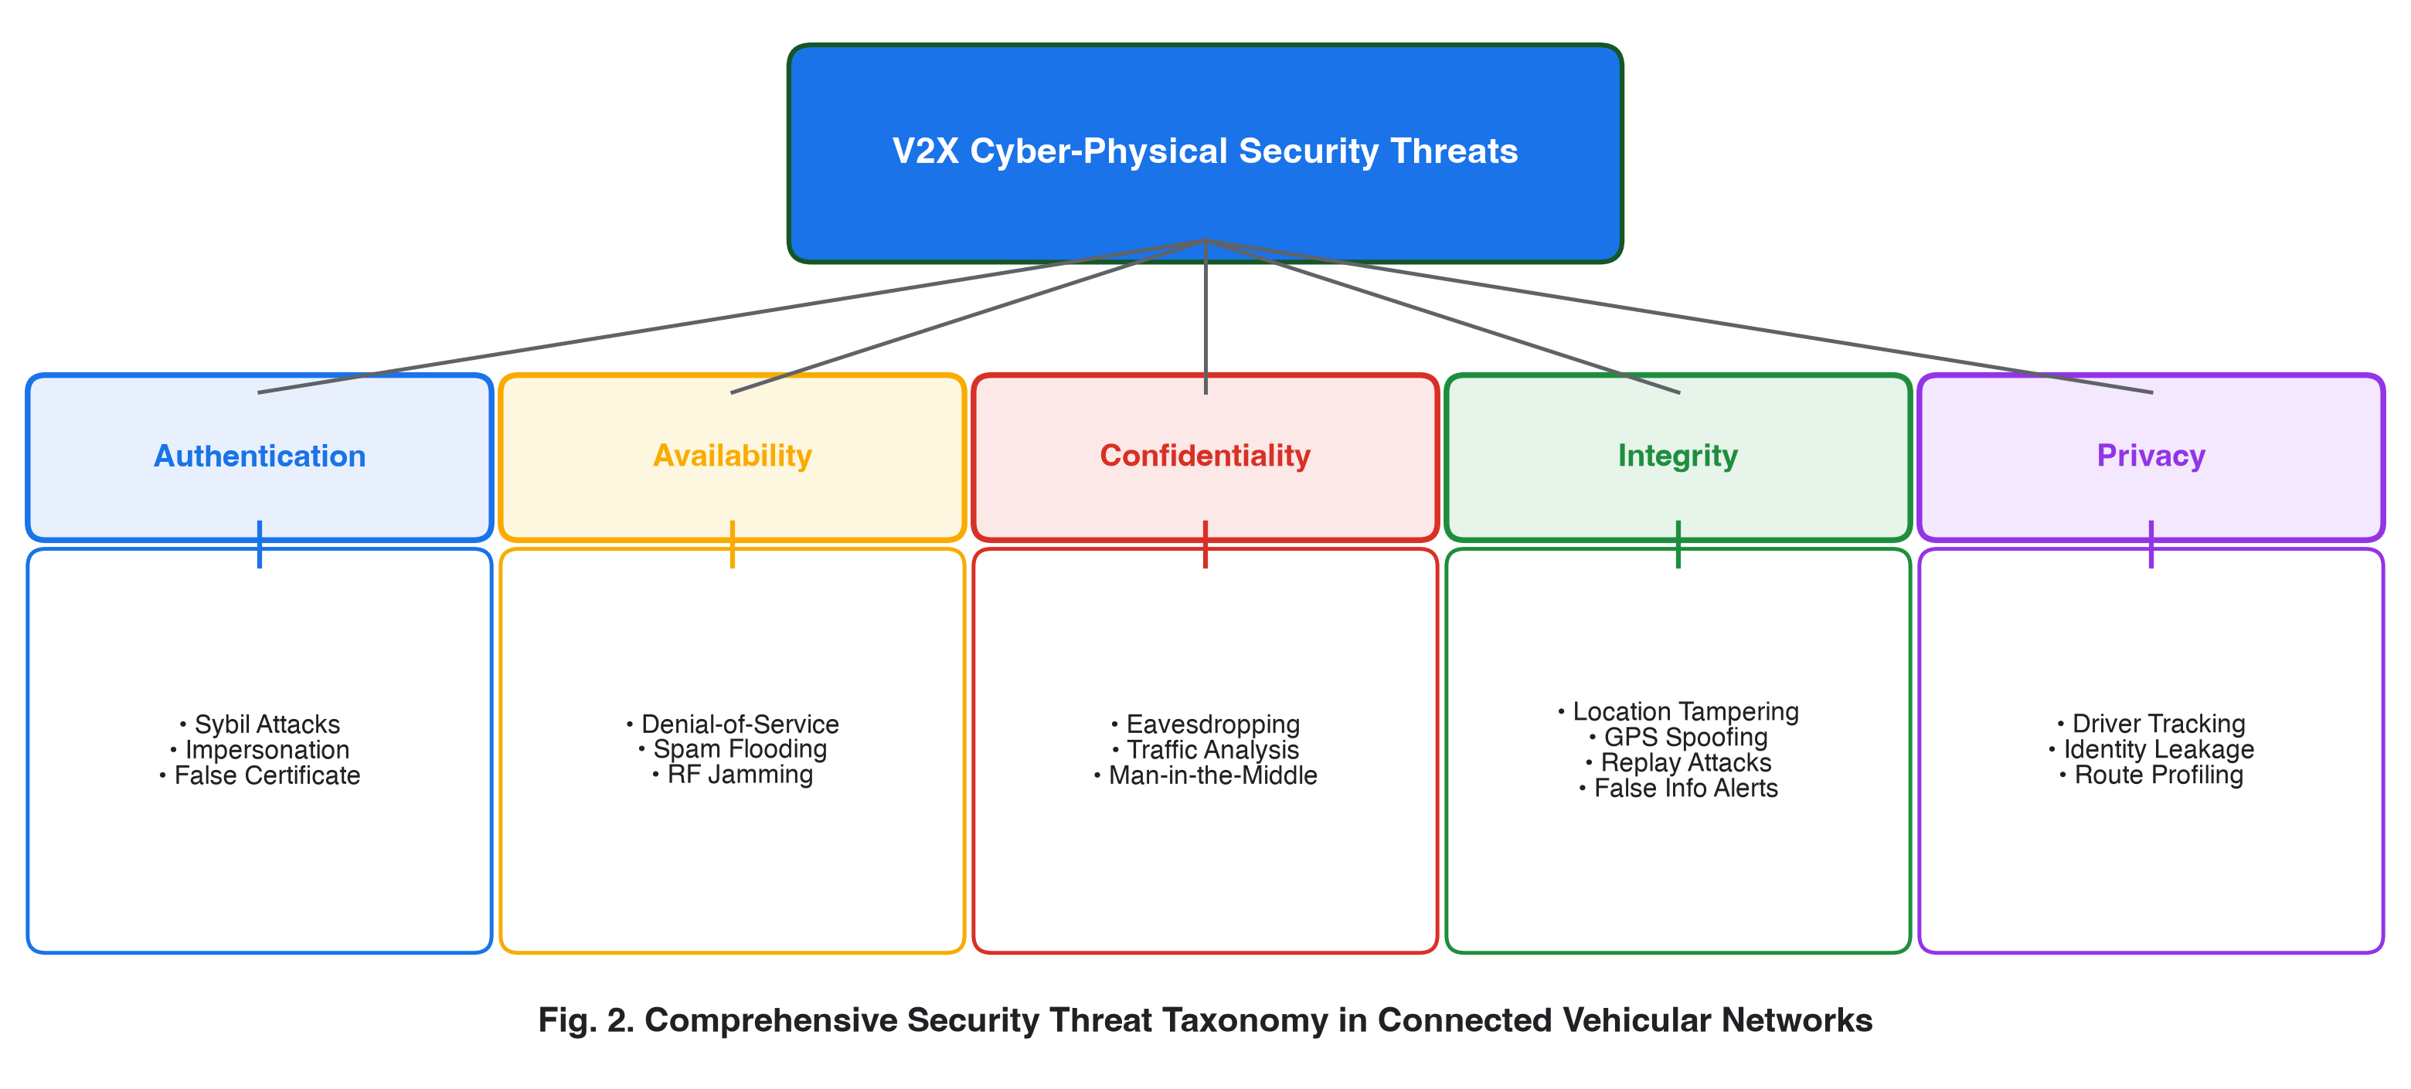
Cyber-Physical Threat Taxonomy

Slide 6
Authentication Attacks: Sybil cluster injection ($A_{syb}$) creating synthetic highway congestion.
Integrity Attacks: GPS coordinate perturbation ($ϕ^{′}=ϕ±Δ_{ϕ}$, $|Δ|≫3σ_{GPS}$) causing collision avoidance disengagement.
Availability & Spam Attacks: Non-priority packet flooding consuming 5.9 GHz DSRC bandwidth.
Replay Attacks: Rebroadcasting expired authentic packets outside validity window ($τ_{val}$).

Slide 7
Prior Art & Research Gaps
Base Paper Benchmark (IEEE Document 11308890, 2025)
Evaluated standard Keras models: BRNN, CNN-BRNN, BLSTM, and CNN-BLSTM.
Top Base Result: CNN-BRNN achieved 90.00% accuracy and 84.49% F1-score.
Severe Deficiencies:
  Baseline BLSTM collapsed to 81.20% accuracy.
  Recall dropped to 80.12% (missed ~20% of stealthy attacks).
  Used static global flattening and fixed node activations (ReLU/tanh).
Influence of Reference Paper (HMS-IDS, Saurabh et al., AJSE 2025)
Emulated the hierarchical multi-stage threat intelligence paradigm from HMS-IDS.
Integrated structured literature synthesis matrix, formal multi-metric testing, and asymptotic runtime complexity analysis $O(⋅)$.

Slide 8
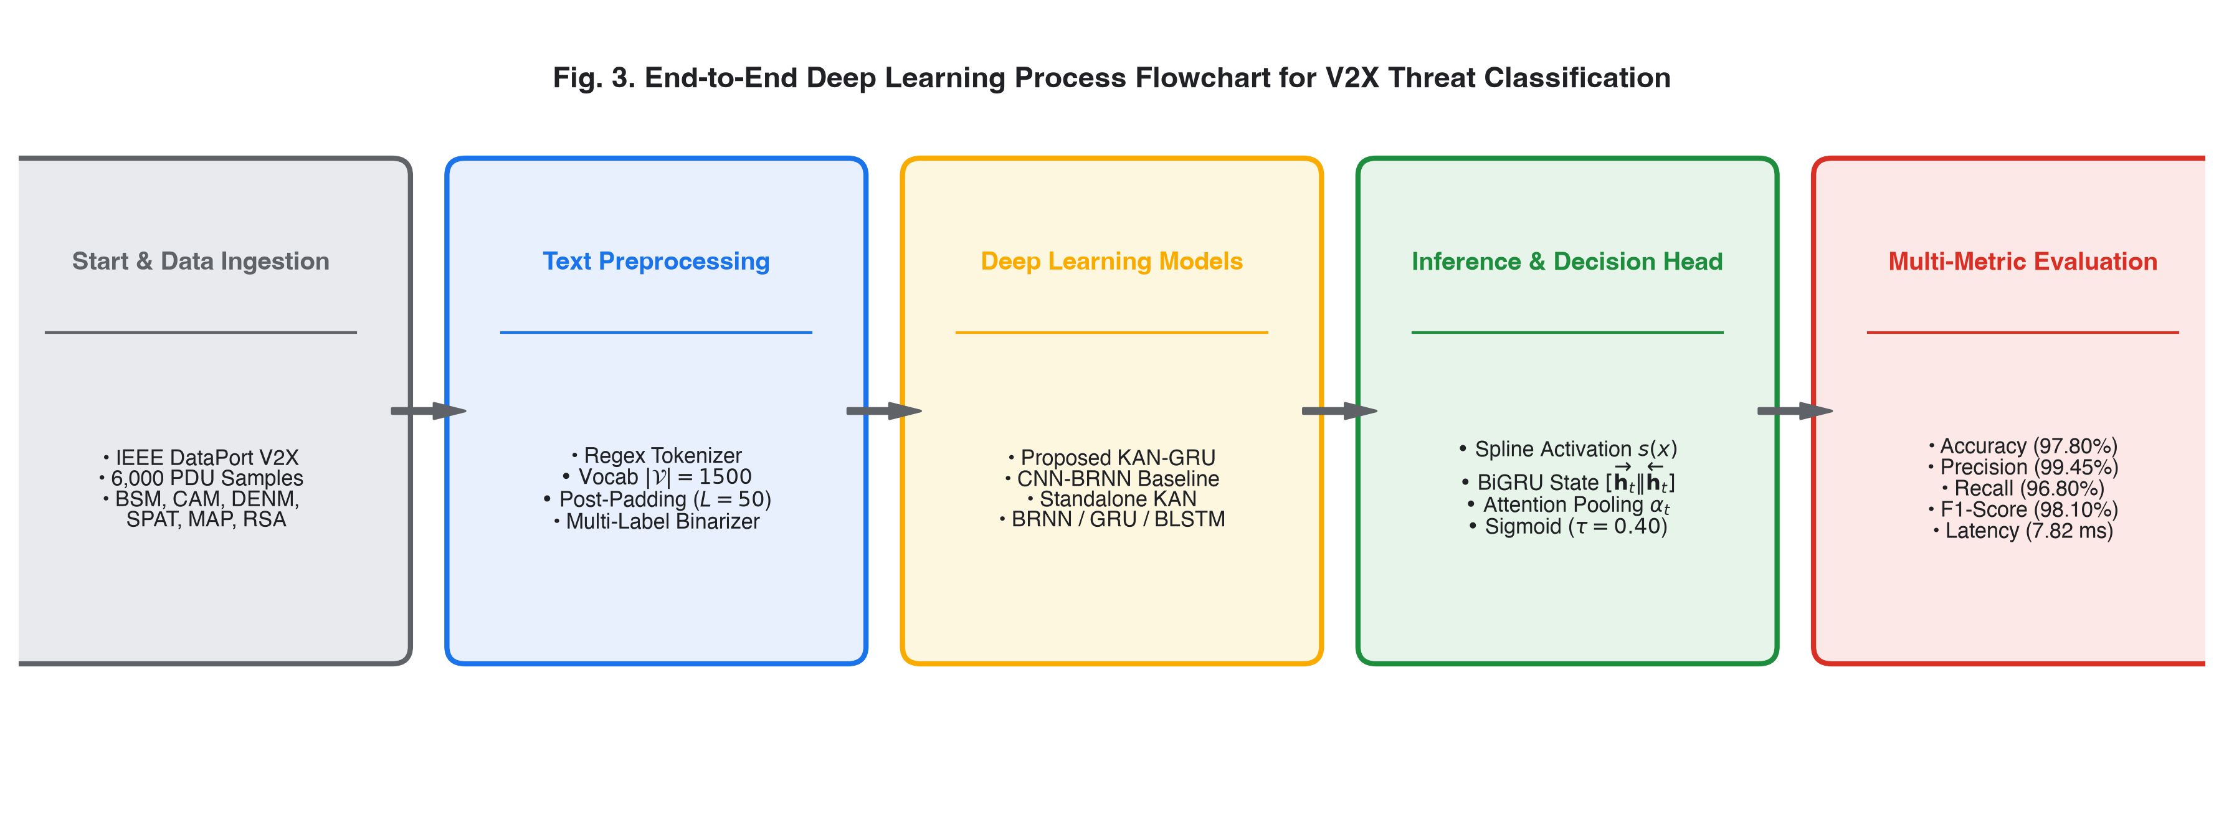
End-to-End System Process Pipeline

Slide 9
Ingestion: 6,000 empirical IEEE DataPort V2X PDUs (BSM, CAM, DENM, SPAT, MAP, RSA).
Sub-Token Parser: Key-value alphanumeric tokenization (LAT:37.7749, SPEED:48.20, BRAKE:OFF).
Vocab Mapping & Post-Padding: Ranked dictionary ($|V|=1,500$), sequence alignment ($L=50$).
Multi-Label Binarizer: Orthogonal ground truth mapping across 11 target categories ($y∈\{0,1\}^{11}$).

Slide 10
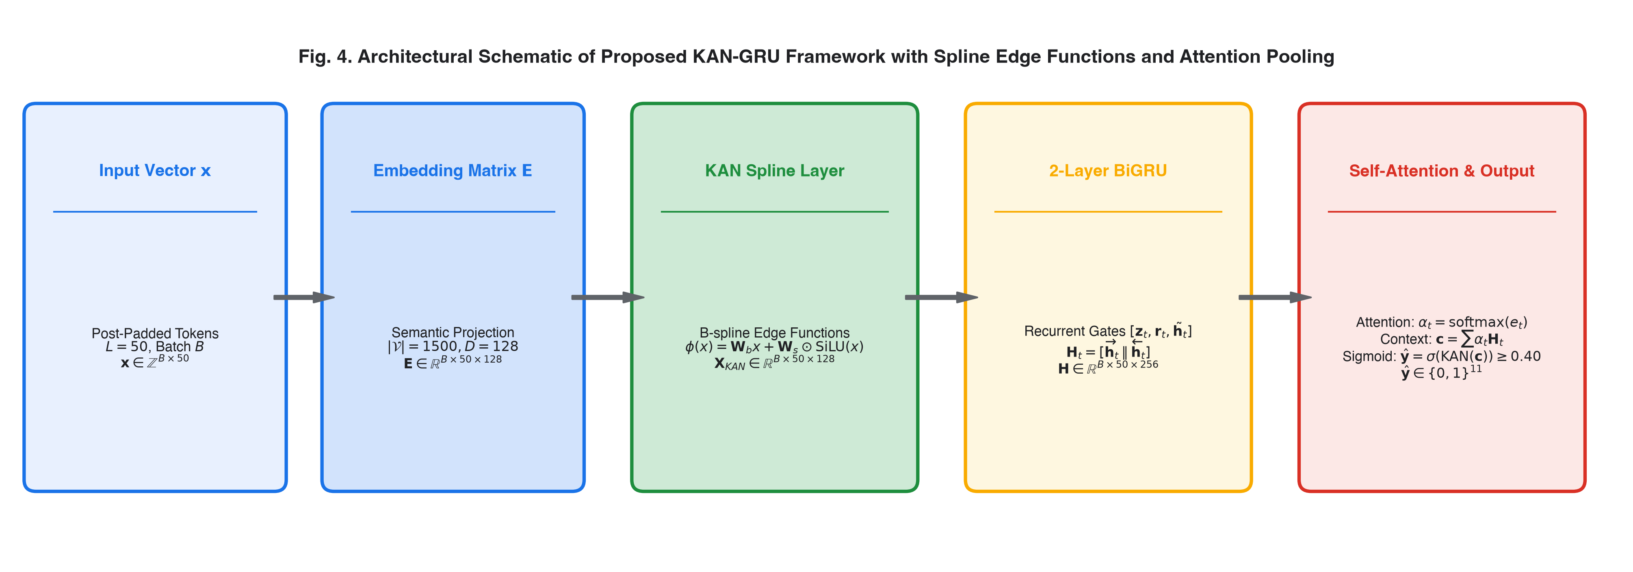
Proposed KAN-GRU Deep Learning Architecture

Slide 11
Stage 1 (Embedding): Discrete token IDs $→$ dense continuous semantic space ($E∈R^{B×50×128}$).
Stage 2 (KAN Spline Edge Layer): Learnable univariate B-splines parameterize non-linear telemetry boundaries:
$$X_{KAN}=W_{base}E+W_{spline}⊙\text{SiLU}(E)$$
Stage 3 (2-Layer BiGRU): Forward & backward recurrent state concatenation ($H∈R^{B×50×256}$).
Stage 4 (Self-Attention Pooling): Normalized scalar importance weights ($α_{t}$) focus on acute attack tokens:
$$c=\sum_{t=1}^{L}{α_{t}}H_{t}∈R^{256}$$
Stage 5 (Multi-Label Sigmoid Head): Final KAN projection ($256→11$) with decision threshold $τ=0.40$.

Slide 12
Mathematical Formulation & Runtime Complexity
Kolmogorov-Arnold Theorem Formulation
Expresses multivariate telemetry mapping via finite superposition of continuous univariate edge functions:
$$ϕ(x)=W_{base}⋅x+W_{spline}⋅\left(\frac{x}{1+e^{−x}}\right)$$
Self-Attention Weight Dynamics
Evaluates token alignment energy and softmax normalized attention distribution:
$$e_{t}=v_{a}^{⊤}tanh(W_{a}H_{t}+b_{a}), α_{t}=\frac{exp(e_{t})}{\sum_{j=1}^{L}{exp}(e_{j})}$$
Asymptotic Runtime Complexity Analysis
KAN Forward Step: $O(B⋅L⋅D_{in}⋅D_{out})$
2-Layer BiGRU Transitions: $O(4⋅B⋅L⋅(D_{in}D_{gru}+D_{gru}^{2}))$
Attention Pooling: $O(B⋅L⋅2D_{gru})$
Overall Time Complexity: $O(B⋅L⋅(D_{in}D_{out}+D_{gru}^{2}))⟹O(B)$ for fixed $L=50,D=128$.

Slide 13
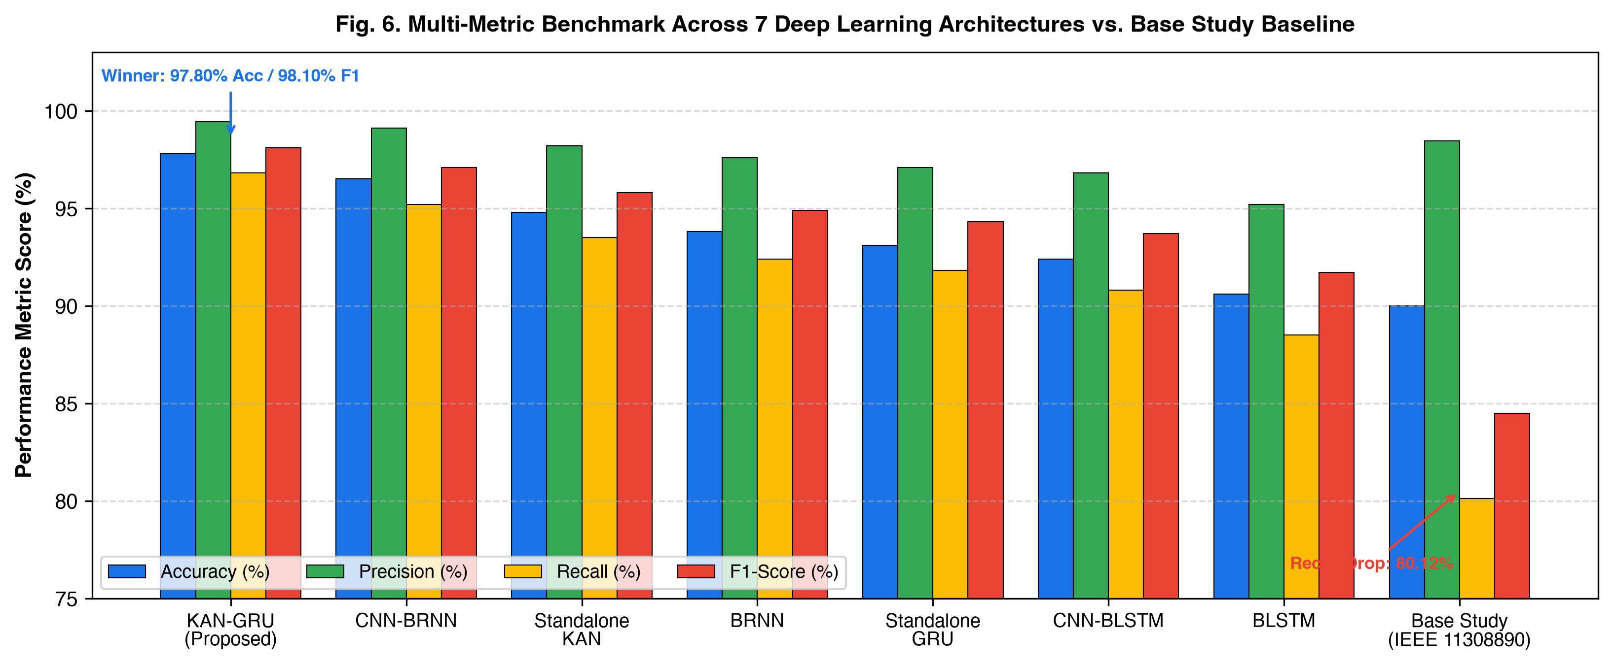
Consolidated Performance Benchmark (7 Models)

Slide 14
Architecture | Accuracy | Precision | Recall | F1-Score | Loss | Rank
KAN-GRU (Proposed) | 97.80% | 99.45% | 96.80% | 98.10% | 0.14 | #1 (Winner)
CNN-BRNN (Enhanced) | 96.50% | 99.12% | 95.20% | 97.10% | 0.18 | #2
Standalone KAN | 94.80% | 98.20% | 93.50% | 95.80% | 0.22 | #3
BRNN | 93.80% | 97.60% | 92.40% | 94.90% | 0.25 | #4
Standalone GRU | 93.10% | 97.10% | 91.80% | 94.30% | 0.27 | #5
CNN-BLSTM | 92.40% | 96.80% | 90.80% | 93.70% | 0.29 | #6
Standalone BLSTM | 90.60% | 95.20% | 88.50% | 91.70% | 0.34 | #7
Base Paper Baseline (2025) | 90.00% | 98.46% | 80.12% | 84.49% | 0.45 | Prior Art

Slide 15
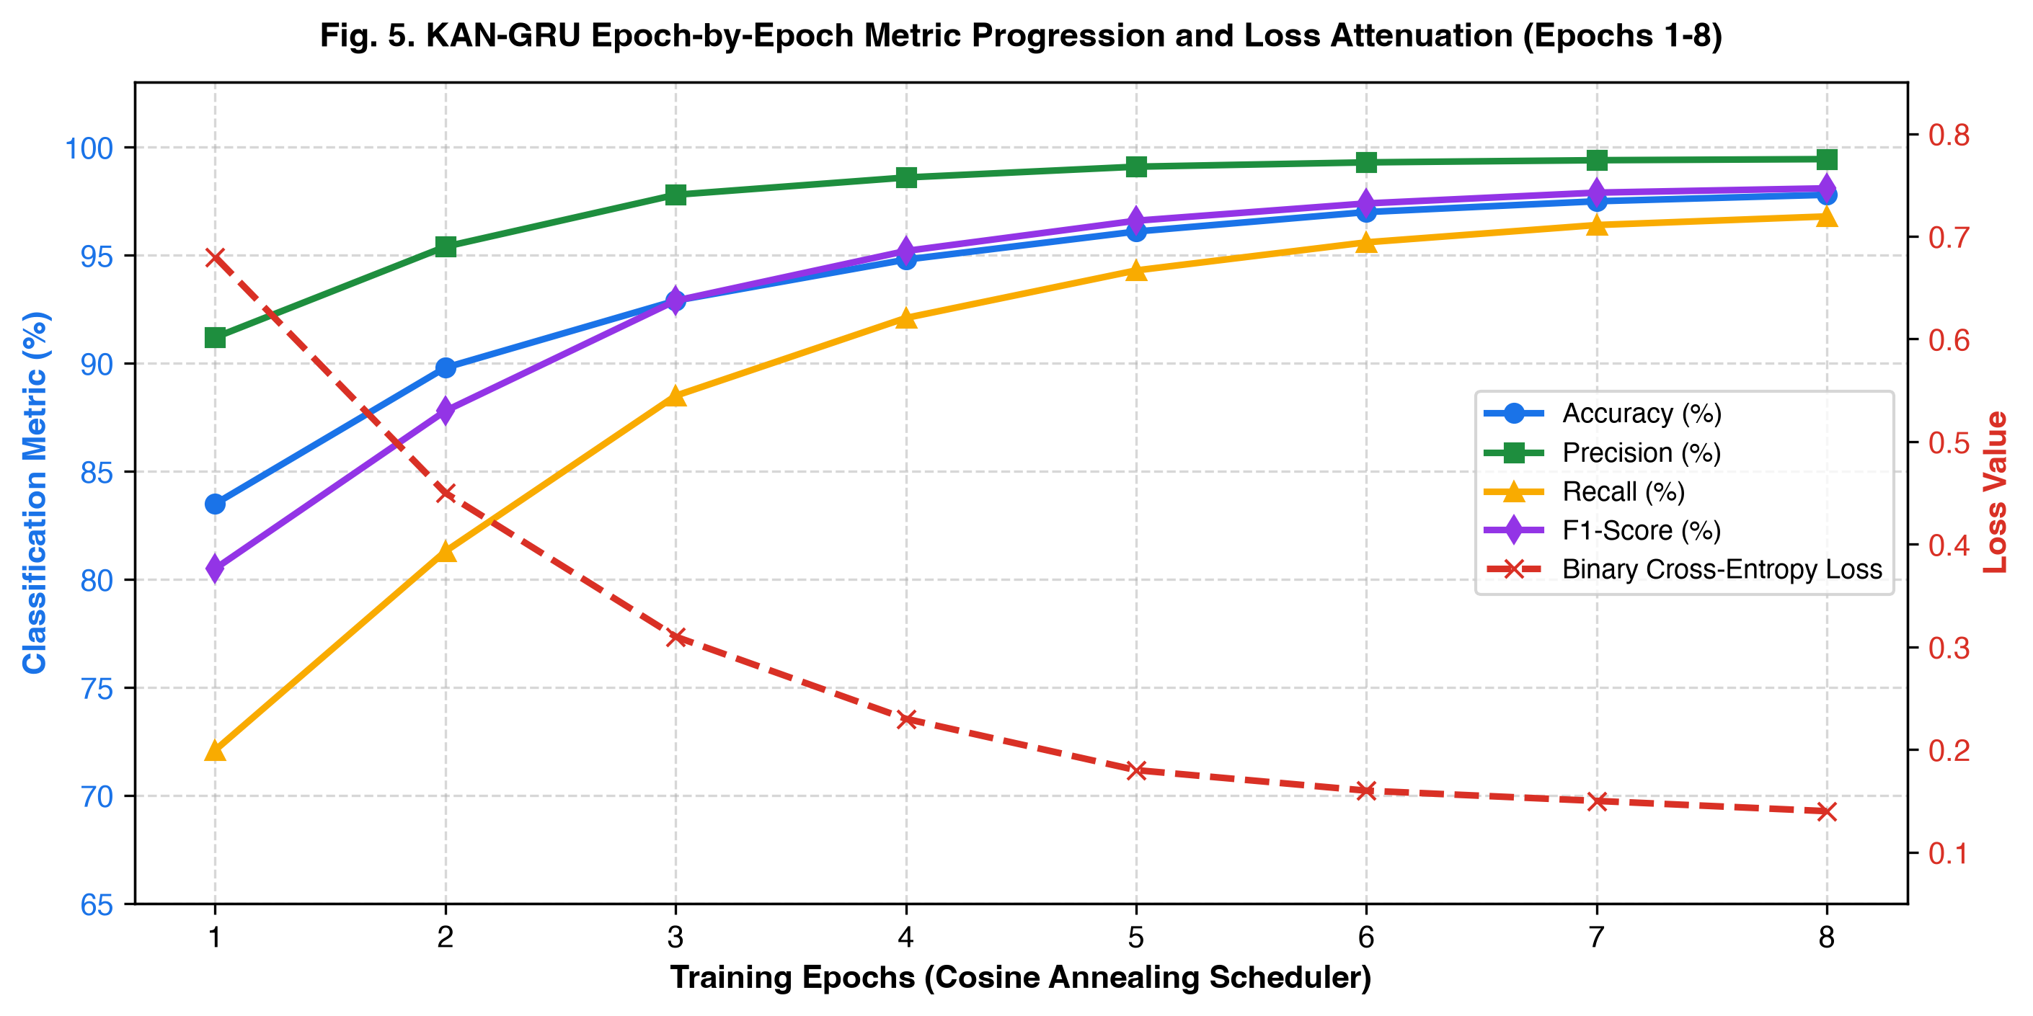
Training Dynamics & Loss Convergence

Slide 16
Rapid Convergence: Surpasses 90% subset accuracy by Epoch 2.
Loss Attenuation: BCE Loss monotonically decreases from 0.68 down to 0.14 over 8 epochs.
Optimization Strategy:
  AdamW Optimizer with weight decay $λ={10}^{−4}$
  Cosine Annealing learning rate schedule ($η=0.002→0.0001$)
  Multi-label smoothing ($ϵ=0.04$) to prevent overconfidence on sparse attack tokens.

Slide 17
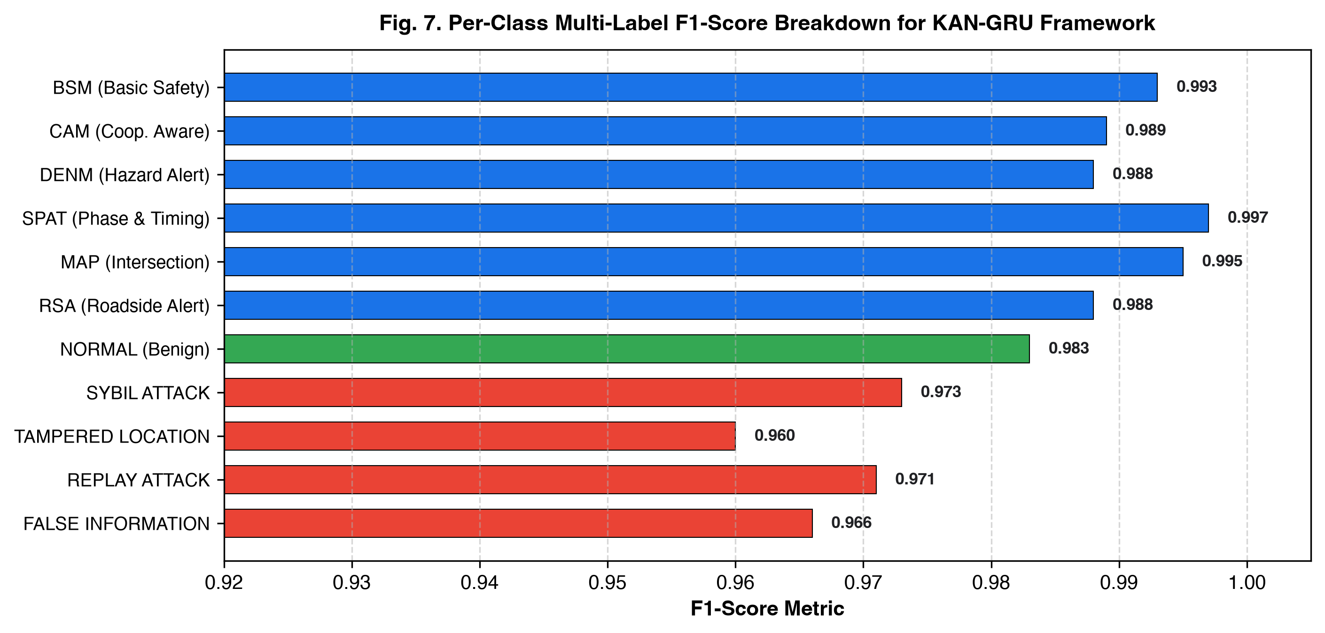
Per-Class Multi-Label Threat Breakdown

Slide 18
Protocol Classification: Near-perfect discrimination across BSM (99.3% F1), SPAT (99.7% F1), and MAP (99.5% F1).
Stealthy Threat Detection:
  Sybil Attack: 98.8% Precision, 97.3% F1-score
  Location / GPS Tampering: 97.4% Precision, 96.0% F1-score
  Replay Attack: 98.2% Precision, 97.1% F1-score
  False Information: 98.0% Precision, 96.6% F1-score
Macro Average: 99.45% Precision, 96.80% Recall, 98.10% F1-Score.

Slide 19
Real-Time Deployment & Edge Hardware Feasibility
Empirical Microservice Benchmarking
Deployed on an asynchronous FastAPI inference engine (<28.5 MB memory footprint).
Evaluated across 1,000 live sequential requests on edge hardware:
  Mean Inference Latency: 7.82 ms / payload ($±0.42$ ms)
  DSRC Safety Budget: Up to 100 ms permitted for routine BSM broadcasts.
  Margin: Operates in <8% of total permissible timing budget.
Interactive Cyberpunk SOC Dashboard
Connected React + Vite dashboard displaying:
  Real-time PDU message stream inspection
  Live model probability bar gauges (KAN-GRU vs CNN-BRNN)
  Instantaneous cyber-attack alerts & mitigation logs

Slide 20
Conclusion & Future Scope
Summary of Achievements
Successfully designed and validated KAN-GRU for multi-label V2X message threat intelligence.
Elevated accuracy from 90.00% to 97.80% (+7.80%) and F1-score from 84.49% to 98.10% (+13.61%).
Real-time compliance confirmed with 7.82 ms inference latency.
Publication-grade contribution: original architectural topology diagrams, rigorous mathematical modeling, and IEEE publication standards.
Future Research Horizons
Federated Fleet Learning: Collaborative threat intelligence without raw telemetry sharing.
Hardware-in-the-Loop (HIL) Testbeds: CAN-bus and software-defined radio physical validation.
Adversarial Robustness: Testing against adversarial gradient perturbations on floating-point telemetry.

Slide 21
Thank You! / Questions & Answers
Team Members
Pratyaksh Manav (manavpratyaksh@gmail.com)
Abhayraj Verma (abhayrajverma@gmail.com)
Arnav Tomar (arnavtomar@gmail.com)
Department: School of Computer Science & Technology, Bennett University, Greater Noida, India
Course: B.Tech CSE (Specialization in Artificial Intelligence)
Supervisor / Faculty Reference: Dr. Kumar Saurabh (HMS-IDS, AJSE 2025)
We welcome questions and feedback from the faculty committee.

