Slide 1
Face Recognition from a Single Training Sample per Person(SSPP)
Pratyaksha
Kamil Mansuri
MLSP Final Project 2021

Slide 2
Problem Definition
In Practical Scenarios only few images of each person is available(e.g.- Official Documents)
Number of features becomes much more than number of samples
Conventional Methods fail in such scenarios
GOAL : Solving the face recognition problem for Single training Sample per Person (SSPP)
SOLUTION APPROACH :
Crop the images
Divide each image into a number of non-overlapping patches
Consider each image as a manifold of local patches
Implement Discriminative Multi-Manifold Analysis(DMMA) method
Design two other experiments to compare with the above method(on Yale Faces Database)

Slide 3
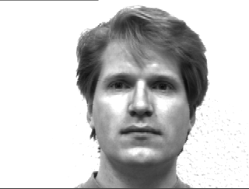
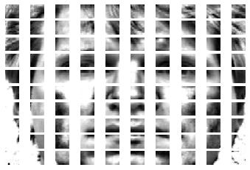
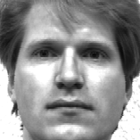
Technical Details
Pre-processing:
Original image Cropped image Image patches
Method 1 :
Consider the patches as individual samples
Label these samples with corresponding subject names
Apply SVM classifier
Method 2 :
Do not treat the points of manifolds as individual samples
Find manifold-manifold distances of test image with train images
Assign the label of the subject with minimum distance
Method 3 (DMMA):
Goal is to decrease the across manifold similarity and increase the within manifold similarity
Formulate a manifold-manifold matching method for the above goal
Simplify the objective function to come up with an iterative solution
Implement the solution

Slide 4
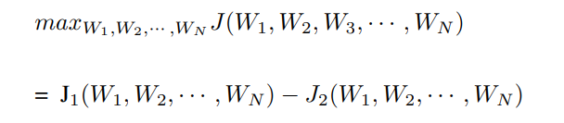


Technical Details
DETAILS OF DMMA METHOD:
Training:
Maximize the distance between points across manifolds in the projected feature space
Minimize the distance between points within a manifold in the projected feature space
Learn unique projection matrices(Wi) for each subject
Maximization problem can be written as:
J1 ( across manifold distance) : to be maximized
J2 (within manifold distance) : to be minimized
Find the eigen vectors corresponding to top k eigen values of the matrix H1 - H2
Wi consists of these eigen vectors as columns
Project each manifold point
Testing:
Use matrices learnt above to project the original manifold of test image
Projected manifold contains new discriminative feature space
Use the following to find the label for the test image
* Detailed equations and notations can be referred from the appendix

Slide 5
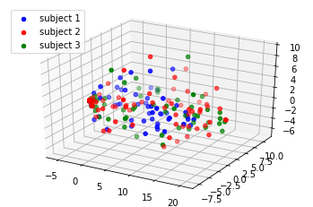
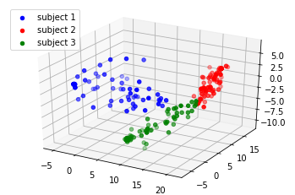
Results
3D Visualization of 3 manifolds corresponding to 3 different subjects in original feature space
3D Visualization of 3 manifolds corresponding to 3 different subjects in projected feature space

Slide 6
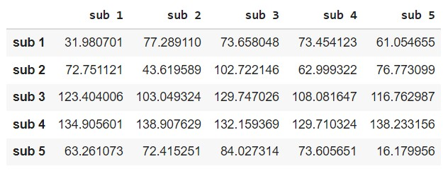
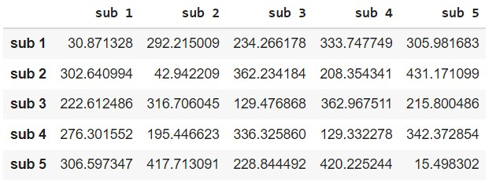
Results
Manifold-Manifold distances in original feature space
Manifold-Manifold distances in Projected feature space
Train set :
Train set :
Test Set
Test Set
Method 1 :
Did not perform up to the mark
Ignored the geometric information of the patches within a manifold
Method 2 :
Performed better than Method 1
Issue: Features for the same facial parts across manifolds are more similar than different parts within manifold.
Method 3
Resolves the above issues
Performs better than the above methods
Train accuracy : 100% for all the three methods
Test accuracies : < 50 % for Method 1, 71.5% for Method 2, 77.5% for Method 3.

Slide 7
Novel Contributions
Paper talks about Method 3 (DMMA) Only
Method 1 and Method 2 were formulated as a part of our comparative study
DMMA discussed in the paper uses different dimensionalities for projected features
It makes the experiment complex
Applying the projections and reconstruction seemed expensive
Increasing the number of subjects further increases the complexity
As a change, projection matrices learnt were kept fixed dimensional across the subjects
Also, we use simple manifold-manifold distance method
Even with the above simplifications, we got a decent performance
Initial study, plan and implementation were performed together by both the team members over Teams screen share

Slide 8
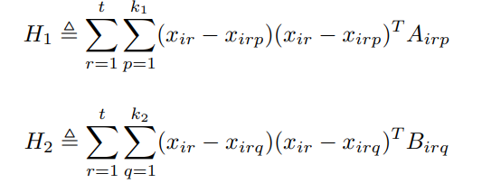
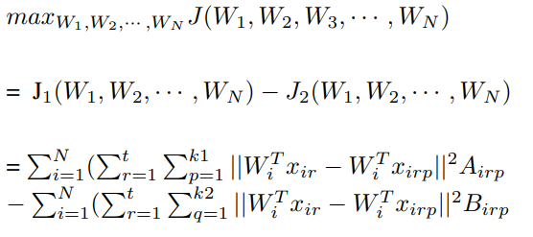
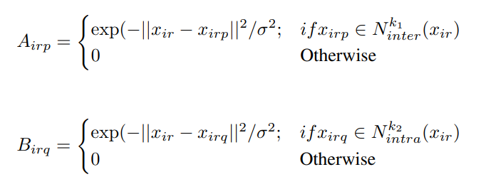
Appendix
)
)

Slide 9
References
"Discriminative multimanifold analysis for face recognition from a single training sample per person." IEEE transactions on pattern analysis and machine intelligence 35.1 (2013): 39-51.
By. Lu, Jiwen, Yap-Peng Tan, and Gang Wang.
Data : http://vision.ucsd.edu/content/yale-face-database 5. Tools Used Google
Colab : For coding the equations OpenCV : For pre-processing(Cropping) the images

