Slide 1

Continuous non-malleable codes joint work with sebastian faust, jesper buus nielsen, daniele venturi
TCC 2014

Slide 2




The “tampering experiment’’
“Tampering Experiment” for encoding scheme (Enc,Dec):
C
C*=f(C)
s
Enc
Tamper
Dec
s*
f
2F
f is chosen adversarially from some fixed family F$=\{ \text{f} \}$
Goal: Design encoding scheme (Enc,Dec) for “interesting” F that provides “meaningful guarantees” about s*.

Slide 3


Error correction/detection & Non-malleability
C
C*=f(C)
s
Enc
Tamper
Dec
s*
f 2F
Error-Correction: Requires s* = s but e.g. for hamming codes f must be such that: Ham-Dist(C,C*) < d/2. i.e. F is very limited !
Error-Detection: Requires s* = {s, ?} but F can’t contain simple function e.g. constant functions f_{Ĉ}(.)= Ĉ
Non-Malleability[DPW10]: Requires s* = s or unrelated to s.
Hope: Achievable for rich F

Slide 4
Limitation and possibility
  Impossibility [DPW10]: Not achievable if F contains f which knows Dec.
  For any (Enc, Dec) consider f_{bad} which decodes C, flips 1-bit and re-encodes to C*.
Conclusion: There is no NMC for F_{all}
Possibilities to restrict F :
Compromise complexity : make |F |[FMVW14] small.
Compromise granularity – Split-state : Considered in [DPW10, LL12, DKO13, ADL13, CG13 (last talk)] and this work.
Notes:
Check if the CG paper contains this or it’s the other paper. Swap first 2 lines

Slide 5
Split-state tampering
In this model, C = (C₁,C₂) and f =(f₁, f₂) for arbitrary f₁, f₂
C₁
f₁
C₁*
s
Enc
Dec
s*
C₂
f₂
C₂*
Why split-state ?
Might be easy to implement.
well-studied model in leakage-resilient crypto.
generalizes some other models (e.g. independent bit tampering [DPW10])
Rest of the talk
5

Slide 6
Outline: Rest of the talk
Formalize and introduce CNMC.
Explore a necessary requirement for CNMC.
Present the construction.
Overview of proof.
Application.

Slide 7

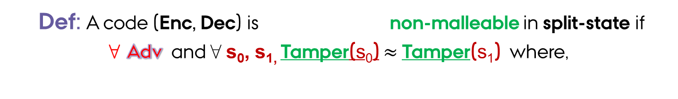
CNMC: A natural extension
continuous
Def: A code (Enc, Dec) is non-malleable in split-state if
8 Adv and 8 s₀, s_{1,} Tamper(s₀) $≈$Tamper(s₁) where,
Tamper(s_{b})
Encode (C₁,C₂) ← Enc(s_{b}).
Tampering:
Repeat adaptively
(f₁, f₂)
Set (C₁*,C₂*) ←(f₁(C₁), f₂(C₂))
If (C₁*,C₂*) = (C₁,C₂) return same
Else return (C₁*,C₂*)
3. Output View
return
Attack[GLMMR04]: Guess each bit, overwrite and check if the output is same- recover bit by bit
Way Out: Assume Self-Destruct: If output ? once, then STOP interaction.
View

Slide 8
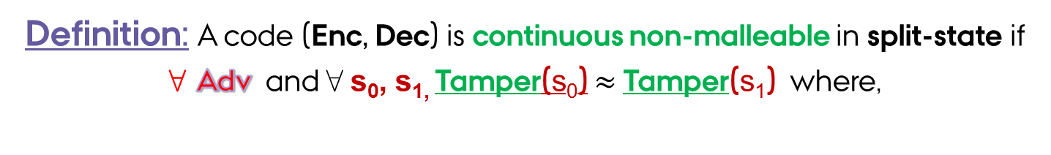
CNMC: A natural extension
Definition: A code (Enc, Dec) is continuous non-malleable in split-state if
8 Adv and 8 s₀, s_{1,} Tamper(s₀) $≈$Tamper(s₁) where,
Hang on for applications
Tamper(s_{b})
Encode (C₁,C₂) ← Enc(s_{b}).
Tampering:
Repeat adaptively
(f₁, f₂)
Set (C₁*,C₂*) ←(f₁(C₁), f₂(C₂))
If (C₁*,C₂*) = (C₁,C₂) return same
Else if Dec(C₁*,C₂*)= ?
then return ? and self-destruct .
Else return (C₁*,C₂*)
3. Output View
return
View

Slide 9
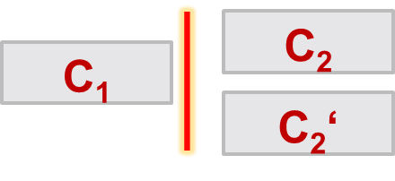

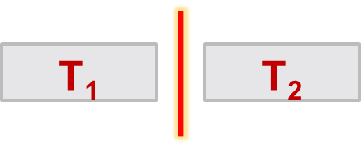

Uniqueness: a necessary property
Def: For any Adv it’s hard to find (C₁,C₂,C₂‘) such that:
[LL12] construction does not satisfy
Both (C₁,C₂) and (C₁,C₂‘) are valid
C₁
Why necessary ?
Otherwise suppose ∃
(f₁, f₂)
Recovers T₂
Corollary: Information theoretic CNMC (split-state) is impossible.
C₂
After knowing T_{2:}
3. f₁ hard-code T₂ and decode s← Dec(T₁,T₂).
4. Depending on s f₁ leaves it same or tampers.
f₁ always replaces T₁ with C₁
f₂ checks if T₂[i] = 0,
then replaces T₂ with C₂
else replaces T₂ with C₂‘

Slide 10

Towards constructing cnmc
Idea: Similar to [LL12], but adjusted to satisfy uniqueness.
Leakage reveals nothing about s
The ingredients:
Leakage(bounded) Resilient Encoding in split-state.
Collision Resistant Hash Functions
Robust Non-Interactive Zero Knowledge.
Possible to extract a witness from a valid proof which is not simulated
C₁
s
Enc
C₂

Slide 11
Our construction
Encoding
Encode using LRE : (z₀,z₁)←LREnc(s)
Compute hashes with CRHF H : h₀ = H(z₀) & h₁ = H(z₁)
3. Generate NIZK-POK : π₀ ← Prove(CRS,h_{0,} z₀) & π₁ ← Prove(CRS,h_{1,} z₁)
Part-0
CRS
Part-1
z₀
h₁
π₁
π₀
= C₀
C₁=
z₁
h₀
π₀
π₁
Uniqeness holds: Easy to see.
Decoding
Local Check: Check if proofs in each side verify using CRS.
Global Check: Check if the hashes are correct and the proofs match.
If all of above pass decode using LRE: (s)←LRDec(z₀,z₁), else output ?

Slide 12
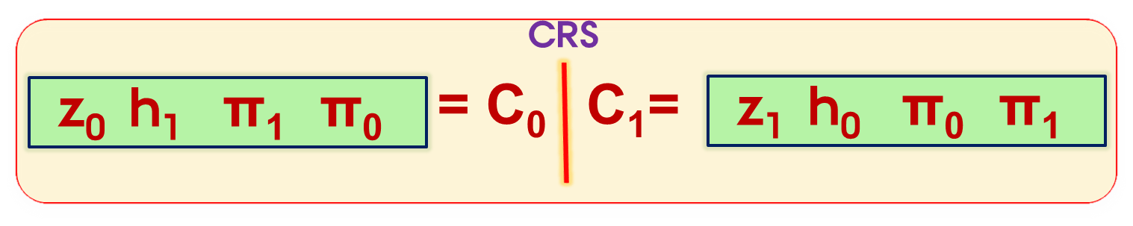
Proof intuitions
recall
Complicated case-analysis involves uniqeness, robustness of NIZK, collision resistance etc…..
Main Task:.
simulate tampering view of A
Main Idea: Reduction from Leakage Resilient Encoding.
LRE game: challenger C ↔ adv B^{A} (cnmc-adv A)
Main Difficulties.
1.simulate continuous tampering using only bounded leakage.
2. Simulate the tamper view with independent leakage access to each part of codword.
B
A
j* denotes the index where it outputs ? for the first time.
C
Easy to simulate: always output ?
Simulate
How to know j* ? possible using bounded leakage.
leakage
tampering
1
2
j*
…

Slide 13

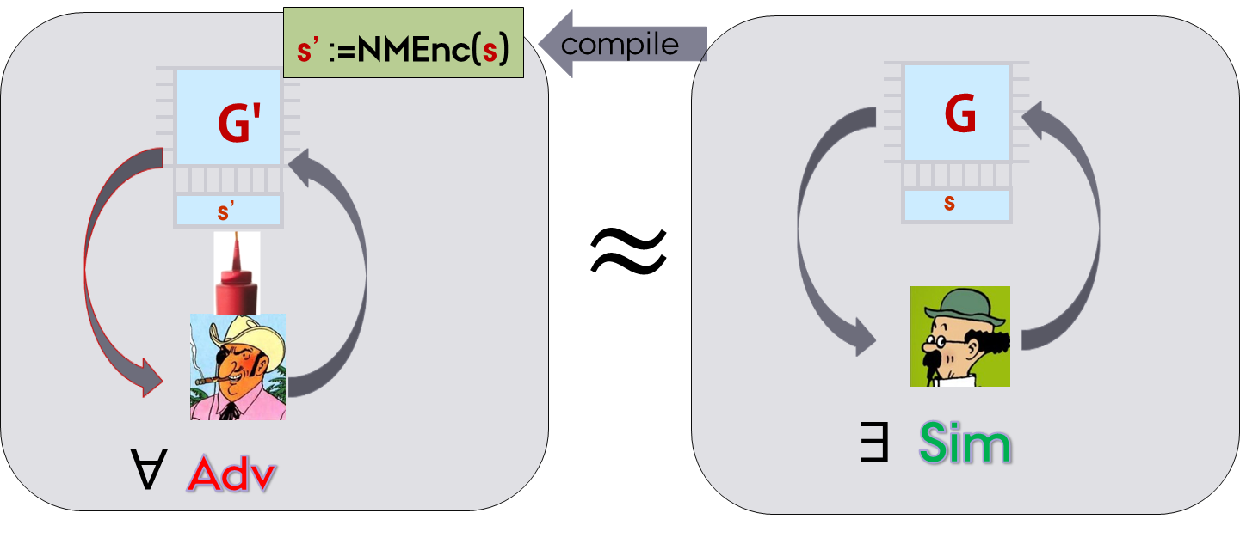
Application to protect against memory-tampering
Idea: Build compiler for any functionality [DPW 10]
Circuit
Circuit
G’
G
Initialization: s' := NMEnc(s)
compile
Execution of G’[s‘](x):
1. s = NMDec(s‘)
2. if s = ? then self-destruct
else output G[s](x)
Memory
Memory
s
s'
Tamper-simlatability:

Slide 14

Drawback and solution
Requires perfect erasures.
    Each time the new state is re-encoded, the old one must be erased. Otherwise Adv can copy.
    Must erase entire memory !
    Transformation is stateful even for stateless functionalities.
    . Decode, compute and re-encode with fresh randomness - constructing stateless transformation was open queation [DPW10]
Both solved with CNMC !

Slide 15
Our tampering model
Memory space much bigger than length of codeword.
f
C := NMEnc(s)
C‘
C
Memory M
Memory M*=f(M)
Main application.
In this model we construct a Stateless Transformation for stateless functionalities assuming 1untamperable bit (used for self-destruct).

Slide 16
summarize
CNMC: A natural extension of NMC.
First concrete construction.
Application: Protect against memory tampering in much stronger and practical model.
Open: We consider only split-state model, could be interesting to consider also global model.

Slide 17


Slide 18
Proof intuitions
recall
Main Idea: Reduction from Leakage Resilient Encoding.
Main Challenge:. simulate continuous tampering using only bounded leakage
Simulate based on cases:
1. C₀* = C₀ output same.
2. C₀*≠C_{0:}:
(i) if any proof fails output ?
(ii) π₁* ≠ π₁ : extracts z₁ from π₁*
(iii) Else output ?
Almost done except …. How to learn j* ? – Non-trivial as the leakage is only bounded.
It runs the same simulator inside leakage oracle.
Find j* by binary search comparing the simulated output.
LRE game: challenger C ↔ adv B^{A} (cnmc-adv A)
B
Assume that B knows the self-destruct index j*
C
A
Ask to Reveal C₀
Run A:
Get f_{0,},f₁
Before round j*:
Compute C₀* = f₀(C₀);
Let C₀* = (z₀*,h₁*, π₁*, π₀*)

