Slide 1


Efficient Non-Malleable Codes and Key-derivations against Poly-size Tampering Circuits
PRATYAY MUKHERJEE
(Aarhus University)
Joint work with
Sebastian Faust, Daniele Venturi and Daniel Wichs
EUROCRYPT 2014, COPENHAGEN
May 12, 2014

Slide 2
Two Parts
This talk
More
Part-1
Efficient Non-malleable Codes
against Poly-size circuits
Part-2
Efficient Non-malleable Key-derivation
against Poly-size circuits
Less

Slide 3
Part-1
Efficient Non-malleable Codes
against Poly-size circuits
Non-malleable Codes (Informally)
A modified codeword contains either original or unrelated message.
E.g. Can not flip one bit of encoded message by modifying the codeword.

Slide 4
The “Tampering Experiment”
Consider the following experiment for some encoding scheme (ENC,DEC)
C
C*=f(C)
s
ENC
Tamper
DEC
s*
f
2F
Note
ENC can be randomized.
There is no secret Key.
Goal:
Design encoding scheme (ENC,DEC) which is Non-malleable for an “interesting” class F

Slide 5
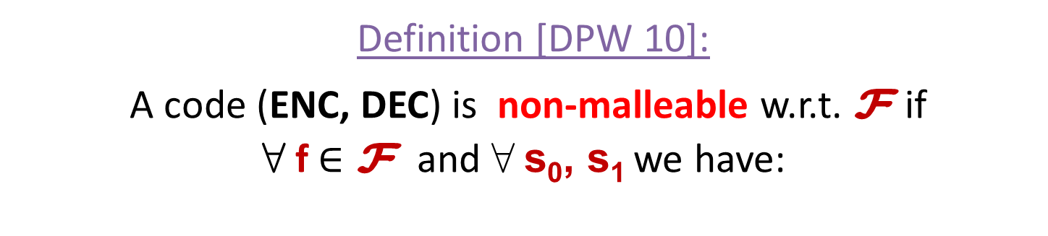
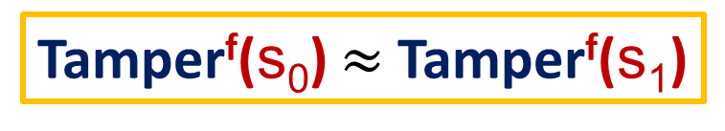
Tamper^{f}(s)
C
C*=f(C)
s
ENC
Tamper
DEC
s*
f
2F
If C* = C return same Else return s*
Definition [DPW 10]:
A code (ENC, DEC) is non-malleable w.r.t. F if
8 f $∈\text{F}$ and 8 s₀, s₁ we have:
Tamper^{f}(s₀) $≈$Tamper^{f}(s₁)

Slide 6
Application : Tamper-Resilient Cryptography
Non-malleable codes are used to protect against key-tampering attacks.
How ?
  Encode the key using NMC.
  The tampering adversary can not modify the encoded key to some related key.

Slide 7
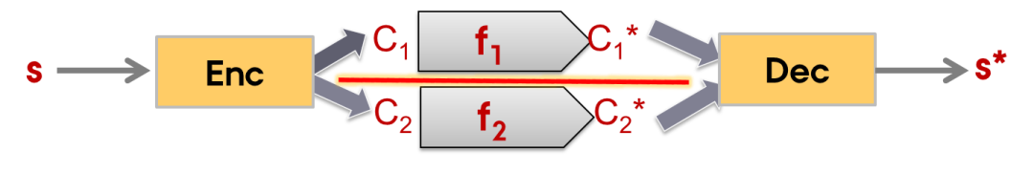
Limitation and Possibility
Limitation: For any (ENC, DEC) there exists f_{bad} which decodes C, flips 1-bit and re-encodes to C*.
Corollary-1: It is impossible to construct encoding scheme which is non-malleable w.r.t. all functions F_{all} .
Corollary-2: It is impossible to construct efficient encoding scheme which is non-malleable w.r.t. all efficient functions F_{eff} .
Question: How to restrict F ?
Way-1: Restrict granularity
Codeword consists of components which are independently tamperable.
Example: Split-state tampering [DPW10, LL12, DKO13, ADL13, CG13, FMNV13, ADK14]:
Way-2: Restrict complexity
The whole codeword is tamperable but only with functions that are not “too complicated”.
Our Focus!

Slide 8
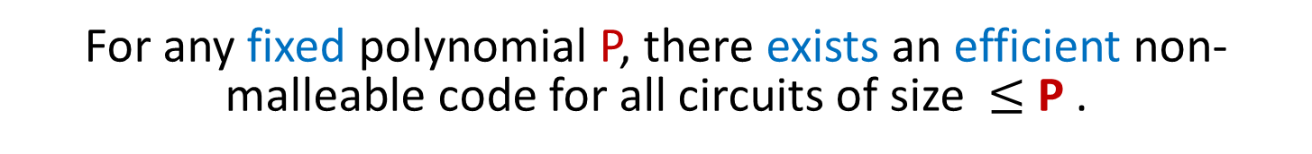
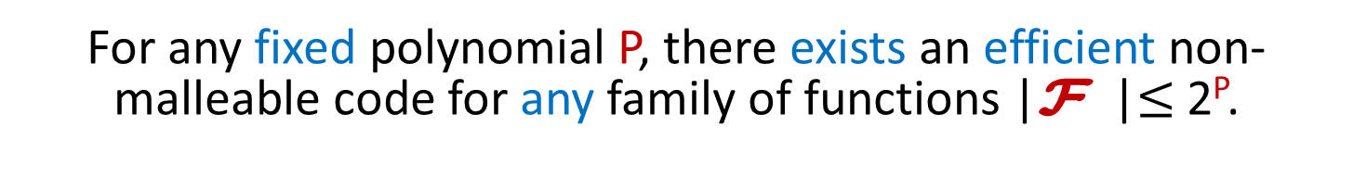
Our Result
recall
Corollary-2: It is impossible to construct efficient encoding scheme which is non-malleable w.r.t. all efficient functions F_{eff} .
Main Result: “The next best thing”
For any fixed polynomial P, there exists an efficient non-malleable code for any family of functions |F |$≤$ 2^{P}.
Corollary-3
For any fixed polynomial P, there exists an efficient non-malleable code for all circuits of size $≤$ P .
Notes:
When we say “The next Best Thing” then that only refers to the stronger result, no ?

Slide 9

Our Result
A similar result [CG 14]
But the encoding/decoding becomes “inefficient” in order to get negligible error
Main Result: “The next best thing”
For any fixed polynomial P, there exists an efficient non-malleable code for any family of functions |F |$≤$ 2^{P}.
Corollary-3
For any fixed polynomial P, there exists an efficient non-malleable code for all circuits of size $≤$ P .
Caveat: Our results hold in CRS model.
Notes:
When we say “The next Best Thing” then that only refers to the stronger result, no ?

Slide 10
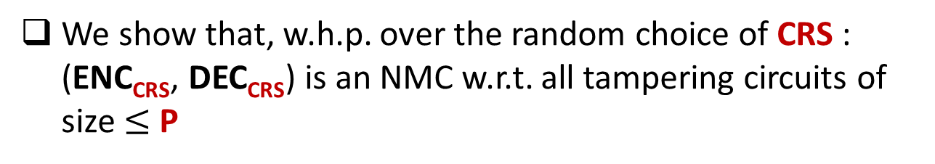
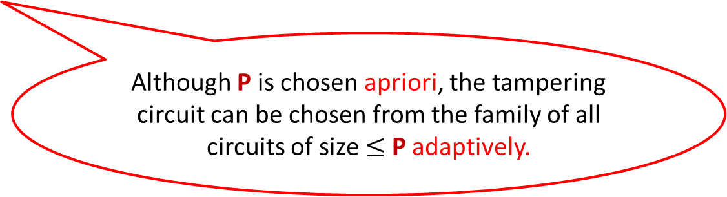
NMC in CRS model
Fix some polynomial P
We construct a family of efficient codes parameterized by CRS: (ENC_{CRS}, DEC_{CRS})
.
We show that, w.h.p. over the random choice of CRS : (ENC_{CRS}, DEC_{CRS}) is an NMC w.r.t. all tampering circuits of size $≤$ P
Although P is chosen apriori, the tampering circuit can be chosen from the family of all circuits of size $≤$ P adaptively.

Slide 11
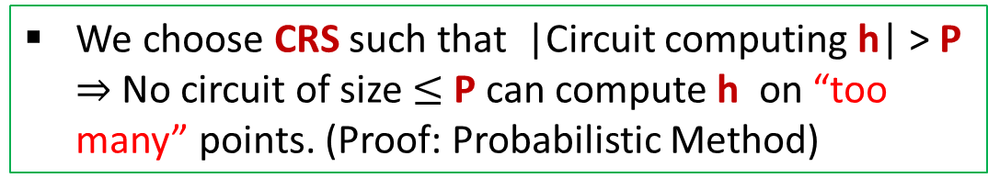
The Construction Overview
Input: s
Intuitions (outer encoding)
Ingredient: a t-wise independent hash function h
Inner Encoding
C₁
||
h( )
C
C₁
Fixed by CRS
C
C
R
||
h( )
is Valid
is of the form
R
C₁
We choose CRS such that |Circuit computing h| > P $⇒$No circuit of size $≤$P can compute h on “too many” points. (Proof: Probabilistic Method)
Outer
Encoding
For every tampering function f there is a “small set” S_{f} such that if a tampered codeword is valid, then it is in S_{f} w.h.p.
C

Slide 12
The Construction Overview
Input: s
Intuitions (outer encoding)
For every tampering function f there is a “small set” S_{f} such that if a tampered codeword is valid, then it is in S_{f} w.h.p.
Inner Encoding
C₁
We call this property Bounded Malleability which ensures that the tampered codeword does not contain “too much information” about the input codeword
Outer
Encoding
C

Slide 13
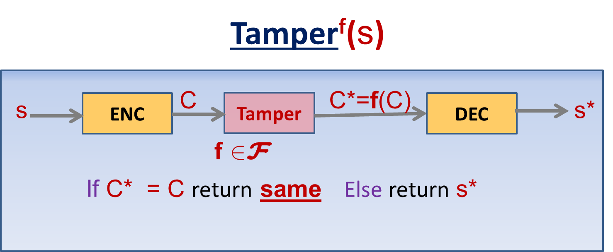
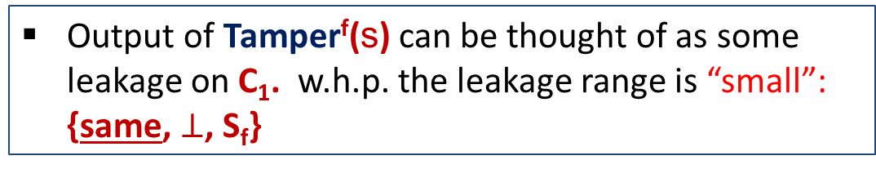
The Construction Overview
Input: s
Intuitions (Inner encoding)
recall
Inner Encoding
A leakage-resilient code
C₁
Output of Tamper^{f}(s) can be thought of as some leakage on C₁. w.h.p. the leakage range is “small”: {same, $⊥$, S_{f}}
Outer
Encoding
Example
C
f can guess some bit(s) of C₁ and if the guess is correct, leave C same otherwise overwrites to some invalid code.

Slide 14
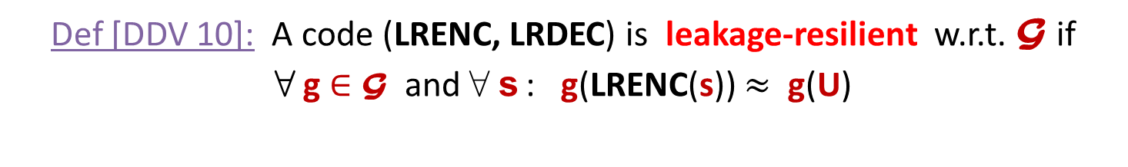
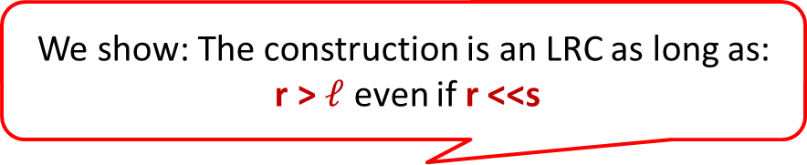
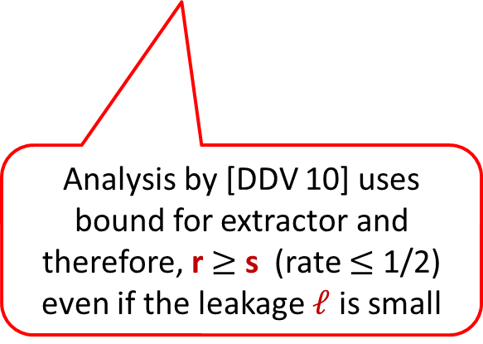

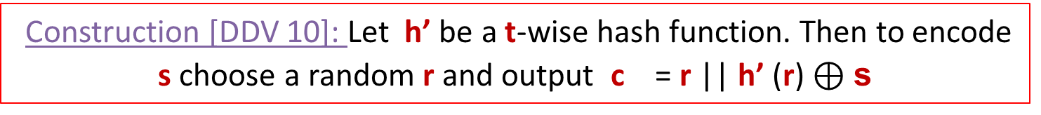
Leakage-Resilient Code
Def [DDV 10]: A code (LRENC, LRDEC) is leakage-resilient w.r.t. G if
8 g $∈$G and 8 s : g(LRENC(s)) $≈$ g(U)
Construction [DDV 10]: Let h’ be a t-wise hash function. Then to encode s choose a random r and output c = r || h’ (r) $⊕\text{s}$
Our Inner Encoding
Analysis by [DDV 10] uses bound for extractor and therefore, r $≥$ s (rate $≤$ 1/2) even if the leakage $ℓ$ is small
We show: The construction is an LRC as long as:
r > $ℓ$ even if r <<s
We use the same construction but improved analysis to achieve optimal rate $≈$ 1.

Slide 15
Putting it together
Input: s
Leakage Resilient Code
Inner Encoding
C₁
Bounded Malleable Code
Outer
Encoding
Non-Malleable Code
C

Slide 16
Part-2
Efficient Non-malleable Key-derivation (NMKD)
against Poly-size circuits

Slide 17


NMKD: A new primitive
Source: X
Tampered Source: f(X)
$$NMKD$$
$$NMKD$$
Output: Y
Output: Y’
NMKD guarantees that if f(X) $≠$X then (Y, Y’) $≈$ (U, Y’)
A dual of Non-Malleable Extractor

Slide 18


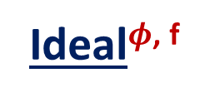
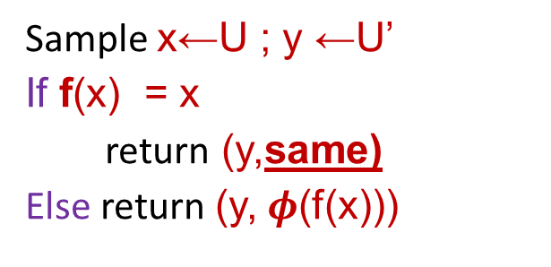
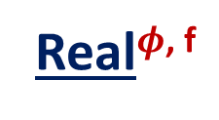
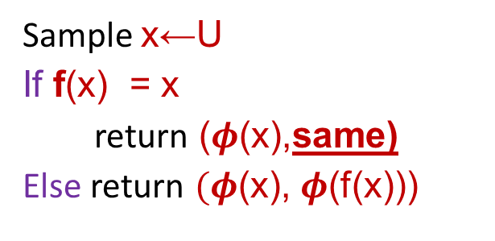
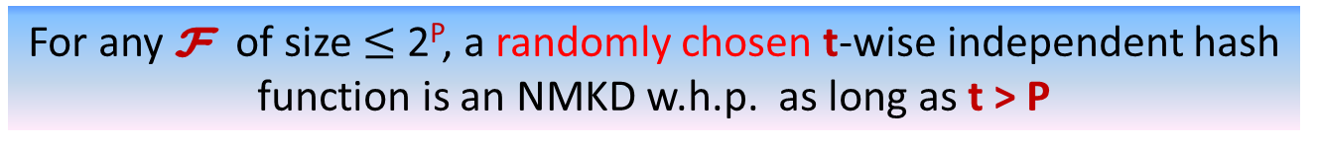
NMKD: Defintion
Real$φ$^{, f}
Ideal$φ$^{, f}
Sample x←U
If f(x) = x
return ($φ$(x),same)
Else return $(φ$(x), $φ$(f(x)))
$$≈$$
Sample x←U ; y ←U’
If f(x) = x
return (y,same)
Else return (y, $φ$(f(x)))
Definition: A function $φ$ is NMKD w.r.t. F if
8 f $∈\text{F}$ if above holds
Theorem (NMKD)
For any $\text{F}$ of size $≤$2^{P}, a randomly chosen t-wise independent hash function is an NMKD w.h.p. as long as t > P
Notes:
May be t > P is not a very good presentation. How can I say t is “sufficiently” larger than P ?

Slide 19
Conclusion
The first construction of non-granular efficient Non-malleable code.
  Our construction is information theoretic and achieves optimal rate.
A new primitive Non-Malleable Key-derivation.
  Application to construct Tamper-resilient Stream Cipher.
Open:
  New Application of NMKD.

Slide 20
Thank You !

