Slide 1

Efficient Non-Malleable Codes and Key-derivations against Poly-size Tampering Circuits
PRATYAY MUKHERJEE
Aarhus University (now @NYU)
Joint work with
Sebastian Faust, Daniele Venturi and Daniel Wichs
(EPFL) (La Sapienza, Rome ) (NEU)
Appeared in Eurocrypt 2014
New York Crypto Day, CUNY
June 27, 2014

Slide 2
Outline
Introduction to Non-Malleable Codes.
Efficient Non-malleable codes against poly-size tampering circuit. (Our result-1)
Applications of NMC in Crypto.
A new and related notion: Non-malleable Key-derivation and it’s application. (Our result-2)

Slide 3
Introduction to
Non-malleable Codes

Slide 4



What is Non-Malleable Codes ?
(Only one sentence!)
NMC
A modified codeword contains either original or unrelated message.
E.g. Can not flip one bit of encoded message by modifying the codeword.

Slide 5
The “Tampering Experiment”
Consider the following experiment for some encoding scheme (ENC,DEC)
C
C*=f(C)
s
ENC
Tamper
DEC
s*
f
2F
Note
ENC can be randomized.
There is no secret Key.
Goal:
Design encoding scheme (ENC,DEC) with meaningful “guarantee” on s* for an “interesting” class F

Slide 6
The “Tampering Experiment”
Consider the following experiment for some encoding scheme (ENC,DEC)
C
C*=f(C)
s
ENC
Tamper
DEC
s*
f
2F
Error-Correcting Codes: Guarantee s* = s
F is very limited !
e.g. For hamming codes with distance d,
f must be such that:
Ham-Dist(C,C*) < d/2.)

Slide 7

The “Tampering Experiment”
Consider the following experiment for some encoding scheme (ENC,DEC)
C
C*=f(C)
s
ENC
Tamper
DEC
s*
f
2F
Error-Correcting Codes: Guarantee s* = s
F is very limited !
Error-Detecting Codes : Guarantee s* = s or $⊥$
F excludes simple functions !
e.g. consider f to be a const. function always maps to a “valid” codeword.

Slide 8

The “Tampering Experiment”
Consider the following experiment for some encoding scheme (ENC,DEC)
C
C*=f(C)
s
ENC
Tamper
DEC
s*
f
2F
Error-Correcting Codes: Guarantee s* = s
F is very limited !
Error-Detecting Codes : Guarantee s* = s or $⊥$
F excludes simple functions !
Non-malleable Codes [DPW ’10] :
Guarantee s* = s or “something unrelated”
Hope: Achievable for “rich”
F

Slide 9

Let’s be formal…..

Slide 10
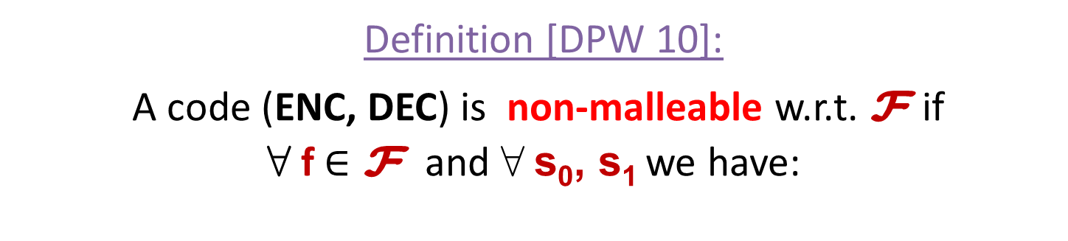
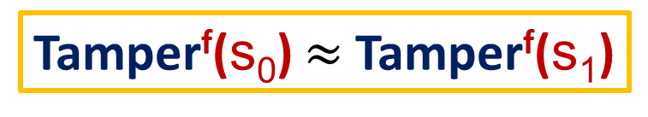
Tamper^{f}(s)
C
C*=f(C)
s
ENC
Tamper
DEC
s*
f
2F
If C* = C return same Else return s*
Definition [DPW 10]:
A code (ENC, DEC) is non-malleable w.r.t. F if
8 f $∈\text{F}$ and 8 s₀, s₁ we have:
Tamper^{f}(s₀) $≈$Tamper^{f}(s₁)

Slide 11
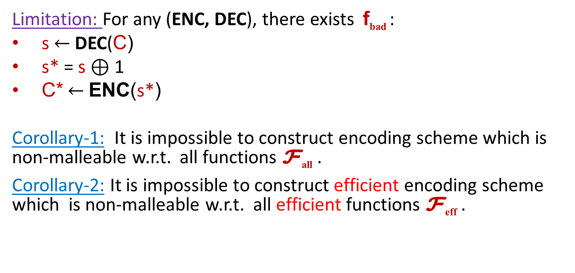
Limitation…
Limitation: For any (ENC, DEC), there exists f_{bad} :
s$←$DEC(C)
s* = s $⊕$ 1
C*$←$ENC(s*)
Corollary-1: It is impossible to construct encoding scheme which is non-malleable w.r.t. all functions F_{all} .
Corollary-2: It is impossible to construct efficient encoding scheme which is non-malleable w.r.t. all efficient functions F_{eff} .
No hope to achieve
non-malleability for such f_{bad} !
Main Question: How to restrict F ?
Other Questions:
  Rate ( =|C|/|s| )
  Efficiency
  Assumption(s)

Slide 12
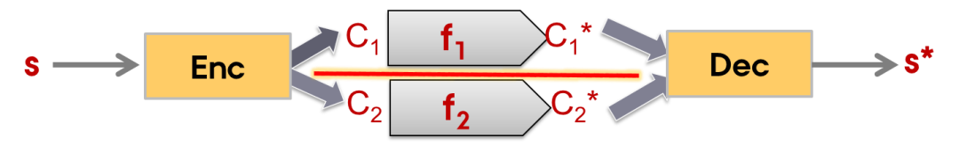
…..and Possibilities
Main Question: How to restrict F ?
Way-1: Granular Tampering
Codeword consists of components which are independently tamperable.
Decoding requires multiple components.
Example: Split-state tampering model where there are only two independently tamperable components.
    [DPW10, LL12, DKO13, ADL13, CG14a, FMNV14, ADK14]

Slide 13
…..and Possibilities
Main Question: How to restrict F ?
Way-2: Low complexity tampering
The whole codeword is tamperable.
The tampering functions are “less complicated” than encoding/decoding.
[CG14b, FMVW 14]
This talk

Slide 14
Efficient NMC for poly-size tampering circuits

Slide 15
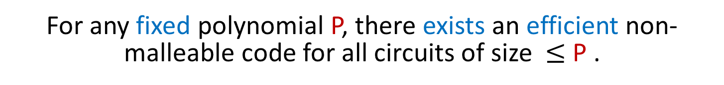
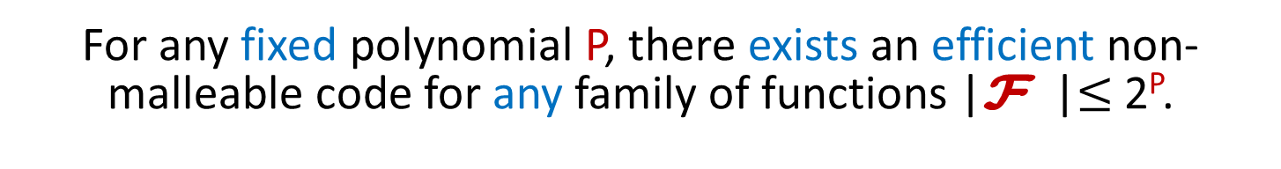
Our Result
recall
Corollary-2: It is impossible to construct efficient encoding scheme which is non-malleable w.r.t. all efficient functions F_{eff} .
Main Result: “The next best thing”
For any fixed polynomial P, there exists an efficient non-malleable code for all circuits of size $≤$ P .
Even more..
For any fixed polynomial P, there exists an efficient non-malleable code for any family of functions |F |$≤$ 2^{P}.
Caveat: Our results hold in CRS model.
Notes:
When we say “The next Best Thing” then that only refers to the stronger result, no ?

Slide 16
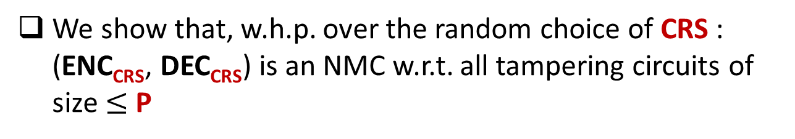
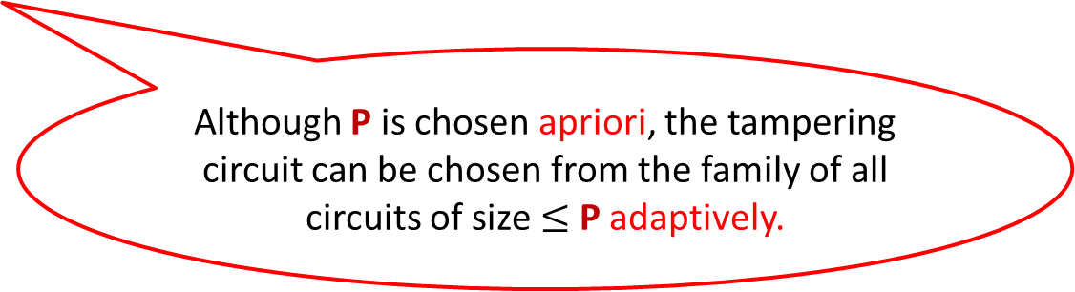
NMC in CRS model
Fix some polynomial P
We construct a family of efficient codes parameterized by CRS: (ENC_{CRS}, DEC_{CRS})
.
We show that, w.h.p. over the random choice of CRS : (ENC_{CRS}, DEC_{CRS}) is an NMC w.r.t. all tampering circuits of size $≤$ P
Although P is chosen apriori, the tampering circuit can be chosen from the family of all circuits of size $≤$ P adaptively.

Slide 17
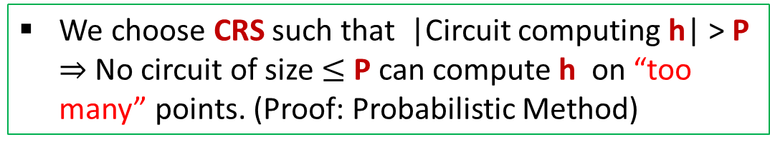
The Construction Overview
Input: s
Intuitions (outer encoding)
Ingredient: a t-wise independent hash function h
Inner Encoding
C₁
||
h( )
C
C₁
described by CRS
C
C
R
||
h( )
is Valid
is of the form
R
C₁
We choose CRS such that |Circuit computing h| > P $⇒$No circuit of size $≤$P can compute h on “too many” points. (Proof: Probabilistic Method)
Outer
Encoding
For every tampering function f there is a “small set” S_{f} such that if a tampered codeword is valid, then it is in S_{f} w.h.p.
C

Slide 18
The Construction Overview
Input: s
Intuitions (outer encoding)
For every tampering function f there is a “small set” S_{f} such that if a tampered codeword is valid, then it is in S_{f} w.h.p.
Inner Encoding
C₁
We call this property Bounded Malleability which ensures that the tampered codeword does not contain “too much information” about the input codeword
Outer
Encoding
C

Slide 19
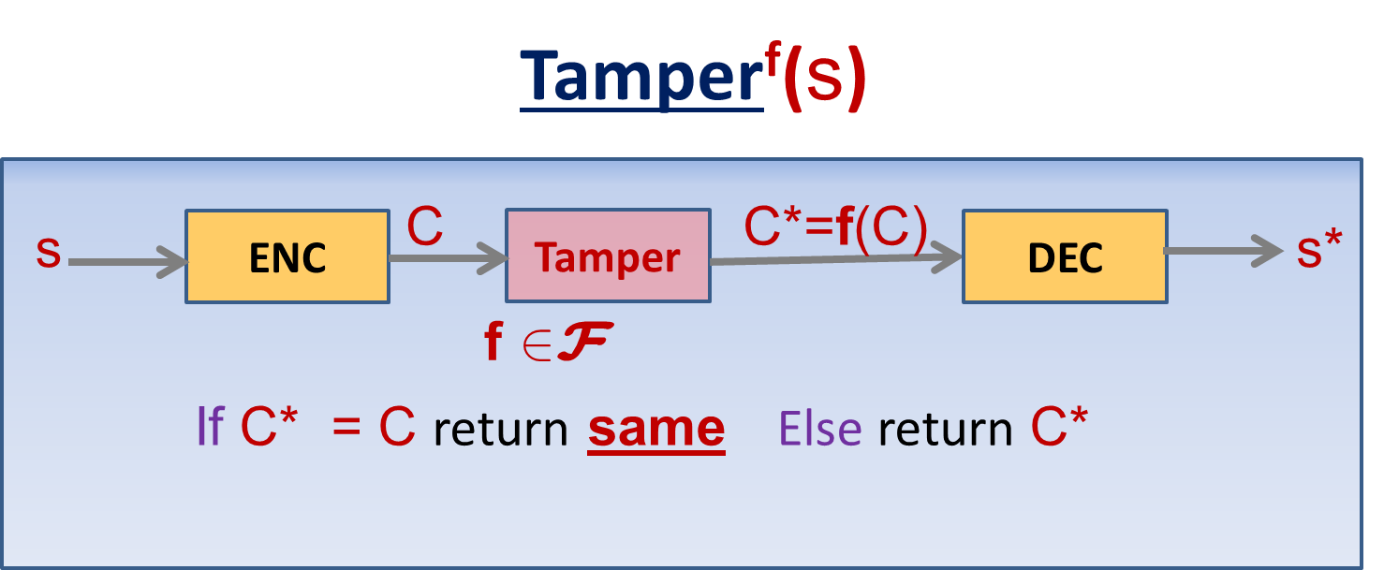
The Construction Overview
Input: s
Intuitions (Inner encoding)
recall
Inner Encoding
A leakage-resilient code
C₁
Output of Tamper^{f}(s) can be thought of as some sort of leakage on C₁
Outer
Encoding
Example
f can guess some bit(s) of C₁ and if the guess is correct, leave C same otherwise overwrites to some invalid code.
C
w.h.p. the leakage range is “small”: {same, $⊥$, S_{f}}

Slide 20
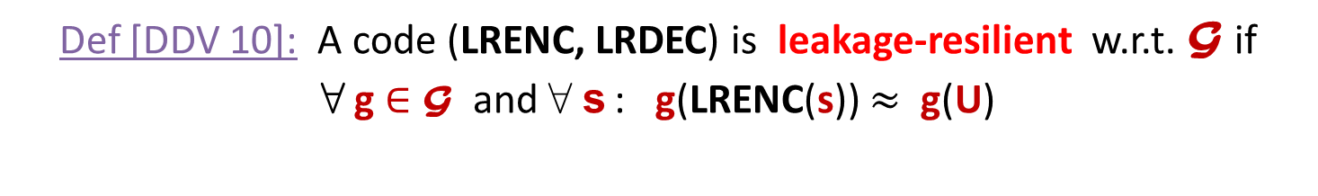
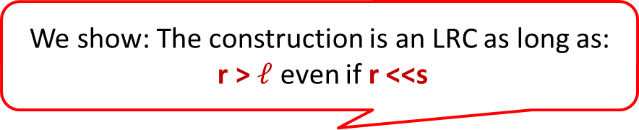
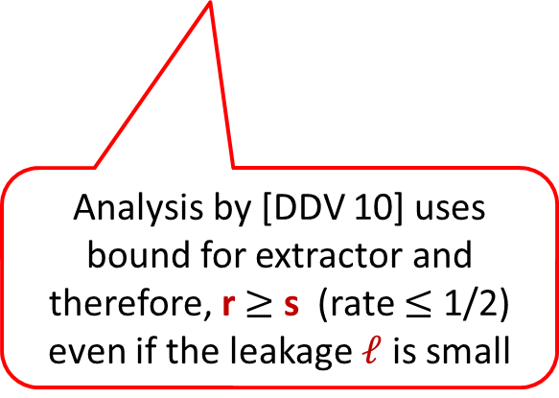

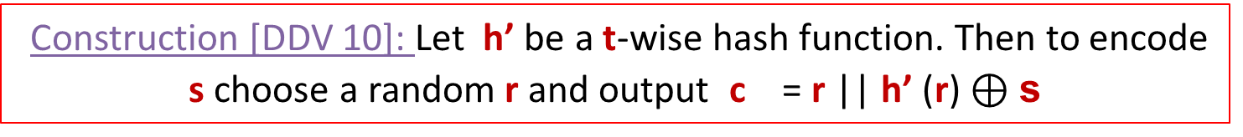
Leakage-Resilient Code
Def [DDV 10]: A code (LRENC, LRDEC) is leakage-resilient w.r.t. G if
8 g $∈$G and 8 s : g(LRENC(s)) $≈$ g(U)
Construction [DDV 10]: Let h’ be a t-wise hash function. Then to encode s choose a random r and output c = r || h’ (r) $⊕\text{s}$
Our Inner Encoding
Analysis by [DDV 10] uses bound for extractor and therefore, r $≥$ s (rate $≤$ 1/2) even if the leakage $ℓ$ is small
We show: The construction is an LRC as long as:
r > $ℓ$ even if r <<s
We use the same construction but improved analysis to achieve optimal rate $≈$ 1.

Slide 21
Putting it together
Input: s
Leakage Resilient Code
Inner Encoding
C₁
Bounded Malleable Code
Outer
Encoding
Non-Malleable Code
C

Slide 22


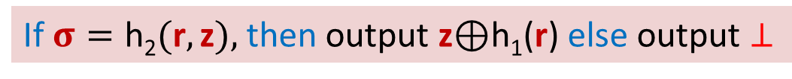

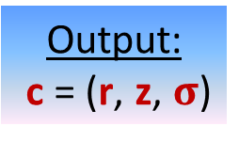
The Construction (Recap)
Pre-processing
Encoding
Param t
Input: s
r ← D_{R}
(h₁, h₂)← H₁$×\text{H}$₂
Inner Code:
c₁ = (r, z)
Both t–wise independent;
h₁(r)
z
h₁
h₂
$$σ=\text{h}\text{2}(r,z)$$
Output:
c = (r, z, $σ$)
Decoding
Input: c = (r, z, $σ$)
If$σ=\text{h}\text{2}(\text{r},\text{z}),$then output z$⊕$h₁(r) else output $⊥$

Slide 23
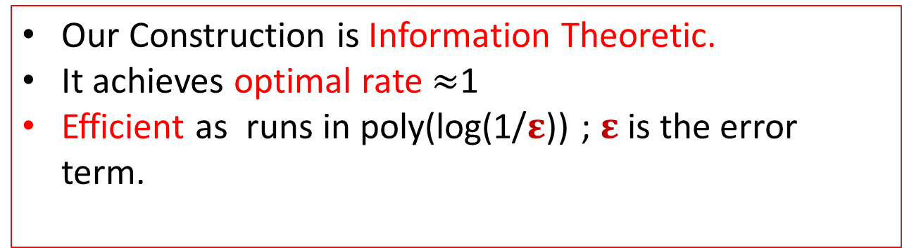
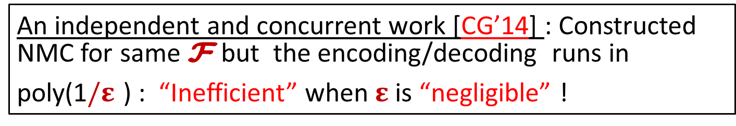
Few additional remarks
Our Construction is Information Theoretic.
It achieves optimal rate $≈$1
Efficient as runs in poly(log(1/$ε$)) ; $ε$ is the error term.
An independent and concurrent work [CG’14] : Constructed NMC for same F but the encoding/decoding runs in poly(1$/ε$ ) : “Inefficient” when $ε$ is “negligible” !

Slide 24

……but I thought this is a CRYPTO talk !

Slide 25
Applications in Crypto
Main Application
Tamper-resilient Cryptography
[DPW 10, LL 12, FMNV 14, FMNV 14a]

Slide 26
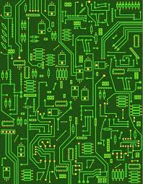
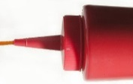


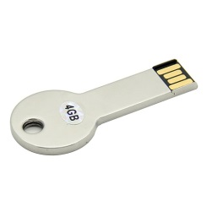

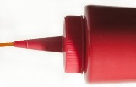
Theoretical models of tampering
Tamper with memory and computation (IPSW ’06)
Tamper only with memory (GLMMR ‘04)
Main Focus
F
F
k
k
Most General Model: Complicated
Limited existing results !
A Natural First Step : Simpler to handle
Might be reasonable in practice !

Slide 27





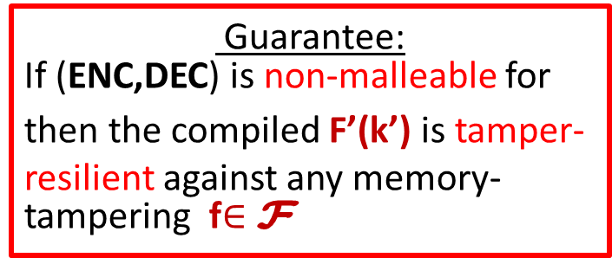
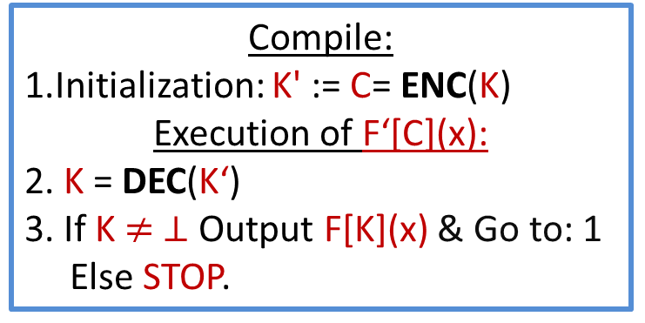


Tamper-resilient compiler using NMC [DPW 10]
Compile:
1.Initialization: K' := C= ENC(K)
Execution of F‘[C](x):
2. K = DEC(K‘)
3. If K $≠ ⊥$Output F[K](x) & Go to: 1
Else STOP.
F’
F
NMC
K’
K
Guarantee:
If (ENC,DEC) is non-malleable for then the compiled F’(k’) is tamper-resilient against any memory-tampering f$∈$F
$$∀$$
$$∃$$
Adv
$$≈$$
Sim

Slide 28
Other Recent Applications
FMNV 14a : Tamper-resilient RAM- considers tampering also with computation.
AGMPP 14: Bit-commitment to String-commitment using NMC secure against bit-permutation.
CMTV 14: One-bit CCA encryption=> Multi-bit CCA encryption using NMC secure against continuous bit-wise tampering.
More applications ? – Open !

Slide 29
Non-malleable Key-derivation (NMKD)

Slide 30


Intuition
Source: X
Tampered Source: f(X)
$$NMKD$$
$$NMKD$$
Output: Y
Output: Y’
NMKD guarantees that if f(X) $≠$X then (Y, Y’) $≈$ (U, Y’)
A dual of Non-Malleable Extractor

Slide 31


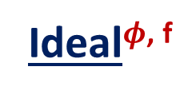
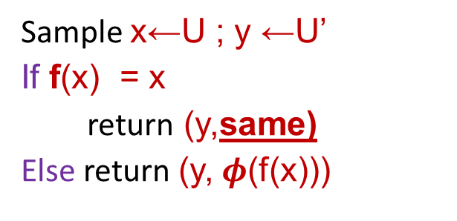
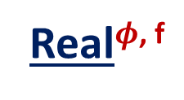
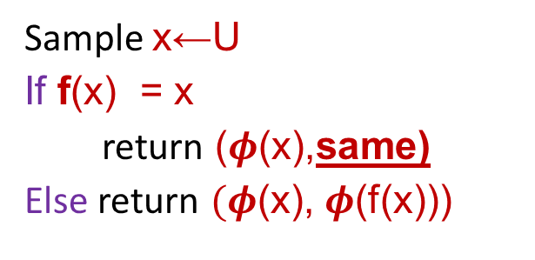
NMKD: Defintion
Definition: A function $φ$ is NMKD w.r.t. F if
8 f $∈\text{F}$ following holds
Real$φ$^{, f}
Ideal$φ$^{, f}
Sample x←U
If f(x) = x
return ($φ$(x),same)
Else return $(φ$(x), $φ$(f(x)))
Sample x←U ; y ←U’
If f(x) = x
return (y,same)
Else return (y, $φ$(f(x)))
$$≈$$
Notes:
May be t > P is not a very good presentation. How can I say t is “sufficiently” larger than P ?

Slide 32


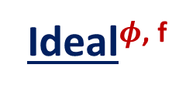
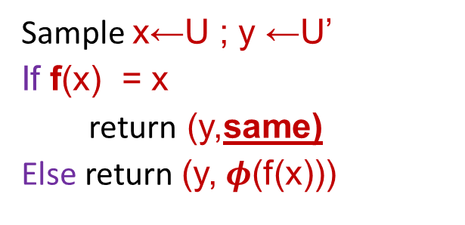
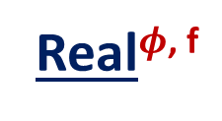
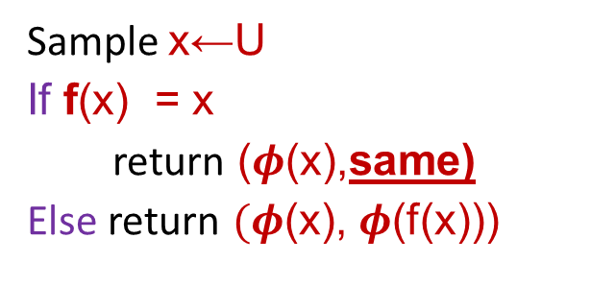
NMKD: Defintion
Real$φ$^{, f}
Ideal$φ$^{, f}
Sample x←U
If f(x) = x
return ($φ$(x),same)
Else return $(φ$(x), $φ$(f(x)))
$$≈$$
Sample x←U ; y ←U’
If f(x) = x
return (y,same)
Else return (y, $φ$(f(x)))
Definition: A function $φ$ is NMKD w.r.t. F if
8 f $∈\text{F}$ if above holds
Notes:
May be t > P is not a very good presentation. How can I say t is “sufficiently” larger than P ?

Slide 33
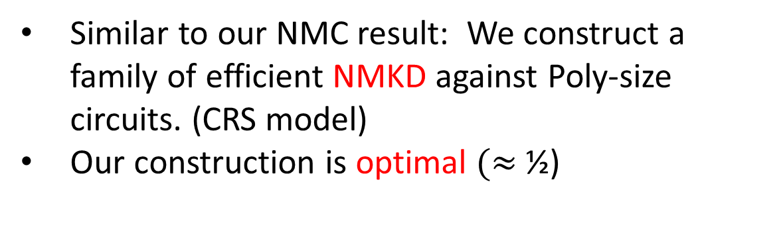
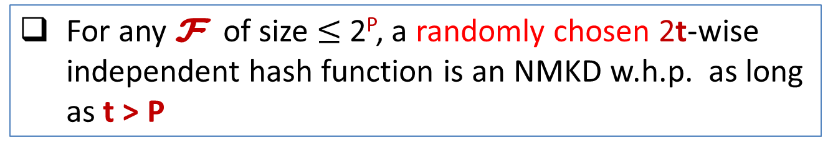
Results
Similar to our NMC result: We construct a family of efficient NMKD against Poly-size circuits. (CRS model)
Our construction is optimal $(≈$ ½)
Theorem (informal)
For any $\text{F}$ of size $≤$2^{P}, a randomly chosen 2t-wise independent hash function is an NMKD w.h.p. as long as t > P

Slide 34


Application of NMKD : Tamper-Resilient Stream Cipher
Model
s₁
s₂
Normal
Chain
s₀
SC(.)
SC(.)
SC(.)
x₀
x₁
x₂/u
f₁
f₀
x’₀
x’₁
s'₁
Tampered
Chain
s'₀
SC(.)
SC(.)

Slide 35




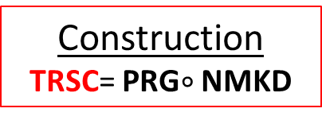

Application of NMKD : Tamper-Resilient Stream Cipher
Construction
TRSC= PRG$∘$ NMKD
s₁
s₂
Normal
Chain
s₀
prg($φ$(.))
prg($φ$(.))
prg($φ$(.))
x₀
x₁
x₂/u
f₁
f₀
x’₀
x’₁
s'₁
Tampered
Chain
s'₀
prg($φ$(.))
prg($φ$(.))

Slide 36
Conclusion
The first construction of non-granular and efficient Non-malleable code.
  Our construction is information theoretic and achieves optimal rate.
A new primitive Non-Malleable Key-derivation.
  Application to construct Tamper-resilient Stream Cipher.
Open:
  New Application of NMKD.
  Extend our result in plain model. (partial results by AGMPP 14)
  More applications of NMC

Slide 37
Thank You !

Slide 38
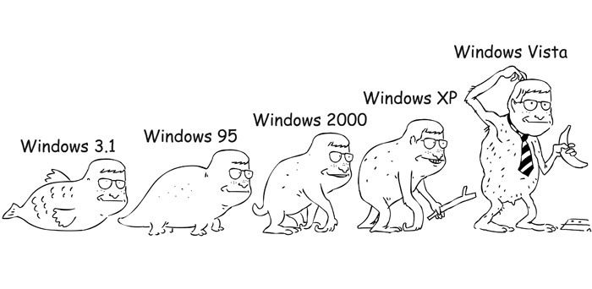
A brief history of
Non-malleable Codes

Slide 39

Application of NMKD : Tamper-Resilient Stream Cipher
Construction
TRSC= PRG$∘$ NMKD
s₁
s₂
Normal
Chain
s₀
prg($φ$(.))
prg($φ$(.))
x₀
x₁
f₁
f₀
x’₀
x’₁
s'₁
s'₂
Tampered
Chain
s'₀
prg($φ$(.))
prg($φ$(.))

Slide 40
Limitation and Possibility
Limitation: For any (ENC, DEC) there exists f_{bad} which decodes C, flips 1-bit and re-encodes to C*.
Corollary-1: It is impossible to construct encoding scheme which is non-malleable w.r.t. all functions F_{all} .
Corollary-2: It is impossible to construct efficient encoding scheme which is non-malleable w.r.t. all efficient functions F_{eff} .
Question: How to restrict F ?
Way-1: Restrict granularity
Codeword consists of components which are independently tamperable.
Example: Split-state tampering [DPW10, LL12, DKO13, ADL13, CG13, FMNV13, ADK14]:
Way-2: Restrict complexity
The whole codeword is tamperable but only with functions that are not “too complicated”.
Our Focus!

Slide 41
Tamper^{f}(s)
C
C*=f(C)
s
ENC
Tamper
DEC
s*
f
2F
If C* = C return same Else return C*

Slide 42



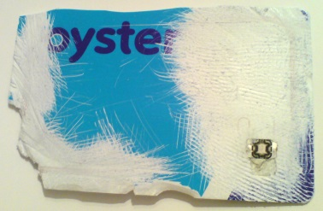
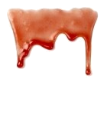



Physical attacks on implementations
Mathematical Model:
Blackbox
Reality:
PHYSICAL ATTACKS
Our focus
tampering
input
input
F_{k}$(.)$
F’_{k’} $(.)$
F_{k}$(.)$
tampered output
output
output

