Slide 1
Obfuscation without the Vulnerabilities of
Multi-linear Maps
Pratyay Mukherjee
(UC Berkeley)
Jointly with
Sanjam Garg & Akshayaram Srinivasan
  Safeware Reading Group
  June 8, 2016

Slide 2
Software Obfuscation
*Note: |O(P)| = poly(|P|)
Goal: make computer programs unintelligible while preserving their functionality.
O(P)
Alice
Bob
P: {X}-> {Y}
O(P): {X}-> {Y}

Slide 3
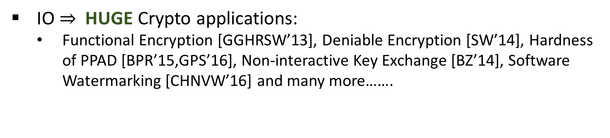
Formalizing Obfuscation
First formalized by Barak, Goldreich, Impagliazzo, Rudich, Sahai, Vadhan and Yang [BGIRSVY’01]
  Most natural definition- Virtual Black Box (VBB) – Impossible !
  Natural weakening: Indistinguishability Obfuscation (IO)
If (P₁ :{X} $→${Y}) $≡$ (P₂ : {X} $→${Y}); then O(P₁)$≈$O(P₂)
IO $⇒$HUGE Crypto applications:
  Functional Encryption [GGHRSW’13], Deniable Encryption [SW’14], Hardness of PPAD [BPR’15,GPS’16], Non-interactive Key Exchange [BZ’14], Software Watermarking [CHNVW’16] and many more…….
Notes:
ড়ে ReadRead ReRead s

Slide 4
Candidate constructions of IO
GGHRSW’14: Garg, Gentry, Halevi, Raykova, Sahai, Waters
First Candidate Construction of IO
from assumptions on Multi-linear maps
Subsequently more IO candidates from Multi-linear Maps
[BGKPS’14], [BR’14],[PST’14],[AGIS’14],[Zim’15],[AB’15],[GLSW’15],[BMSZ’16],[Lin’16]….
Security of mMaps are poorly understood
Vulnerabilities on mMap: [HJ’15], [CHLRS’15],[CGHLMMRST’15], [MSZ’16]….
Notes:
-These attacks are built on a common platform.
Note that these attacks are not known to break any of these IO candidates except for certain toy examples and that too only for certain constructions --e.g. none of these extend to GGHRSW.
However, these attacks are powerful and even though they are not known to work currently against IO, in future we might see extendsions of these attacks which can potentially break the IO schemes.

Slide 5
Multi-linear Maps (a.k.a. Graded Encodings)
[BS’03]: Extension of Bilinear maps
  First defined by Boneh & Silverberg
[GGH’13]: First candidate construction.
  Realized an approximate/noisy version from Ideal Lattices.
More candidates (& variants) followed: [CLT’13], [GGH’15], [CLT’15]
More applications found (except IO):
  ABE[GGHSW’13],NIKE[GGH’13], FE [GGHZ’16]….
Notes:
Check what exactly it breaks for GGH15

Slide 6
Security guarantees of previous mMap-IO candidates
Proof in Ideal Graded Encoding Model [BGKPS’14,AB’14…]
  Ideal Graded Encoding model assumes the underlying mMap is perfectly secure.
Guarantee: security against any attack that does not exploit the underlying mMap constructions.
Failed to address any attack on concrete mMap construction.

Slide 7

Vulnerabilities in GGH13: Impact on Obfuscation
Our Goal
To avoid this Future !
[GGHRSW’14]
Conceivable Extension
Zeroizing
[HJ’15]
Annihilation
[MSZ’16]
NIKE, FE…
Weak DL
[GGH13]
Existing
Obfuscation Constructions
Current Status
Future ???
[BGKPS’14,AGIS’14,BMSZ’16…….]
Notes:
- The attacks follow a pattern.

Slide 8
Question
Can we construct Obfuscation that is
provably secure assuming this weaker notion of mMaps?
This work
Answer
Yes, based on Garg-Gentry-Halevi-13 (GGH13) mMap
Notes:
- This weaker notion => that accounts for any attacks following the pattern.

Slide 9
Security guarantee of our Construction
Proof in Hybrid Graded Encoding (based on a modified GGH13) model.
Guarantee: security against all conceivable extensions of the current attacks on GGH13.

Slide 10
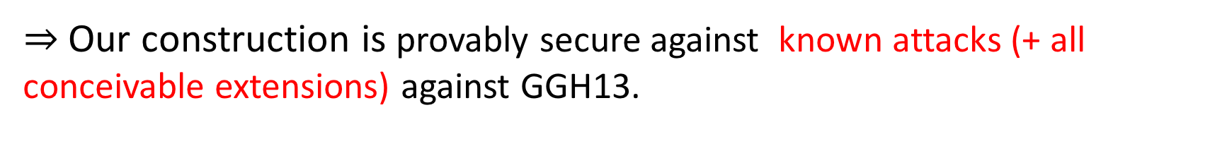
Our Results
  An obfuscation candidate based on (modified) GGH13 mMap
Proof of security in a new model: Hybrid Graded Encoding.
Uses structure of GGH13 map.
Captures all known vulnerabilities (& any conceivable extension) of GGH13 map.
  $⇒$ Our construction is provably secure against known attacks (+ all conceivable extensions) against GGH13.

Slide 11
Our Contribution:
Paradigm shift in (GGH13-based) Obfuscation Landscape
Feared Future(recall)
[GGHRSW’14]
Conceivable Extension
Zeroizing
[HJ’15]
Annihilation
[MSZ’16]
Weak DL
[GGH13]
Existing
Obfuscation Constructions
Our Candidate
[BGKPS’14,AGIS’14,BMSZ’16…….]
Notes:
- The attacks follow a pattern.

Slide 12
Rest of the talk
GGH13 map (Generic), vulnerabilities (Zeroizing) in Hybrid Model.
Previous obfuscation candidates based on GGH13 [BGKPS’14…..]
Vulnerabilities of obfuscation based on GGH13 map (Annihilation).
Our obfuscation candidate and our modification on GGH13.

Slide 13
GGH13 Map (Generic overview)

Slide 14
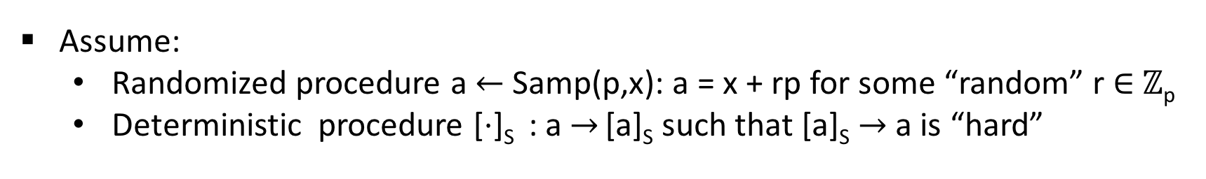
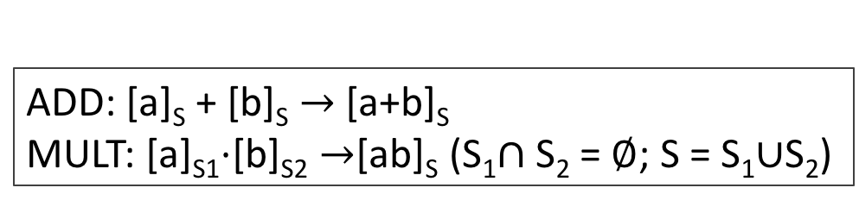
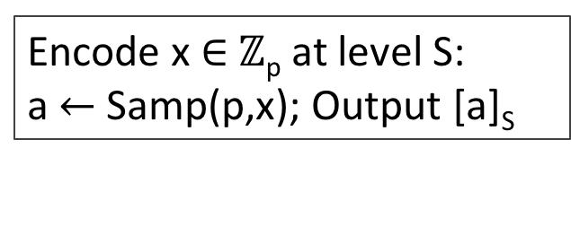
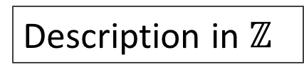
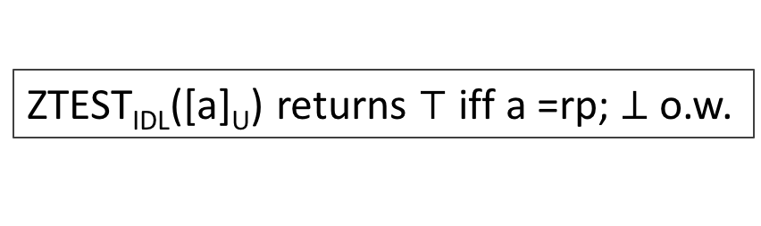
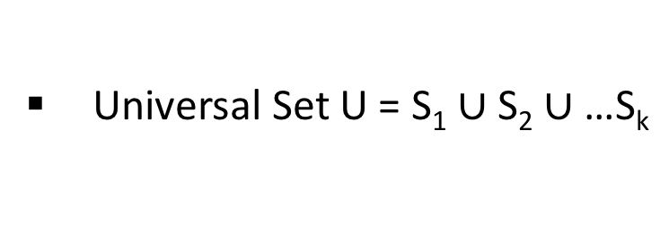
GGH13 Map (Generic overview)
Description in $ℤ$
Large secret prime p
Universal Set U = S₁ $∪$S₂ $∪$…S_{k}
Assume:
  Randomized procedure a$←$Samp(p,x): a = x + rp for some “random” r $∈$ $ℤ$_{p}
  Deterministic procedure [$⋅$]_{S} : a $→$ [a]_{S} such that [a]_{S} $→$ a is “hard”
Private Encoding
Multi-linear ops
Encode x $∈$ $ℤ$_{p} at level S:
a$←$Samp(p,x); Output [a]_{S}
ADD: [a]_{S} + [b]_{S} $→$[a+b]_{S}
MULT: [a]_{S1}$⋅$[b]_{S2} $→$[ab]_{S} (S₁$∩$ S₂ = $∅$; S = S₁$∪$S₂)
Zero-test (Ideal Model)
ZTEST_{IDL}([a]_{U}) returns $⊤$ iff a =rp; $⊥$o.w.

Slide 15
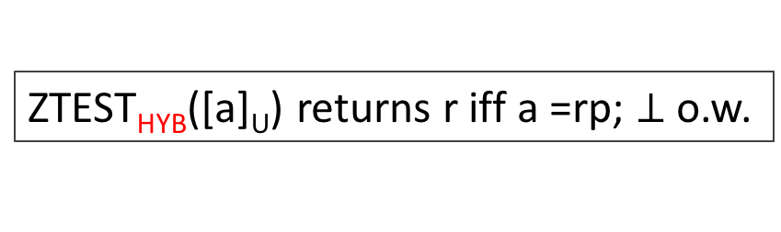
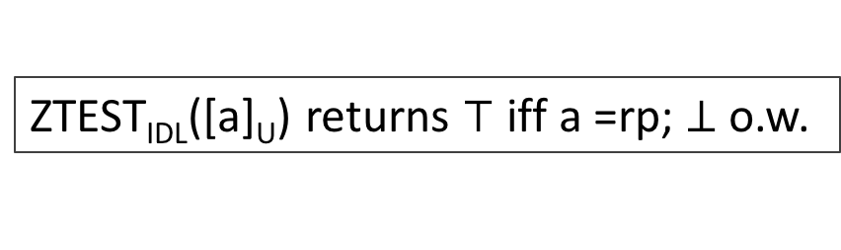
GGH13 Map (Generic overview)
Description in $ℤ$
Large secret prime p
Universal Set U = S₁ $∪$S₂ $∪$…S_{k}
Assume:
  Randomized procedure a$←$Samp(p,x): a = x + rp for some “random” r $∈$ $ℤ$_{p}
  Deterministic procedure [$⋅$]_{S} : a $→$ [a]_{S} such that [a]_{S} $→$ a is “hard”
Private Encoding
Multi-linear ops
Encode x $∈$ $ℤ$_{p} at level S:
a$←$Samp(p,x); Output [a]_{S}
ADD: [a]_{S} + [b]_{S} $→$[a+b]_{S}
MULT: [a]_{S1}$⋅$[b]_{S2} $→$[ab]_{S} (S₁$∩$ S₂ = $∅$; S = S₁$∪$S₂)
Zero-test (Ideal Model)
Zero-test (Hybrid)
ZTEST_{IDL}([a]_{U}) returns $⊤$ iff a =rp; $⊥$o.w.
ZTEST_{HYB}([a]_{U}) returns r iff a =rp; $⊥$o.w.
Hybrid Model captures “leaked info” if ZTEST succeeds

Slide 16
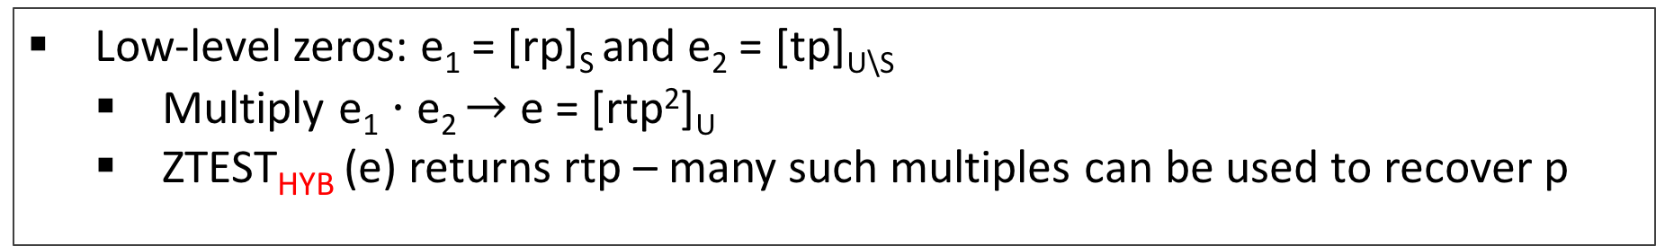
GGH13: Vulnerabilities with low-level zeros (Zeroizing)
Exploiting Low-level zeros [GGH’13(weak DL), HJ’16 (Zeroizing)]
Low-level zeros: e₁ = [rp]_{S} and e₂ = [tp]_{U\S}
  Multiply e₁ $⋅$e₂ $→$e = [rtp²]_{U}
  ZTEST_{HYB} (e) returns rtp – many such multiples can be used to recover p
Not captured in Ideal Model
Not possible with top level zero [rp]_{U}
Most Obfuscation Constructions do not yield low-level zeros
[Miles-Sahai-Zhandry’16]
Annihilation Attacks: top-level encoding of 0 suffices
Breaks [BGKPS’14,AGIS’14,MSW’14,…] when based on GGH13
Notes:
Taking GCD one can recover p

Slide 17
Overview:
A previous candidate IO based on GGH13 Map
(simplified [Barak-Garg-Kalai-Paneth-Sahai’14])

Slide 18
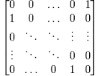
Obfuscation based on GGH13
Input Branching Program
Permutation matrices
e.g.
BP =

Slide 19
Obfuscation based on GGH13
Input Branching Program
BP =
Recall
BP(x) implements computation of boolean circuit C(x) via computing matrix product of correct order

Slide 20
Obfuscation based on GGH13
Input Branching Program
BP =
= C(0110) = 0/1
Recall
BP(x) implements computation of boolean circuit C(x) via computing matrix product of correct order
For example x = 0110

Slide 21
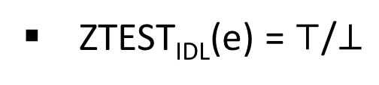
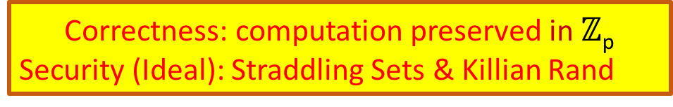

Obfuscation based on GGH13
*Killian randomized
Input Branching Program
Randomized Matrix Encoding:
Rand*-ENC($⋅$,S_{i})
BP =
S_{i}
  Correctness: computation preserved in $ℤ$_{p}
Security (Ideal): Straddling Sets & Killian Rand
Obfuscator
Evaluator
Encode the i-th matrix-pair w.r.t. level S_{i} to generate the encodings.
Output the encoded matrices
For each input x, multiply encoded matrices
e.g. x = 1001
S₁
S₂
S₃
S₄
= [f_{x}]_{U} = e
S₁
S₂
S₃
S₄
S₁
S₂
S₃
S₄
S₁
S₂
S₃
S₄
ZTEST_{IDL}(e) = $⊤$/$⊥$

Slide 22
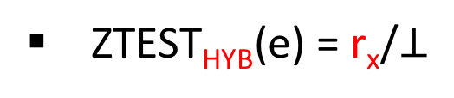
Obfuscation based on GGH13
*Killian randomized
Input Branching Program
Randomized Matrix Encoding:
Rand*-ENC($⋅$,S_{i})
BP =
S_{i}
  Correctness: computation preserved in $ℤ$_{p}
Security (Ideal): Straddling Sets & Killian Rand
Obfuscator
Evaluator
Annihilation Attack (HYB) exploits the “leaked info” from successful ZTEST_{HYB}
For each input x, multiply encoded matrices
Encode the i-th matrix-pair w.r.t. level S_{i} to generate the encodings.
Output the encoded matrices
e.g. x = 1001
S₁
S₂
S₃
S₄
= [f_{x}]_{U} = e
S₁
S₂
S₃
S₄
S₁
S₂
S₃
S₄
S₁
S₂
S₃
S₄
ZTEST_{HYB}(e) = r_{x}/$⊥$
(f_{x} = r_{x}p + f’_{x})

Slide 23
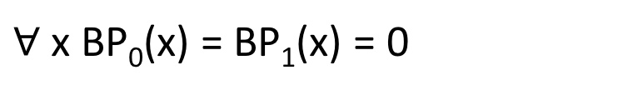
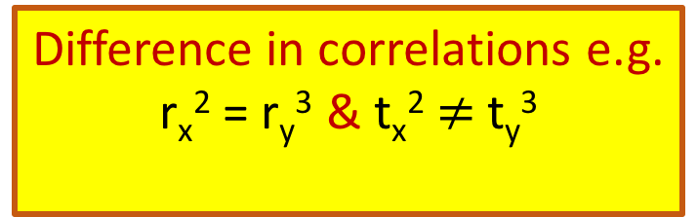
Annihilation Attack with top-level zeros [MSZ’16]
BP₀ =
S₁
S₂
S₃
S₄
(r_{x},r_{y})
OBF(BP₀)
EVAL(x,y)
S₁
S₂
S₃
S₄
S₁
S₂
S₃
S₄
EVAL(x,y)
(t_{x},t_{y})
BP₁=
OBF(BP₁)
S₁
S₂
S₃
S₄
Adv comes up with two BP’s such that
$∀$ x BP₀(x) = BP₁(x) = 0
Difference in correlations e.g.
r_{x}² = r_{y}³ & t_{x}² $≠$ t_{y}³
Distinguished!

Slide 24
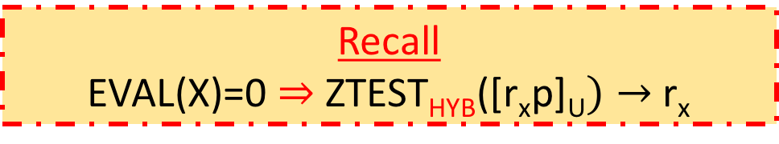
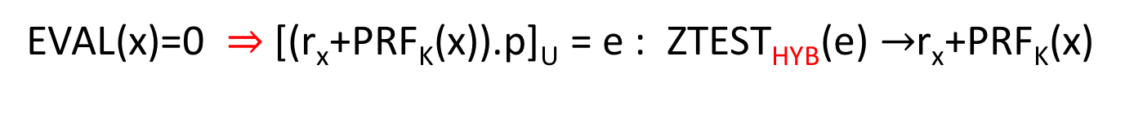
Annihilation Attack with top-level zeros [MSZ’16]
Recall
EVAL(X)=0 $⇒$ ZTEST_{HYB}([r_{x}p]_{U}$)→$ r_{x}
BP₀ =
S₁
S₂
S₃
S₄
(r_{x},r_{y})
OBF(BP₀)
EVAL(x,y)
Our Idea
Mask “leaked info” with PRF
S₁
S₂
S₃
S₄
“Self-fortification” : The evaluation EVAL(x) itself computes PRF_{K}(x) along with BP(x)
(t_{x},t_{y})
BP₁=
OBF(BP₁)
S₁
S₂
S₃
S₄
EVAL(x,y)
S₁
S₂
S₃
S₄
EVAL(x)=0 $⇒$ [(r_{x}+PRF_{K}(x)).p]_{U} = e : ZTEST_{HYB}(e) $→$r_{x}+PRF_{K}(x)
Adv comes up with two BP’s such that
$∀$ x BP₀(x) = BP₁(x) = 0
Difference in correlations e.g.
r_{x}² = r_{y}³ & t_{x}² $≠$ t_{y}³
Distinguished!
Destroy Correlations

Slide 25
Our Candidate Obfuscation
based on
(modified) GGH13 map

Slide 26
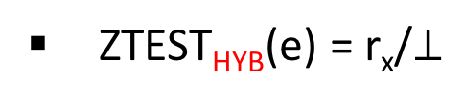
How to compute ?
Our Candidate Obfuscation
Input Branching Program
Auxiliary Branching Program
BP =
BP’ =
Obfuscator
BP’(x) = u_{x}.p : u_{x} = PRF_{K}(x)
BP*(x) = BP(x) + u_{x}.p
S₁
S₂
S₃
S₄
BP* =
GGH13* ENC
Where
=
S₁
S₂
S₃
S₄
Evaluator
If f_{x} =s_{x}.p then r_{x} = u_{x}+s_{x} – “ps-random”
Let x = 1001, then
S₁
S₂
S₃
S₄
= [f_{x}+u_{x}.p]_{U} = e
ZTEST_{HYB}(e) = r_{x}/$⊥$
S₁
S₂
S₃
S₄

Slide 27
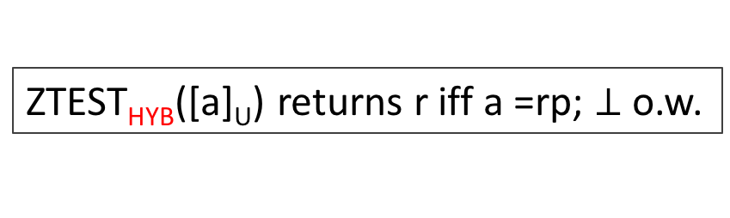
RECALL
GGH13 Map (Hybrid Model)
Description in $ℤ$
Large secret prime p
Universal Set U = S₁ $∪$S₂ $∪$…S_{k}
Assume:
  Randomized procedure a$←$Samp(p,x): a = x + rp for some “random” r $∈$ $ℤ$_{p}
  Deterministic procedure [$⋅$]_{S} : a $→$ [a]_{S} such that [a]_{S} $→$ a is “hard”
Private Encoding
Multi-linear ops
Encode x $∈$ $ℤ$_{p} at level S:
a$←$Samp(p,x); Output [a]_{S}
ADD: [a]_{S} + [b]_{S} $→$[a+b]_{S}
MULT: [a]_{S1}$⋅$[b]_{S2} $→$[ab]_{S} (S₁$∩$ S₂ = $∅$; S = S₁$∪$S₂)
Zero-test (Hybrid)
ZTEST_{HYB}([a]_{U}) returns r iff a =rp; $⊥$o.w.

Slide 28
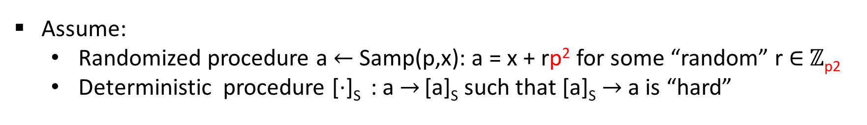
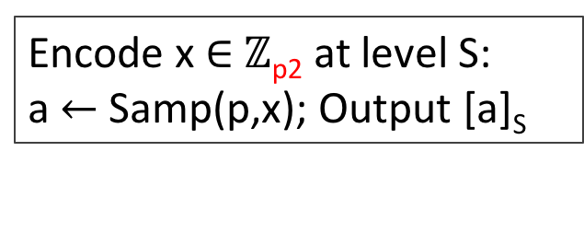
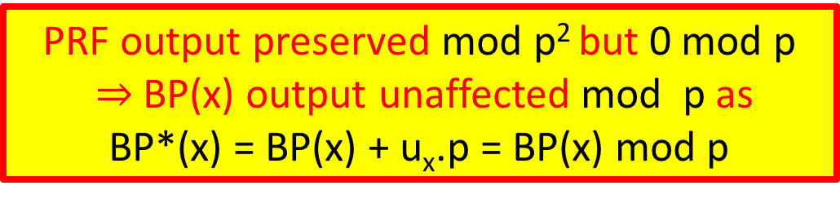
Our Modifications on GGH13 (Hybrid Model)
Description in $ℤ$
Large secret prime p
Universal Set U = S₁ $∪$S₂ $∪$…S_{k}
Assume:
  Randomized procedure a$←$Samp(p,x): a = x + rp² for some “random” r $∈$ $ℤ$_{p2}
  Deterministic procedure [$⋅$]_{S} : a $→$ [a]_{S} such that [a]_{S} $→$ a is “hard”
PRF output preserved mod p² but 0 mod p
$⇒$BP(x) output unaffected mod p as
BP*(x) = BP(x) + u_{x}.p = BP(x) mod p
Private Encoding
Multi-linear ops
Encode x $∈$ $ℤ$_{p2} at level S:
a$←$Samp(p,x); Output [a]_{S}
ADD: [a]_{S} + [b]_{S} $→$[a+b]_{S}
MULT: [a]_{S1}$⋅$[b]_{S2} $→$[ab]_{S} (S₁$∩$ S₂ = $∅$; S = S₁$∪$S₂)
Zero-test (Hybrid)
ZTEST_{HYB}([a]_{U}) returns r iff a =rp; $⊥$o.w.
No change in the zero-test
PRF_{K}(x) comes alive when ZTEST succeeds and ``masks’’ the coeff of p

Slide 29
Conclusion-1: Paradigm shift in obfuscation landscape
Feared Future(recall)
[GGHRSW’14]
Conceivable Extension
Zeroizing
[HJ’15]
Annihilation
[MSZ’16]
Weak DL
[GGH13]
Existing
Obfuscation Constructions
Our Candidate
All Attacks using zero-encodings
[BGKPS’14,AGIS’14,BMSZ’16…….]
Notes:
- The attacks follow a pattern.

Slide 30
Conclusion-2: Requirement for new generation of attacks
Safe
Unknown/unsafe
mMap(zero)
mMap
Non-mMap
Attacks known
Non-mMap
Attacks known
Our Work
mMap (w/o zero)
Attacks NOT known
Any attack must exploit underlying mMap
Any attack must NOT use encoding of 0

Slide 31
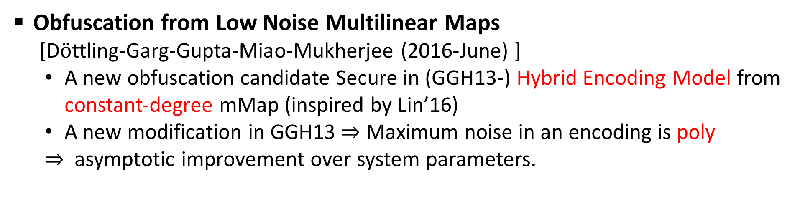
Conclusion-3: Follow up works
Secure obfuscation in a weak multilinear map model: A simple construction secure against all known attacks [Miles-Sahai-Zhandry (2016-June)]
  Proposed a simplified version of our construction.
Obfuscation from Low Noise Multilinear Maps
[D$ö$ttling-Garg-Gupta-Miao-Mukherjee (2016-June) ]
  A new obfuscation candidate Secure in (GGH13-) Hybrid Encoding Model from constant-degree mMap (inspired by Lin’16)
  A new modification in GGH13 $⇒$ Maximum noise in an encoding is poly
  $⇒$ asymptotic improvement over system parameters.

Slide 32
Questions ?
Thank You !

Slide 33
Conclusion-3: Follow up works and future directions.
Follow up-1 : Miles-Sahai-Zhandry (2016-June)
  Propose a simplified version of our work
  Crucial technical difference: used standard GGH13
Follow up-2 : Dotling-Garg-Gupta-Miao-Mukherjee (2016-June)
  Another obfuscation candidate from constant-degree mMap (inspired by Lin’16)
  Crucial technical difference: based on composite order GGH13
Future Directions:
  Exploring other mMaps: [CLT’13][CLT’15][GGH’15]
  Exploring vulnerabilities of mMaps without using encodings of 0.

Slide 34
Our Candidate Obfuscation
Input: Branching Program
Auxiliary Branching Program
BP =
BP’ =
BP’(x) = u.p
where u = PRFK(x) for random key K

Slide 35
Our Candidate Obfuscation
Input: Branching Program
Auxiliary Branching Program
BP =
BP’ =

Slide 36

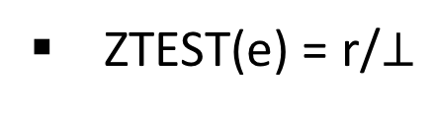
Obfuscation based on GGH
recall
S₁
Input Branching Program
Notation:
ENC($⋅$,S_{i})
BP =
S_{i}
Obfuscator
Evaluator
Encode the i-th matrix w.r.t. level S_{i} to generate the encoded matrix
Output the encoded matrices
For each input x, multiply encoded matrices e.g. x = 1001
S₁
S₂
S₃
S₄
= [f]_{U} = e
S₁
S₂
S₃
S₄
S₁
S₂
S₃
S₄
S₁
S₂
S₃
S₄
ZTEST(e) = r/$⊥$

Slide 37
Obfuscation based on GGH
Input: Branching Programs
Notation:
ENC($⋅$,S_{i})
BP =
S_{i}
Obfuscator
Evaluator
Encode the i-th matrix w.r.t. level S_{i} to generate the encoded matrix
Output the encoded matrices
For each input x multiply encoded matrices e.g. x = 1001
S₁
S₂
S₃
S₄
S₁
S₂
S₃
S₄
S₁
S₂
S₃
S₄
S₁
S₂
S₃
S₄

Slide 38
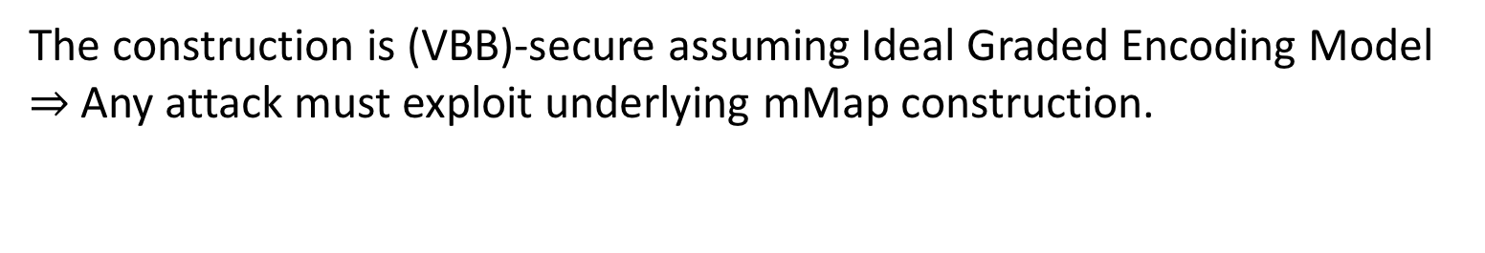
BGKPS’14: Proof in Ideal Encoding Model
The construction is (VBB)-secure assuming Ideal Graded Encoding Model
$⇒$ Any attack must exploit underlying mMap construction.
Existing attacks against mMaps:
Basic Attacks: Adv requires low-level encoding of 0 – [GGH13][HuJia16]
Advancaed attacks: Adv requires top-level encoding of 0 – [MSZ16] aka Annihilation
Does not break any Obfuscation
Breaks BGKPS

Slide 39

Software Obfuscation
Goal: make computer programs unintelligible while preserving their functionality.
O(P)
Alice
Adv
P: {X}-> {Y}
O(P): {X}-> {Y}

Slide 40

Applications of Obfuscations
P

Slide 41
Attacks on mMaps
[GGH’13]: Compute weak DL on GGH’13 – Not complete break.
[CHLRS’15, CGHLMMRST’15, Hal’15,CLR’15]: Zeroizing [CLT’13], [CLT’15],[GGH’15] – Total break for [CLT’13,’15]
[HJ’16]: Breaks applications (NIKE) based on [GGH’13]
[MSZ’]: Annihilation – distinguish specific obfuscation candidates based on GGH’13

Slide 42
Multi-linear Maps (a.k.a. Graded Encodings)
Vulnerabilities:
  On [GGH’13]:
    [HJ’15], [MSZ’16] …
  On [CLT’13,’15]:
    [CHLRS’15], [CGHLMMRST’15], [CLR’15]….
  On [GGH’15]:
    [Hal’15]…
Our Goal
Construct GGH-based Obfuscation Candidate
Without the known vulnerabilities
min
max
min
max
Our Understanding
Notes:
Check what exactly it breaks for GGH15

Slide 43
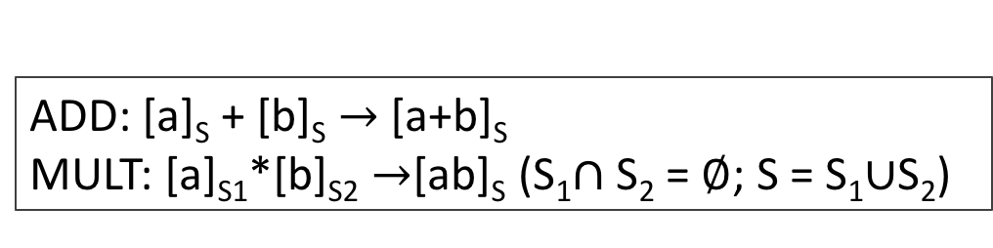
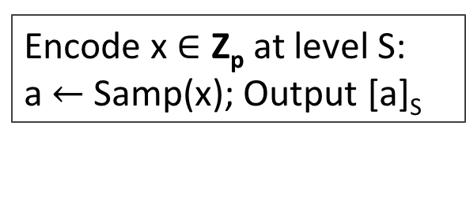
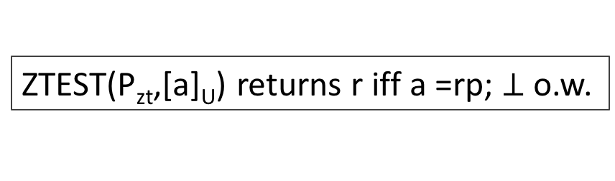
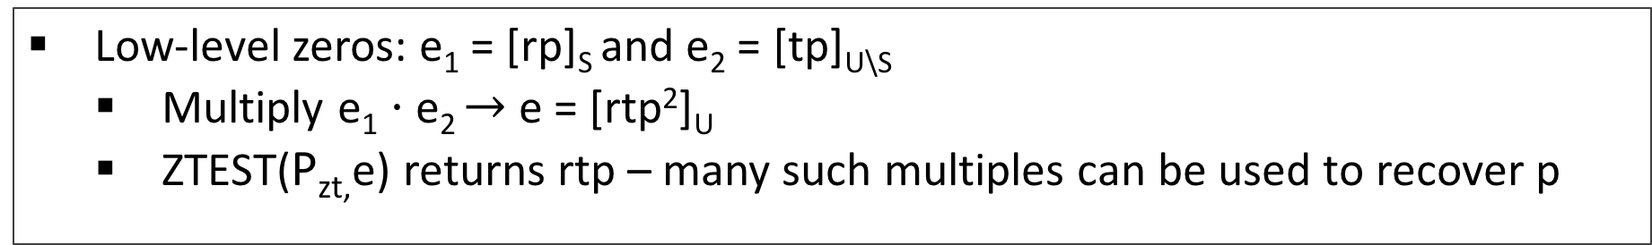
GHH13 Map : Vulnerabilities with low-level zeros
Encoding
Multi-linear ops
Encode x $∈$ Z_{p} at level S:
a$←$Samp(x); Output [a]_{S}
ADD: [a]_{S} + [b]_{S} $→$[a+b]_{S}
MULT: [a]_{S1}*[b]_{S2} $→$[ab]_{S} (S₁$∩$ S₂ = $∅$; S = S₁$∪$S₂)
Zero-test
ZTEST(P_{zt},[a]_{U}) returns r iff a =rp; $⊥$o.w.
Exploiting Low-level zeros [HJ’16,GGH’13]
Low-level zeros: e₁ = [rp]_{S} and e₂ = [tp]_{U\S}
  Multiply e₁ $⋅$e₂ $→$e = [rtp²]_{U}
  ZTEST(P_{zt,}e) returns rtp – many such multiples can be used to recover p
Notes:
Taking GCD one can recover p

Slide 44
How Annihilation Attack works: Step-2
EVAL
Ex = ENC(0)
Ey = ENC(0)
EVAL
E’x = ENC(0)
E’y = ENC(0)
Elements are more correlated
Adv evaluates both correctly on inputs x,y

Slide 45
How Annihilation Attack works: Step-3
EVAL
Ex = ENC(0)
Ey = ENC(0)
EVAL
E’x = ENC(0)
E’y = ENC(0)
Elements are more correlated
Adv computes an annihilation polynomial P(a,b)
Correlations are such that P(E’x,E’y) = 0 but P(Ex,Ey)$≠$ 0
Distinguishing!

Slide 46
Obfuscation based on GGH
Input: Branching Programs
BP =
Recall
BP(x) can be computed by computing matrix product of correct order
For example x = 0110
BP(X) implements a boolean circuit and outputs 0/1

Slide 47
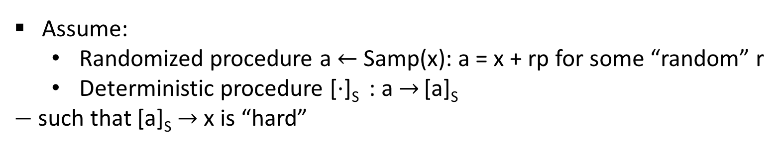
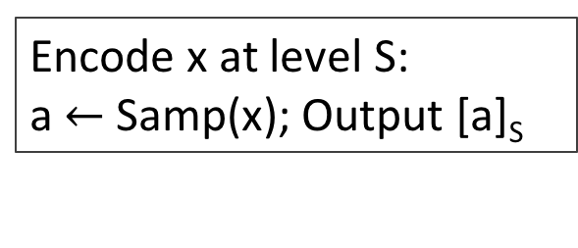

GGH13 Map : Hybrid description
*Description in Z
Large secret prime p
Public param: P_{zt}
Universal Set U = S₁ $∪$S₂ $∪$…S_{k}
Assume:
  Randomized procedure a$←$Samp(x): a = x + rp for some “random” r
  Deterministic procedure [$⋅$]_{S} : a $→$ [a]_{S}
  $−$ such that [a]_{S} $→$ x is “hard”
Encoding
Multi-linear ops
Encode x at level S:
a$←$Samp(x); Output [a]_{S}
ADD: [a]_{S} + [b]_{S} $→$[a+b]_{S}
MULT: [a]_{S1}$⋅$[b]_{S2} $→$[ab]_{S} (S₁$∩$ S₂ = $∅$; S = S₁$∪$S₂)
Zero-test
TEST if 0 mod p
ZTEST(P_{zt},[a]_{U}) returns r iff a =rp; $⊥$o.w.

Slide 48
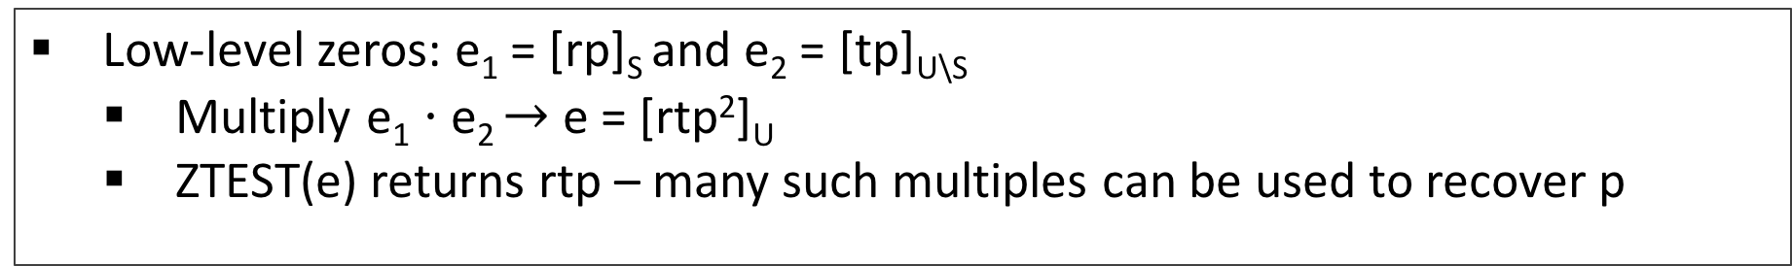
Hyb-GGH13: Vulnerabilities with low-level zeros
Exploiting Low-level zeros [HJ’16,GGH’13]
Low-level zeros: e₁ = [rp]_{S} and e₂ = [tp]_{U\S}
  Multiply e₁ $⋅$e₂ $→$e = [rtp²]_{U}
  ZTEST(e) returns rtp – many such multiples can be used to recover p
Not captured in Ideal Model
Not possible with top level zero [rp]_{U}
Obfuscation Constructions do not yield low-level zeros
[MSZ’16]
Annihilation Attacks: top-level encoding of 0 suffices
Breaks [BGKPS’14,AGIS’14,MSW’14,BMSZ’15…] when based on GGH13
Notes:
Taking GCD one can recover p

Slide 49
Obfuscation based on GGH
*Killian randomized
S₁
Input Branching Program
Notation:
ENC($⋅$,S_{i})
BP =
S_{i}
Obfuscator
Evaluator
Encode the i-th matrix-pair* w.r.t. level S_{i} to generate the encodings.
Output the encoded matrices
For each input x, multiply encoded matrices e.g. x = 1001
S₁
S₂
S₃
S₄
= [f]_{U} = e
S₁
S₂
S₃
S₄
S₁
S₂
S₃
S₄
S₁
S₂
S₃
S₄

Slide 50
Obfuscation based on GGH
*Killian randomized
S₁
Input Branching Program
Notation:
ENC($⋅$,S_{i})
BP =
S_{i}
Obfuscator
Evaluator
Encode the i-th matrix-pair* w.r.t. level S_{i} to generate the encodings.
Output the encoded matrices
For each input x, multiply encoded matrices e.g. x = 1001
S₁
S₂
S₃
S₄
= [f]_{U} = e
S₁
S₂
S₃
S₄
S₁
S₂
S₃
S₄
S₁
S₂
S₃
S₄
ZTEST(e) = r/$⊥$

Slide 51
Obfuscation based on GGH
*Killian randomized
S₁
Input Branching Program
Notation:
ENC($⋅$,S_{i})
BP =
S_{i}
Correctness:
Evaluator gets 0 iff f mod p = 0
Obfuscator
Evaluator
Encode the i-th matrix-pair* w.r.t. level S_{i} to generate the encodings.
Output the encoded matrices
For each input x, multiply encoded matrices e.g. x = 1001
S₁
S₂
S₃
S₄
= [f]_{U} = e
S₁
S₂
S₃
S₄
S₁
S₂
S₃
S₄
S₁
S₂
S₃
S₄
ZTEST(e) = r/$⊥$

Slide 52
Annihilation Attack with top-level zeros [MSZ’16]
BP₀ =
S₁
S₂
S₃
S₄
(r_{x},r_{y})
mMap ENC
EVAL(x,y)
S₁
S₂
S₃
S₄
S₁
S₂
S₃
S₄
EVAL(x,y)
(t_{x},t_{y})
BP₁=
mMap ENC
S₁
S₂
S₃
S₄
Adv comes up with two BP’s such that
$∀$ x BP₀(x) = BP₁(x) = 0
Difference in correlations e.g.
r_{x}² = r_{y}³ & t_{x}² $≠$ t_{y}³
Distinguished!

Slide 53

Annihilation Attack with top-level zeros [MSZ’16]
Question
How to compute the PRF ?
BP₀ =
S₁
S₂
S₃
S₄
(r_{x},r_{y})
mMap ENC
EVAL(x,y)
S₁
S₂
S₃
S₄
Our Idea
S₁
S₂
S₃
S₄
EVAL(x,y)
(t_{x},t_{y})
BP₁=
Mask the leaked value with PRF
mMap ENC
S₁
S₂
S₃
S₄
Destroy any correlation
Adv comes up with two BP’s such that
Answer
$∀$ x BP₀(x) = BP₁(x) = 0
Difference in correlations e.g.
r_{x}² = r_{y}³ & t_{x}² $≠$ t_{y}³
Self-fortification: The evaluation computes
PRF_{K}(x) along with C(x)
Distinguished!

Slide 54
Our Candidate Obfuscation
Input Branching Program
Auxiliary Branching Program
BP =
BP’ =
BP’(x) = u.p
where u = PRFK(x) for random key K
Define :
BP* =
Where
=
Such that: BP*(x) = BP(x) + u.p

Slide 55
GGH13: Vulnerabilities with low-level zeros
Exploiting Low-level zeros [HJ’16,GGH’13]
Low-level zeros: e₁ = [rp]_{S} and e₂ = [tp]_{U\S}
  Multiply e₁ $⋅$e₂ $→$e = [rtp²]_{U}
  ZTEST(e) returns rtp – many such multiples can be used to recover p
Not captured in Ideal Model
Not possible with top level zero [rp]_{U}
Obfuscation Constructions do not yield low-level zeros
[MSZ’16]
Annihilation Attacks: top-level encoding of 0 suffices
Breaks [BGKPS’14,AGIS’14,MSW’14,BMSZ’15…] when based on GGH13
Notes:
Taking GCD one can recover p

Slide 56
Vulnerabilities in mMap construatcions
Two most studied mMap constructions:
GGH13 [Garg-Gentry-Halevi] & CLT13 [Coron-Lepoint-Tibouchi]
Vulnerabilities discovered: [HJ’15], [CHLRS’15],[CGHLMMRST’15], [CLR’15]….
Other new constructions: GGH15 [Gentry-Gorbunov-Halevi]; CLT15 [Coron-Lepoint-Tibouchi]
Notes:
-These attacks are built on a common platform.
Note that these attacks are not known to break any of these IO candidates except for certain toy examples and that too only for certain constructions --e.g. none of these extend to GGHRSW.
However, these attacks are powerful and even though they are not known to work currently against IO, in future we might see extendsions of these attacks which can potentially break the IO schemes.

Slide 57
A different approach: GLSW’15
Reduced to concrete assumptions on concrete mMap.
Assumptions found to be false !
Improved our understanding of security provided by mMap

Slide 58
Prior Security guarantees of IO candidates
Generation-1: [GGHRSW’14]
Proof in Generic Colored Matrix model
Guarantee: security only against very weak attacks.
Assumed (almost) the construction is secure.
Generation-2: [BGKPS’14,AGIS’14, AB’15, Zim’15, Lin’16, BMSZ’16…..]
Proof in Ideal Graded Encoding Model
Guarantee: security against any attack that that does not exploit the mMap constructions.
Failed to address any attack on concrete mMap construction.

Slide 59
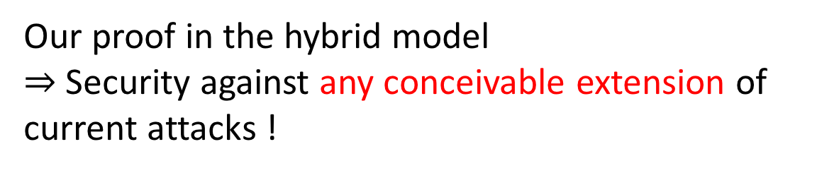
Impact: Paradigm shift of (GGH13-based)Obfuscation Landscape
Our proof in the hybrid model
$⇒$Security against any conceivable extension of current attacks !
Our Obfuscation Candidate
Notes:
- We show that essentially anything following this pattern is useless.

Slide 60
Vulnerabilities in GGH13: Impact on Obfuscation
[GGHRSW’14]
Feared Future
Zeroizing
[HJ’15]
Annihilation
[MSZ’16]
Current
Future
Weak DL
[GGH13]
All Obfuscation Constructions
[BGKPS’14,AGIS’14,BMSZ’16…….] (only specific examples)
Notes:
- The attacks follow a pattern.

Slide 61
Impact: Paradigm shift in (GGH13-based)Obfuscation Landscape
Recall: Feared Future
[GGHRSW’14]
Our Candidate
Conceivable Extension
Zeroizing
[HJ’15]
Annihilation
[MSZ’16]
Current
Future
Future
Weak DL
[GGH13]
New
All Obfuscation Constructions
[BGKPS’14,AGIS’14,BMSZ’16…….] (only specific examples)
Notes:
- The attacks follow a pattern.

Slide 62
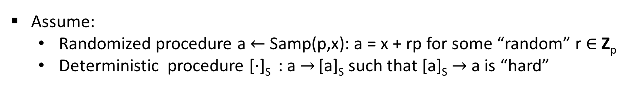

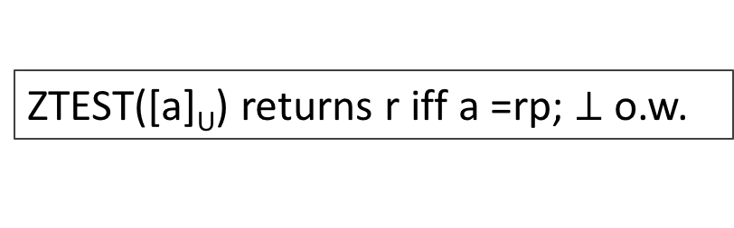
RECALL
GGH13 Map (in Hybrid Encoding Model)
Description in Z
Large secret prime p
Universal Set U = S₁ $∪$S₂ $∪$…S_{k}
Assume:
  Randomized procedure a$←$Samp(p,x): a = x + rp for some “random” r $∈$ Z_{p}
  Deterministic procedure [$⋅$]_{S} : a $→$ [a]_{S} such that [a]_{S} $→$ a is “hard”
Private Encoding
Multi-linear ops
Encode x $∈$ Z_{p} at level S:
a$←$Samp(p,x); Output [a]_{S}
ADD: [a]_{S} + [b]_{S} $→$[a+b]_{S}
MULT: [a]_{S1}$⋅$[b]_{S2} $→$[ab]_{S} (S₁$∩$ S₂ = $∅$; S = S₁$∪$S₂)
Zero-test
ZTEST([a]_{U}) returns r iff a =rp; $⊥$o.w.

Slide 63
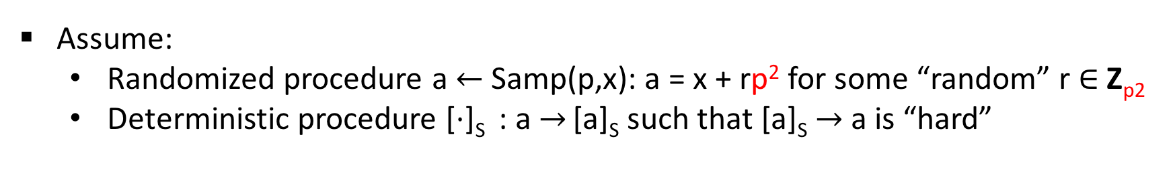
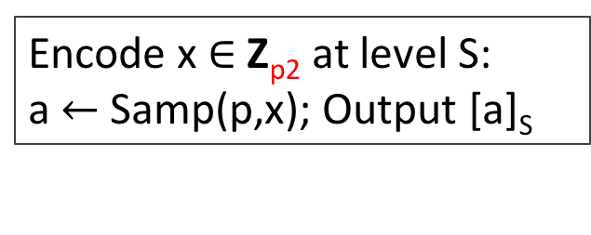
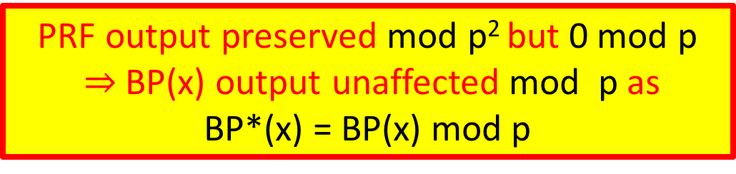
Our Modifications on GGH13
Description in Z
Large secret prime p
Universal Set U = S₁ $∪$S₂ $∪$…S_{k}
Assume:
  Randomized procedure a$←$Samp(p,x): a = x + rp² for some “random” r $∈$ Z_{p2}
  Deterministic procedure [$⋅$]_{S} : a $→$ [a]_{S} such that [a]_{S} $→$ a is “hard”
PRF output preserved mod p² but 0 mod p
$⇒$BP(x) output unaffected mod p as
BP*(x) = BP(x) mod p
Private Encoding
Encode x $∈$ Z_{p2} at level S:
a$←$Samp(p,x); Output [a]_{S}
Multi-linear ops
ADD: [a]_{S} + [b]_{S} $→$[a+b]_{S}
MULT: [a]_{S1}$⋅$[b]_{S2} $→$[ab]_{S} (S₁$∩$ S₂ = $∅$; S = S₁$∪$S₂)
Zero-test
No change in the zero-test
ZTEST([a]_{U}) returns r iff a =rp; $⊥$o.w.

Slide 64
Conclusion-1: Paradigm shift in obfuscation landscape
[GGHRSW’14]
RECALL
Conceivable Extension
Zeroizing
[HJ’15]
Annihilation
[MSZ’16]
Future
Weak DL
[GGH13]
All Attacks using zero-encodings
[BGKPS’14,AGIS’14,BMSZ’16…….] (only specific examples)
Notes:
- The attacks follow a pattern.

Slide 65
Our Results
  An obfuscation candidate based on (modified) GGH13 mMap
  - provably secure against known attacks against GGH13.
Proof of security in a new model: Hybrid Graded Encoding.
Uses structure of GGH13 map.
Captures all known vulnerabilities (& any conceivable extension) of GGH13 map.

