Slide 1
Obfuscation from Multi-linear Maps: Vulnerabilities and Protections
Pratyay Mukherjee
(UC Berkeley)
Based on a joint work with
Sanjam Garg, Akshayaram Srinivasan
The SaTC Workshop on Privacy and Security
  University of Wisconsin, Madison
  June 17, 2016
Notes:
Finally, I am gonna talk about obfuscation. Yesterday Vinod already built some motivations saying obfuscation is crypto complete. So, now I am going to talk about the construction in general – mostly based on my recent work with Sanjam and Akshay.

Slide 2
Software Obfuscation
*Note: |O(P)| = poly(|P|)
Goal: make computer programs unintelligible while preserving their functionality.
O(P)
Alice
Bob
P: {X}-> {Y}
O(P): {X}-> {Y}

Slide 3


Magical Power of Obfuscation:
Private Key to Public Key Encryption [DH76]
Private-key
Plain-text
Cipher-text
Plain-text
Encrypt
Decrypt
Obf
= O( )
Public-key
Plain-text
Cipher-text
Plain-text
Encrypt
Decrypt

Slide 4

Formalization: Indistinguishability Obfuscation
First formalized by Barak, Goldreich, Impagliazzo, Rudich, Sahai, Vadhan and Yang [BGIRSVY’01]
  Most natural definition- Virtual Black Box (VBB) – Impossible !
A natural weakening of VBB: avoids the impossibility.
IO
O is IO if for any functionally equivalent P₁ and P₂; for any Adv
$$≈$$
Can still have useful applications !
Notes:
What was the equivalence ? Read it, people might ask.
Read the Barak Impossibility.

Slide 5
If IO exists then …..
Obfustopia

Slide 6

If
IO exists then …..
Obfustopia
Deniable Encryption
[SW’14]
Functional Encryption [GGHRSW’14]
Hardness of PPAD
[BPR’15,GPS’16]
IO
Non-interactive
Key Exchange
[BZ’14]
Trapdoor Permutations [BPW’16]
Software Watermarking
[CHNVW’16]

Slide 7
Candidate constructions of IO
GGHRSW’14: Garg, Gentry, Halevi, Raykova, Sahai, Waters
First Candidate Construction of IO
from assumptions on Multi-linear maps
Subsequently more IO candidates from Multi-linear Maps
[BGKPS’14], [BR’14],[PST’14],[AGIS’14],[Zim’15],[AB’15],[GLSW’15],[BMSZ’16],[Lin’16]….
Security of assumptions on mMaps are poorly understood
Vulnerabilities on mMap: [HJ’15], [CHLRS’15],[CGHLMMRST’15], [MSZ’16]….
Vinod’s Talk, yesterday
A separate direction [BV’15,AJ’15] builds IO from FE – can only be built using IO
Notes:
No improvements on constructions but on understanding/equivalence.

Slide 8

Multi-linear Maps (a.k.a. Graded Encodings)
[BS’03]: Extension of Bilinear maps
  First defined by Boneh & Silverberg
[GGH’13]: First candidate construction.
  Realized an approximate/noisy version from Ideal Lattices.
More candidates (& variants) followed: [CLT’13], [GGH’15], [CLT’15]
More applications found (except IO):
  ABE[GGHSW’13],NIKE[GGH’13], FE [GGHZ’16]….
Notes:
Check what exactly it breaks for GGH15

Slide 9

Security guarantees of previous mMap-IO candidates
Proof in Ideal Graded Encoding Model [BGKPS’14,AB’14…]
  Ideal Graded Encoding model assumes the underlying mMap is perfectly secure.
Guarantee: security against any attack that does not exploit the underlying mMap constructions.
Reality: mMap constructions realized an approximate/noisy version.
  Failed to address any attack on IO with concrete mMap instantiaion.

Slide 10

Vulnerabilities in GGH13: Impact on Obfuscation
Our Goal
To avoid this Future !
[GGHRSW’14]
Conceivable Extensions
Zeroizing
[HJ’15]
Annihilation
[MSZ’16]
NIKE, FE…
Weak DL
[GGH13]
Existing
Obfuscation Constructions
Current Status
Feared Future !
[BGKPS’14,AGIS’14,BMSZ’16…….]
Notes:
- The attacks follow a pattern.

Slide 11
Question
Can we construct Obfuscation that is
provably secure assuming this weaker notion of mMaps?
This work
Answer
Yes, based on Garg-Gentry-Halevi-13 (GGH13) mMap
Notes:
- This weaker notion => that accounts for any attacks following the pattern.

Slide 12
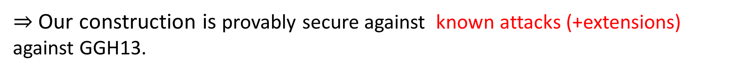
Our Results
  An obfuscation candidate based on (modified) GGH13 mMap
Proof of security in a new model: Hybrid Graded Encoding.
Uses structure of GGH13 map.
Captures all known vulnerabilities (& any conceivable extension) of GGH13 map.
  $⇒$ Our construction is provably secure against known attacks (+extensions) against GGH13.

Slide 13
Our Contribution:
Paradigm shift in (GGH13-based) Obfuscation Landscape
[GGHRSW’14]
Current Status
Conceivable Extension
Zeroizing
[HJ’15]
Annihilation
[MSZ’16]
Weak DL
[GGH13]
Existing
Obfuscation Constructions
Our Candidate
A Better
Future !
[BGKPS’14,AGIS’14,BMSZ’16…….]
Notes:
- The attacks follow a pattern.

Slide 14
Rest of the talk
GGH13 map (Generic); Zeroizing attacks.
An obfuscation construction (simplified BGKPS’14).
Annihilation Attacks.
Our obfuscation construction – protection strategy.

Slide 15
GGH13 Map (Generic Model)

Slide 16
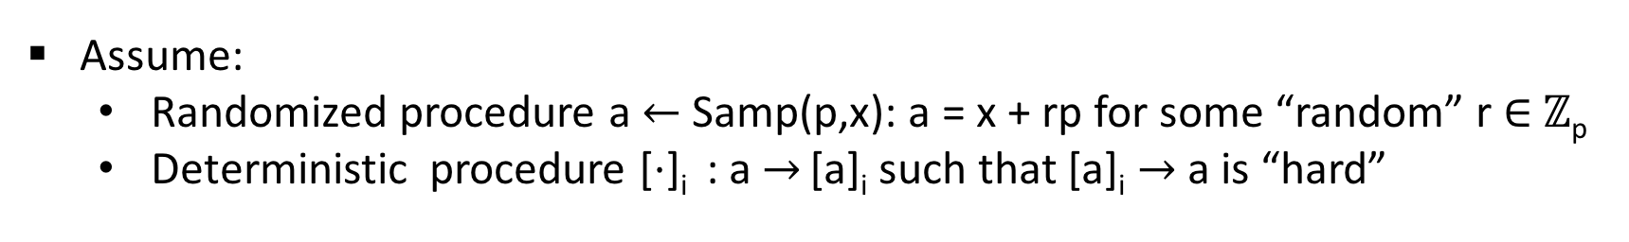
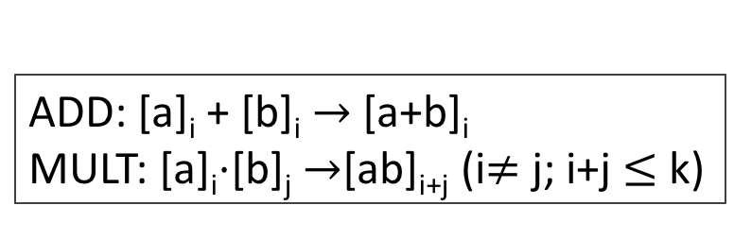
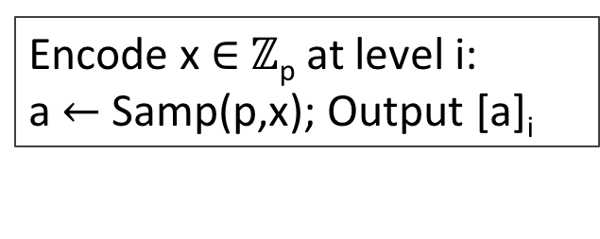
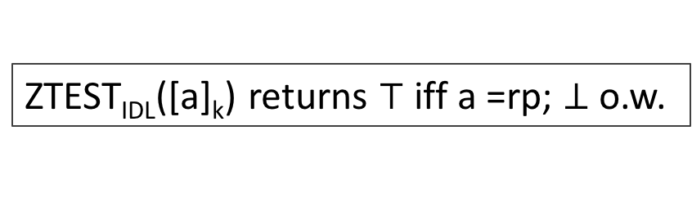
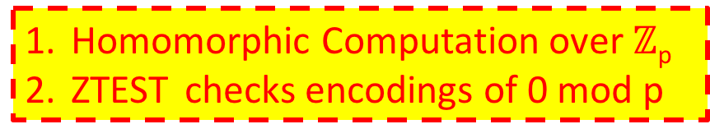
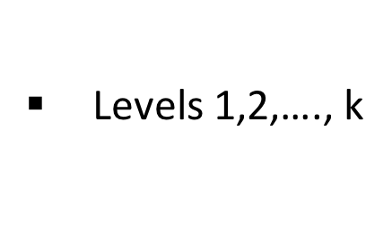
GGH13 Map (Generic Model)
Description in $ℤ$
Large secret prime p
Levels 1,2,…., k
Assume:
  Randomized procedure a$←$Samp(p,x): a = x + rp for some “random” r $∈$ $ℤ$_{p}
  Deterministic procedure [$⋅$]_{i} : a $→$ [a]_{i} such that [a]_{i} $→$ a is “hard”
Private Encoding
Multi-linear ops
Encode x $∈$ $ℤ$_{p} at level i:
a$←$Samp(p,x); Output [a]_{i}
ADD: [a]_{i} + [b]_{i} $→$[a+b]_{i}
MULT: [a]_{i}$⋅$[b]_{j} $→$[ab]_{i+j} (i$≠$ j; i+j $≤$ k)
Zero-test (Ideal Model)
Homomorphic Computation over $ℤ$_{p}
ZTEST checks encodings of 0 mod p
ZTEST_{IDL}([a]_{k}) returns $⊤$ iff a =rp; $⊥$o.w.

Slide 17
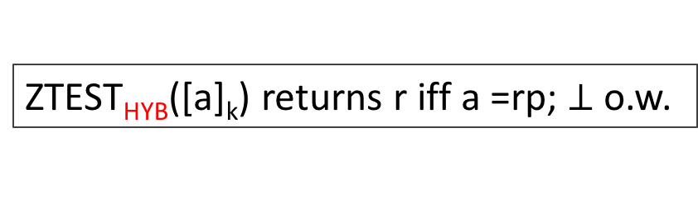
GGH13 Map (Generic Model)
Description in $ℤ$
Large secret prime p
Levels 1,2,…., k
Assume:
  Randomized procedure a$←$Samp(p,x): a = x + rp for some “random” r $∈$ $ℤ$_{p}
  Deterministic procedure [$⋅$]_{i} : a $→$ [a]_{i} such that [a]_{i} $→$ a is “hard”
Private Encoding
Multi-linear ops
Encode x $∈$ $ℤ$_{p} at level i:
a$←$Samp(p,x); Output [a]_{i}
ADD: [a]_{i} + [b]_{i} $→$[a+b]_{i}
MULT: [a]_{i}$⋅$[b]_{j} $→$[ab]_{i+j} (i$≠$ j; i+j $≤$ k)
Zero-test (Ideal Model)
Zero-test (Hybrid)
ZTEST_{IDL}([a]_{k}) returns $⊤$ iff a =rp; $⊥$o.w.
ZTEST_{HYB}([a]_{k}) returns r iff a =rp; $⊥$o.w.
Hybrid Model captures leakage of “exact element” if ZTEST succeeds

Slide 18
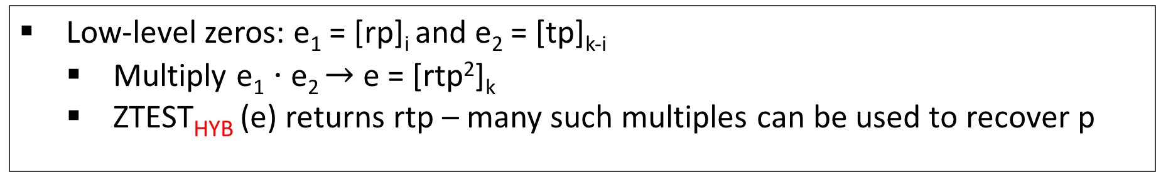
GGH13: Vulnerabilities with low-level zeros (Zeroizing)
Exploiting Low-level zeros [GGH’13(weak DL), HJ’16 (Zeroizing)]
Low-level zeros: e₁ = [rp]_{i} and e₂ = [tp]_{k-i}
  Multiply e₁ $⋅$e₂ $→$e = [rtp²]_{k}
  ZTEST_{HYB} (e) returns rtp – many such multiples can be used to recover p
Not captured in Ideal Model
Not possible with top level zero [rp]_{k}
Most Obfuscation Constructions do not yield low-level zeros
[Miles-Sahai-Zhandry’16]
Annihilation Attacks: top-level encoding of 0 suffices
Breaks [BGKPS’14,AGIS’14,MSW’14,…] when based on GGH13
Notes:
Taking GCD one can recover p

Slide 19
Overview:
A previous candidate IO based on GGH13 Map
(simplified [Barak-Garg-Kalai-Paneth-Sahai’14])

Slide 20
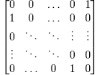
Obfuscation based on GGH13
Input Branching Program
Permutation matrices
e.g.
BP =

Slide 21
Obfuscation based on GGH13
Input Branching Program
BP =
Recall
BP(x) implements computation of boolean circuit C(x) via computing matrix product of correct order

Slide 22
Obfuscation based on GGH13
Input Branching Program
BP =
= C(0110) = 0/1
Recall
BP(x) implements computation of boolean circuit C(x) via computing matrix product of correct order
For example x = 0110

Slide 23
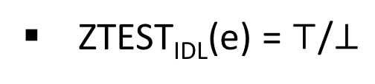


Obfuscation based on GGH13
*Killian randomized
Input Branching Program
Randomized Matrix Encoding:
Rand*-ENC($⋅, i$)
BP =
i
  Correctness: computation preserved in $ℤ$_{p}
Security (Ideal): Multi-linear levels & Killian Rand
Obfuscator
Evaluator
Encode the i-th matrix-pair w.r.t. level i to generate the encodings.
Output the encoded matrices
For each input x, multiply encoded matrices
e.g. x = 1001
1
2
3
4
= [f_{x}]_{k} = e
1
2
3
4
1
2
3
4
1
2
3
4
ZTEST_{IDL}(e) = $⊤$/$⊥$

Slide 24
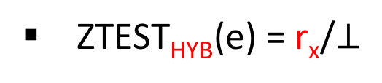
Obfuscation based on GGH13
*Killian randomized
Input Branching Program
Randomized Matrix Encoding:
Rand*-ENC($⋅, i$)
BP =
i
  Correctness: computation preserved in $ℤ$_{p}
Security (Ideal): Multi-linear levels & Killian Rand
Obfuscator
Evaluator
Annihilation Attack (HYB) exploits the “leaked info” from successful ZTEST_{HYB}
Encode the i-th matrix-pair w.r.t. level i to generate the encodings.
Output the encoded matrices
For each input x, multiply encoded matrices
e.g. x = 1001
1
2
3
4
= [f_{x}]_{k} = e
1
2
3
4
1
2
3
4
1
2
3
4
ZTEST_{HYB}(e) = r_{x}/$⊥$
(f_{x} = r_{x}p + f’_{x})

Slide 25
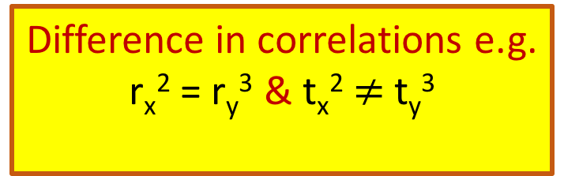

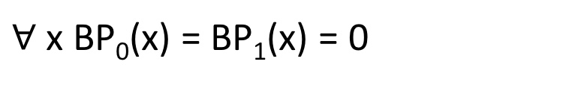
Annihilation Attack with top-level zeros [MSZ’16]
Recall: EVAL(X)=0 $⇒$ ZTEST_{HYB}([r_{x}p]_{k}$)→$ r_{x}
BP₀ =
1
2
3
4
(r_{x},r_{y})
OBF(BP₀)
EVAL(x,y)
1
2
3
4
1
2
3
4
EVAL(x,y)
(t_{x},t_{y})
BP₁=
OBF(BP₁)
1
2
3
4
Adv comes up with two BP’s such that
$∀$ x BP₀(x) = BP₁(x) = 0
Difference in correlations e.g.
r_{x}² = r_{y}³ & t_{x}² $≠$ t_{y}³
Distinguished!

Slide 26
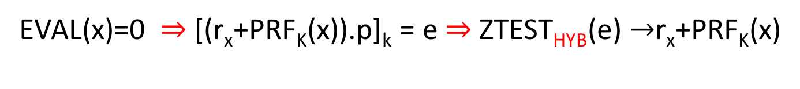
Annihilation Attack with top-level zeros [MSZ’16]
Recall: EVAL(X)=0 $⇒$ ZTEST_{HYB}([r_{x}p]_{k}$)→$ r_{x}
BP₀ =
S₁
S₂
S₃
S₄
(r_{x},r_{y})
OBF(BP₀)
EVAL(x,y)
Our Idea
Mask “leaked info” with PRF
S₁
S₂
S₃
S₄
“Self-fortification” : The evaluation EVAL(x) itself computes PRF_{K}(x) along with BP(x) such that:
(t_{x},t_{y})
BP₁=
OBF(BP₁)
S₁
S₂
S₃
S₄
EVAL(x,y)
S₁
S₂
S₃
S₄
EVAL(x)=0 $⇒$ [(r_{x}+PRF_{K}(x)).p]_{k} = e $⇒$ZTEST_{HYB}(e) $→$r_{x}+PRF_{K}(x)
Adv comes up with two BP’s such that
$∀$ x BP₀(x) = BP₁(x) = 0
Difference in correlations e.g.
r_{x}² = r_{y}³ & t_{x}² $≠$ t_{y}³
Distinguished!
Destroy Correlations

Slide 27
Our Candidate Obfuscation
based on
(modified) GGH13 map

Slide 28
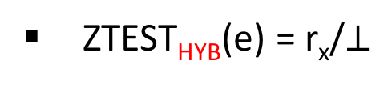
How to compute ?
Our Candidate Obfuscation
Input Branching Program
Auxiliary Branching Program
BP =
BP’ =
Obfuscator
BP’(x) = u_{x}.p : u_{x} = PRF_{K}(x)
BP*(x) = BP(x) + u_{x}.p
1
2
3
4
BP* =
GGH13* ENC
Where
=
1
2
3
4
Evaluator
If f_{x} =s_{x}.p then r_{x} = u_{x}+s_{x} – “ps-random”
Let x = 1001, then
1
2
3
4
= [f_{x}+u_{x}.p]_{k} = e
ZTEST_{HYB}(e) = r_{x}/$⊥$
1
2
3
4

Slide 29
RECALL
GGH13 Map (Hybrid Model)
Description in $ℤ$
Large secret prime p
Levels 1,2,…., k
Assume:
  Randomized procedure a$←$Samp(p,x): a = x + rp for some “random” r $∈$ $ℤ$_{p}
  Deterministic procedure [$⋅$]_{i} : a $→$ [a]_{i} such that [a]_{i} $→$ a is “hard”
Private Encoding
Multi-linear ops
Encode x $∈$ $ℤ$_{p} at level i:
a$←$Samp(p,x); Output [a]_{i}
ADD: [a]_{i} + [b]_{i} $→$[a+b]_{i}
MULT: [a]_{i}$⋅$[b]_{j} $→$[ab]_{i+j} (i$≠$ j; i+j $≤$ k)
Zero-test (Hybrid)
Homomorphic Computation over $ℤ$_{p}
ZTEST checks encodings of 0 mod p
ZTEST_{HYB}([a]_{k}) returns r iff a =rp; $⊥$o.w.

Slide 30
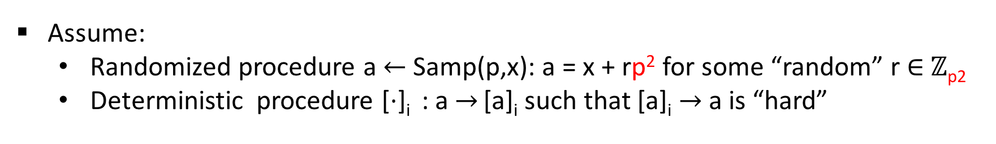
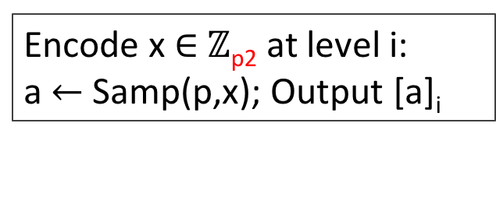
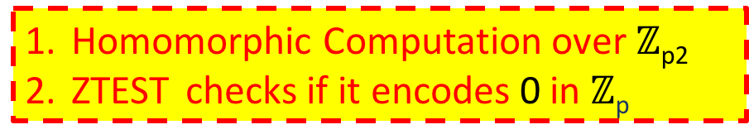
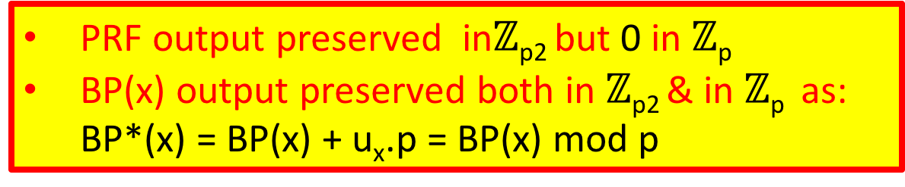
Our Modifications on GGH13 (Hybrid Model)
Description in $ℤ$
PRF_{K}(x) comes alive when ZTEST succeeds and ``masks’’ the coeff of p
Large secret prime p
Levels 1,2,…., k
Assume:
  Randomized procedure a$←$Samp(p,x): a = x + rp² for some “random” r $∈$ $ℤ$_{p2}
  Deterministic procedure [$⋅$]_{i} : a $→$ [a]_{i} such that [a]_{i} $→$ a is “hard”
PRF output preserved in$ℤ$_{p2} but 0 in $ℤ$_{p}
BP(x) output preserved both in $ℤ$_{p2} & in $ℤ$_{p} as: BP*(x) = BP(x) + u_{x}.p = BP(x) mod p
Private Encoding
Multi-linear ops
Encode x $∈$ $ℤ$_{p2} at level i:
a$←$Samp(p,x); Output [a]_{i}
ADD: [a]_{i} + [b]_{i} $→$[a+b]_{i}
MULT: [a]_{i}$⋅$[b]_{j} $→$[ab]_{i+j} (i$≠$ j; i+j $≤$ k)
Zero-test (Hybrid)
Homomorphic Computation over $ℤ$_{p2}
ZTEST checks if it encodes 0 in $ℤ$_{p}
ZTEST_{HYB}([a]_{k}) returns r iff a =rp; $⊥$o.w.
No change in the zero-test

Slide 31
Conclusion-1: Paradigm shift in obfuscation landscape
Recall
[GGHRSW’14]
Conceivable Extension
Zeroizing
[HJ’15]
Annihilation
[MSZ’16]
Weak DL
[GGH13]
Existing
Obfuscation Constructions
Our Candidate
Any attack exploiting correlations among zero-encodings
[BGKPS’14,AGIS’14,BMSZ’16…….]
Notes:
- The attacks follow a pattern.

Slide 32
Conclusion-2: Requirement for new generation of attacks
Safe
Unknown/unsafe
mMap-based
mMap-based
Non-mMap
Attacks known
Non-mMap
Attacks known
Our Work
mMap-based
Attacks NOT known
Any attack must exploit underlying mMap
Any attack must NOT follow this pattern

Slide 33
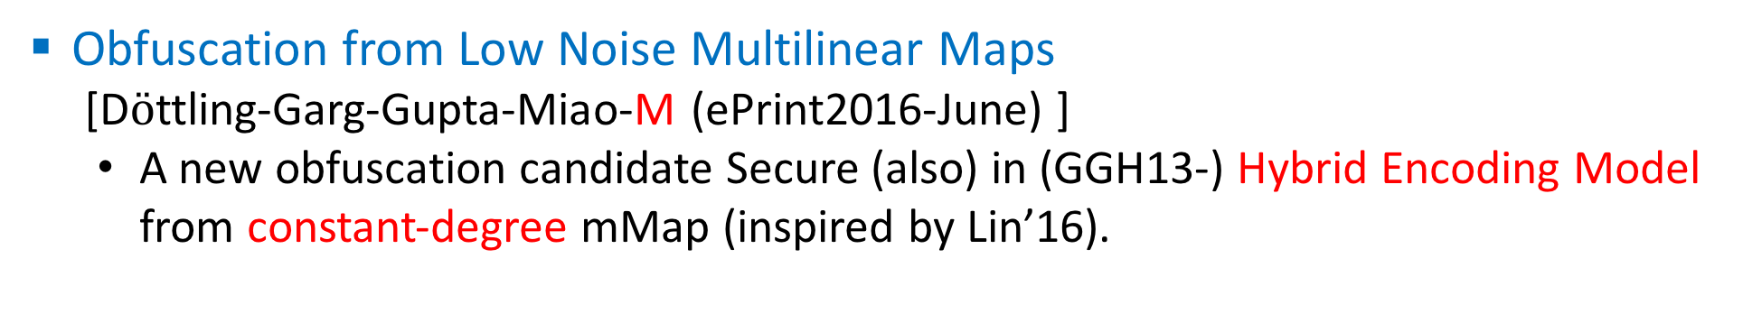
Follow ups
Secure obfuscation in a weak multilinear map model: A simple construction secure against all known attacks [Miles-Sahai-Zhandry (ePrint2016-June)]
  Proposed a simplified version of our construction.
Obfuscation from Low Noise Multilinear Maps
[D$ö$ttling-Garg-Gupta-Miao-M (ePrint2016-June) ]
  A new obfuscation candidate Secure (also) in (GGH13-) Hybrid Encoding Model from constant-degree mMap (inspired by Lin’16).

Slide 34
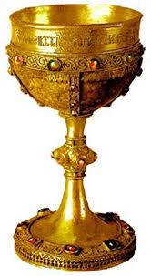

Open Questions:
IO from Learning With Errors.
IO from simple assumption over mMap
(even no reduction from LWE).
Building specific-IO from standard assumptions (LWE…)
Current state-of-art: [BVWW’16] IO for conjunctions from entropic RLWE.

Slide 35
Questions ?
Thank You !

Slide 36
Conclusion-3: Follow up works and future directions.
Follow up-1 : Miles-Sahai-Zhandry (2016-June)
  Propose a simplified version of our work
  Crucial technical difference: used standard GGH13
Follow up-2 : Dotling-Garg-Gupta-Miao-Mukherjee (2016-June)
  Another obfuscation candidate from constant-degree mMap (inspired by Lin’16)
  Crucial technical difference: based on composite order GGH13
Future Directions:
  Exploring other mMaps: [CLT’13][CLT’15][GGH’15]
  Exploring vulnerabilities of mMaps without using encodings of 0.

Slide 37
Our Candidate Obfuscation
Input: Branching Program
Auxiliary Branching Program
BP =
BP’ =
BP’(x) = u.p
where u = PRFK(x) for random key K

Slide 38
Our Candidate Obfuscation
Input: Branching Program
Auxiliary Branching Program
BP =
BP’ =

Slide 39

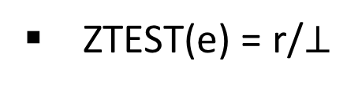
Obfuscation based on GGH
recall
S₁
Input Branching Program
Notation:
ENC($⋅$,S_{i})
BP =
S_{i}
Obfuscator
Evaluator
Encode the i-th matrix w.r.t. level S_{i} to generate the encoded matrix
Output the encoded matrices
For each input x, multiply encoded matrices e.g. x = 1001
S₁
S₂
S₃
S₄
= [f]_{U} = e
S₁
S₂
S₃
S₄
S₁
S₂
S₃
S₄
S₁
S₂
S₃
S₄
ZTEST(e) = r/$⊥$

Slide 40
Obfuscation based on GGH
Input: Branching Programs
Notation:
ENC($⋅$,S_{i})
BP =
S_{i}
Obfuscator
Evaluator
Encode the i-th matrix w.r.t. level S_{i} to generate the encoded matrix
Output the encoded matrices
For each input x multiply encoded matrices e.g. x = 1001
S₁
S₂
S₃
S₄
S₁
S₂
S₃
S₄
S₁
S₂
S₃
S₄
S₁
S₂
S₃
S₄

Slide 41
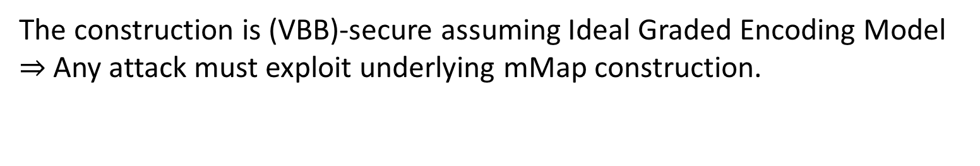
BGKPS’14: Proof in Ideal Encoding Model
The construction is (VBB)-secure assuming Ideal Graded Encoding Model
$⇒$ Any attack must exploit underlying mMap construction.
Existing attacks against mMaps:
Basic Attacks: Adv requires low-level encoding of 0 – [GGH13][HuJia16]
Advancaed attacks: Adv requires top-level encoding of 0 – [MSZ16] aka Annihilation
Does not break any Obfuscation
Breaks BGKPS

Slide 42

Software Obfuscation
Goal: make computer programs unintelligible while preserving their functionality.
O(P₂)
Alice
Adv
P: {X}-> {Y}
O(P): {X}-> {Y}

Slide 43

Applications of Obfuscations
P

Slide 44
Attacks on mMaps
[GGH’13]: Compute weak DL on GGH’13 – Not complete break.
[CHLRS’15, CGHLMMRST’15, Hal’15,CLR’15]: Zeroizing [CLT’13], [CLT’15],[GGH’15] – Total break for [CLT’13,’15]
[HJ’16]: Breaks applications (NIKE) based on [GGH’13]
[MSZ’]: Annihilation – distinguish specific obfuscation candidates based on GGH’13

Slide 45
Multi-linear Maps (a.k.a. Graded Encodings)
Vulnerabilities:
  On [GGH’13]:
    [HJ’15], [MSZ’16] …
  On [CLT’13,’15]:
    [CHLRS’15], [CGHLMMRST’15], [CLR’15]….
  On [GGH’15]:
    [Hal’15]…
Our Goal
Construct GGH-based Obfuscation Candidate
Without the known vulnerabilities
min
max
min
max
Our Understanding
Notes:
Check what exactly it breaks for GGH15

Slide 46
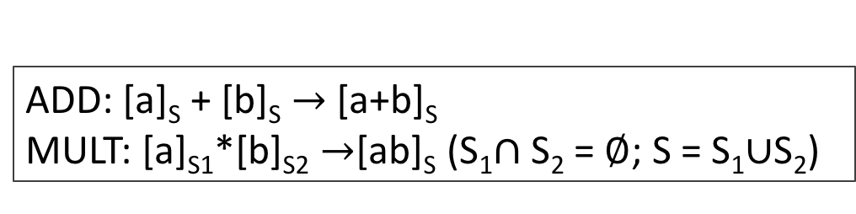
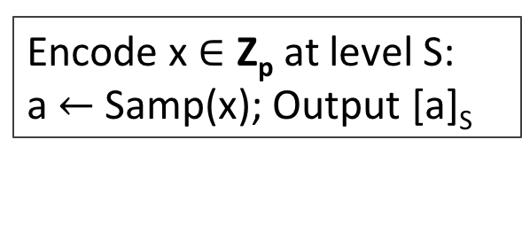
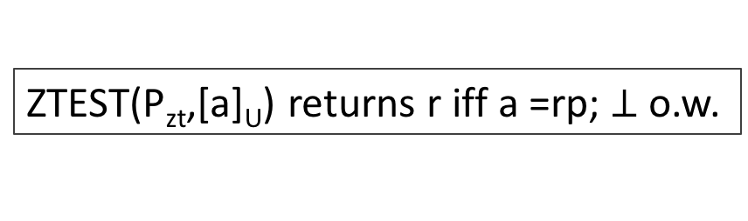
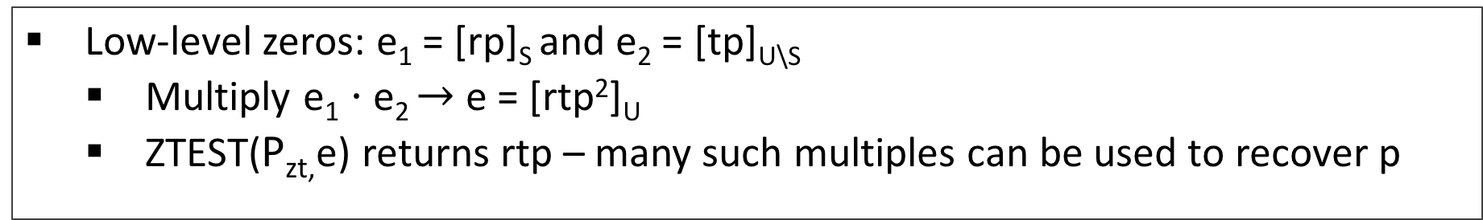
GHH13 Map : Vulnerabilities with low-level zeros
Encoding
Multi-linear ops
Encode x $∈$ Z_{p} at level S:
a$←$Samp(x); Output [a]_{S}
ADD: [a]_{S} + [b]_{S} $→$[a+b]_{S}
MULT: [a]_{S1}*[b]_{S2} $→$[ab]_{S} (S₁$∩$ S₂ = $∅$; S = S₁$∪$S₂)
Zero-test
ZTEST(P_{zt},[a]_{U}) returns r iff a =rp; $⊥$o.w.
Exploiting Low-level zeros [HJ’16,GGH’13]
Low-level zeros: e₁ = [rp]_{S} and e₂ = [tp]_{U\S}
  Multiply e₁ $⋅$e₂ $→$e = [rtp²]_{U}
  ZTEST(P_{zt,}e) returns rtp – many such multiples can be used to recover p
Notes:
Taking GCD one can recover p

Slide 47
How Annihilation Attack works: Step-2
EVAL
Ex = ENC(0)
Ey = ENC(0)
EVAL
E’x = ENC(0)
E’y = ENC(0)
Elements are more correlated
Adv evaluates both correctly on inputs x,y

Slide 48
How Annihilation Attack works: Step-3
EVAL
Ex = ENC(0)
Ey = ENC(0)
EVAL
E’x = ENC(0)
E’y = ENC(0)
Elements are more correlated
Adv computes an annihilation polynomial P(a,b)
Correlations are such that P(E’x,E’y) = 0 but P(Ex,Ey)$≠$ 0
Distinguishing!

Slide 49
Obfuscation based on GGH
Input: Branching Programs
BP =
Recall
BP(x) can be computed by computing matrix product of correct order
For example x = 0110
BP(X) implements a boolean circuit and outputs 0/1

Slide 50
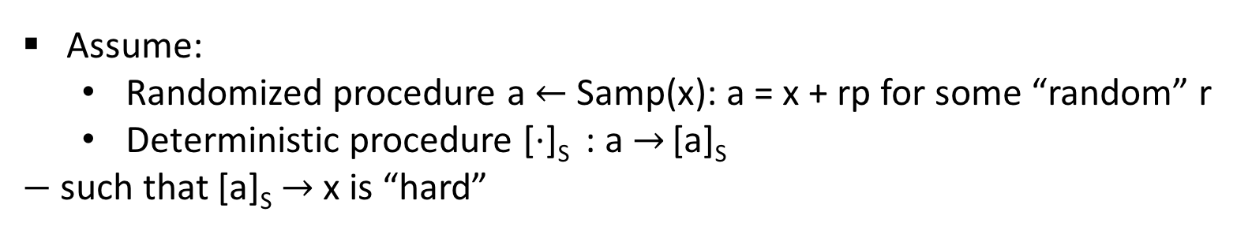
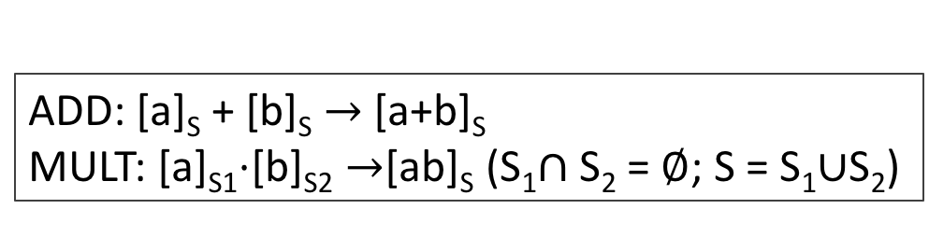
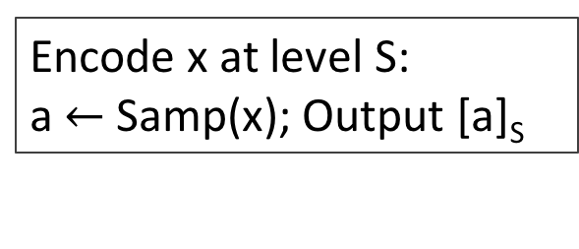


GGH13 Map : Hybrid description
*Description in Z
Large secret prime p
Public param: P_{zt}
Universal Set U = S₁ $∪$S₂ $∪$…S_{k}
Assume:
  Randomized procedure a$←$Samp(x): a = x + rp for some “random” r
  Deterministic procedure [$⋅$]_{S} : a $→$ [a]_{S}
  $−$ such that [a]_{S} $→$ x is “hard”
Encoding
Multi-linear ops
Encode x at level S:
a$←$Samp(x); Output [a]_{S}
ADD: [a]_{S} + [b]_{S} $→$[a+b]_{S}
MULT: [a]_{S1}$⋅$[b]_{S2} $→$[ab]_{S} (S₁$∩$ S₂ = $∅$; S = S₁$∪$S₂)
Zero-test
TEST if 0 mod p
ZTEST(P_{zt},[a]_{U}) returns r iff a =rp; $⊥$o.w.

Slide 51
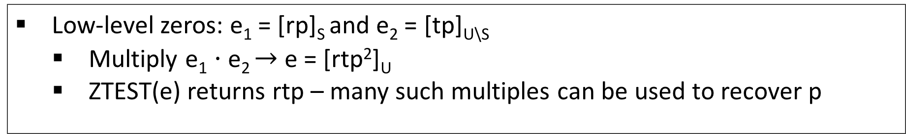
Hyb-GGH13: Vulnerabilities with low-level zeros
Exploiting Low-level zeros [HJ’16,GGH’13]
Low-level zeros: e₁ = [rp]_{S} and e₂ = [tp]_{U\S}
  Multiply e₁ $⋅$e₂ $→$e = [rtp²]_{U}
  ZTEST(e) returns rtp – many such multiples can be used to recover p
Not captured in Ideal Model
Not possible with top level zero [rp]_{U}
Obfuscation Constructions do not yield low-level zeros
[MSZ’16]
Annihilation Attacks: top-level encoding of 0 suffices
Breaks [BGKPS’14,AGIS’14,MSW’14,BMSZ’15…] when based on GGH13
Notes:
Taking GCD one can recover p

Slide 52
Obfuscation based on GGH
*Killian randomized
S₁
Input Branching Program
Notation:
ENC($⋅$,S_{i})
BP =
S_{i}
Obfuscator
Evaluator
Encode the i-th matrix-pair* w.r.t. level S_{i} to generate the encodings.
Output the encoded matrices
For each input x, multiply encoded matrices e.g. x = 1001
S₁
S₂
S₃
S₄
= [f]_{U} = e
S₁
S₂
S₃
S₄
S₁
S₂
S₃
S₄
S₁
S₂
S₃
S₄

Slide 53
Obfuscation based on GGH
*Killian randomized
S₁
Input Branching Program
Notation:
ENC($⋅$,S_{i})
BP =
S_{i}
Obfuscator
Evaluator
Encode the i-th matrix-pair* w.r.t. level S_{i} to generate the encodings.
Output the encoded matrices
For each input x, multiply encoded matrices e.g. x = 1001
S₁
S₂
S₃
S₄
= [f]_{U} = e
S₁
S₂
S₃
S₄
S₁
S₂
S₃
S₄
S₁
S₂
S₃
S₄
ZTEST(e) = r/$⊥$

Slide 54
Obfuscation based on GGH
*Killian randomized
S₁
Input Branching Program
Notation:
ENC($⋅$,S_{i})
BP =
S_{i}
Correctness:
Evaluator gets 0 iff f mod p = 0
Obfuscator
Evaluator
Encode the i-th matrix-pair* w.r.t. level S_{i} to generate the encodings.
Output the encoded matrices
For each input x, multiply encoded matrices e.g. x = 1001
S₁
S₂
S₃
S₄
= [f]_{U} = e
S₁
S₂
S₃
S₄
S₁
S₂
S₃
S₄
S₁
S₂
S₃
S₄
ZTEST(e) = r/$⊥$

Slide 55
Annihilation Attack with top-level zeros [MSZ’16]
BP₀ =
S₁
S₂
S₃
S₄
(r_{x},r_{y})
mMap ENC
EVAL(x,y)
S₁
S₂
S₃
S₄
S₁
S₂
S₃
S₄
EVAL(x,y)
(t_{x},t_{y})
BP₁=
mMap ENC
S₁
S₂
S₃
S₄
Adv comes up with two BP’s such that
$∀$ x BP₀(x) = BP₁(x) = 0
Difference in correlations e.g.
r_{x}² = r_{y}³ & t_{x}² $≠$ t_{y}³
Distinguished!

Slide 56

Annihilation Attack with top-level zeros [MSZ’16]
Question
How to compute the PRF ?
BP₀ =
S₁
S₂
S₃
S₄
(r_{x},r_{y})
mMap ENC
EVAL(x,y)
S₁
S₂
S₃
S₄
Our Idea
S₁
S₂
S₃
S₄
EVAL(x,y)
(t_{x},t_{y})
BP₁=
Mask the leaked value with PRF
mMap ENC
S₁
S₂
S₃
S₄
Destroy any correlation
Adv comes up with two BP’s such that
Answer
$∀$ x BP₀(x) = BP₁(x) = 0
Difference in correlations e.g.
r_{x}² = r_{y}³ & t_{x}² $≠$ t_{y}³
Self-fortification: The evaluation computes
PRF_{K}(x) along with C(x)
Distinguished!

Slide 57
Our Candidate Obfuscation
Input Branching Program
Auxiliary Branching Program
BP =
BP’ =
BP’(x) = u.p
where u = PRFK(x) for random key K
Define :
BP* =
Where
=
Such that: BP*(x) = BP(x) + u.p

Slide 58
GGH13: Vulnerabilities with low-level zeros
Exploiting Low-level zeros [HJ’16,GGH’13]
Low-level zeros: e₁ = [rp]_{S} and e₂ = [tp]_{U\S}
  Multiply e₁ $⋅$e₂ $→$e = [rtp²]_{U}
  ZTEST(e) returns rtp – many such multiples can be used to recover p
Not captured in Ideal Model
Not possible with top level zero [rp]_{U}
Obfuscation Constructions do not yield low-level zeros
[MSZ’16]
Annihilation Attacks: top-level encoding of 0 suffices
Breaks [BGKPS’14,AGIS’14,MSW’14,BMSZ’15…] when based on GGH13
Notes:
Taking GCD one can recover p

Slide 59
Vulnerabilities in mMap construatcions
Two most studied mMap constructions:
GGH13 [Garg-Gentry-Halevi] & CLT13 [Coron-Lepoint-Tibouchi]
Vulnerabilities discovered: [HJ’15], [CHLRS’15],[CGHLMMRST’15], [CLR’15]….
Other new constructions: GGH15 [Gentry-Gorbunov-Halevi]; CLT15 [Coron-Lepoint-Tibouchi]
Notes:
-These attacks are built on a common platform.
Note that these attacks are not known to break any of these IO candidates except for certain toy examples and that too only for certain constructions --e.g. none of these extend to GGHRSW.
However, these attacks are powerful and even though they are not known to work currently against IO, in future we might see extendsions of these attacks which can potentially break the IO schemes.

Slide 60
A different approach: GLSW’15
Reduced to concrete assumptions on concrete mMap.
Assumptions found to be false !
Improved our understanding of security provided by mMap

Slide 61
Prior Security guarantees of IO candidates
Generation-1: [GGHRSW’14]
Proof in Generic Colored Matrix model
Guarantee: security only against very weak attacks.
Assumed (almost) the construction is secure.
Generation-2: [BGKPS’14,AGIS’14, AB’15, Zim’15, Lin’16, BMSZ’16…..]
Proof in Ideal Graded Encoding Model
Guarantee: security against any attack that that does not exploit the mMap constructions.
Failed to address any attack on concrete mMap construction.

Slide 62
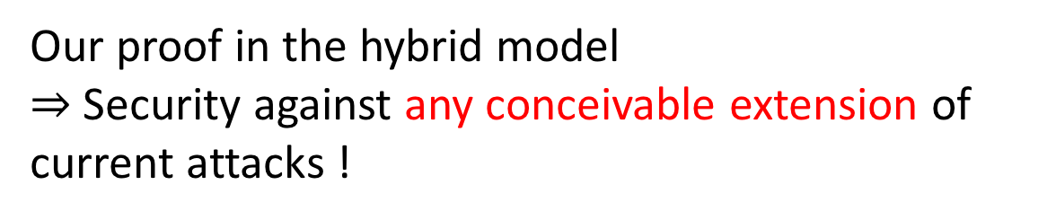
Impact: Paradigm shift of (GGH13-based)Obfuscation Landscape
Our proof in the hybrid model
$⇒$Security against any conceivable extension of current attacks !
Our Obfuscation Candidate
Notes:
- We show that essentially anything following this pattern is useless.

Slide 63
Vulnerabilities in GGH13: Impact on Obfuscation
[GGHRSW’14]
Feared Future
Zeroizing
[HJ’15]
Annihilation
[MSZ’16]
Current
Future
Weak DL
[GGH13]
All Obfuscation Constructions
[BGKPS’14,AGIS’14,BMSZ’16…….] (only specific examples)
Notes:
- The attacks follow a pattern.

Slide 64
Impact: Paradigm shift in (GGH13-based)Obfuscation Landscape
Recall: Feared Future
[GGHRSW’14]
Our Candidate
Conceivable Extension
Zeroizing
[HJ’15]
Annihilation
[MSZ’16]
Current
Future
Future
Weak DL
[GGH13]
New
All Obfuscation Constructions
[BGKPS’14,AGIS’14,BMSZ’16…….] (only specific examples)
Notes:
- The attacks follow a pattern.

Slide 65
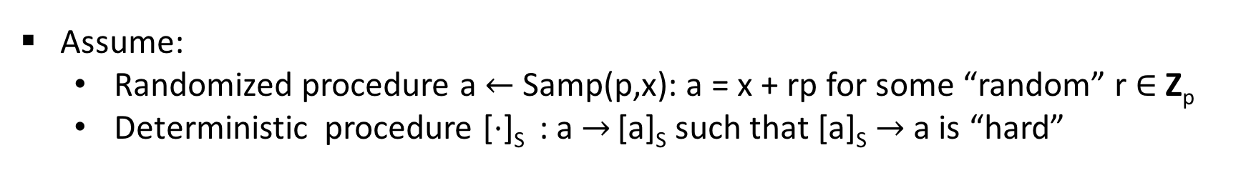

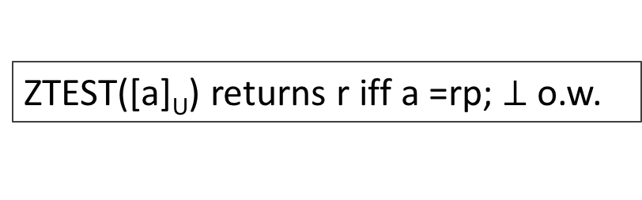
RECALL
GGH13 Map (in Hybrid Encoding Model)
Description in Z
Large secret prime p
Universal Set U = S₁ $∪$S₂ $∪$…S_{k}
Assume:
  Randomized procedure a$←$Samp(p,x): a = x + rp for some “random” r $∈$ Z_{p}
  Deterministic procedure [$⋅$]_{S} : a $→$ [a]_{S} such that [a]_{S} $→$ a is “hard”
Private Encoding
Multi-linear ops
Encode x $∈$ Z_{p} at level S:
a$←$Samp(p,x); Output [a]_{S}
ADD: [a]_{S} + [b]_{S} $→$[a+b]_{S}
MULT: [a]_{S1}$⋅$[b]_{S2} $→$[ab]_{S} (S₁$∩$ S₂ = $∅$; S = S₁$∪$S₂)
Zero-test
ZTEST([a]_{U}) returns r iff a =rp; $⊥$o.w.

Slide 66
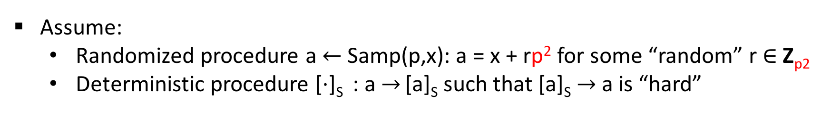
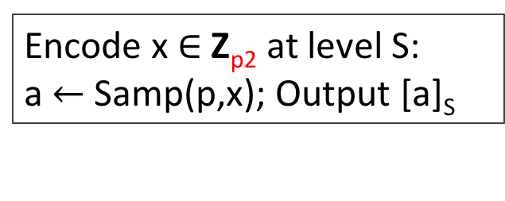
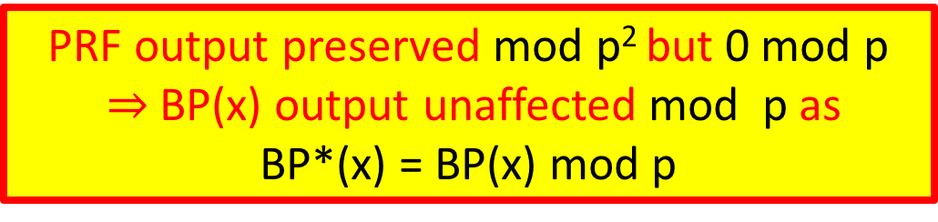
Our Modifications on GGH13
Description in Z
Large secret prime p
Universal Set U = S₁ $∪$S₂ $∪$…S_{k}
Assume:
  Randomized procedure a$←$Samp(p,x): a = x + rp² for some “random” r $∈$ Z_{p2}
  Deterministic procedure [$⋅$]_{S} : a $→$ [a]_{S} such that [a]_{S} $→$ a is “hard”
PRF output preserved mod p² but 0 mod p
$⇒$BP(x) output unaffected mod p as
BP*(x) = BP(x) mod p
Private Encoding
Encode x $∈$ Z_{p2} at level S:
a$←$Samp(p,x); Output [a]_{S}
Multi-linear ops
ADD: [a]_{S} + [b]_{S} $→$[a+b]_{S}
MULT: [a]_{S1}$⋅$[b]_{S2} $→$[ab]_{S} (S₁$∩$ S₂ = $∅$; S = S₁$∪$S₂)
Zero-test
No change in the zero-test
ZTEST([a]_{U}) returns r iff a =rp; $⊥$o.w.

Slide 67
Conclusion-1: Paradigm shift in obfuscation landscape
[GGHRSW’14]
RECALL
Conceivable Extension
Zeroizing
[HJ’15]
Annihilation
[MSZ’16]
Future
Weak DL
[GGH13]
All Attacks using zero-encodings
[BGKPS’14,AGIS’14,BMSZ’16…….] (only specific examples)
Notes:
- The attacks follow a pattern.

Slide 68
Our Results
  An obfuscation candidate based on (modified) GGH13 mMap
  - provably secure against known attacks against GGH13.
Proof of security in a new model: Hybrid Graded Encoding.
Uses structure of GGH13 map.
Captures all known vulnerabilities (& any conceivable extension) of GGH13 map.

Slide 69
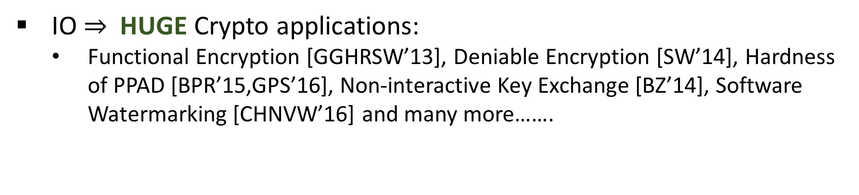
Formalizing Obfuscation
  Natural weakening: Indistinguishability Obfuscation (IO)
If (P₁ :{X} $→${Y}) (P₂ : {X} $→${Y}); then O(P₁)$≈$O(P₂)
IO $⇒$HUGE Crypto applications:
  Functional Encryption [GGHRSW’13], Deniable Encryption [SW’14], Hardness of PPAD [BPR’15,GPS’16], Non-interactive Key Exchange [BZ’14], Software Watermarking [CHNVW’16] and many more…….
Notes:
ড়ে ReadRead ReRead s

Slide 70

Obfuscation based on GGH13
*Killian randomized
Input Branching Program
Randomized Matrix Encoding:
Rand*-ENC($⋅$,S_{i})
BP =
S_{i}
  Correctness: computation preserved in $ℤ$_{p}
Security (Ideal): Straddling Sets & Killian Rand
Obfuscator
Evaluator
Annihilation Attack (HYB) exploits the “leaked info” from successful ZTEST_{HYB}
For each input x, multiply encoded matrices
Encode the i-th matrix-pair w.r.t. level S_{i} to generate the encodings.
Output the encoded matrices
e.g. x = 1001
S₁
S₂
S₃
S₄
= [f_{x}]_{U} = e
S₁
S₂
S₃
S₄
S₁
S₂
S₃
S₄
S₁
S₂
S₃
S₄
ZTEST_{HYB}(e) = r_{x}/$⊥$
(f_{x} = r_{x}p + f’_{x})

Slide 71
Agenda
Basics of Obfuscation.
Current/Plausible future status.
Previous constructions
Attacks on them
Our construction

Slide 72
Security guarantee of our Construction
Proof in Hybrid Graded Encoding (based on a modified GGH13) model.
Guarantee: security against all conceivable extensions of the current attacks on GGH13.

Slide 73
Conclusion-2: Calls for new generations of attacks
Safe
Unknown/unsafe
mMap-based
mMap-based
Non-mMap
Non-mMap
Attacks known
Attacks known
Our Work
mMap-based
Attacks NOT known
Any attack must exploit underlying mMap
Any attack must NOT use encoding of 0 in this pattern

Slide 74
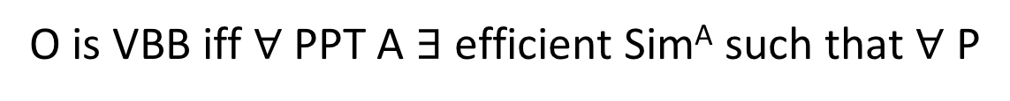

Formalizing Obfuscation: VBB
First formalized by Barak, Goldreich, Impagliazzo, Rudich, Sahai, Vadhan and Yang [BGIRSVY’01]
  Most natural definition- Virtual Black Box (VBB)
VBB
O is VBB iff $∀$ PPT A $∃$ efficient Sim^{A} such that $∀$ P
$$≈$$
comp
Sim
Impossibility: There exists P for which VBB is impossible to achieve – [BGIRSVY’01]
Notes:
ড়ে ReadRead ReRead s

Slide 75

Formalizing Obfuscation: VBB
First formalized by Barak, Goldreich, Impagliazzo, Rudich, Sahai, Vadhan and Yang [BGIRSVY’01]
  Most natural definition- Virtual Black Box (VBB) – Impossible !
$$≈$$
Impossibility: There exists P for which VBB is impossible to achieve – [BGIRSVY’01]
Notes:
ড়ে ReadRead ReRead s

Slide 76
Indistinguishability Obfuscation
A natural weakening of VBB: avoids the impossibility [BGIRSVY’01]
IO
O is IO iff for any functionally equivalent P₁ and P₂; for any PPT A
$$≈$$
comp
Can still have useful applications– [BGIRSVY’01]
Notes:
What was the equivalence ? Read it, people might ask.
Read the Barak Impossibility.

