Slide 1

Protecting Cryptographic Memory against Tampering Attack
PRATYAY MUKHERJEE
PhD Dissertation Seminar
Supervised by
Jesper Buus Nielsen
October 8, 2015

Slide 2
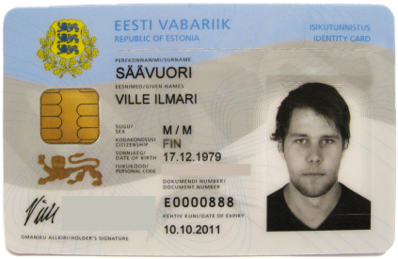
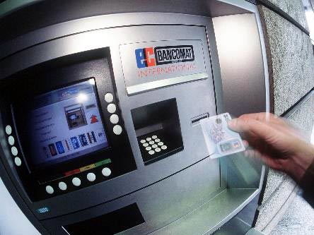

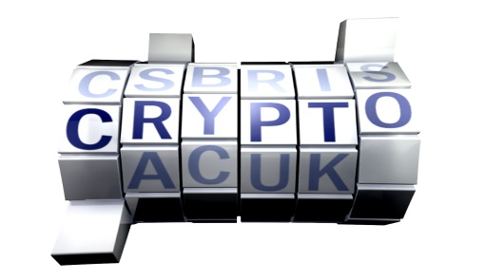
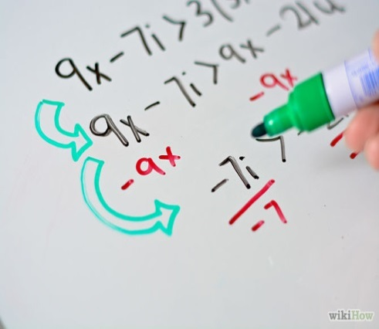
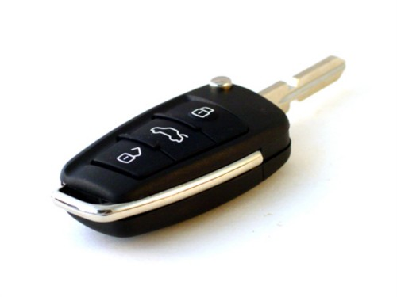
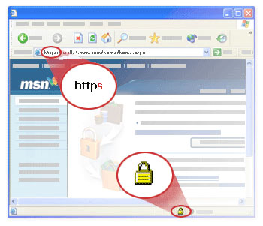

CRYPTO is everywhere in modern digital life
How to analyze security ?
Find all possible attacks ?
- Infeasible !
Need mathematical modelling and proofs a.k.a. Provable Security

Slide 3
Provable security at a glance
1. Define formal security models.
2. Design crypto-scheme
Usually described in mathematical language.
3. Prove security
Reduce security of complex scheme to simple assumption, e.g.,
Number theoretic: factoring is hard.
Complexity theoretic: one-way function exists.
Guarantee: NO practical adversary can break the security if the assumption holds

Slide 4



Time to relax?
Security proof implies…
  secure against
all possible attacks
However, provably secure systems get broken in practice!
So what’s wrong?
Reality
Model

Slide 5


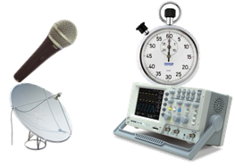
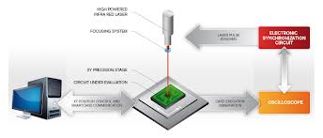


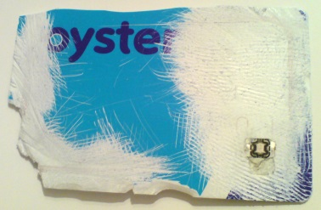
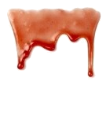

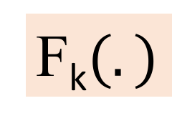
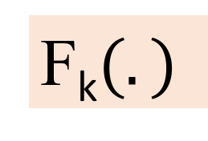
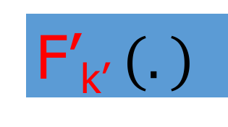
Physical attacks on implementations
Mathematical Model:
Blackbox
Reality:
PHYSICAL ATTACKS
Our focus
tampering
input
input
F_{k}$(.)$
leakage
F’_{k’} $(.)$
F_{k}$(.)$
output
output
tampered output

Slide 6
Why care about tampering ?
Devastating attacks on Provably Secure Crypto-systems!
More…
Anderson and Kuhn ’96
Skorobogatov et al. ’02
Coron et al. ’09
…………and many more…….
BDL’01: Inject single (random) fault to the signing-key of some type of RSA-sig
Factor RSA-modulus !

Slide 7
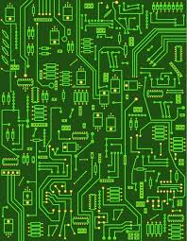
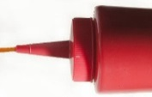


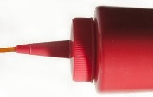
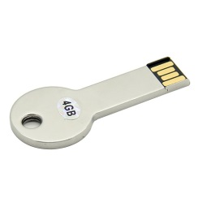
Theoretical models of tampering
Tamper with memory and computation (IPSW ’06)
Tamper only with memory (GLMMR ‘04)
Our Focus
F
F
k
k
Most General Model, but…
Very hard to analyze.
Weak existing results even using heavy tools like PCP [DK12, DK14] !
Restricted Model, but…
Much simpler to analyze
Has practical relevance!

Slide 8
Ways to Protect against memory tampering
Protecting Specific schemes
2. Protecting Arbitrary Computation
Build concrete tamper resilient schemes: e.g.
PRF, PKE, Sigs,
[BK 03; BCM11; KKS 11; BPT 12..........];
Build tamper-resilient compiler for any functionality
[GLMMR04,.....]
Circuit
Circuit
F’
F
compile
Memory
Memory
K
K'

Slide 9
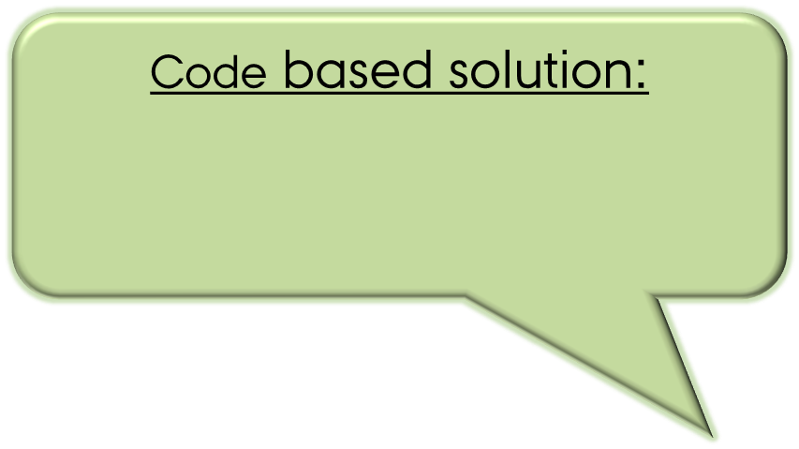
Ways to Protect against memory tampering
Protecting Specific schemes
2. Protecting Arbitrary Computation
Initialization: K' := C= Enc(K)
Build concrete tamper resilient schemes: e.g.
PRF, PKE, Sigs,
[BK 03; BCM11; KKS 11; BPT 12..........];
Execution of F‘[C](x):
1. K = Dec(C)
2. Output F[K](x)
Build tamper-resilient compiler for any functionality
[GLMMR04,.....]
Dziembowski, Pietrzak and Wichs [ICS 2010]
Non-malleable Codes
Circuit
Circuit
F’
F
compile
Memory
Memory
K
K'

Slide 10
Ways to Protect against memory tampering
Protecting Specific schemes
2. Protecting Arbitrary Computation
Initialization: K' := C= Enc(K)
Non-malleable Codes
Execution of F‘[C](x):
1. K = Dec(C)
2. Output F[K](x)
Build tamper-resilient compiler for any functionality
GLMMR04, DPW10.....
Build concrete tamper resilient schemes: e.g. PRF, PKE, Sigs,
e.g:
[BK 03; BCM11; KKS 11; BPT 12..........];
Circuit
Circuit
F’
F
compile
Memory
Memory
K
K'

Slide 11
The Dissertation
Protecting Specific schemes
2. Protecting Arbitrary Computation
Continuous Non-malleable Codes
[TCC 2014]:
Joint work with
Sebastian Faust, Jesper Buus Nielsen and Daniele Venturi
Bounded Tamper Resilience: How to go beyond the algebraic barrier
[Asiacrypt 2013]:
Joint work with
Ivan Damgård, Sebastian Faust and Daniele Venturi
Efficient Non-malleable Codes and Key-derivation for poly-size tampering circuits
[Eurocrypt 2014]:
Joint work with
Sebastian Faust, Daniele Venturi and Daniel Wichs
Tamer-resilient Identification and PKE scheme.
Existing schemes like sigma-protocols, BHHO encryptions are tamper-resilient. – No need for additional machinery

Slide 12
The Dissertation
Protecting Specific schemes
2. Protecting Arbitrary Computation
Continuous Non-malleable Codes
[TCC 2014]:
Joint work with
Sebastian Faust, Jesper Buus Nielsen and Daniele Venturi
Bounded Tamper Resilience: How to go beyond the algebraic barrier
[Asiacrypt 2013]:
Joint work with
Ivan Damgård, Sebastian Faust and Daniele Venturi
Brief mention
Efficient Non-malleable Codes and Key-derivation for poly-size tampering circuits
[Eurocrypt 2014]:
Joint work with
Sebastian Faust, Daniele Venturi and Daniel Wichs
Tamer-resilient Identification and PKE scheme.
Existing schemes like sigma-protocols, BHHO encryptions are tamper-resilient. – No need for additional machinery
This talk

Slide 13
Outline: rest of the talk
Basics of Non-malleable codes
FMVW: Efficient NMC against poly-size tampering circuits
Tamper-resilient compiler using NMC (DPW) (Briefly)
Continuous Non-malleable codes (Briefly)
Conclusion: Subsequent and Future works.

Slide 14
Basics of
Non-malleable Codes

Slide 15



What is Non-Malleable Codes ?
(Only 10 words!)
NMC
A modified codeword contains either original or unrelated message.
E.g. Can not flip one bit of encoded message by modifying the codeword.

Slide 16
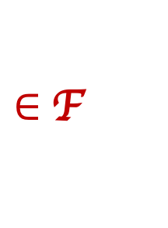
The “Tampering Experiment”
Consider the following experiment for some encoding scheme (ENC,DEC)
C
C*=f(C)
s
ENC
Tamper
DEC
s*
f
$∈$F
Note
ENC can be randomized.
There is no secret Key.
Goal:
Design encoding scheme (ENC,DEC) with meaningful “guarantee” on s* for an “interesting” class F

Slide 17
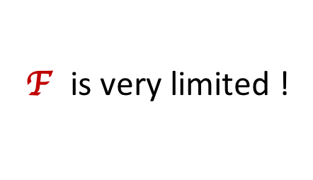
The “Tampering Experiment”
Consider the following experiment for some encoding scheme (ENC,DEC)
C
C*=f(C)
s
ENC
Tamper
DEC
s*
f
$∈$F
Error-Correcting Codes: Guarantee s* = s
F is very limited !
e.g. For hamming codes with distance d,
f must be such that:
Ham-Dist(C,C*) < d/2.)

Slide 18

The “Tampering Experiment”
Consider the following experiment for some encoding scheme (ENC,DEC)
C
C*=f(C)
s
ENC
Tamper
DEC
s*
f
$∈$F
Error-Correcting Codes: Guarantee s* = s
F is very limited !
Error-Detecting Codes : Guarantee s* = s or $⊥$
F excludes simple functions !
e.g. consider f to be a const. function always maps to a “valid” codeword.

Slide 19


The “Tampering Experiment”
Consider the following experiment for some encoding scheme (ENC,DEC)
C
C*=f(C)
s
ENC
Tamper
DEC
s*
f
$∈$F
Error-Correcting Codes: Guarantee s* = s
F is very limited !
Error-Detecting Codes : Guarantee s* = s or $⊥$
F excludes simple functions !
Non-malleable Codes [DPW ’10] :
Guarantee s* = s or “something unrelated”
Hope: Achievable for “rich”
F

Slide 20

Let’s be formal…..

Slide 21

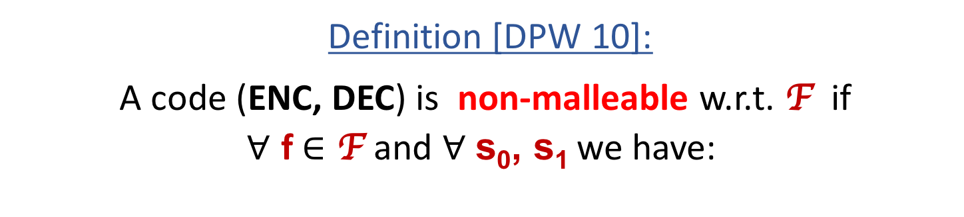
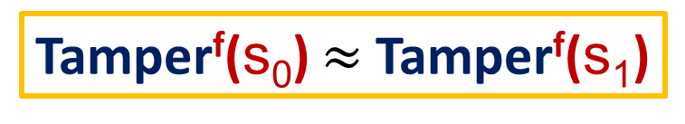
FORMALLY
Tamper^{f}(s)
C
C*=f(C)
s
ENC
Tamper
DEC
s*
f
$∈$F
If C* = C return same Else return s*
Definition [DPW 10]:
A code (ENC, DEC) is non-malleable w.r.t. F if
$∀$ f $∈\text{F}$and $∀$ s₀, s₁ we have:
Tamper^{f}(s₀) $≈$Tamper^{f}(s₁)

Slide 22
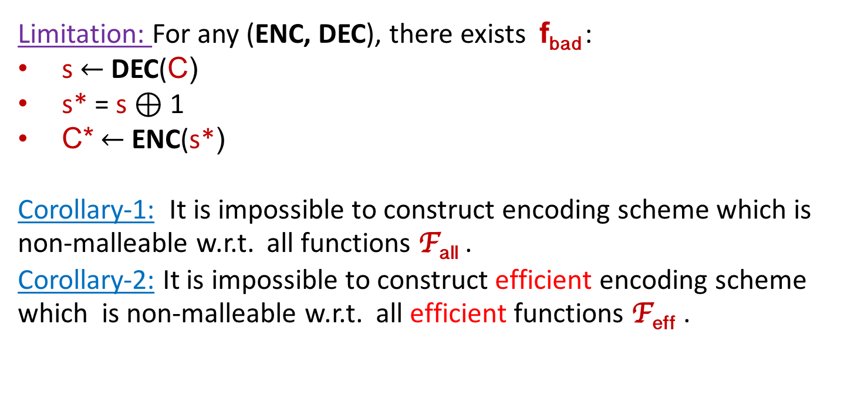
Limitation…
Limitation: For any (ENC, DEC), there exists f_{bad} :
s$←$DEC(C)
s* = s $⊕$ 1
C*$←$ENC(s*)
Corollary-1: It is impossible to construct encoding scheme which is non-malleable w.r.t. all functions F_{all} .
Corollary-2: It is impossible to construct efficient encoding scheme which is non-malleable w.r.t. all efficient functions F_{eff} .
No hope to achieve
non-malleability for such f_{bad} !
Main Question: How to restrict F ?
Other Questions:
  Rate ( =|s|/|C| )
  Efficiency
  Assumption(s)
Notes:
ENC DEC size...change

Slide 23
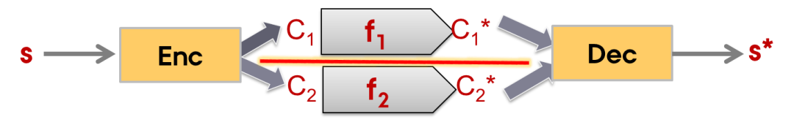
…..and Possibilities
Main Question: How to restrict F ?
Way-1: Granular Tampering
Codeword consists of components which are independently tamperable.
Decoding requires whole codewords.
Example: Split-state tampering model where there are only two independently tamperable components.
    [DPW10, LL12, DKO13, ADL13, CG14a, FMNV14, CZ15, ADKO15....]
Continuous
Notes:
F font

Slide 24
…..and Possibilities
Main Question: How to restrict F ?
Way-2: Low complexity tampering
The whole codeword is tamperable.
The tampering functions are “less complicated” than encoding/decoding.
[CG14b, FMVW 14]
Our focus

Slide 25
Efficient Non-Malleable Codes for poly-size tampering circuits

Slide 26
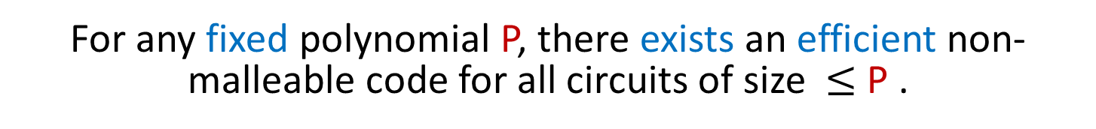
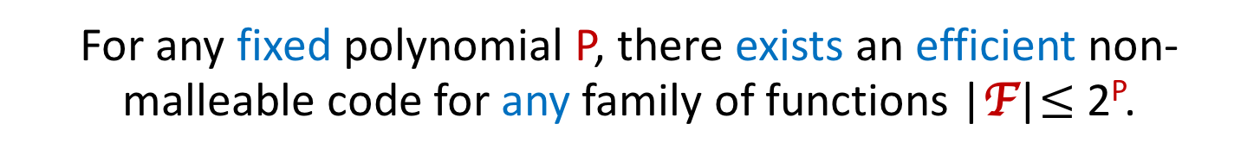
Our Result
recall
Corollary-2: It is impossible to construct efficient encoding scheme which is non-malleable w.r.t. all efficient functions F_{eff} .
Main Result: “The next best thing”
For any fixed polynomial P, there exists an efficient non-malleable code for all circuits of size $≤$ P .
Even more..
For any fixed polynomial P, there exists an efficient non-malleable code for any family of functions |F|$≤$ 2^{P}.
Caveat: Our results hold in CRS model.
Notes:
When we say “The next Best Thing” then that only refers to the stronger result, no ?

Slide 27
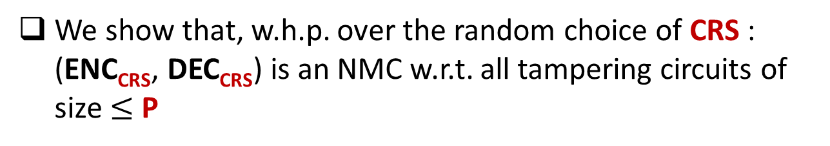
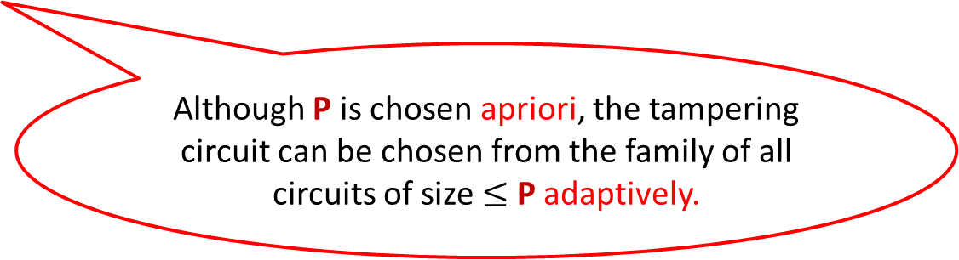
NMC in CRS model
Fix some polynomial P
We construct a family of efficient codes parameterized by CRS: (ENC_{CRS}, DEC_{CRS})
.
We show that, w.h.p. over the random choice of CRS : (ENC_{CRS}, DEC_{CRS}) is an NMC w.r.t. all tampering circuits of size $≤$ P
Although P is chosen apriori, the tampering circuit can be chosen from the family of all circuits of size $≤$ P adaptively.

Slide 28
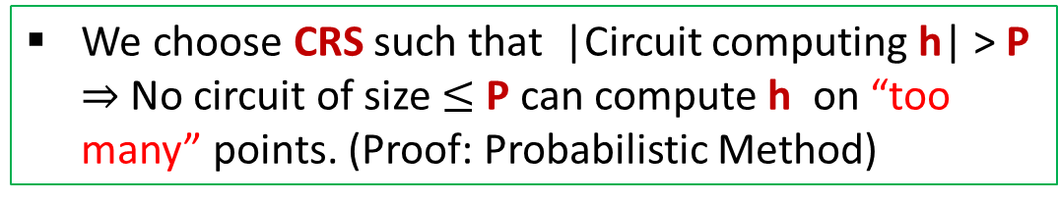
The Construction Overview
Input: s
Intuitions (outer encoding)
Ingredient: a t-wise independent hash function h
Inner Encoding
C₁
||
h( )
C
C₁
described by CRS
C
C
R
||
h( )
is Valid
is of the form
R
C₁
We choose CRS such that |Circuit computing h| > P $⇒$No circuit of size $≤$P can compute h on “too many” points. (Proof: Probabilistic Method)
Outer
Encoding
For every tampering function f there is a “small set” S_{f} such that if a tampered codeword is valid, then it is in S_{f} w.h.p.
C

Slide 29
The Construction Overview
Input: s
Intuitions (outer encoding)
For every tampering function f there is a “small set” S_{f} such that if a tampered codeword is valid, then it is in S_{f} w.h.p.
Inner Encoding
C₁
We call this property Bounded Malleability which ensures that the tampered codeword does not contain “too much information” about the input.
Outer
Encoding
C

Slide 30
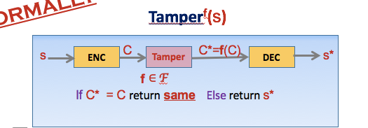
The Construction Overview
Input: s
Intuitions (Inner encoding)
recall
Inner Encoding
A leakage-resilient code
C₁
Output of Tamper^{f}(s) can be thought of as some sort of leakage on C₁
Outer
Encoding
Example
f can guess some bit(s) of C₁ and if the guess is correct, leave C same otherwise overwrites to some invalid code.
C
w.h.p. the leakage range is “small”: {same, $⊥$, S_{f}}

Slide 31
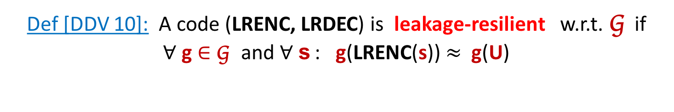
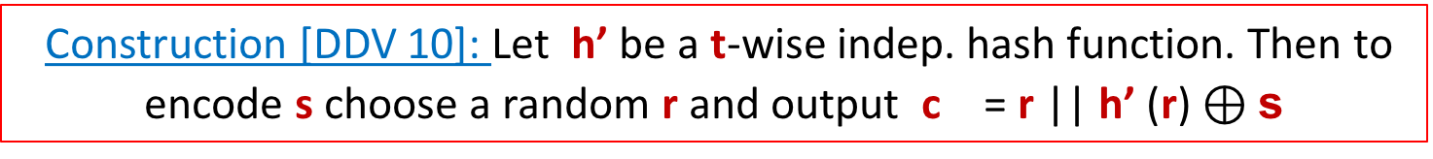

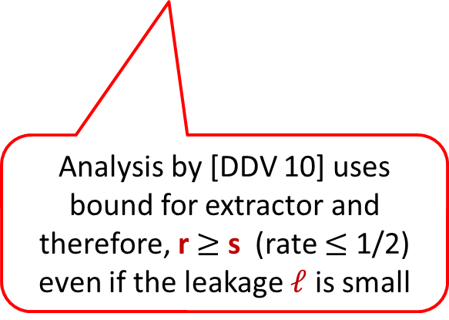
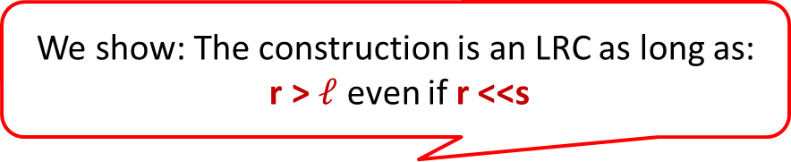
Leakage-Resilient Code
Def [DDV 10]: A code (LRENC, LRDEC) is leakage-resilient w.r.t. G if
$∀$g $∈$G and $∀$ s : g(LRENC(s)) $≈$ g(U)
Construction [DDV 10]: Let h’ be a t-wise indep. hash function. Then to encode s choose a random r and output c = r || h’ (r) $⊕\text{s}$
Our Inner Encoding
Analysis by [DDV 10] uses bound for extractor and therefore, r $≥$ s (rate $≤$ 1/2) even if the leakage $ℓ$ is small
We show: The construction is an LRC as long as:
r > $ℓ$ even if r <<s
We use the same construction but improved analysis to achieve optimal rate $≈$ 1.

Slide 32
Putting everything together
Input: s
Leakage Resilient Code for G
Inner Encoding
|F| = |G|
C₁
Bounded Malleable Code for F
Outer
Encoding
Non-Malleable Code for F
C

Slide 33
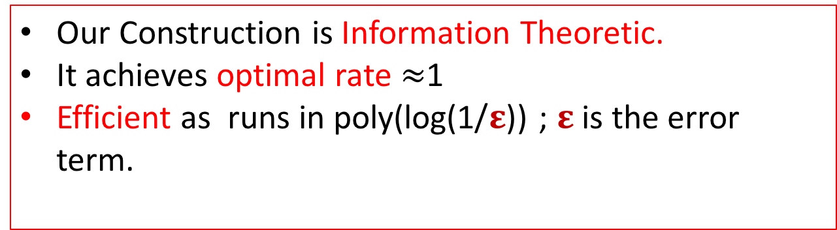
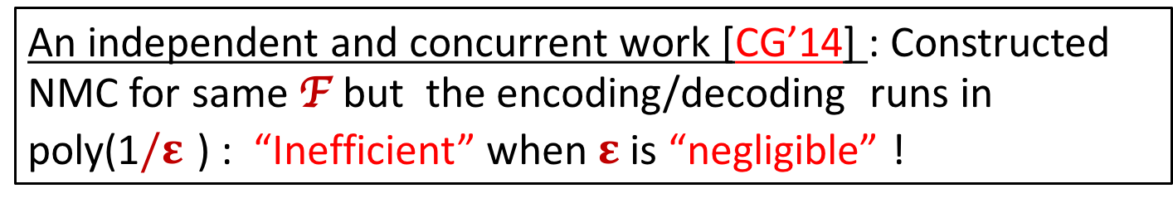
Few additional remarks
Our Construction is Information Theoretic.
It achieves optimal rate $≈$1
Efficient as runs in poly(log(1/$ε$)) ; $ε$ is the error term.
An independent and concurrent work [CG’14] : Constructed NMC for same F but the encoding/decoding runs in poly(1$/ε$ ) : “Inefficient” when $ε$ is “negligible” !

Slide 34
Tamper-resilient Compiler
via Non-malleable Codes (Briefly)
[DPW10]

Slide 35
Ways to Protect against memory tampering
RECALL
Protecting Specific schemes
2. Protecting Arbitrary Computation
Initialization: K' := C= Enc(K)
Build concrete tamper resilient schemes: e.g.
PRF, PKE, Sigs,
[BK 03; BCM11; KKS 11; BPT 12..........];
Execution of F‘[C](x):
1. K = Dec(C)
2. Output F[K](x)
Build tamper-resilient compiler for any functionality
[GLMMR04,.....]
Circuit
Circuit
F’
F
compile
Memory
Memory
K
K'

Slide 36



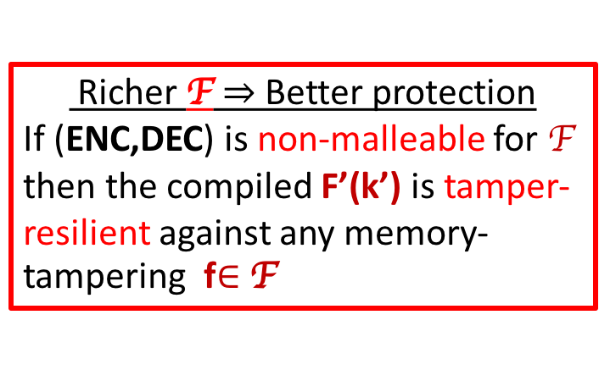

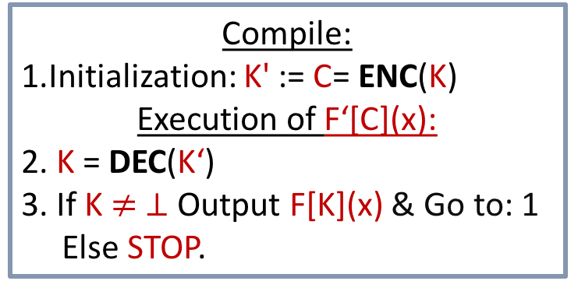


Tamper-resilient compiler using NMC
Compile:
1.Initialization: K' := C= ENC(K)
Execution of F‘[C](x):
2. K = DEC(K‘)
3. If K $≠ ⊥$Output F[K](x) & Go to: 1
Else STOP.
F’
F
NMC
K’
K
Self-destruct
Guarantee
Richer F $⇒$Better protection
If (ENC,DEC) is non-malleable for F then the compiled F’(k’) is tamper-resilient against any memory-tampering f$∈$F
$$∀$$
$$∃$$
Adv
$$≈$$
Sim

Slide 37
Continuous Non-malleable Codes (Briefly)

Slide 38
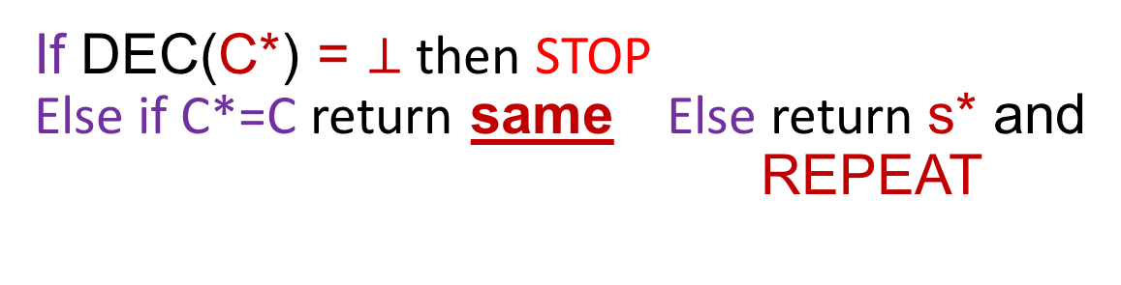
Continuous NMC
ContTamper^{f}(s)
C
C*=f(C)
s
ENC
Tamper
DEC
s*
f
$∈$F
If DEC(C*) = $⊥$ then STOP
Else if C*=C return same Else return s* and REPEAT
Definition [DPW 10]:
A code (ENC, DEC) is non-malleable w.r.t. F if
$∀$ f $∈\text{F}$and $∀$ s₀, s₁ we have:
Tamper^{f}(s₀) $≈$Tamper^{f}(s₁)

Slide 39

A natural extension:Continuous Non-malleable Codes:
The same codeword can be tampered many times.
Gives a better compiler : protects against stronger tampering where memory is much bigger and there is no earsure.
EXEC
C := NMEnc(s)
C’
C
Memory M
Memory M*=f(M)
Adv can tamper continuously
with the same codeword.

Slide 40
Conclusion: Subsequent and Future Works

Slide 41
Conclusion: Subsequent and Future Works
In a nutshell: showed different theoretical methods of protecting against tampering attack.
  En route improved theory of Non-malleable Codes.
Several subsequent works: [FMNV15], [JW15], [DFMV15],[QLYDC15]……
Open:
  Reduding gaps with practical models of tampering.
    Inspiration from Leakage-resilient crypto [DDF14].
  Improvement of state-of-art in tampering with the computation itself.
  New applications of Non-malleable Codes.
Notes:
theoretical / leakage hope

Slide 42


