Slide 1
DiSE
Distributed Symmetric Encryption
Pratyay Mukherjee
(VISA Research)
joint work with
Shashank Agrawal (VR), Payman Mohassel (VR) and Peter Rindal (OSU)

Slide 2
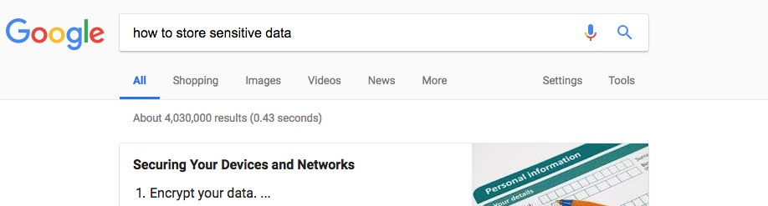
How to store sensitive data?
Encryption reduces the storage requirement from BIG data to SMALL key
How to store the key?
Notes:
Also want to use data at a later time, then need to decrypt. Decryption key must be stored securely.

Slide 3
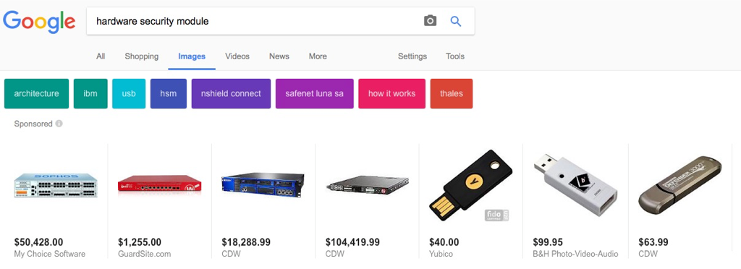
How to store the secret key?
Naïve Approach:
Cons: Single point of failure
C ← ENCRYPT(sk,M)
sk
HSM?
Cons: side-channels, costly, lacks flexibility…

Slide 4


Software only solutions
Distributing (secret-sharing) the key among multiple servers:
C ← ENCRYPT(sk,M)
sk₁ $⊕$ sk₂ = sk
Cons: Keys need to be reconstructed
sk₁
sk₂
Notes:
Keys are reconstructed at a single server and hence vulnerable to so-called snapshot attacks.

Slide 5
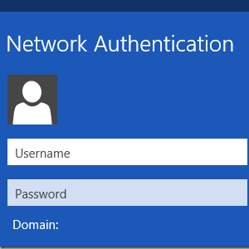
Software only solutions (no reconstruction)
Threshold Crypto
Threshold Crypto Prior to this work:
Mostly limited to PKE/Signatures [F’89, CG’99, Shoup’00…BGGJKRS’18,DKLA’18…]
Do not meet security/efficiency requirements for inherently symmetric-key apps:
  Encrypting data & credentials (passwords, tokens etc.) at rest (e.g. cloud)
  Network authentication/ticket granting (e.g. Kerberos)
  Multi-device IoT authentication (e.g. removing trusted hardware on device)
Notes:
, Mention that BGG has universal thresholdizer which may lead to a construction satisfying our def, but it uses FHE which is not yet practical, and here we focus on practicaility.
Ask more points why PKE is bad
Ask more about the apps.

Slide 6
Our Solution:
Threshold Symmetric Encryption
Our Contribution
  New security definitions
    intuitive and natural; handled many subtleties due to interaction (detailed later)
  We propose a generic construction based on any distributed PRF
    several simple and lightweight protocols:
      2-round of communication (request-response)
      the responders don’t interact: total O(N) communication
  Implement with (variants of) DPRF from [NPR’99]
    most efficient protocol achieves 1 mil enc/dec per second for 18 parties
Pros: Compute any scheme (e.g. AES) – comply to standards
Alternative solution: Encrypt/decrypt via MPC [KORSSV’17, RSS’17….]
Cons: - Not scalable: highly interactive (> 2 rounds) &
  bandwidth intensive (O(N²) communication);
  - Non-black box use of scheme: blow up in computation

Slide 7
Rest of the talk
Definition of Threshold Symmetric Encryption (TSE)
  Correctness
  Privacy
  Authenticity
Constructions
  Generic construction based on any Distributed PRF
  Instantiations
Performance

Slide 8
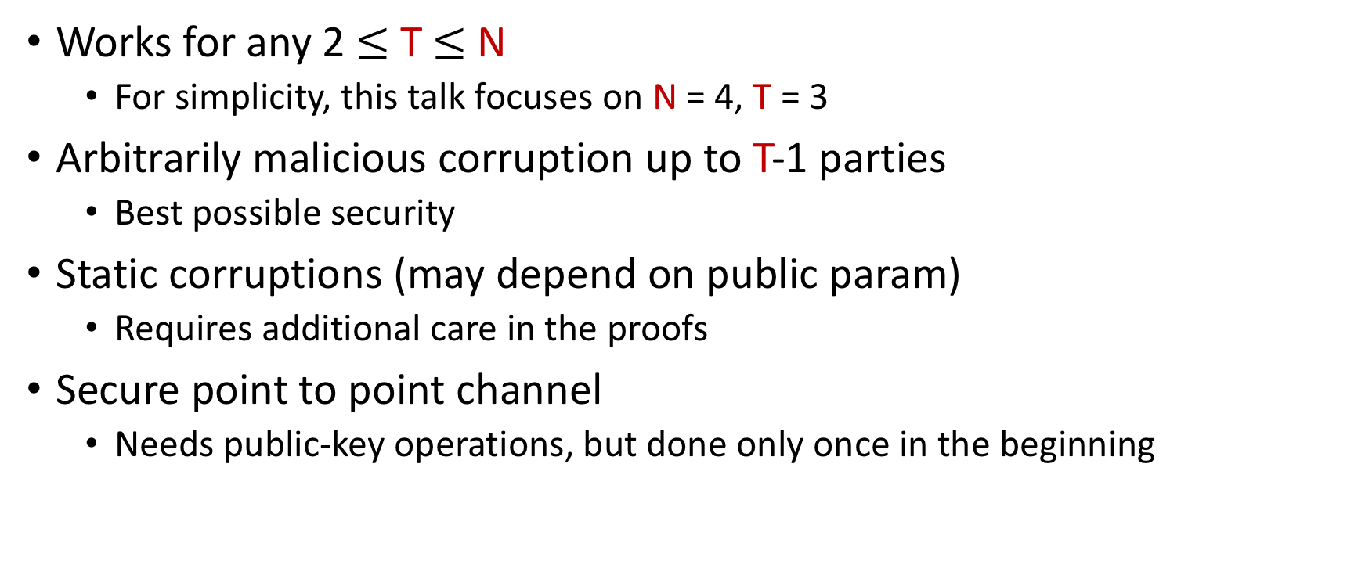
The Setting
Works for any 2$≤$ T $≤$ N
  For simplicity, this talk focuses on N = 4, T = 3
Arbitrarily malicious corruption up to T-1 parties
  Best possible security
Static corruptions (may depend on public param)
  Requires additional care in the proofs
Secure point to point channel
  Needs public-key operations, but done only once in the beginning

Slide 9
Definitions

Slide 10
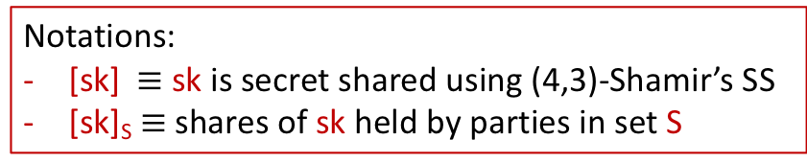
Basic Template for (4,3)-TSE
= initiator
SETUP→ (pp,[sk])
T-ENC(pp,[sk]_{S},M)→ C
T-DEC(pp,[sk]_{S‘},C)→ M
P₁
P₂
(pp, sk₁)
(pp, sk₂)
M, S = {2,3}
C
M
C, S’ = {1,2}
  Consistency: works for any S, S’
P₄
P₃
(pp, sk₄)
Notations:
[sk]$≡$ sk is secret shared using (4,3)-Shamir’s SS
[sk]_{S} $≡$shares of sk held by parties in set S
(pp, sk₃)

Slide 11
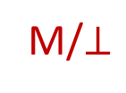
Correctness
(Non-interactive) SE: $∀$ M: DEC(pp,sk,ENC(pp,sk,M)) = M
two game-based def
TSE: adv involved in both T-ENC & T-DEC:
P₂
P₁
M
C
M/$⊥$
C
  Correctness
P₄
P₃

Slide 12
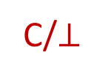
Correctness
(Non-interactive) SE: $∀$ M: DEC(pp,sk,ENC(pp,sk,M)) = M
two game-based def
TSE: adv involved in both T-ENC & T-DEC:
P₂
P₁
M
C/$⊥$
Constructions that achieve strong correctness slower due to NIZK
Parties can detect whether C is valid during encryption
  Strong Correctness
P₄
P₃

Slide 13
Message Privacy
(Non-interactive) SE (IND-CPA-security)): adv makes only encryption queries
TSE: adv receives transcript during enc/dec initiated by honest parties:
we consider two types of queries
P₂
P₁
M
C
Query Type- 1
Encryption (like CPA-SE)
P₄
P₃
Notes:
Say that we also have IND def

Slide 14
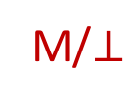
Message Privacy
(Non-interactive) SE (IND-CPA-security)): adv makes only encryption queries
TSE: adv receives transcript during enc/dec initiated by honest parties: we consider two types of queries
P₂
P₁
Result not given to adv
(can query on challenge C*)
C
Ensures adv learns nothing by participating
We consider IND-security (CPA-SE) given those queries
C
Query Type- 2
Indirect Decryption (unlike CPA-SE)
M/$⊥$
P₄
P₃

Slide 15
Ciphertext Authenticity
(Non-interactive) SE : adv should not be able to produce ctxt not in the list of ctxts queried
TSE:
how to define such list if adv initiates the query?
must ensure that the adv can’t produce ciphertexts only by participating:
we consider two types of queries
P₂
P₁
M
C
Keep track with a counter cnt
Query Type- 1
Encryption or Decryption by adv
P₄
P₃

Slide 16
Ciphertext Authenticity
(Non-interactive) SE : adv should not be able to produce ctxt not in the list of ctxts queried
TSE:
how to define such list if adv initiates the query?
must ensure that the adv can’t produce ciphertexts only by participating:
we consider two types of queries
P₂
M
P₁
Output not given to adv
C
Ensures adv can’t predict C from participation
Not keeping track with cnt
C computed by such query is a valid forgery
One-more type of def: adv wins if returns cnt+1 ciphertexts
Query Type- 2
Encryption/Decryption by honest party
P₄
P₃
Notes:
Say that one more helps us to bypass the valid ciphertext as increment ct whenever adv has enough information to compute a valid C.

Slide 17
Constructions

Slide 18
Main Ingredient: Distributed PRF [Naor-Pinkas-Reingold’99]
DP.SETUP→ (pp,[k])
DPRF(pp,[k]_{S},X)→ Y
P₁
P₂
(pp, k₁)
(pp, k₂)
X, S = {2,3}
Y
Must hold in presence of malicious adv (New)
Parties are corrupted depending on pp (New)
  Weak DPRF
  Consistency: same Y for any S, S’
P₄
P₃
(pp, k₄)
  Pseudorandomness: Y is pseudorandom
(pp, k₃)

Slide 19
Warm Up: A four round protocol
Idea: Use DPRF output to Encrypt-then-MAC?
P₁
P₂
M
(pp, k₁)
(pp, k₂)
Random R
Y ← DPRF(R)
E ← ENC_{Y}(M)
T ← DPRF(E)
C = (T,E)
Seems inherently sequential
  How can we parallelize Encrypt-and-MAC?
  (known to be insecure for SE [BC’00])
P₄
P₃
(pp, k₄)
  Idea: MAC commitment of message, not E
(pp, k₃)

Slide 20
Our Construction (almost)
  Idea: MAC commitment of message, not E,
P₁
P₂
M
(pp, k₁)
(pp, k₂)
Random R
Q ← COM(M,R)
Y← DPRF(Q)
  Commitment binds Q and M : adv can’t change M : gets ptxt-integrity
E ← ENC_{Y}(M||R)
Attack-1: adv can generate new valid E keeping Q same: breaks ctxt-integrity
C = (Q,E)
  Fix: Make ENC deterministic
P₄
P₃
(pp, k₄)
(pp, k₃)

Slide 21
Our Construction (almost)
  Idea: MAC commitment of message, not E,
P₁
P₂
Q
M
(pp, k₁)
(pp, k₂)
Random R
Q ← COM(M,R)
Y← DPRF(Q)
  Commitment binds Q and M : adv can’t change M : gets ptxt-integrity
E ← ENC_{Y}(M||R)
Attack-1: adv can generate new valid E keeping Q same: breaks ctxt-integrity
C = (Q,E)
  Fix: Make ENC deterministic
Attack-2: adv can query on Q to recover Y and decrypt C: breaks msg-privacy
P₄
P₃
(pp, k₄)
(pp, k₃)

Slide 22
Our Construction
  Idea: MAC commitment of message, not E,
P₁
P₂
Q
M
(pp, k₁)
(pp, k₂)
Random R
Check if P₁ is requesting; if not abort
Q ← COM(M,R)
Y← DPRF(1,Q)
  Commitment binds Q and M : adv can’t change M : gets ptxt-integrity
E ← ENC_{Y}(M||R)
Attack-1: adv can generate new valid E keeping Q same: breaks ctxt-integrity
C = (1,Q,E)
  Fix: Make ENC deterministic
Check if P₁ is requesting; if not abort
Attack-2: adv can query on Q to recover Y and decrypt C: breaks msg-privacy
  Fix: Compute DPRF(j,Q) + responder checks if j is requesting
P₄
P₃
(pp, k₄)
(pp, k₃)
  Decryption works by computing DPRF, decrypting and then checking the commitment

Slide 23
Instantiations
Any DPRF → TSE with Strong Correctness + Privacy + Authenticity
Weak DPRF → TSE with correctness + Privacy + Authenticity
Weak DPRF candidates [NPR’99]:
  DP-DDH: based on DDH; Random Oracle; trapdoor commitment
  DP-PRF: based on any PRF, works only for small N,T
DPRF candidate (a variant of [NPR’99]):
  DP-NIZK: based on DDH; Random Oracle; trapdoor commitment and NIZK
Instantiating we get three TSE protocols:
  1. DISE-DDH
  2. DISE-PRF
  3. DISE-NIZK

Slide 24
Performance
N = 18; RO = Blake2; PRF = AES; DDH = Curve p256k1 (Miracl); LAN 10 GBps, 0.1ms
Throughput (Enc/sec)
Threshold (T) | DISE-PRF | DISE-DDH | DISE-NIZK
2 | 1,037,703 | 553 | 226
6 | 45,434 | 297 | 64
9 | 10,194 | 231 | 42
16 | 524,109 | 135 | 23
Bandwidth (MBps)
Threshold (T) | DISE-PRF | DISE-DDH | DISE-NIZK
2 | 253 | 0.14 | 0.28
6 | 55 | 0.77 | 0.40
9 | 20 | 0.45 | 0.50
16 | 1919 | 0.49 | 0.43

Slide 25
Performance
N = 18; RO = Blake2; PRF = AES; DDH = Curve p256k1 (Miracl); LAN 10 GBps, 0.1ms
Latency (ms/Enc)
Threshold (T) | DISE-PRF | DISE-DDH | DISE-NIZK
2 | 0.1 | 4.6 | 9.6
6 | 0.6 | 5.4 | 21.5
9 | 1.1 | 8.0 | 31.3
16 | 2.2 | 12.6 | 55.2
- We also implemented for N = 6, 12, 24 and corresponding values of T
- We also implemented over WAN

Slide 26
Summary
  We initiate the formal study of Threshold (authenticated) Symmetric Encryption
  We propose a generic framework based on any Distributed PRF and many concrete instantiations
  Our implementations are extremely fast and scales to a large number of parties
  Future directions:
    Dealing with practical features of standard authenticated encryption:
      nonce-misuse
      multi-user security etc.
Thank you and let’s DiSE!

Slide 27
Performance (WAN 40 MBps, 80ms)
Setting: N = 18; RO = Blake2; PRF = AES; DDH = Curve p256k1 (Miracl); C++
Throughput (Enc/sec)
Threshold (T) | DISE-PRF | DISE-DDH | DISE-NIZK
2 | 1,037,703 | 553 | 226
6 | 45,434 | 297 | 64
9 | 10,194 | 231 | 42
16 | 524,109 | 135 | 23
Bandwidth (MBps)
Threshold (T) | DISE-PRF | DISE-DDH | DISE-NIZK
2 | 253 | 0.14 | 0.28
6 | 55 | 0.77 | 0.40
9 | 20 | 0.45 | 0.50
16 | 1919 | 0.49 | 0.43

Slide 28

Software only solutions (no reconstruction)
1. Encrypt/decrypt via MPC [KORSSV’17, RSS’17….]
Pros: Compute any scheme (e.g. AES) – comply to standards
Cons:
does not scale to more than a few parties:
  highly interactive (> 2 rounds)
  bandwidth intensive (O(N²) communication)
heavy computation due to non-black-box use of scheme
2. Threshold Crypto – Our approach
Notes:
DO NOT DISCUSS pros and cons here

Slide 29
Software only solution (no reconstruction)-2
Our approach: Threshold Crypto
Goal:
Only two rounds (request-response)
O(N) communications
Lightweight
Notes:
DO NOT DISCUSS pros and cons here

Slide 30
Threshold Crypto: State-of-the-art
Threshold PKE/Sig [F89,DF89…]
  Lot of Public-key operations
  Extensive interaction, communication
  Overkill for many symmetric key application:
Encrypting data & credentials (tokens, passwords, certificates...) at rest
  on premise
  users' devices
  third-party cloud storage
Network authentication services like Kerberos
Token services on mobile platforms: for example mobile payments
+ something from the paper… IoT
Symmetric key is long term
Threshold Symmetric Encryption: This work.

Slide 31
Failed Attempt-1 (suggestion from NPR)
NPR idea
Explain with pics
Problem: adv has too much flexibility.

Slide 32
Message Privacy
(Non-interactive) SE (IND-CPA-security)): adv makes only encryption queries
TSE: adv receives transcript during encryption/decryption initiated by honest parties: we consider three types of queries
P₂
M
P₁
M
C
C
(explicitly given like SE)
Query Type- 2
Indirect Encryption (unlike SE)
P₄
P₃

