Slide 1


Approximate Trapdoors for Lattices
& smaller hash-and-sign signatures
Pratyay Mukherjee
(Visa Research)
Stanford Security Seminar
December 5, 2019
Nicholas Genise
(Rutgers)
Yilei Chen
(Visa Research)

Slide 2




Slide 3
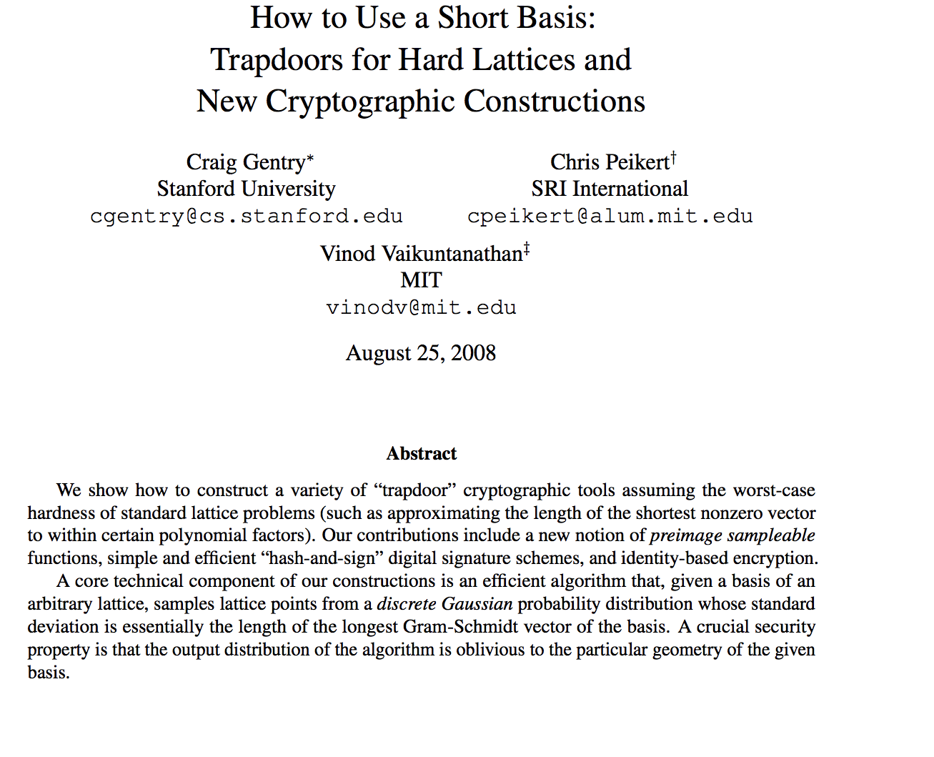
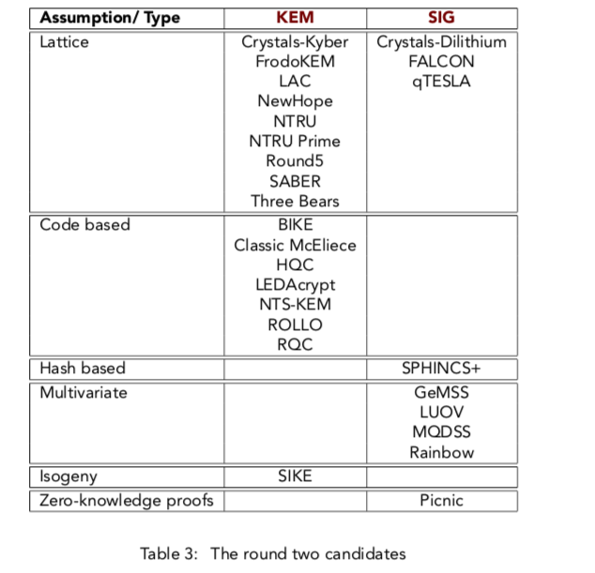
Post-quantum Crypto@NIST

Slide 4


Post-quantum Crypto@NIST
Scheme | Assumption, Technique | PK size | Sig size
FALCON | NTRU, lattice-trapdoor | 0.9 kB | 0.6 kB
Dilithim | MLWE, rejection-sampling | 1.5 kB | 2.7 kB
q-Tesla | RLWE, rejection-sampling | 4.1 kB | 3.1 kB
GPV08 | RLWE, lattice-trapdoor | 22.5 kB* | 18.7 kB*
*without much optimizations, taken from:
[Bansarkhani-Buchmann’13];
[Gur-Polyakov-Rohloff-Ryan-Savas’18]
Notes:
Anime, RSA/ECDSA

Slide 5


Post-quantum Crypto@NIST
Scheme | Assumption, Technique | PK size | Sig size
FALCON | NTRU, lattice-trapdoor | 0.9 kB | 0.6 kB
Dilithim | MLWE, rejection-sampling | 1.5 kB | 2.7 kB
q-Tesla | RLWE, rejection-sampling | 4.1 kB | 3.1 kB
GPV08+ | RLWE, approx-trapdoor | 11.2 kB* | 9.3 kB*
This work: Make GPV Signatures Competitive Again!
*not as optimized as others.

Slide 6

Hash-and-Sign Signatures from Lattice Trapdoors
[Gentry-Peikert-Vaikuntanathan 08]
Recall: Inhomogeneous Short Integer Solution (ISIS)
x
A
t
= mod q
Hard
Given random A, t, find a ``short’’ vector x

Slide 7
Hash-and-Sign Signatures from Lattice Trapdoors
[Gentry-Peikert-Vaikuntanathan 08]
Recall: Inhomogeneous Short Integer Solution (ISIS)
Trapdoor of A: T_{A}
x
A
t
= mod q
Hard
Given random A, t, find a ``short’’ vector x

Slide 8

Hash-and-Sign Signatures from Lattice Trapdoors
[Gentry-Peikert-Vaikuntanathan 08]
Recall: Inhomogeneous Short Integer Solution (ISIS)
Trapdoor of A: T_{A}
x
A
t
= mod q
Easy with
Given random A, t, find a ``short’’ vector x
SolveISIS(T_{A},A,t)→ x
TrapGen() → (A,T_{A})

Slide 9















Hash-and-Sign Signatures from Lattice Trapdoors
[Gentry-Peikert-Vaikuntanathan 08]
Trapdoor of A: T_{A}
vk
x
Hash(m)
sk
$σ$
A
t
= mod q
runs TrapGen() → (A,T_{A})
runs SolveISIS(T_{A, ,}H(m)) → $σ$
Check A . $σ$ = H(m) &$σ$ short
KeyGen→ (sk, vk)
Sign(sk, m)→ $σ$
Verify(vk, m, $σ$):= Y/N

Slide 10

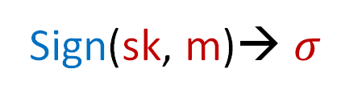
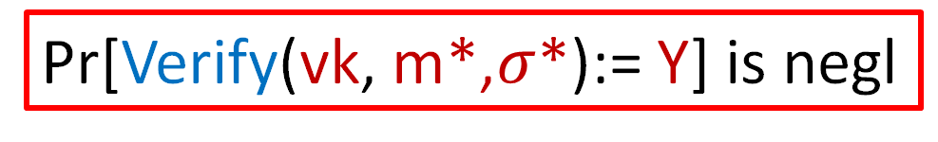


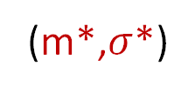


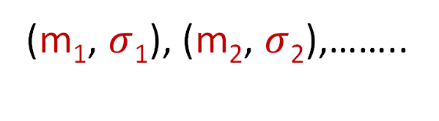
Recall: Unforgeability notion of signatures
KeyGen→ (sk, vk)
Sign(sk, m)→ $σ$
Verify(vk, m, $σ$):= Y/N
Pr[Verify(vk, m*,$σ$*):= Y] is negl
m
(sk, vk)
(vk)
$$σ$$
(m₁, $σ$₁), (m₂, $σ$₂),……..
(m*,$σ$*)
Notes:
Improve.

Slide 11
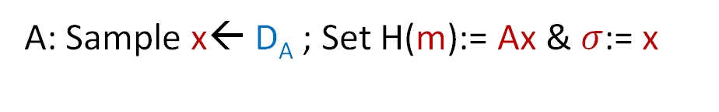
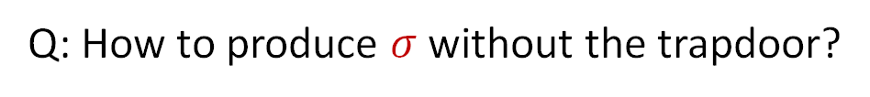

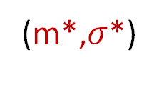




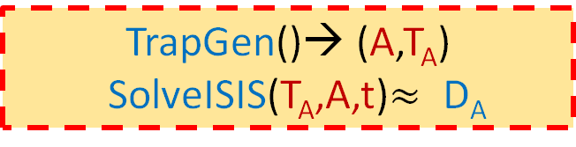



Security of GPV08 Signature
[Gentry-Peikert-Vaikuntanathan 08]
Reduction to ISIS:
m
H(m)
$σ$
(m*,$σ$*)
A
t
TrapGen()→ (A,T_{A})
SolveISIS(T_{A},A,t)$≈$ D_{A}
Program RO: H(m*) = t
Q: How to produce $σ$ without the trapdoor?
A: Sample x← D_{A} ; Set H(m):= Ax & $σ$:= x
Output $σ$* as the ISIS solution

Slide 12


Approximate ISIS and Approximate Trapdoors
x
A
t
Trapdoor of A: T_{A}
= mod q
Hope: an approximate trapdoor can be set up with a smaller dimensions
x
t
e
Approx Trapdoor of A: S_{A}
A
= + mod q
Approx ISIS: Given random A, t, find a ``short’’ vector x such that Ax $≈$ t (mod q)

Slide 13
Approximate ISIS and Approximate Trapdoors
x
A
t
Trapdoor of A: T_{A}
= mod q

Slide 14



Approximate ISIS and Approximate Trapdoors
ASolveISIS(S_{A},A,t)→ x
ATrapGen() → (A,S_{A})
x
Approx Trapdoor of A: S_{A}
A
t
$≈$ mod q
Easy with S_{A}; hard otherwise
Approx ISIS: Given random A, t, find a ``short’’ vector x such that Ax $≈$ t (mod q)
A
x
t
e
= + mod q
Hope: an approximate trapdoor can be set up with ``smaller’’ dimensions

Slide 15

Approx ISIS is as hard as ISIS (This work)
x
Reduction:
A
t
= mod q
Given uniform A,t find x such that:
Can access Approximate ISIS oracle

Slide 16





Approx ISIS is as hard as ISIS (This work)
x
Reduction:
M
A’
t
= mod q
Given uniform A,t find x such that:
Can access Approximate ISIS oracle
M is invertible w.h.p. (since A is random)
x₁
I_{n}
A’’
t’
x₂
= mod q
A’’ = M⁻¹A’, t’ = M⁻¹t

Slide 17

Approx ISIS is as hard as ISIS (This work)
x₁
Reduction:
M
A’
t
= mod q
Given uniform A,t find x such that:
x₂
Can access Approximate ISIS oracle
M is invertible w.h.p. (since A is random)
Give Approx-ISIS oracle A’’, t’;
Obtain back x₂;
A’’
x₂
t’
x₁
= - mod q
Output
A’’ = M⁻¹A’, t’ = M⁻¹t
x₁ can be computed

Slide 18
RECALL: Hash-and-Sign Signatures from Lattice Trapdoors
[GPV08]
Trapdoor of A: T_{A}
vk
x
Hash(m)
sk
$σ$
A
t
= mod q
runs TrapGen() → (A,T_{A})
runs SolveISIS(T_{A, ,}H(m)) → $σ$
Check A . $σ$ = H(m) &$σ$ short
KeyGen→ (sk, vk)
Sign(sk, m)→ $σ$
Verify(vk, m, $σ$):= Y/N

Slide 19



Hash-and-Sign Signatures from Approx-Trapdoors
[GPV08]+
Approx Trapdoor of A: S_{A}
vk
x
Hash(m)
sk
$σ$
A
t
$≈$ mod q
runs ATrapGen() → (A,S_{A})
runs ASolveISIS(S_{A, ,}H(m)) → $σ$
Check A . $σ$ $≈$ H(m) &$σ$ short
KeyGen→ (sk, vk)
Sign(sk, m)→ $σ$
Verify(vk, m, $σ$):= Y/N

Slide 20
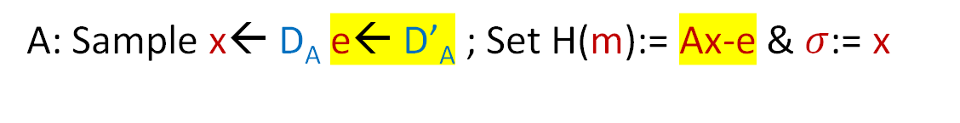
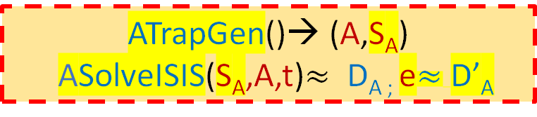

Security of GPV08+ [This work]
Reduction to AISIS:
m
H(m)
$σ$
(m*,$σ$*)
A
t
ATrapGen()→ (A,S_{A})
ASolveISIS(S_{A},A,t)$≈$ D_{A ;} e$≈$D’_{A}
Program RO: H(m*) = t
Q: How to produce $σ$ without the trapdoor?
A: Sample x← D_{A} e← D’_{A} ; Set H(m):= Ax-e & $σ$:= x
Output $σ$* as the AISIS solution

Slide 21




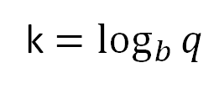



Constructing Trapdoor [Micciancio-Peikert’12]
k $=\log_{b}{q}$
[
]
1, b, … b^{k-1}
… …
1, b, … b^{k-1}
G
a.k.a.
“Power-of-b” matrix
Gadget =
Property: ``easy’’ to solve for short y : Gy = t
A
C_{A}
G
=
Problem: x $≈$ D_{A}
Given C_{A} one can solve ISIS for A,t: Find short y: Gy = t and then x = C_{A}y as Ax = AC_{A}y = t

Slide 22







Constructing Trapdoor [Micciancio-Peikert’12]
Given T_{A} one can solve ISIS for A,t: Find short y: Gy = t and then x = C_{A}y as Ax = AC_{A}y = t
A
C_{A}
G
=
TrapGen() → (A,T_{A})
SolveISIS(T_{A},A,t)→ x
Define A and C_{A} for uniform A’ and ``short’’ T_{A}:
A’
G-A’T_{A}
T_{A}
G
=
I_{nk}
Trapdoor of A: T_{A}

Slide 23











Constructing Approximate Trapdoor (This work)
A
C_{A}
G
=
=
ATrapGen() → (A,S_{A})
Saves nj dimensions!
Replace G by F_{j}:
[
]
A’
F_{j}-A’S_{A}
S_{A}
F_{j}
=
b^{j}, … b^{k-1}
… …
b^{j}, … b^{k-1}
=
I_{n(k-j)}
Approx Trapdoor of A: S_{A}

Slide 24











Using Approximate Trapdoor
y₁
G
$$≡$$
N
F_{j}
N
F_{j}
t
=
y₂
short
Solve Approx-ISIS for A,t using S_{A}
Gy $≡$ Ny₁ + F_{j}y₂ = t $⇒$ F_{j}y₂ = t - Ny₁ ;
find y₂ then x := D_{A}y₂ as Ax = F_{j}y₂= t - Ny₁
$≈$ t
S_{A}
Easy to solve
D_{A} =
I_{n(k-j)}
x is the approx-ISIS solution!
ASolveISIS(S_{A},A,t)→ x
Notes:
Improve, not very clear.

Slide 25
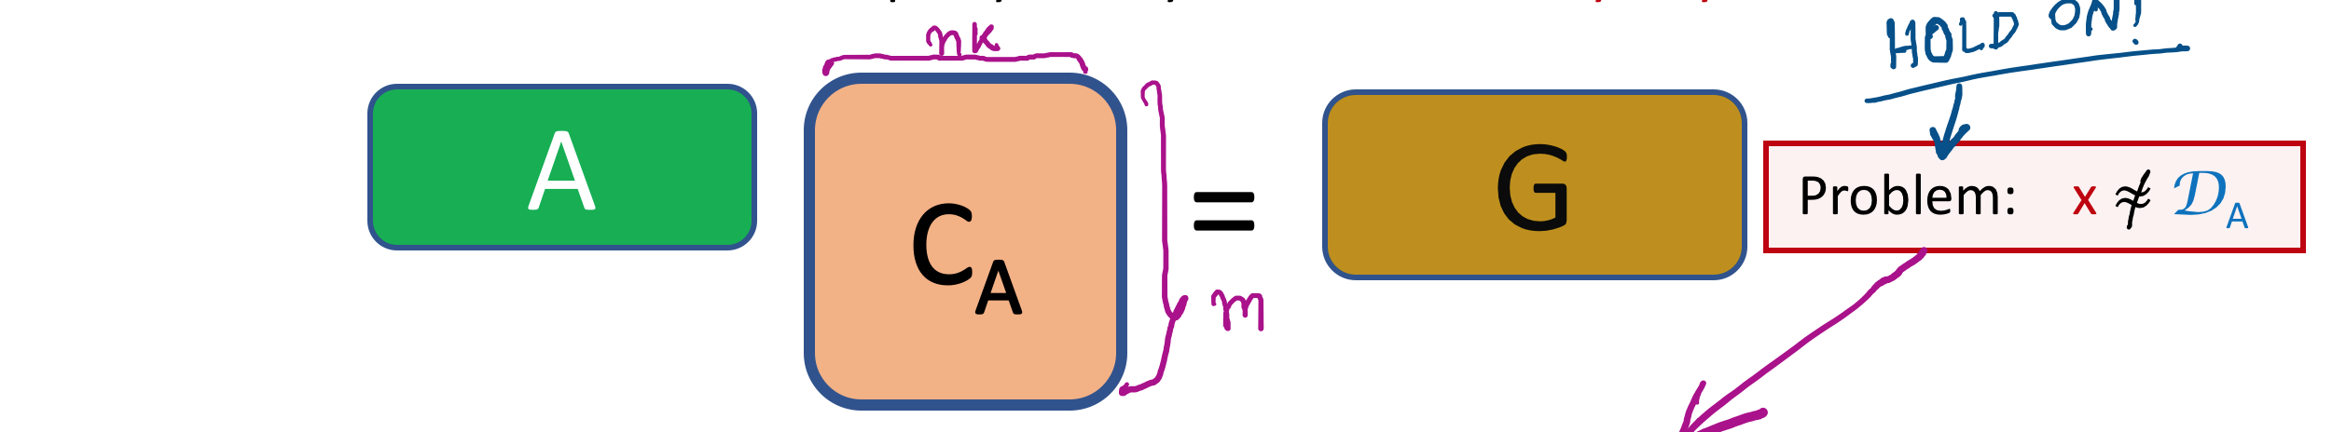
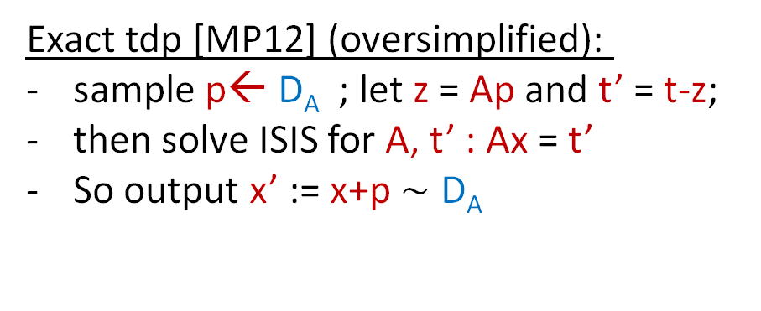


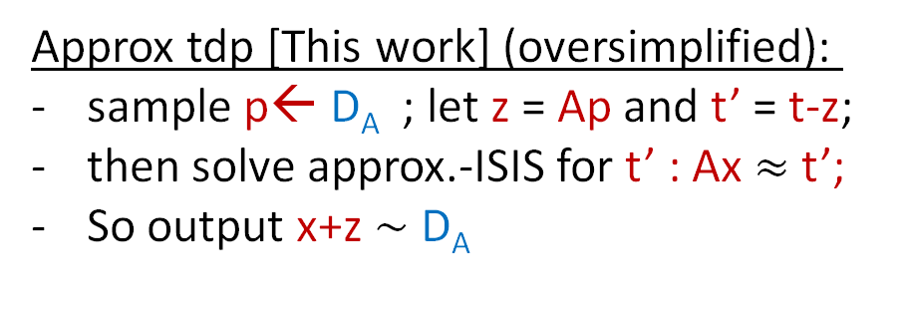
Fixing the distribution (briefly)
Given C_{A} one can solve ISIS for A,t: Find short y: Gy = t and then x = C_{A}y as Ax = AC_{A}y = t
Caveat: Our new analysis works only for uniform t (ok for signatures)
Exact tdp [MP12] (oversimplified):
sample p← D_{A} ; let z = Ap and t’ = t-z;
then solve ISIS for A, t’ : Ax = t’
So output x’ := x+p $∼$ D_{A}
Approx tdp [This work] (oversimplified):
sample p← D_{A} ; let z = Ap and t’ = t-z;
then solve approx.-ISIS for t’ : Ax $≈$ t’;
So output x+z $∼$ D_{A}
(Ax’ = Ax + Ap = t’ + z = t)
More Care to handle the distribution of e$∼$ D’_{A}

Slide 26
Performance
 | Exact | Approx | Exact | Approx | Exact | Approx | Exact | Approx
n | 512 |  | 512 |  | 1024 |  | 1024
log₂ q | 24 |  | 16 |  | 18 |  | 18
b | 2 |  | 4 |  | 4 |  | 8
k/j | 24/0 |  | 8/0 |  | 9/0 |  | 6/0
|PK| (kB) | 37.50 |  | 9.00 |  | 22.50 |  | 15.75
|Sig| (kB) | 25.68 |  | 7.62 |  | 18.74 |  | 13.70
LWE | 100.0 |  | 104.7 |  | 192.7 |  | 192.7
ApproxISIS | 80.2 |  | 82.8 |  | 175.8 |  | 165.3

Slide 27
Performance
 | Exact | Approx | Exact | Approx | Exact | Approx | Exact | Approx
n | 512 | 512 | 512 | 512 | 1024 | 1024 | 1024 | 1024
log₂ q | 24 | 24 | 16 | 16 | 18 | 18 | 18 | 18
b | 2 | 2 | 4 | 4 | 4 | 4 | 8 | 8
k/j | 24/0 | 24/15 | 8/0 | 8/4 | 9/0 | 9/5 | 6/0 | 6/3
|PK| (kB) | 37.50 | 15.00 | 9.00 | 5.00 | 22.50 | 11.25 | 15.75 | 9.00
|Sig| (kB) | 25.68 | 10.51 | 7.62 | 4.45 | 18.74 | 9.38 | 13.70 | 8.36
LWE | 100.0 | 100.0 | 104.7 | 104.7 | 192.7 | 192.7 | 192.7 | 192.7
ApproxISIS | 80.2 | 81.1 | 82.8 | 87.8 | 175.8 | 183.7 | 165.3 | 174.9

Slide 28
Summary
We show a simple technique of using Approximate Trapdoors to improve efficiency of primitives based on Lattice trapdoors.
As our main application we improve the efficiency of GPV hash-and-sign signature.
Open:
  Improve analysis to support arbitrary t : application to ABE, Multilinear Maps.
  Generalize our technique beyond Gadget Trapdoors.
  Approx Trapdoor for NTRU: will improve FALCON.
  Combine our optimization technique with other to improve GPV sig further.

Slide 29
“All exact science is dominated by the idea of Approximation”
– Bertrand Russell
Thank you!
https://eprint.iacr.org/2019/1029.pdf

Slide 30
Approx ISIS is as hard as ISIS (This work)
x
Reduction:
M
A’
t
= mod q
Given:
,
M is invertible w.h.p. (since A is random)
A
t
Give Approx-ISIS oracle A’’, t’
A’’
x₂
t’
x₁
= - mod q
Obtain back x₂
Output
x₁ can be computed from
A’’ = M⁻¹A’, t’ = M⁻¹t

Slide 31
Approximation using HNF [Micciancio-Regev’09]
x
A
t
Trapdoor of A: T_{A}
= mod q
M is invertible w.h.p. (since A is random)
x
M
A’
t
= mod q

Slide 32
Approximation using HNF [Micciancio-Regev’09]
x
A
t
Trapdoor of A: T_{A}
= mod q
M is invertible w.h.p. (since A is random)
x
I_{n}
A’
t
= mod q
Without loss of generality

Slide 33


Approximation using HNF [Micciancio-Regev’09]
x₁
Trapdoor of A: T_{A}
I_{n}
A’
t
x₂
= mod q
T_{A} = S_{A’}
Approx Trapdoor of A’: S_{A’}
A’
x₂
t
x₁
= - mod q
This saves n dimensions; can we save more?

Slide 34




Constructing Trapdoor [Micciancio-Peikert’12]
Given T_{A} one can solve ISIS for A: Find y: G_{k}y = t and then x = C_{A}y as Ax = AC_{A}y = t
G_{k-j}
2^{j}.
=
[
]
=
b^{j}, … b^{k-1}
… …
b^{j}, … b^{k-1}

Slide 35
Constructing Trapdoor [Micciancio-Peikert’12]
Given S_{A} one can solve ISIS for A: Find y: G_{k}y = t and then x = C_{A}y as Ax = AC_{A}y = t
A
C_{A}
G_{k}
=
=
Saves another nj dimensions, but there is a trade-off!
G_{k-j}
2^{j}.
Replace G_{k} by F_{k,j}:
=
[
]
A’
F_{k,j}-A’S_{A}
S_{A}
F_{k,j}
=
b^{j}, … b^{k-1}
… …
b^{j}, … b^{k-1}
=
I_{n(k-j)}
Approx Trapdoor of A: S_{A}

Slide 36
A’
G-A’R_{A}
R_{A}
G
=
I_{nk}
A’
G-A’R_{A}
S_{A}
F
=
I_{nk’}
Storing G-Trapdoor R_{A} suffices!
Define A = [A’ | G – A’R_{A}] for uniform A’ and ``short’’ R_{A}

Slide 37

Using Approximate Trapdoor
S_{A}
G
$$≡$$
N
F_{j}
D_{A} =
I_{n(k-j)}
Easy to solve
short
Gy = Ny₁ + F_{j}y₂ = t $⇒$ F_{j}y₂ = t - Ny₁ ;
find y₂ then x := D_{A}y₂ as Ax = F_{j}y₂= t - Ny₁
x is the approx-ISIS solution!
F_{j}
=
=
G’
b^{j}.
Notes:
Improve, not very clear.

