Slide 1
Reusable Two-Round MPC from DDH
James Bartusek (UC Berkeley)
Sanjam Garg (UC Berkeley)
Daniel Masny (Visa Research)
Pratyay Mukherjee (Visa Research)

Slide 2
Reusable computation on private data
w
x₁
y
z
w
x₂
y
z
w
x₃
y
z
Main challenge:
Unbounded number (poly) of computations
P₁
P₂
P₃
Compute: y = F(x₁,x₂,x₃)
Msg²(H)
Msg²(F)
Msg²(G)
Msg³(H)
Msg³(F)
Msg¹(H)
Msg³(G)
Msg¹(F)
Msg¹(G)
Compute: z = G(x₁,x₂,x₃)
[x₁]
[x₂]
[x₃]
Compute: w = H(x₁,x₂,x₃)
Requirements:
The output must be correct.
The computation does not leak anything but the outputs
The second round must be reusable across computations
A Solution: Reusable 2-round Multiparty Computation

Slide 3












Feasibility of 2-round MPC: past and present
Reusable?
[GGHR’14]: Indistinguishability Obfuscation
[MW’16,PS’16,BP’16]: LWE (Multi-key FHE)
[GS’17]: Bilinear Pairing (Garbled Circuits)
[GS’18,BL’18]: DDH (OT + Garbled Circuits)
Requires CRS even against semi-honest
Our Result:
Reusable MPC from DDH
Concurrent and Independent Work:
- [BL’20]: Reusable MPC from Bilinear Pairing
- [AJJ’20]: Reusable MPC from LWE in the plain model against semi-honest adv

Slide 4

Our Result: Reusable 2-round MPC from DDH
DDH
Main Theorem:
2-round X-MPC protocol + HSS + PRF in NC¹ → Reusable 2-round X –MPC
X ∈ {semi-honest in plain model, malicious in common random/reference string}
- Our corruption model is static: adv decides whom to corrupt in the beginning
- We support maximal (upto n-1) corruption
- We necessarily assume broadcast channels

Slide 5
Our Approach: 3 steps
Step-1: Homomorphic Secret Sharing (HSS) +PRF(NC₁) + Garbled Protocols[GS’18] → Sharing Compact HSS (ScHSS)
Step-2: ScHSS + 2-round MPC + Garbled Circuits (GC) → First-message Succinct (FMS) MPC
Step-3: First-message Succinct (FMS) MPC + PRG-PRF[GGM’84] + GC →
Reusable 2-round MPC

Slide 6






Recall Basic ingredients: OT and GC
Oblivious Transfer (OT):
OT₁
M₀,M₁
S
R
b $∈ \{0,1\}$
OT₂
M_{b}
No knowledge of b
No knowledge of M_{1-b}
Garbled Circuits (GC):
GC(C)
C(.)
G
E
x$∈ \{0,1\}$
Eval(GC(C),lab_{x}) = C(x)
lab₀,lab₁
OT
lab_{x}
No knowledge of x
No knowledge of C except C(x)

Slide 7
Recall Garbled Protocols[GS’18]: 2-round MPC
Template
Idea: Take any MPC protocol and squish it to 2 rounds
First round: each pair of parties exchanges a set of OT₁ messages (setup correlations)
Second round: each party releases a sequence of garbled circuits
Finalize: Each party locally evaluates the GCs (Garbled Protocols)
Why not (unboundedly) reusable?
Number of OT₁ messages exchanged in first round scales with the computation
Second round consumes all the OT messages
Can we setup the Round-1 correlations to generate unbounded number of pair-wise OT correlations as required?

Slide 8
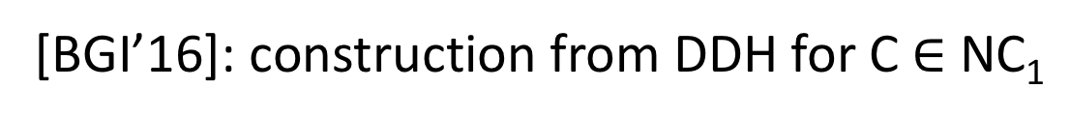

Tool: Homomorphic Secret Sharing [BGI’16]
P₁
(C, S₀)
EVAL
Y₀
S₀
X
D
Y₀$⊕$ Y₁ = Y = C(x)
Compute C(x)
Next: Use HSS to generate OT correlations
SHARE
S₁
P₂
(C, S₁)
EVAL
Y₁
S₀,S₁
[BGI’16]: construction from DDH for C $∈$NC₁
(where correctness holds except 1/poly probability)

Slide 9



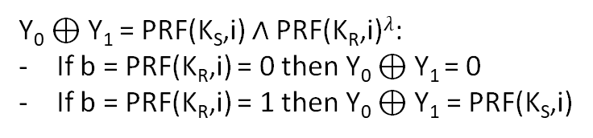


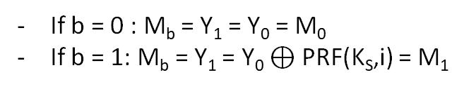





OT correlations using HSS [BCGIKS’19]
(random) OT Correlations
S
R
PRF(K_{S},.) $∈{\left\{0,1\right\}}^{λ}$
PRF(K_{R},.) $∈{\left\{0,1\right\}}^{}$
[NR’97]
random
(M₀,M₁)
(b,M_{b})
P₁
(C, S₀)
EVAL
Y₀
K_{S},
S₀
M₀:= Y₀
M₁:= Y₀$⊕$ PRF (K_{S},i)
K_{S},K_{R}
D
Compute PRF(K_{S},i) $∧$PRF(K_{R},i)$λ$
SHARE
K_{R},
S₁
P₂
(C, S₁)
EVAL
Y₁
M_{b}:= Y₁
b:=PRF (K_{R},i)
Towards Reusability:
Possible to generate many OT correlations
S₀,S₁
Y₀ $⊕$ Y₁ = PRF(K_{S},i) $∧$PRF(K_{R},i)$λ$:
If b = PRF(K_{R},i) = 0 then Y₀ $⊕$Y₁ = 0
If b = PRF(K_{R},i) = 1 then Y₀ $⊕$ Y₁ = PRF(K_{S},i)
If b = 0 : M_{b} = Y₁ = Y₀ = M₀
If b = 1: M_{b} = Y₁ = Y₀ $⊕$ PRF(K_{S},i) = M₁

Slide 10

OT correlations+ GS18 → ScHSS
(random) OT Correlations
S
R
P₀
OT_{S}
OT_{R}
P₁
OT_{S}
OT’_{R}
X₁
d_{S}
d’_{R}
D
Reconstruction runs Finalize of [GS18]:
Garbled Protocol
X
Compute C(x)
Second Round of [GS18]*
X₂
d_{R}
d’_{S}
P₂
OT_{R}
OT’_{S}
Multi-party Sharing Compact HSS
P₃
The Dealer’s messages are independent of C
C is in P/poly
Not Reusable due to 1/poly error of HSS**
*requires slightly more structured correlations
**negl error by $λ$ virtual parties per party

Slide 11





Multiparty ScHSS
Challenge remains:
Remove Dealer (Step-2)
Make Round-2 Reusable (Step-3)
P₀
(C, S₀)
EVAL
Y₀
Compact S_{i} (indep of C)
S₀
P₁
(C, S₁)
EVAL
Y₁
Non-linear
S₁
X
D
Compute C(x)
(Y₁….Y_{n})
RECON
Y
S₂
P₂
SHARE
(C, S₂)
EVAL
Y₂
S₃
HSS [BGI’16]:
2-party
Linear Recon
S_{i} indep of C
P₃
(C, S₃)
EVAL
Y₃
S₀,S₁,….,S_{n}

Slide 12
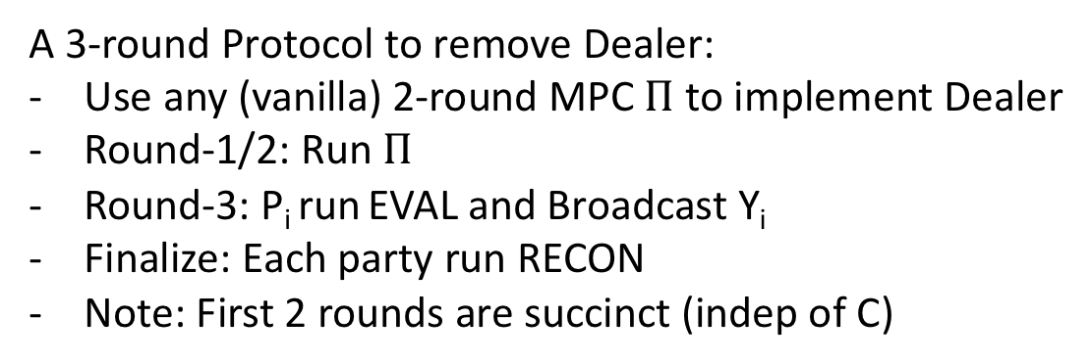
Step-2: ScHSS → First Message Succinct-MPC
A 3-round Protocol to remove Dealer:
Use any (vanilla) 2-round MPC $Π$ to implement Dealer
Round-1/2: Run $Π$
Round-3: P_{i} run EVAL and Broadcast Y_{i}
Finalize: Each party run RECON
Note: First 2 rounds are succinct (indep of C)
Use GC to make it 2-round

Slide 13


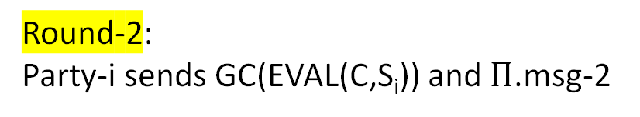


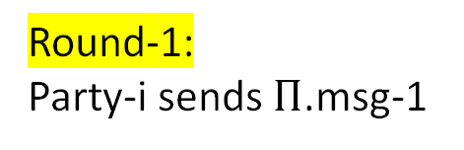
2-Round FMS-MPC using GC
Independent of C (FMS)
A 2-round protocol
Round-1:
Party-i sends $Π$.msg-1
Round-2:
Party-i sends GC(EVAL(C,S_{i})) and $Π$.msg-2
Finalize:
Party-i obtains
  labels lab_{s1}…. lab_{sn}
  GC(EVAL(C,s₁)), ….GC(EVAL(C,s_{n}))
Run GC with the labels to get y_{1…}y_{n}
RECON(y_{1…}y_{n}) → y
DLAB(x₁,…x_{n}):
Compute (s₁,….s_{n})← SHARE(x₁…||….x_{n})
Output labels lab_{s1}…. lab_{sn}
The vanilla 2-round MPC $Π$ will compute DLAB

Slide 14
First Message Succinct-MPC
x₁
y
x₂
y
x₃
y
P₁
P₂
P₃
Compute: y = C(x₁,x₂,x₃)
Round-2
Round-1
Finalize
Msg²(C)
Msg¹(C)
Msg³(C)
[x₁]
[x₂]
[x₃]
Final Challenge
Make it reusable (Step-3)

Slide 15
Step-3: FMS-MPC → Reusable MPC
FMS-MPC is an expanding object, like a Pseudorandom Generator
Reusable MPC is an exponentially expanding object, like a Pseudorandom Function.
Key-idea: adapt [GGM84] PRG → PRF to FMS-MPC→ Reusable MPC

Slide 16



Recall: GGM-tree [GGM’84]
y= PRF(r,x)
(r₀,r₁)←PRG(r)
X = 010…
PRG(r)
r₀
r₁
PRG(r₀)
PRG(r₁)
Key Idea:
For each circuit C use a unique instance of FMS-MPC
use GGM-tree implicitly to compute the unique randomness PRF(r,C)→r_{C}
r₀₀
r₀₁
r₁₀
r₁₁
PRG(r₀₀)
PRG(r₀₁)
PRG(r₁₀)
PRG(r₁₁)
PRG(r_{000..0})
PRG(r_{11..1})
y

Slide 17
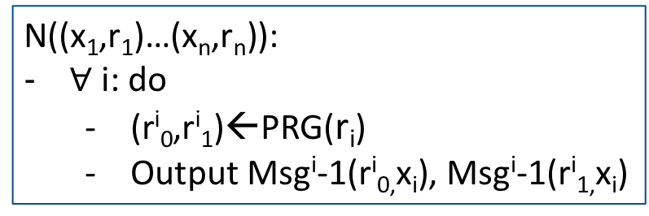
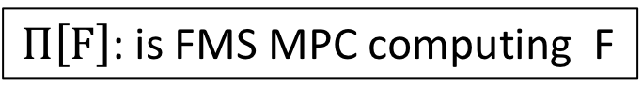
A multi-round protocol
$Π\left[F\right]$: is FMS MPC computing F
N((x₁,r₁)…(x_{n},r_{n})):
$∀$ i: do
  (r^{i}₀,r^{i}₁)←PRG(r_{i})
  Output Msg^{i}-1(r^{i}_{0,}x_{i}), Msg^{i}-1(r^{i}_{1,}x_{i})

Slide 18

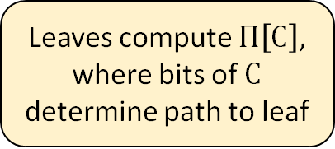










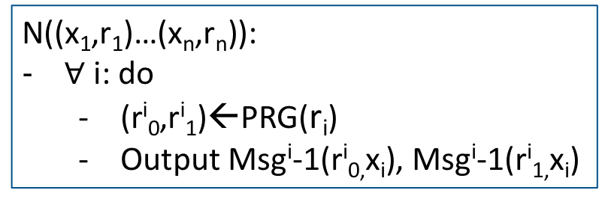





A multi-round protocol
1st round: 1st round of ${Π\left[N\right]}^{()}$
$Π\left[F\right]$: is FMS MPC computing F
C = 010…
$${Π\left[N\right]}^{()}$$
After 1st Round: C known
2nd round: 2nd round of ${Π\left[N\right]}^{()}$
After 2nd Round:
Msg^{i}-1(r_{0,}x_{i}), Msg^{i}-1(r_{1,}x_{i}) known
$${Π\left[N\right]}^{\left(0\right)}$$
$${Π\left[N\right]}^{\left(1\right)}$$
N((x₁,r₁)…(x_{n},r_{n})):
$∀$ i: do
  (r^{i}₀,r^{i}₁)←PRG(r_{i})
  Output Msg^{i}-1(r^{i}_{0,}x_{i}), Msg^{i}-1(r^{i}_{1,}x_{i})
3rd round: 2nd round of ${Π\left[N\right]}^{\left(0\right)}$
$${Π\left[N\right]}^{\left(00\right)}$$
$${Π\left[N\right]}^{\left(01\right)}$$
$${Π\left[N\right]}^{\left(10\right)}$$
$${Π\left[N\right]}^{\left(11\right)}$$
Before final Round:
Msg^{i}-1(r_{C,}x_{i})
Leaves compute $Π\left[C\right]$, where bits of $C$ determine path to leaf
$$Π\left[0…0\right]$$
$$Π\left[C\right]$$
$$Π\left[1…1\right]$$
Final round: 2nd round of $Π\left[C\right]$
Possible due to FMSness

Slide 19
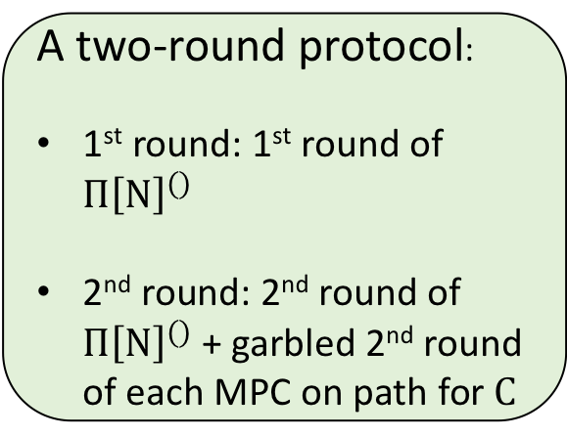
Two round protocol using Garbled Circuits
1st round: 1st round of ${Π\left[N\right]}^{()}$
$Π\left[F\right]$: is FMS MPC computing F
C = 010…
$${Π\left[N\right]}^{()}$$
2nd round: 2nd round of ${Π\left[N\right]}^{()}$
A two-round protocol:
1st round: 1st round of ${Π\left[N\right]}^{()}$
2nd round: 2nd round of ${Π\left[N\right]}^{()}$+ garbled 2nd round of each MPC on path for $C$
$${Π\left[N\right]}^{\left(0\right)}$$
$${Π\left[N\right]}^{\left(1\right)}$$
N((x₁,r₁)…(x_{n},r_{n})):
$∀$ i: do
  (r^{i}₀,r^{i}₁)←PRG(r_{i})
  Output Msg^{i}-1(r^{i}_{0,}x_{i}), Msg^{i}-1(r^{i}_{1,}x_{i})
3rd round: 2nd round of ${Π\left[N\right]}^{\left(0\right)}$
$${Π\left[N\right]}^{\left(00\right)}$$
$${Π\left[N\right]}^{\left(01\right)}$$
$${Π\left[N\right]}^{\left(10\right)}$$
$${Π\left[N\right]}^{\left(11\right)}$$
Leaves compute $Π\left[C\right]$, where bits of $C$ determine path to leaf
$$Π\left[0…0\right]$$
$$Π\left[C\right]$$
$$Π\left[1…1\right]$$
Final round: 2nd round of $Π\left[C\right]$
Possible due to FMSness

Slide 20
Summary
Reusable MPC is possible without Obfuscation or lattices!
Main tools used: HSS, PRF in NC₁, 2-round MPC – all instantiated from DDH.
Future directions:
  Minimal assumptions for Reusable MPC
  Adaptive corruption
“Uncommon thinkers reuse what common thinkers refuse”
– J.R.D. Tata
Thank You!

