Slide 1

Exploring the power of Threshold BLS
Pratyay Mukherjee
MPTS 2023: NIST Workshop on Multi-Party Threshold Schemes 2023
Sep 26, 2023

Slide 2
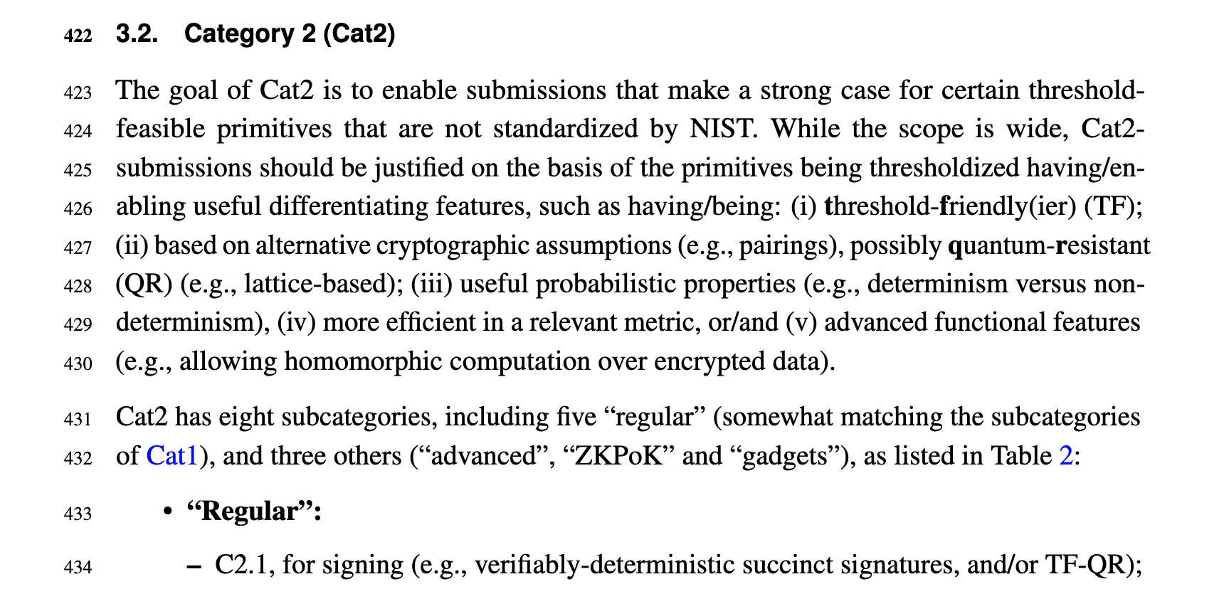

Slide 3
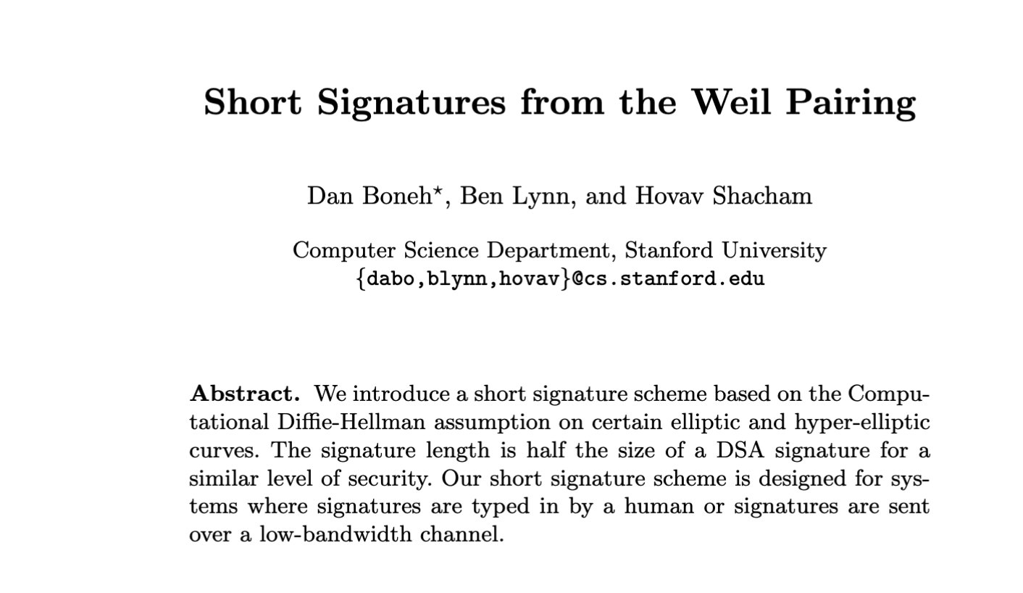
BLS (Asiacrypt’01, JoC’04)

Slide 4
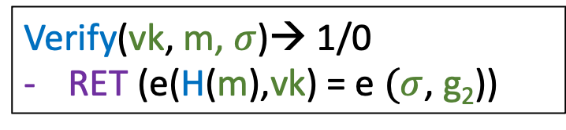
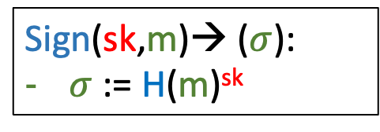
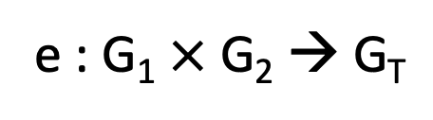
Recall: BLS Signature
Pairing(bilinear map)
e : G₁ $×$ G₂ → G_{T}
: e(g₁ª,g₂^{b}) = e(g₁^{b},g₂ª) = e(g₁,g₂)^{ab}
H : MSG → G₁ (Random Oracle)
KGen→ (sk, vk):
sk ←$ Z_{p}
vk := g₂^{sk}
Sign(sk,m)→ ($σ$):
$σ$ := H(m)^{sk}
Verify(vk, m, $σ$)→ 1/0
RET (e(H(m),vk) = e $(σ$, g₂))

Slide 5



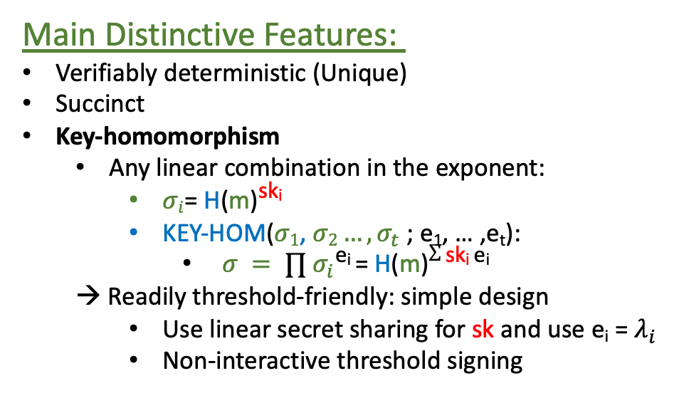


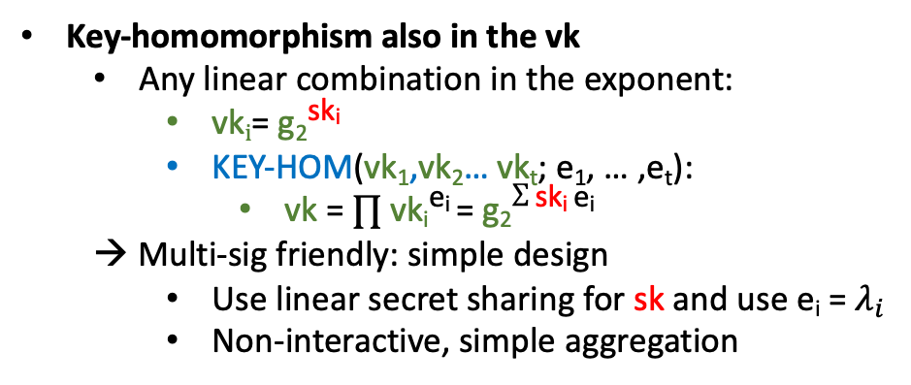
Recall: BLS Signature
Recall
Main Distinctive Features:
Verifiably deterministic (Unique)
Succinct
Key-homomorphism
  Any linear combination in the exponent:
    $σi$= H(m)^{ski}
    KEY-HOM($σ1$, $σ2…, σ_{t}$ ; e₁, … ,e_{t}):
      $σ = ∏$ $σ_{i}$^{ei} = H(m)$∑$ ^{ski ei}
  → Readily threshold-friendly: simple design
    Use linear secret sharing for sk and use e_{i} = $λ_{i}$
    Non-interactive threshold signing
Key-homomorphism also in the vk
  Any linear combination in the exponent:
    vk$i$= g₂^{ski}
    KEY-HOM($\text{vk}\text{1}$,vk₂… vk_{t}; e₁, … ,e_{t}):
      vk = $∏$ vk_{i}^{ei} = g₂$∑$ ^{ski ei}
  → Multi-sig friendly: simple design
    Use linear secret sharing for sk and use e_{i} = $λ_{i}$
    Non-interactive, simple aggregation
Cons:
Needs Bilinear Pairing
Verification more expensive: Pairing
Not PQ-secure

Slide 6
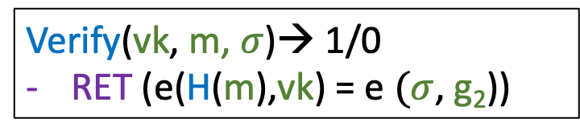
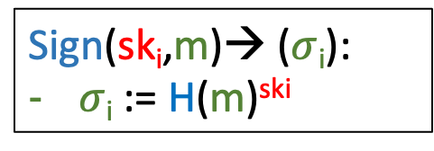
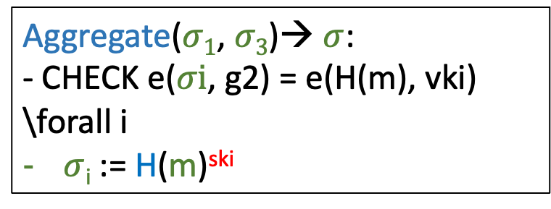
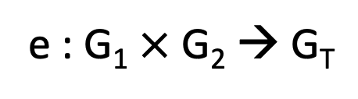
Recall: Threshold BLS
Pairing(bilinear map)
e : G₁ $×$ G₂ → G_{T}
H : MSG → G₁ (Random Oracle)
DKG→ (sk₁, sk_{2,} sk₃ vk₁, vk₂ , vk_{3,} vk):
sk ←$ Z_{p}
(sk₁, sk_{2,} sk₃)← Shamir(sk)
vk := g₁^{sk}
vk₁ := g₁^{ski} vk₂ := g₁^{sk2} vk₃ := g₁^{sk3}
Verify(vk, m, $σ$)→ 1/0
RET (e(H(m),vk) = e $(σ$, g₂))
\forall i:
Aggregate($σ1$, $σ3$)→ $σ$:
- CHECK e($σi$, g2) = e(H(m), vki) \forall i
$σ$_{i} := H(m)^{ski}
Sign(sk_{i},m)→ ($σ$_{i}):
$σ$_{i} := H(m)^{ski}

Slide 7
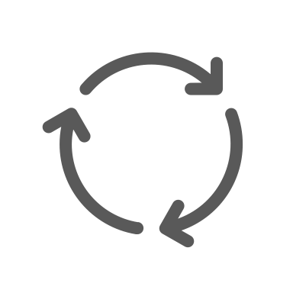

Recall: Threshold BLS
(Example: N = 3, T = 2)
Dist-Kgen (same as Schnorr/ECDSA)
sk₁
sk₂
vk
vk₁
vk₂
vk₃
sk₃

Slide 8
Recall: Threshold BLS
(Example: N = 3, T = 2)
Dist-Kgen (similar to Schnorr/ECDSA)

Slide 9
Recall: Threshold BLS
(Example: N = 3, T = 2)
Dist-Kgen (similar to Schnorr/ECDSA)
sk₁
sk₂
vk
(sk₁, sk₂, sk₃)← Shamir_{2,3}(sk)
sk₃

Slide 10
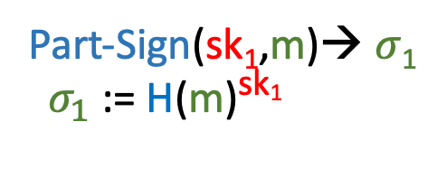
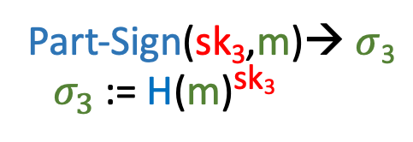
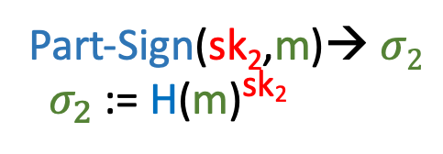
Recall: Threshold BLS
(Example: N = 3, T = 2)
Part-Sign (same as non-threshold BLS)
sk₁
sk₂
Part-Sign(sk₁,m)→ $σ$₁
${ σ}_{1}$ := H(m)^{sk1}
Part-Sign(sk₂,m)→ $σ2$
${ σ}_{2}$ := H(m)^{sk2}
Part-Sign(sk₃,m)→ $σ$₃
${ σ}_{3}$ := H(m)^{sk3}
sk₃

Slide 11
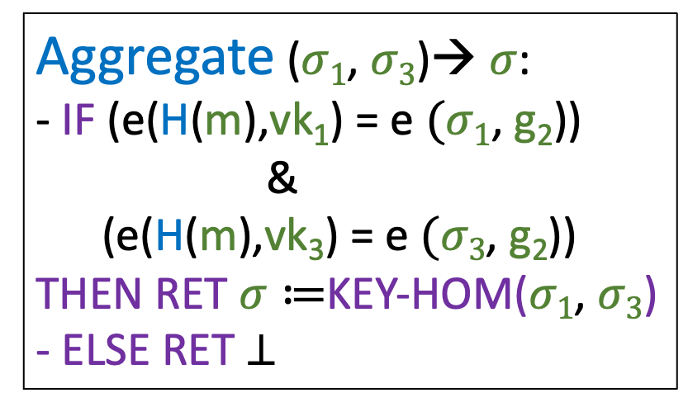

Recall: Threshold BLS
(Example: N = 3, T = 2)
Aggregate ($σ1$, $σ3$)→ $σ$:
- IF (e(H(m),vk₁) = e $(σ1$, g₂))
&
(e(H(m),vk₃) = e $(σ3$, g₂))
THEN RET $σ≔$KEY-HOM($σ1$, $σ3$)
- ELSE RET $⊥$
sk₁
sk₂
vk
vk₁
vk₂
vk₃
Interchangeability – same verification
Verify(vk, m, $σ$)→ 1/0
RET (e(H(m),vk) = e $(σ$, g₂))
sk₃

Slide 12
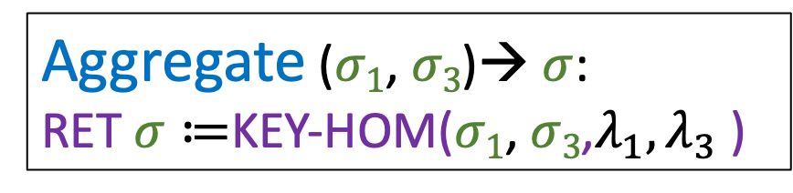
Recall: Threshold BLS
(Example: N = 3, T = 2)
sk₁
sk₂
Aggregate ($σ1$, $σ3$)→ $σ$:
RET $σ≔$KEY-HOM($σ1$, $σ3$,$λ_{1}, λ_{3}$)
vk
Interchangeability – same verification
Verify(vk, m, $σ$)→ 1/0
RET (e(H(m),vk) = e $(σ$, g₂))
sk₃

Slide 13
Threshold BLS: Non-interactive workflow
Dist-Kgen: Interactive, but reusable*
sk₁
sk₂
vk
*Schnorr, ECDSA’s pre-processing NOT reausable
sk₃

Slide 14





Threshold BLS: Non-interactive workflow
Signing
vk
vk₁ vk₂ vk₃
$$σ1$$
$$σ2$$
sk₁
sk₂
Bulletin Board
(Blockchain)
$$σ3$$
sk₃

Slide 15



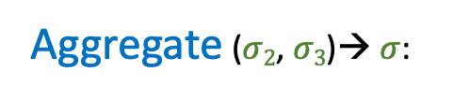
Threshold BLS: Non-interactive workflow
Signing
vk
vk₁ vk₂ vk₃
$$σ1$$
sk₁
sk₂
$σ$₂ $σ$₃
Delayed
Aggregate ($σ2$, $σ3$)→ $σ$:
Bulletin Board
(Blockchain)
Any t signatures suffice – suitable to Blockchain SMR channel
sk₃

Slide 16
Threshold BLS: Non-interactive workflow
Signing
vk
$$σ1$$
$$σ2$$
sk₁
sk₂
Bulletin Board
(Blockchain)
$$σ3$$
sk₃

Slide 17
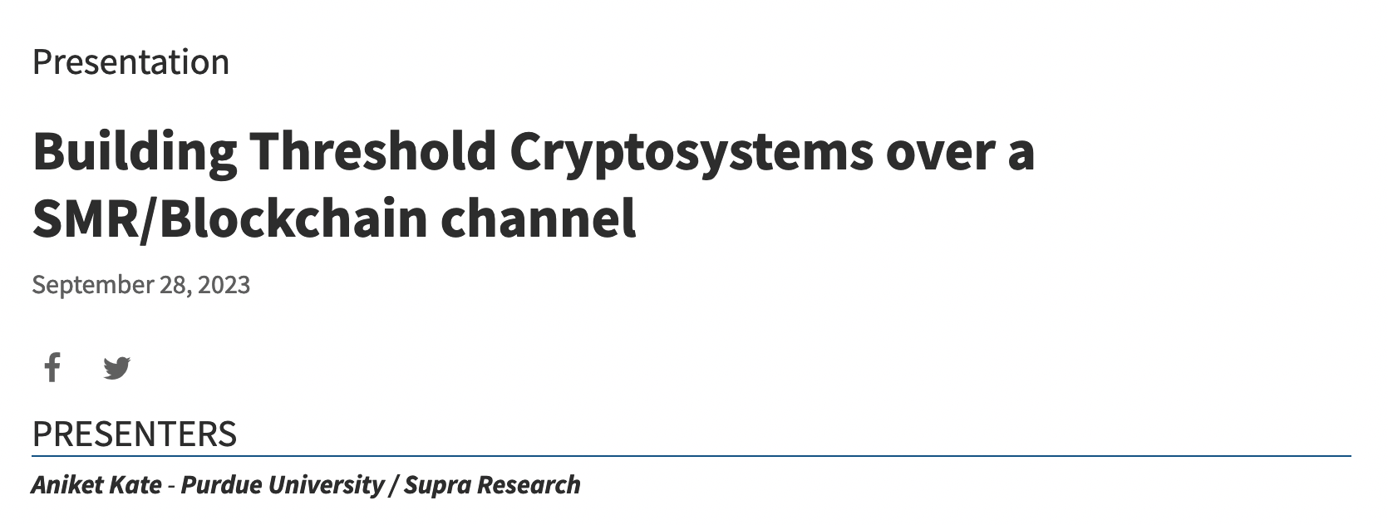
Threshold BLS: Non-interactive workflow
Signing
vk
$$σ1$$
sk₁
sk₂
$σ$₂ $σ$₃
Delayed
Aggregate ($σ2$, $σ3$)→ $σ$:
Bulletin Board
(Blockchain)
Any t signatures suffice – suitable to SMR/Blockchain channel
28th Sept@ MPTS
sk₃

Slide 18
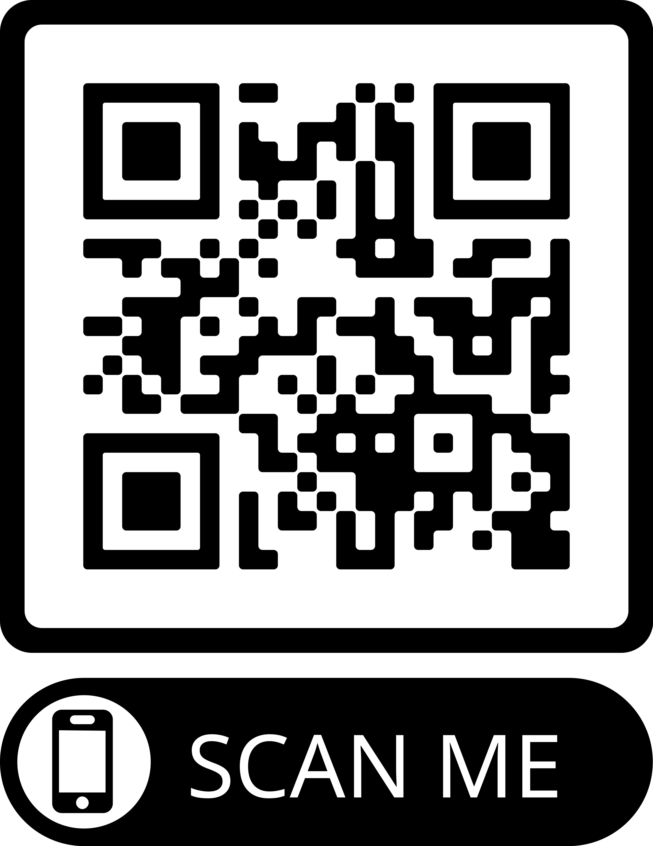
Performance
Signing: 1 exp per singer
Aggregation: 1 t-multi-exp over G₁: O(t/log(t))
Verification: 2 pairing
Signature size: 1 G₁
Ethereum BLS implementation numbers

Slide 19
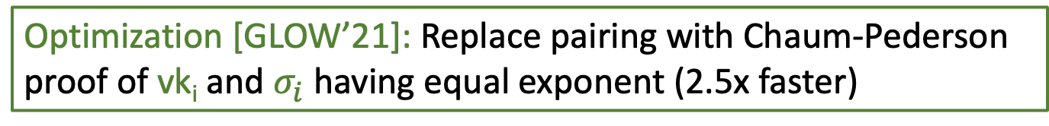
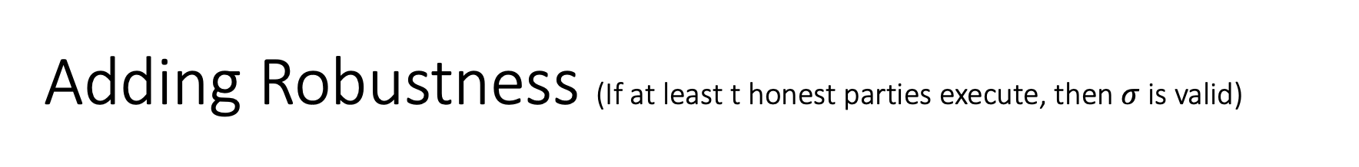
Adding Robustness (If at least t honest parties execute, then $σ$ is valid)
Costly Aggregation: 1 t-multi-exp over G₁: O(t/log(t)) exp + 2n pairing
Aggregate ($σ1$, $σ3$)→ $σ$:
- IF (e(H(m),vk₁) = e $(σ1$, g₂))
&
(e(H(m),vk₃) = e $(σ3$, g₂))
THEN RET $σ≔$KEY-HOM($σ1$, $σ3$)
- ELSE RET $⊥$
sk₁
sk₂
vk
vk₁
vk₂
vk₃
Robustness + honest majority → Guaranteed Output Delivery
Optimization [GLOW’21]: Replace pairing with Chaum-Pederson proof of vk_{i} and $σ_{i}$ having equal exponent (2.5x faster)
sk₃

Slide 20

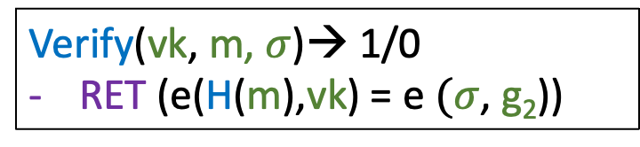
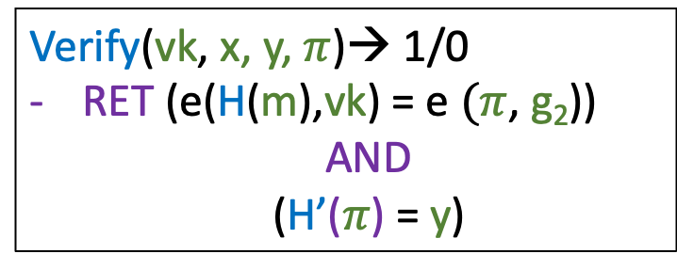

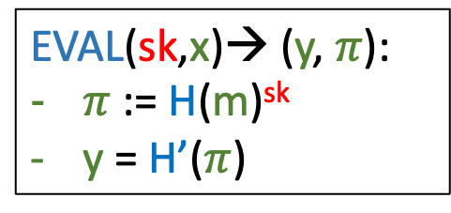
More features: (Distributed) VRF from BLS
Signature
VRF
Sign(sk,m)→ ($σ$):
$σ$ := H(m)^{sk}
EVAL(sk,x)→ (y, $π$):
$π$ := H(m)^{sk}
y = H’($π$)
Verify(vk, m, $σ$)→ 1/0
RET (e(H(m),vk) = e $(σ$, g₂))
Verify(vk, x, y, $π$)→ 1/0
RET (e(H(m),vk) = e $(π$, g₂))
AND
(H’($π$) = y)
Readily distributed using key-homomorphism

Slide 21
Even more…
New results:
  Efficient Weighted (in fact, general access structure) Threshold Signature without DKG (compatibility with SNARK + Key-hom) [GJMSWZ’24, DCXNBR’23]:
  Multiverse Threshold Signatures [BGJMSWZ’23] (Key-hom)
  Adaptive security in AGM [BL’22]

Slide 22


High-level comparison w ECDSA and Schnorr
Verifiably deterministic: only BLS
Fully Non-interactive: only BLS
Most threshold/multi-sig/aggregation friendly: BLS
Most succinct: BLS
  2x smaller
Signing time: Similar (?)
Assumption:
  BLS – pairing; ECDSA – heuristic; Schnorr – Dlog
Verification time:
  BLS about 5x costlier

Slide 23





Adaptation (in blockchain)
Algorand Validation
Dfinity Chain-key
Ethereum 2.0 Validation (Multi-sig)
Hashgraph State-proof
DVRF based on Threshold BLS

Slide 24
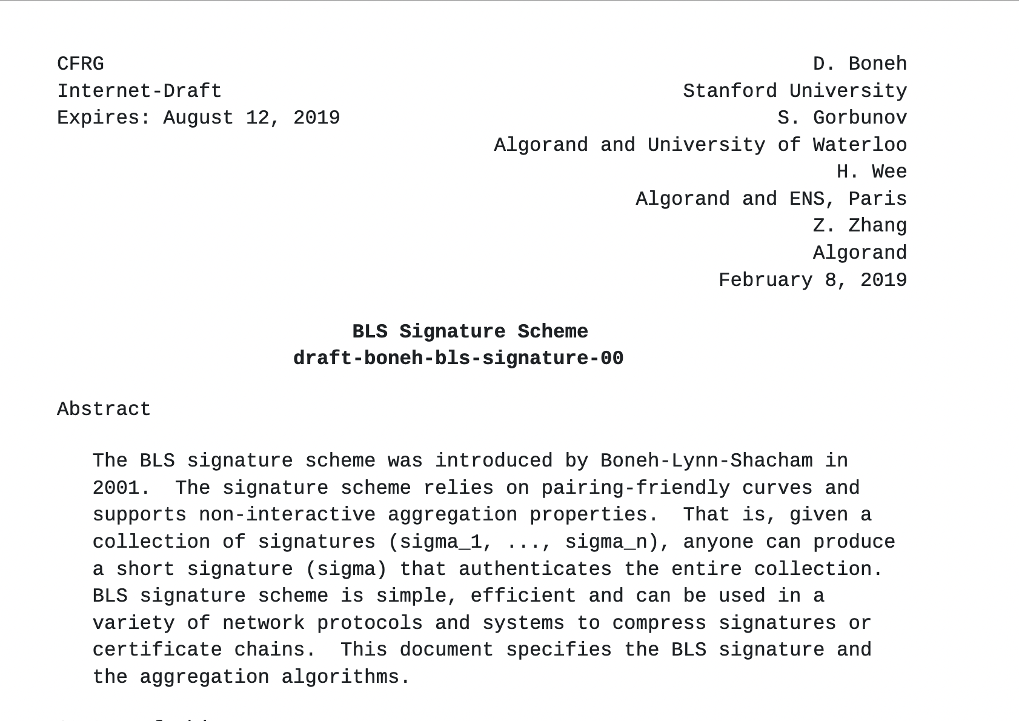
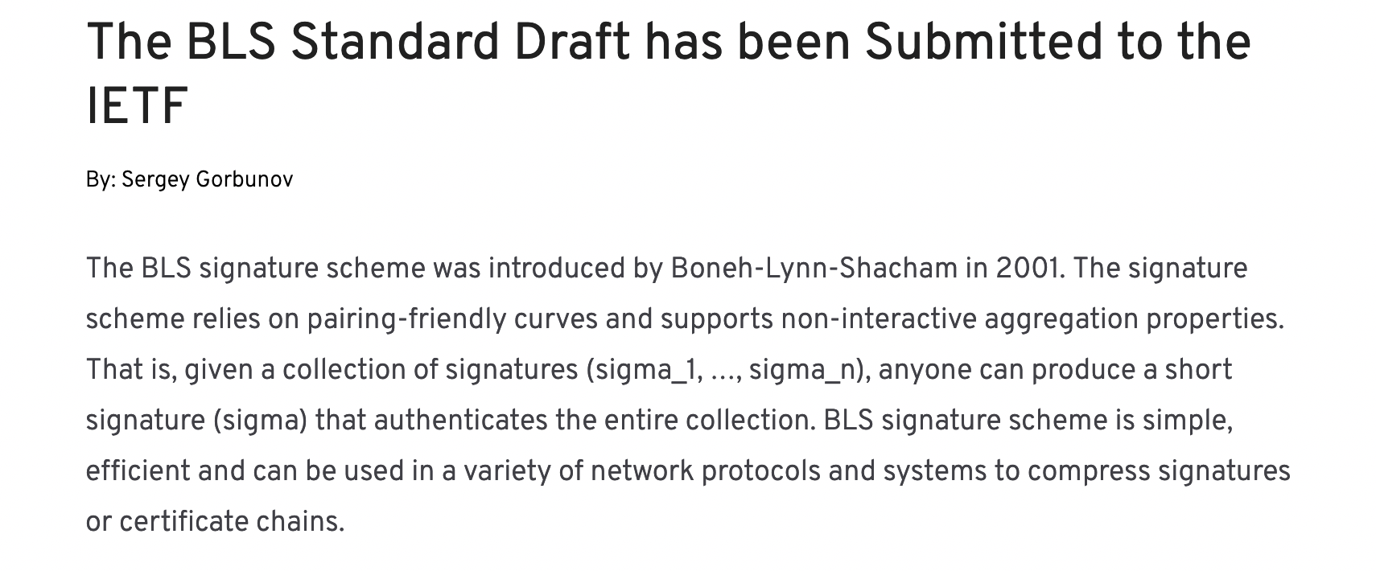
Standardization of (non-threshold) BLS

Slide 25

Summary
Threshold BLS is great! (if ok with bilinear pairing)
  Simple, non-interactive, deterministic, aggregatable….
Active area of research:
  Adaptive security (currently only in AGM + OMDL)
  More efficient robustness
  More efficient verification
  More efficient weighted signatures
A Great Match
Thank You!

