Slide 1

Supra DVRF Service
Pratyay Mukherjee

Slide 2


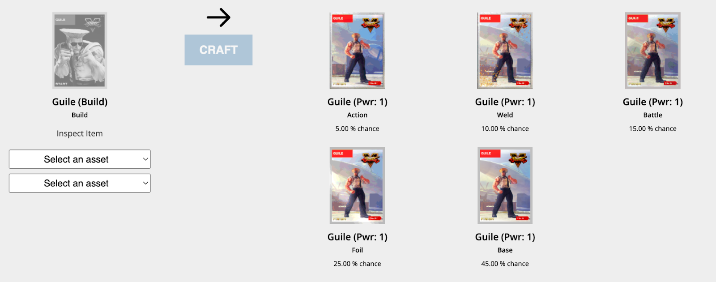

Randomness in Blockchain Games
How do Smart contracts get “good” randomness?
Lottery
NFT Crafting
Lootbox
GET_RND(…)
Notes:
Randomness is an extremely useful resource. With the gigantic rise of blockchain technology, the demand for good source of online randomness has also increased enormously. So the

Slide 3



What is “good” randomness?
Unbiasable
Unpredictable
Publicly Verifiable

Slide 4
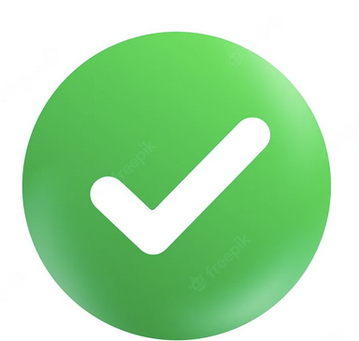

Off-chain Computation and Verifiability
First approach:
Pseudorandom Functions (PRF)
Requirements:
Unbiasble
Unpredictable
Publicly Verifiable
PRF_{sk}(x)
Problem:
Unpredictability relies on the secrecy of sk
How to store sk securely?
A solution: Off-chain computation
Public Verifiability: Given (x, y) and a proof $π$, anyone can verify

Slide 5
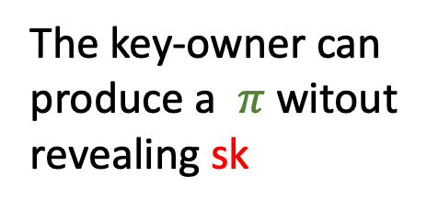
Verifiable random Functions (VRF)
y = F_{sk}(x)
Unbiasability
Unpredictability
Public Verifiability
Hard to predict y on a given x without sk
The key-owner can produce a $π$ witout revealing sk
y can NOT be biased

Slide 6


Single point of Failure
Problem
Only one node holds sk

Slide 7
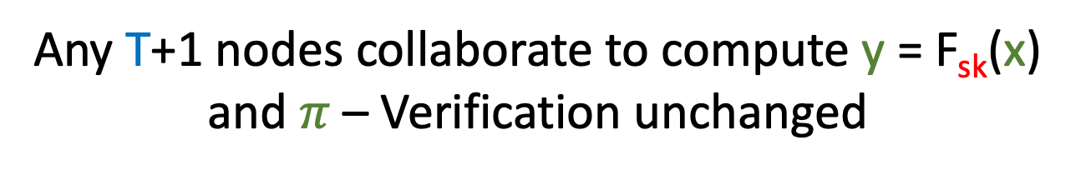
Solution: Distributed VRF (DVRF)
sk is secret shared in T out of N using DKG
Any T+1 nodes collaborate to compute y = F_{sk}(x) and $π$ – Verification unchanged
Up to T malicious corruption

Slide 8
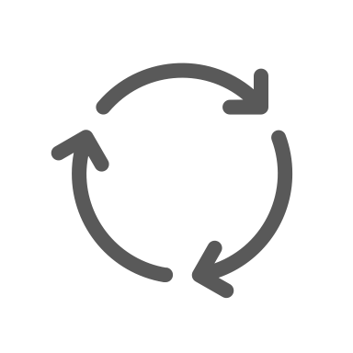

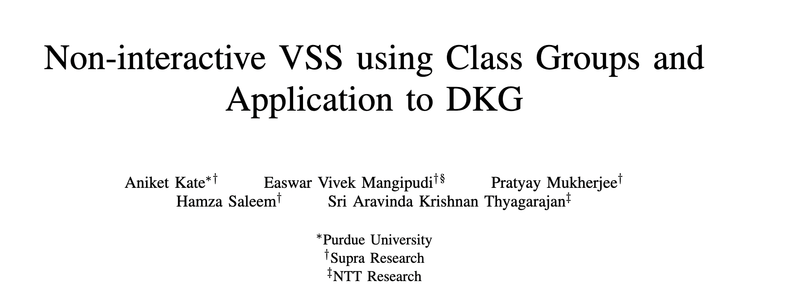
Distributed VRF (DVRF)
Example: N = 3, T = 1
DKG(sk) → (sk₁, sk₂, sk₃) (interactive)
https://eprint.iacr.org/2023/451.pdf
sk₁
sk₂
sk₃

Slide 9

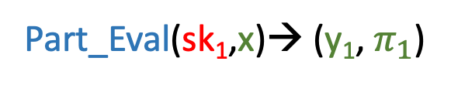
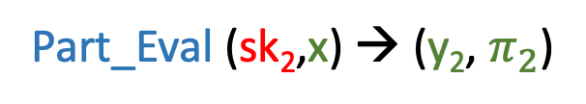
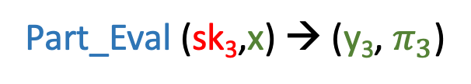
Distributed VRF (DVRF)
Example: N = 3, T = 1
sk₁
sk₂
Part_Eval(sk₁,x)→ (y₁, $π_{1}$)
Part_Eval (sk₂,x) → (y₂, $π_{2}$)
Input: x
Part_Eval (sk₃,x) → (y₃, $π_{3}$)
sk₃

Slide 10
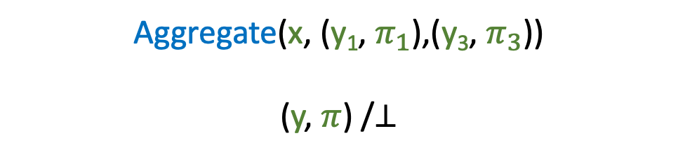
Distributed VRF (DVRF)
Example: N = 3, T = 1
sk₁
sk₂
Part_Eval(sk₁,x)→ (y₁, $π_{1}$)
Part_Eval (sk₂,x) → (y₂, $π_{2}$)
Input: x
Aggregate(x, (y₁, $π_{1}$),(y₃, $π_{3}$))
(y, $π$) /$⊥$
Part_Eval (sk₃,x) → (y₃, $π_{3}$)
sk₃

Slide 11

Distributed VRF (DVRF)
Example: N = 3, T = 1
sk₁
sk₂
Part_Eval(sk₁,x)→ (y₁, $π_{1}$)
Part_Eval (sk₂,x) → (y₂, $π_{2}$)
Input: x
Aggregate(x, (y₁, $π_{1}$),(y₃, $π_{3}$))
(y, $π$) /$⊥$
Part_Eval (sk₃,x) → (y₃, $π_{3}$)
sk₃

Slide 12



DVRF: Additional Requirements
Consistency
Strong Pseudorand
Robustness
Liveness
Participating set does not matter – like Threshold Sig
y pseudorandom even if upto T corruption
If aggregation succeeds, verification must also
Execution must output a correct y

Slide 13

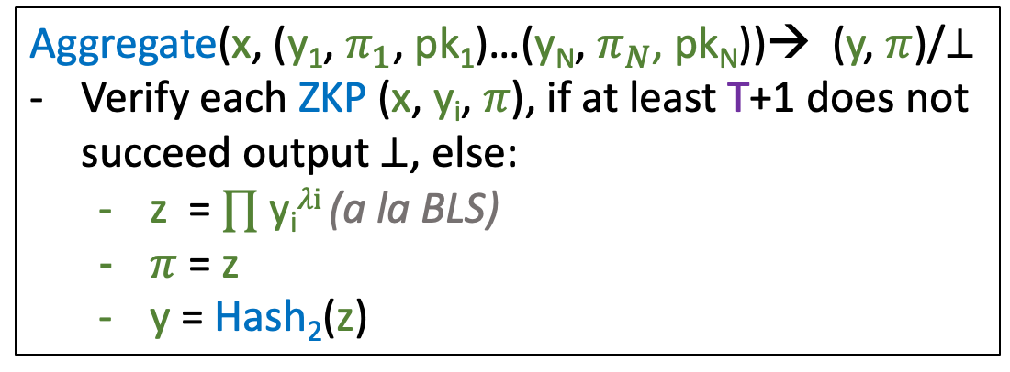
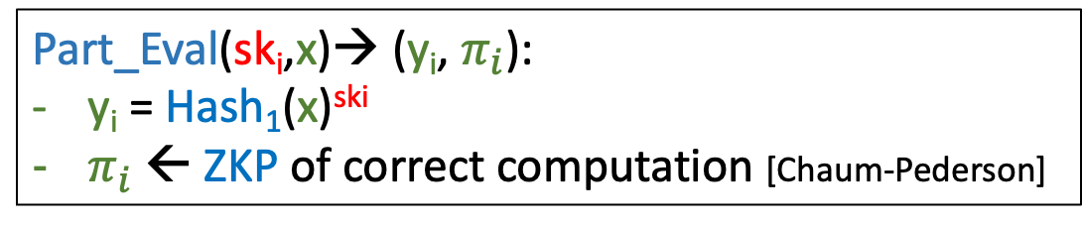
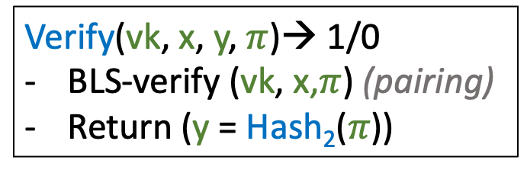
Supra DVRF Construction [GLOW’21]
DKG(N,T, sk)→ ((sk₁ pk₁)…. (sk_{N} pk_{N}), vk)[Our Classgroup-based Protocol]
Part_Eval(sk_{i},x)→ (y_{i}, $π_{i}$):
y_{i} = Hash₁(x)^{ski}
$π_{i}$ ← ZKP of correct computation [Chaum-Pederson]
Verify(vk, x, y, $π$)→ 1/0
BLS-verify (vk, x,$π$) (pairing)
Return (y = Hash₂($π$))
Ensures Strong Pseudorandomness
2.5x faster than pairing
Aggregate(x, (y₁, $π_{1}$, pk₁)…(y_{N}, $π_{N}$, pk_{N}))→ (y, $π$)/$⊥$
Verify each ZKP (x, y_{i}, $π$), if at least T+1 does not succeed output $⊥$, else:
  z = $∏$ y_{i}$λi$ (a la BLS)
  $π$ = z
  y = Hash₂(z)
Ensures Robustness

Slide 14
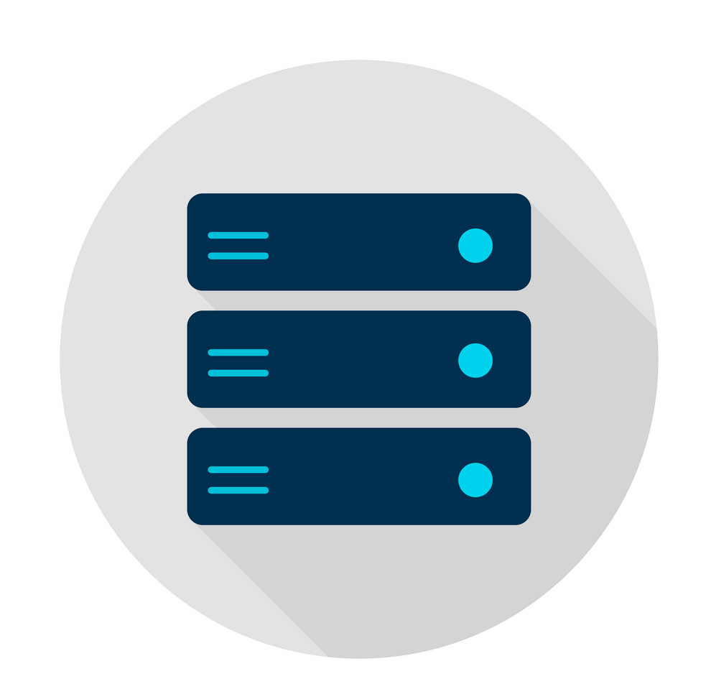
DVRF Service Framework V#1.0
Smart Contract
REQ
Generate INP x
Broadcast INP x
Read INP x
Aggregate y
User
Verify (x,y)
RESP
Relay
Send Output y
Send Part_Eval y_{i}
VRF Committee

Slide 15


DVRF #1.0 vs Randomness Beacon
Smart Contract
REQ
Generate INP x
Broadcast INP x
Read INP x
Aggregate y
User
Verify (x,y)
Read
Relay
Send Output y
Send Part_Eval y_{i}
NO user control
VRF Committee
Synchronization Reqd.

Slide 16
DVRF Service Framework V#1.0
Smart Contract
REQ
Generate INP x
Broadcast INP x
Read INP x
Aggregate y
User
Verify (x,y)
RESP
Relay
Send Output y
Send Part_Eval y_{i}
VRF Committee
INP: x = [user_input, block_hash, unique_nonce, chain_id, user_id, callback_function_name]

Slide 17
Input format (work in progress)
INP: x = [user_input, block_hash, unique_nonce, chain_id, user_id, callback_function_name]
user_input – User chosen arbitrary input
block_hash – Partially unpredictable
unique_nonce – Enforce distinct inputs by Smart -contract
chain_id – Specific to chain
user_id – Specific to user
callback_function_name – Specific to function

Slide 18

DVRF Service Framework V#1.0: An issue
Smart Contract
REQ
Generate INP x
Broadcast INP x
Read INP x
Aggregate y
User
Verify (x,y)
RESP
Relay
Send Output y
Send Part_Eval y_{i}
Output Exposed
VRF Committee
INP: x = [block_hash, unique_nonce, chain_id, user_contract_address, callback_function_name]

Slide 19

DVRF Service Framework V#1.0: An issue
Can not be re-used later: H(y,1), H(y,2)…
Can not be made in advance
Smart Contract
REQ
Generate INP x
Broadcast INP x
Read INP x
Aggregate y
User
Verify (x,y)
RESP
Relay
Send Output y
Send Part_Eval y_{i}
Output Exposed
VRF Committee
INP: x = [block_hash, unique_nonce, chain_id, user_contract_address, callback_function_name]

Slide 20
DVRF Service Framework V#1.1
(with output privacy, aka FlexiRand)
Smart Contract
REQ
Generate INP x
INP x
User
Blinded INP x’
Relay
VRF Committee

Slide 21


DVRF Service Framework V#1.1
(with output privacy, aka FlexiRand)
Reveal y (delayed verification)
Requester knows first
Smart Contract
REQ
Generate INP x
B-INP x’
INP x
Read B-INP x’
Aggregate y’
User
Blinded INP x’
Pre-Verify (x’,y’)
Relay
Send B-Output y’
Send B-Part_Eval y’_{i}
RESP
z₁ = Hash(y|1),
Can be made in advance
VRF Committee
z₂ = Hash(y|2),
…….
Reusable (with delayed verification)
TODO: Downside

Slide 22
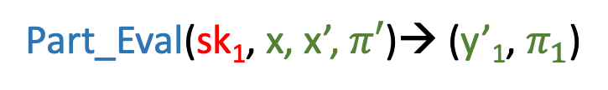
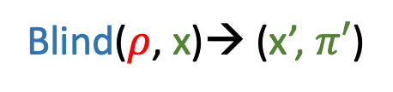
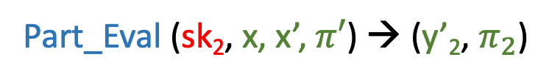

Output-Private Distributed VRF (Pri-VRF)
Example: N = 3, T = 1
Part_Eval(sk₁, x, x’, $π′$)→ (y’₁, $π_{1}$)
sk₂
sk₁
Part_Eval (sk₂, x, x’, $π′$) → (y’₂, $π_{2}$)
Blinding Factor
Part_Eval (sk₃, x, x’, $π′$) → (y’₃, $π_{3}$)
Blind($ρ$, x)→ (x’, $π′$)
sk₃

Slide 23

Output-Private Distributed VRF (Pri-VRF)
Example: N = 3, T = 1
Proof of correct blinding
Part_Eval(sk₁, x, x’, $π′$)→ (y’₁, $π_{1}$)
sk₂
sk₁
Blinded partial output
Part_Eval (sk₂, x, x’, $π′$) → (y’₂, $π_{2}$)
Blinded input
Part_Eval (sk₃, x, x’,$π′$) → (y’₃, $π_{3}$)
Blind($ρ$, x)→ (x’, $π′$)
sk₃

Slide 24
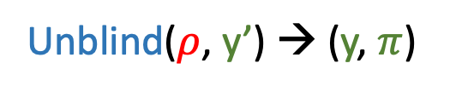
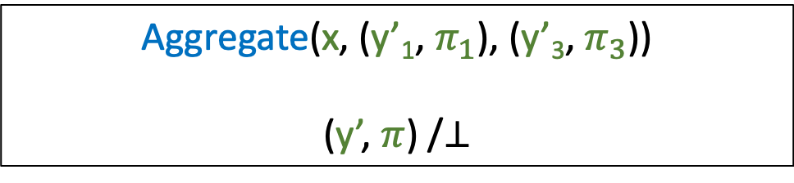
Output-Private Distributed VRF (Pri-VRF)
Example: N = 3, T = 1
Unblind($ρ$, y’) → (y, $π$)
sk₁
sk₂
Aggregate(x, (y’₁, $π_{1}$), (y’₃, $π_{3}$))
(y’, $π$) /$⊥$
Blinding Factor
sk₃

Slide 25
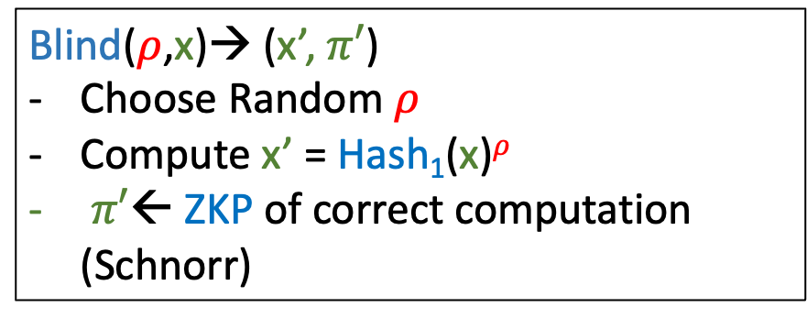
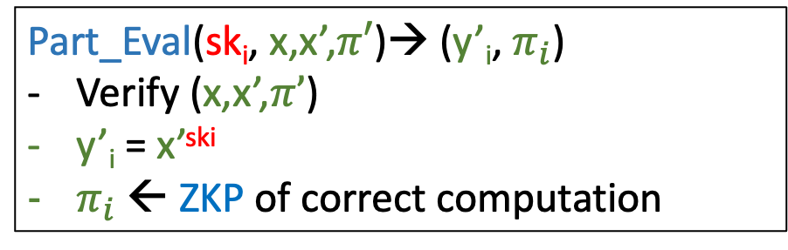
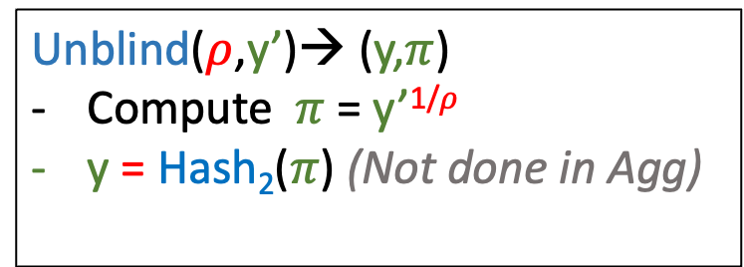
Our PVRF Construction
Blind($ρ$,x)→ (x’, $π′$)
Choose Random $ρ$
Compute x’ = Hash₁(x)$ρ$
$π′$← ZKP of correct computation (Schnorr)
Unblind($ρ$,y’)→ (y,$π$)
Compute $π$ = y’^{1/}$ρ$
y = Hash₂($π$) (Not done in Agg)
Maintains Output Privacy
Hashing done before Eval (Similar to OPRF)
Part_Eval(sk_{i}, x,x’,$π′$)→ (y’_{i}, $π_{i}$)
Verify (x,x’,$π’$)
y’_{i} = x’^{ski}
$π_{i}$ ← ZKP of correct computation

Slide 26
FlexiRand+ (Private) DVRF Framework V#2.1
Can make a NP-REQ even if P-REQ
Smart Contract
REQ P/NP
INP x
User
Relay
Input Exposed
Output Exposed
VRF Committee

Slide 27
FlexiRand+ Input format (work in progress)
INP: x = [user_input, block_hash, unique_nonce, chain_id, user_id, callback_function_name, P_or_NP]
user_input – User chosen arbitrary input
block_hash – Partially unpredictable
unique_nonce – Enforce ditinct inputs by Smart -contract
chain_id – Specific to chain
user_id – Specific to user
callback_function_name – Specific to function
P_or_NP – Specific to function

Slide 28

Who cares?

Slide 29
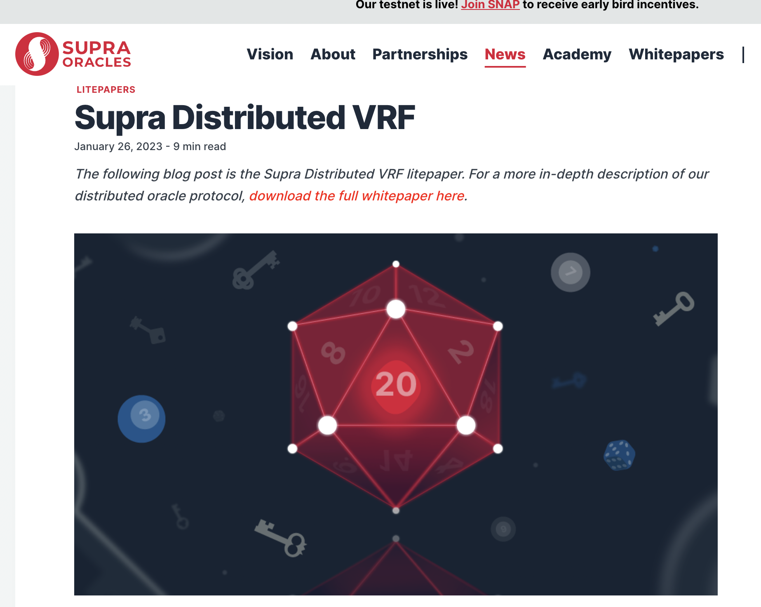

Summarizing…
Use GLOW + New DKG
Output Privacy – New Concept
  FlexiRand [Kate-Mangipudi-Maradana-M] (Conditional Accept@CCS’2023)
Open: INP formatting – standardized INP?
Thank You!

