Slide 1


Rolling a Dice on Blockchain
Pratyay Mukherjee
Symposium 2.0 @ IIT Indore
March 16, 2024
Copyright © 2023 Supra

Slide 2

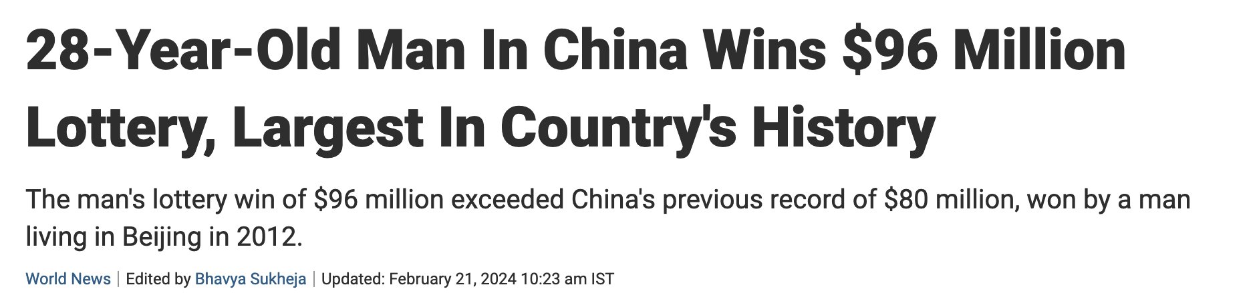
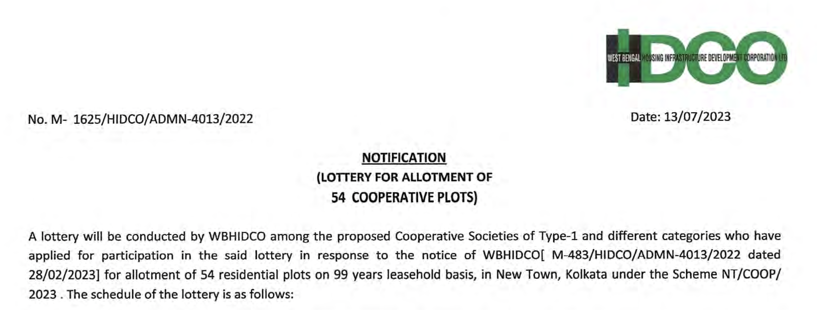
Lottery in Real World

Slide 3
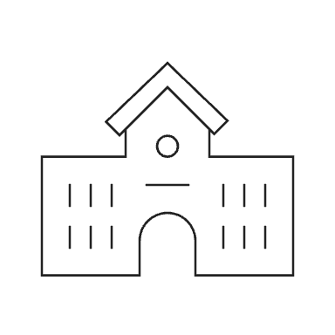


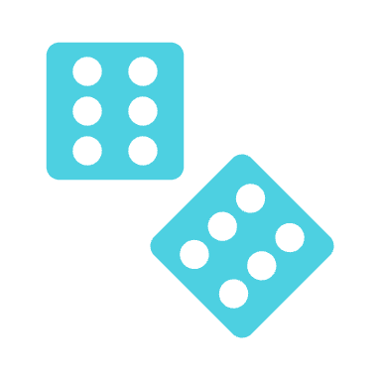
Example: School Admission
List
4826
6154
7392
8240
3678
5490
9264
Why only even?

Slide 4
Example: School Admission
List
5738
2194
6487
3829
9065
1743
7562
Looks unbiased, but what if someone can predict?

Slide 5


Unbiasability and Unpredictability
Unbiasability
Unpredictability
No one can guess an output with high probability
No detectable pattern, e.g. about half should be even

Slide 6


Example: School Admission
Let’s audit
Here’s my code
RandGen

Slide 7

Example: School Admission
RandGen
Use a PRF!

Slide 8
Pseudorandom Functions (PRF)
y = F_{sk}(x)
Unbiasability
Unpredictability
y can NOT be biased as long as sk is random
Hard to predict y on a given x without sk

Slide 9


Pseudorandom Functions (PRF)
Unbiasability
y = F_{sk}(x)
Unpredictability
Pseudorandomness
If sk is random and secret, then y is as good as random

Slide 10
Pseudorandom Functions (PRF)
y = F_{sk}(x)
Pseudorandomness
If sk is random and secret, then y is as good as random

Slide 11


Example: School Admission
List
5327
9176
6482
3059
7241
1863
5902
Looks ok, but how do I know you are using PRF?
PRF

Slide 12

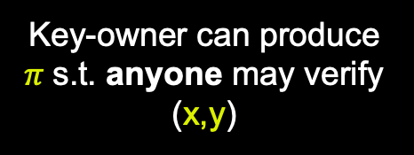
Verifiable Random Functions (VRF)
y = F_{sk}(x)
Pseudorand
Unbiasability
Unpredictability
Verifiability
y can NOT be biased as long as sk is random
Hard to predict y on a given x without sk
Key-owner can produce $π$s.t. anyone may verify (x,y)

Slide 13




Example: School Admission
x = 16032024
List
5327
9176
6482
3059
7241
1863
5902
Anyone can Verify a VRF is computed on x
$$π$$
VRF
Unbiasability
Unpredictability
Verifiability

Slide 14

Randomness in Blockchain
Web3 Gaming or GameFi

Slide 15
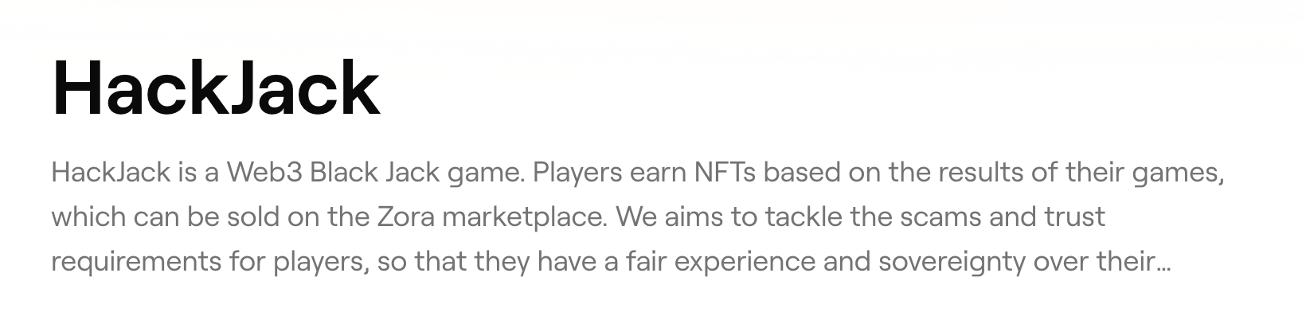
Randomness in Blockchain
Web3 BlackJack

Slide 16
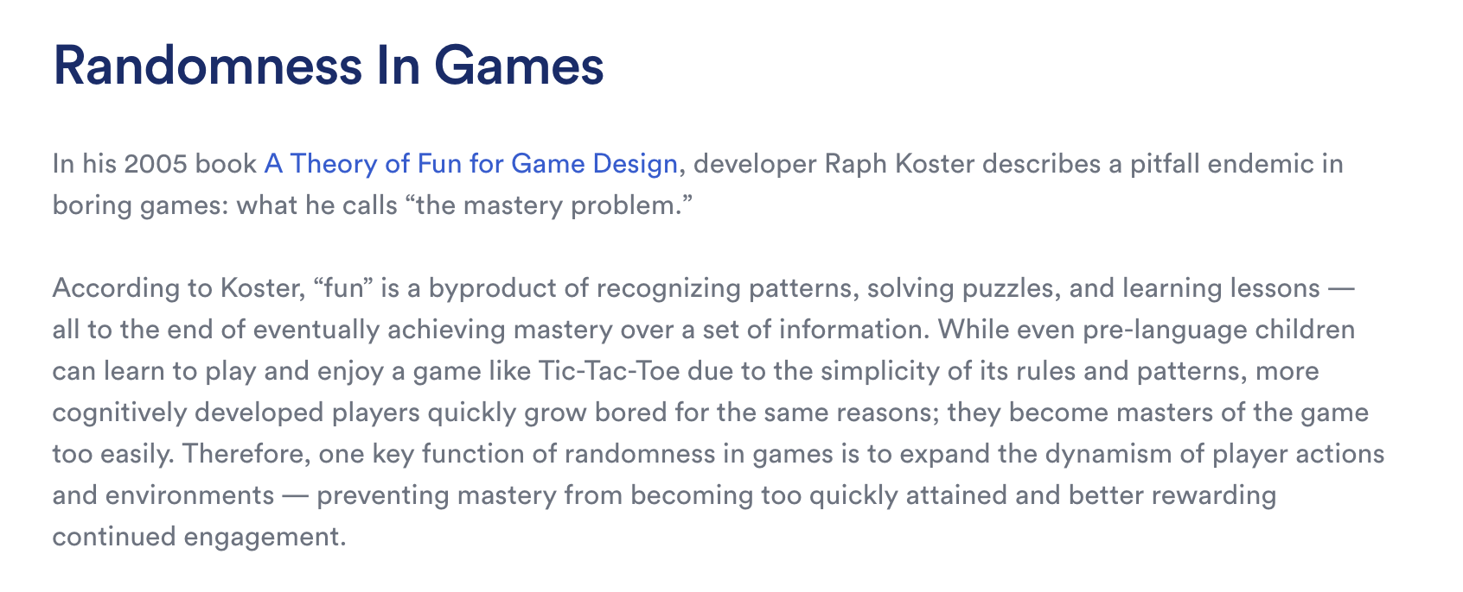
Randomness in Blockchain
https://chain.link/education-hub/random-rewards-blockchain-games

Slide 17
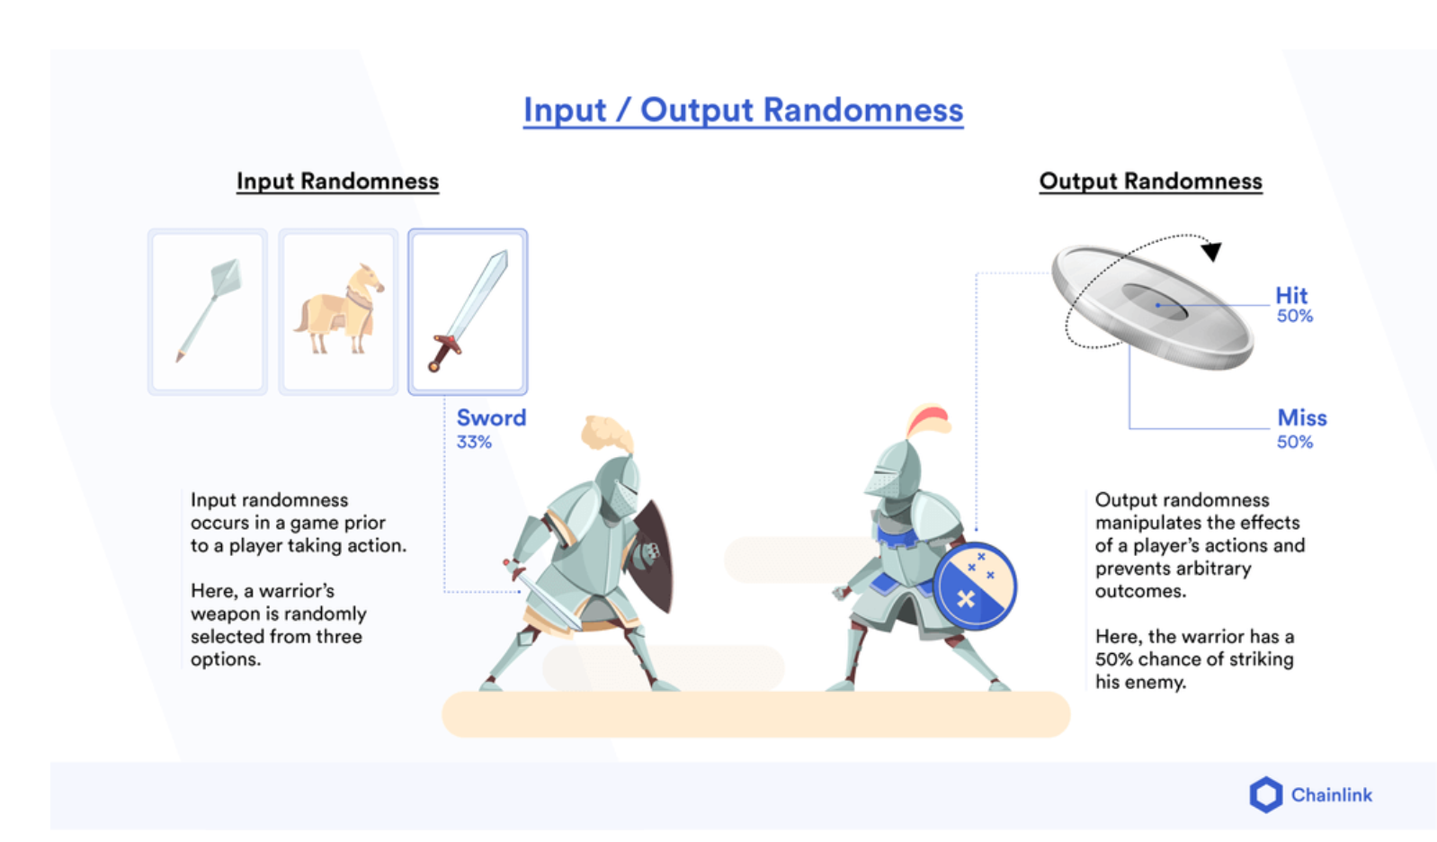
Randomness in Blockchain

Slide 18
Randomness in Blockchain

Slide 19

Randomness in Blockchain
Web3 Poker

Slide 20




Producing Randomness on Blockchain
GetRand()
RND

Slide 21


Producing Randomness on Blockchain with VRF
VRF_{sk}()
RND
How to hide sk?

Slide 22



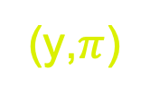
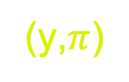
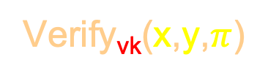

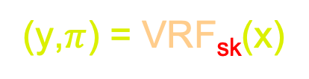
Outsourcing (Off-chain) VRF
Unbiasability
Unpredictability
Verifiability
vk
x
x
x
y
$$π$$
(y,$π$)
(y,$π$)
VRF_{sk}()
Verify_{vk}(x,y,$π$)
(y,$π$) = VRF_{sk}(x)
Anyone can verify

Slide 23
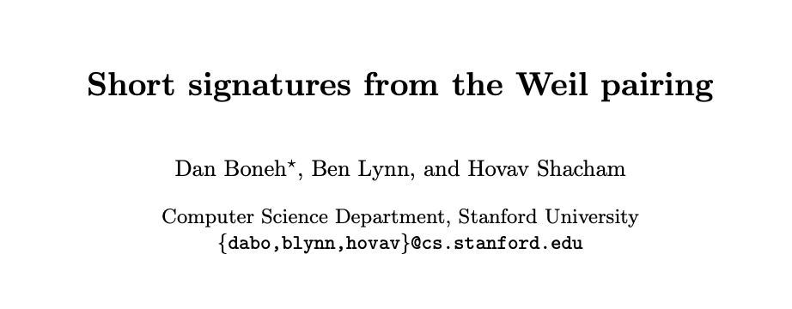

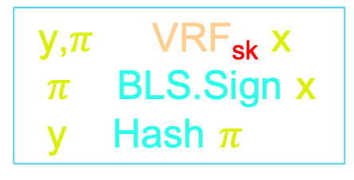
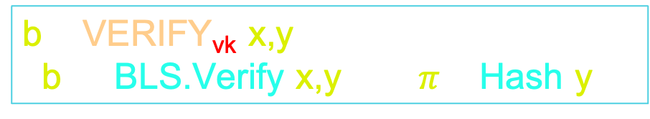
A VRF Construction based on BLS Signature
2001
Unforge + Hash → Pseudorand
Sig.Verify + Hash → Verifiability
(y,$π$) = VRF_{sk}(x):
$π$ = BLS.Sign(x)
y = Hash($π$)
b = VERIFY_{vk}(x,y):
  b = (BLS.Verify(x,y) )$∧$( $π$= Hash(y))
Pairing, hence expensive
Chainlink uses another

Slide 24



Off-chain VRF: Single Point of Failure
Single point of failure
Unbiasability
Unpredictability
Verifiability
vk
x
x
x
y
$$π$$
(y,$π$)
(y,$π$)
VRF_{sk}()
Verify_{vk}(x,y,$π$)
(y,$π$) = VRF_{sk}(x)

Slide 25





Distributed Random Function (dVRF)
< T+1 shares give nothing
Common
Example: N = 3, T = 1
Share
sk₁
vk
sk₂
Threshold
a₁sk₁ + a₂sk₂ = sk
b₂sk₂ + b₃sk₃ = sk
c₁sk₁ + c₃sk₃ = sk
Any T+1 shares give sk, linearly
Coeff (public) only depend on subset
sk₃
Shamir’s Secret Sharing

Slide 26


Distributed Random Function (dVRF)
DKG → (vk, sk₁, sk₂, sk₃) (interactive setup)
sk₁
vk
sk₂
sk₃

Slide 27
Distributed Random Function (dVRF)
DKG → (vk, sk₁, sk₂, sk₃) (interactive setup)
sk₁
vk
sk₂
vk
sk₃

Slide 28

Distributed Random Function (dVRF)
sk₁
x
x
x
sk₂
vk
sk₃
Example: N = 3, T = 1

Slide 29


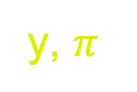

Distributed Random Function (dVRF)
y₁= dVRFsk₁(x)
sk₁
y, $π$
y, $π$
x
y₂ = dVRFsk₂(x)
sk₂
vk
y, $π$
Any 2
Public Verification
y₃ = dVRFsk₃(x)
sk₃
Example: N = 3, T = 1

Slide 30
dVRF: Additional Requirements
Consistency
Any T+1 parties yield same y

Slide 31
dVRF Consistency
y₁= dVRFsk₁(x)
sk₁
y, $π$
y, $π$
x
y₂ = dVRFsk₂(x)
sk₂
vk
y, $π$
sk₃
Example: N = 3, T = 1

Slide 32
dVRF Consistency
y₁= dVRFsk₁(x)
sk₁
y, $π$
y, $π$
x
y₂ = dVRFsk₂(x)
sk₂
vk
y, $π$
y₃ = dVRFsk₃(x)
sk₃
Example: N = 3, T = 1

Slide 33
dVRF Consistency
y₁= dVRFsk₁(x)
sk₁
y, $π$
y, $π$
x
y₂ = dVRFsk₂(x)
sk₂
vk
y, $π$
y₃ = dVRFsk₃(x)
sk₃
Example: N = 3, T = 1

Slide 34


dVRF: Additional Requirements
Consistency
Strong Pseudorand
Any T+1 parties yield same y
Holds even if $≤$ T parties are corrupt and colluding

Slide 35
dVRF Strong Pseudorandomness
y₁= dVRFsk₁(x)
sk₁
y, $π$
y, $π$
x
y₂ = dVRFsk₂(x)
sk₂
vk
y, $π$
y₃ = dVRFsk₃(x)
sk₃
Example: N = 3, T = 1

Slide 36

dVRF: Additional Requirements
Consistency
Strong Pseudorand
Liveness
Any T+1 parties yield same y
Holds even if $≤$ T parties are corrupt and colluding
Output is guaranteed

Slide 37


dVRF Liveness/Guaranteed Output
y₁= dVRFsk₁(x)
sk₁
y, $π$
y, $π$
x
y₂ = dVRFsk₂(x)
sk₂
vk
y, $π$
Necessary:
N > 2T (51%)
y₃ = dVRFsk₃(x)
sk₃
Example: N = 3, T = 1

Slide 38
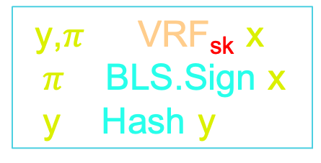
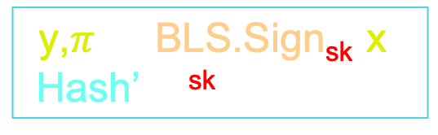
BLS-based dVRF [GLOW’21]
Recall BLS-VRF
(y,$π$) = VRF_{sk}(x):
$π$ = BLS.Sign(x)
y = Hash(y)
y₁= dVRFsk₁(x)
sk₁
y₂ = dVRFsk₂(x)
sk₂
(y,$π$) = BLS.Sign_{sk}(x):
Hash’(x)^{sk}
Homomorphic
y₃ = dVRFsk₃(x)
sk₃
Hash’(x)^{a1sk1} + Hash’(x) ^{a2sk2} =Hash’(x)^{sk}

Slide 39
Recall: dVRF Setup Shamir’s Secret Sharing
< T+1 shares give nothing
Common
Example: N = 3, T = 1
Share
sk₁
vk
sk₂
Threshold
a₁sk₁ + a₂sk₂ = sk
b₂sk₂ + b₃sk₃ = sk
c₁sk₁ + c₃sk₃ = sk
Any T+1 shares give sk, linearly
Coeff (public) only depend on subset
sk₃
Shamir’s Secret Sharing

Slide 40

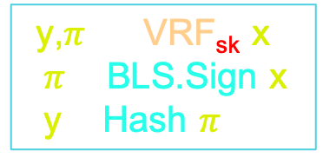
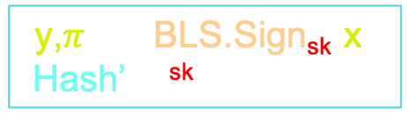
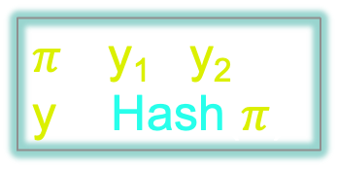
GLOW dVRF: Consistency
Recall BLS-VRF
(y,$π$) ←VRF_{sk}(x):
$π$ = BLS.Sign(x)
y = Hash($π$)
y₁= BLS.Signsk₁(x)
sk₁
(y,$π$) ← BLS.Sign_{sk}(x):
Hash’(x)^{sk}
$π$ = y₁^{a1} y₂^{a2} ;
y = Hash($π$)
y₂ = BLS.Signsk₂(x)
sk₂
Hash’(x)^{a1sk1} Hash’(x) ^{a2sk2} =Hash’(x)^{sk}
y₃ = BLS.Signsk₃(x)
sk₃
Linear SS + Homomorphism → Consistency

Slide 41
Recall: dVRF Setup Shamir’s Secret Sharing
< T+1 shares give nothing
Common
Example: N = 3, T = 1
Share
sk₁
vk
sk₂
Threshold
a₁sk₁ + a₂sk₂ = sk
b₂sk₂ + b₃sk₃ = sk
c₁sk₁ + c₃sk₃ = sk
Any T+1 shares give sk, linearly
Coeff (public) only depend on subset
sk₃
Shamir’s Secret Sharing

Slide 42
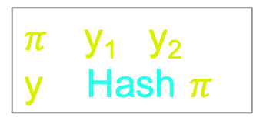
GLOW dVRF: Strong Pseudorand
Recall BLS-VRF
(y,$π$) ←VRF_{sk}(x):
$π$ = BLS.Sign(x)
y = Hash($π$)
y₁= BLS.Signsk₁(x)
sk₁
(y,$π$) ← BLS.Sign_{sk}(x):
Hash’(x)^{sk}
$π$ = y₁^{a1} y₂^{a2} ;
y = Hash($π$)
y₂ = BLS.Signsk₂(x)
sk₂
Knows nothing!
Hash’(x)^{a1sk1} Hash’(x) ^{a2sk2} =Hash’(x)^{sk}
y₃ = BLS.Signsk₃(x)
sk₃
Linear SS + Pseudorand → Strong Pseudorand

Slide 43




High cost: Optimization?
sk₁
Can not be made in advance
Optimization Fails
vk
y, $π$
x
y, $π$
y, $π$
sk₂
z₁ = Hash(y||1)
z₂ = Hash(y||2)
……….
Output Exposed!
z₁, z₂ predictable
sk₃

Slide 44

High Latency: Advanced Request
sk₁
Can not be made in advance
Advanced Req does not work
vk
y, $π$
x
y, $π$
y, $π$
sk₂
Output Exposed!
sk₃

Slide 45

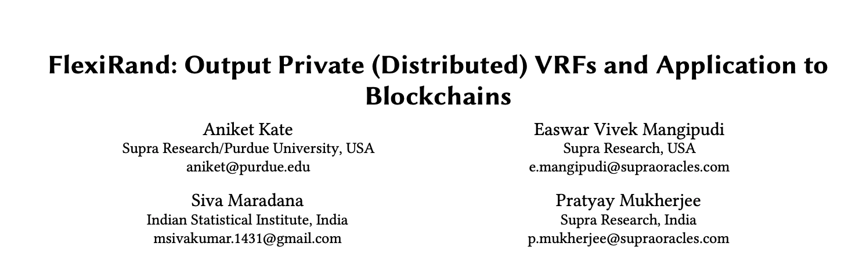
Can we hide the Output?

Slide 46
Attempt#1: Private dVRF
sk₁
vk
x,[x]
x,[x]
x,[x]
sk₂
[v] : blinded v (blind known only to user)
sk₃

Slide 47




Attempt#1: Private dVRF
Knowledge of x not guaranteed
sk₁
vk
[y₁]
[y], $π$
x,[x]
x,[x]
[y₂]
[y], $π$
sk₂
[y], $π$
[y₃]
y, $π$
[v] : blinded v (blind known only to user)
sk₃

Slide 48

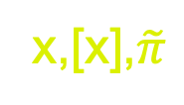







FlexiRand
Optimization works (delayed verification)
Advance Req Possible
IP-VER(x,[x],$\tilde{π}$)
sk₁
PoK of x
vk
[y₁]
[y], $π$
x,[x],$\tilde{π}$
x,[x],$\tilde{π}$
[y₂]
[y], $π$
sk₂
[y], $π$
[y₃]
([x],$\tilde{π}$) ← Blind (x)
y
IP-VER(x,[x],$\tilde{π}$)
y
y ← Unblind ([y])
Verification
IP-VER(x,[x],$\tilde{π}$)
$\tilde{π}$ : Proof of knowledge (PoK) of x wrt [x]
sk₃

Slide 49

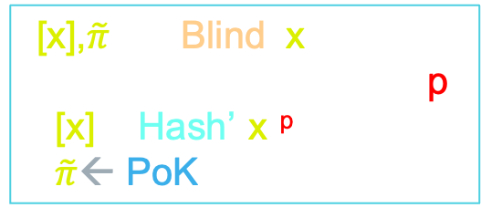
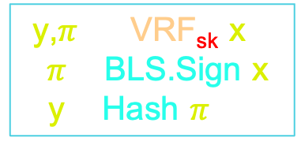
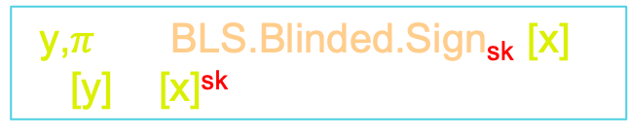
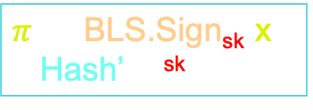
FlexiRand Blinding Technique
Recall BLS-VRF
FlexiRand
([x],$\tilde{π}$) ← Blind (x):
Choose random blind p
[x] = Hash’(x)^{p}
$\tilde{π}$← PoK(Schnorr)
(y,$π$) ←VRF_{sk}(x):
$π$ = BLS.Sign(x)
y = Hash($π$)
$π$ ← BLS.Sign_{sk}(x):
Hash’(x)^{sk}
(y,$π$) ← BLS.Blinded.Sign_{sk}([x]):
[y] = [x]^{sk}
y ← Unblind ([y]):
y = [y]^{1/p}

Slide 50
FlexiRand
Optimization works (delayed verification)
Advance Req Possible
IP-VER(x,[x],$\tilde{π}$)
sk₁
PoK of x
vk
[y₁]
[y], $π$
x,[x],$\tilde{π}$
x,[x],$\tilde{π}$
[y₂]
[y], $π$
sk₂
[y], $π$
[y₃]
([x],$\tilde{π}$) ← Blind (x)
y
IP-VER(x,[x],$\tilde{π}$)
y ← Unblind ([y])
y
Verification
IP-VER(x,[x],$\tilde{π}$)
$\tilde{π}$ : Proof of knowledge (PoK) of x wrt [x]
sk₃

Slide 51




Delayed Verification in FlexiRand
Can not be made in advance
[x]
vk
([x],$\tilde{π}$) ← Blind (x)
x,[x],$\tilde{π}$
[y], $π$
[y],$π$
y ← Unblind ([y])
y
y
z₁ = Hash(y||1)
z₂ = Hash(y||2)
……….
Given y all z_{i} are predictable

Slide 52


Delayed Verification in FlexiRand
Can not be made in advance
x,[x],$\tilde{π}$
vk
([x],$\tilde{π}$) ← Blind (x)
x,[x],$\tilde{π}$
[y], $π$
[y],$π$
y ← Unblind ([y])
y
y
z₁ = Hash(y||1)
z₂ = Hash(y||2)
……….
Given y all z_{i} are predictable

Slide 53
Delayed Verification in FlexiRand
Can not be made in advance
[x]
vk
([x],$\tilde{π}$) ← Blind (x)
x,[x],$\tilde{π}$
[y], $π$
[y],$π$
y ← Unblind ([y])
z₁
z₂
z₁ = Hash(y||1)
z₂ = Hash(y||2)
……….
….
Delayed Verification
y
y

Slide 54



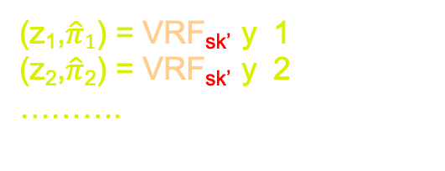

FlexiRand 2.0: Instant Verification (WIP)
vk’
x,[x],$\tilde{π}$
vk
vk’
([x],$\tilde{π}$) ← Blind (x)
x,[x],$\tilde{π}$
(sk’,vk’)
[y], $π$
[y],$π$
y ← Unblind ([y])
y
Instant Verification
y
z₁,$\hat{π}1$
(z₁,$\hat{π}1$) = VRF_{sk’}(y||1)
(z₂,$\hat{π}$₂) = VRF_{sk’}(y||2)
……….
Verify_{vk’}(y,z₁,$\hat{π}$₁)
z₂,$\hat{π}2$
….

Slide 55
RECAP
Randomness: A universally important resource

Slide 56
RECAP
VRF: An important tool

Slide 57
RECAP
Centralized VRF: Non-optimal

Slide 58
RECAP
dVRF: Fully Decentralized

Slide 59


RECAP
dVRF suffers from practical issues
Core Problem

Slide 60
RECAP
FlexiRand: Output Hiding dVRF
May cause problem

Slide 61
RECAP
FlexiRand 2.0: Instantly Verifiable
Use client-side VRF instead of hashing

Slide 62
What I did not talk about
Other non-VRF approaches:
Verifiable Delay Functions
Verifiable Random Beacons
Other (open/active) questions:
How to choose input x?
How to design the smart contract?
Post-quantum Security?

Slide 63
“Random numbers should not be generated with a method chosen at random.”
- Donald Knuth
Thank You!
(https://www.random.org/quotations/)

