Slide 1


NCPP Blockchain Research Workshop, IIT Bombay
December 16, 2024
ANARKey
A New Approach to (socially) Recover Keys
Pratyay Mukherjee
Joint work with
Aniket Kate, Hamza Saleem, Pratik Sarkar, Bhaskar Roberts

Slide 2



How blockchain transactions are authenticated?
PK
Tx, Sign_{SK} (Tx)
(SK, PK)

Slide 3


How blockchain transactions are authenticated?
PK
How to store SK securely and reliably?
Tx, S=Sign_{SK} (Tx)
(SK, PK)
validator
Verify_{PK}(Tx, S)

Slide 4
Passwords vs Secret Key
Passwords are much easier to remember
  E.g. “Coffee#Love@9Forever”
If forgotten, passwords can be easily reset with same access
  Facilitated by central auth
Secret keys are virtually impossible to remember
  E.g.“0x2b7e151628aed2a6abf7158809cf4f3c”
If SK is lost, the corresponding assets wrt PK is lost forever!
  No central auth

Slide 5



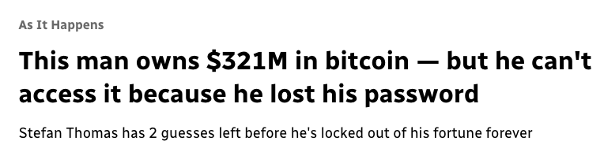

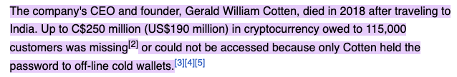
Real Life Examples
Disposed Hardware
Password Locked
Lost due to demise

Slide 6
Recovery Trilemma
Security
Reliability
Usability

Slide 7
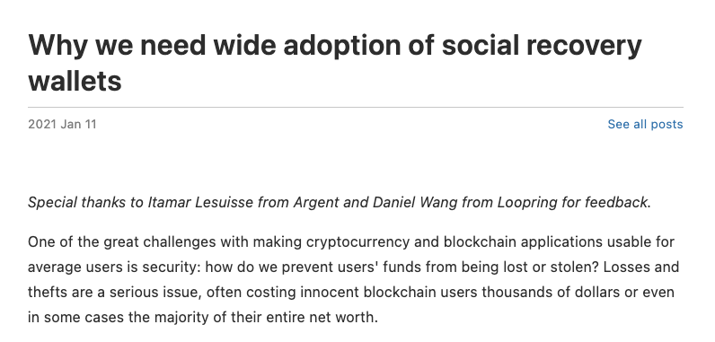
Two Main Approaches used Currently
Our Focus:
Improved Social Recovery
Pass phrases/mnemonics
  E.g. “coral jump island pretty…”
  Stored offline
  Secret keys are derived using KDF(Pass-Phrase)
  Single point of failure
  No recovery for demise
  Very High security, high usability, moderate reliability
  Typical worst case:
    Permanent loss
Social Recovery
  Share(SK) → S₁, S₂, S₃,….
  S_{i} given to Guardian-i
  Any (T+1) guardians can recover
  Perfect security for < T+1 collusion
    Guardians don’t know each other
  For demise T+1 guardians can be asked to publish their shares
  High security, Very High reliability, Moderate usability
  Typical worst case:
    T+1 guardians compromised/collude
https://vitalik.eth.limo/

Slide 8
Main Qualities of a Guardian
Availability
  Can respond quickly when needed
Technical Competence
  Can manage data securely and reliably
Incentive Alignment
  Care about owner’s security

Slide 9



Main Qualities of a Guardian
Availability
  Can respond quickly when needed
Technical Competence
  Can manage data securely and reliably
Incentive Alignment
  Care about owner’s security
Grandpa?

Slide 10

Main Qualities of a Guardian
Availability
  Can respond quickly when needed
Technical Competence
  Can manage data securely and reliably
Incentive Alignment
  Care about owner’s security
Peer?

Slide 11




Our Idea: Community Social Recovery
SK₁
SK₂
Each user manages a secret key
Everyone helps everyone else
SK₃
SK₄

Slide 12

Main Qualities of a Guardian
Availability
  Can respond quickly when needed
  Usually well connected
Technical Competence
  Can manage data securely and reliably
  Easy for Web3 users managing secrets
Incentive Alignment
  Care about owner’s security
  Because of self-interest
Community of Web3 users

Slide 13
Community Social Recovery: Strawman
SK₁
SK₂
SK in secure and reliable storage
SK₃
SK₄

Slide 14

Community Social Recovery: Strawman
S₁₂
SK₁
(S₁₂,S₁₃,S₁₄)
SK₂
S₁₄
S₁₃
SK₃
SK₄

Slide 15
Community Social Recovery: Strawman
S₁₂
SK₁
SK₂
S₁₃
S₁₄
SK₃
SK₄

Slide 16

Community Social Recovery: Strawman
S₁₂
SK₁
(S₂₁,S₂₂,S₂₃)
SK₂
S₁₃
S₁₄
SK₃
(S₃₁,S₃₂,S₃₃)
(S₄₁,S₄₂,S₄₃)
SK₄

Slide 17

Community Social Recovery: Strawman
S₂₁
S₁₂
S₃₁
S₃₂
S₄₁
S₄₃
SK₁
SK₂
Secure Storage Size: O(N)
S₁₃
S₁₄
S₂₃
S₂₄
S₄₂
S₃₄
SK₃
SK₄

Slide 18


Community Social Recovery: Our Protocol
SK₁
SK₂
Secure Storage Size: O(1)
SK₃
Public Storage Size O(N)
SK₄

Slide 19
A building block:
Bottom-Up Secret Sharing (BUSS)
Recall: Standard Shamir Secret Sharing
(S₁,S₂,S₃)←SHARE_{2,3}(SK)
SK←REC_{2,3}(S₁,S₃)
SK := P(0) = L_{1,0}S₁ + L_{3,0}S₃
Choose a random
1-deg polynomial P(x) subject to: P(0) = SK
RETURN S_{i} := P(i)
L_{1,0,} L_{3,0} are Lagrange coeff (public)
P(0) = L_{1,0}S₁ + L_{2,0}S₂ = L_{3,0}S₃ + L_{2,0}S₂

Slide 20
A building block:
Bottom-Up Secret Sharing (BUSS)
Shamir Secret Sharing
BUSS
(S₁,S₂,S₃)←SHARE_{2,3}(SK)
(U₋₁,U₋₂)←B.SHARE_{2,3}(SK, S₁,S₂,S₃)
Choose a random
1-deg polynomial P(x) subject to: P(0) = SK
RETURN S_{i} := P(i)
Define
3-deg polynomial P(x) subject to:
P(0) = SK; P(1) = S₁; P(2) = S₂; P(3) = S₃
P(-1) := L_{0,-1}SK + L_{1,-1}S₁ + L_{2,-1}S₂ + L_{3,-1}S₃
P(-2) := L_{0,-2}SK + L_{1,-2}S₁ + L_{2,-2}S₂ + L_{3,-2}S₃
RETURN U₋₁ := P(-1) and U₋₂ :=P(-2)
SK←REC_{2,3}(S₁,S₃)
SK := P(0) = L_{1,0}S₁ + L_{3,0}S₃
SK←B.REC_{2,3}(S₁,S₃, U₋₁,U₋₂)
SK := P(0) = L_{1,0}S₁ + L_{3,0}S₃ + L_{-1,0} U₋₁ + L_{-2,0} U₋₂

Slide 21
A building block:
Bottom-Up Secret Sharing (BUSS)
(U₋₁,U₋₂)←B.SHARE_{2,3}(SK, S₁,S₂,S₃)
SK←B.REC_{2,3}(S₁,S₃, U₋₁,U₋₂)
DEFINE 3-deg polynomial P(x) subject to:
P(0) = SK;
P(1) = S₁;
P(2) = S₂;
P(3) = S₃
COMPUTE:
P(-1) := L_{0,-1}SK + L_{1,-1}S₁ + L_{2,-1}S₂ + L_{3,-1}S₃
P(-2) := L_{0,-2}SK + L_{1,-2}S₁ + L_{2,-2}S₂ + L_{3,-2}S₃
RETURN U₋₁ := P(-1) and U₋₂ :=P(-2)
SK := P(0) = L_{1,0}S₁ + L_{3,0}S₃ + L_{-1,0} U₋₁ + L_{-2,0} U₋₂
Recon Threshold = 2
Deg of Poly = 3
Shamir
Recon Threshold = 2
Deg of Poly = 1
*BGJMSWZ [S&P 2023] uses a similar technique for multiverse threshold sigs

Slide 22
Community Social Recovery: Our Protocol using BUSS
“I am #1 and I’ll Backup”
SK₁
SK₂
“I am #1 and I’ll Backup”
“I am #1 and I’ll Backup”
SK₃
SK₄

Slide 23
Community Social Recovery: Our Protocol using BUSS
Verify id#1
If passes then
S₂ := H(SK₂,#1)
SK₁
SK₂
Verify id#1
If passes then
S₃ := H(SK₃,#1)
Verify id#1
If passes then
S₄ := H(SK₄,#1)
SK₃
SK₄

Slide 24
Community Social Recovery: Our Protocol using BUSS
S₂
Verify id#1
If passes then
S₂ := H(SK₂,#1)
SK₁
SK₂
S₄
S₃
Verify id#1
If passes then
S₃ := H(SK₃,#1)
Verify id#1
If passes then
S₄ := H(SK₄,#1)
SK₃
SK₄

Slide 25
Community Social Recovery: Our Protocol using BUSS
Secure Storage Size: O(1)
SK₁
SK₂
(U₋₁,U₋₂)←B.SHARE_{2,3}(SK₁, S₂,S₃,S₄)
Store (U₋₁,U₋₂) public memory
Public Storage Size O(N)
SK₃
SK₄

Slide 26
Community Social Recovery: Our Protocol - Recovery
“I am #1 and I’ll Recover”
SK₂
“I am #1 and I’ll Recover”
SK₃
SK₄

Slide 27
Community Social Recovery: Our Protocol - Recovery
S₂
Verify id#1
If passes then
S₂ := H(SK₂,#1)
SK₂
S₃
Verify id#1
If passes then
S₃ := H(SK₃,#1)
SK₃
SK₄

Slide 28
Community Social Recovery: Our Protocol - Recovery
Retrieve (U₋₁,U₋₂) from public memory
SK₂
SK₁←B.REC_{2,3}(S₂,S₃, U₋₁,U₋₂)
Malicious Recon detected using PK₁ = g^{SK1}
SK₃
SK₄

Slide 29
Extension
What if guardians prefer not to use their SK?
  They can just use another key – still O(1)
Cold wallets?
  Only produces signatures
  If deterministic, the signatures can be used
Updatability
  Possible with one message and updating public values

Slide 30
Summary
We introduce the concept of community social recovery
  Provides a more comprehensive solution in a setting of crypto-natives
We propose a new protocol, that requires no extra secret storage
  Also very efficient
Our main technical tool: BUSS - new definition
  Maybe of independent interest
Thank You!

