Slide 1
Event Management System
Team No. 1
Team Members:
Dhruv Aggarwal 2210990270
Divesh Gupta 2210990291
Divyansh Saini 2210990298
Kavyam Sachdeva 2210090501

Slide 2
Index
Objective
Introduction
Methodology, Approach & Techniques
Source Code(Screenshots)
Result
Conclusion
Reference

Slide 3
Objectives
Select a Date and Venue
Date Selection: Choose a date that aligns with the availability of the target audience and avoids conflicts with other major events.
Venue Booking: Select and book a venue that meets the size, location, and technical requirements of the event.
Develop a Comprehensive Event Plan
Timeline Creation: Develop a timeline outlining all major milestones, tasks, and deadlines leading up to the event.
Task Assignment: Assign specific tasks to team members with clear responsibilities and deadlines.

Slide 4
Introduction
Our Event Management System is designed to streamline event planning and enhance the user experience
Key Features:-
User-Friendly Interface: Enjoy an intuitive design that makes event management straightforward and accessible for all users.
Event Creation Tools: Set up and customize events efficiently, from detailing logistics to sending invitations.
Reliable Performance: Benefit from a robust system that ensures smooth operation and real-time updates for stress-free management.
Our system blends ease of use with powerful functionality, offering a comprehensive solution for effective event management.

Slide 5
Methodology, Approach & Techniques
Methodology:
Agile Development
Approach:
Component-Based Development
Single-page Application(SPA)
React Integration
RESTful API integration
Techniques:
HTML (Hypertext Markup Language)
CSS (Cascading Style Sheets)
JavaScript
React Js

Slide 6
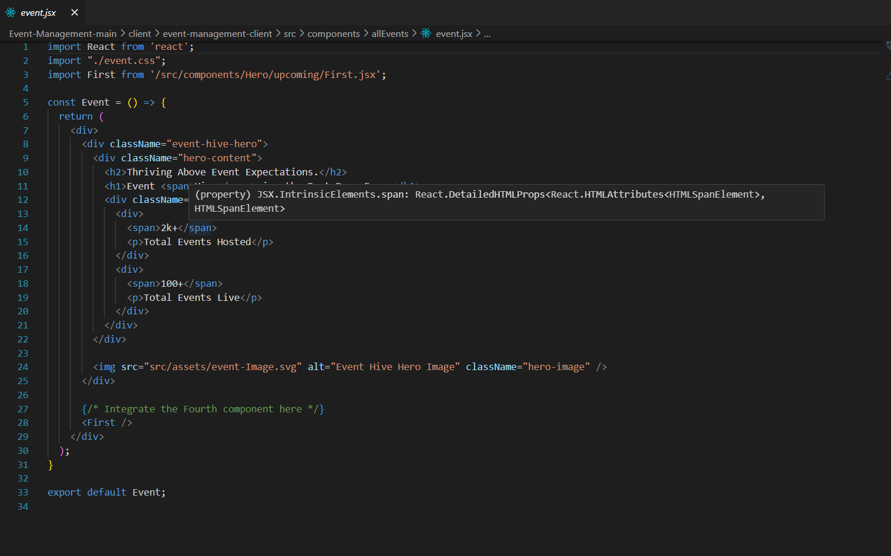
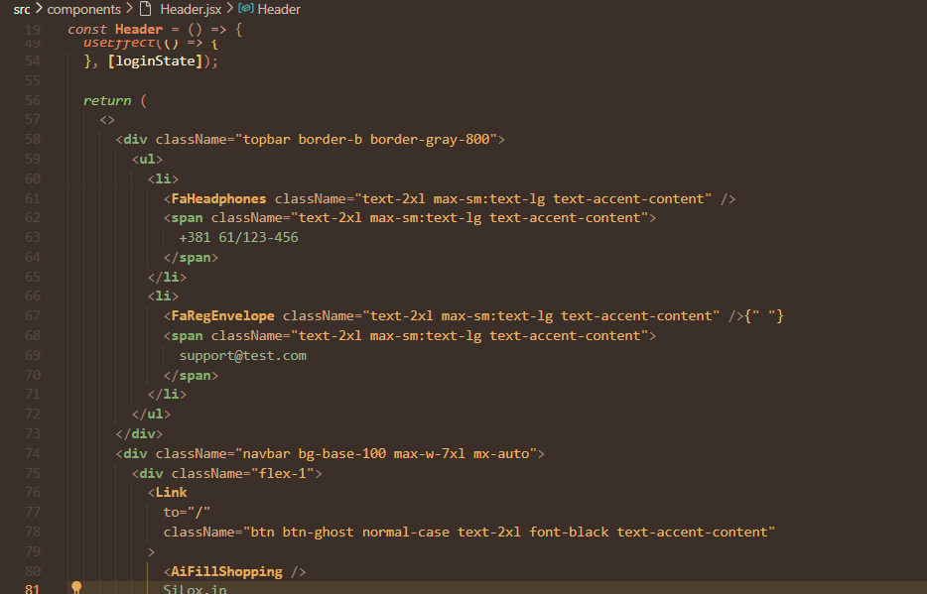
Source Code

Slide 7
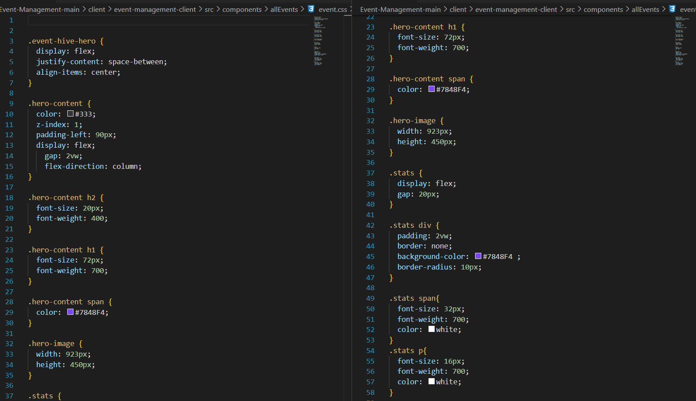
Source Code

Slide 8
Result
Add New Events: Users can easily create and customize events by entering key details, setting up logistics, and personalizing invitations. The streamlined process ensures quick setup and flexibility.
View All Events: Access a well-organized list of scheduled events, providing a centralized view for efficient monitoring, management, and coordination.
Filter Events: Use filtering options to sort events by date, category, or location, making it easy to find and focus on relevant activities.
Track Event Details: View detailed event information, including schedules, venues, and participant lists, for improved planning and oversight.

Slide 9
Conclusion
Streamlined Planning: Simplify the event planning process with an intuitive interface and easy-to-use tools.
Efficient Event Management: Easily add, customize, and oversee events
Enhanced Navigation: Quickly find relevant events using powerful filters.
Detailed Oversight: Access and manage detailed event information.
Real-Time Updates: Enjoy reliable performance and timely updates.
Developed with ReactJS, HTML, and CSS, our Event Management System provides a comprehensive, efficient, and user-friendly platform. Leveraging these technologies, it ensures a seamless experience for both organizers and attendees.

Slide 10
Reference
https://nodejs.org/docs/latest/api/
https://legacy.reactjs.org/docs/getting-started.html

Slide 11
Future Scope
User Registration and Login: -Implement secure user sign-up and sign-in processes.
Authentication and Authorization:- Ensure robust methods for user authentication and role-based authorization.
Payment Gateway Integration and Ticket Booking:- Integrate a reliable payment gateway for secure transactions and streamline the ticket booking process.
User Feedback and Review System:- Provide an option for users to leave feedback and reviews on their experience.

Slide 12


