Slide 1


Design Pattern
Elements of Reusable Object Oriented Software.
Diya Systems
Diya Systems

Slide 2
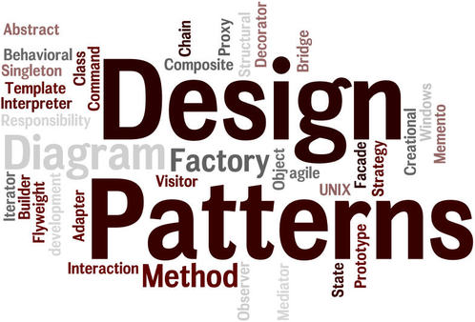

Slide 3
Design Pattern an overview.
A developer writing codes to develop a software using any programming language. When we are developing a software, we face lots of problems and some of the problems are very common and faced by lots of developers.
What if, we have common problem and can we solve it and have a common solution of it and can anybody use it who face the same type of problem. The solution is like a conceptual solution (not related to domain problems like banking domain, ecommerce domain or any social networking domain) that can be followed by other developers faced with same problem, we can think as it a set of guide lines that followed by developers to overcome the common problem. In simple terms we can call it as a best practices defined for developing a software.
In software industry we have a group of professional who provide set of guide lines to overcome the common problems what we called as best practices and these best practices we technically called as design patterns.
In 1994 there are group of 4 peoples who first introduces the set of best practices to provide the common solutions for the common reoccurring problems called design pattern, who are known as GoF (Gang of four) and the set of guide lines introduces by them called as GoF design patterns.
We are following the design patterns while writing codes more or less, knowingly or unknowingly like in every coding language and in every project we have a set of best practices guide line.

Slide 4
Defination
In software engineering, a design pattern is a general repeatable solution to a commonly occurring problem in software design.
A design pattern may not be a finished design that can be transformed directly into code. It is a description or template for how to solve a problem that can be used in many different situations.
Design patterns are used to represent some of the best practices adapted by experienced object-oriented software developers.
A design pattern systematically names, motivates, and explains a general design that addresses a recurring design problem in object-oriented systems. It describes the problem, the solution, when to apply the solution, and its consequences.

Slide 5
A Pattern describes mainly four things.
Pattern Name.
Problem
Solution
intent
motivation
applicability
structure
implementation
Consequences
It can be think of a set of guide lines that can be followed to avoid some of the common mistakes at the time of writing the code and provide general solutions, documented in a format that doesn't require specifics tied to any particular language.
Identify the problem
Analyze the problem
Apply the solution.

Slide 6
Benefits of design pattern.
Design Patterns are already defined and provides industry standard approach to solve a recurring problem, so it saves time if we sensibly use the design pattern. There are many java design patterns that we can use in our java based projects.
Using design patterns promotes reusability that leads to more robust and highly maintainable code. It helps in reducing total cost of ownership (TCO) of the software product.
Since design patterns are already defined, it makes our code easy to understand and debug. It leads to faster development and new members of team understand it easily.
Design patterns can speed up the development process by providing tested, proven development paradigms.
Design patterns allow developers to communicate using well-known, well understood names for software interactions.
Reusing design patterns helps to prevent subtle issues that can cause major problems and improves code readability for coders and architects familiar with the patterns.
Common design patterns can be improved over time, making them more robust than ad-hoc designs.
Design patterns don’t guarantee an absolute solution to a problem. They provide clarity to the system architecture and the possibility of building a better system.

Slide 7
When we can use design pattern.
Design patterns are supposed to provide a structure/set of guide lines in which problems can be solved. When solving a real problem, you have to consider many tiny variations of a solution to that problem to see whether any fits a design pattern. In particular, you will probably need to generalise your problem, or its solution, in order to make a design pattern fit.
We must use the design patterns during the analysis and requirement phase of SDLC(Software Development Life Cycle).
Design patterns ease the analysis and requirement phase of SDLC by providing information based on prior hands-on experiences.

Slide 8
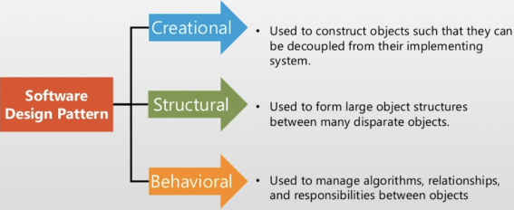
Types of Design Pattern

Slide 9
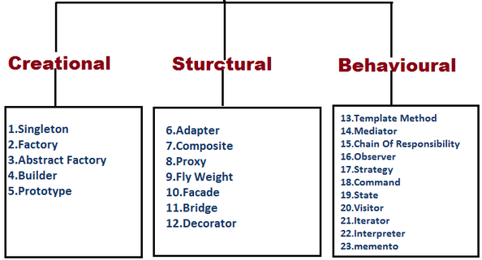

Slide 10
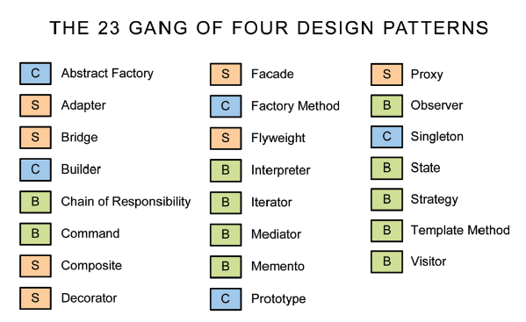
There are mainly three types of design patterns are there.
Creational Design Pattern
Structural Design Pattern
Behavioural Design Pattern

Slide 11
Creational Design Pattern
Creational Design Pattern deals with the way we are creating objects.

Slide 12
Singleton Design Pattern
In object-oriented programming, a singleton class is a class that can have only one object (an instance of the class) at a time.
To design a singleton class:
Declare a static variable of type Singleton class.
Make constructor as private.
Write a static method that has return type object of this singleton class.
Properties of Singleton class.
It should have only one instance
Instance should be globally accessible
Advantage of Singleton design pattern
Saves memory because object is not created at each request. Only single instance is reused again and again.
Usage of Singleton design pattern
Singleton pattern is mostly used in multi-threaded and database applications. It is used in logging, caching, thread pools, configuration settings etc.
Initialization type
Early Initialization
Lazy Initialization

Slide 13
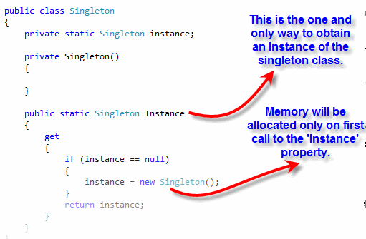
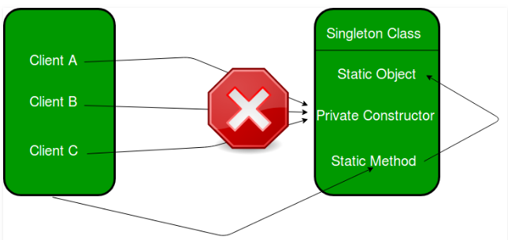
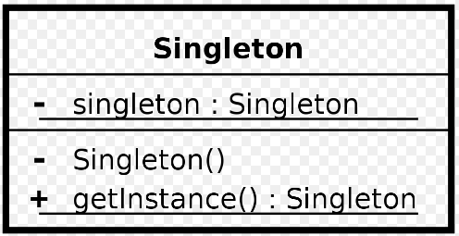

Slide 14
Factory Design Pattern
A Factory Pattern or Factory Method Pattern says that just define an interface or abstract class for creating an object but let the subclasses decide which class to instantiate. In other words, subclasses are responsible to create the instance of the class.
The Factory Method Pattern is also known as Virtual Constructor.
Advantage of Factory Design Pattern
Factory Method Pattern allows the sub-classes to choose the type of objects to create.
It promotes the loose-coupling by eliminating the need to bind application-specific classes into the code. That means the code interacts solely with the resultant interface or abstract class, so that it will work with any classes that implement that interface or that extends that abstract class.
Usage of Factory Design Pattern
When a class doesn't know what sub-classes will be required to create
When a class wants that its sub-classes specify the objects to be created.

Slide 15
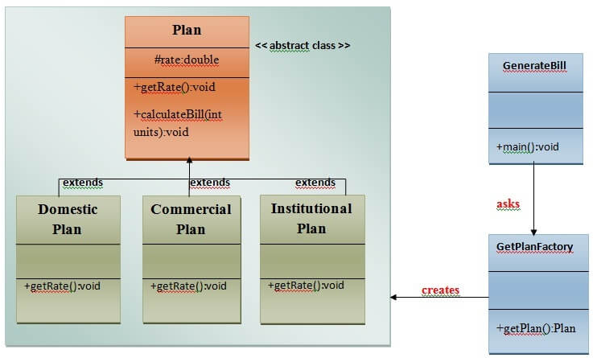

Slide 16
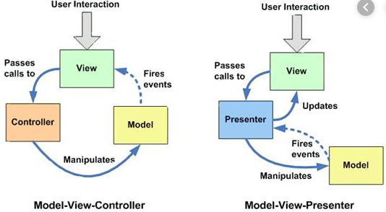
MVC Design Pattern

Slide 17
Prototype Design Pattern
Prototype Pattern says that cloning of an existing object instead of creating new one and can also be customized as per the requirement.
This pattern should be followed, if the cost of creating a new object is expensive and resource intensive.
Advantage of Prototype Pattern
The main advantages of prototype pattern are as follows:
It reduces the need of sub-classing.
It hides complexities of creating objects.
The clients can get new objects without knowing which type of object it will be.
It lets you add or remove objects at runtime.
Usage of Prototype Pattern
When the classes are instantiated at runtime.
When the cost of creating an object is expensive or complicated.
When you want to keep the number of classes in an application minimum.

Slide 18
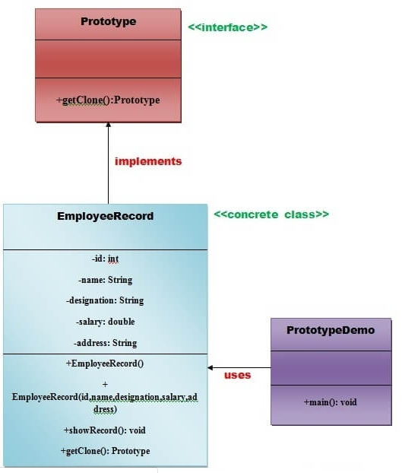

Slide 19
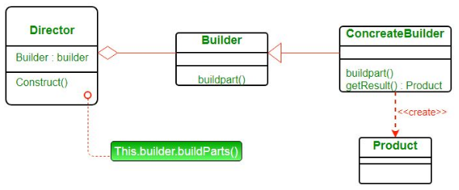
Builder Design Pattern.
Builder pattern aims to “Separate the construction of a complex object from its representation so that the same construction process can create different representations.” It is used to construct a complex object step by step and the final step will return the object. The process of constructing an object should be generic so that it can be used to create different representations of the same object.

Slide 20
Structural Design Pattern
Structural design patterns are concerned with how classes and objects can be composed, to form larger structures.
The structural design patterns simplifies the structure by identifying the relationships.
These patterns focus on, how the classes inherit from each other and how they are composed from other classes.

Slide 21
Adapter Design Pattern
An Adapter Pattern says that just "converts the interface of a class into another interface that a client wants".
In other words, to provide the interface according to client requirement while using the services of a class with a different interface.
The Adapter Pattern is also known as Wrapper
Advantage of Adapter Pattern
It allows two or more previously incompatible objects to interact.
It allows reusability of existing functionality.
Usage of Adapter pattern:
It is used:
When an object needs to utilize an existing class with an incompatible interface.
When you want to create a reusable class that cooperates with classes which don't have compatible interfaces.
When you want to create a reusable class that cooperates with classes which don't have compatible interfaces.
There are the following specifications for the adapter pattern:
Target Interface: This is the desired interface class which will be used by the clients.
Adapter class: This class is a wrapper class which implements the desired target interface and modifies the specific request available from the Adaptee class.
Adaptee class: This is the class which is used by the Adapter class to reuse the existing functionality and modify them for desired use.
Client: This class will interact with the Adapter class.

Slide 22
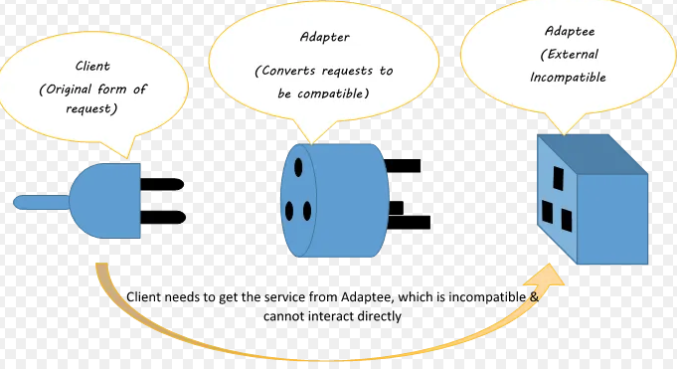
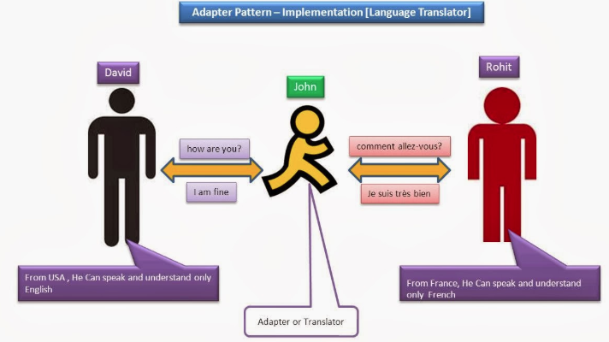
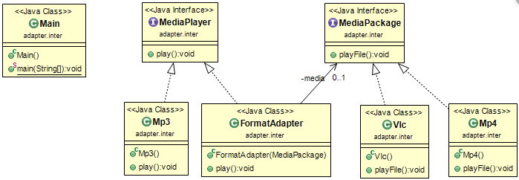

Slide 23
Composite Design Pattern
Composite pattern is one of the Structural design patterns and is used when we have to represent a part-whole hierarchy as a tree structure. When we need to create a structure in a way that the objects in the structure have to be treated the same way, we can apply the composite design pattern.
Advantage of Composite Design Pattern
It defines class hierarchies that contain primitive and complex objects.
It makes easier to you to add new kinds of components.
It provides flexibility of structure with manageable class or interface.
Usage of Composite Pattern
It is used:
When you want to represent a full or partial hierarchy of objects.
When the responsibilities are needed to be added dynamically to the individual objects without affecting other objects. Where the responsibility of object may vary from time to time.

Slide 24
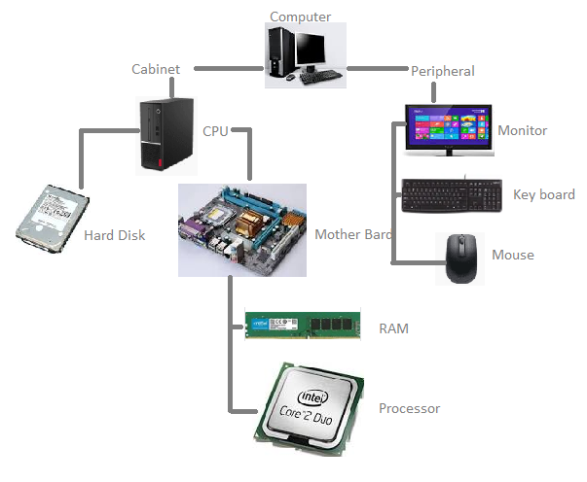

Slide 25
Bridge Pattern
A Bridge Pattern says that just "decouple the functional abstraction from the implementation so that the two can vary independently".
The Bridge Pattern is also known as Handle or Body.
Advantage of Bridge Pattern
It enables the separation of implementation from the interface.
It improves the extensibility.
It allows the hiding of implementation details from the client.
Usage of Bridge Pattern
When you don't want a permanent binding between the functional abstraction and its implementation.
When both the functional abstraction and its implementation need to extended using sub-classes.
It is mostly used in those places where changes are made in the implementation does not affect the clients.

Slide 26
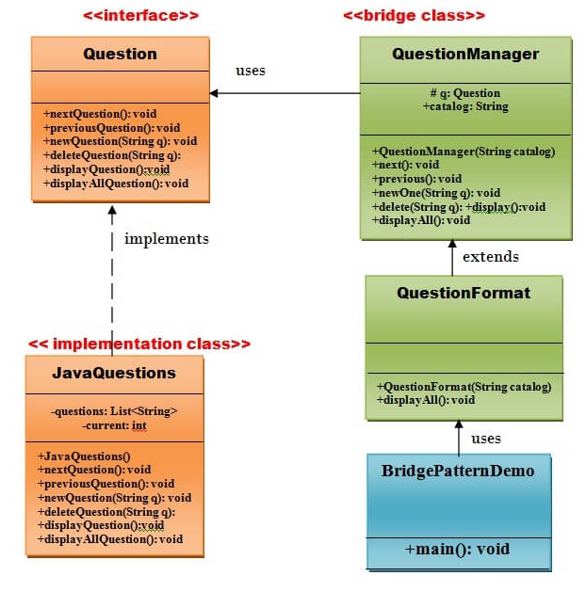

Slide 27
Facade Pattern
A Facade Pattern says that just "just provide a unified and simplified interface to a set of interfaces in a subsystem, therefore it hides the complexities of the subsystem from the client".
In other words, Facade Pattern describes a higher-level interface that makes the sub-system easier to use.
Advantage of Facade Pattern
It shields the clients from the complexities of the sub-system components.
It promotes loose coupling between subsystems and its clients.
Usage of Facade Pattern:
When you want to provide simple interface to a complex sub-system.
When several dependencies exist between clients and the implementation classes of an abstraction.

Slide 28
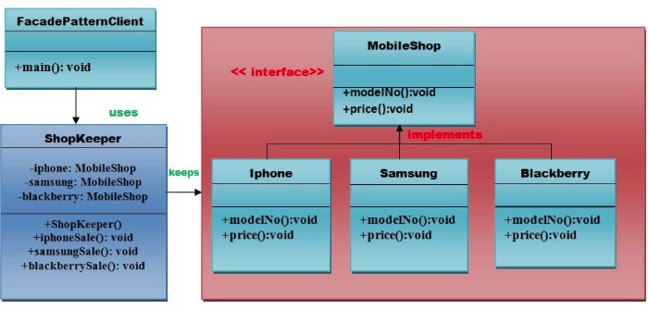
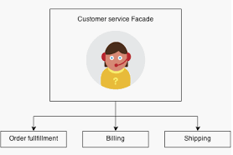

Slide 29
Proxy Pattern
Simply, proxy means an object representing another object.
According to GoF, a Proxy Pattern "provides the control for accessing the original object".
So, we can perform many operations like hiding the information of original object, on demand loading etc.
Advantage of Proxy Pattern
It provides the protection to the original object from the outside world.
Usage of Proxy Pattern:
It can be used in Virtual Proxy scenario---Consider a situation where there is multiple database call to extract huge size image. Since this is an expensive operation so here we can use the proxy pattern which would create multiple proxies and point to the huge size memory consuming object for further processing. The real object gets created only when a client first requests/accesses the object and after that we can just refer to the proxy to reuse the object. This avoids duplication of the object and hence saving memory.
It can be used in Protective Proxy scenario---It acts as an authorization layer to verify that whether the actual user has access the appropriate content or not. For example, a proxy server which provides restriction on internet access in office. Only the websites and contents which are valid will be allowed and the remaining ones will be blocked.
It can be used in Remote Proxy scenario---A remote proxy can be thought about the stub in the RPC call. The remote proxy provides a local representation of the object which is present in the different address location. Another example can be providing interface for remote resources such as web service or REST resources.
It can be used in Smart Proxy scenario---A smart proxy provides additional layer of security by interposing specific actions when the object is accessed. For example, to check whether the real object is locked or not before accessing it so that no other objects can change it.

Slide 30
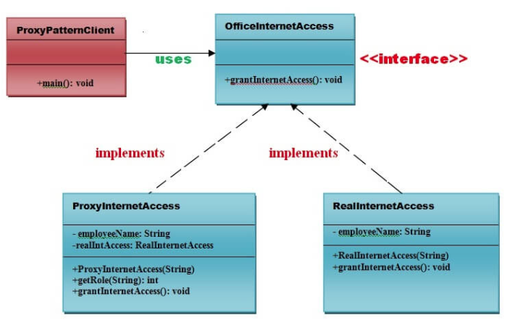

Slide 31
Behavioural Design Pattern
Behavioural design patterns are concerned with the interaction and responsibility of objects.
In these design patterns, the interaction between the objects should be in such a way that they can easily talk to each other and still should be loosely coupled.

Slide 32
Chain Of Responsibility
In chain of responsibility, sender sends a request to a chain of objects. The request can be handled by any object in the chain.
A Chain of Responsibility Pattern says that just "avoid coupling the sender of a request to its receiver by giving multiple objects a chance to handle the request". For example, an ATM uses the Chain of Responsibility design pattern in money giving process.
In other words, we can say that normally each receiver contains reference of another receiver. If one object cannot handle the request then it passes the same to the next receiver and so on.
Advantage of Chain of Responsibility Pattern
It reduces the coupling.
It adds flexibility while assigning the responsibilities to objects.
It allows a set of classes to act as one; events produced in one class can be sent to other handler classes with the help of composition.
Usage of Chain of Responsibility Pattern:
When more than one object can handle a request and the handler is unknown.
When the group of objects that can handle the request must be specified in dynamic way.

Slide 33
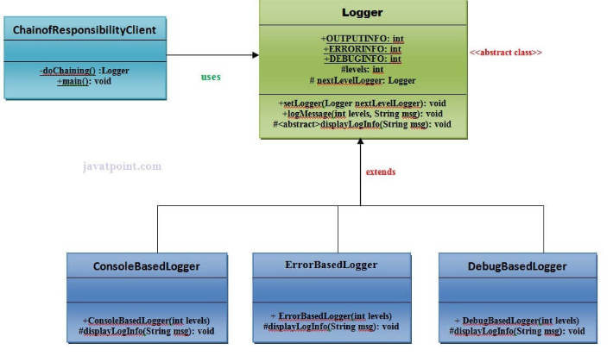

Slide 34
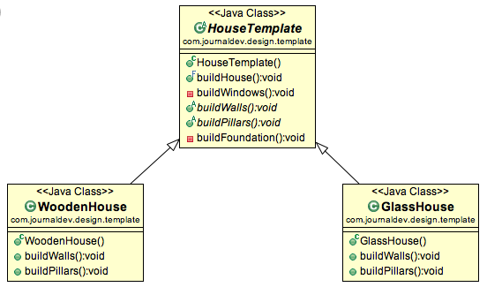
Template Design Pattern
A Template Pattern says that "just define the skeleton of a function in an operation, deferring some steps to its subclasses".
Benefits:
It is very common technique for reusing the code.This is only the main benefit of it.
Usage:
It is used when the common behavior among sub-classes should be moved to a single common class by avoiding the duplication.

Slide 35
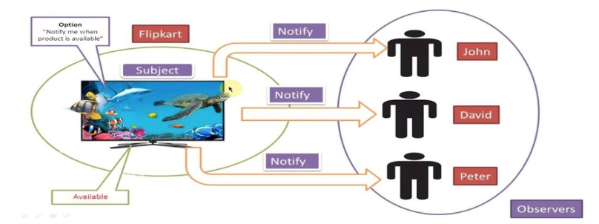
Observer Pattern
An Observer Pattern says that "just define a one-to-one dependency so that when one object changes state, all its dependents are notified and updated automatically". It works in the concept of publish/subscribe.
Benefits:
It describes the coupling between the objects and the observer.
It provides the support for broadcast-type communication.
Usage:
When the change of a state in one object must be reflected in another object without keeping the objects tight coupled.
When the framework we writes and needs to be enhanced in future with new observers with minimal changes.

Slide 36
Design Principles
The Object-Oriented Design Principles are the core of OOP programming,
It's important to learn the basics of Object-oriented programming like Abstraction, Encapsulation, Polymorphism, and Inheritance. But, at the same time, it's equally important to know object-oriented design principles. They will help you to create a clean and modular design, which would be easy to test, debug, and maintain in the future.

Slide 37
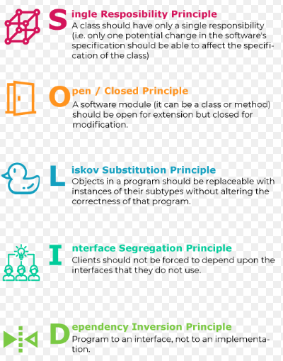

Slide 38
Object oriented design principle 1 – DRY (Don’t repeat yourself)
As name suggest DRY (don’t repeat yourself) means don’t write duplicate code, instead use abstraction to abstract common things in one place. if you use a hardcoded value more than one time consider making it public final constant, if you have block of code in more than two place consider making it a separate method. Benefit of this SOLID design principle is in maintenance. Its worth to note is don’t abuse it, duplicate is not for code but for functionality means if you used common code to validate OrderID and SSN it doesn’t mean they are same or they will remain same in future. By using common code for two different functionality or thing you closely couple them forever and when your OrderID changes its format, your SSN validation code will break. So be aware of such coupling and just don’t combine anything which uses similar code but are not related.
Object oriented design principle 2 – Encapsulate what varies
Only one thing is constant in software field and that is “Change”, So encapsulate the code you expect or suspect to be changed in future. Benefit of this OOPS Design principle is that Its easy to test and maintain proper encapsulated code. If you are coding in Java then follow principle of making variable and methods private by default and increasing access step by step e.g. from private to protected and not public. Several of design pattern in Java uses Encapsulation, Factory design pattern is one example of Encapsulation which encapsulate object creation code and provides flexibility to introduce new product later with no impact on existing code.
Object oriented design principle 3 – Open Closed principle
Classes, methods or functions should be Open for extension (new functionality) and Closed for modification. This is another beautiful object oriented design principle which prevents some-one from changing already tried and tested code. Ideally if you are adding new functionality only than your code should be tested and that’s the goal of Open Closed Design principle.
Object oriented design principle 4 – Single Responsibility Principle (SRP)
There should not be more than one reason for a class to change or a class should always handle single functionality. If you put more than one functionality in one Class in Java it introduce coupling between two functionality and even if you change one functionality there is chance you broke coupled functionality which require another round of testing to avoid any surprise on production environment.

Slide 39
Object oriented design principle 5 – Dependency Injection or Inversion principle
Don’t ask for dependency it will be provided to you by framework. This has been very well implemented in Spring framework, beauty of this design principle is that any class which is injected by DI framework is easy to test with mock object and easier to maintain because object creation code is centralized in framework and client code is not littered with that.There are multiple ways to implemented Dependency injection like using byte code instrumentation which some AOP (Aspect Oriented programming) framework like AspectJ does or by using proxies just like used in Spring.
Object oriented design principle 6 – Favour Composition over Inheritance
Always favour composition over inheritance if possible. Some of you may argue this but I found that Composition is lot more flexible than Inheritance. Composition allows to change behaviour of a class at runtime by setting property during runtime and by using Interfaces to compose a class we use polymorphism which provides flexibility of to replace with better implementation any time. Even Effective Java advise to favor composition over inheritance.
Object oriented design principle 7 – Liskov Substitution Principle (LSP)
According to Liskov Substitution Principle Subtypes must be substitutable for super type i.e. methods or functions which uses super class type must be able to work with object of sub class without any issue”. LSP is closely related to Single responsibility principle and Interface Segregation Principle. If a class has more functionality than subclass might not support some of the functionality and does violated LSP. In order to follow LSP design principle, derived class or sub class must enhance functionality not reducing it.

Slide 40
Object oriented design principle 8 – Interface Segregation principle (ISP)
Interface Segregation Principle stats that a client should not implement an interface if it doesn’t use that. this happens mostly when one interface contains more than one functionality and client only need one functionality and not other.Interface design is tricky job because once you release your interface you can not change it without breaking all implementation. Another benefit of this desing principle in Java is, interface has disadvantage to implement all method before any class can use it so having single functionality means less method to implement.
Object oriented design principle 9 – Programming for Interface not implementation
Always program for interface and not for implementation this will lead to flexible code which can work with any new implementation of interface. So use interface type on variables, return types of method or argument type of methods in Java. This has been advised by many Java programmer including in Effective Java and head first design pattern book.
Object oriented design principle 10 – Delegation principle
Don’t do all stuff by yourself, delegate it to respective class. Classical example of delegation design principle is equals() and hashCode() method in Java. In order to compare two object for equality we ask class itself to do comparison instead of Client class doing that check. Benefit of this design principle is no duplication of code and pretty easy to modify behaviour.
All these object oriented design principle helps you write flexible and better code by striving high cohesion and low coupling. Theory is first step but what is most important is to develop ability to find out when and to apply these design principle and find our whether we are violating any design principle and compromising flexibility of code. but again as nothing is perfect in this world, don’t always try to solve problem with design patterns and design principle they are mostly for large enterprise project which has longer maintenance cycle.

