Slide 1
FACE RECOGNITION USING
PRINCIPAL COMPONENT ANALYSIS
Under Guidance of:
Dr. Abhishek Sharma
Date: 11-02-2022
Kondury Rishabh (201020425)
Pratyush Parashar (201020441)
Vikalp Kumar Tripathi (201020258)
International Institute of Information Technology, Naya Raipur

Slide 2
Introduction
Face recognition requires good computational algorithms because it is a complicated multidimensional structure.
Face recognition is treated as a two-dimensional problem in our approach. Face recognition is accomplished using Principal Component Analysis in this technique (PCA).
Face photos are projected into a face space that encapsulates the most diversity among known face images. The face space is characterized by eigenfaces, which are eigenvectors of a set of faces that may or may not correspond to common facial characteristics like eyes, noses, and lips.
The PCA is used in the eigenface technique to recognize images. The method works by projecting a pre-extracted face image onto a set of face space that represents substantial differences between known face images.

Slide 3
Principal Component Analysis
PCA is an unsupervised dimensionality reduction approach that is useful when there is some duplication in the data.
As a result, variables will be reduced to a smaller set of variables known as Principal Components, which will account for the majority of the variance in the observed variable.
The main benefit of PCA is that it can be used in an eigenface approach, which reduces the amount of database needed to recognize test images.

Slide 4
Eigenfaces
Eigenfaces are a set of Eigenvectors used in the human face recognition problem in Computer Vision.
They refer to a face recognition approach based on appearance, which aims to capture variation in a collection of face images and use this information to encode and compare images of individual faces in a holistic manner.
The Eigenfaces are the Principal Components of a Face Distribution. Alternatively, the Eigenvectors of the face set's covariance matrix images, where an N by N pixel image is treated as a point in an N 2-dimensional space.

Slide 5

Mean Centered Images
Average face image is calculated by,
Each face differs from the average by,
and it is called mean-centered image.

Slide 6
Description of ORL Dataset
There is a well-known ORL face database which can be downloaded from the Kaggle Source mentioned in the References Section.
It contains ten different images of each of 40 distinct people.
Conditions for Generation of Data
For some subjects, the images were taken at different times, varying the lighting, facial expressions and details.
All the images have been taken against a dark homogeneous background with the subjects in an upright, frontal position.
The face image should be normalized and frontal-view.

Slide 7
Training and Testing Dataset
We will be including a total of 389 images in our Training Dataset out of the 400 available in our Kaggle Dataset. We will be removing one image of any one of the people (say A) and all the images of the 40th person. We will be including these 11 images in our Testing Dataset and will test our code using these as queries.
Conditions for Proper Functioning of Code-
If we give one image of A as query, we should get only one of his images in the best match out of the 389 possible images in the Training Data.
If we give any image of the 40th person, we must get the person which resembles him the most in facial features out of the 39 possible people as none of the images of the 40th person are already in the Training Dataset.

Slide 8
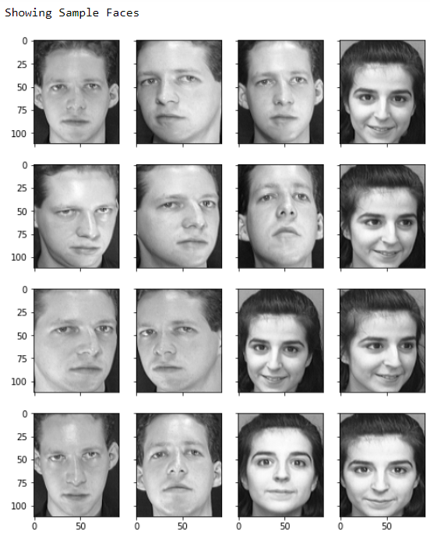

Steps for Implementation
Read all 400 images from the downloaded Zip File by importing the Library zipfile.
Show 16 of the Sample Faces using the Library matplotlib.
Print details including the pixel size of each provided image, the number of people detected and the total number of images.
Output of Step 3
Output of Step 2

Slide 9
Steps for Implementation
4. Iterate through the dataset and append only 389 of the 400 images in the list facematrix which will be our Training Dataset. 11 remaining images will be used as testing dataset for generating queries as explained.
5. Create a NxM matrix with N images and M pixels per image.
6. Import PCA from Scikit Learn Library in Python.
7. Apply PCA and take first K principal components as eigenfaces.

Slide 10
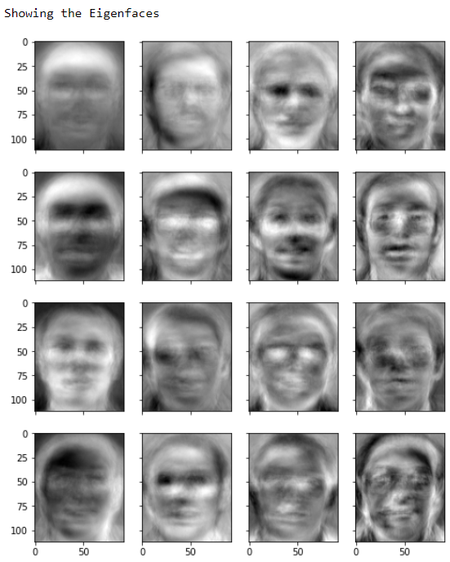
Steps for Implementation
8. Show the sample eigenfaces generated from any 16 images.
9. Generate weights as a KxN matrix where K is the number of eigenfaces and N the number of samples.
10. Test the code by making use of the 11 separated images as queries, the results of which are pasted in the Results Section. You can also test it using random queries i.e, choosing any 11 of the 400 images as Testing Dataset for checking the proper execution of the code.
Output of Step 8

Slide 11
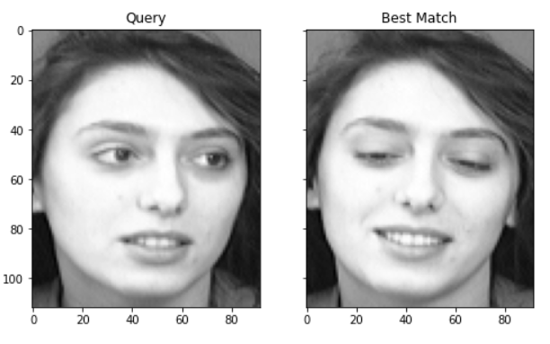
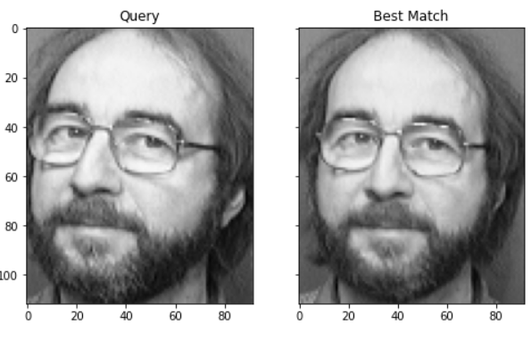
Results
Results generated on excluding one of ten faces of the 8th and 28th person respectively from the training dataset to store it as a query and then test the code.
Query- 1 (Testing on 10th Face of 8th Person)
Query- 2 (Testing on 10th Face of 28th Person)
Results display the proper working of the code due to which it provides the image of the same person as the Best Match out of 389 images in the Training Dataset.

Slide 12
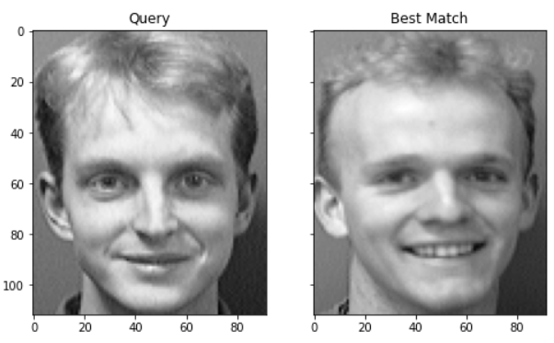
Results
Results generated on excluding all ten faces of the 40th person from the training dataset to store all of them as a query and then test the code.
Query- 3 (Testing on 6th Face of 40th Person)
Results display the proper working of the code due to which it provides the image of the 5th person who highly resembles the facial features of the 40th person. As we have not included even a single picture of the 40th person in the training set, it gives the picture of the person who resemble him the most out of the 39 people.

Slide 13
Future Scope and Improvements
As faces are complex visual stimuli that differ dramatically, hence developing an efficient computational approach for accurate face recognition is very difficult.
The accuracy by using PCA is “an average of 96% with light variation, 85% with orientation variation, and 64% with size variation.” Therefore it may not be very practical as a face recognition system.
Various advanced techniques like CNN and deep learning give higher accuracy than PCA and work with different transformations.

Slide 14
Conclusion
From the implementation and research that we have produced a project on human face recognition system. Finally, the PCA approach is used to recognize faces in this research. As a result, we discovered that our system successfully recognized human faces and performed better in various face orientations. But after varying the transformations, the accuracy of the model drastically decreases. More advanced methods like CNN would give better accuracy with varying transformations but are difficult to train and require a comparatively larger dataset.

Slide 15
References
Paul, Liton & Suman, Abdulla. (2012). Face recognition using principal component analysis method. International Journal of Advanced Research in Computer Engineering & Technology (IJARCET). 1. 135-139.
L. Sirovich and M. Kirby (1987). “Low-dimensional procedure for the characterization of human faces“. Journal of the Optical Society of America A. 4(3): 519–524.
K. I. Diamantaras and S. Y. Kung, “Principal Component Neural Networks: Theory and Applications”, John Wiley & Sons,Inc., 1996.
ORL Dataset Source from Kaggle
M. Turk and A. Pentland (1991). “Eigenfaces for recognition“. Journal of Cognitive Neuroscience. 3(1): 71–86.

Slide 16

Thank You!
..
Dr. Shyama Prasad Mukherjee International Institute of Information Technology, Naya Raipur
*
International Institute of Information Technology, Naya Raipur
‹#›

