Slide 1

FAKE NEWS DETECTION
Foundation Of Data Analytics (Project)

Slide 2
TABLE OF CONTENTS
01
Project overview
02
Problem Statement
03
Objectives/Motivation/ Innovation
04
Block Diagram
05
Timeline

Slide 3

01
PROJECT OVERVIEW

Slide 4
PROJECT OVERVIEW
Fake news exist way before from social media but it multifold when soc media was introduced.
Fake news is a news designed to deliberately spread hoaxes, propagi
and disinformation.
Fake News stories usually spread through social media sites like Facebook, Twitter etc

Slide 5
02
PROBLEM STATEMENT

Slide 6

PROBLEM STATEMENT
TO STOP THE SPREAD OF FAKE NEWS THAT CREATES CHAOS IN THE PUBLIC ENVIRONMENT.

Slide 7
Problem Statement
MAJOR PROBLEM
By clicking on a clickbait, users are led to a page that contains false information.
Fake news inﬂuences people's perceptions.
The rise of Fake news has become a global problem that even major tech companies like Facebook and google are struggling to solve. It can be diﬃcult to determine whether a text is factual without additional context and human judgement.

Slide 8
03
OBJECTIVES MOTIVATION

Slide 9
OBJECTIVES
The main objective is to detect the fake news, which is a classic text classiﬁcation problem with a straightforward proposition.
MOTIVATION
In order to stop people from spreading fake news that creates chaos with no real grounds.
Seeing people harming each other on the basis of false information that is being conveyed to people to create havoc.
We want to create a peaceful environment so that people live in peace & harmony for the beneﬁt of mankind.

Slide 10
BLOCK DIAGRAM
06

Slide 11
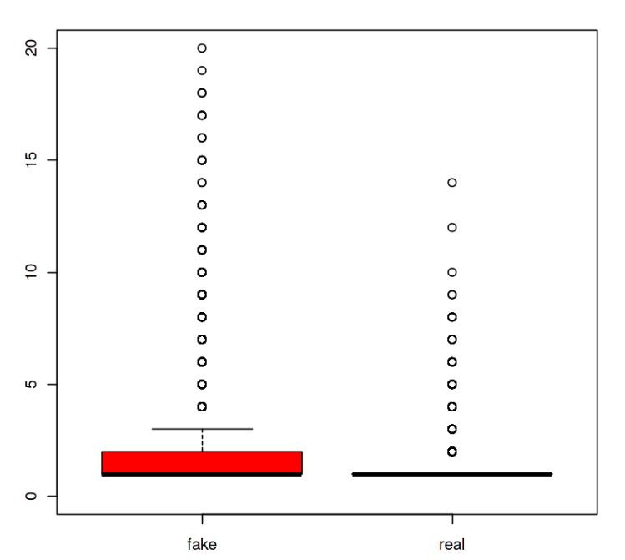
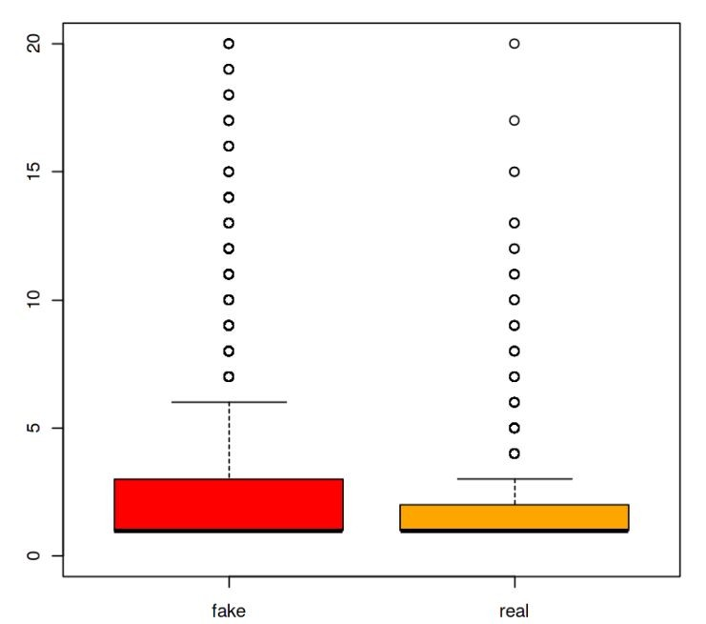
BLOCK DIAGRAM
RAW DATA
(from User)
ANALYZING THE DATA
TRUE / FALSE
(percentage)

Slide 12
TIMELINE
07

Slide 13







TIMELINE
Exploring further details. Coding the prototype.
Deciding workﬂow, ﬁguring out implementation techniques.
SEP
Finalising implementations
NOV
Jul-Aug
Team formation and domain Choosing, Preparing Outline, Collecting data
OCT
Analysing data.
Developing further and more eﬃcient code.
DEC
Final Implementation, deployment and submission of project.

Slide 14
REFERENCES
https://link.springer.com/article/10.1007/s10844-021-00646-9
https://nishitpatel01.github.io/Fake_News_Detection/
https://www.interviewbit.com/blog/r-projects/
https://iopscience.iop.org/article/10.1088/1757-899X/1099/1/ 012040

Slide 15
OUR TEAM
APURV CHOUDHARY - 20BEC1233
SALUGU JANAKI MANOJ - 20BEC1213
PRATYUSH RAJ - 20BEC1273

Slide 16

THANK YOU

